Slide 1
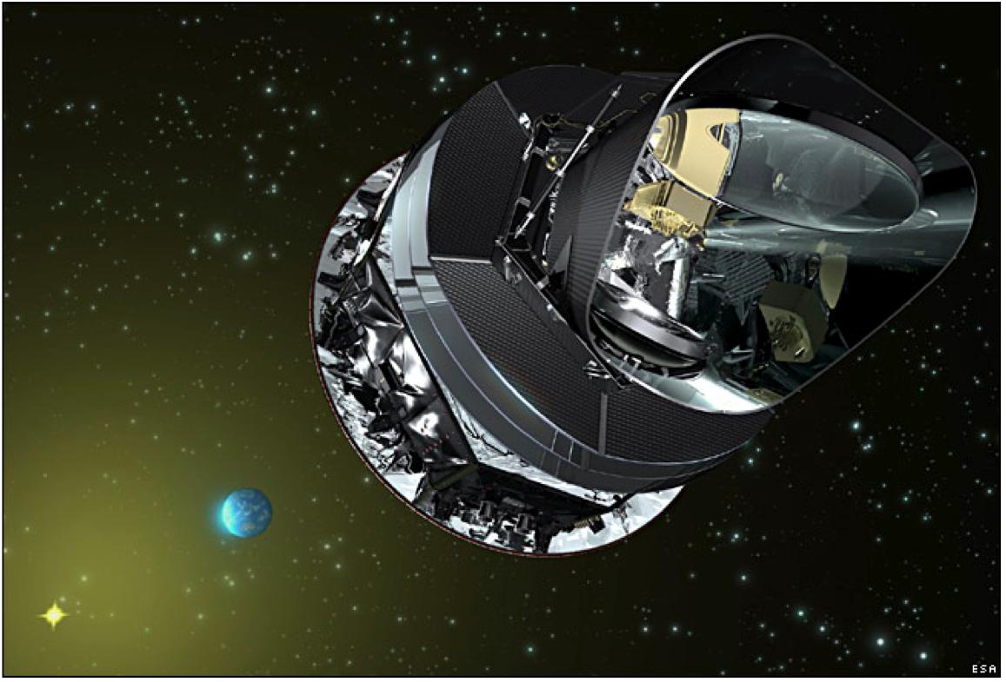
Planck Unchained
G. Efstathiou KICC

Slide 2
COBE WMAP PLANCK

Slide 3
PLANCK FREQUENCYMAPS
Notes:
Cosmology, origin of time and space, experiments

Slide 4
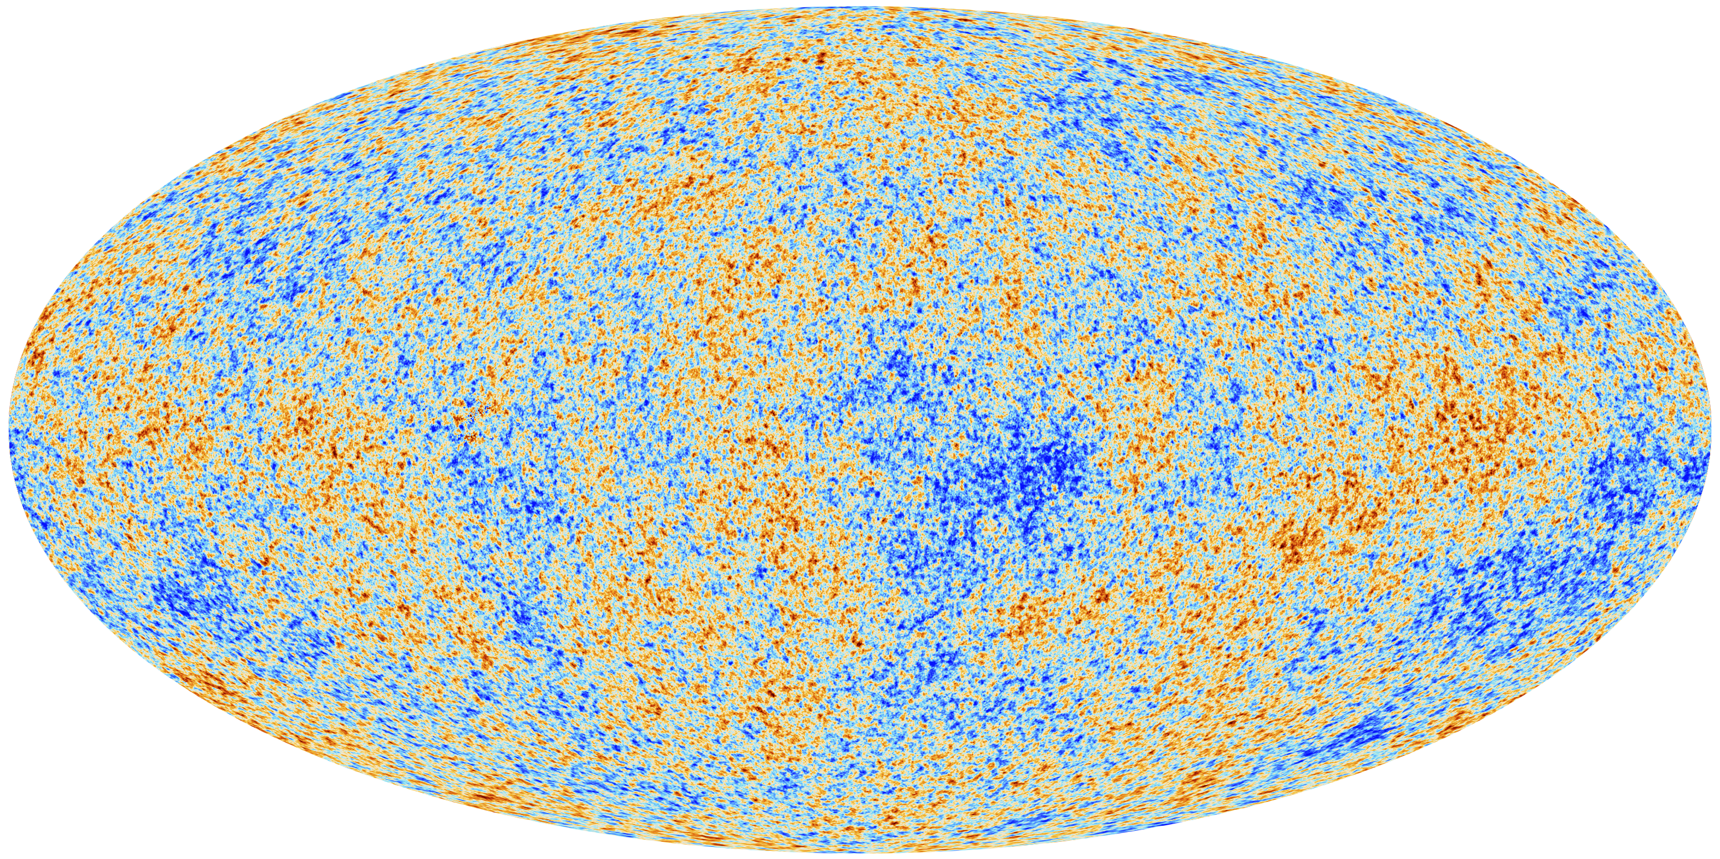
THE CMB AS SEEN BY PLANCK
Notes:
Jobs, applications, growth competitiveness, benefits for European citizens

Slide 8
Foreground /Nuisance parameters
Frequency independent parameters:
A^{tSZ}, A^{kSZ}, ξ (tSZ/CIB), γ^{CIB}
100x100 parameters:
A^{PS}₁₀₀, c_{100,} β¹⁰⁰₁, β¹⁰⁰₂, β¹⁰⁰₃, β¹⁰⁰_{4,} β¹⁰⁰₅
143x143 parameters:
A^{PS}₁₄₃, A^{CIB}₁₄₃ β¹⁴³₁, β¹⁴³₂, β¹⁴³₃, β¹⁴³_{4,} β¹⁴³₅
217x217 parameters:
A^{PS}₂₁₇, c₂₁₇, A^{CIB}_{217,} β²¹⁷₁, β²¹⁷₂, β²¹⁷₃, β²¹⁷_{4,} β²¹⁷₅
143x217 parameters:
r^{PS}_{143x217}, r^{CIB}_{143x217}, β^{143x217}₁, β^{143x217}₂, β^{143x217}₃, β^{143x217}_{4,} β^{143x217}₅

Slide 10
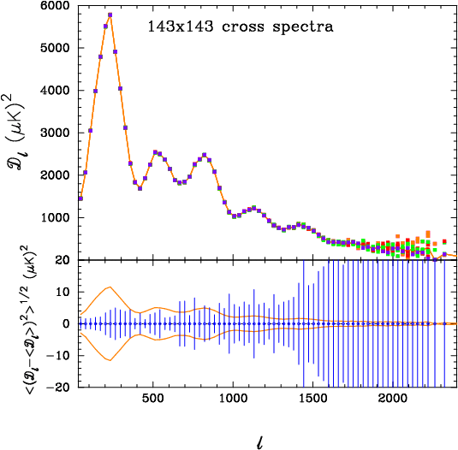

Slide 11
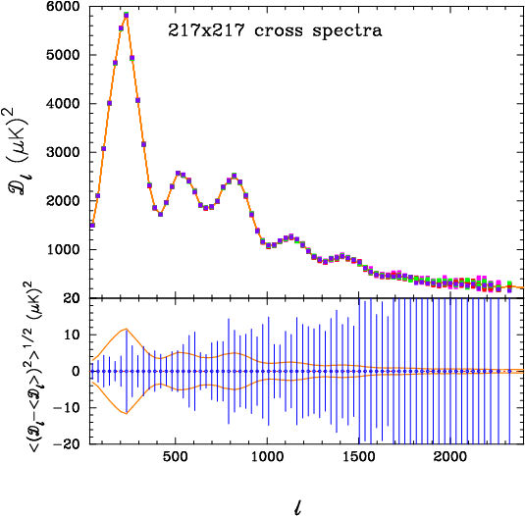

Slide 23
BASE ΛCDM MODEL
Parameter | Value (68%)
Ω_{b}h² | 0.02207±0.00027
Ω_{c}h² | 0.1198±0.0026
100θ* | 1.04148±0.00062
τ | 0.091±0.014
n_{s} | 0.9585±0.0070
H₀ | 67.3±1.2
Ω_{Λ} | 0.685±0.017
σ₈ | 0.828±0.012
z_{re} | 11.1±1.1

Slide 24
EXTENDED ΛCDM MODELS (Planck+BAO)
Parameter | Value (95%)
Ω_{K} | -0.0005±0.0066
Σ m_{ν} (eV) | <0.23
N_{eff} | 3.30±0.54
Y_{P} | 0.267±0.040
dn_{s}/dlnk | -0.014±0.017
r_{0.002} | <0.11
w | -1.13±0.24

Slide 29
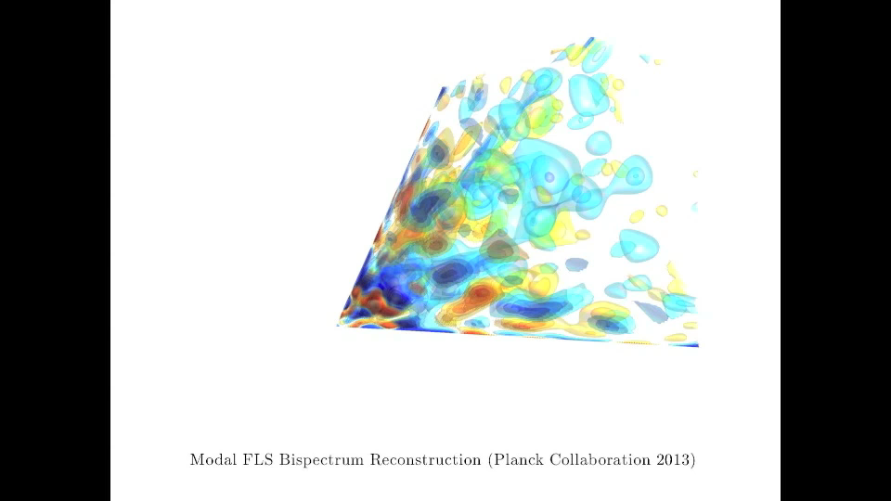

Slide 31
Some inconsistencies with ΛCDM
“Anomalies” – as WMAP, including hemispherical power asymmetry, cold spot, low multipole alignments, `Bianchi’ type large-scale anisotropy.
“Favouritism” for a power-spectrum feature at k ≈ 0.1 Mpc^{-1.}
“Feature” model non-Gaussianity seen in modal estimator.
Cluster count σ ₈-Ω_{m} discrepancy with power spectrum parameters.
Compton y map σ₈-Ω_{m} discrepancy with power spectrum parameters.
……………

