Slide 1
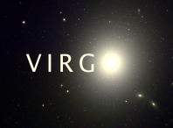
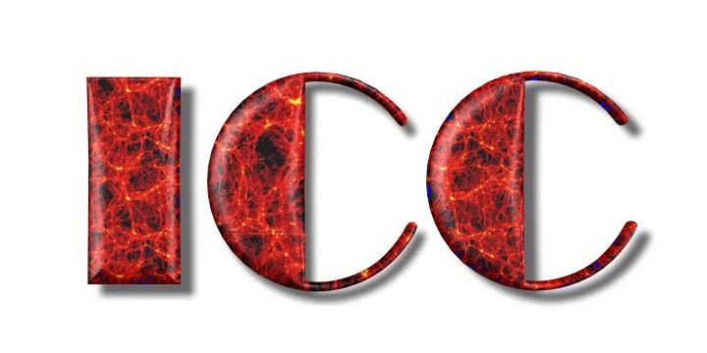
Galaxy formation with warm dark matter
Mark Lovell
Adrian Jenkins, Carlos Frenk, Vince Eke, Tom Theuns, Liang Gao, Shi Shao, Simon White, Alexey Boyarsky, Oleg Ruchayskiy…
Ripples in the Cosmos 22/07/2013

Slide 2
Outline
WDM reminder (see Carlos’ talk)
How does subhalo structure change with WDM particle mass?
Effect of WDM on reionisation?

Slide 3
νMSM
Neutrino Minimal Standard Model (νMSM) conceived to explain neutrino masses (Asaka & Shaposhnikov, 2005).
Adds three sterile neutrinos to the SM. The lightest of these would be a dark matter candidate.
Large velocities at early times => WDM / CWDM
U
C
T
g
D
S
B
γ
e
μ
τ
W
ν_{e}
ν_{μ}
ν_{τ}
Z
H
Ν₁
Ν₂
Ν₃

Slide 4
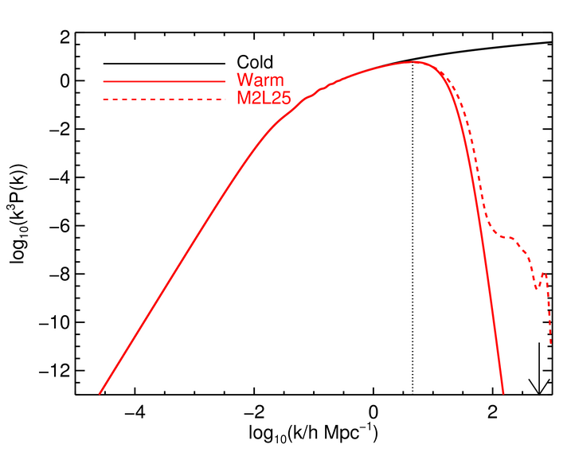
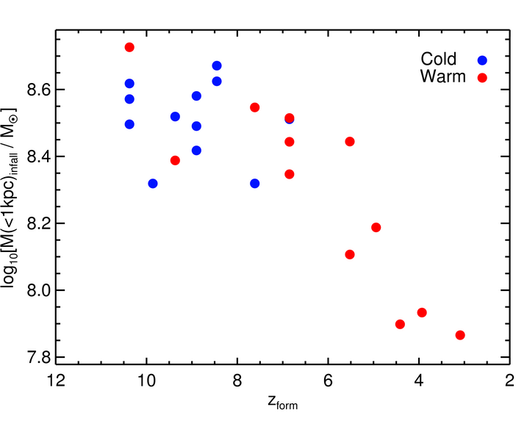
WDM
Phase space limit (small cores ~pc)
Free-streaming
Low mass substructures suppressed.
Later formation times
Concentrations lower
Reionisation delayed
Lovell et al. 2012

Slide 5
Subhalo structure

Slide 6
Simulation Suite – Vital Statistics
5 resimulations of the Aquarius Aq-A halo: 4WDM models + CDM, WMAP7 cosmology
Dark matter simulation particle mass 1.5x10⁴M_{sun}
WDM particle masses m_{p}=1.4keV, 1.6keV, 2.0keV, 2.3keV (thermal relics)
P_{WDM}/P_{CDM} = (1+(αk)^{ν})^{-10/ν} [ν=1]
α=α[m_{p}]

Slide 7
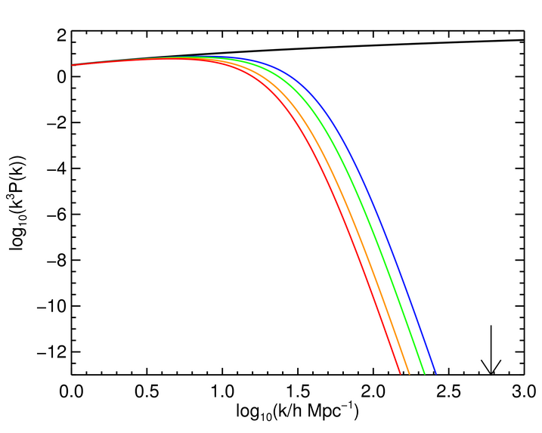
P_{WDM}/P_{CDM} = (1+(αk)^{ν})^{-10/ν} [ν=1]
(Bode et al. 2001)
m_{1.4}
m_{1.6}
m_{2.0}
m_{2.3}
CDM
Lovell et al. (in prep.)

Slide 8
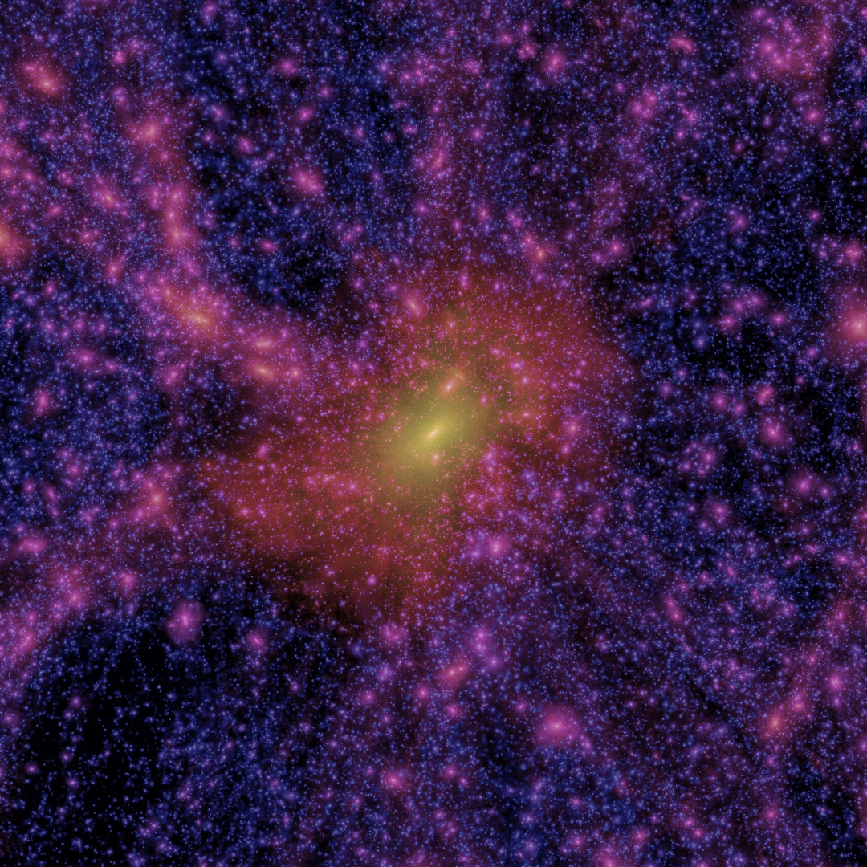
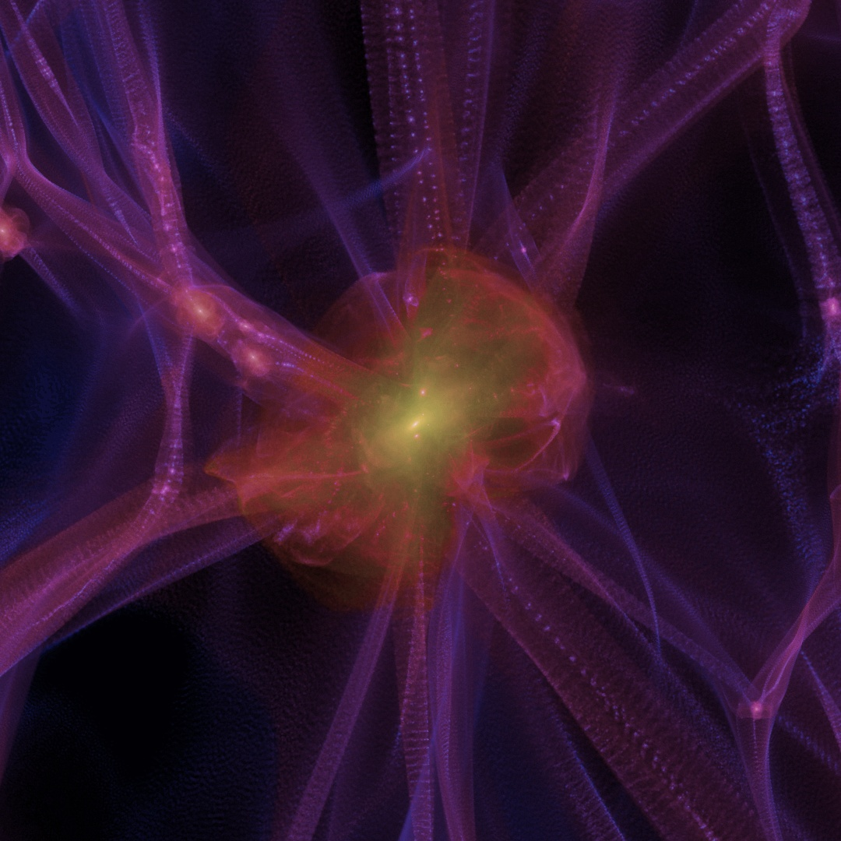
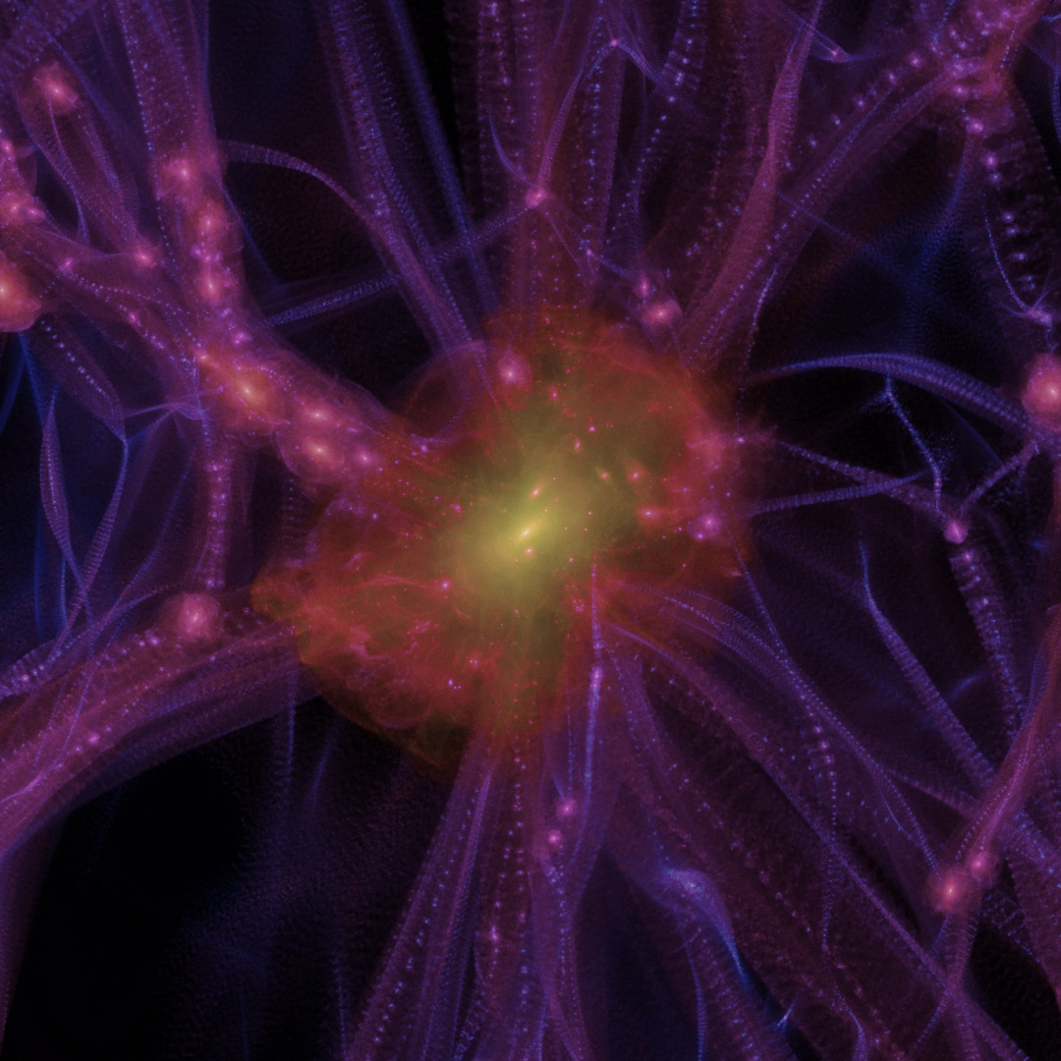
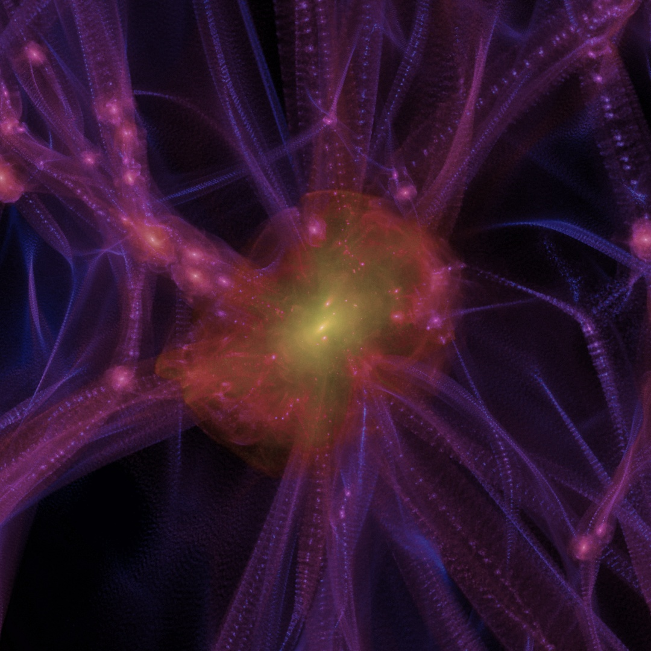
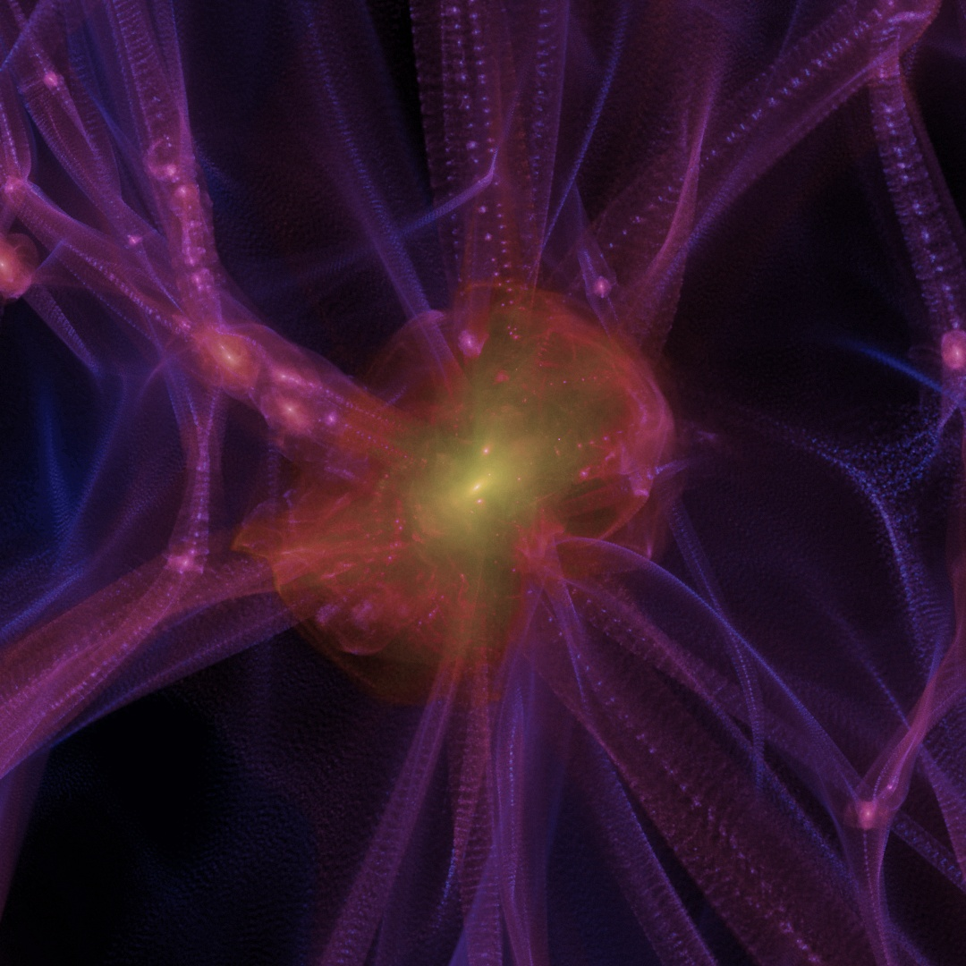
z=3

Slide 9
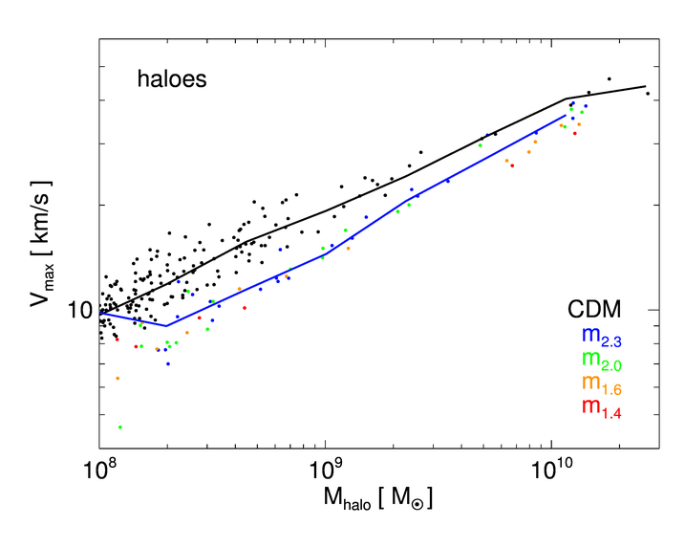
M_{sub} - V_{max}
Lovell et al. (in prep.)

Slide 10
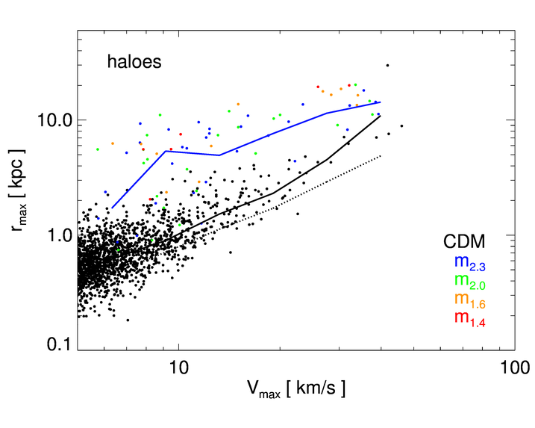
V_{max} – r_{max} [concentration]
WMAP7
WMAP1
Lovell et al. (in prep.)

Slide 11
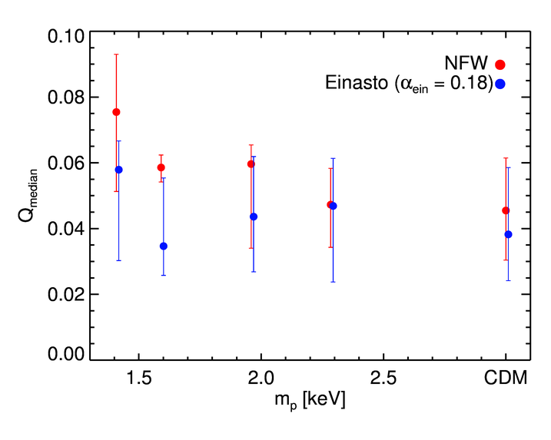
NFW vs Einasto
Lovell et al. (in prep.)

Slide 12
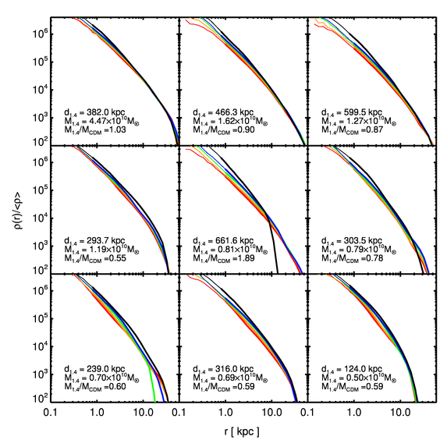
Density Profiles (1)
Lovell et al. (in prep.)

Slide 13
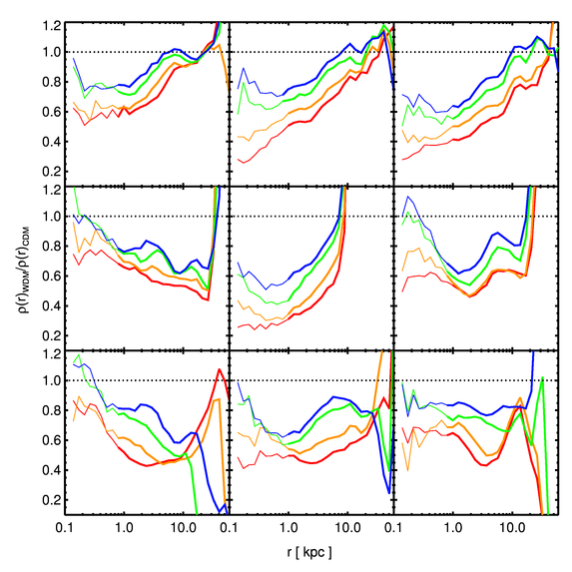
Density Profiles (2)
Lovell et al. (in prep.)

Slide 14
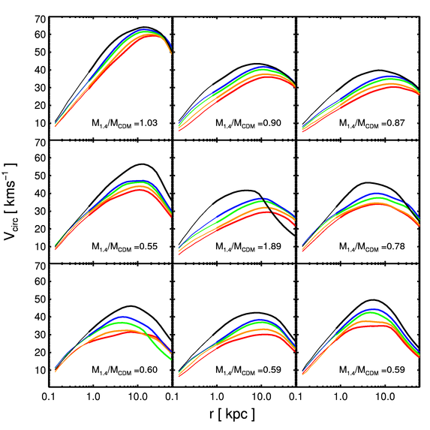
V_{circ} profiles

Slide 15
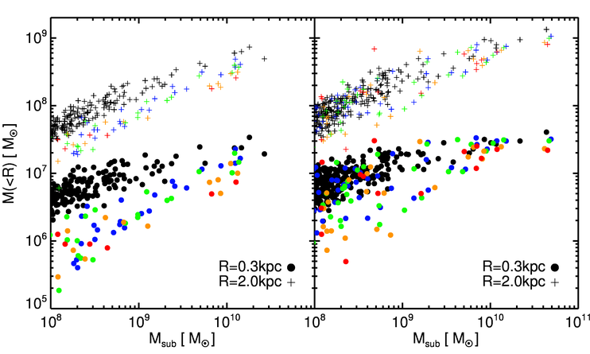
Central Densities
# Too Big to Fail:
CDM: 6
m_{2.3}: 4
m_{2.0}: 3
m_{1.6}: 3
m_{1.4}: 1
Field Haloes
Subhaloes
No Problem for WDM

Slide 16
Reionisation

Slide 17
Simulations
No feedback
Feedback enabled
Aq-A4 halo
SPH – Gadget3 code
CDM/WDM vs. Supernova feedback/no feedback
Salpeter IMF
Multiphase ISM
Primordial cooling tables
Decoupled winds (Springel&Hernquist 2003)
CN
CW
CDM
WN
WW
WDM (1.4keV)

Slide 18
No theory talk is complete without a movie …

Slide 19
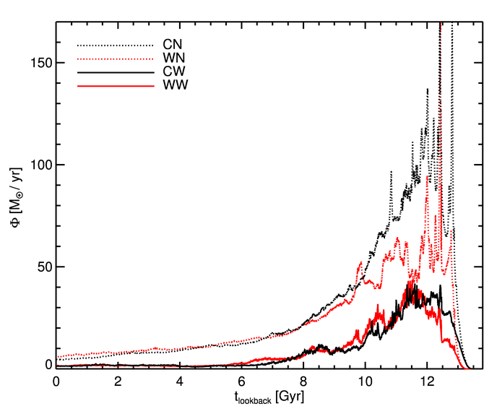
Star formation rate

Slide 20
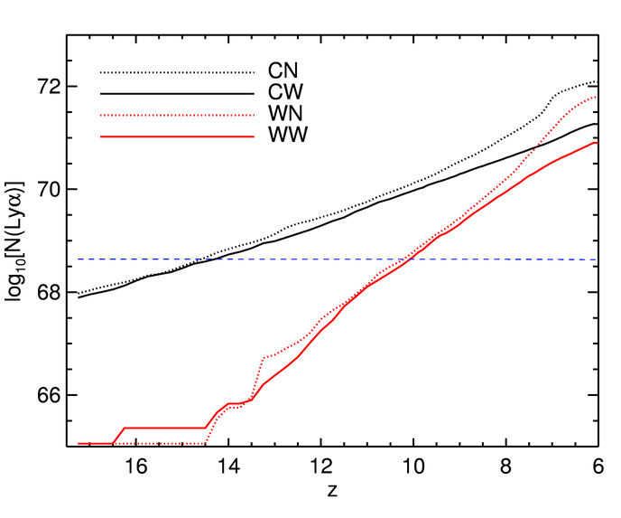
Reionising the (Local) Universe…
Preliminary
Warning!!
Uber-simple model!

Slide 21
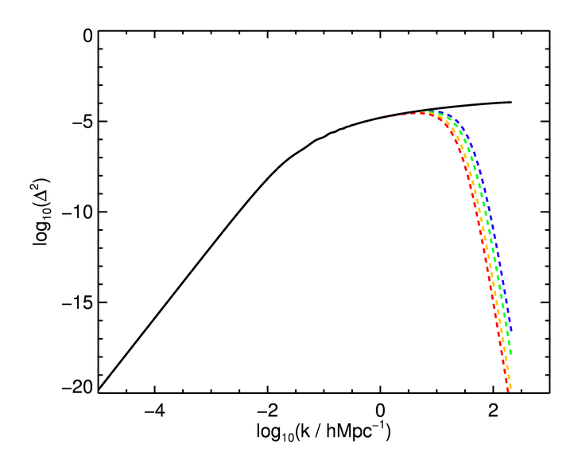
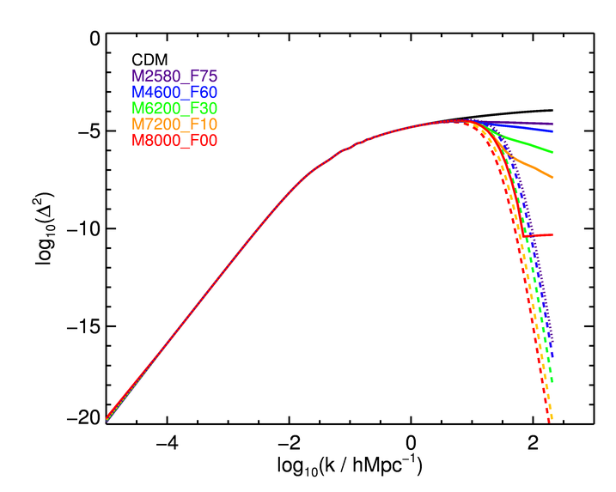
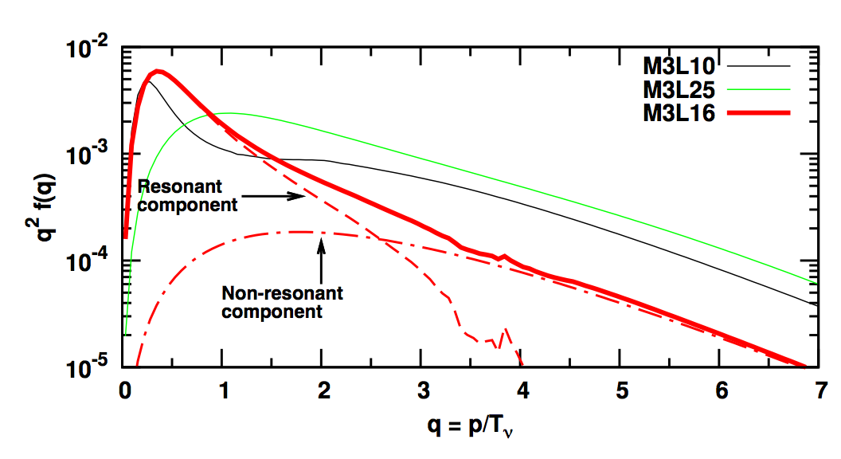
Just WDM?

Slide 22
Conclusions
Exciting WDM / CWDM models motivated by νMSM
Subhalo structure
Vmaxes, central densities lower with progressively warmer models at a given mass – alleviates ‘too big too fail’ problem. Cosmology also plays a role.
Reionisation
WDM models produce enough photons to reionise each hydrogen atom, subgrid model important.

Slide 23
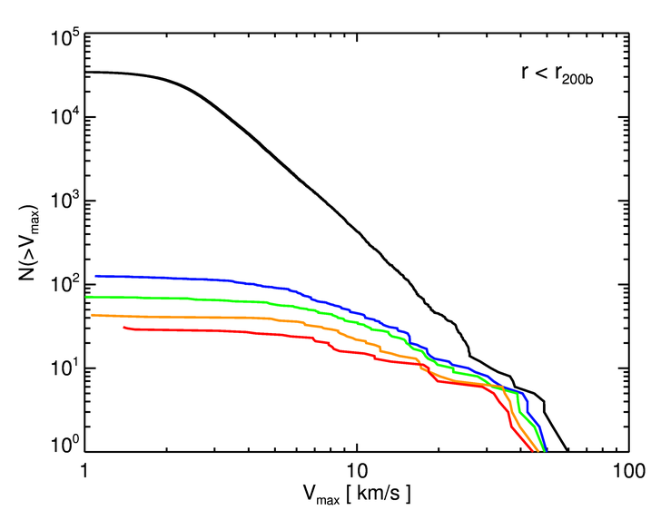
Mass functions
Lovell et al. (in prep.)

Slide 24
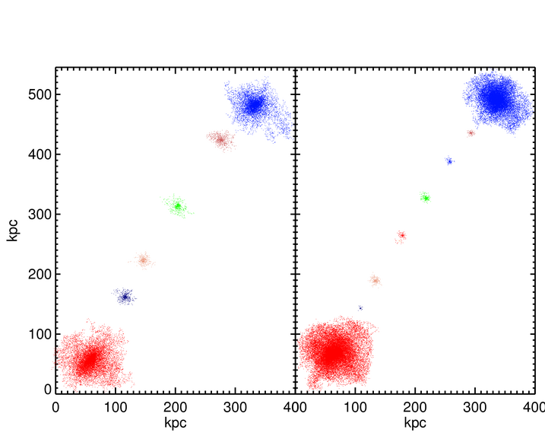
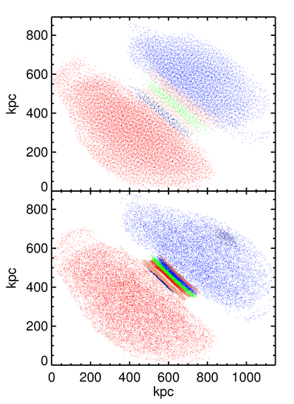
Since you asked…
Lovell et al. (in prep.)

Slide 25
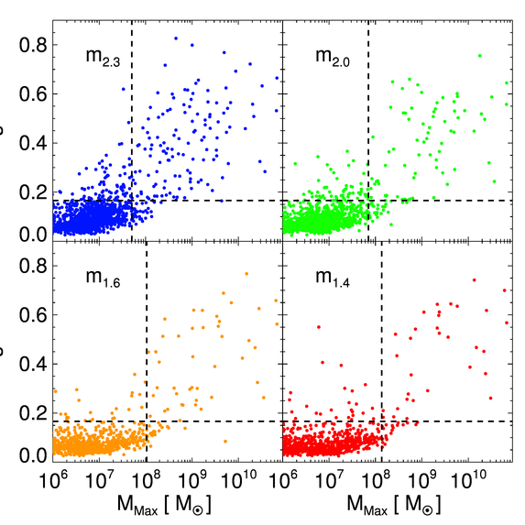
…
S
S
Lovell et al. (in prep)

