Slide 1
Foundations 1: Quantum mechanics Prof Chris Done chris.done@durham.ac.uk Young & Freedman chapter 38,39,40 LearnUltra for lecture capture, discussion board, full notes

Slide 2
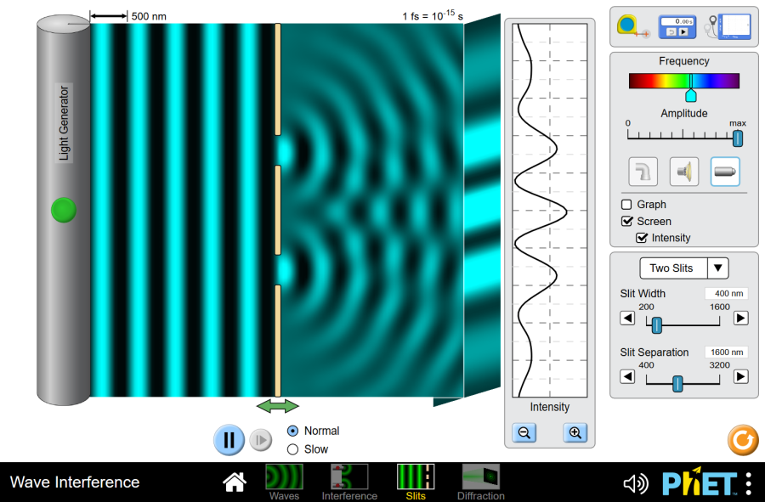
Photons are WAVES(!)
Need this to explain double slit
But doesn’t explain everything!

Slide 3
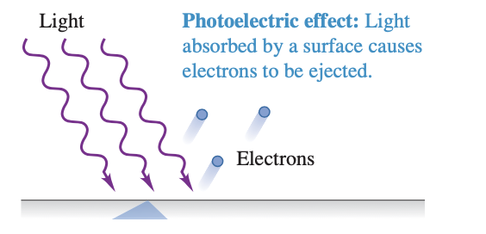
1 Photons as particles
1.1 photoelectric effect light as waves

Slide 4
1 Photons as particles
V_{ac} + -
1.1 photoelectric effect
Electrons collected at anode by +Vac where
e Vac >> initial KE of electrons
A
+ + + + + +
anode
cathode
- - - - - - -

Slide 5
1 Photons as particles
V₀ + -
1.1 photoelectric effect
Swap battery round!
Increase till electrons stopped
V0=stopping potential
Measures KE=-V0
A
- - - - - - -
+ + + + + +

Slide 6
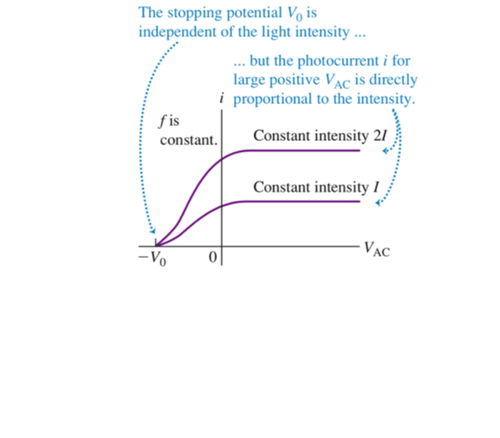
Current goes with intensity of light

Slide 7
Stopping potential (electron KE) goes with
frequency of light

Slide 8
Stopping potential (electron KE) goes with
frequency of light

Slide 9
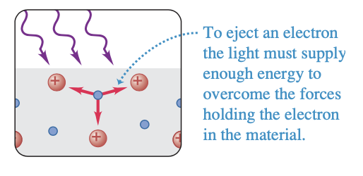
Light comes in bits – photons
E=hf=hc/λ

Slide 10
1.2 X-ray EMISSION
Light ABSORBED in bits
E=hf=hc/λ
Is it also EMITTED in bits??
Heat cathode to release electrons accelerate to anode via Vac.
V_{ac} + -
A
+ + + + + +
anode
- - - - - - -
cathode

Slide 11
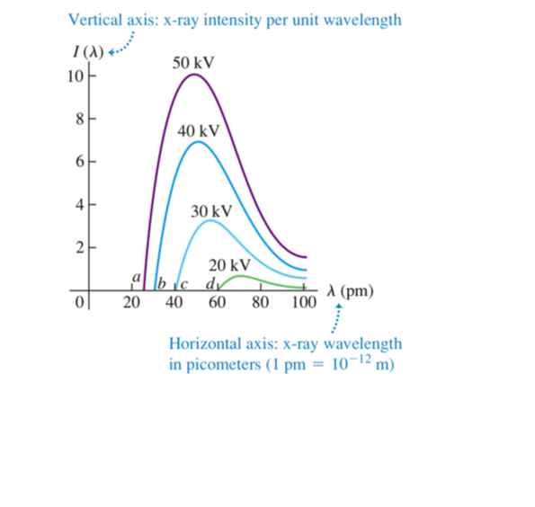
1.2 X-ray EMISSION Bremsstrahlung radiation

Slide 12
1.3 photons carry momentum
(Compton scattering – we’ll do in relativity when we know more)

Slide 13
1.4 wave-particle duality
photons E=hf=hc/λ, p=E/c= h/λ
Can see these bits directly in double slit! Turn down intensity
Only 1 photon at a time
Detected individually
But builds up wave diffraction pattern over time.

Slide 14
Quantum weirdness.
Light as a wave - we expect wave interference pattern but not the individual events on screen!
Light as a particle – we expect the individual events but not the interference pattern
If only 1 photon in the slits at a time, what did it interfere with?
Why can’t we figure out exactly where each one should hit? Individual events are anywhere-random position…
…But with probability that builds up a standard wave interference pattern.

Slide 15
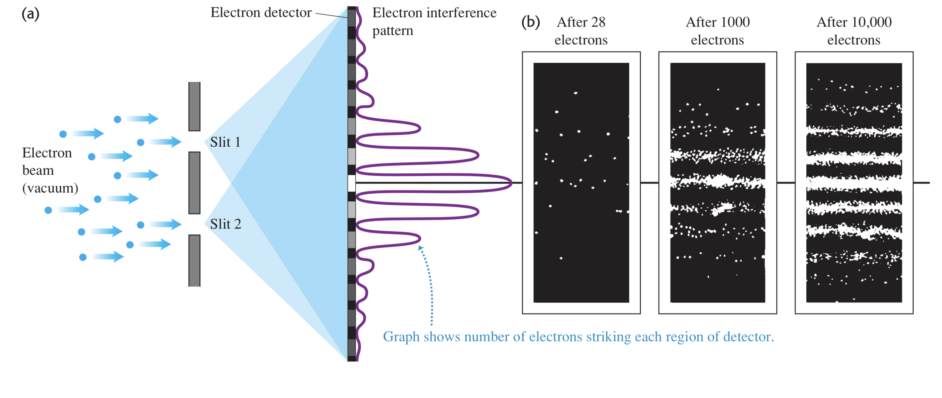
Heads up!
Same thing for electrons – here we are NOT surprised about the individual events on the screen but we ARE surprised by the WAVE interference pattern
If only 1 electron in the slits at a time, what did it interfere with?
Why can’t we figure out where each one should hit? Random individual events
But build up a wave interference pattern!

Slide 16
Quantum mechanics: L2
Light as a wave:
Double slit interference pattern!
Light as a particle:
Absorbed (photoelectric) and emitted (X-ray bremsstrahlung) in bits E=hf
Carries momentum p=E/c=hf/c=h/λ
Light as wave-particle:
One at a time through slits (so what does it interfere with?), one event detected on screen in position we CAN’T predict
…But with probability that builds up a standard wave interference pattern.

Slide 17
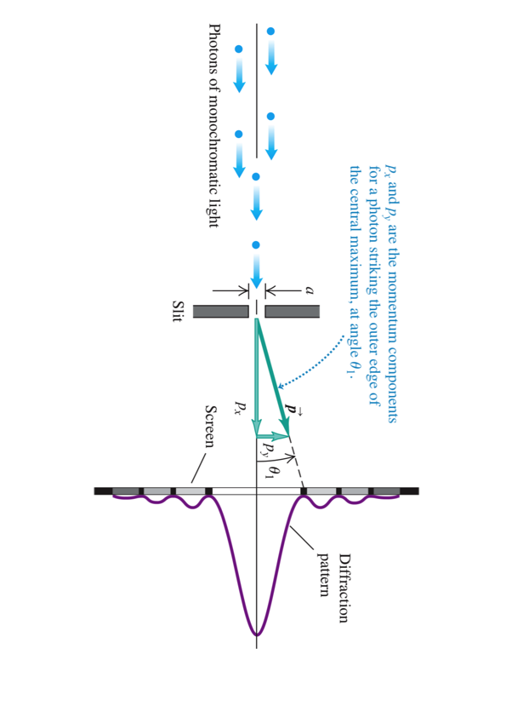
1.5 uncertainty: Photons as particles
Δx Δp > hbar/2

Slide 18
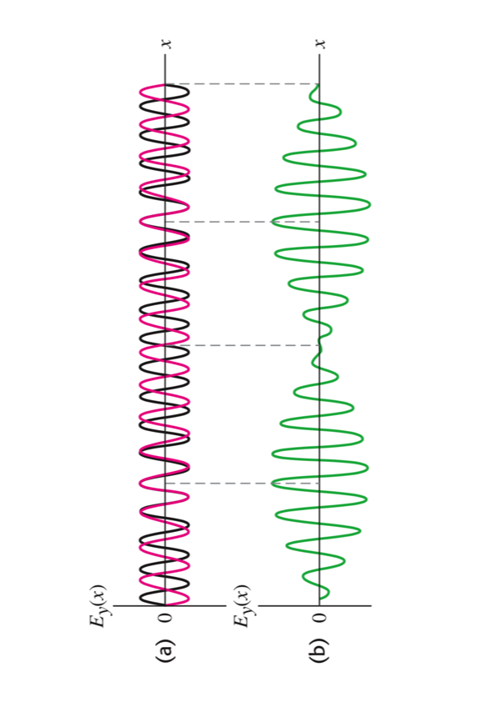
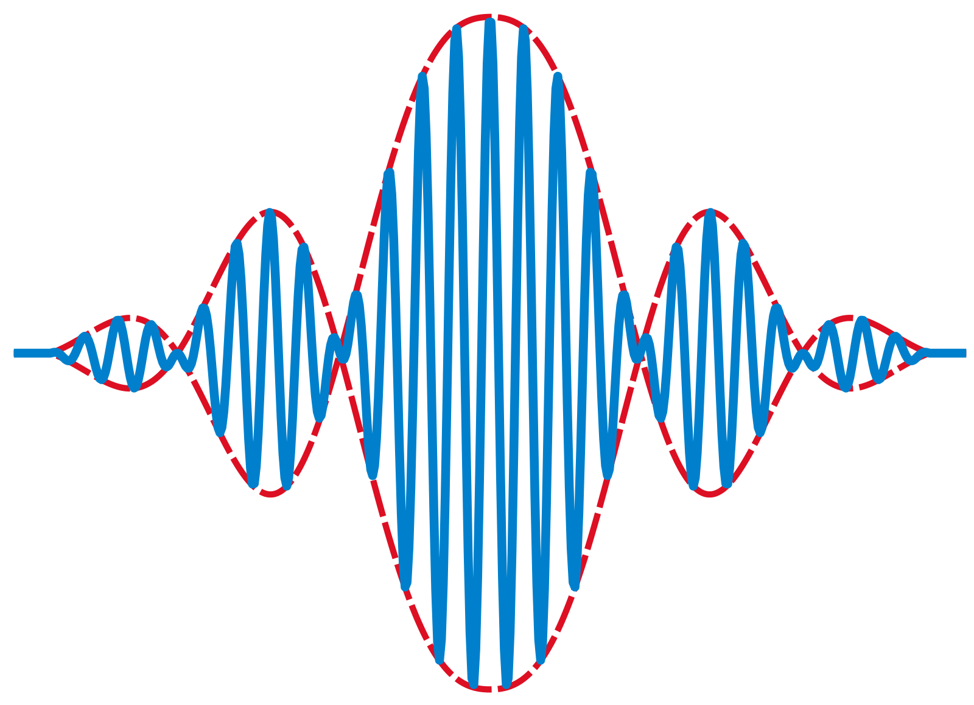
1.6 uncertainty: photons as waves
Δx Δp > hbar/2

Slide 19
1.6 uncertainty: FUNDAMENTAL
Δx Δp > hbar/2
But beats are TIME DEPENDENT
so limit on position/momentum also means limit on energy/time….
ΔΕ Δt > hbar/2

Slide 20
Quick review of LIGHT
Light as a wave:
Double slit interference pattern!
Light as a particle:
Absorbed (photoelectric) and emitted (X-ray bremsstrahlung) in bits E=hf
Carries momentum p=E/c=hf/c=h/λ
Light as wave-particle:
One at a time through slits (so what does it interfere with?), one event detected on screen in position we CAN’T predict Δx Δp > hbar/2
…But with probability that builds up a standard wave interference pattern.

Slide 21
2. ELECTRONS
2.1 Electrons as wave-particle:
One at a time through slits (so what does it interfere with?), one event detected on screen in position we CAN’T predict
…But with probability that builds up a standard wave interference pattern.

Slide 22
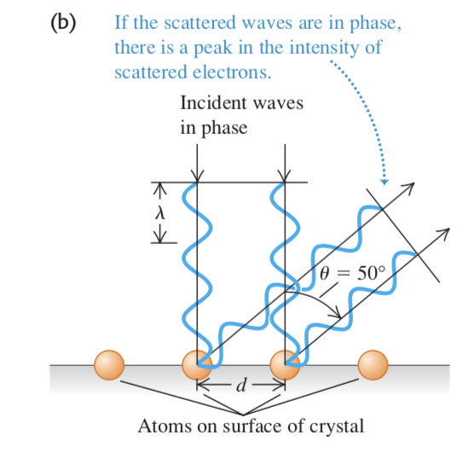
2. ELECTRONS
2.1 Electrons as wave-particle:
Crystal spacing usefully close to electron λ
When accelerated to keV energies
V=54keV
First peak intensity at 50deg
d sinθ = mλ
Knew d from X-ray scattering experiments

Slide 23
3. Atomic structure
Heated dense gas glows as continuum (blackbody)
Heated sparse gas glows in LINES??
WHY???
Hydrogen: λ = 363.5 n²
(n² − 4)
For n>=3

Slide 24
3. Atomic structure
Heated dense gas glows as continuum (blackbody)
Heated sparse gas glows in LINES??
WHY???
Hydrogen: λ = 363.5 n²
(n² − 4)
For n>=3
Each element/molecule
has its own set of lines!!
λ

Slide 25
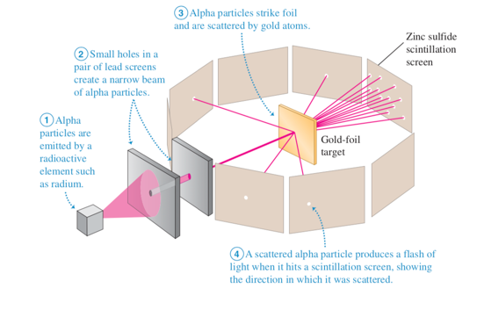
3.1 models for atoms
Atomic structure probed by He nuclei (alpha particles)
KE of alpha particles known 4.5MeV = 7.27 × 10⁻¹³ J
Gold foil: 79 protons/electrons
Electrostatic V=qQ/(4πε₀R²)
R=5x10⁻¹⁴ m
4 orders of magnitude smaller that atomic size scale!!
NUCLEAR MODEL of ATOM

Slide 26
3.1 models for atoms
NUCLEAR MODEL of ATOM
BUT ITS IMPOSSIBLE WITH PARTICLES
Electron ‘orbiting’ in circle
Like gravitational orbits??? But we can give it a push!!
Also, circle so accelerating. Accelerating charges radiate!! Lose energy and crash into nucleus

Slide 27
Quantum mechanics: Lecture 3
Photons (wavy particles) – p=h/λ
Electrons (particle waves) - p=h/λ
Fundamental indeterminacy Δx Δp > hbar/2
Atomic structure – tiny nucleus!!
HOW???
e⁻
+

Slide 28
3.1 models for atoms (cont)
Electrons (particle waves) - p=h/λ
Fundamental indeterminacy Δx Δp > hbar/2

Slide 29
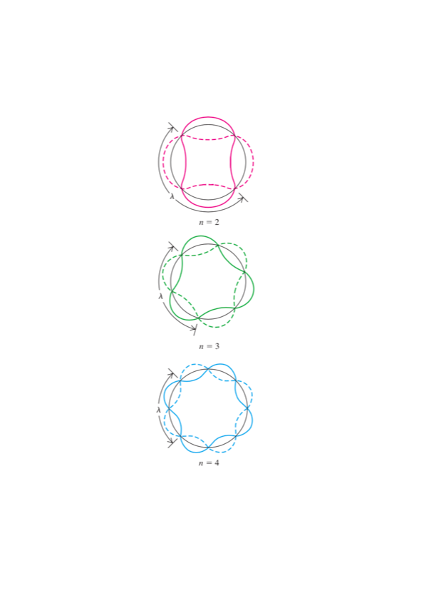
3.2 Bohr model
Electrons have wavelength
So can only exist (no destructive interference) at radii where l fits an integer number of times
Assume:
Electrons in these orbits DON’T radiate (standing waves?)

Slide 30
3.2 Bohr model (velocity)

Slide 31
3.2 Bohr model (radius)

Slide 32
3.2 Bohr model (energy)

Slide 33
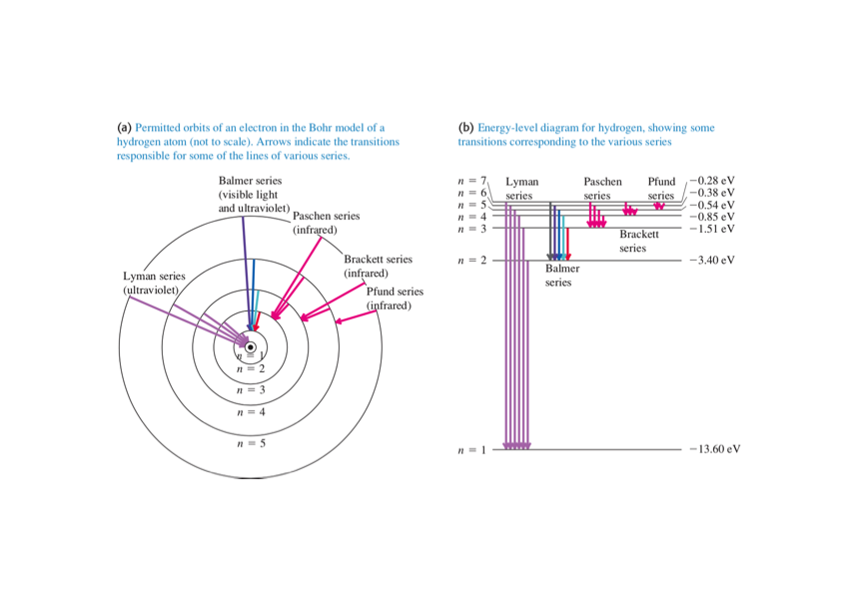
3.2 Bohr model (energy levels)

Slide 34
3.3 limitations of Bohr model

Slide 35
3.4 blackbody radiation

Slide 36
Quantum mechanics: Lecture 4
Borh model – awesome…
…but clunky classical-quantum merger
A wave equation for matter!!
Schroedinger equation!

Slide 37
4. Quantum mechanics

Slide 38
4. Quantum mechanics

Slide 39
4. Quantum mechanics

Slide 40
4.1 what is Ψ(x,t)?

Slide 41
4.2 Normalisation

Slide 42
4.2 Normalisation

Slide 43
5. Solving for Ψ(x,t) using time INDEPENDENT schroedinger equation.

Slide 44
5. Solving for Ψ(x,t) using time INDEPENDENT schroedinger equation.

