Slide 1
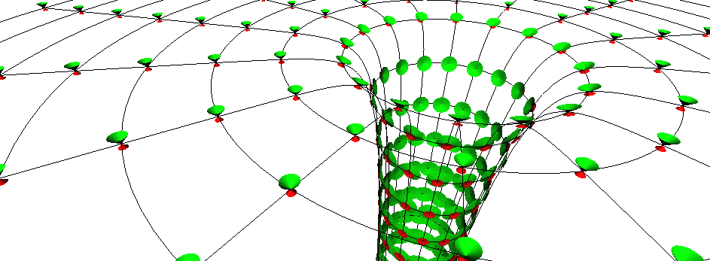
Black holes science fact, fiction or fantasy!
Prof Chris Done, University of Durham

Slide 2
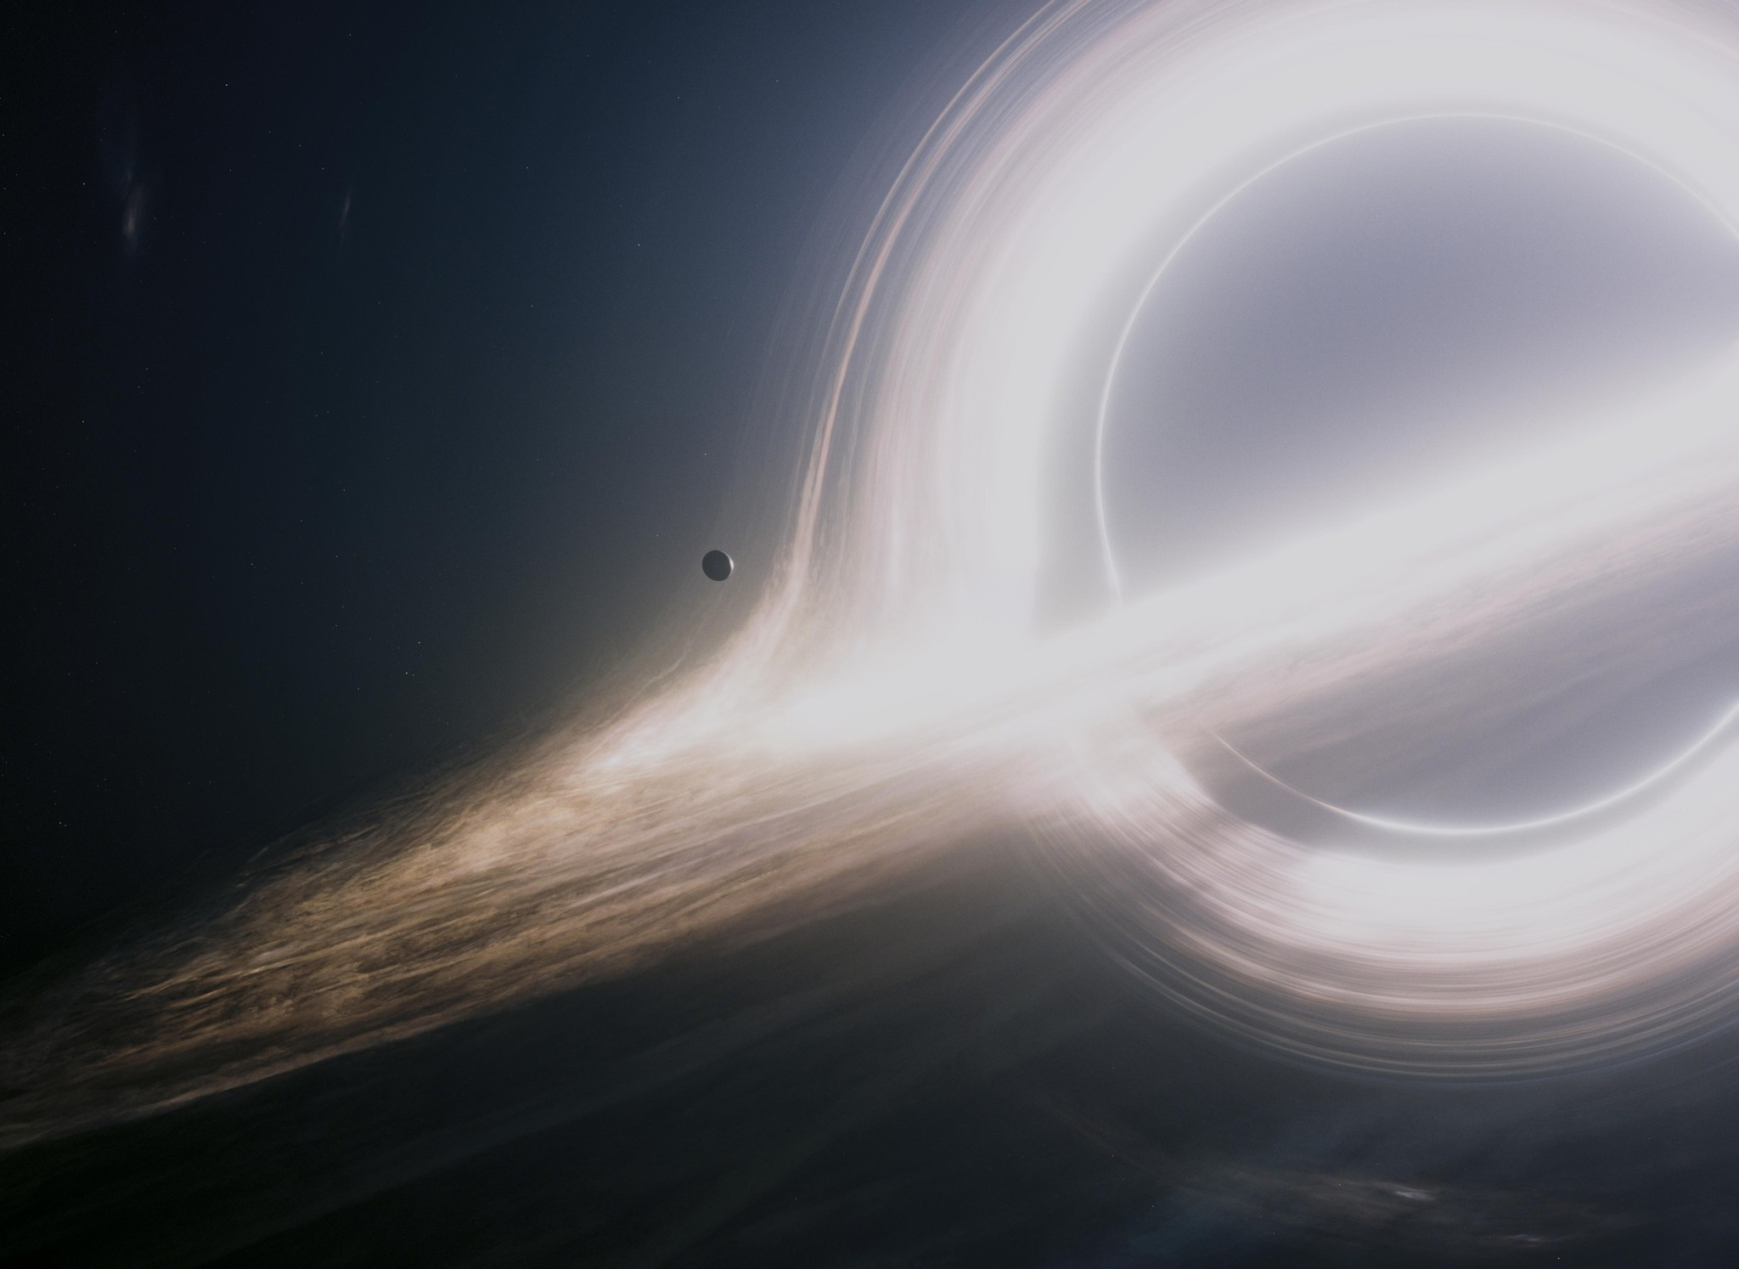
Black holes in
Science fiction
Movies
Interstellar!

Slide 3
What are they?
How could they form?
How can we know they exist?

Slide 4
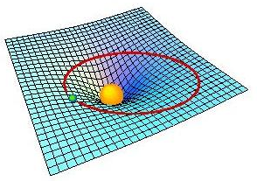
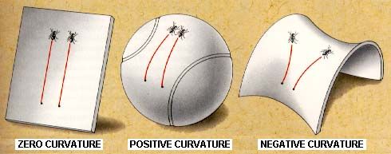
Gravity: warped spacetime
Straight paths on curved space!!
NOT a spooky, action at a distance force (Newtonian)
Space(time) warped by mass(energy)

Slide 5
Gravity: warped spacetime
Matter tells space how to curve, curvature tells matter how to move

Slide 6
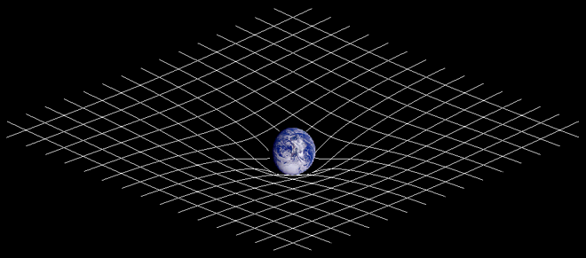
Gravity: Einstein
NOT a spooky, action at a distance force (Newtonian)
Space(time) warped by mass(energy)
http://en.wikipedia.org/wiki/General_relativity

Slide 7
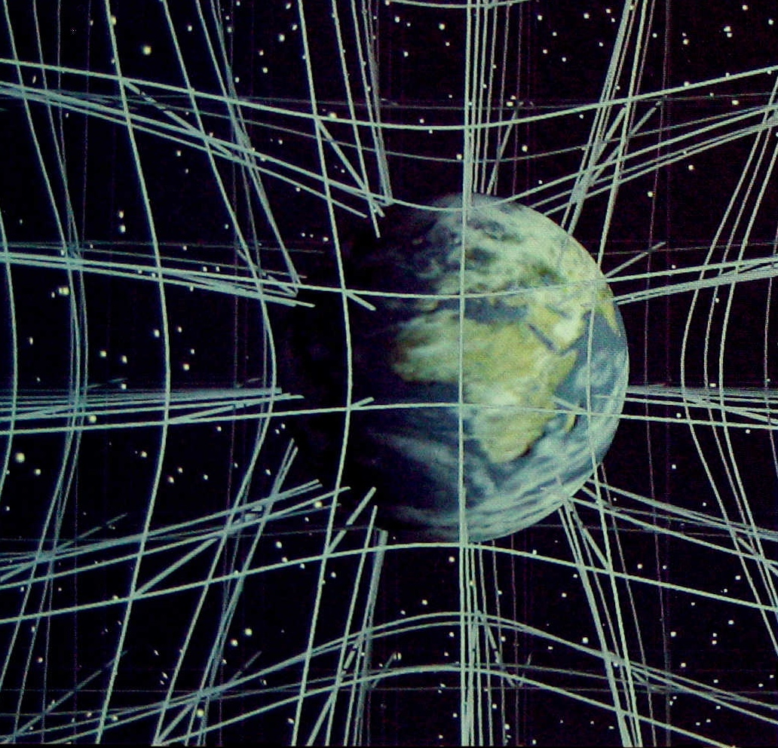
Gravity: Einstein
Should think of it in 3D but difficult to draw!
Christopher Vitale of Networkologies and the Pratt Institute.

Slide 8
Gravity: Einstein
And time is bent as well (slowed down)!
Christopher Vitale of Networkologies and the Pratt Institute.

Slide 9
Gravity: warped spacetime
So light is affected too!
Lightbending – light travels in straight lines over curved surface so path looks curved!
One of first tests of GR …
True position
Apparent position

Slide 10
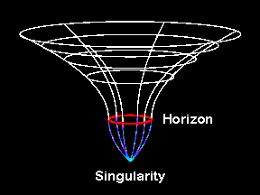
Gravity: warped spacetime
More gravity, more mass in same space or same mass, smaller size
Black hole – escape velocity is faster than light so can’t get out!
Black holes don’t suck inexorably! Unlike bad SF movies…

Slide 11
Gravity: warped spacetime
More gravity, more mass in same space or same mass, smaller size
Black hole – escape velocity is faster than light so can’t get out!
Black holes don’t suck inexorably! Unlike bad SF movies…

Slide 12
Gravity: warped spacetime
More gravity, more mass in same space or same mass, smaller size
Black hole – escape velocity is faster than light so can’t get out!
Black holes don’t suck inexorably! Unlike bad SF movies…

Slide 13
Gravity: warped spacetime
More gravity, more mass in same space or same mass, smaller size
Black hole – escape velocity is faster than light so can’t get out!
Black holes don’t suck inexorably! Unlike bad SF movies…
© Andrew Hamilton

Slide 14
Black hole radii
Event horizon –escape velocity is c in radial direction
R=Rs=2GM/c²
R=3 (M/M⊙) km

Slide 15
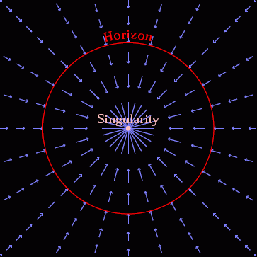
Gravity: warped spacetime
Spacetime itself in falling in at the speed of light
Nothing travels faster than light so everything swept down below event horizon
© Andrew Hamilton

Slide 16
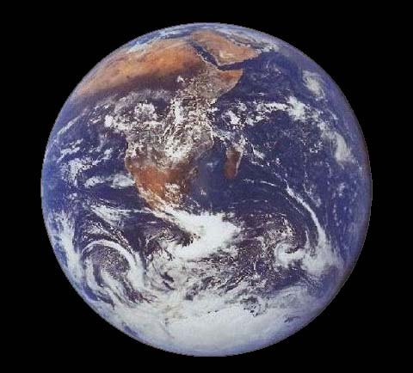
Gravity: warped spacetime
Utterly extreme.
mass of sun squashed into size of London.
mass of earth squashed <1cm!
Impossible!!!!!!!!?
How to get such extreme compression?
NASA image

Slide 17
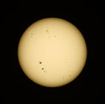
Black hole recipe…
Take 1 massive star (at least 10 bigger than Sun)
Stars fuse 4H to He
Lose mass, gain energy via Einstein’s E=mc²
Hydrogen bomb! in its stable life – outward pressure of hot gas (fusion) balanced by inward pull of gravity.

Slide 18
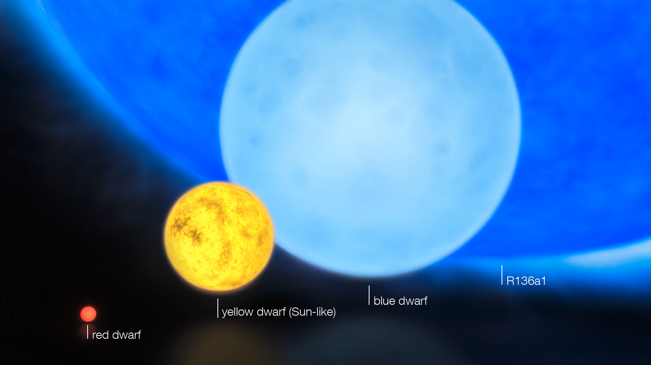
What happens next? Mass

Slide 19
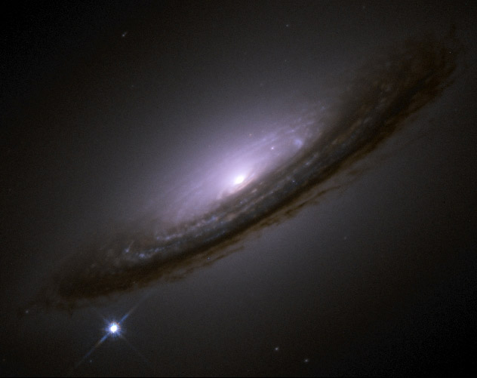
Supernovae
Supernovae - massive star core collapse
Single exploding star can outshine an entire galaxy!
NASA image

Slide 20
Observing black holes?
How to test this ?
The thing about a black hole, its main distinguishing feature is its black! And the thing about space, your basic space colour is its black! So how are you supposed to see them ? Red Dwarf

Slide 21
Observing black holes?
Iconic image of black hole shadow….

Slide 22
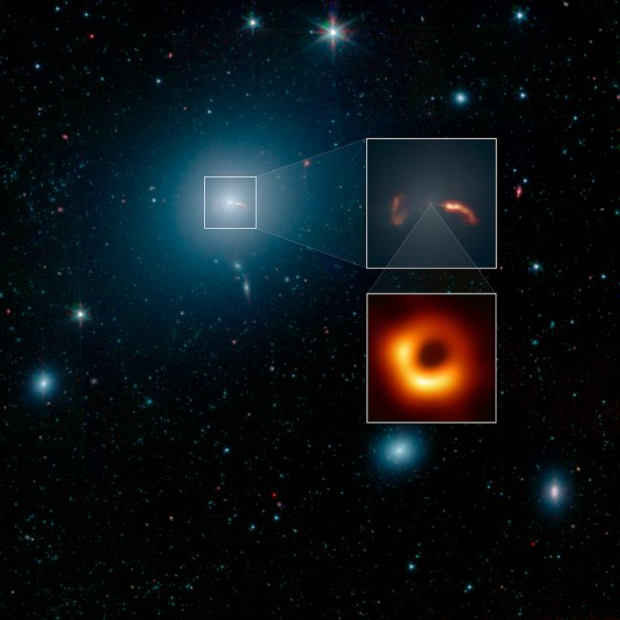
Observing black holes?
Size of full image - like sun/moon (your thumb at arms length)
Size of black hole – like reading text of a newspaper in New York from a sidewalk café in Paris

Slide 23
Black hole radii
Event horizon –escape velocity is c in radial direction
R=Rs=2GM/c²
R=3 (M/M⊙) km
Photon orbit – tangential c
R=3GM/c²=1.5Rs
R=4.5 (M/M⊙) km

Slide 24
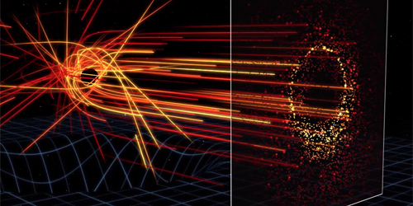
Very dim accretion flow – event horizon and photon orbits
See a shadow due to the light from matter falling in!!
Very very dim, picks out the light orbit ring
But if the matter falling in was brighter - easier to see!

Slide 25
Observing black holes?
Only see a shadow because there is some light - from material falling into the black hole!!
BUT ITS EXTREMELY DIM as very little mass is falling in!
So lets study the black hole and its accretion flow when its brighter and easier to see!

Slide 26
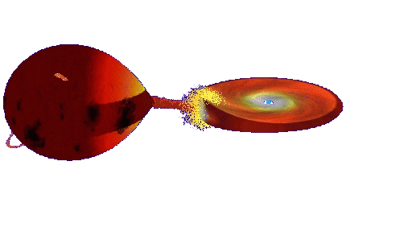
Accretion
Continuous ring of gas – friction dissipates energy
Makes material hot
BRIGHT accretion discs glowing X-ray hot
© Andrew Beardmore

Slide 27
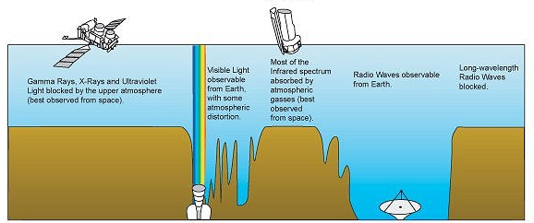
X-rays blocked by atmosphere
NASA image
X-rays
Visible
Radio
Wavelength

Slide 28
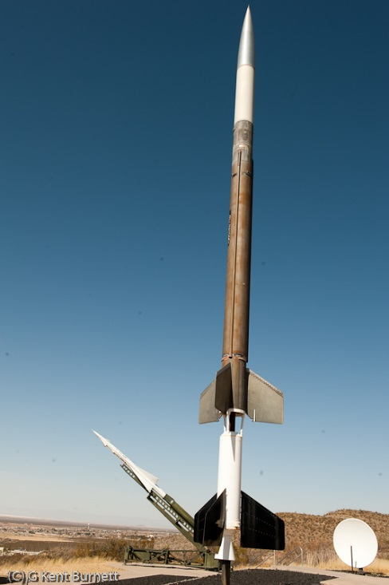
Rocket Science!
Nobel Prize to Giaconni in 2002 for discovery of cosmic X-ray sources in the 1960s
Black holes position highlighted by the high energy X-ray radiation released by material falling towards the event horizon
NASA image

Slide 29
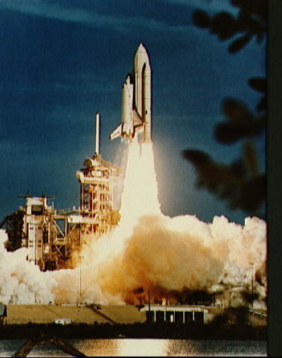
Rocket Science!
X-ray astronomy transforms black holes from theoretical speculation to observable objects
Observe black holes and get to do rocket science!!

Slide 30
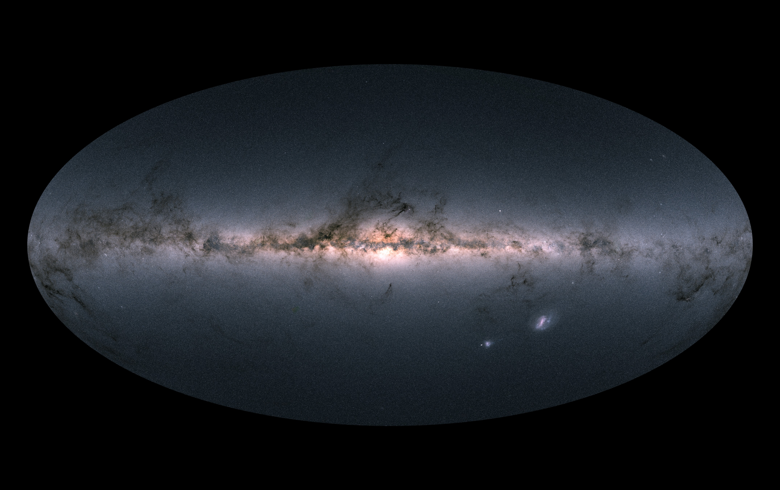
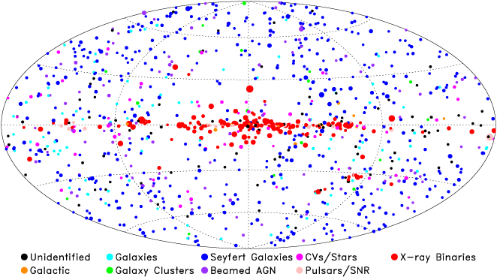
The whole sky in optical
Gaia image

Slide 31
The whole sky in X-rays
Giacconi: Nobel prize in 2002 for discovery of BH
Stellar mass BH
10x Sun
NASA image

Slide 32
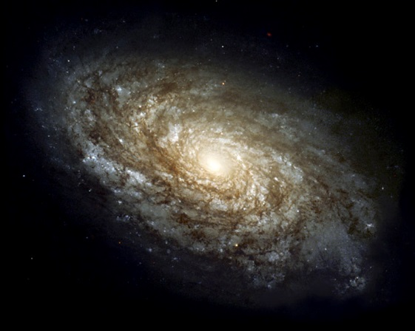
The whole sky in X-rays
Supermassive BH
Million-Billion x Sun
Stellar mass BH
10x Sun
NASA image

Slide 33
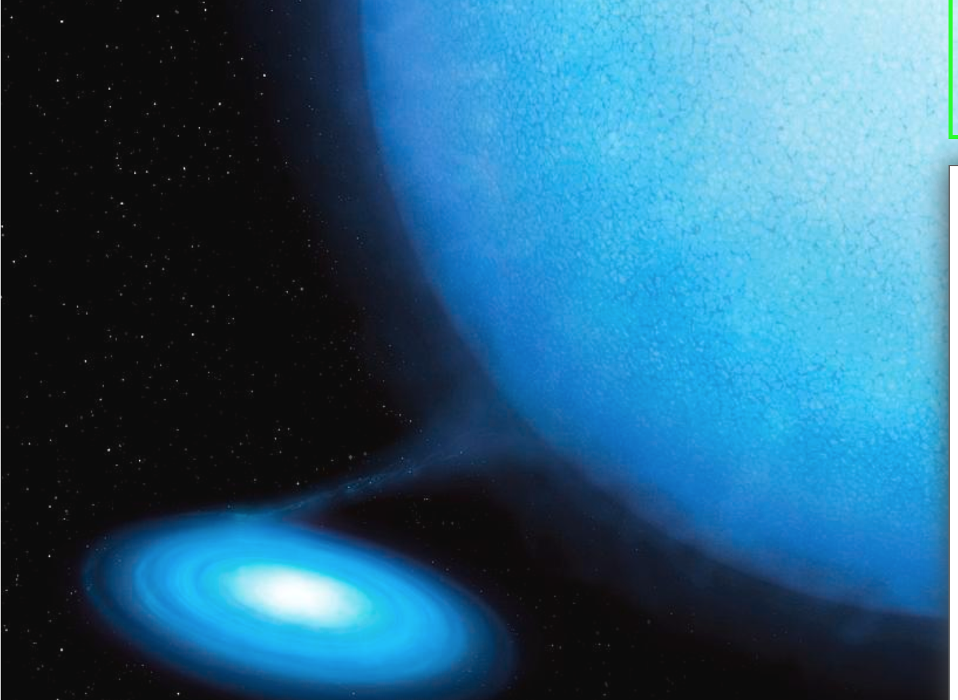
Supermassive BH
Million-Billion x Sun
Stellar mass BH
10x Sun
NASA image

Slide 34
Gravitational waves!

Slide 35
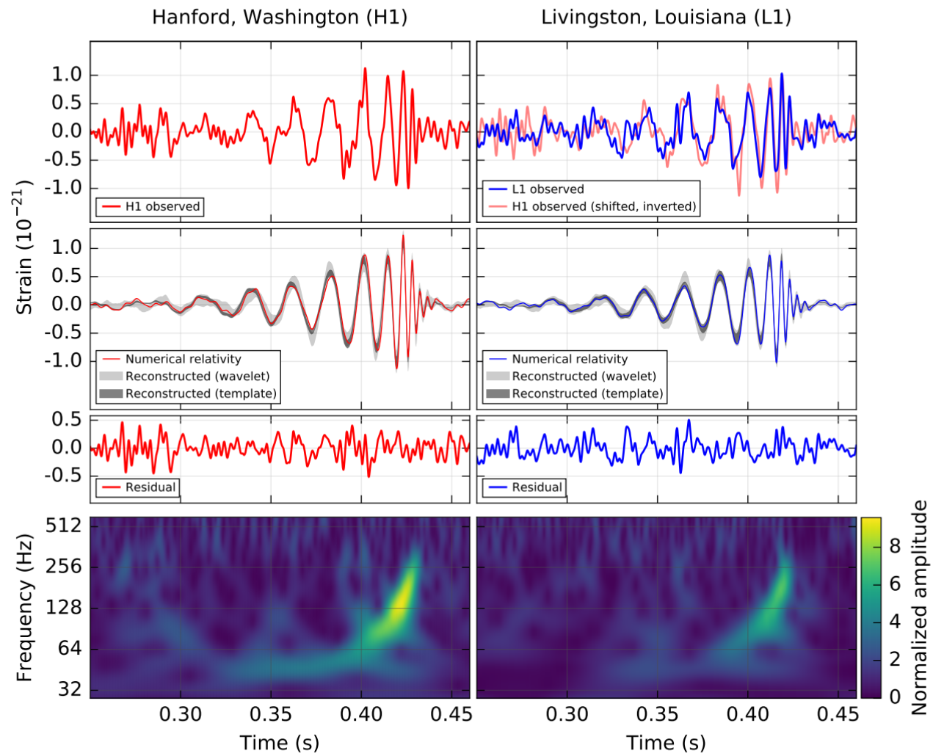

Slide 36
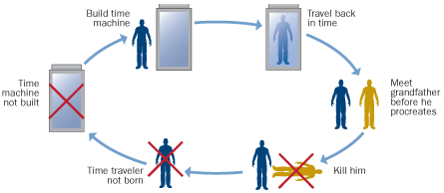
So can we use them for time travel??
YES to the future
NO(?) to the past which is good as Grandfather paradox!

Slide 37
Back to the Future!!

Slide 38
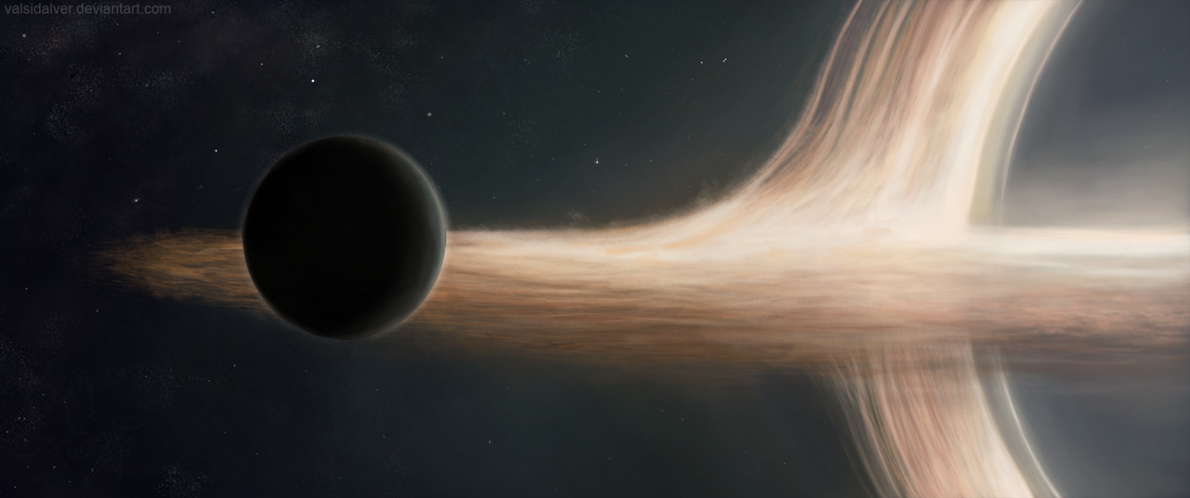
Interstellar – planet so close to black hole that time is slowed down!
YES - to the future!

Slide 39
Conclusions
Einstein GR, strong gravity, event horizon
We see such objects !! They exist!
So we could do time travel to the far future
But probably not to the past…
But they make excellent SciFy plots!

Slide 40
Needs Gargantua - or ripped apart
Tidal forces are the difference in gravity = curvature between your head and feet.
Scale of curved space relative to scale of us

Slide 41
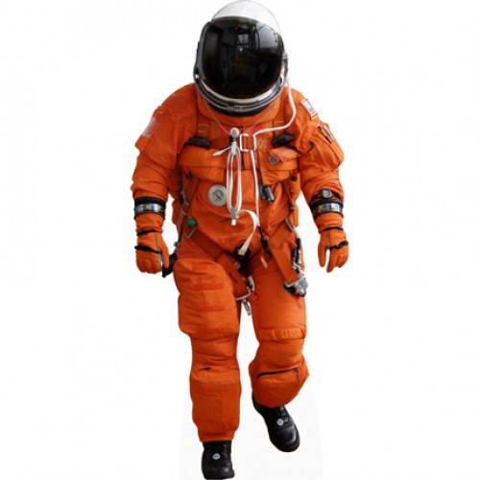
Tidal forces are the difference in gravity = curvature between your head and feet.
Scale of curved space relative to scale of us

Slide 42
Needs Gargantua - or ripped apart

Slide 43
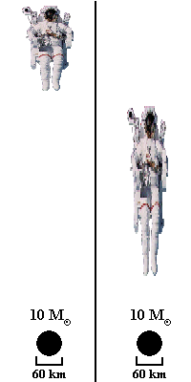
Needs Gargantua! Tidal forces are the difference in gravity = curvature between your head and feet.
Scale of curved space relative to scale of us

Slide 44
Tidal forces are the difference in gravity = curvature between your head and feet.
Scale of curved space relative to scale of us

Slide 46
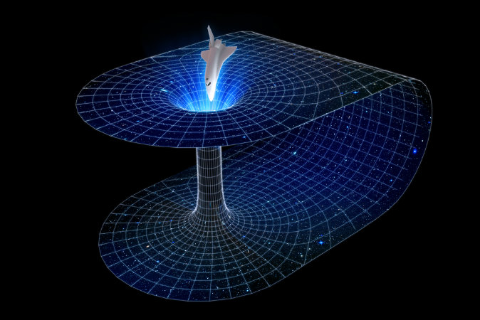
Wormholes:short cut through space
Need to do this WITHOUT black holes (or you end up at the bottom of a black hole!!

Slide 47
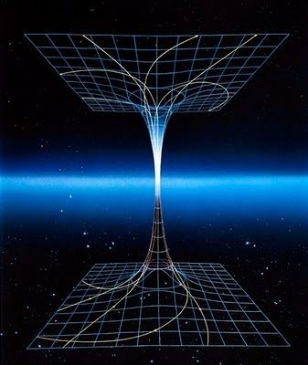
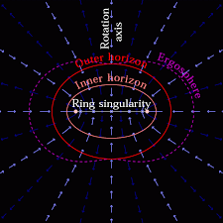
Wormholes: to another universe!!
Rotating black holes….

Slide 48
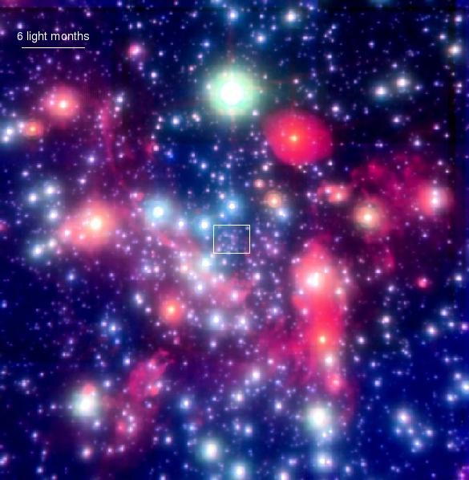
By gravity – all they possess!
Gravitational effect on nearby stars
Stars in GC get to within a lightday, but this is 2000x event horizon. Not probing the REALLY curved BH spacetime.
Hard to detect

Slide 49
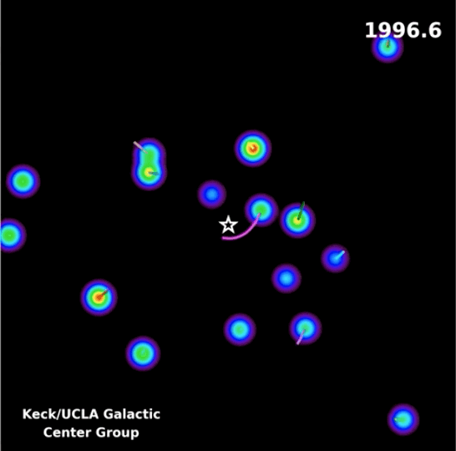
By gravity – all they possess!
Gravitational effect on nearby stars
Stars in GC get to within a lightday, but this is 2000x event horizon. Not probing the REALLY curved BH spacetime.
Hard to detect

Slide 50
2020 Nobel Prize

