Slide 1
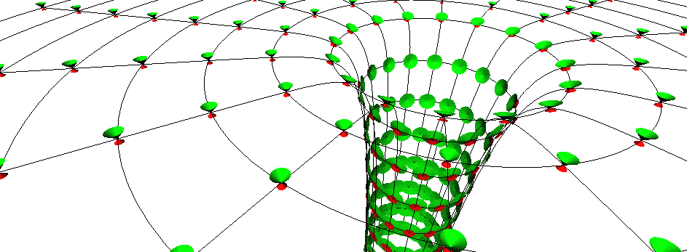
Black holes recent breakthrough results!
Prof Chris Done, University of Durham

Slide 2
Observing black holes?
The thing about a black hole, its main distinguishing feature is its black! And the thing about space, your basic space colour is its black! So how are you supposed to see them ? Red Dwarf

Slide 3
Talk Plan
What are they
And what are these recent breakthrough results which have enabled us to ‘see’ them ??

Slide 4
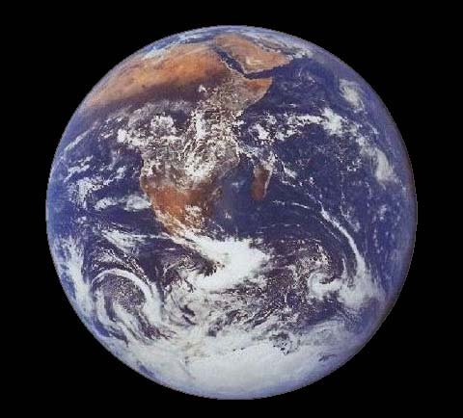
Escape speed - newton
Ball height depends on initial speed versus gravity
Stronger gravity – throw faster to escape…
..gravity so strong that escape velocity is speed of light
M

Slide 5
Escape speed
Ball height depends on initial speed versus gravity
Stronger gravity – throw faster to escape…
..gravity so strong that escape velocity is speed of light
Newtons gravity only affects things with mass…
M

Slide 6
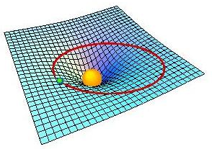
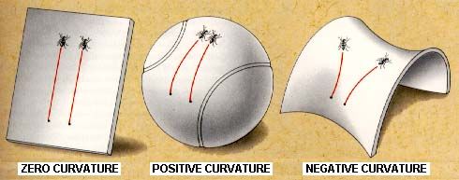
Gravity: warped spacetime
Gravity IS curvature
Natural paths (no forces acting ie inertial frames) are ‘straight lines’ on curved space - geodesics

Slide 7
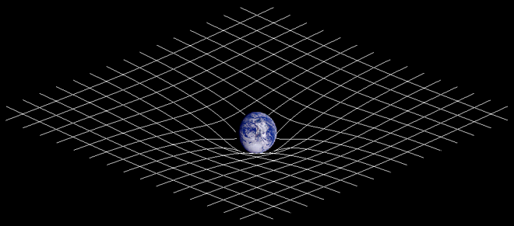
Gravity: Einstein
NOT action at a distance force (Newtonian)
Space(time) warped by mass(energy)
http://en.wikipedia.org/wiki/General_relativity

Slide 8
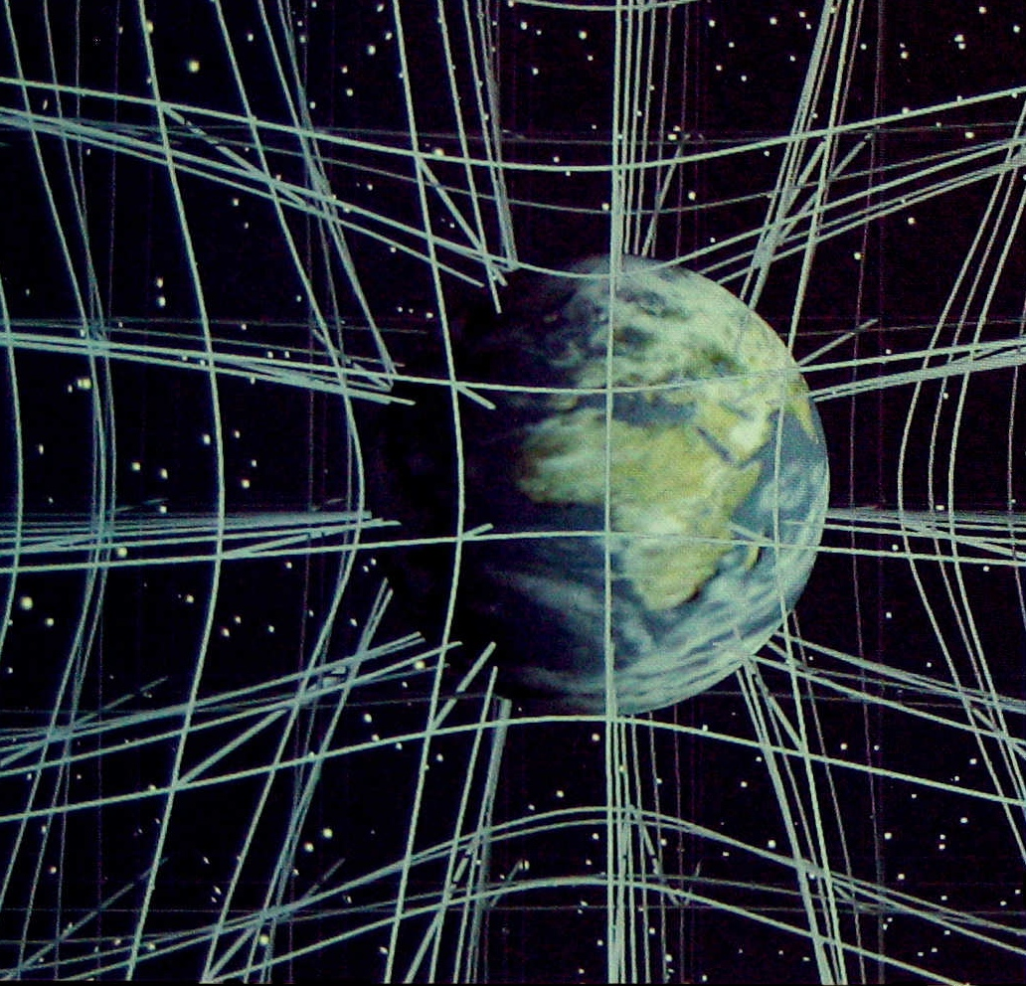
Gravity: Einstein
Should think of it in 3D but difficult to draw!
Christopher Vitale of Networkologies and the Pratt Institute.

Slide 9
100 years of Einstein’s gravity
mass(energy) curve space(time)
Light travels in ’straight line’ across surface that is curved
So its path is curved - verified by Eddington solar eclipse May 1919, results at Royal Society 6th Nov 1919
True position
Apparent position

Slide 10
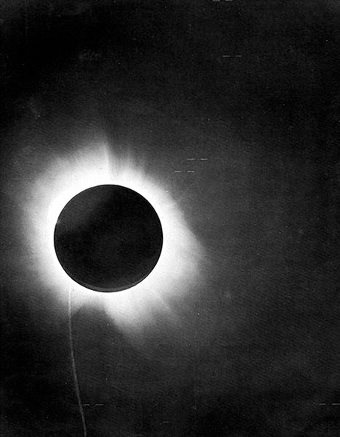
100 years of Einstein’s gravity

Slide 11
101 years of Einstein’s gravity
mass(energy) curve space(time)
Light travels in ’straight line’ across surface that is curved
So its path is curved - verified by Eddington solar eclipse May 1919, results at Royal Society 6th Nov 1919
True position
Apparent position

Slide 12
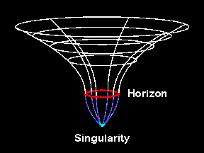
Gravity: warped spacetime
More gravity, more mass in same space or same mass, smaller size

Slide 13
Gravity: warped spacetime
More gravity, more mass in same space or same mass, smaller size
Faster speed to escape

Slide 14
Gravity: warped spacetime
More gravity, more mass in same space or same mass, smaller size
Faster speed to escape
Black hole – escape velocity is faster than light so can’t get out!

Slide 15
Gravity: warped spacetime
More gravity, more mass in same space or same mass, smaller size
Black hole – escape velocity is faster than light so can’t get out!
Singularity – space and time crushed to infinitesimal point of infinite density….
…Decently hidden below event horizon!
© Andrew Hamilton

Slide 16
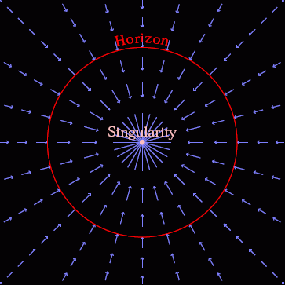
Gravity: warped spacetime
Spacetime itself in falling in at the speed of light
Nothing travels faster than light so everything swept down below event horizon
Event horizon….
© Andrew Hamilton

Slide 17
Gravity: warped spacetime
Utterly extreme.
mass of sun squashed into size of London.
mass of earth squashed <1cm!
Impossible!!!!!!!!?
How to get such extreme compression?
NASA image

Slide 18
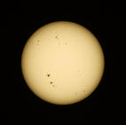
Black hole recipe…
Take 1 massive star (at least 10 bigger than Sun)
Stars fuse 4H to He
Lose mass, gain energy via Einstein’s E=mc²
Hydrogen bomb! in its stable life – outward pressure of hot gas (fusion) balanced by inward pull of gravity.

Slide 19
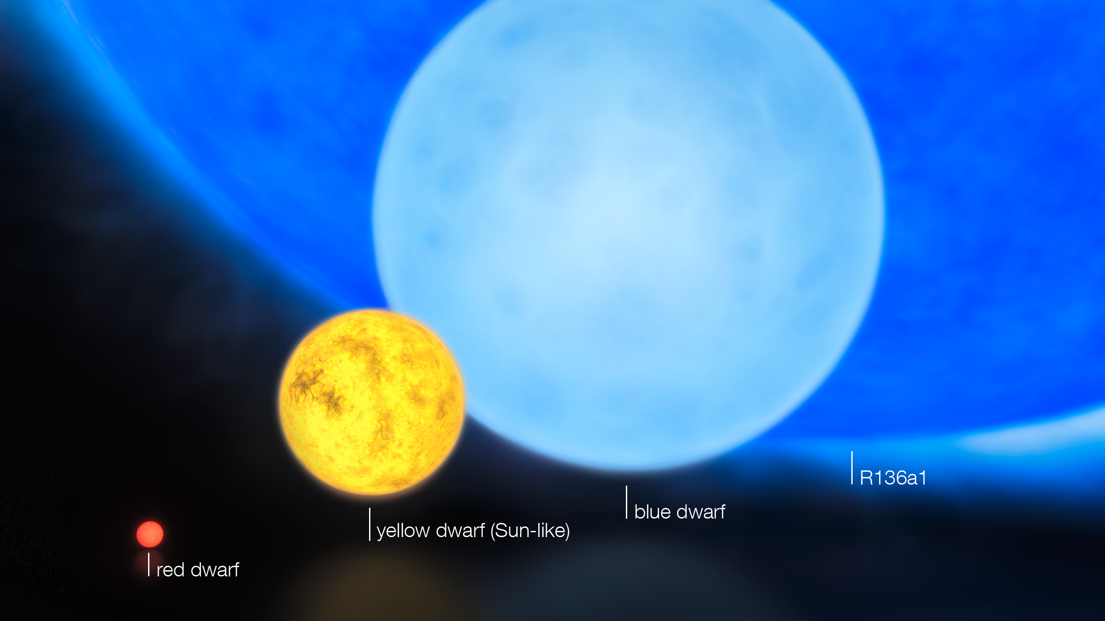
What happens next? Mass

Slide 20
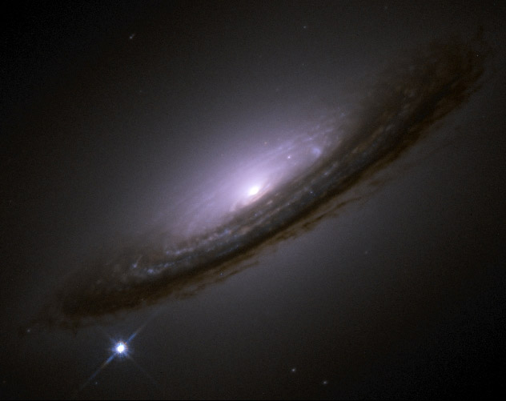
Supernovae
Supernovae - massive star core collapse
Single exploding star can outshine an entire galaxy!
NASA image

Slide 21
But also supermassive black holes!
NASA image

Slide 22
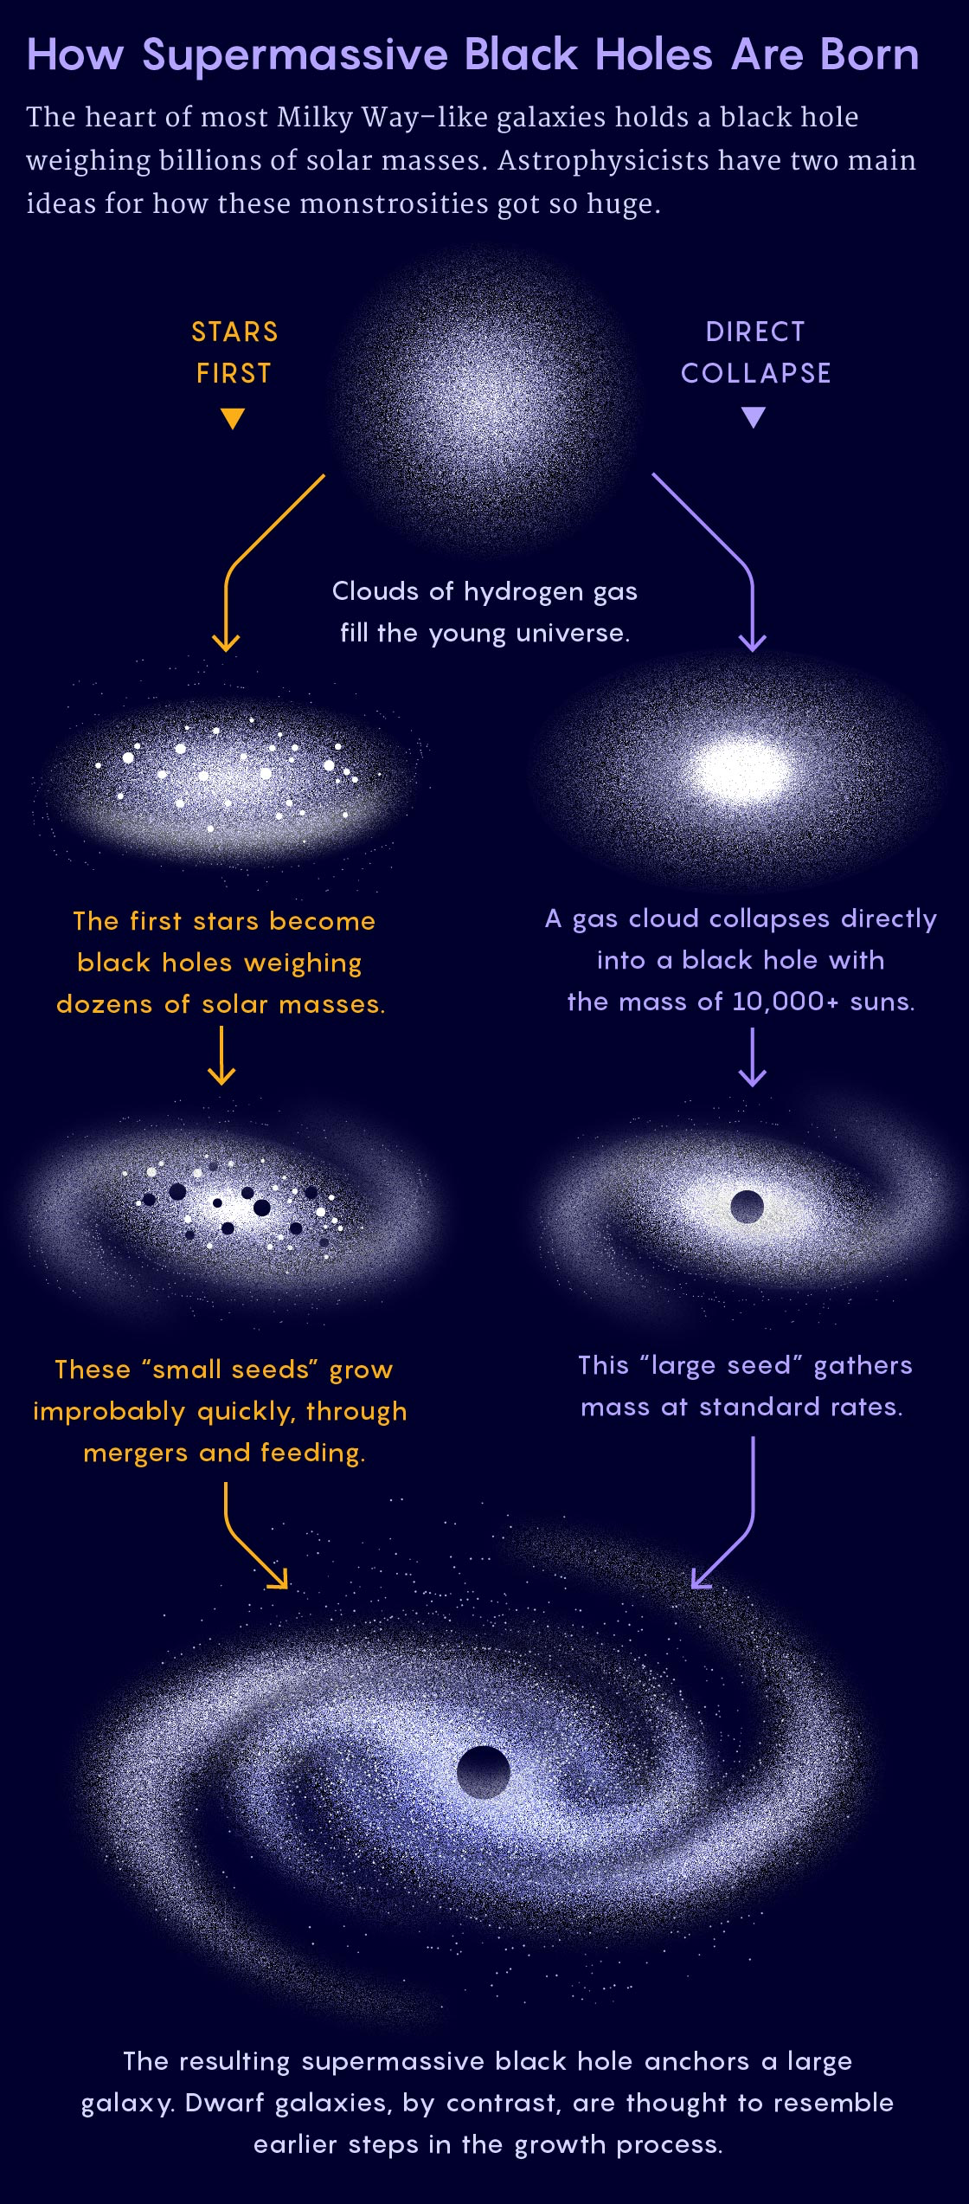
But also supermassive black holes!

Slide 23
Feed by merging and gas!

Slide 24
Observing black holes?
Einstein’s gravity tested in solar system - very weak field
Black holes – strongest possible observable field
Quite an extrapolation…
Black hole on the black background of space means no way to test this??

Slide 25
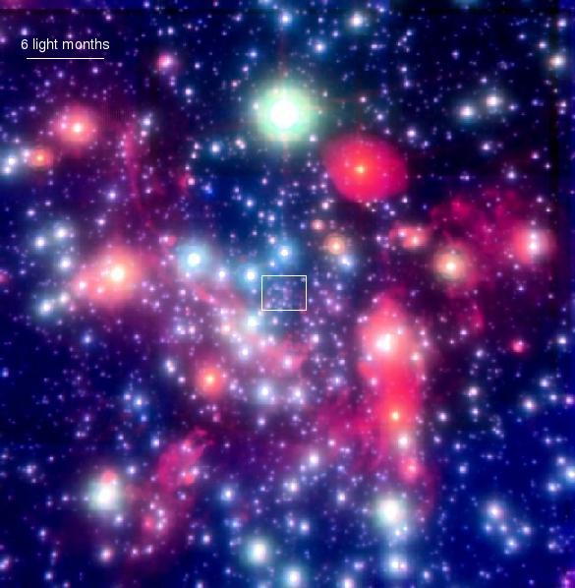
By gravity – all they possess!
Gravitational effect on nearby stars
Stars in GC get to within a lightday, but this is 2000x event horizon. Not probing the REALLY curved BH spacetime.
Hard to detect

Slide 26
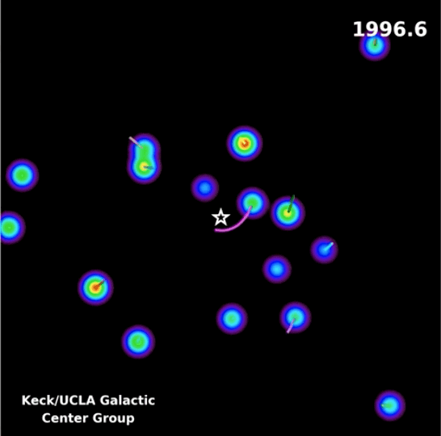
By gravity – all they possess!
Gravitational effect on nearby stars
Stars in GC get to within a lightday, but this is 2000x event horizon. Not probing the REALLY curved BH spacetime.
Hard to detect

Slide 27
Nobel prize 2020!

Slide 28
Black hole radii
Photon orbit – tangential c
R=3GM/c²=1.5Rs

Slide 29
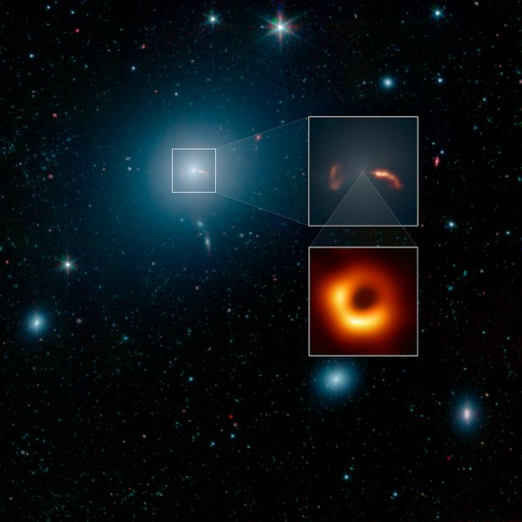
Observing black holes?
Iconic image of black hole shadow
Size of full image - like sun/moon
Size of black hole – like reading a newspaper in New York from a sidewalk café in Paris

Slide 30
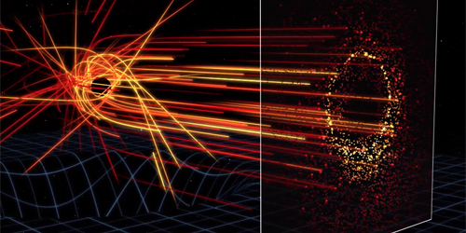
Very dim accretion flow – event horizon and photon orbits
See a shadow due to the light from matter falling in!!
Very very dim, picks out the light orbit ring
But if the matter falling in was brighter - easier to see!

Slide 31
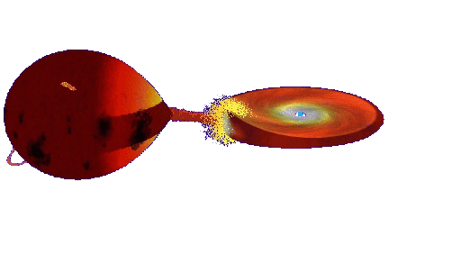
Accretion
Continuous ring of gas – friction dissipates energy
Makes material hot
BRIGHT accretion discs glowing X-ray hot
© Andrew Beardmore

Slide 32
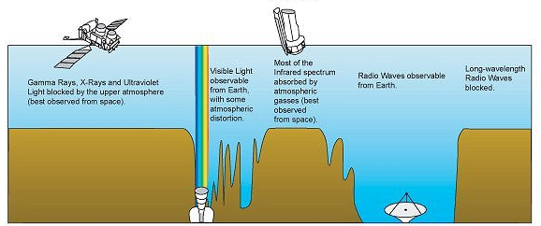
X-rays blocked by atmosphere
NASA image
X-rays
Visible
Radio
Wavelength

Slide 33
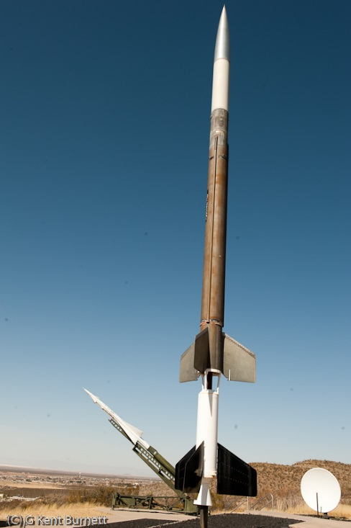
Rocket Science!
Nobel Prize to Giaconni in 2002 for discovery of cosmic X-ray sources in the 1960s
Black holes position highlighted by the high energy X-ray radiation released by material falling towards the event horizon
NASA image

Slide 34
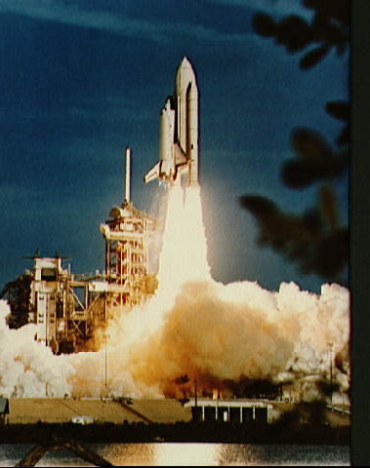
Rocket Science!
X-ray astronomy transforms black holes from theoretical speculation to observable objects
Observe black holes and get to do rocket science!!

Slide 35
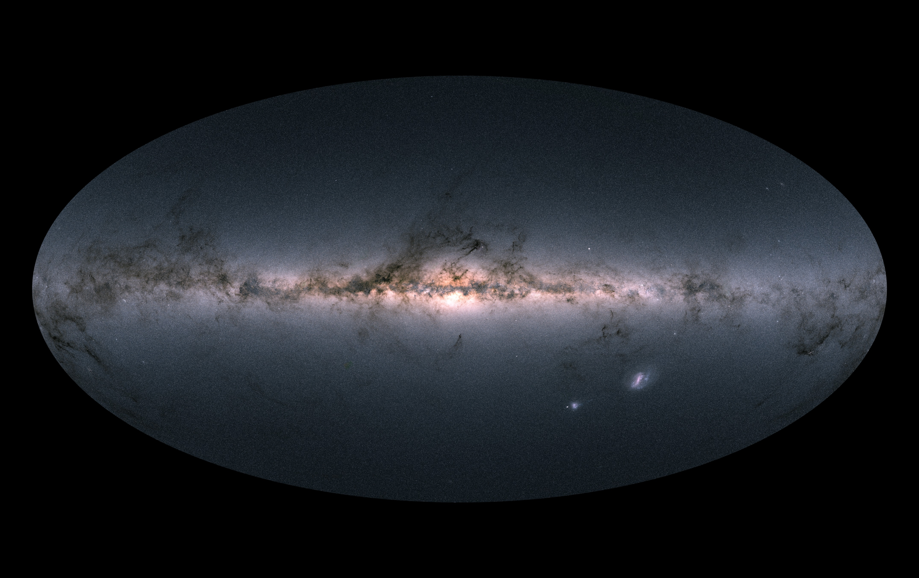
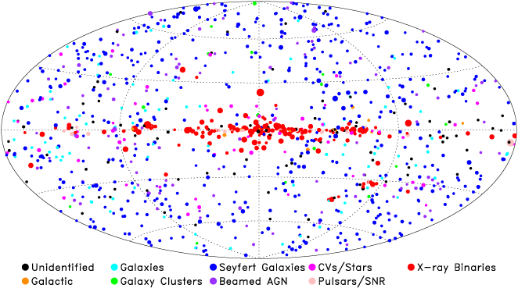
The whole sky in optical
Gaia image

Slide 36
The whole sky in X-rays
Giacconi: Nobel prize in 2002 for discovery of BH
Stellar mass BH
10x Sun
NASA image

Slide 37
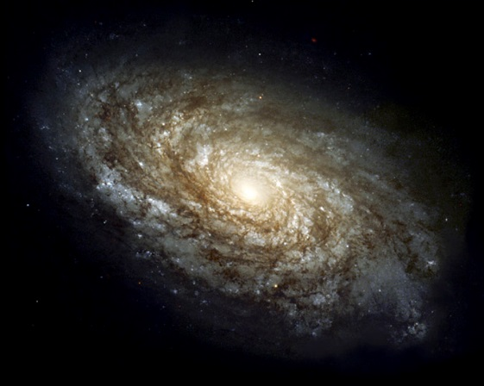
The whole sky in X-rays
Supermassive BH
Million-Billion x Sun
Stellar mass BH
10x Sun
NASA image

Slide 38
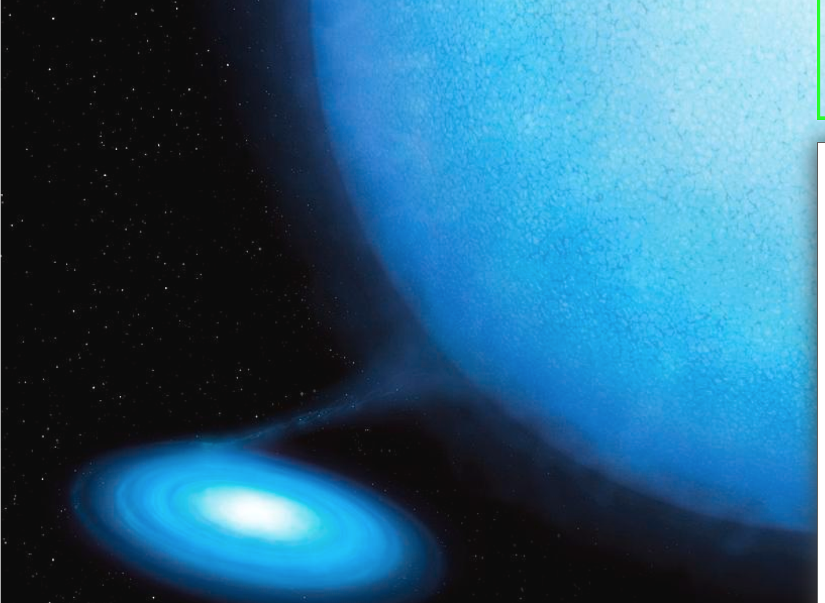
Supermassive BH
Million-Billion x Sun
Stellar mass BH
10x Sun
NASA image

Slide 39
Gravitational waves!

Slide 40
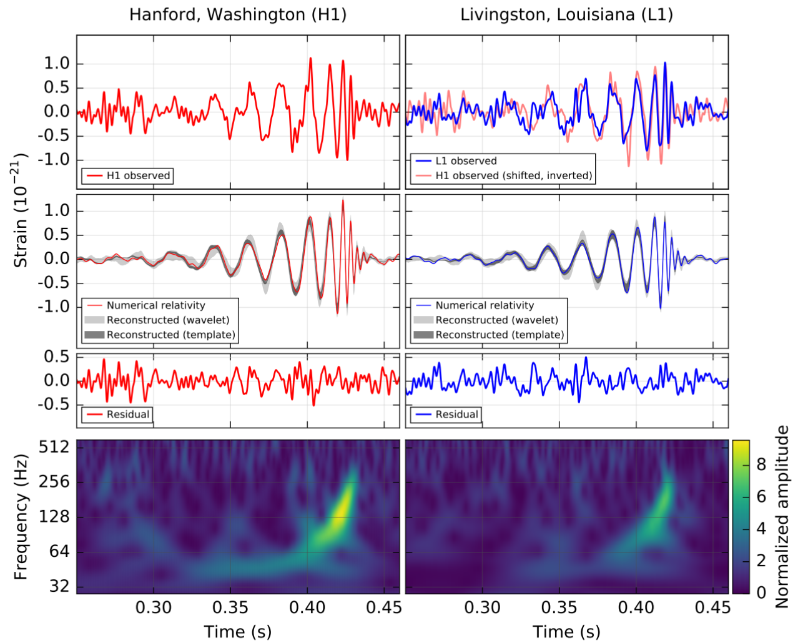

Slide 41
So can we use them for time travel??
YES to the future
NO(?) to the past which is good as Grandfather paradox!

Slide 42
Back to the Future!!

Slide 43
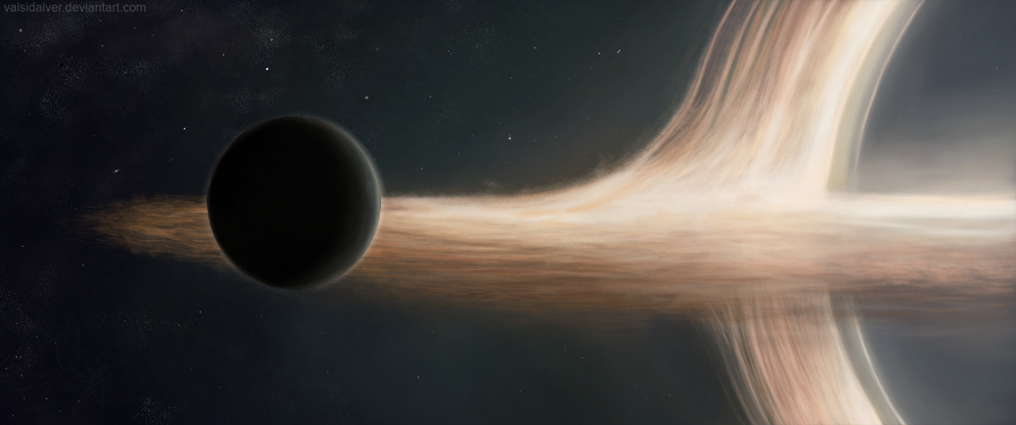
Interstellar – planet so close to black hole that time is slowed down!
YES - to the future!

Slide 44
Conclusions
Einstein GR, strong gravity, event horizon
We see such objects !! They exist!
So we could do time travel to the far future
But probably not to the past…
But they make excellent SciFy plots!

Slide 45
Gravity: warped spacetime
Utterly extreme.
mass of sun squashed into size of London.
mass of earth squashed <1cm!
Impossible!!!!!!!!?
How to get such extreme compression?
NASA image

Slide 46
Black hole recipe: I
Take 1 massive star (at least 10 bigger than Sun)
Stars fuse 4H to He
Lose mass, gain energy via Einstein’s E=mc²
Hydrogen bomb! in its stable life – outward pressure of hot gas (fusion) balanced by inward pull of gravity.

Slide 47
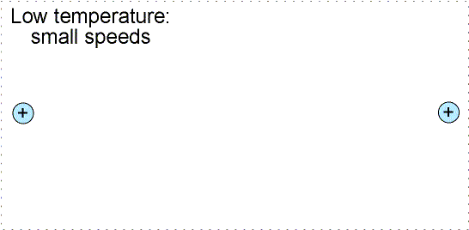
Electrostatic repulsion

Slide 49
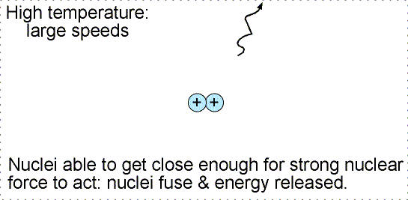
But now got 2 protons both with +ve charge
Strong repulsion between them as well as the strong nuclear force binding them together

Slide 50
One of them decays into a positron
(+ve electron = anti-electron = antimatter!) and a neutrino.
Leaves neutron next to proton bound together by strong nuclear force. Isotope of Hydrogen called Deuterium

Slide 52
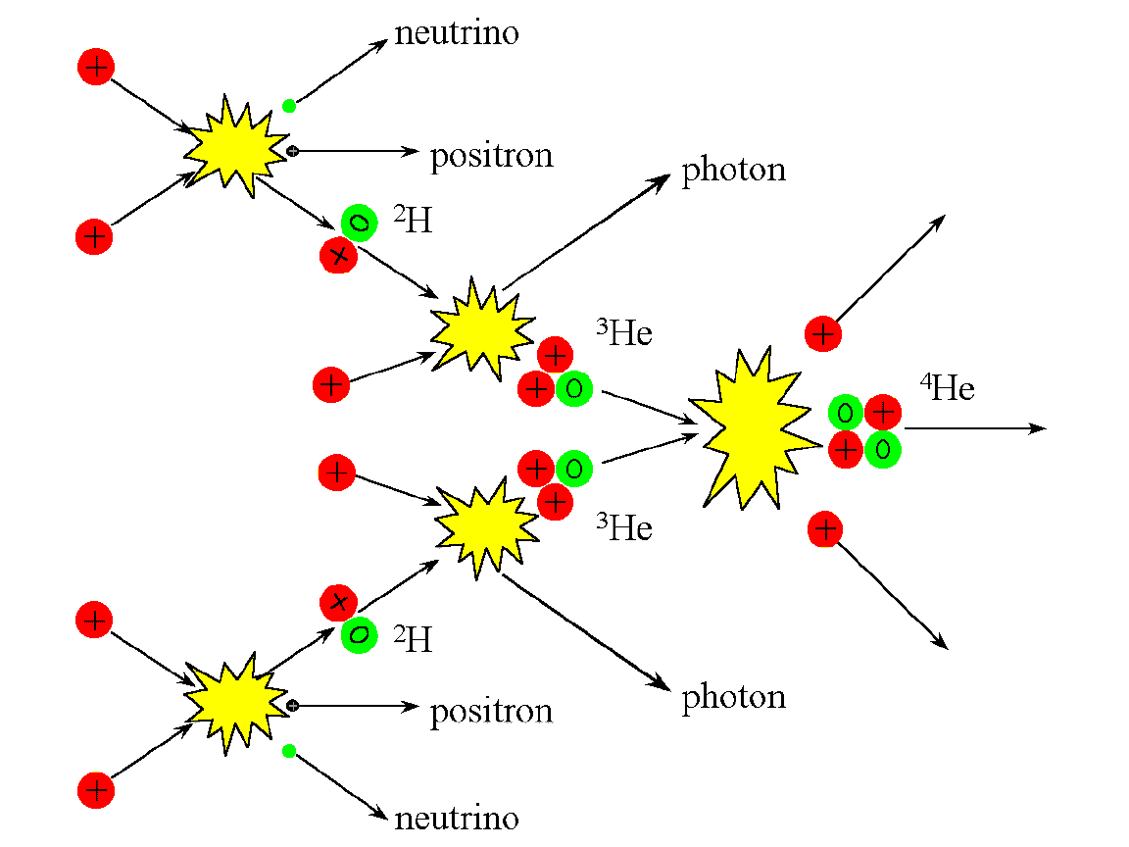

Slide 53
Black hole recipe: I
Take 1 massive star (at least 10 bigger than Sun)
Stars fuse 4H to He
Lose mass, gain energy via Einstein’s E=mc²
Hydrogen bomb! in its stable life – outward pressure of hot gas (fusion) balanced by inward pull of gravity.

Slide 54
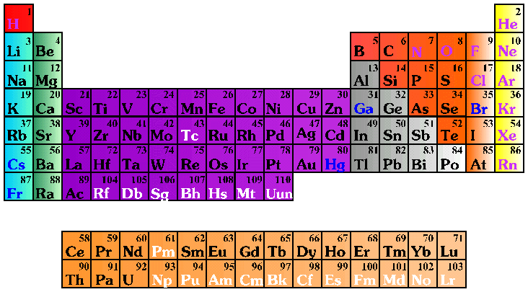
Chemistry!

Slide 55
Black hole recipe: I
Cook until H all gone.

Slide 56
Chemistry!
He core pulled in by gravity, temperature increases. If high enough fuse 3He to C
C core pulled in by gravity temperature increases. If high enough fuse C+He to O
O core pulled…….

Slide 57
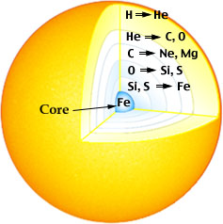
Black hole recipe: II
Run out of H but gravity never runs out – contracts core so higher temperatures
then fuse higher atomic number elements…
Builds up all the chemical elements of the periodic table!

Slide 58
Black hole recipe: II
But get less and less energy!
Iron is crossover between fusion and fission! No more energy!
Iron core builds up as iron ‘ash’ sinks down from layers above. pulled in by gravity but no other energy!

Slide 59
Black hole recipe: III
Fe core pulled in by gravity. How far can material be compressed?
Electron degeneracy pressure – wave-particle duality in quantum mechanics. Smaller box, smaller wavelength, higher energy, faster!
Can’t go faster than c!

Slide 60
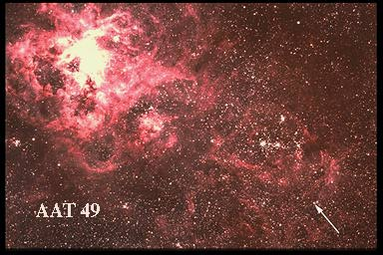
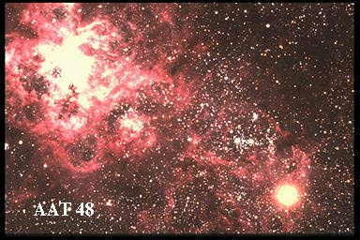
Black hole recipe: IV
Hit this when Fe core is 1.4x mass of Sun
e⁻ + p⁺ > n + ν
Neutrons have higher mass, shorter wavelength so fit in MUCH smaller box! Floor drops away.
Dramatic supernovae explosion!
Neutron star core left held up by degenerate neutrons.
mass of sun, size of London.

Slide 61
Supernovae
Supernovae - massive star core collapse
Single exploding star can outshine an entire galaxy!
NASA image

Slide 62
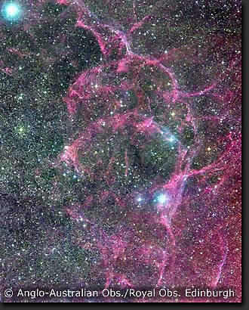
A digression…..
Outer layers blasted across interstellar space
Contains all heavy elements needed for life (C, N, O, Fe etc)
Where slams into molecular gas then triggers next generation of stars/planets(/life?)

Slide 63
Black hole recipe: V
But core being hit by infalling layers from above
Neutrons get squashed into smaller and smaller box, going faster and faster
Hit c at 1.4-3x mass of sun (depends on rotation rate)
no known state of matter can hold up complete collapse
Event horizon only factor of 3 smaller than a neutron star

Slide 64
Needs Gargantua - or ripped apart
Tidal forces are the difference in gravity = curvature between your head and feet.
Scale of curved space relative to scale of us

Slide 65
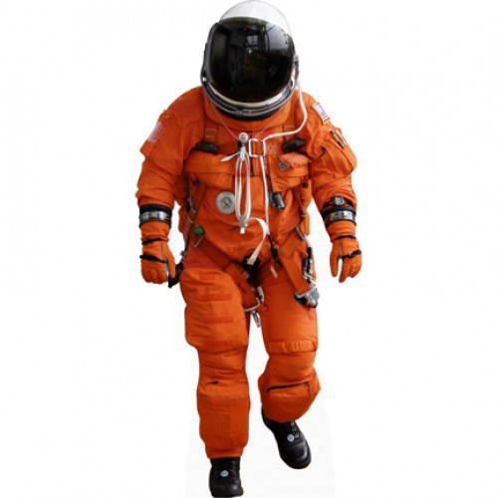
Tidal forces are the difference in gravity = curvature between your head and feet.
Scale of curved space relative to scale of us

Slide 66
Needs Gargantua - or ripped apart

Slide 67
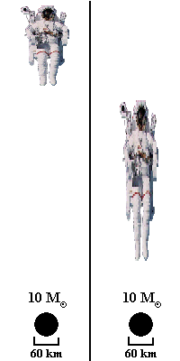
Needs Gargantua! Tidal forces are the difference in gravity = curvature between your head and feet.
Scale of curved space relative to scale of us

Slide 68
Tidal forces are the difference in gravity = curvature between your head and feet.
Scale of curved space relative to scale of us

Slide 70
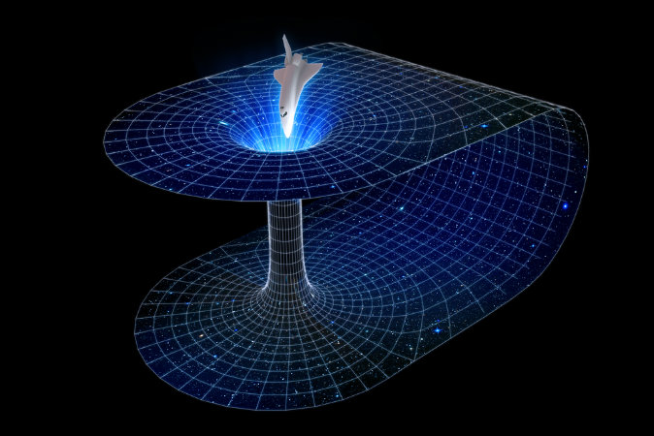
Wormholes:short cut through space
Need to do this WITHOUT black holes (or you end up at the bottom of a black hole!!

Slide 71
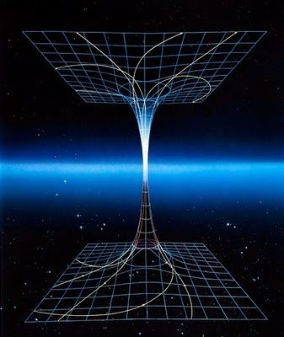
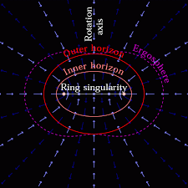
Wormholes: to another universe!!
Rotating black holes….

Slide 73
Gravitational waves!

Slide 75
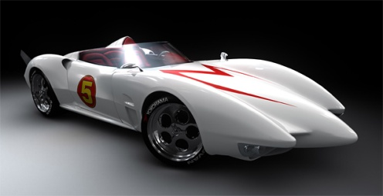
Einstein’s gravity: Special relativity
Travelling at fixed speed c through spacetime….
Generally all through time
If put some of the motion through space then takes longer to move through time (time dilation)!!
speed = distance/time so length contraction along motion

Slide 76
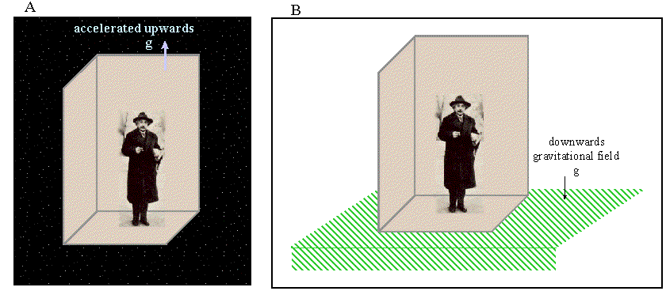
Einstein’s gravity: general relativity
SR doesn’t do acceleration, gravity makes acceleration
Is there a difference? Look the same, behave the same…
Maybe they ARE the same - ‘happiest thought’
Principle of equivalence: acceleration=gravity

Slide 77
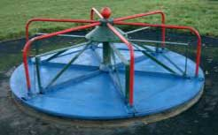
Acceleration: Special relativity
Circular motion easiest to think about
Measure roundabout circumference C and diameter D by crawling around with ruler
Get ratio C/D=π
Now rotate ….

Slide 78
Acceleration: special relativity
Length contracts along direction of motion so need more ruler lengths to go round C’ > C!! But diameter is not affected as its not in direction of motion
Ratio C/D > π
Can’t happen!! …in flat space

Slide 79
By gravity – all they possess!
Gravitational effect on nearby stars
Stars in GC get to within a lightday, but this is 2000x event horizon. Not probing the REALLY curved BH spacetime.
Hard to detect

Slide 80
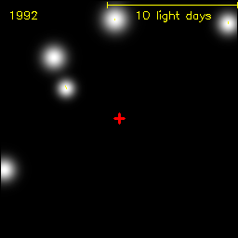
By gravity – all they possess!
Gravitational effect on nearby stars
Stars in GC get to within a lightday, but this is 2000x event horizon. Not probing the REALLY curved BH spacetime.
Hard to detect

Slide 81
Observing black holes?
How to test this ?
The thing about a black hole, its main distinguishing feature is its black! And the thing about space, your basic space colour is its black! So how are you supposed to see them ? Red Dwarf

Slide 82
Gravity: warped spacetime
Spacetime itself in falling in at the speed of light
Nothing travels faster than light so everything swept down below event horizon
© Andrew Hamilton

Slide 83
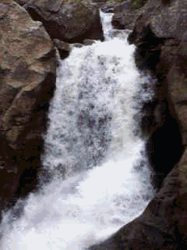
Gravity: warped spacetime
Spacetime itself in falling in at the speed of light

