Slide 1
Role of the jet
Chris Done & Emma Gardner
University of Durham

Slide 2
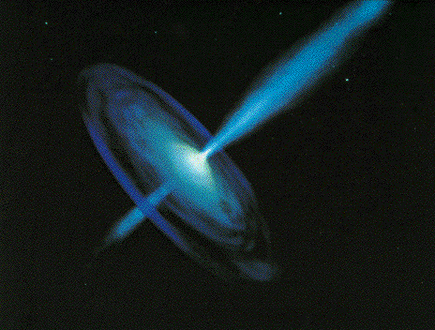
Black holes
Black hole binaries –
Observational template of how accretion flows (spectra and variability) and their associated jet behave
Build a working physical model of accretion flows
Black hole spin

Slide 3
Black holes
Scale up to AGN – what works and what doesn’t

Slide 4
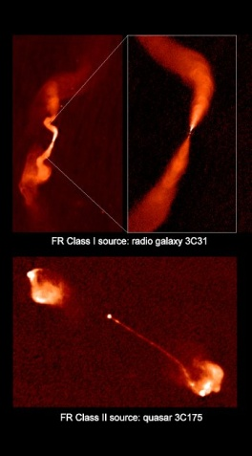
Different types of large scale jet
FRI – BL Lacs - fluffy
FRII – Flat spectrum radio QSO

Slide 5
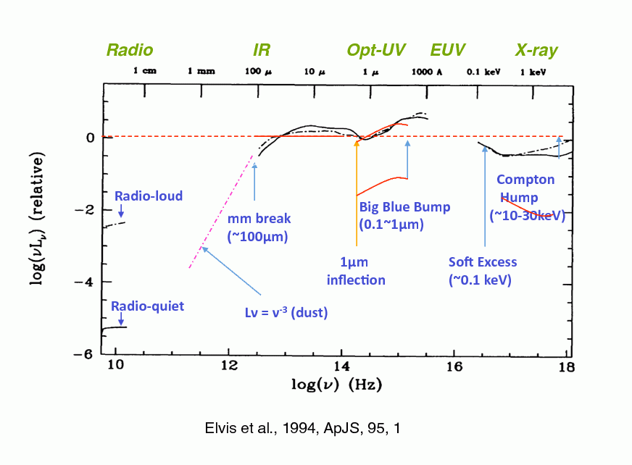
Compare to normal QSO
Richards et al 2006, Elvis et al 2004
Radio loud QSO (FRII) not very different at all from radio quiet
Except in radio!

Slide 6
FRI/LINER AGN
LINERS – which are all FRI
Don’t seen to have BBB or IR bump
But its contaversial (Maoz 2007v Yu, Yuan & Ho 2011)
But not at all contraversial that when you look DOWN the jet they are different!
M=2x10⁸
Nemmen et al 2012
L/L_{Edd}~10⁻⁵
M/M_{Edd}~10^{-2.5}

Slide 7
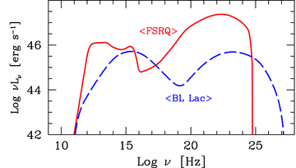
Spectral differences
Ghisellini et al 2010
Notes:
The disc models assumed that the emission thermalised. That’s not necessarily true at low L/Ledd where the flow is not very dense. If its not thermalising then its not cooling as efficiently so the flow heats up. This can lead to a hot, optically thin, geometrically thick inner flow replacing the inner disc. The hot electrons in this flow can compton upscatter any low energy photons from a residual outer disc, but there are not many of these, so the spectrum is hard

Slide 8
Unification with blazars
Ghisellini et al 2010

Slide 9
Optically thin nonthermal compton
power law by single scattering of nonthermal electrons N (γ) ∝ γ^{−p}
index α = (p-1)/2 (p >2 so α > 0.5 – monoenergetic injection)
Starts a factor τ down from seed photons, extends to γ_{max}² ε_{in}
ε_{in}
ε_{out}~γ²ε_{in}
f(ε) ∝ ε^{−(p-1)/2}
γ
Log N(γ)
Log fν
N (γ) ∝ γ^{−p}
Log γ
γ_{max}
ε_{in}
Log ν
γ_{max}² ε_{in}

Slide 10
Nonthermal synchrotron
power law by single scattering of nonthermal electrons N (γ) ∝ γ^{−p}
index α = (p-1)/2 (p >2 so α > 0.5 – monoenergetic injection)
Starts a factor τ down from seed photons, extends to γ_{max}² ε_{in}
ε_{in}
ε_{out}~γ²ε_{in}
f(ε) ∝ ε^{−(p-1)/2}
γ
Log N(γ)
Log fν
N (γ) ∝ γ^{−p}
Log γ
γ_{max}
ε_{in}
Log ν
γ_{max}² ε_{in}

Slide 11
Synchrotron self compton
Put in vfv
Expect index α = (p-1)/2~0.6 for p=2.2 from shocks
Log vfν
γ_{max}
ε_{in}
Log ν
γ_{max}² ε_{in}

Slide 12
Synchrotron self compton
Klein nisina cutoff – can’t have more energy than electron had to start with γ² hν < γ mc² so γ ε < 1 where ε=hν/mc²
Synchrotron self absorption
Log vfν
γ_{max}
ε_{in}
Log ν
γ_{max}² ε_{in}

Slide 13
Synchrotron self compton
Klein nisina cutoff – can’t have more energy than electron had to start with γ² hν < γ mc² so γ ε < 1 where ε=hν/mc²
Synchrotron self absorption
Log vfν
γ_{max}
ε_{in}
Log ν
γ_{max}² ε_{in}

Slide 14
Synchrotron self compton
Doppler boosting due to bulk motion Γ (don’t confuse with lorentz factor of electrons γ) – δ = 1/[Γ(1−βcosθ)]
Eobs=Eint δ
Fobs=Fint δ^{3+α}
Log vfν
γ_{max}
ε_{in}
Log ν
γ_{max}² ε_{in}

Slide 15
BL Lacs as SSC
need Γ ~ 10-20, θ<5ο, γmax∼10⁵ double power law electron distribution
Can’t make FSRQ
Ghisellini et al 2010
Notes:
The disc models assumed that the emission thermalised. That’s not necessarily true at low L/Ledd where the flow is not very dense. If its not thermalising then its not cooling as efficiently so the flow heats up. This can lead to a hot, optically thin, geometrically thick inner flow replacing the inner disc. The hot electrons in this flow can compton upscatter any low energy photons from a residual outer disc, but there are not many of these, so the spectrum is hard

Slide 16
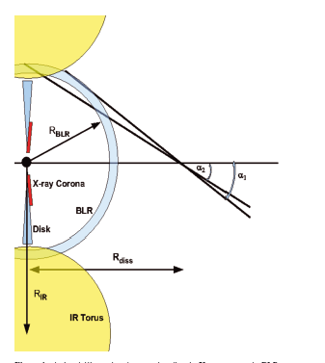
FSRQ –disc and BLR
Disc is behing jet so strongly deboosted
BLR may be much more isotropic so these external seed photons can be more important self produced synchrotron
Ghisellini et al 2009
Notes:
The disc models assumed that the emission thermalised. That’s not necessarily true at low L/Ledd where the flow is not very dense. If its not thermalising then its not cooling as efficiently so the flow heats up. This can lead to a hot, optically thin, geometrically thick inner flow replacing the inner disc. The hot electrons in this flow can compton upscatter any low energy photons from a residual outer disc, but there are not many of these, so the spectrum is hard

Slide 17
FSRQ –disc and BLR
Disc is behing jet so strongly deboosted
BLR may be much more isotropic so these external seed photons can be more important self produced synchrotron
Log vfν
γ_{max}
ε_{in}
Log ν
γ_{max}² ε_{in}
Ghisellini et al 2009
Notes:
The disc models assumed that the emission thermalised. That’s not necessarily true at low L/Ledd where the flow is not very dense. If its not thermalising then its not cooling as efficiently so the flow heats up. This can lead to a hot, optically thin, geometrically thick inner flow replacing the inner disc. The hot electrons in this flow can compton upscatter any low energy photons from a residual outer disc, but there are not many of these, so the spectrum is hard

Slide 18
FSRQ –disc and BLR
need Γ ~ 10-20, θ<5^{ο}, γmax∼10⁵ double power law electron distribution similar to BL Lacs
Log vfν
γ_{max}
ε_{in}
Log ν
γ_{max}² ε_{in}
Ghisellini et al 2009
Notes:
The disc models assumed that the emission thermalised. That’s not necessarily true at low L/Ledd where the flow is not very dense. If its not thermalising then its not cooling as efficiently so the flow heats up. This can lead to a hot, optically thin, geometrically thick inner flow replacing the inner disc. The hot electrons in this flow can compton upscatter any low energy photons from a residual outer disc, but there are not many of these, so the spectrum is hard

Slide 19
Extended jet
That was all from single piece of jet
Jet has extended structure
Kinetic Energy density dL/dV
dL∝mdot dz
Conical jet r=Az
dV=πr² dz= π A² z² dz
UKE ∝ mdot (z/z0)⁻²
UB=UB(r0) (z/z0)⁻²
Urel=Urel(r0)(z/z0)⁻²
N(g)=K f(g) so K goes as z ⁻²

Slide 20
Self absorption gives flat spectrum
And all emission above SSA is dominated by base
Log νf(ν)
Radio IR optical UV X-ray

Slide 21
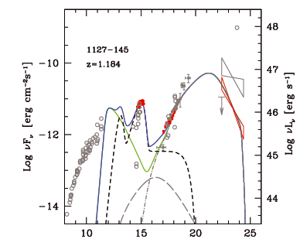
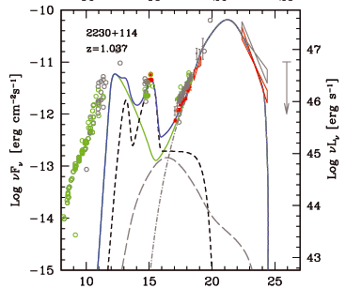

Slide 22
BHB – Quasars for the impatient
BRIGHT! Huge amounts of data, long term variability (days –years) in mass accretion rate (due to H ionisation instability in disc)
Observational template of accretion flow as a function of L/L_{Edd} onto ~10 M BH (very homogeneous!)
2 years
DGK07

Slide 23
Spectral states
very high
Disc dominated - look like a disc but small tail to high energies
Very high/intermediate states at least know something about a disc
Low/hard state look really different, not at all like a disc!
disk dominated
high/soft
Gierlinski & Done 2003

Slide 24
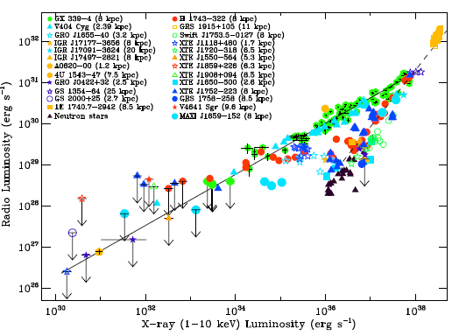
Accretion flows – Jet
Low/hard
High/soft
Very high
Corbel et al 2012
Notes:
The disc models assumed that the emission thermalised. That’s not necessarily true at low L/Ledd where the flow is not very dense. If its not thermalising then its not cooling as efficiently so the flow heats up. This can lead to a hot, optically thin, geometrically thick inner flow replacing the inner disc. The hot electrons in this flow can compton upscatter any low energy photons from a residual outer disc, but there are not many of these, so the spectrum is hard

Slide 25
L/Ledd < 0.01 ADAF,
weak disk, low excitation
broader, slower jet, FRI?
L/Ledd~1 Disc+tail
strong disk, high excitation Narrower, faster jet, FRII?
Log ν f(ν)
Log ν f(ν)
Log ν
Log ν
Notes:
The disc models assumed that the emission thermalised. That’s not necessarily true at low L/Ledd where the flow is not very dense. If its not thermalising then its not cooling as efficiently so the flow heats up. This can lead to a hot, optically thin, geometrically thick inner flow replacing the inner disc. The hot electrons in this flow can compton upscatter any low energy photons from a residual outer disc, but there are not many of these, so the spectrum is hard

Slide 26
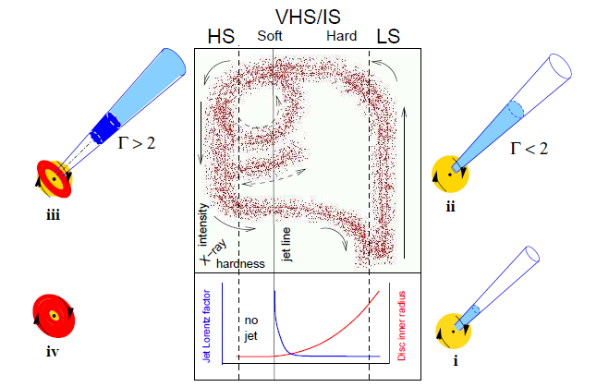
Jet evolution in BHB outburst
Fender Belloni Gallo 2003
Notes:
The disc models assumed that the emission thermalised. That’s not necessarily true at low L/Ledd where the flow is not very dense. If its not thermalising then its not cooling as efficiently so the flow heats up. This can lead to a hot, optically thin, geometrically thick inner flow replacing the inner disc. The hot electrons in this flow can compton upscatter any low energy photons from a residual outer disc, but there are not many of these, so the spectrum is hard

Slide 27
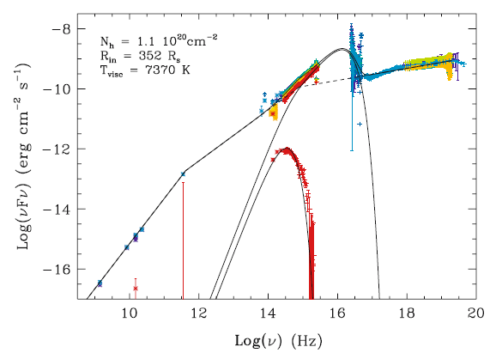
Jet in low/hard state
Radio-IR from jet
Where is optically thin SSA break?
Does it extrapolate to X-rays as well? What is electron dist?
How far does jet extend??
Chaty et al 2003
Notes:
The disc models assumed that the emission thermalised. That’s not necessarily true at low L/Ledd where the flow is not very dense. If its not thermalising then its not cooling as efficiently so the flow heats up. This can lead to a hot, optically thin, geometrically thick inner flow replacing the inner disc. The hot electrons in this flow can compton upscatter any low energy photons from a residual outer disc, but there are not many of these, so the spectrum is hard

Slide 28
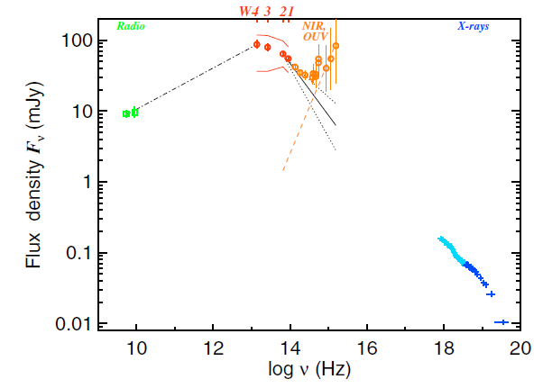
Jet in low/hard state
FLUX!!!!
But see the break from SSA optically thick to optically thin
Gandhi et al 2011
Notes:
The disc models assumed that the emission thermalised. That’s not necessarily true at low L/Ledd where the flow is not very dense. If its not thermalising then its not cooling as efficiently so the flow heats up. This can lead to a hot, optically thin, geometrically thick inner flow replacing the inner disc. The hot electrons in this flow can compton upscatter any low energy photons from a residual outer disc, but there are not many of these, so the spectrum is hard

Slide 29
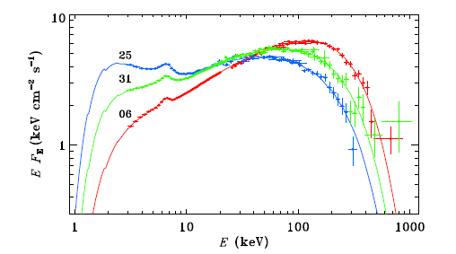
Low/hard Spectra
Low/hard state when see high E rollover its clearly Compton
Can’t do nonthermal synchrotron like this (Zdziarski)
Ibragimov et al 2005

Slide 30
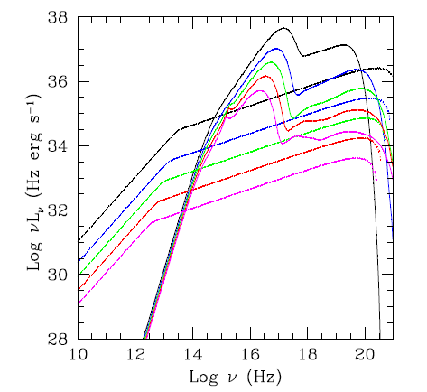
Low/hard state jet
Jet KE = flow radiated luminosity at top of ADAF branch
At base of jet radiate 10% of KE (maximum to not change jet structure by energy loss)
Get radio –X-ray correlation as Lx ∝(mdot)² while self absorbed synchrotron LR ∝(mdot)^{1.4} LR∝(mdot)^{0.7}
Lx(jet) ∝ UB(z0) Urel(z0) so is also ∝ (mdot)² so jet never takes over from flow
Gardner & Done 2013

Slide 31
radio-X ray including hysteresis
Low/hard
Very high
Corbel et al 2012
Notes:
The disc models assumed that the emission thermalised. That’s not necessarily true at low L/Ledd where the flow is not very dense. If its not thermalising then its not cooling as efficiently so the flow heats up. This can lead to a hot, optically thin, geometrically thick inner flow replacing the inner disc. The hot electrons in this flow can compton upscatter any low energy photons from a residual outer disc, but there are not many of these, so the spectrum is hard

Slide 32
Low/hard state jet
BUT VERY DIFFERENT FROM BL LACS
Γ~1.2
WHY??
could there be a BL Lacs type spine? But in BL Lacs the KE of the jet was basically all the accretion flow energy – and much more than the radiated X_ray energy.
Jets don’t seem to scale
Gardner & Done 2013

Slide 33
Conclusions
Highly relativistic jets in Blazars
BL Lacs – L/LEdd < 0.01 no UV inner disc so no broad line region, SSC , Gamma=10-20
FRI when not looking down jet – low ionisation lines, no disc
FSRQ – L/LEdd~1, strong UV, BLR as seed photons for external compton, Gamma=10-20
FRII when not looking down jet – strong BLR and disc
BHB – steady jet in low/hard state. Dramatic flaring at transitions from internal shocks (so maybe not telling us much)
Steady BHB jet for low/hard state should be analogue of Bl Lacs. But Gamma~1.2 – looks very different
Jets don’t seem to scale

Slide 34
Accretion flows onto black holes: Controversy!
Chris Done
University of Durham

Slide 35
Moving disc – moving QPO
Spectra need disc to move from 50-6ish Rg as make transition
Predicts solid angle subtended by disc increases
Predicts relativistic smearing increases
DGK07

Slide 36
Accretion flows without discs
Can form such configuration by thermal conduction from hot corona evaporates inner disc at low L/L_{Edd} Meyer & Meyer Hofmeister 1994; Lui et al 1999; 2002 Rozanska & Czerny 2000
Time dependent disc calculations show this! Mayer & Pringle 2007
Mayer & Pringle 2007
Notes:
The disc models assumed that the emission thermalised. That’s not necessarily true at low L/Ledd where the flow is not very dense. If its not thermalising then its not cooling as efficiently so the flow heats up. This can lead to a hot, optically thin, geometrically thick inner flow replacing the inner disc. The hot electrons in this flow can compton upscatter any low energy photons from a residual outer disc, but there are not many of these, so the spectrum is hard

Slide 37
Accretion flows without discs
Can form such configuration by thermal conduction from hot corona evaporates inner disc at low L/L_{Edd} Meyer & Meyer Hofmeister 1994; Lui et al 1999; 2002 Rozanska & Czerny 2000
Time dependent disc calculations show this! Mayer & Pringle 2007
Mayer & Pringle 2007
Notes:
The disc models assumed that the emission thermalised. That’s not necessarily true at low L/Ledd where the flow is not very dense. If its not thermalising then its not cooling as efficiently so the flow heats up. This can lead to a hot, optically thin, geometrically thick inner flow replacing the inner disc. The hot electrons in this flow can compton upscatter any low energy photons from a residual outer disc, but there are not many of these, so the spectrum is hard

Slide 38
Accretion flows without discs
Can form such configuration by thermal conduction from hot corona evaporates inner disc at low L/L_{Edd} Meyer & Meyer Hofmeister 1994; Lui et al 1999; 2002 Rozanska & Czerny 2000
Time dependent disc calculations show this! Mayer & Pringle 2007
Mayer & Pringle 2007
Notes:
The disc models assumed that the emission thermalised. That’s not necessarily true at low L/Ledd where the flow is not very dense. If its not thermalising then its not cooling as efficiently so the flow heats up. This can lead to a hot, optically thin, geometrically thick inner flow replacing the inner disc. The hot electrons in this flow can compton upscatter any low energy photons from a residual outer disc, but there are not many of these, so the spectrum is hard

Slide 39
But is there really a hole in hard state?
challenge 1
Extreme broad iron lines in the low/hard state:
GX339-4: Miller et al 2006; Reis et al 2008: Rin~2-5Rg with ionised reflection
Miller et al 2006

Slide 40
Relativistic smearing: spin
Relativistic effects (special and general) affect all emission
Emission from side of disc coming towards us:
Doppler blueshifted
Beamed from length contraction
Time dilation as fast moving (SR)
Gravitational redshift (GR)
Fe Kα line from irradiated disc should be broad and skewed, and shape depends on R_{in} (and spin)
flux
Energy (keV)
Fabian et al. 1989
Notes:
Another area where Astro e2 will give major progress in an independent test of the accretion flow models. The accretion disc moves fast in a strong gravitational field, so both special and general relativistic effects modify its spectrum. Doppler shifts and length contraction mean that the emission from the disc moving towards us is blueshifted and boosted, while that moving away is redshifted and suppressed. Then time dilation and gravitational redshift drag everything redwards. The strength of these all effects decrease with radius. All emission from the disc is affected, but its much easier to see on intrinsically narrow features – lines. X-ray illumination of the disc gives iron Kalpha line. Moving inner disc models predict broader line in softer spectra. But the measured line profile can be distorted by narrow absorption features superimposed on the emission. The high spectral resolution of Astro e2 will unambiguously show these, enabling the intrinsic line profile to be measured.

Slide 41
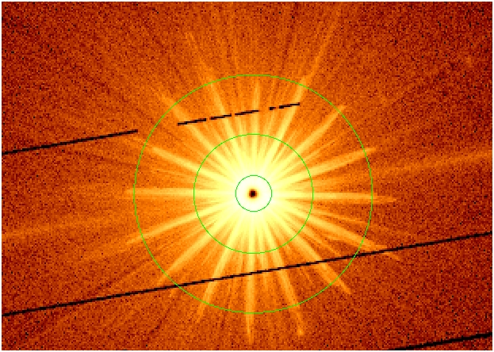
GX339-4 XMM data
Flux gives MOS count rate 200x > than pileup limit
Exclude core. 18-120” singles Miller et al 2006
But data are still piled up Done & Diaz-Trigo 2009
PN in timing mode so not (much) affected by pileup so use them instead (Wilkinson & Uttley 2009; Done & Diaz-Trigo 2009)

Slide 42
Done & Diaz-Trigo 2009
MOS1 18-120 782
PN all columns,
no background

Slide 43
GX339-4 XMM data
Unsmeared, moderately ionised reflection
Single laor line gives much poorer fit but Rin = 33 Rg Done & Diaz-Trigo 2009)

Slide 44
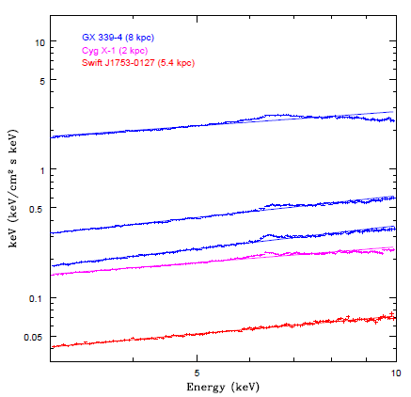
Moving disc
Iron line should be very small and narrow for low L/LEdd
Gets bigger and broader as disc moves in
XMM-Newton timing mode Kolehmainen Done & Diaz Trigo 2011 cf Tomsick et al 2010

Slide 45
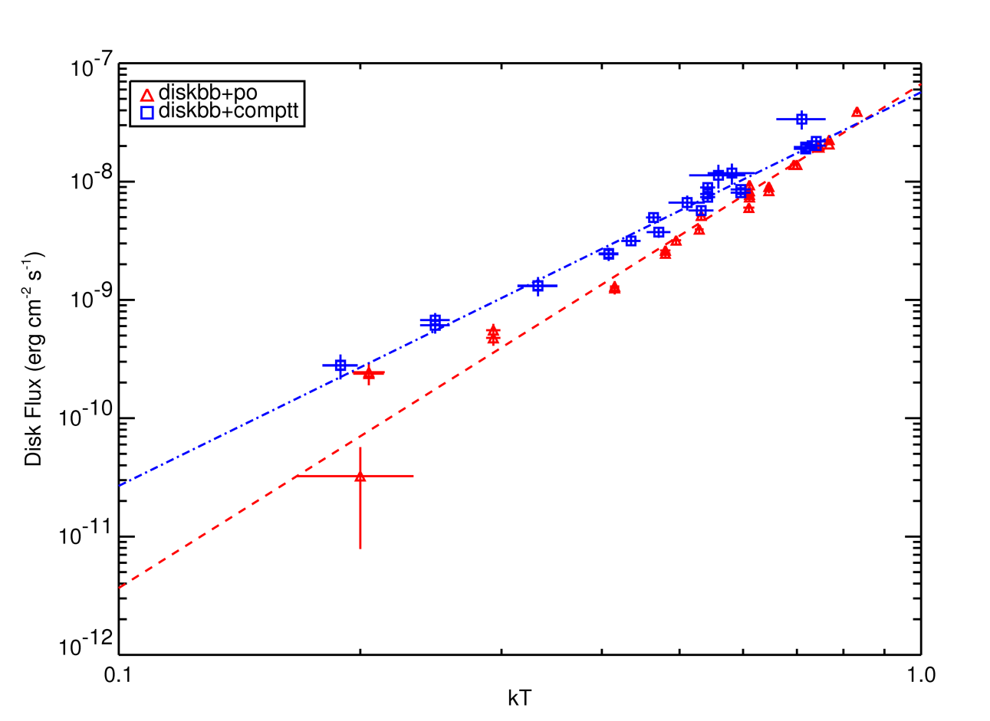
But is there really a hole?
challenge 2
Rykoff et al 2007
See disc with constant inner radius in soft state L = AσT⁴ ie constant radius - Rlso
Same in low/hard state just after transition L_{bol}~0.01L_{Edd}
GX339-4 Miller et al 2006
XTE J1817-330 Rykoff et al 2007
Transition
Soft
Disc dominated
Hard

Slide 46
Modifies optical continuum
X-rays illuminate outer disc where intrinsic flux is low so reprocessed can dominate (van Paradijs 1996)
SWIFT/XMM X-opt simultaneously
XTE J1817-330 - trace scattered fraction through outburst SWIFT+RXTE
L_{opt} ~ 0.002 L_{disc} in high/soft state.
Big changes at transition to low/hard state….
Gierlinski Done & Page 2007

Slide 47
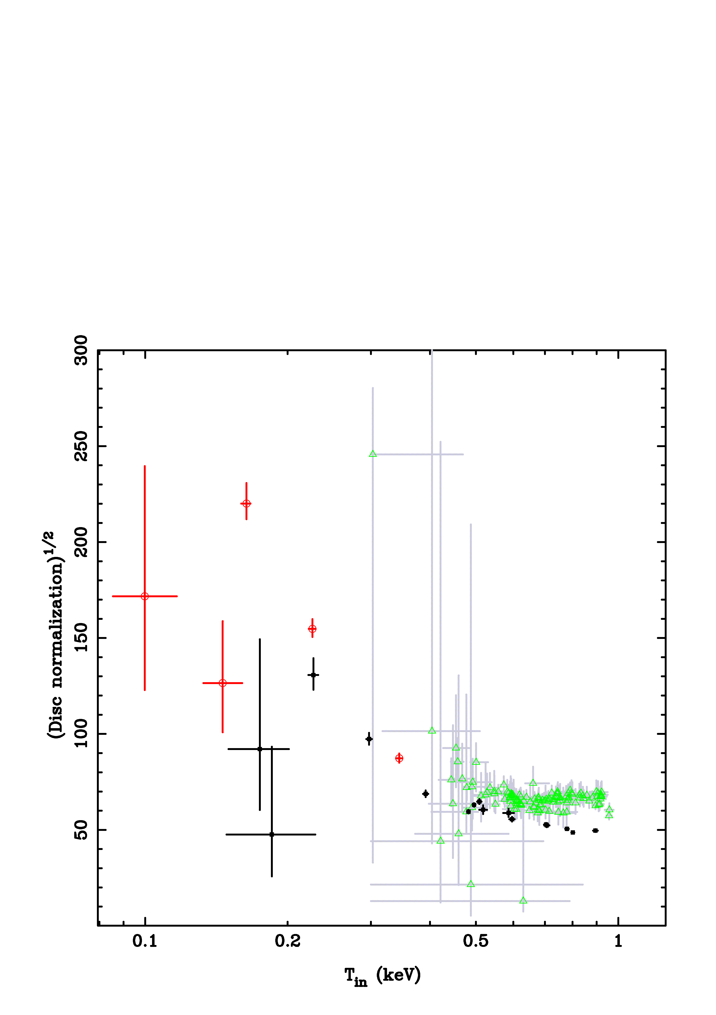
Radius from SWIFT-RXTE
Hard
Soft
Disc dominated
Clear that SWIFT radius does increase in transition
Can actually see in Rykoff et al plot as well but much clearer with RXTE data to define radius in disk dominated state
And their main point is about the disc in the hard state where it does seem small again – but with large errors.
Gierlinski Done & Page 2007

Slide 48
But not simple just after transition
νf_{ν}
L(r)
ν
r
Gierlinski Done & Page 2007

Slide 49
But not simple just after tranistion
νf_{ν}
L(r)
ν
r
Gierlinski Done & Page 2007

Slide 50
Direct illumination
Inferred disc radius moves larger with irradiation
Different stress on inner boundary
Still assuming same colour temperature correction, radiation thermalises and not correcting for Compton scattering Makishima et al 2008
Hard
Soft
Disc dominated
Hard
Soft
Disc dominated
Gierlinski Done & Page 2007

Slide 51
Direct illumination
Inferred disc radius moves larger with irradiation
Different stress on inner boundary
Still assuming same colour temperature correction, radiation thermalises and not correcting for Compton scattering Makishima et al 2008
Hard
Soft
Disc dominated
Gierlinski Done & Page 2007

Slide 52
Direct illumination
Inferred disc radius moves larger with irradiation
Different stress on inner boundary
Still assuming same colour temperature correction, radiation thermalises and not correcting for Compton scattering Makishima et al 2008
Hard
Soft
Disc dominated
Gierlinski Done & Page 2007

Slide 53
But not simple just after transition
Expect transition to be messy! Clumpy?
Disc evaporation gives residual disc close to transition Liu et al 2006; 2008
Cleaner to look at lower luminosity low/hard state

Slide 54
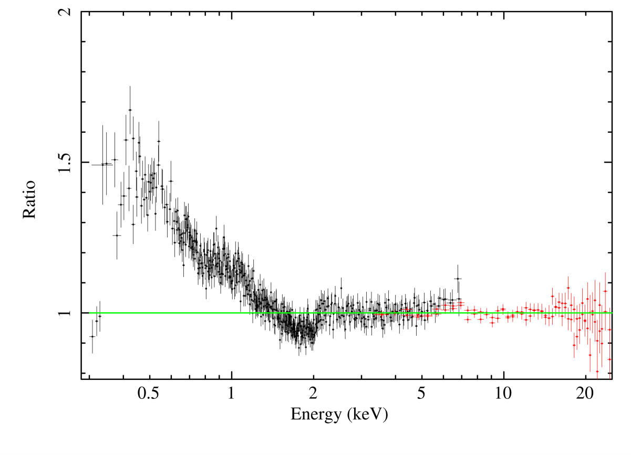
But is there really a hole?
challenge 3
Reis et al 2009
Soft X-ray component in deep quiescence
L_{bol} ~ 0.001L_{Edd}
XTE J1118 Reis, Miller & Fabian 2009
kT ~ 0.2 keV plus luminosity give radius. Most likely small (Reis et al 2009)

Slide 55
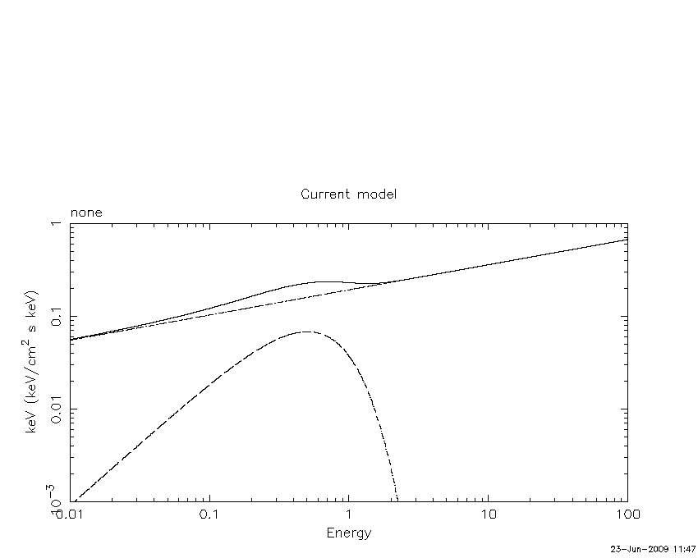
And we do SEE a cool disc
McClintock et al 2001; Reis et al 2009
McClintock et al 2001 & Esin et al 2001 said no soft x-ray disc from same data
But LETGS calibration was preliminary – Reis et al 2009 reanalysis shows soft X-ray rise
Lc~20 Ld

Slide 56
Hot inner flow in low/hard state ?
But corona also must come from small radii as that’s where gravity power is so cospatial
Lc/Ld > 20!!! So mass accretion rate through corona > 20x mass accretion rate through disc!!
But illumination - more thermal emission from reprocessing
Ld > ½(1-a) Lc ie Lc/Ld < 3
(Haardt & Maraschi 1993) as a < 0.3 for hard spectrum
So this weak soft X-ray emission can’t come from this geometry! Chiang & Done 2009
•
m_{c} →L_{c}
thermal
reflection
•
m_{d}→L_{d}

Slide 57
Hot inner flow in low/hard state ?
•
So maybe the hard x-ray source is beamed away from the disc ? Part of jet?
But can’t simultaneously explain very broad line as that need focussing TOWARDS disc – but the ‘line’ is from pileup so its OK
m_{c} →L_{c}
thermal
reflection
•
m_{d}→L_{d}

Slide 58
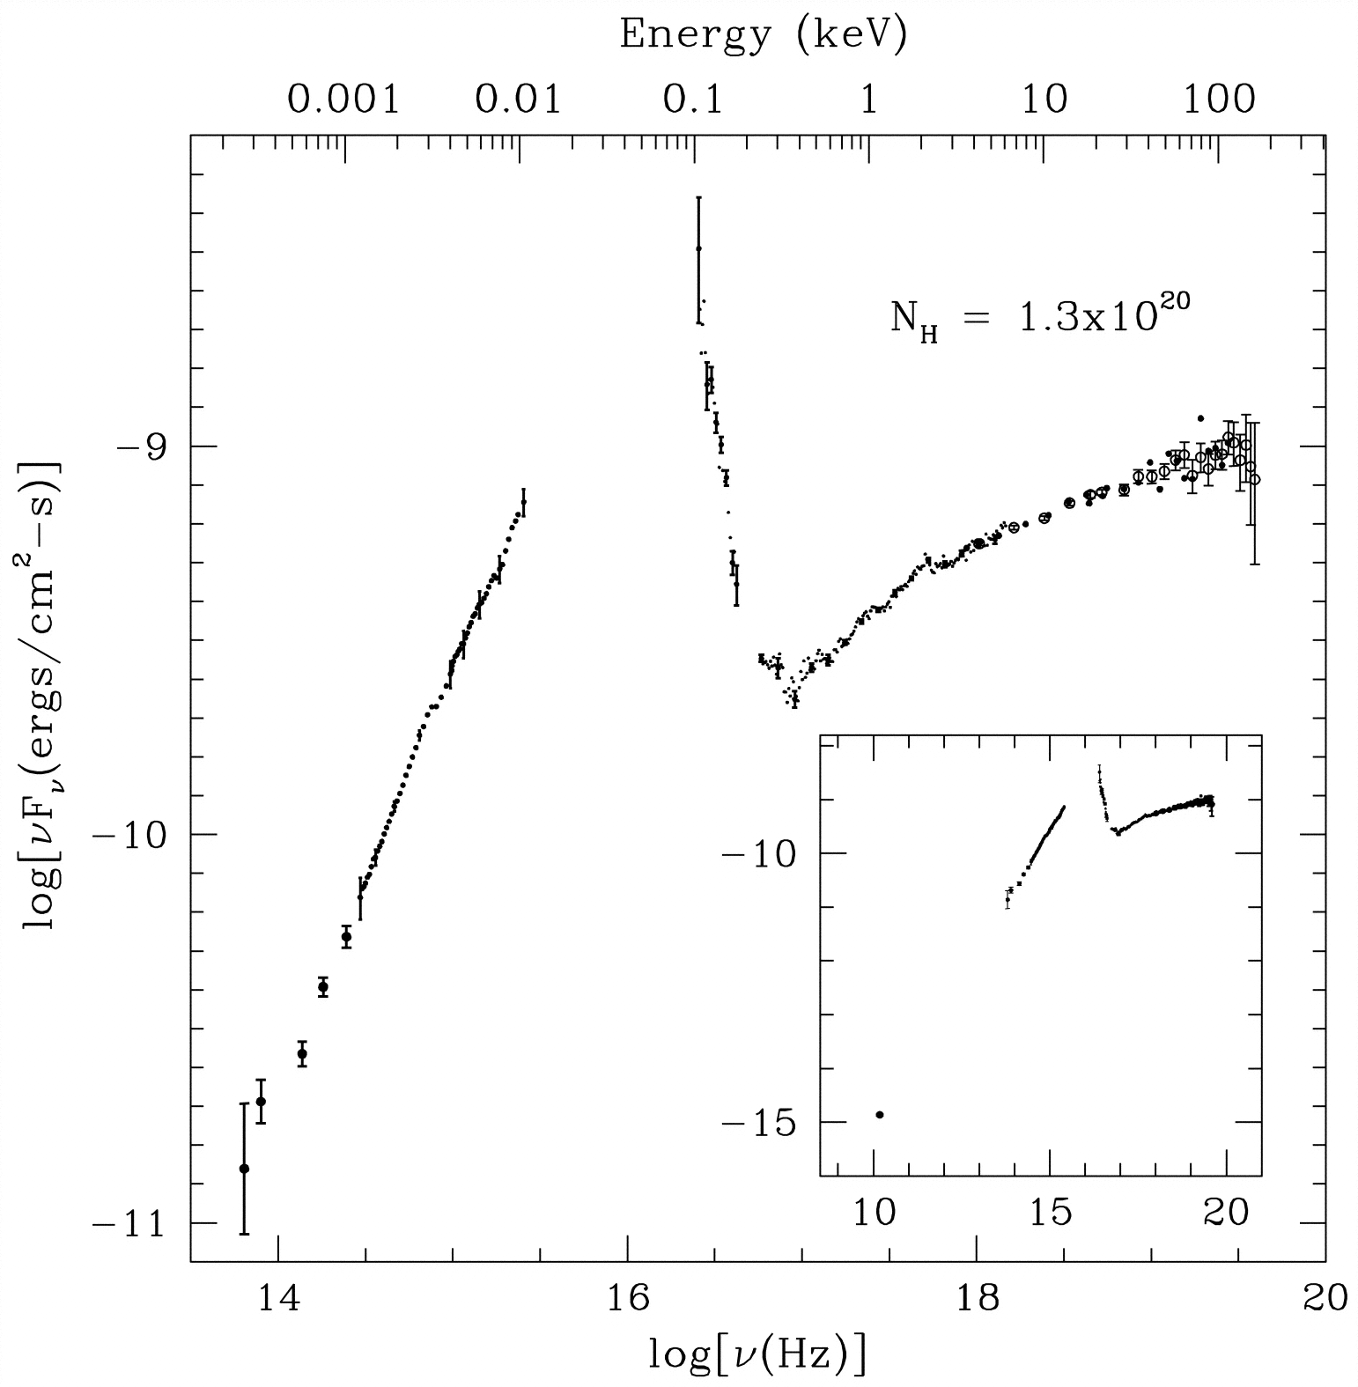
And we do SEE a cool disc
McClintock et al 2001 & Esin et al 2001 said no soft x-ray disc from same data
But LETGS calibration was preliminary – Reis et al 2009 reanalysis shows soft X-ray rise
But simultaneous UV/EUV data show much bigger and cooler - truncated disc!
McClintock et al 2001; Reis et al 2009

Slide 59
And we do SEE a cool disc
Similar to beppoSAX Frontera et al 2001; 2003 from few days earlier
Soft X-ray component in deep quiescence
But simultaneous UV/EUV data show much bigger and cooler - truncated disc!
So if that’s the disc, what is the soft X-ray component??
McClintock et al 2001; Frontera et al 2003

Slide 60
Two components?
Truncated cool disc for UV component
Relatively high kT, small luminosity implies small area
Either residual inner disc
Or inner rim of truncated disc Chiang & Done 2009
Residual inner disc
Inner rim of truncated disc

Slide 61
Soft excess? NOT from the disc!
NOT THE DISC - doesn’t get close to rise in data at 1keV
unless extreme spin and/or modified by advection – but disc tail very steep while SX gradual
Compton scattering of disc by low T_{e}, high τ material? Magdziarz et al 1998, Czerny et al 2003
PG1211: disk for M=10⁸ M L/L_{Edd}=1
Gierliński & Done 2004

Slide 62
Range of local high L/L_{Edd} AGN
Soft excess: factor ~2 at 0.5 keV but can be much larger
Lsx/Lbol <<1 in MOST AGN but REJ1034…
Standard disc is far too cool and its Wien tail is too steep
Always at same energy!
Middleton, Done & Gierlinski 2007

Slide 63
Comptonisation?
10⁶ < M/M < 10⁹
0.1 < L/L_{Edd} < 3
ALL have approx. same kT_{e} for soft excess!! Walter & Fink 1993, Czerny et al 2003, Gierlinski & Done 2004, Crummy et al 2006
Yet this should depend on ratio of electron heating to cooling, and number of electrons to share energy
Some sort of thermostat?
Gierlinski & Done 2004

Slide 64
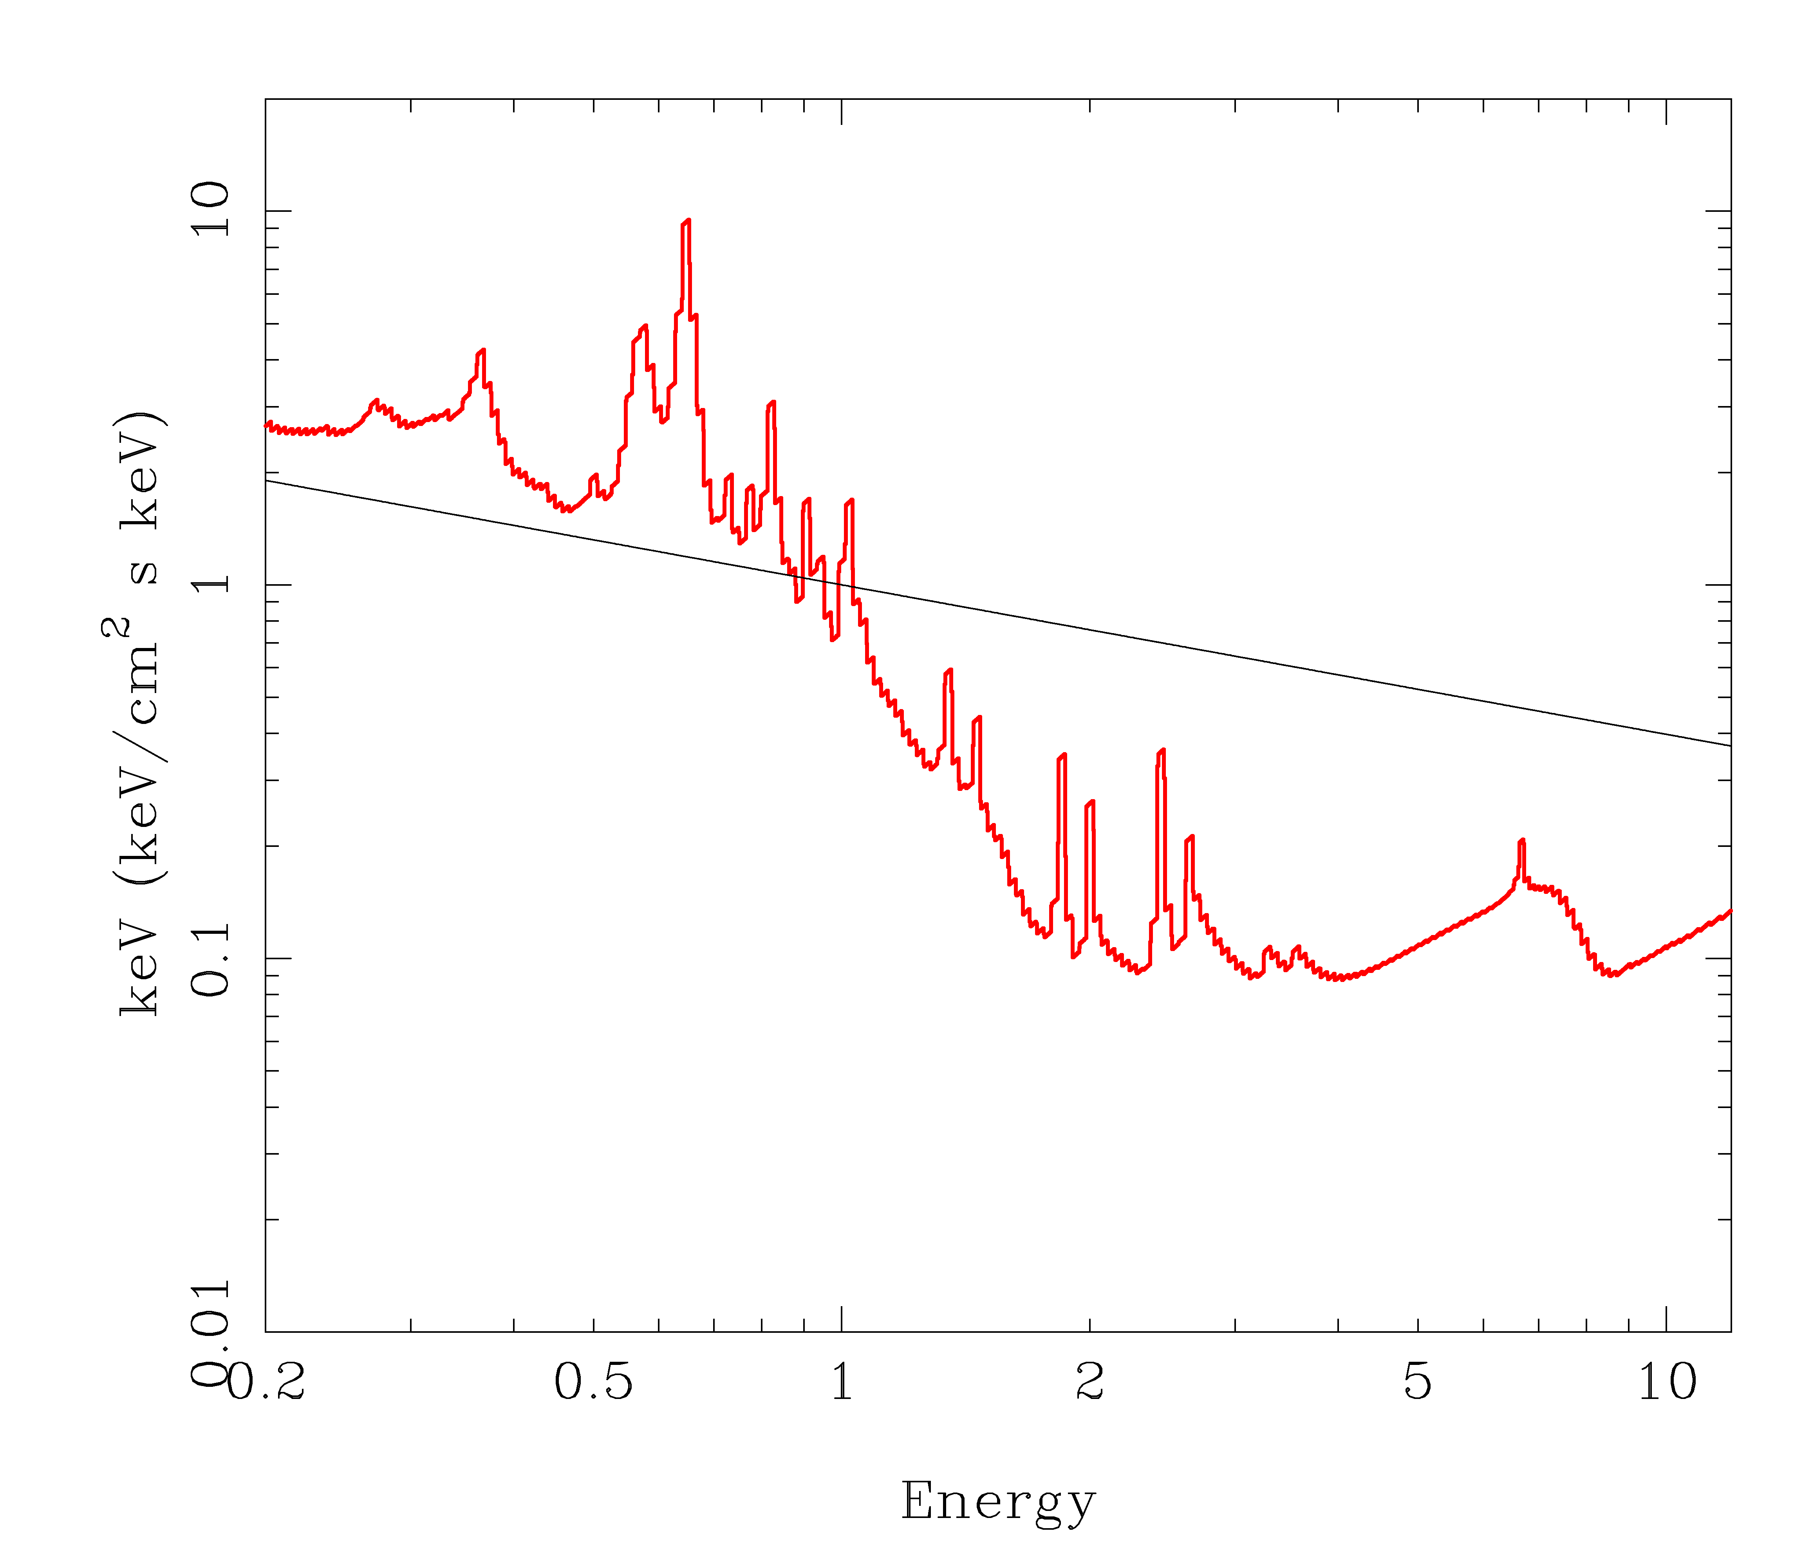
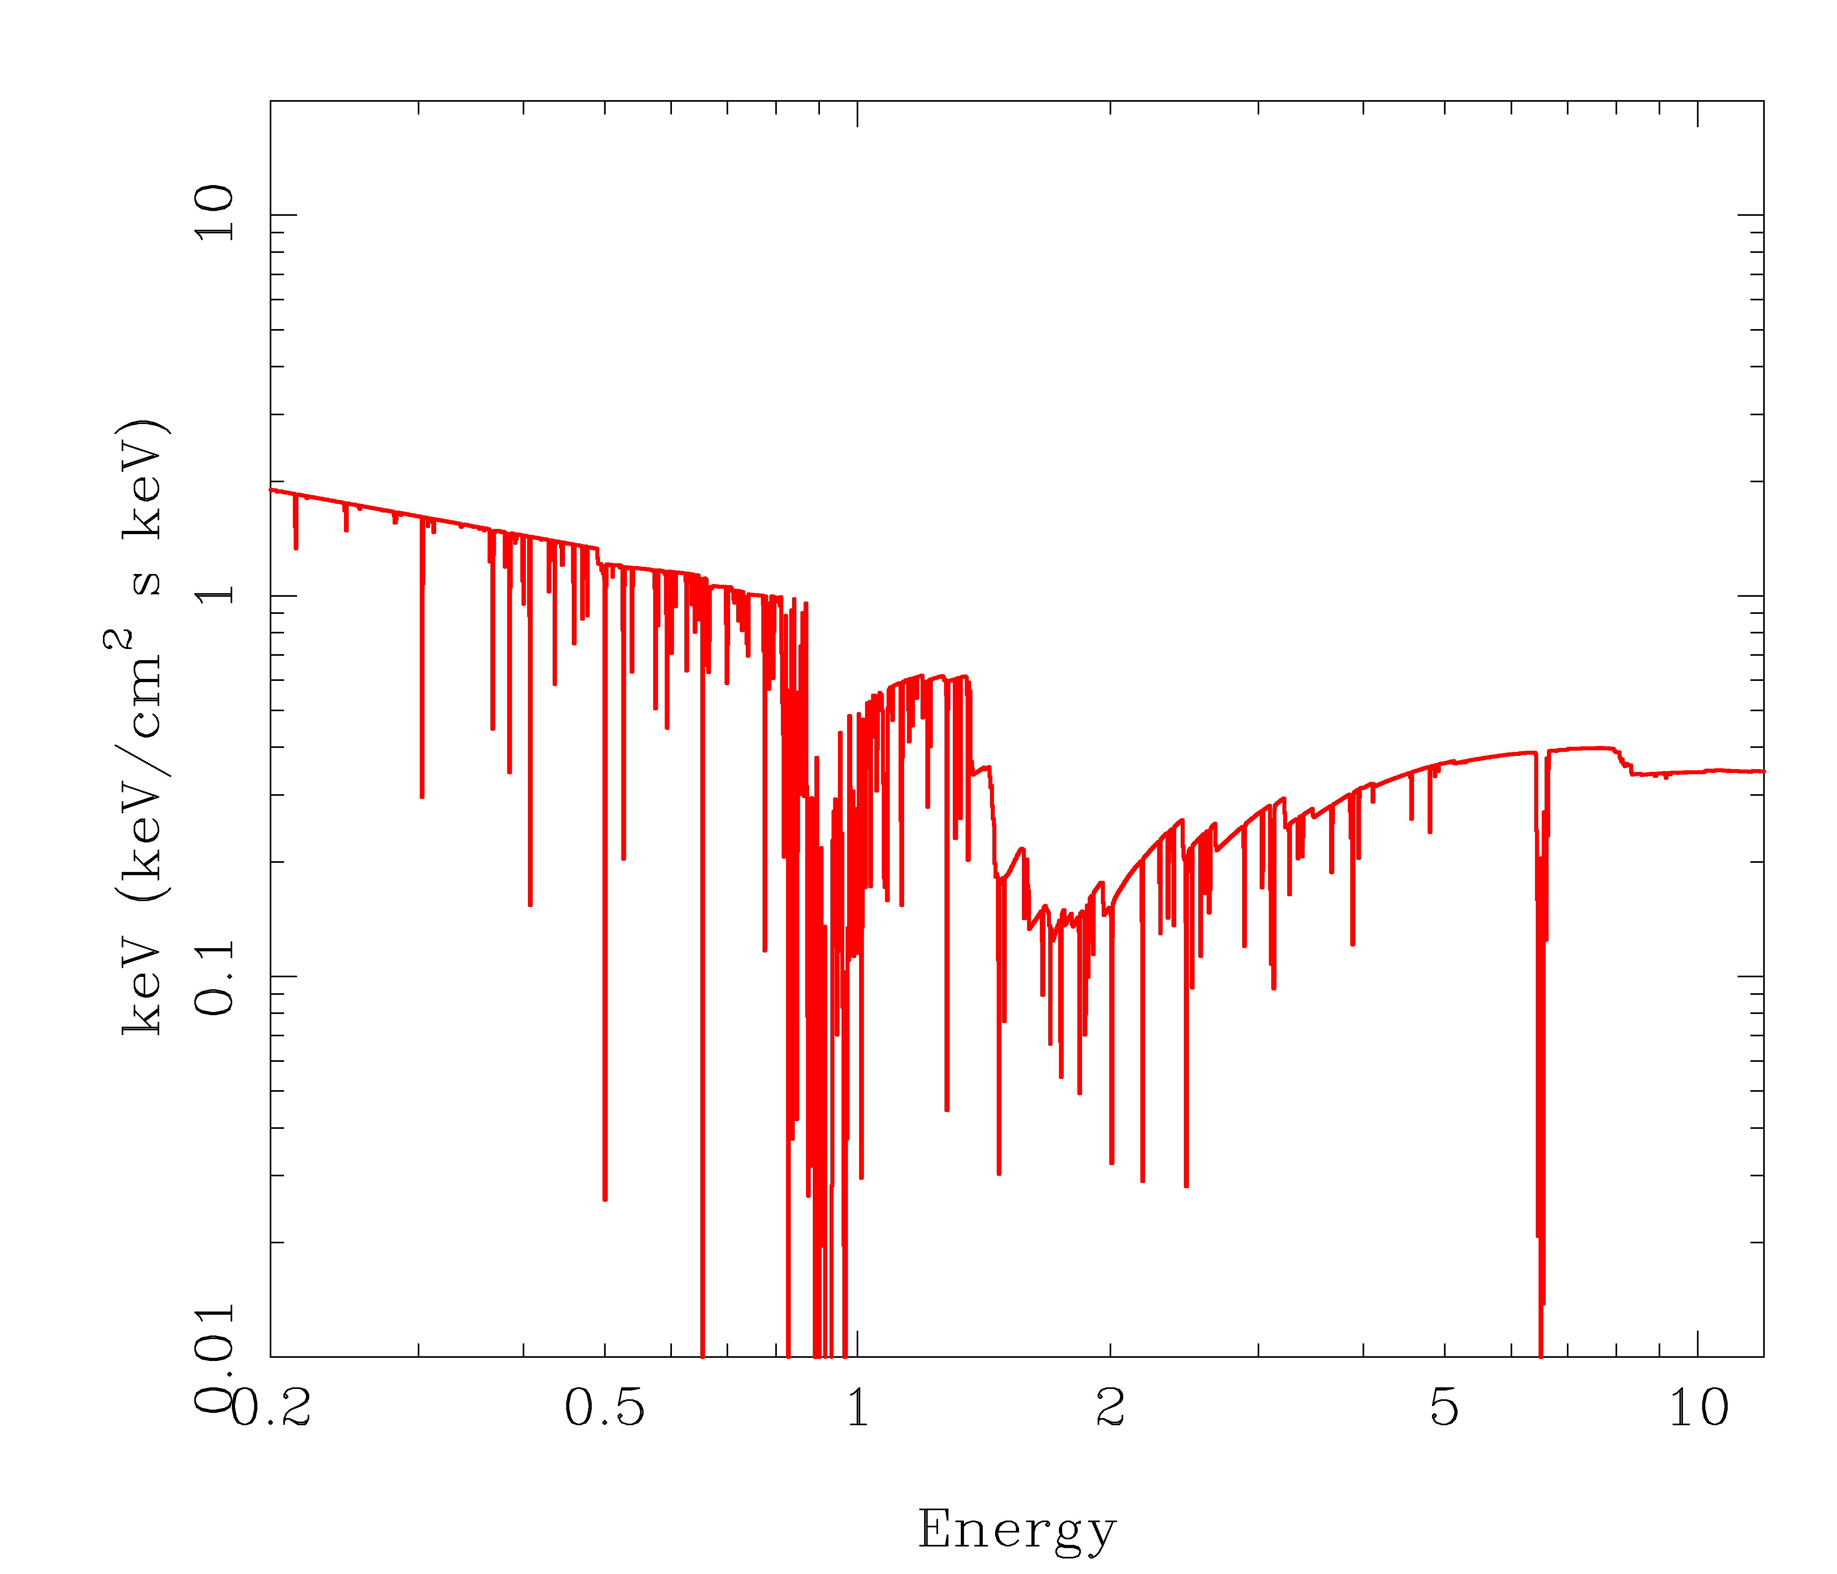
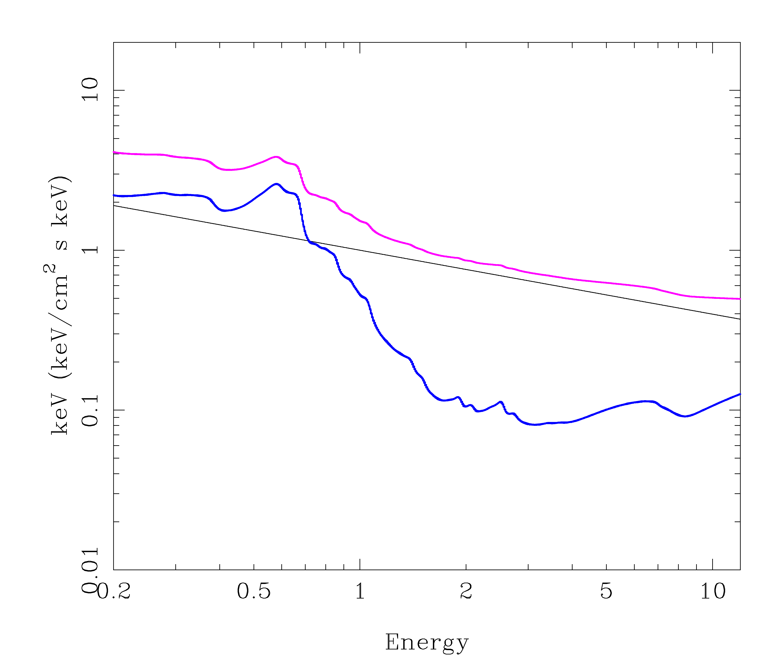
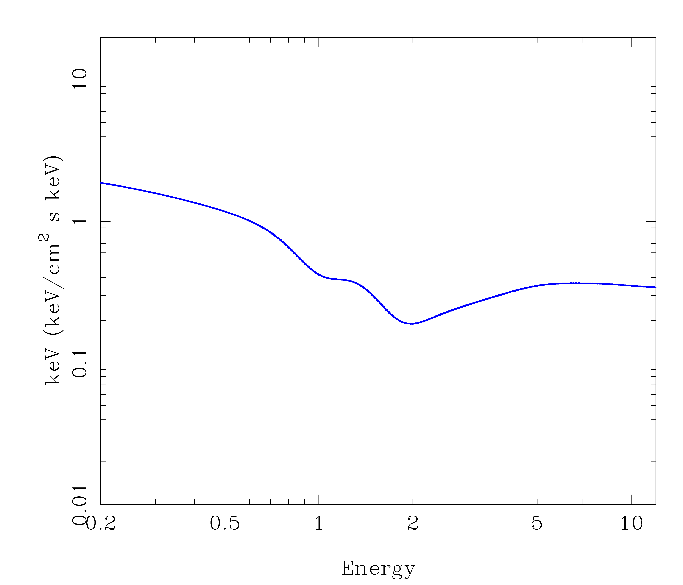
Partially ionised, relativistic material
Opacity jump at OVII/VIII at 0.7 keV: fixed energy
Atomic features not seen so relativistic smearing sometimes extreme
Reflection: needs intrinsic power law suppressed for large SX
Absorption: larger SX by larger column, curvature gives red wing
Gierliński & Done 2004, Chevallier et al 2006
Fabian et al 2002; 2004 Miniutti & Fabian 2004

Slide 65
Partially ionised, partial covering
Opacity jump at OVII/VIII at 0.7 keV: fixed energy
Atomic features not seen due to dilution by unabsorbed flux
Absorption: curvature gives red wing
Inoue 2002; Miller et al 2007; 2008; Turner et al 2007
Fabian et al 2002; 2004 Miniutti & Fabian 2004

Slide 66
Alternative geometries for soft excess from partially ionised material
Reflection Absorption

Slide 67
More soft excesses in AGN
Miller et al 2007, Miller et al 2008

Slide 68
More soft excesses in AGN
Miller et al 2007, Miller et al 2008

Slide 69
Inhomogeneous spectra ?
Overlap softer (and more reflection)
Inner region harder (and less reflection)
WE SEE THIS!!
Log ν f(ν)
Log ν
Notes:
The disc models assumed that the emission thermalised. That’s not necessarily true at low L/Ledd where the flow is not very dense. If its not thermalising then its not cooling as efficiently so the flow heats up. This can lead to a hot, optically thin, geometrically thick inner flow replacing the inner disc. The hot electrons in this flow can compton upscatter any low energy photons from a residual outer disc, but there are not many of these, so the spectrum is hard

Slide 70
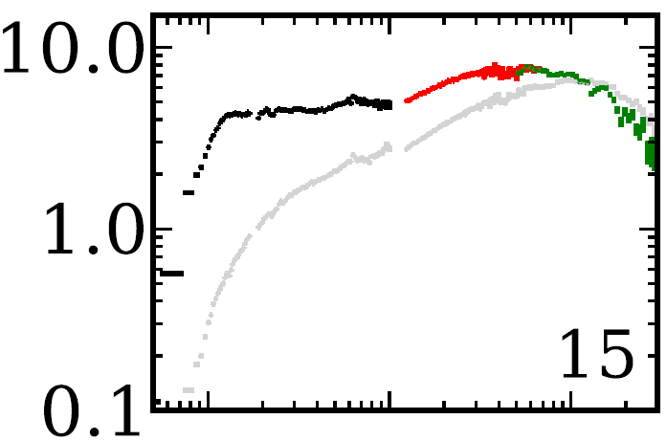
Makishima, et al 2008, Yamada et al 2013

Slide 71
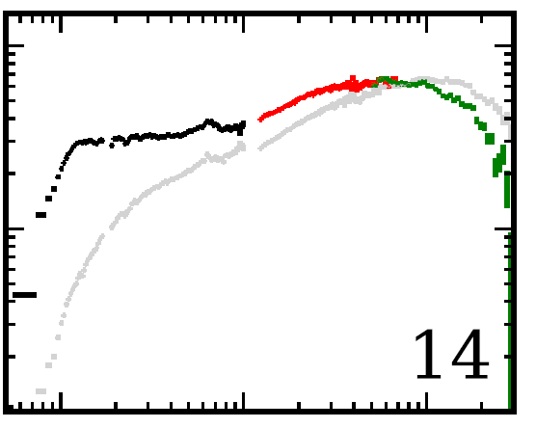
Makishima, et al 2008, Yamada et al 2013

Slide 72
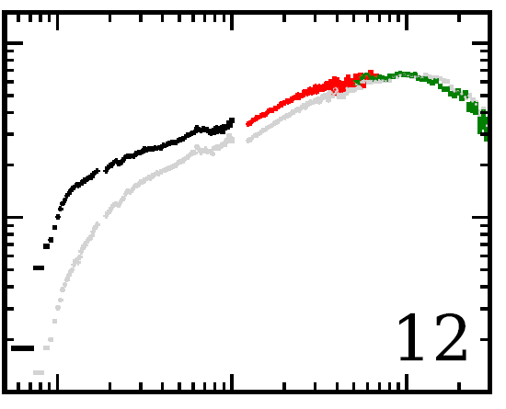
Makishima, et al 2008, Yamada et al 2013

Slide 73
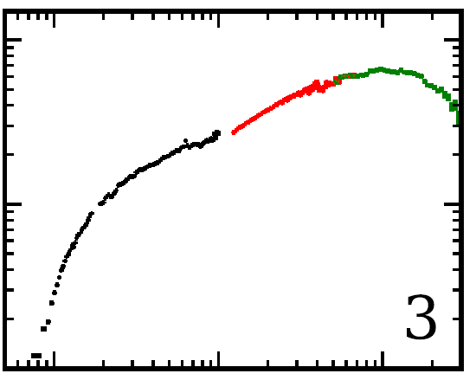
Makishima, et al 2008, Yamada et al 2013

Slide 74
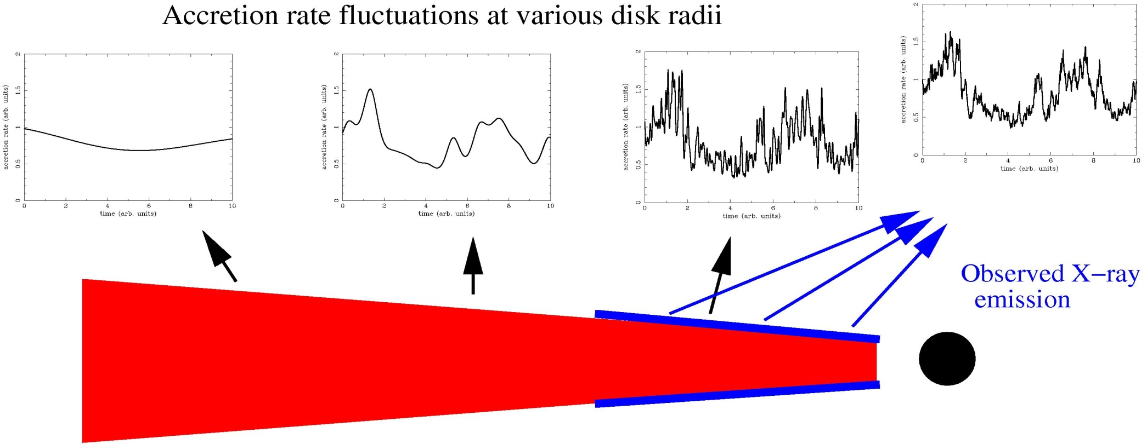
Origin of broad band variability
Fluctuations start at large radii – first, soft and slow with R propagate down to smaller radii – lagged, harder and faster less R

Slide 75
Inhomogeneous close to transition
Overlap softer, and more reflection, slow variability
Fluctuations propagate down to inner region – smaller so faster variability. Fewer seed photons so harder spectrum and less reflection
WE SEE THIS Revnivtsev et al 1999
Notes:
The disc models assumed that the emission thermalised. That’s not necessarily true at low L/Ledd where the flow is not very dense. If its not thermalising then its not cooling as efficiently so the flow heats up. This can lead to a hot, optically thin, geometrically thick inner flow replacing the inner disc. The hot electrons in this flow can compton upscatter any low energy photons from a residual outer disc, but there are not many of these, so the spectrum is hard

Slide 76
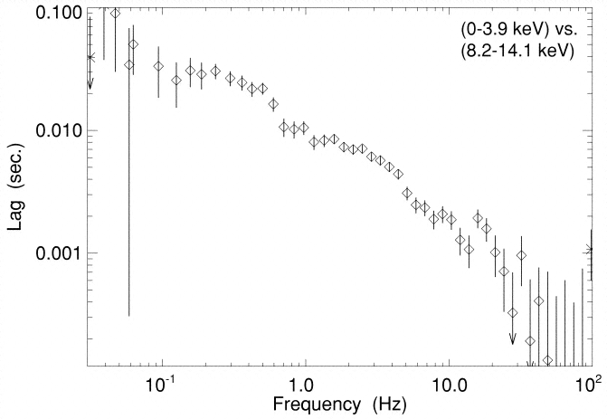
Inhomogeneous close to transition
Overlap softer, slower variability
Fluctuations propagate down to inner region – lagged. But this has harder spectrum. So hard lags soft. But smaller region so faster variability.
Miyamoto & Kitamoto 1988; Kotov et al 2001, Nowak et al 1999, Arevalo & Uttley 2006
Notes:
The disc models assumed that the emission thermalised. That’s not necessarily true at low L/Ledd where the flow is not very dense. If its not thermalising then its not cooling as efficiently so the flow heats up. This can lead to a hot, optically thin, geometrically thick inner flow replacing the inner disc. The hot electrons in this flow can compton upscatter any low energy photons from a residual outer disc, but there are not many of these, so the spectrum is hard

Slide 77
Conclusions
Low/hard state – everyone agrees disc truncates below 0.001L_{Edd}
But see all spectral and timing change at TRANSITION
If the disc comes in below this, why don’t we see it
If it does come in below this, what causes what we do see!
But no real problems either theoretical or observational
Evaporation gives inner hole in disc
Broad line in GX339-4 low/hard from instrumental pileup
Inner disc surface can be irradiated close to transition
Inner disc inner rim can be irradiated further out to get soft X-ray as well as truncated disc in UV
Extreme iron lines in AGN could be from complex partially ionised absorption as well as reflection – might expect very strong outflows in these UV bright disc systems at L~L_{Edd}
But maybe need better models
Notes:
Fabulous time, both in terms of data available and for me personally. For the first time there is enough data

