Slide 1
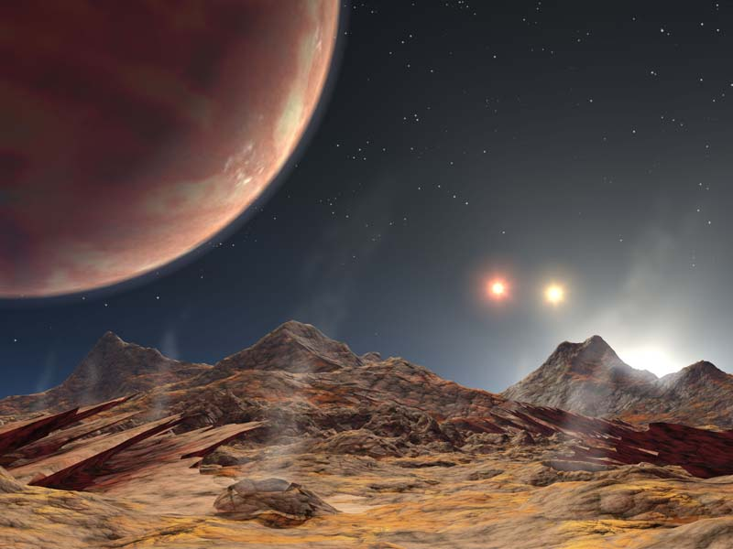
Prof Chris Done
Physics Dept.
Durham
Extrasolar planets and Extraterrestrial life

Slide 2
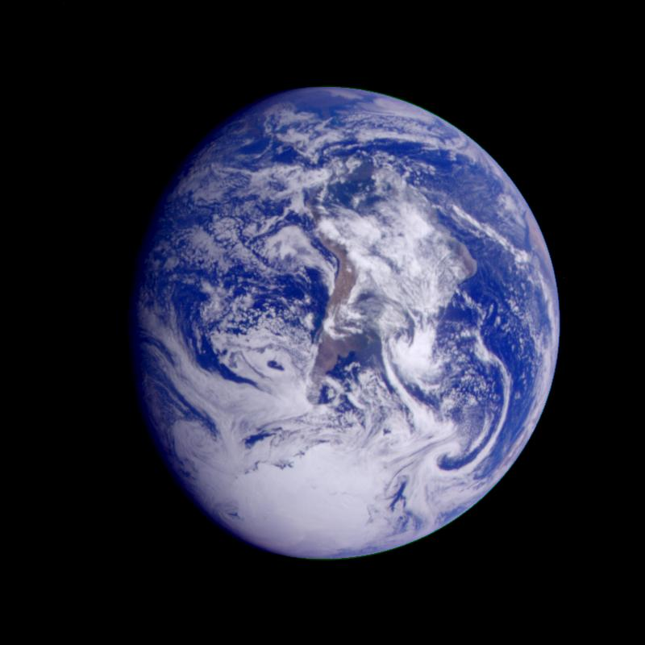

Slide 3
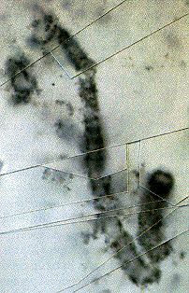
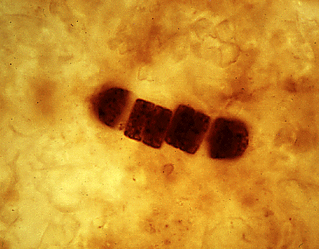
Life on Earth
Earth is 4.5 billion years old. Oldest surviving rocks are 3.8 Gyr, fossil bacteria from 3.5 Gyr.
Liquid water/rock interface with energy from sunlight ?

Slide 4
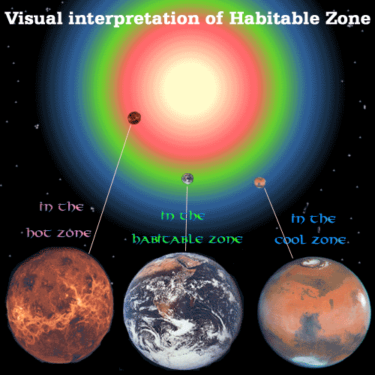

Slide 5
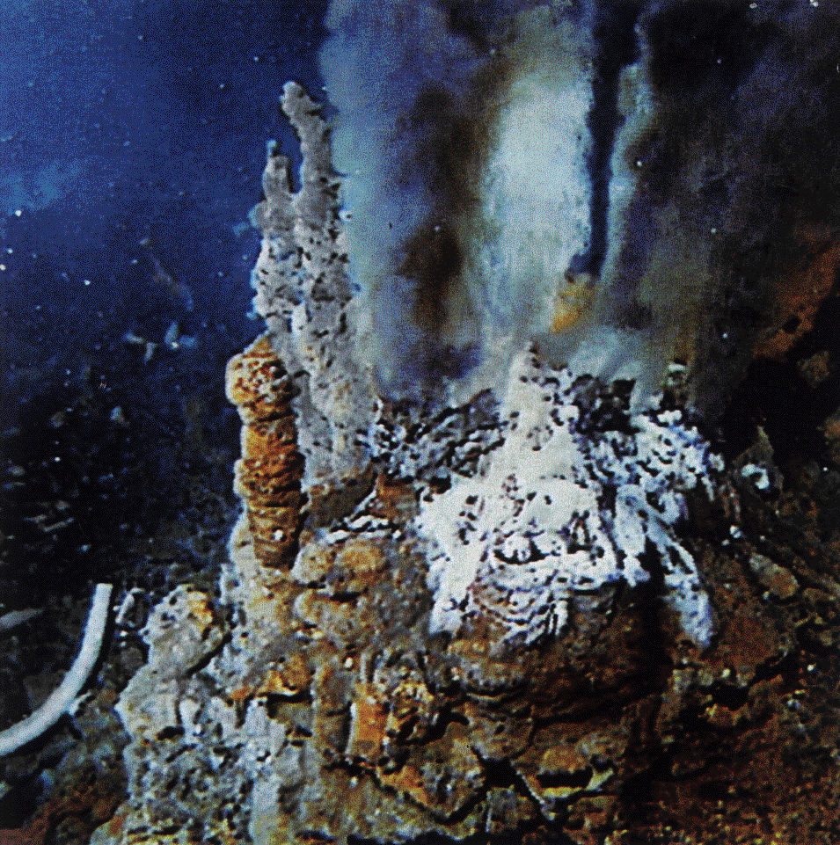

Slide 6
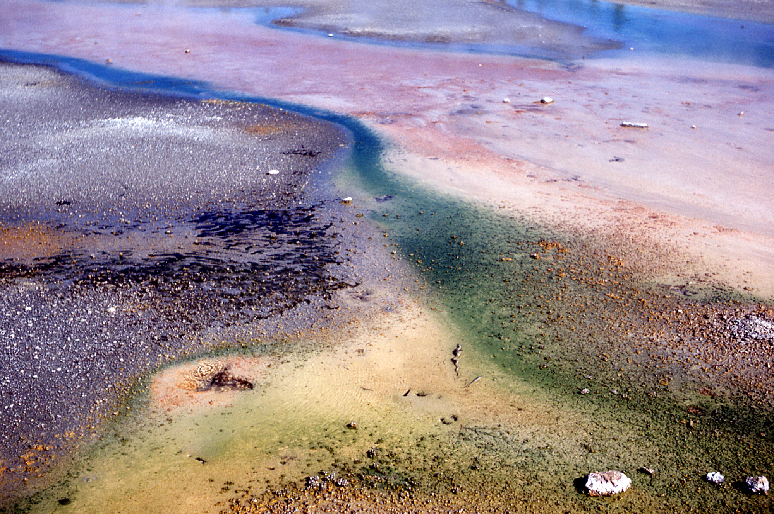

Slide 7
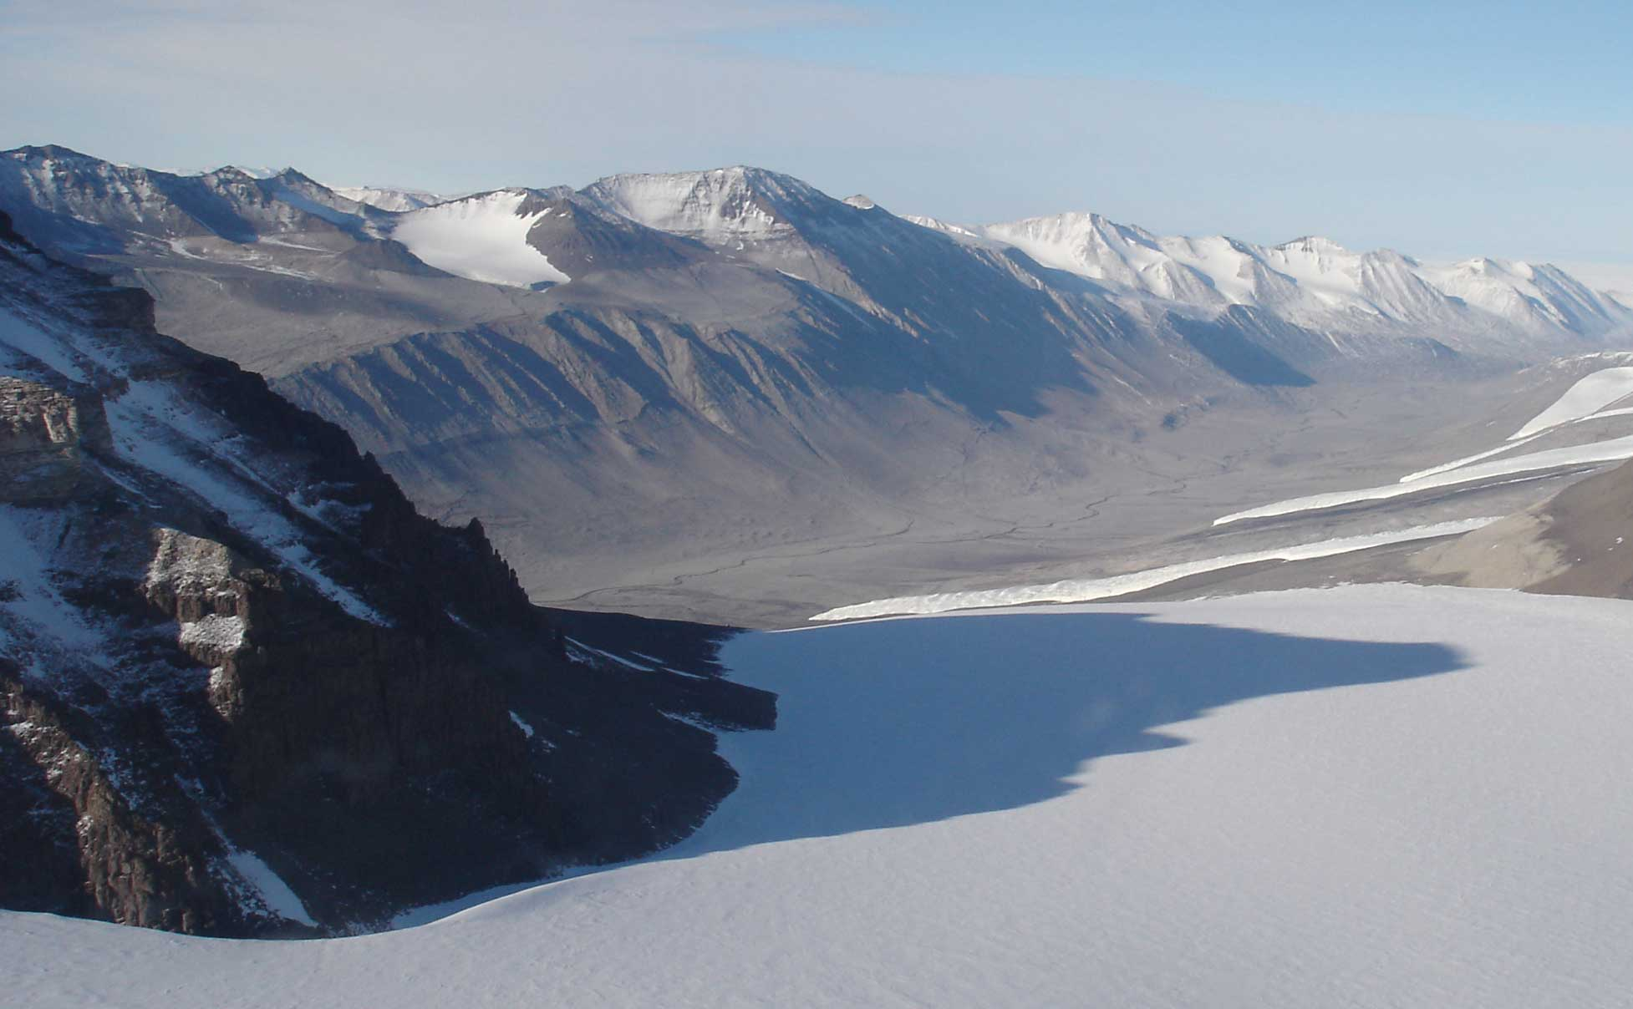

Slide 8
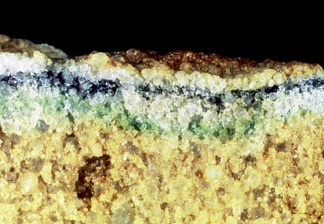

Slide 9
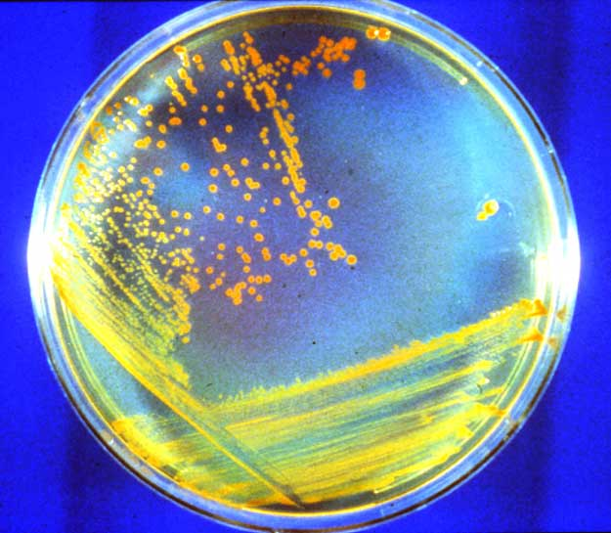

Slide 10
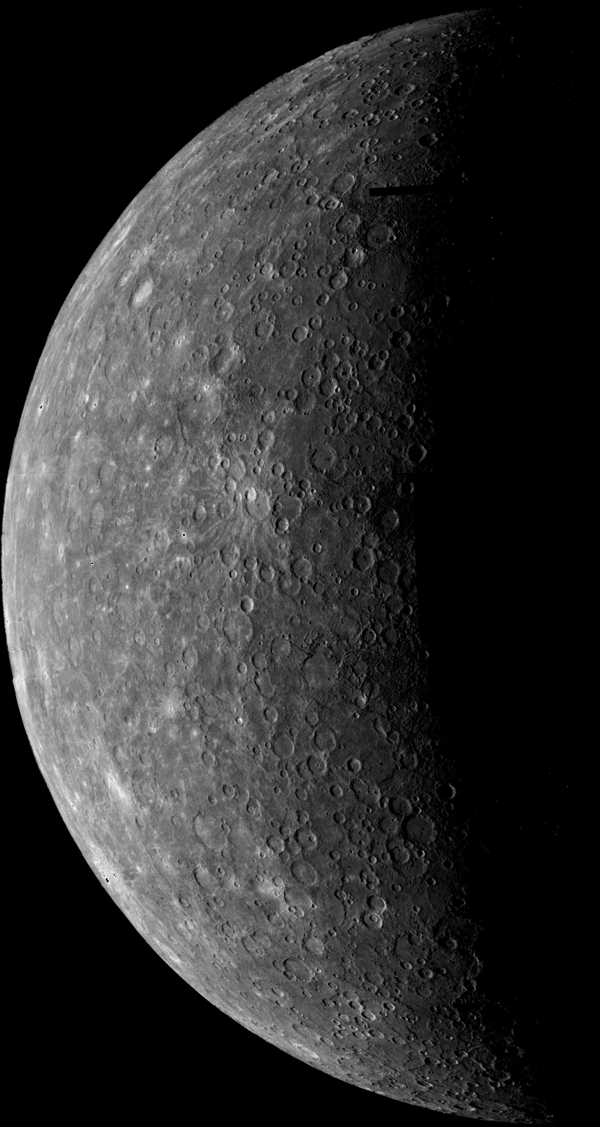

Slide 11
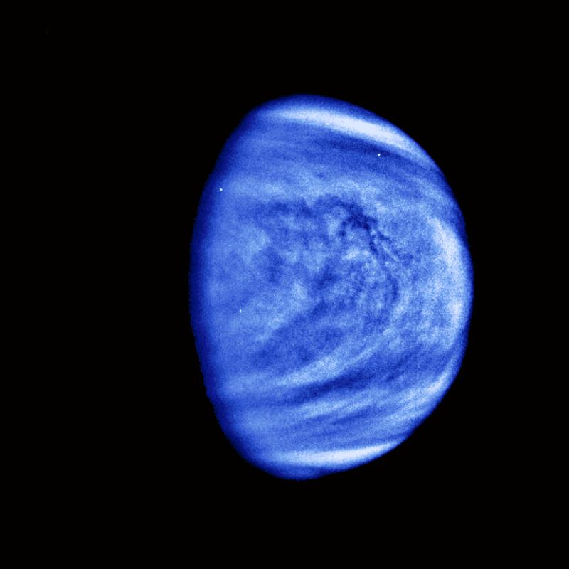

Slide 12
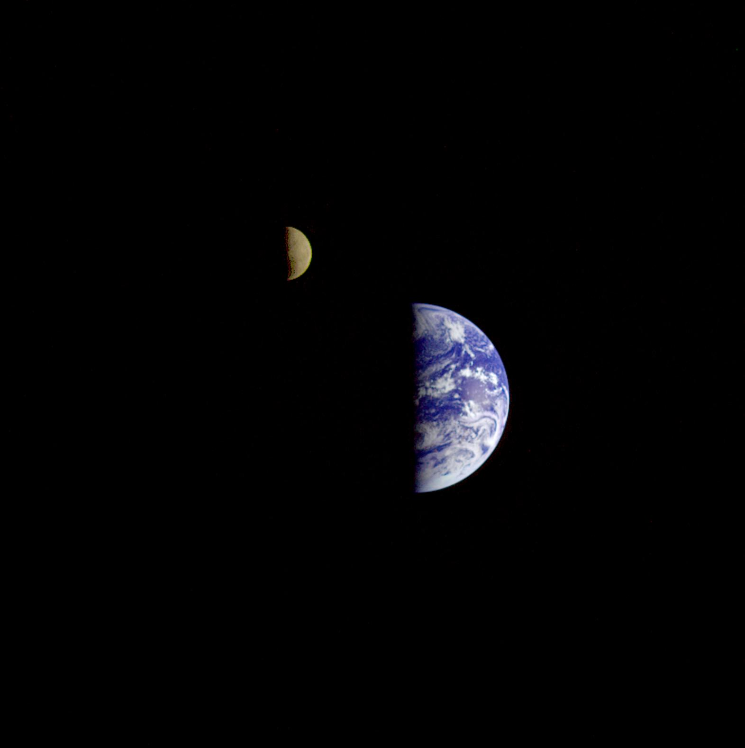

Slide 13
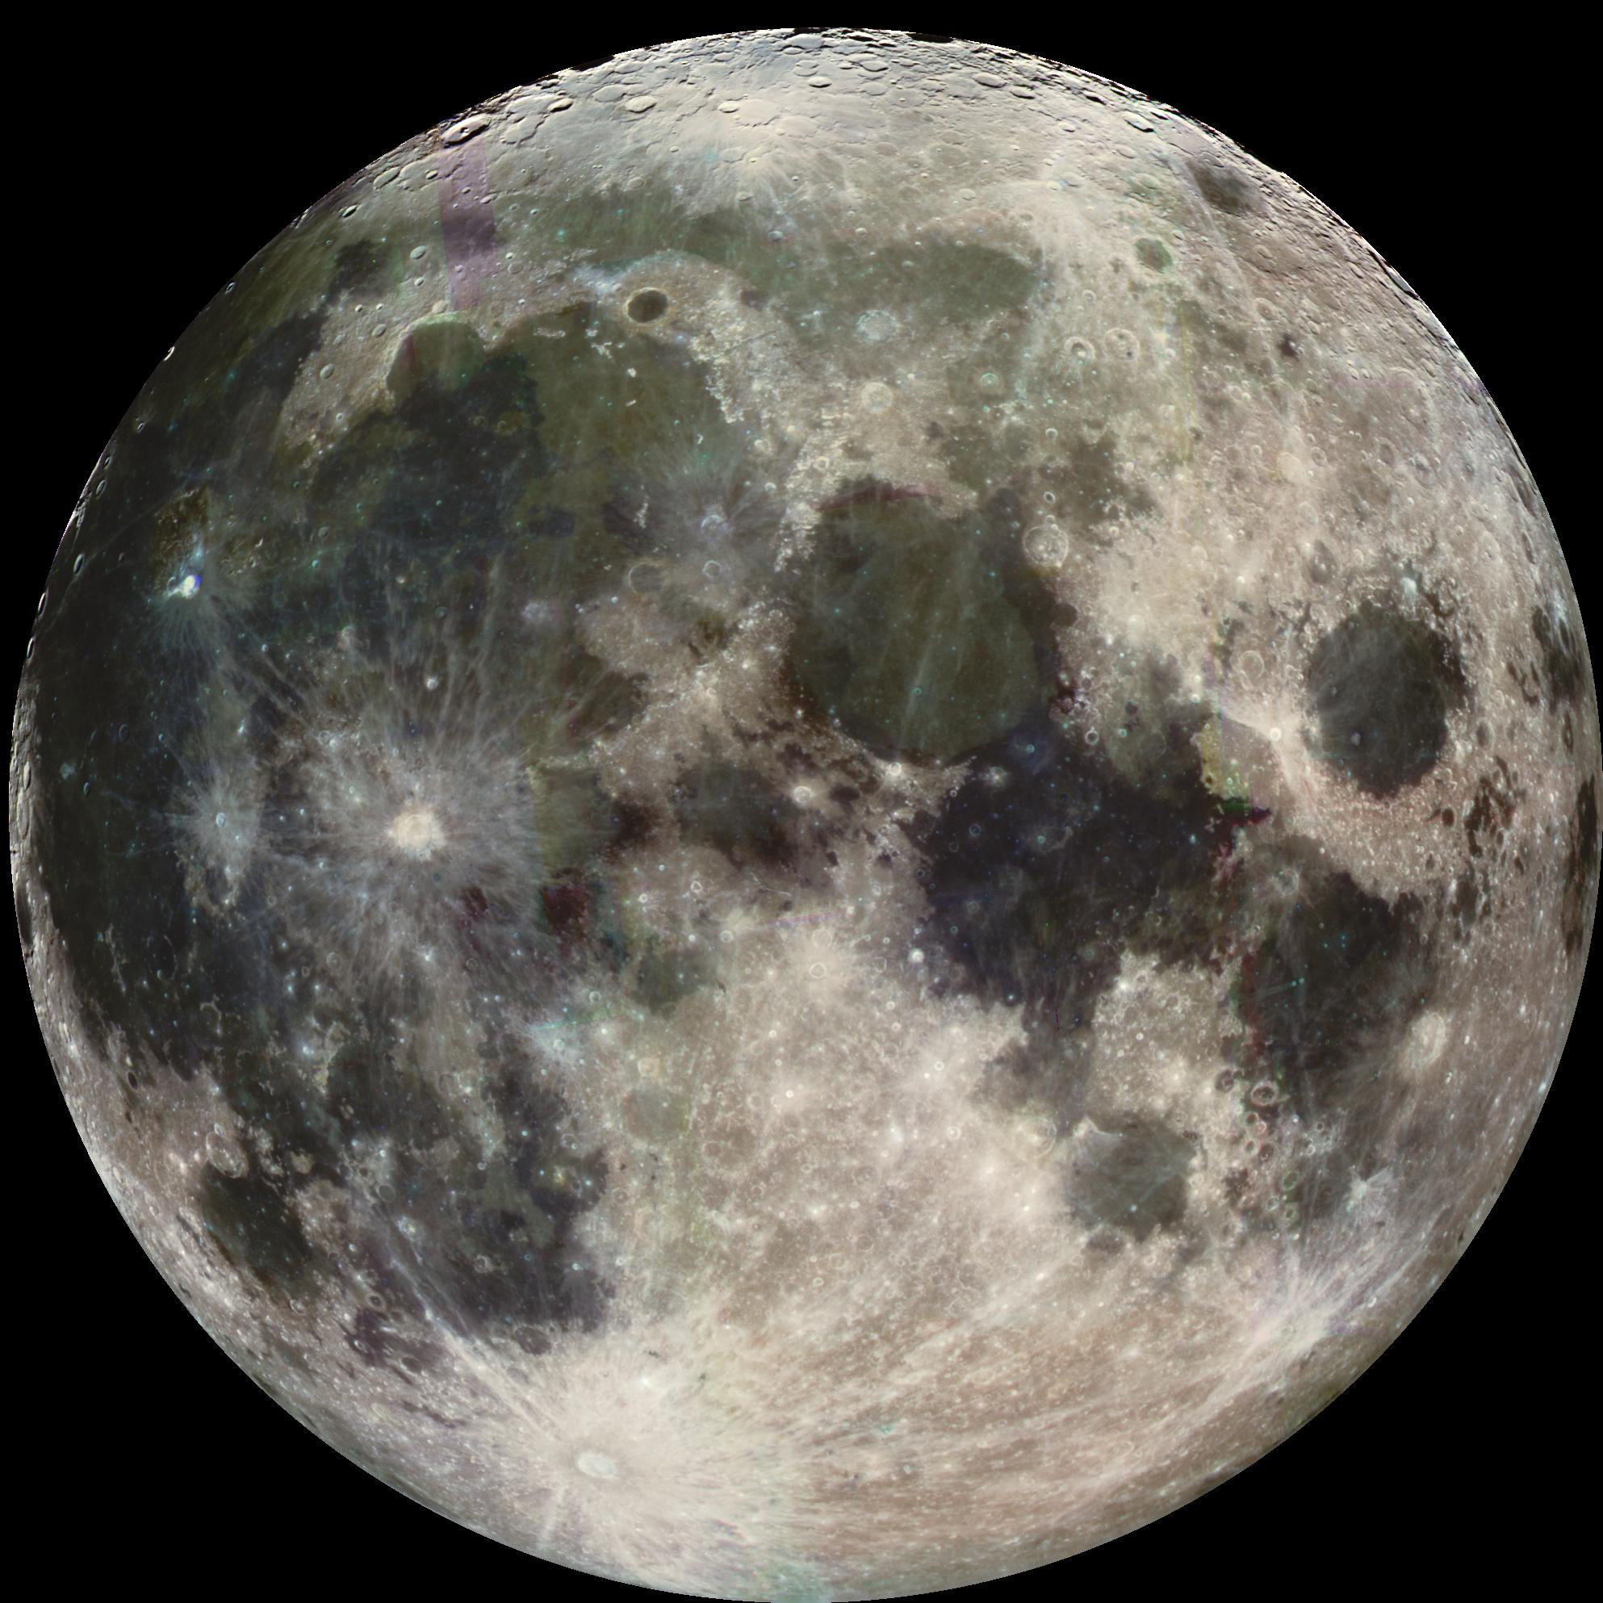

Slide 14
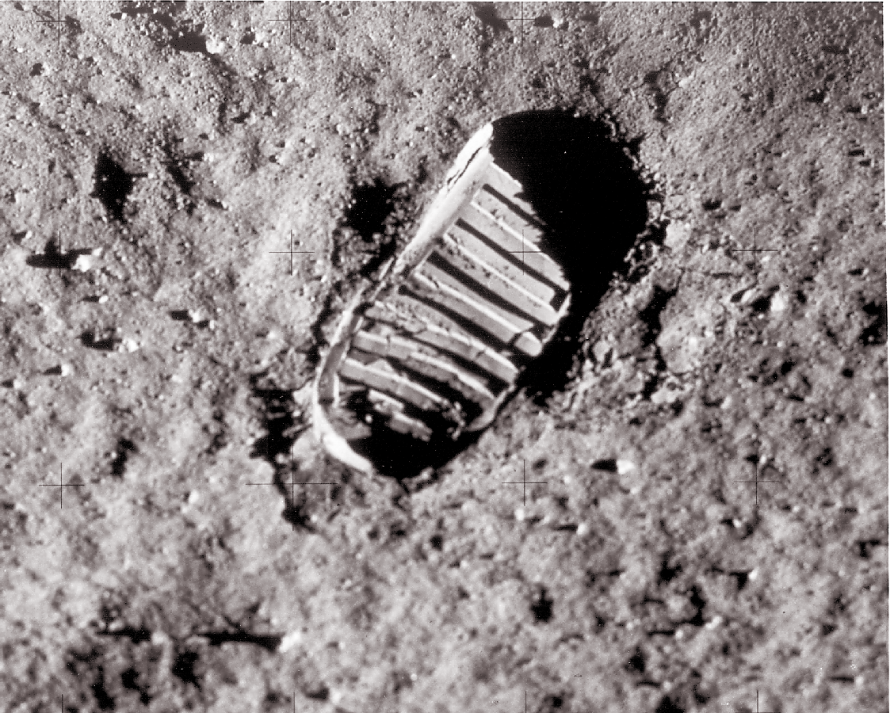

Slide 15
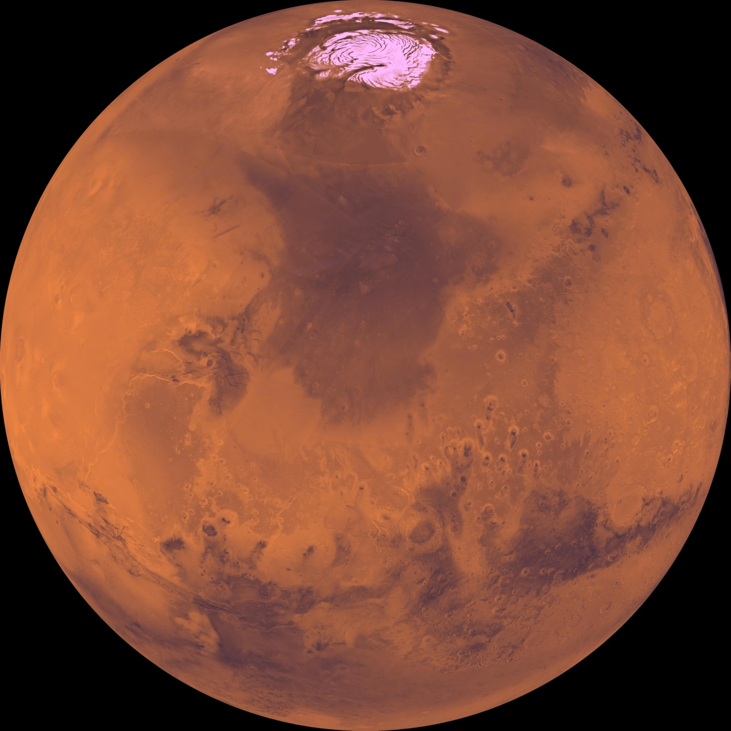

Slide 16
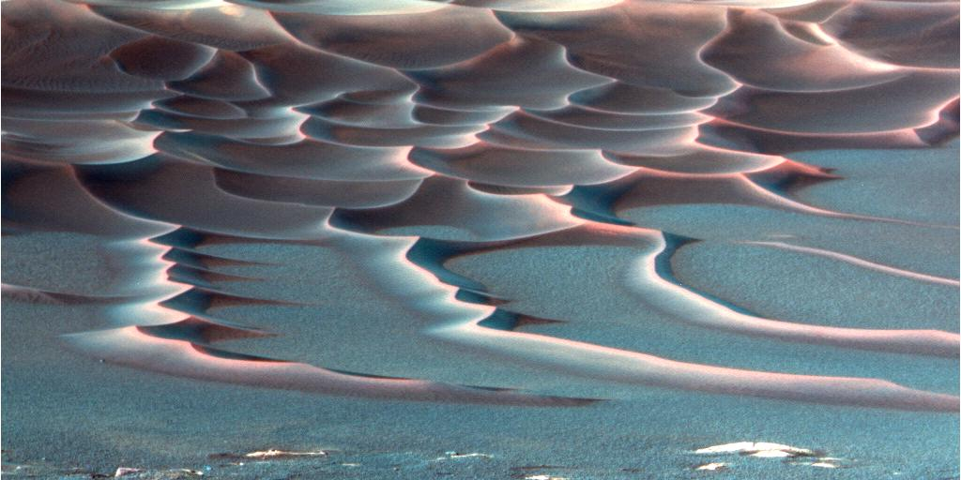

Slide 18
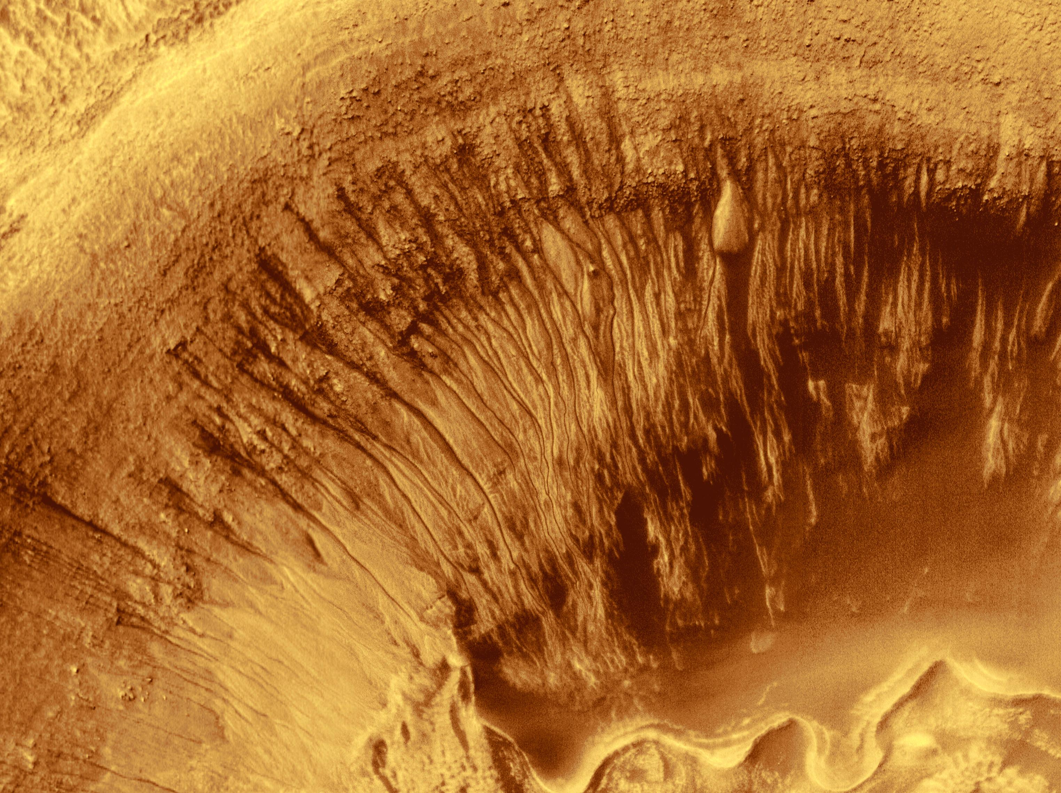

Slide 19
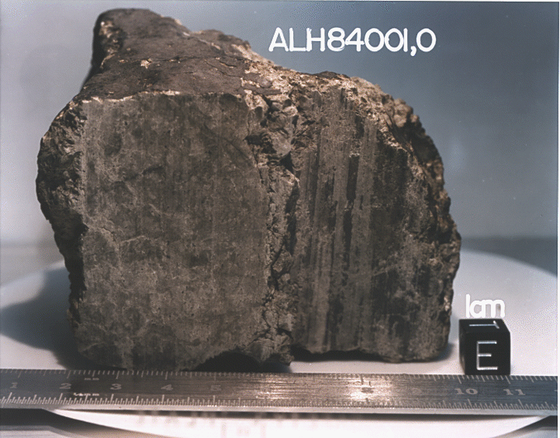
Life on Mars?
Martian meteorite?
Mars gets hit by asteroid, rocks escape, eventually hit Earth
Find in Antarctica (rock on snow!)
MAYBE fossil bacteria: but ambiguous

Slide 20
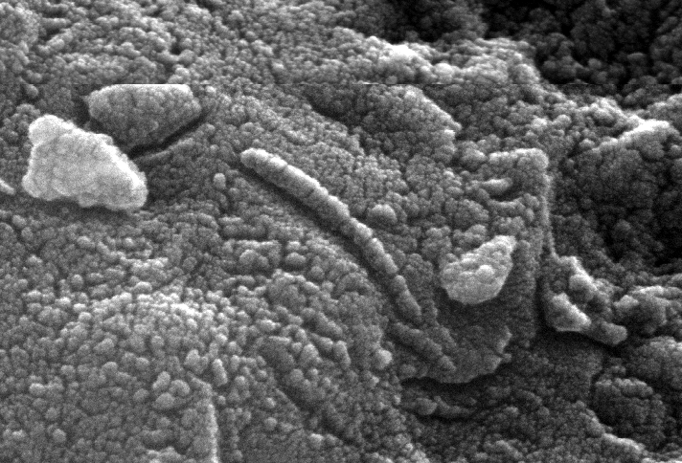
Life on Mars?
Martian meteorite?
Mars gets hit by asteroid, rocks escape, eventually hit Earth
Find in Antarctica (rock on snow!)
MAYBE fossil bacteria: but ambiguous

Slide 22
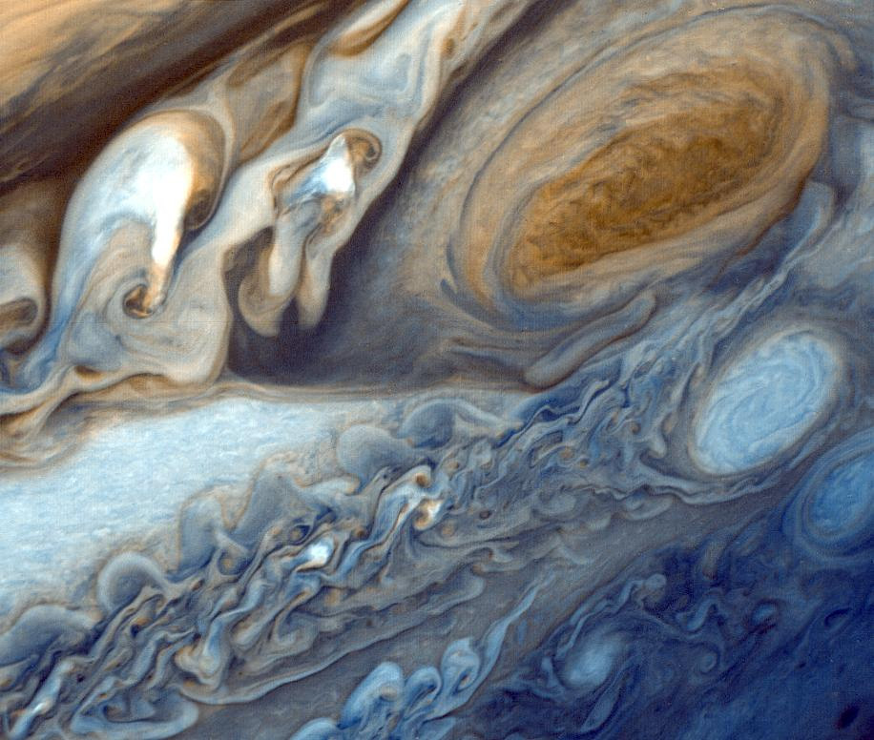

Slide 23
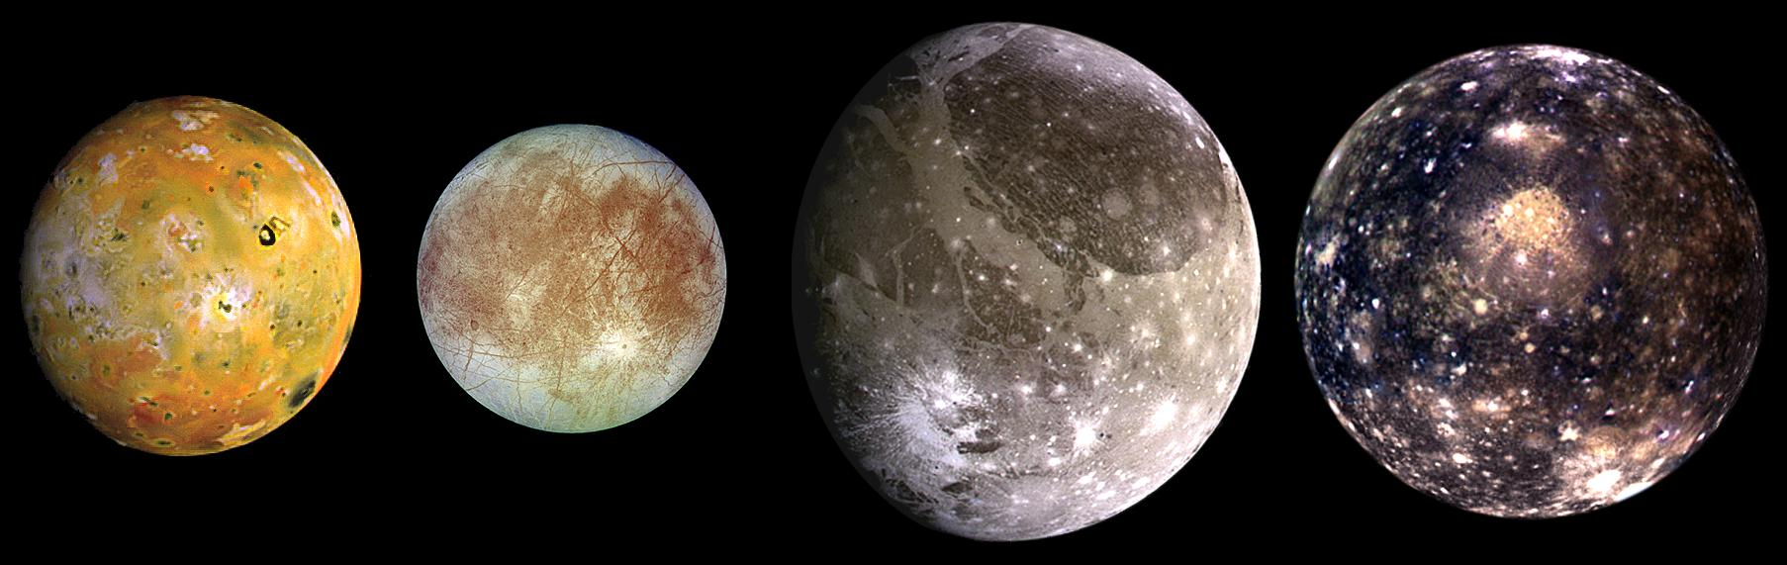

Slide 25
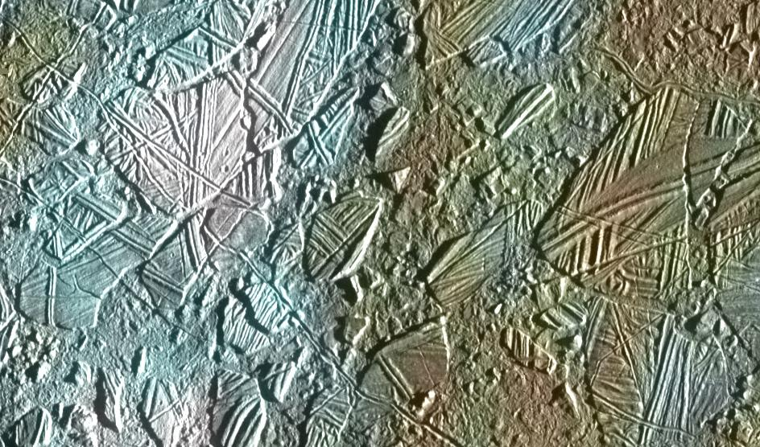

Slide 26
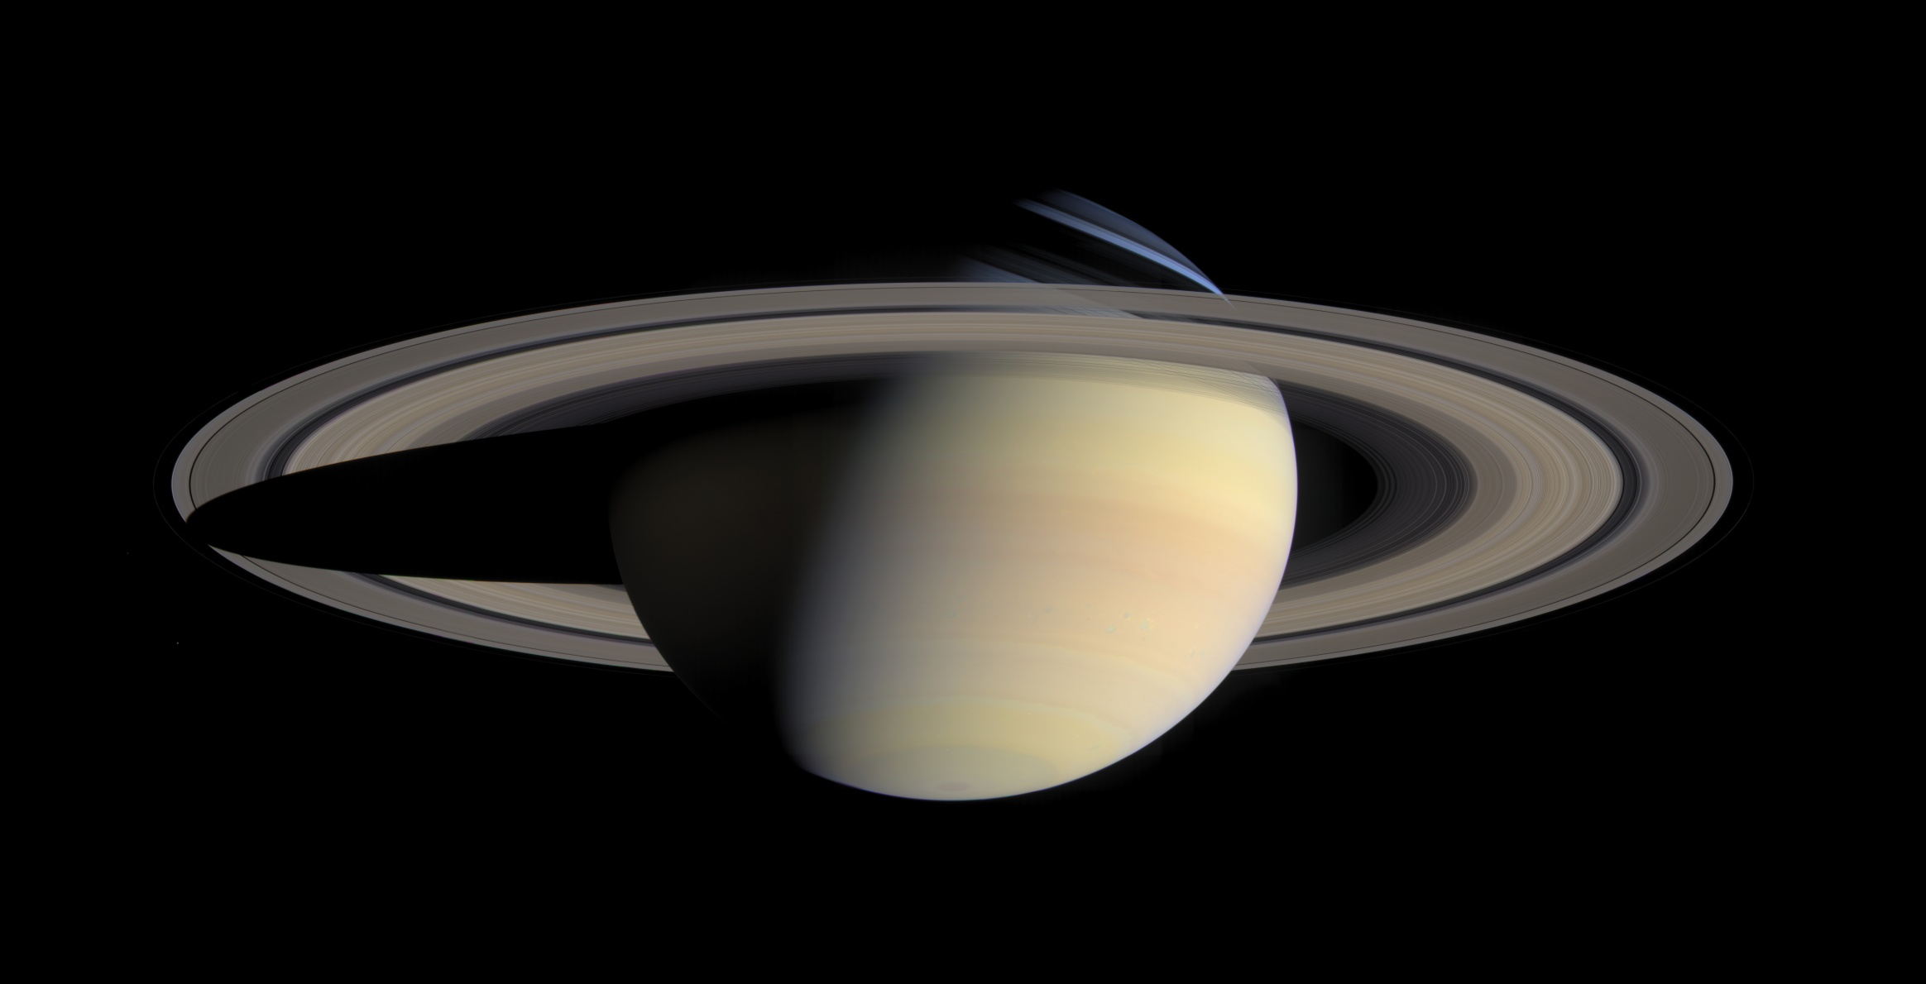

Slide 27
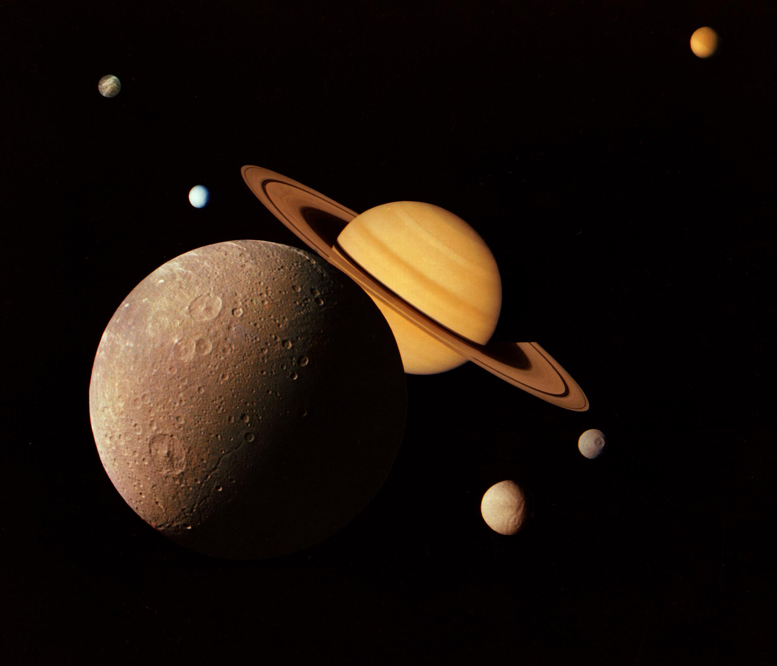

Slide 28
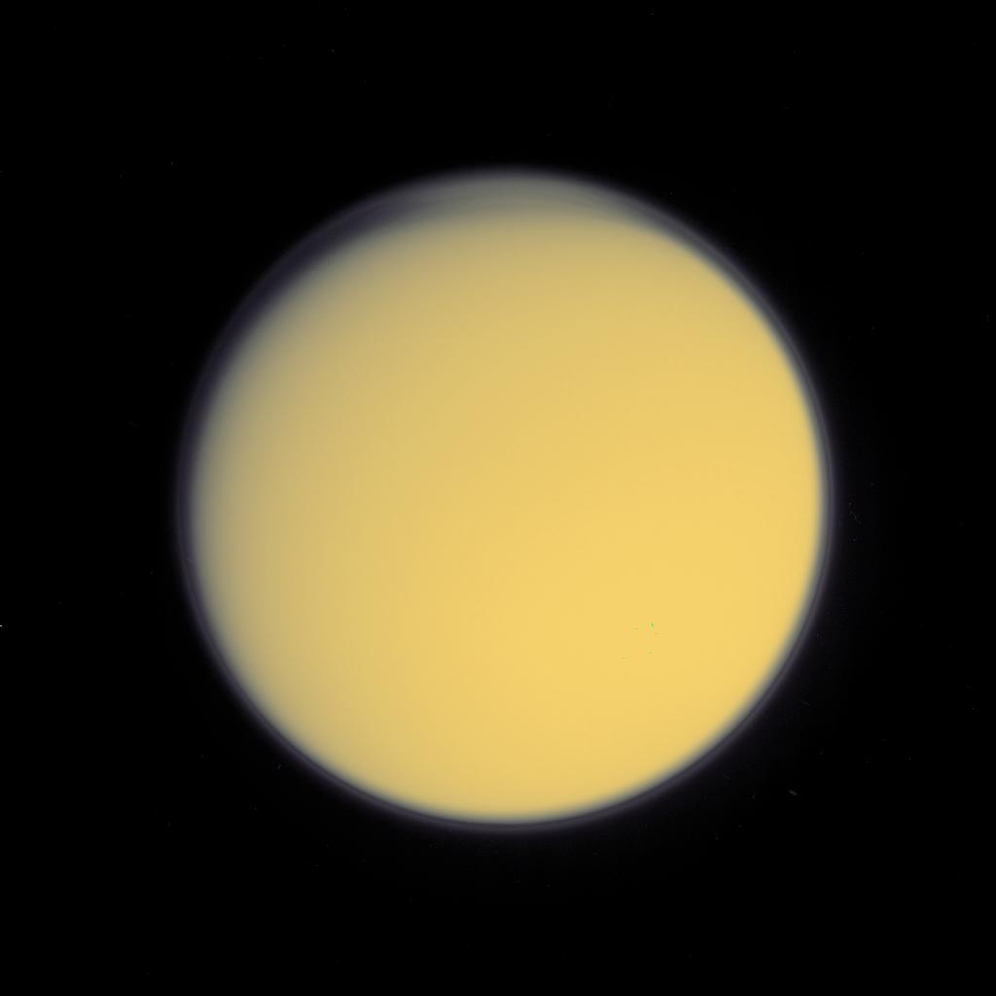

Slide 29
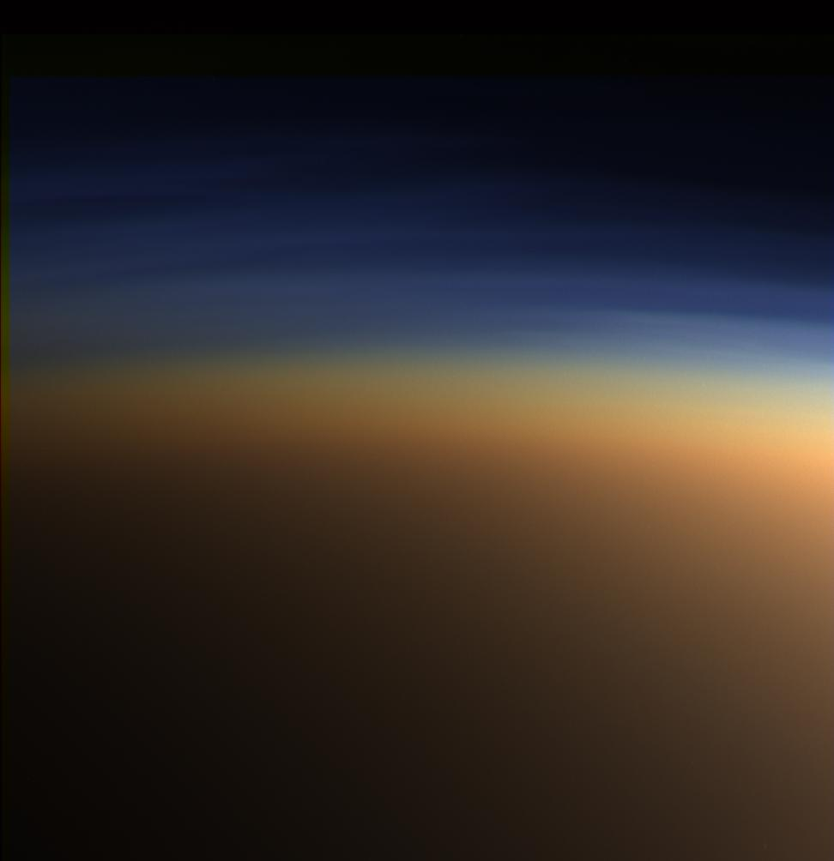

Slide 30
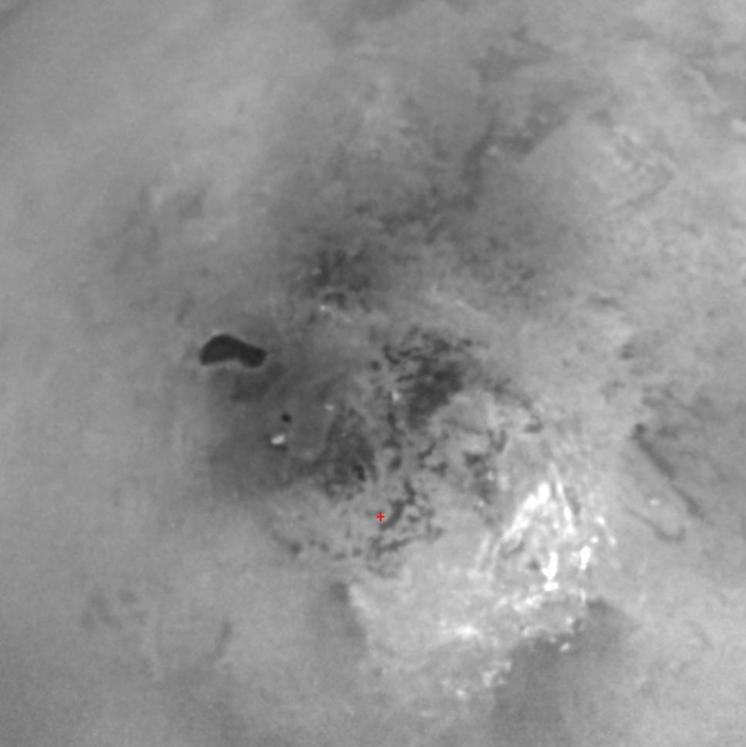

Slide 33
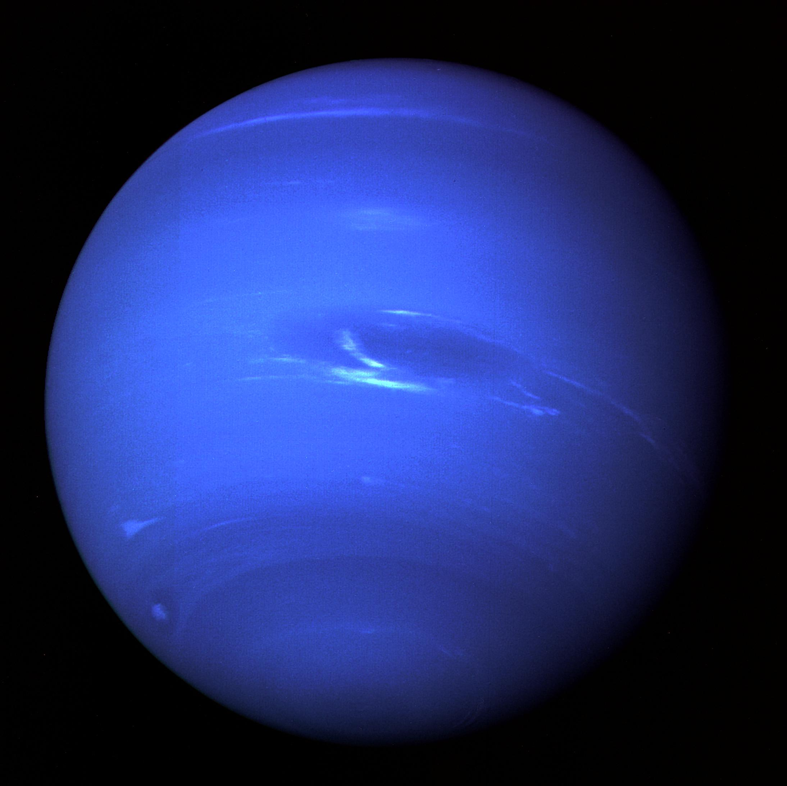

Slide 34
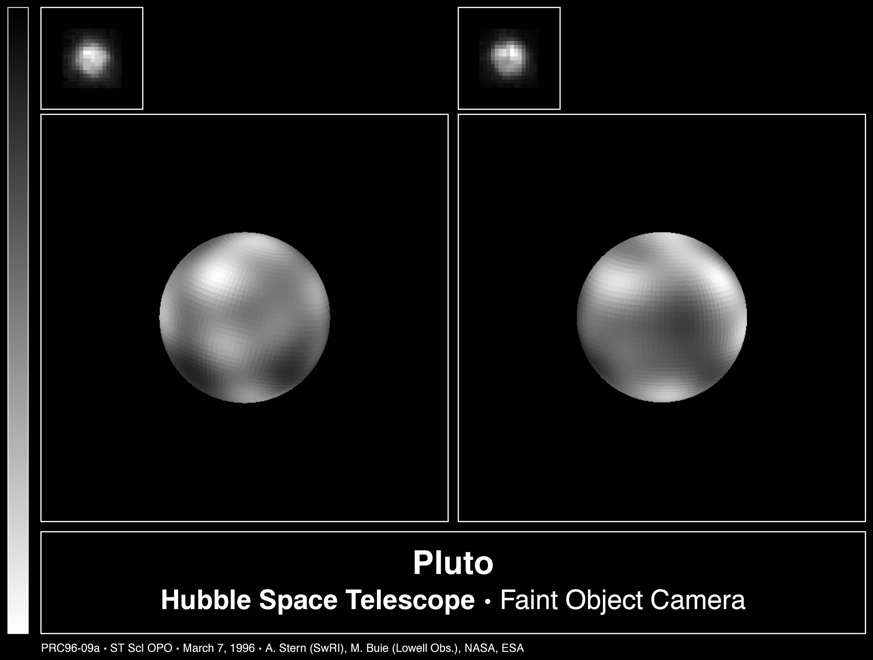

Slide 36
Drake equation
# of civilizations in our galaxy =
number of stars x
fraction of stars with planets x
number of Earth-like planets per star x
fraction on which life arises x
fraction that develop intelligent life x
fraction that develop civilization

Slide 37
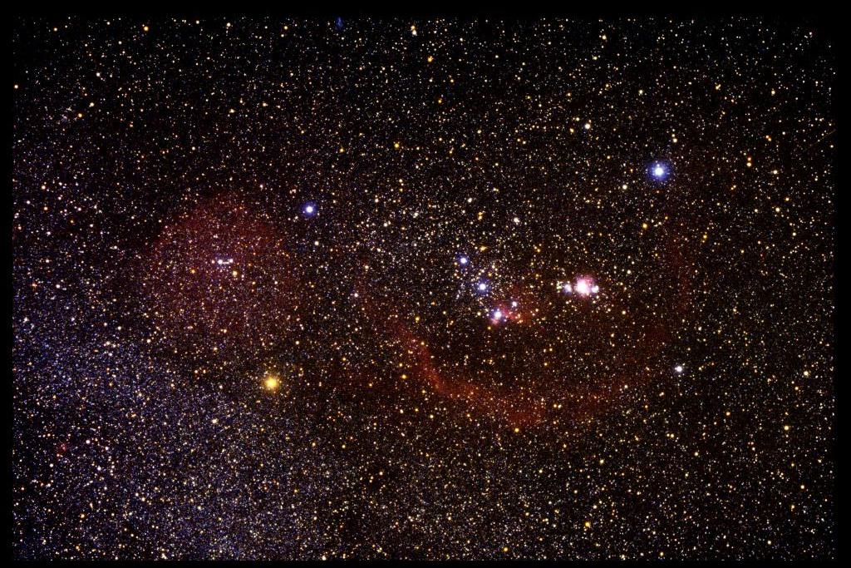

Slide 38
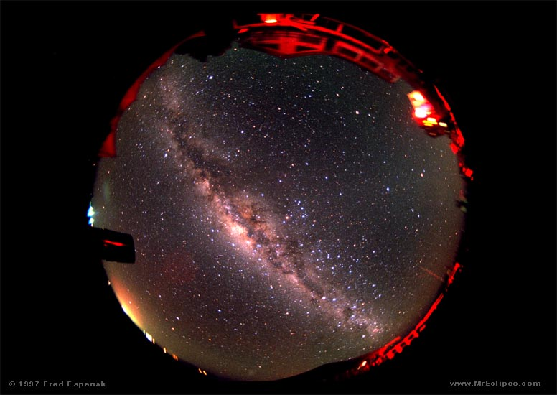

Slide 39
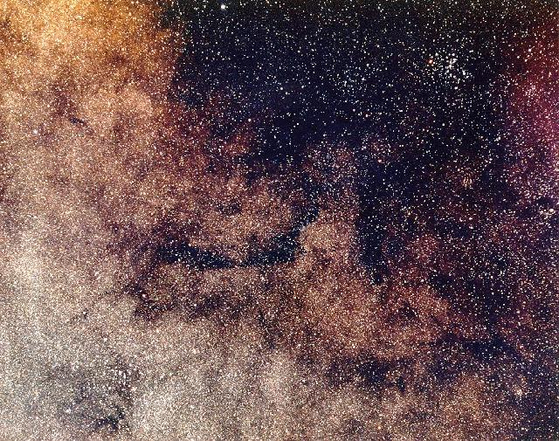

Slide 40
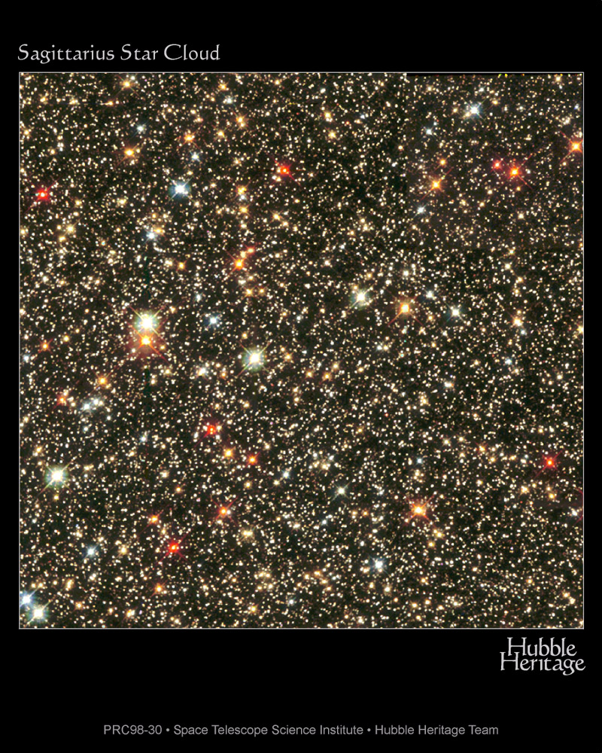

Slide 41
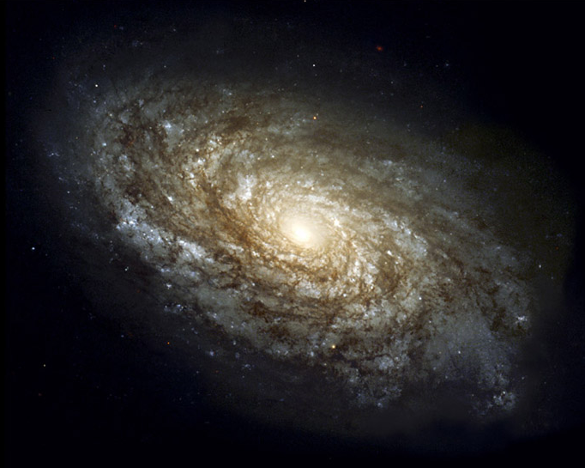
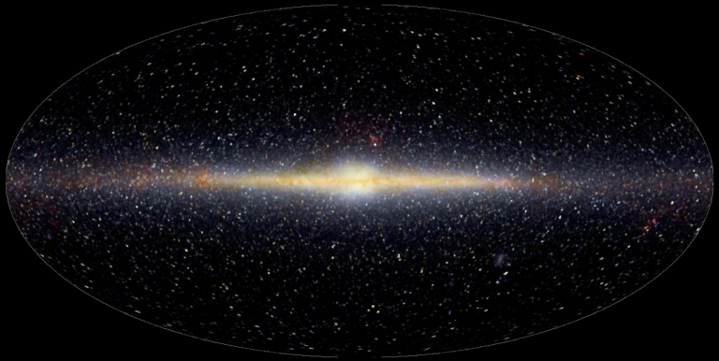
100,000 light years, 100,000 million stars
Sun

Slide 42
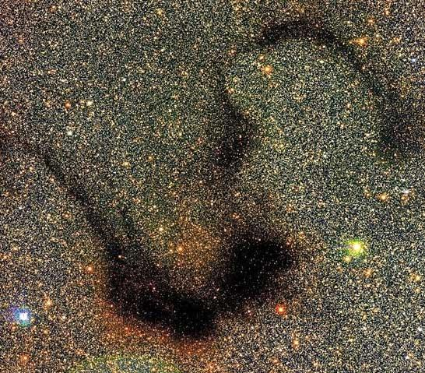

Slide 43
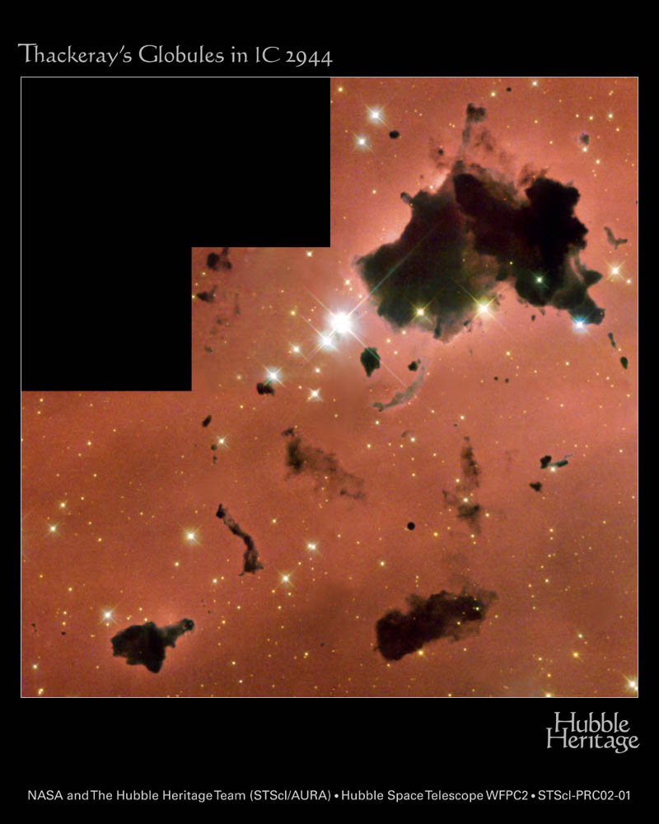

Slide 44
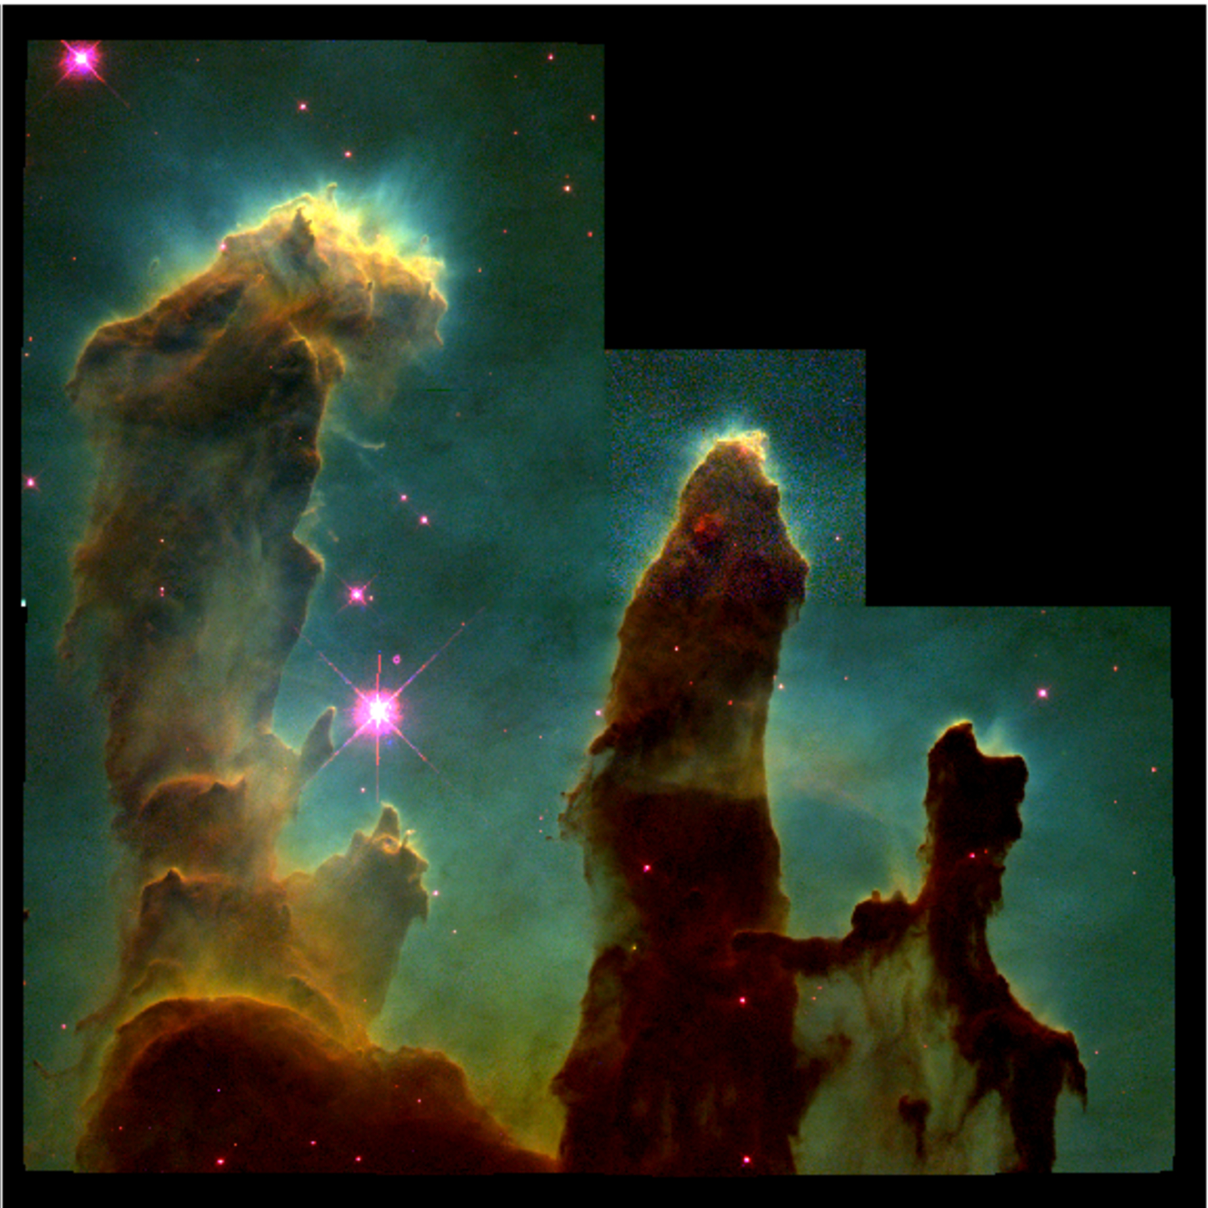

Slide 45
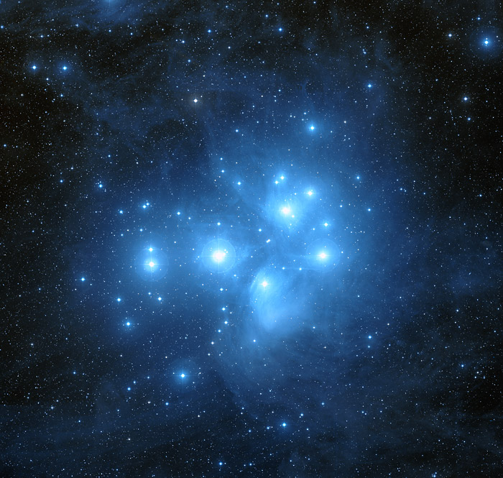

Slide 46
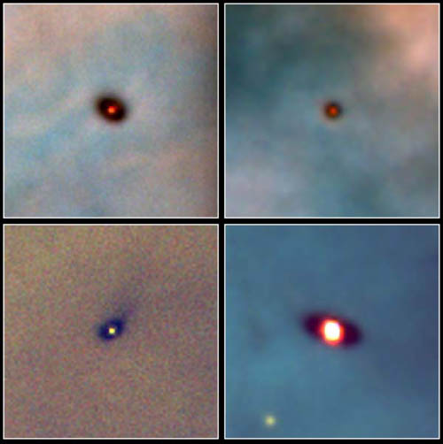

Slide 47
Atomic lines
Characteristic spectral lines
Electron wave fits exactly only at certain distance=energy
Energy

Slide 48
Doppler shift

Slide 49
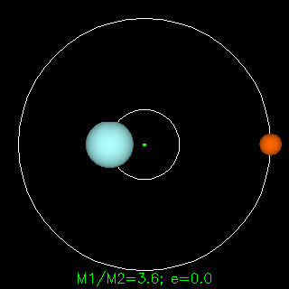

Slide 51
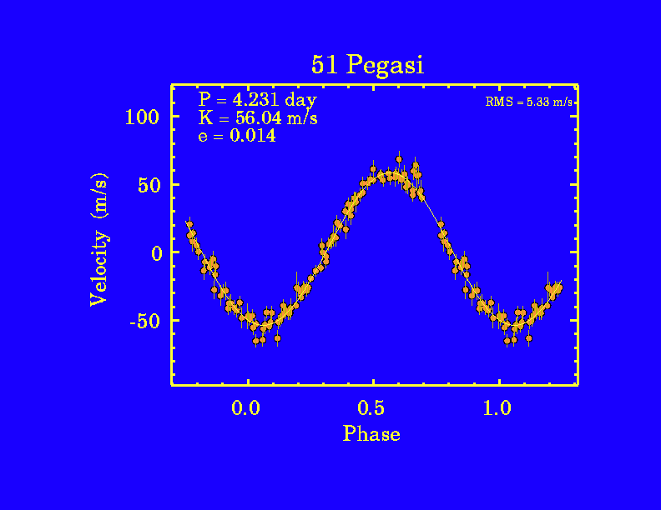
Extrasolar planets!

Slide 52
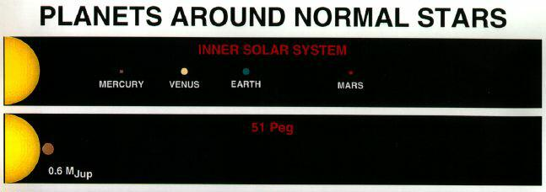

Slide 53
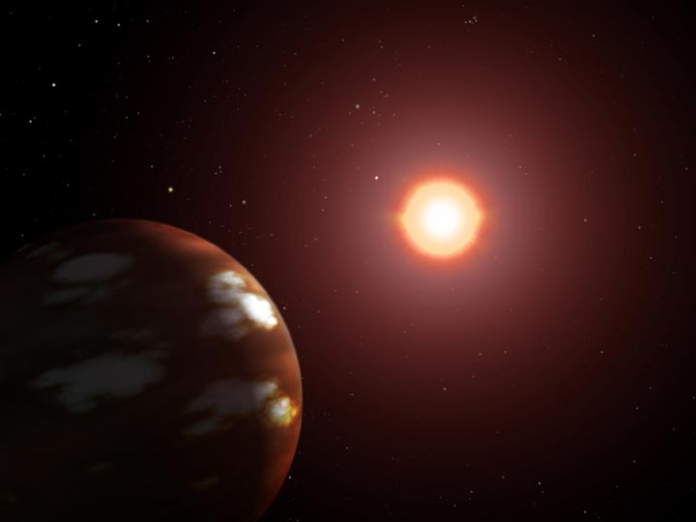

Slide 54
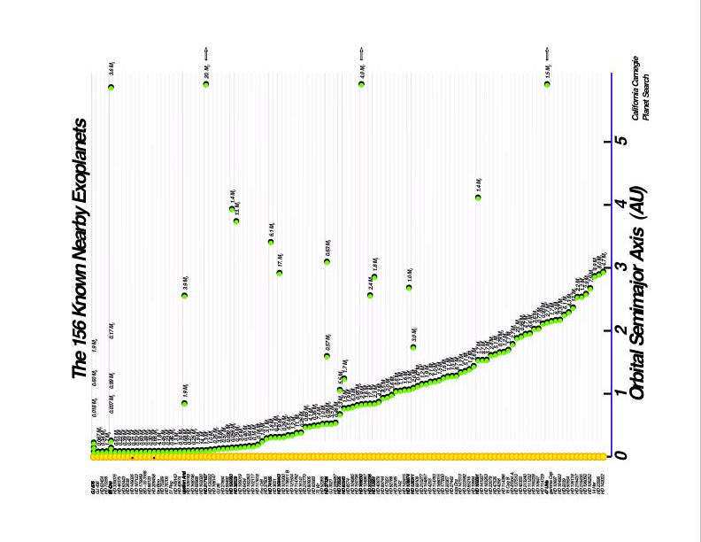
Lots (155++) of extrasolar planets!

Slide 55
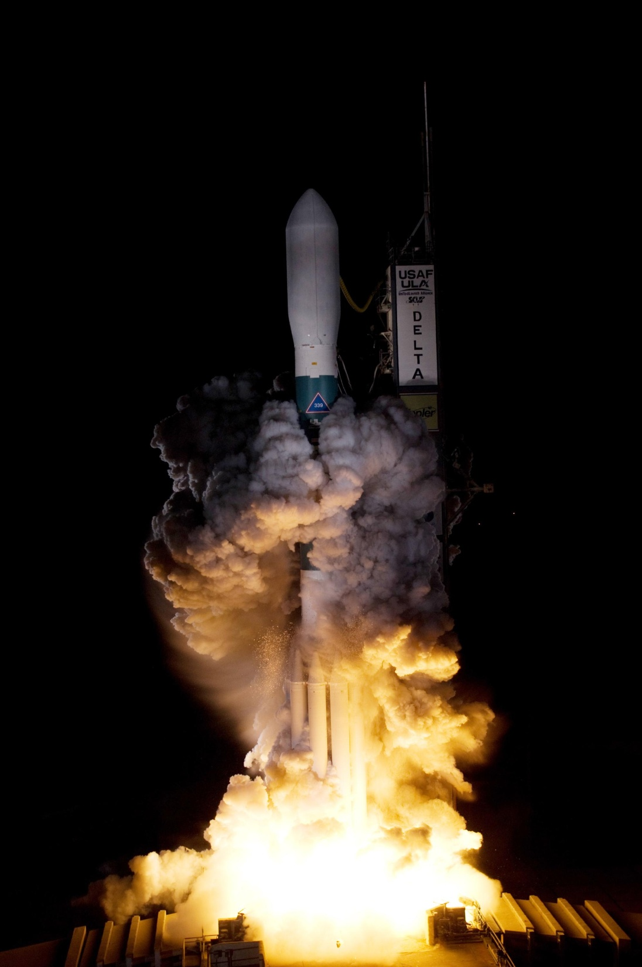
NASA Kepler mission to detect Earth sized planets March 7 2009

Slide 57
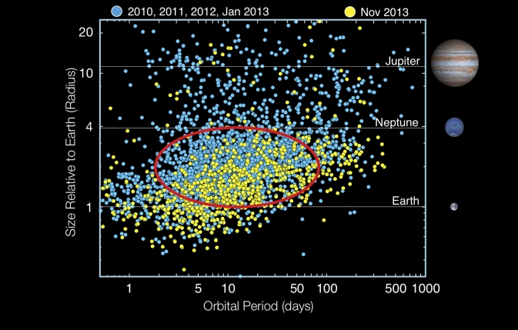
995 confirmed, 4178 candidates

Slide 58
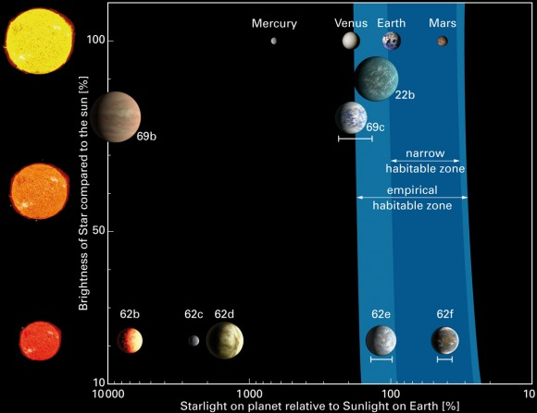

Slide 60
Drake equation
# of civilizations in our galaxy =
number of stars x
fraction of stars with planets x
number of Earth-like planets per star x
fraction on which life arises x
fraction that develop intelligent life x
fraction that develop civilization

Slide 61
