Slide 1
Prof Chris Done
Physics Dept.
Durham
Why study maths??

Slide 2
Chris Done – rocket scientist!
Small seaside town…
…but school really cared about education!

Slide 3
Science: adventure and discovery!
Every week a new adventure, discovery, generally solved by the half Vulcan Science Officer, Mr Spock…
Generally involving black hole time travel or wormholes….

Slide 4
Science: adventure and discovery!
Every week a new adventure, discovery, generally solved by the half Vulcan Science Officer, Mr Spock…
I wanted to be a scientist, the one who discovered new things and explained them

Slide 5
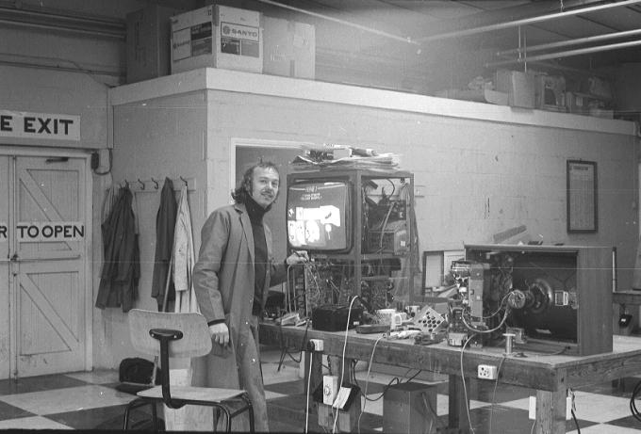
My Dad repaired TVs!

Slide 6
Chris Done – rocket scientist!
Small seaside town…
…but school really cared about education!

Slide 7
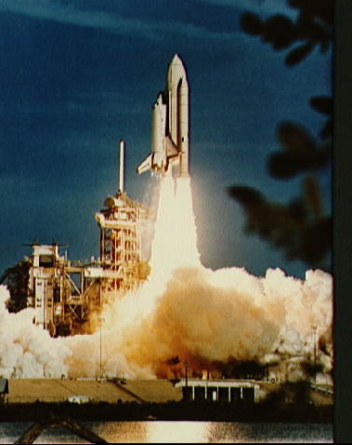
Chris Done – rocket scientist!
BSc Astronomy Astrophysics and Theoretical physics (St Andrews)
PhD Cambridge
NASA- Goddard
Durham – work with European Space agency and Japanese space agency…

Slide 9
But don’t you have to be some sort of genius?
I don’t feel like a genius, so I can’t be any good at maths….

Slide 10
AAARRRGGGGGGGHHHH!!

Slide 12
We need to practice…
And practice…
And practice … to get good at ANYTHING
Music, sport… we understand this really!
Languages – have to learn vocabulary ’no matter naturally’ good we are at it.
Probably its boring to do the maths homework this week. And next week, and the week after…

Slide 13
Science: adventure and discovery!
Alien life?
Can there be life elsewhere in the Universe?
First look round our own solar system planets…

Slide 14
Life elsewhere in the solar system – how to find out ?
Go there – rockets…
Physics – to work out gravity !
Maths – to work out the paths to the planets

Slide 15
Science: adventure and discovery!
Alien life?
Can there be life elsewhere in the Universe?
First look round our own solar system planets…

Slide 16
Life elsewhere in the solar system – how to find out ?
Go there – rockets…
Physics – to work out gravity !
Maths – to work out the paths to the planets
Chemistry – to make the rocket fuel
Engineers – to make it all work in practice
Biologists – to understand life!
Big questions – need big teams of people!

Slide 17
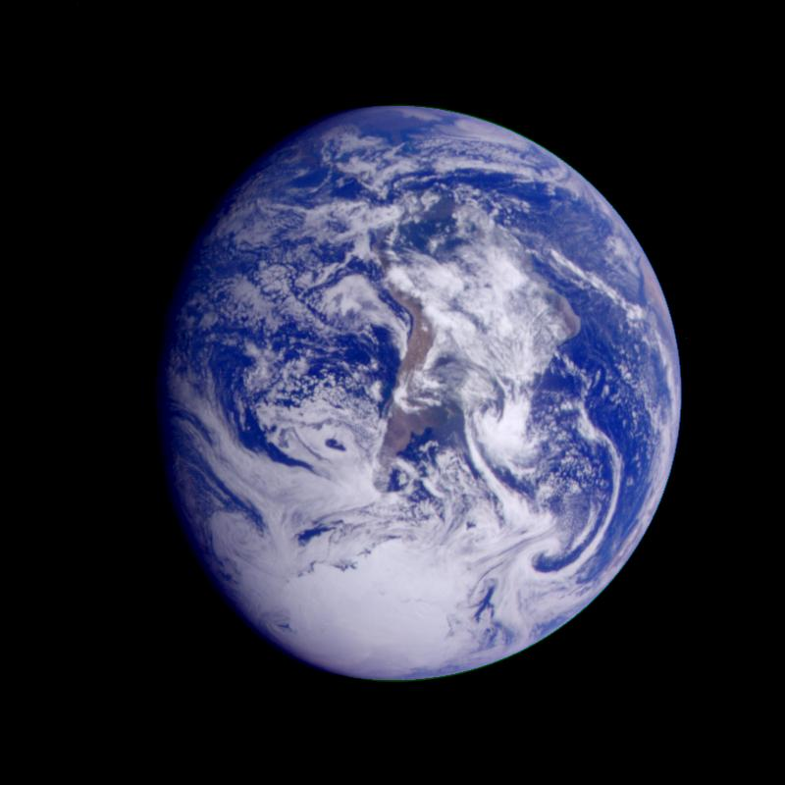

Slide 18
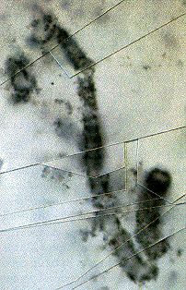
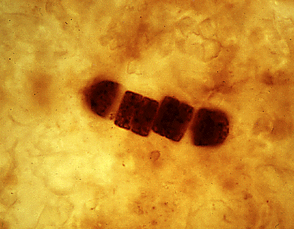
Life on Earth
Earth is 4.5 billion years old. Oldest surviving rocks are 3.8 Gyr, fossil bacteria from 3.5 Gyr.
Liquid water/rock interface with energy from sunlight ?

Slide 19
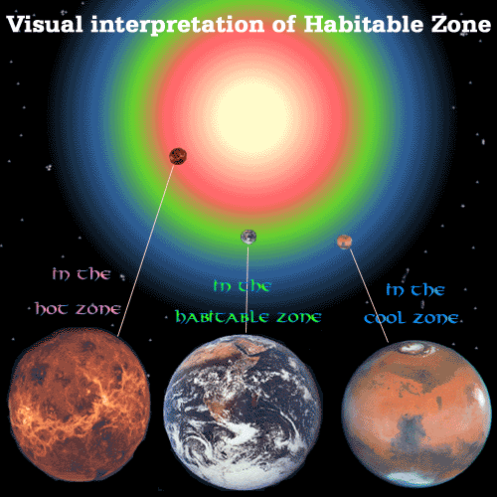

Slide 20
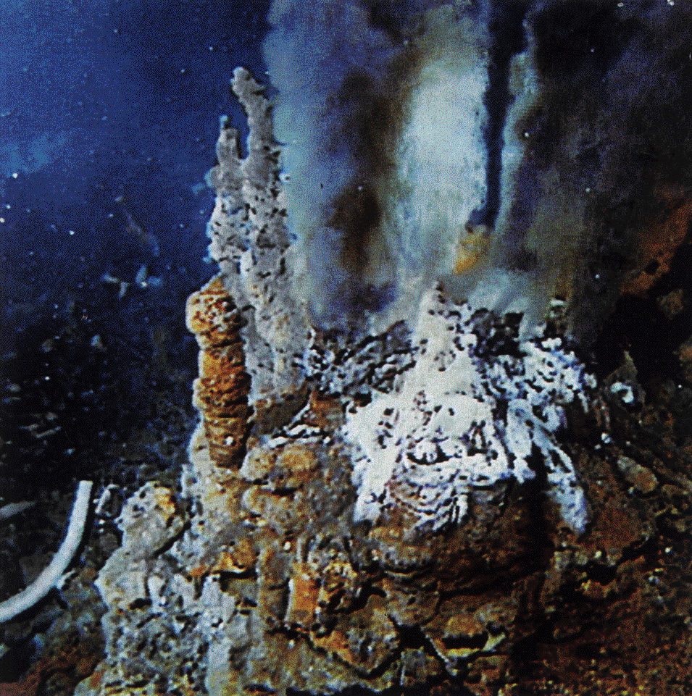

Slide 21
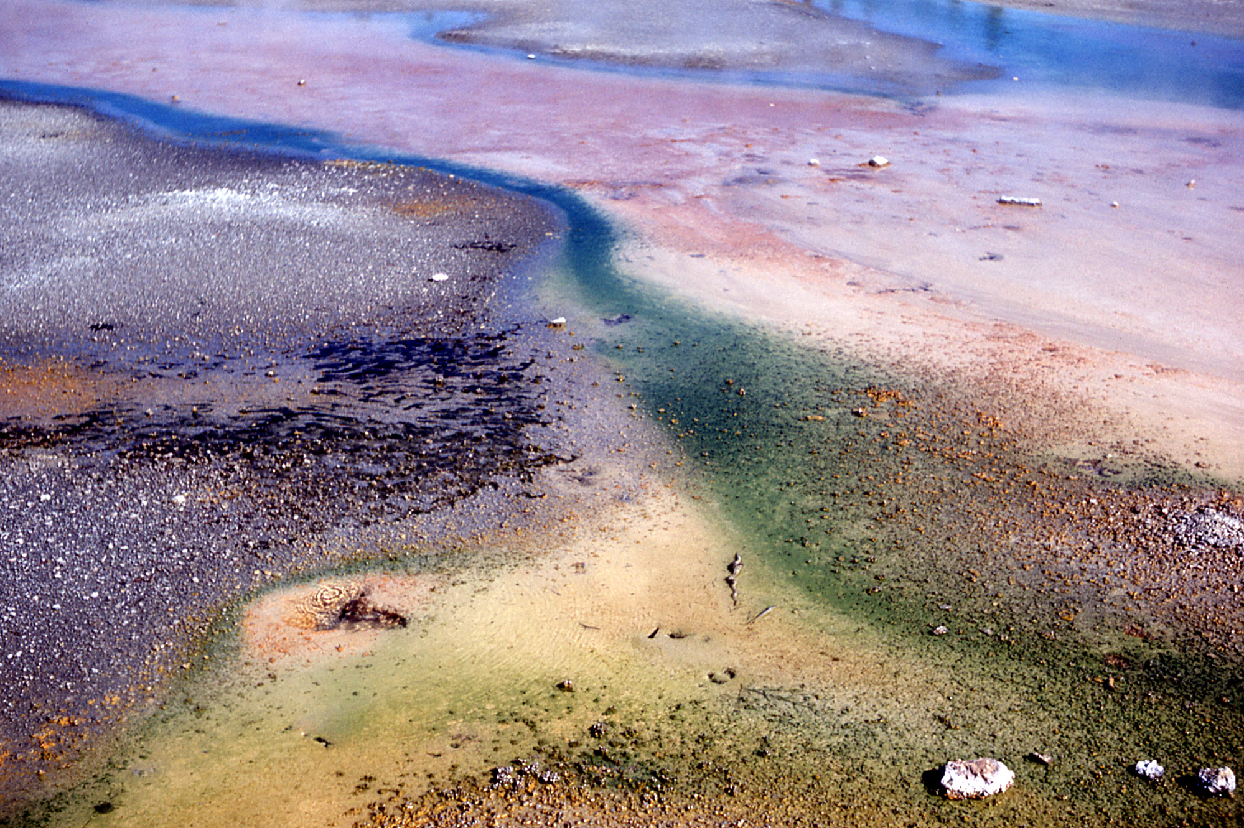

Slide 22
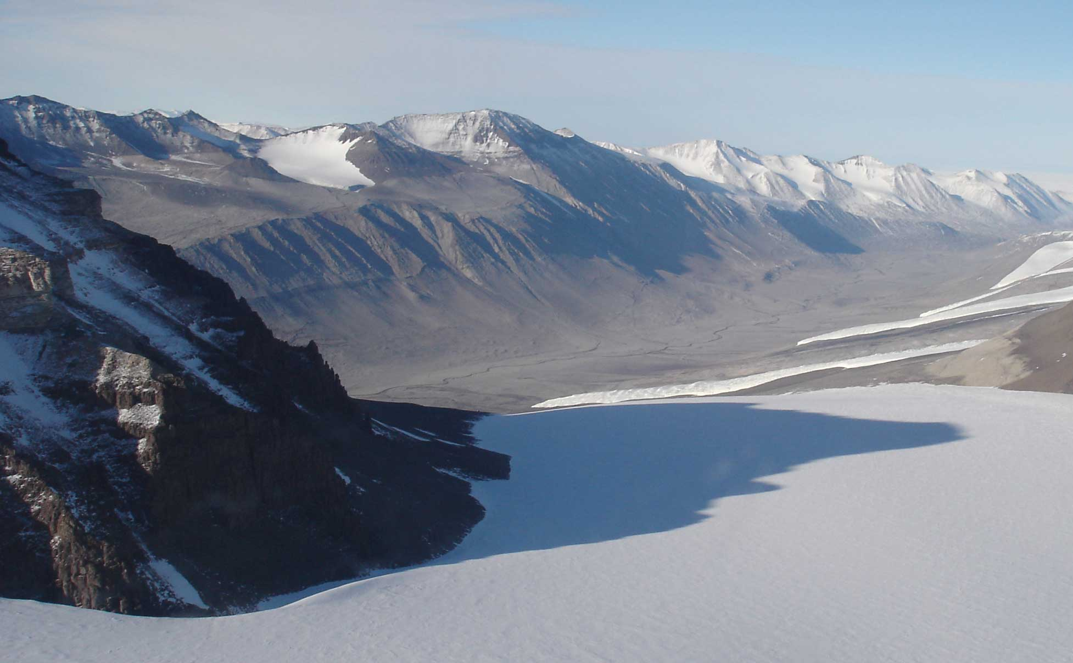

Slide 23
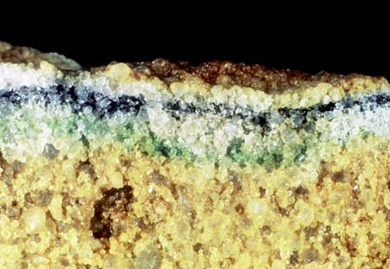

Slide 24
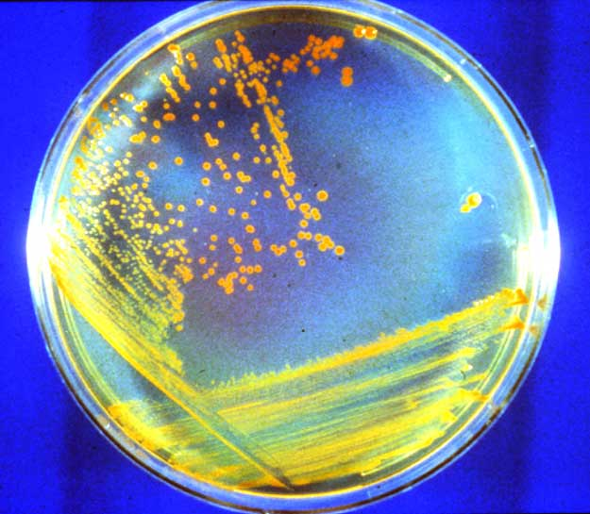

Slide 25
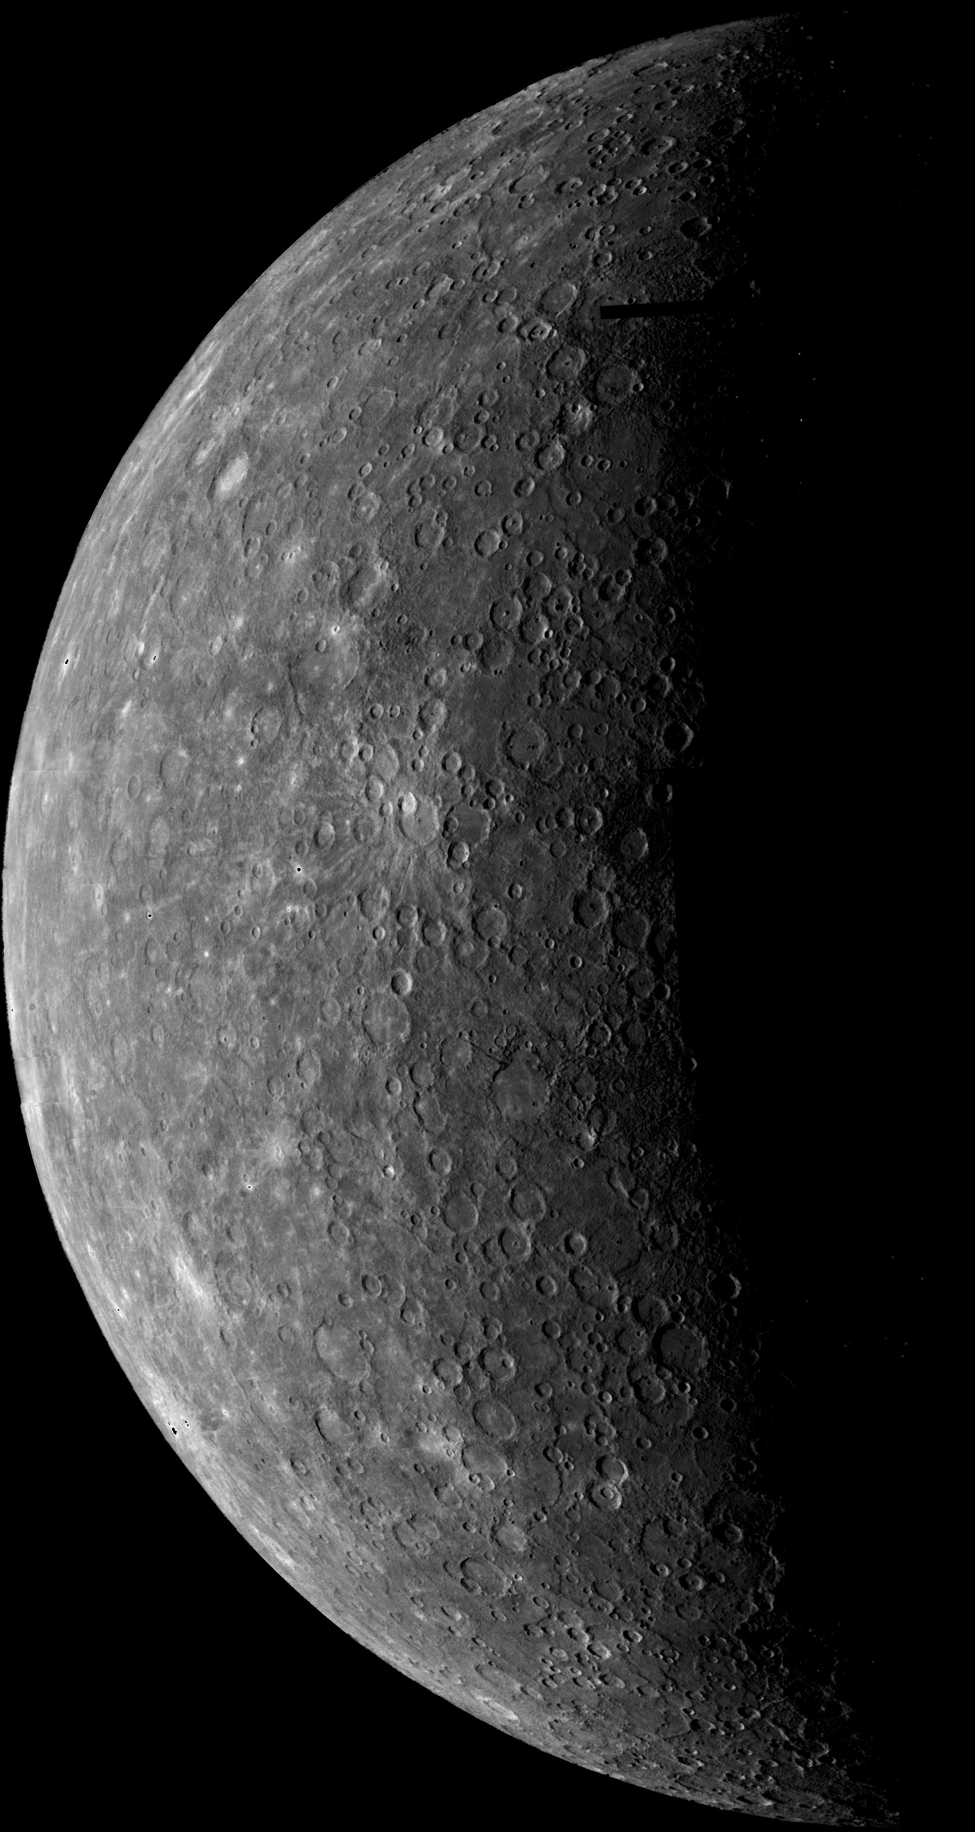

Slide 26
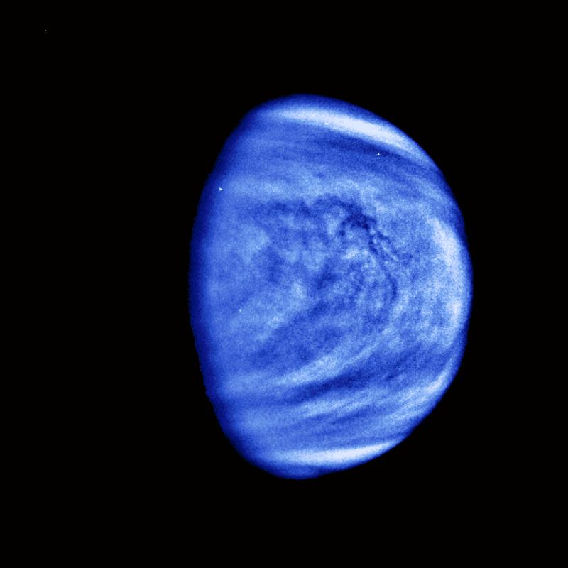

Slide 27
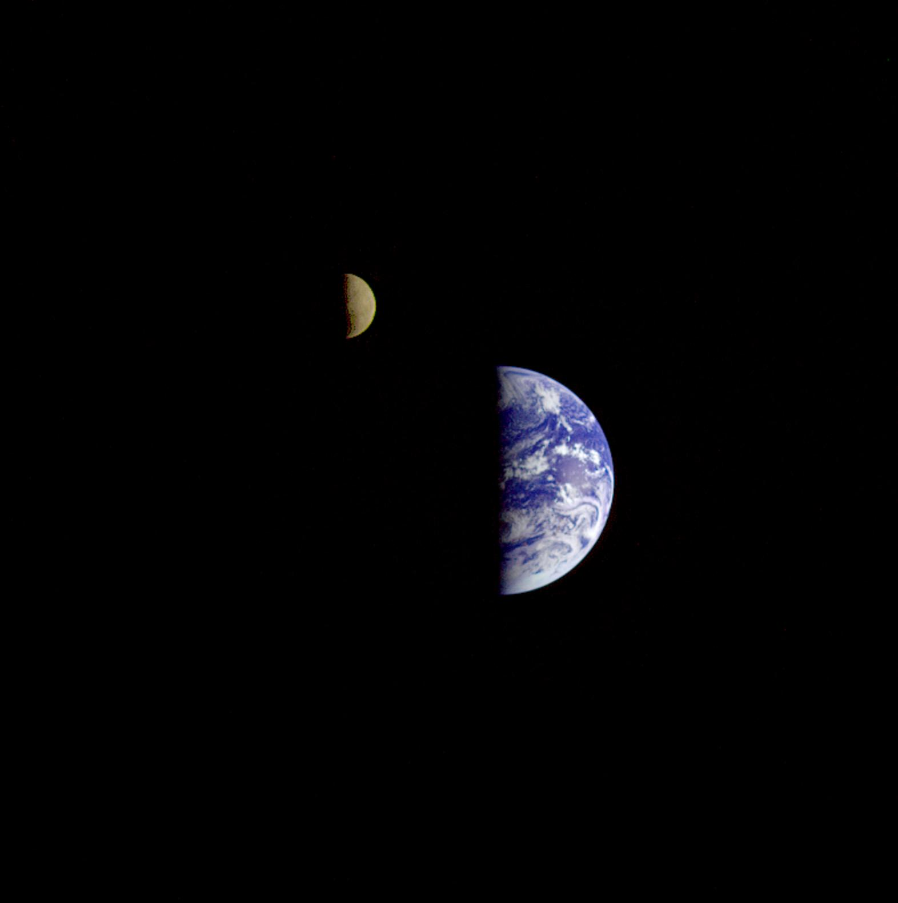

Slide 28
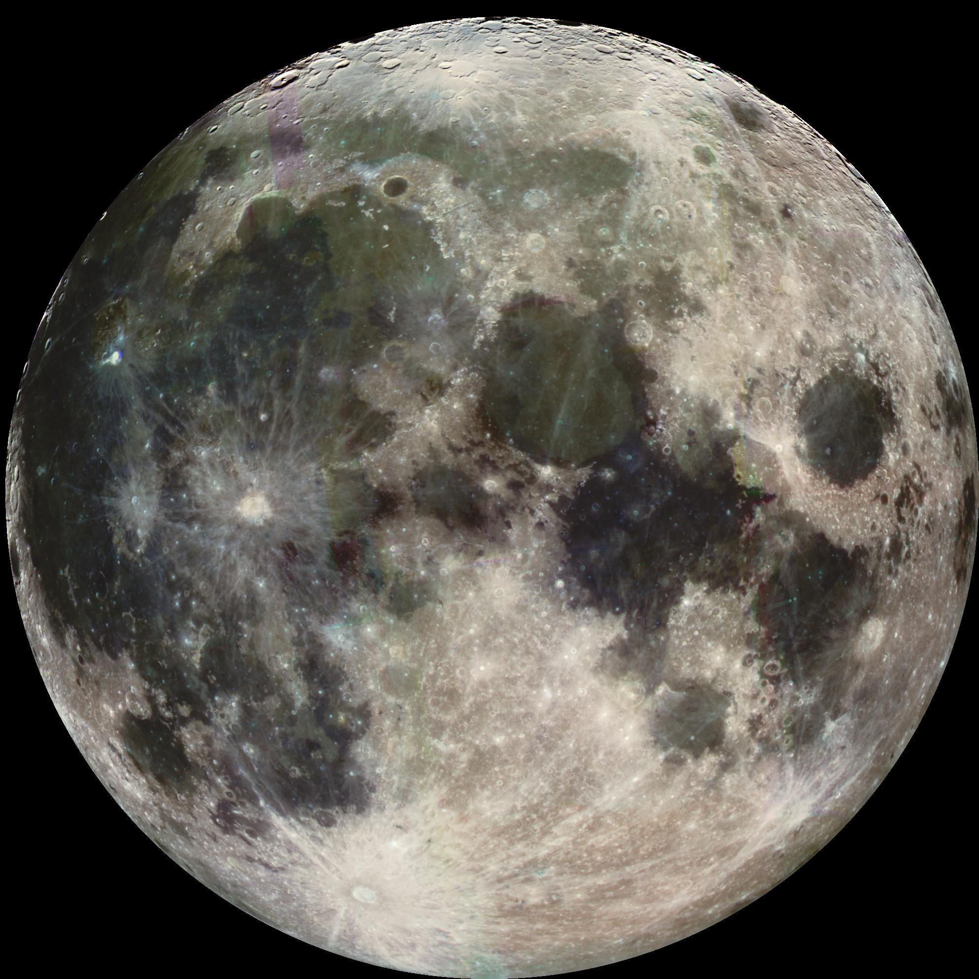

Slide 29
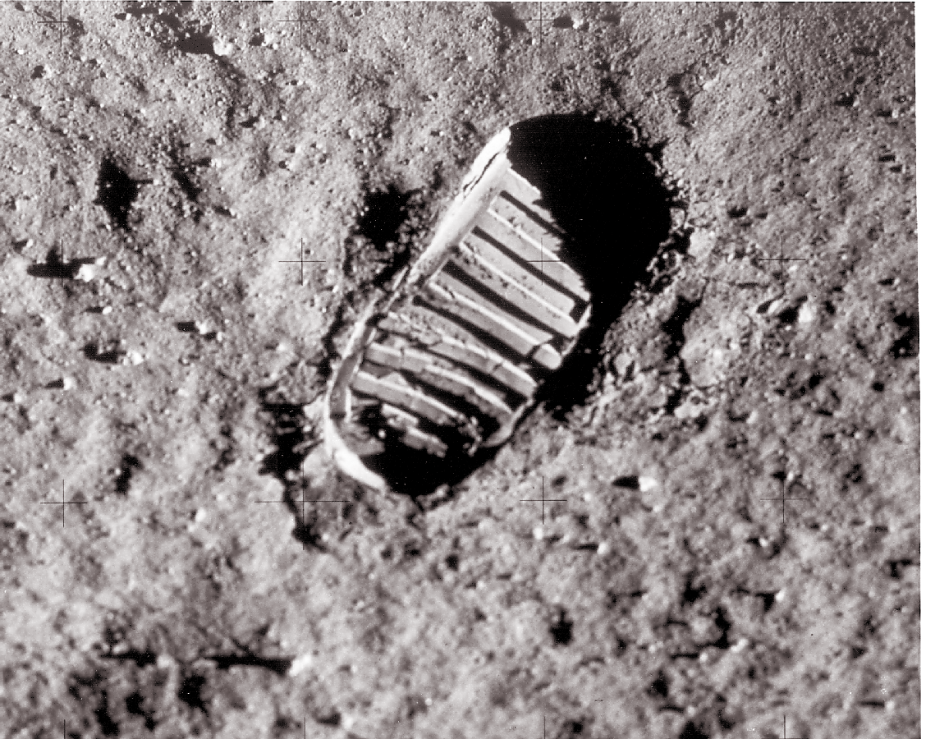

Slide 30
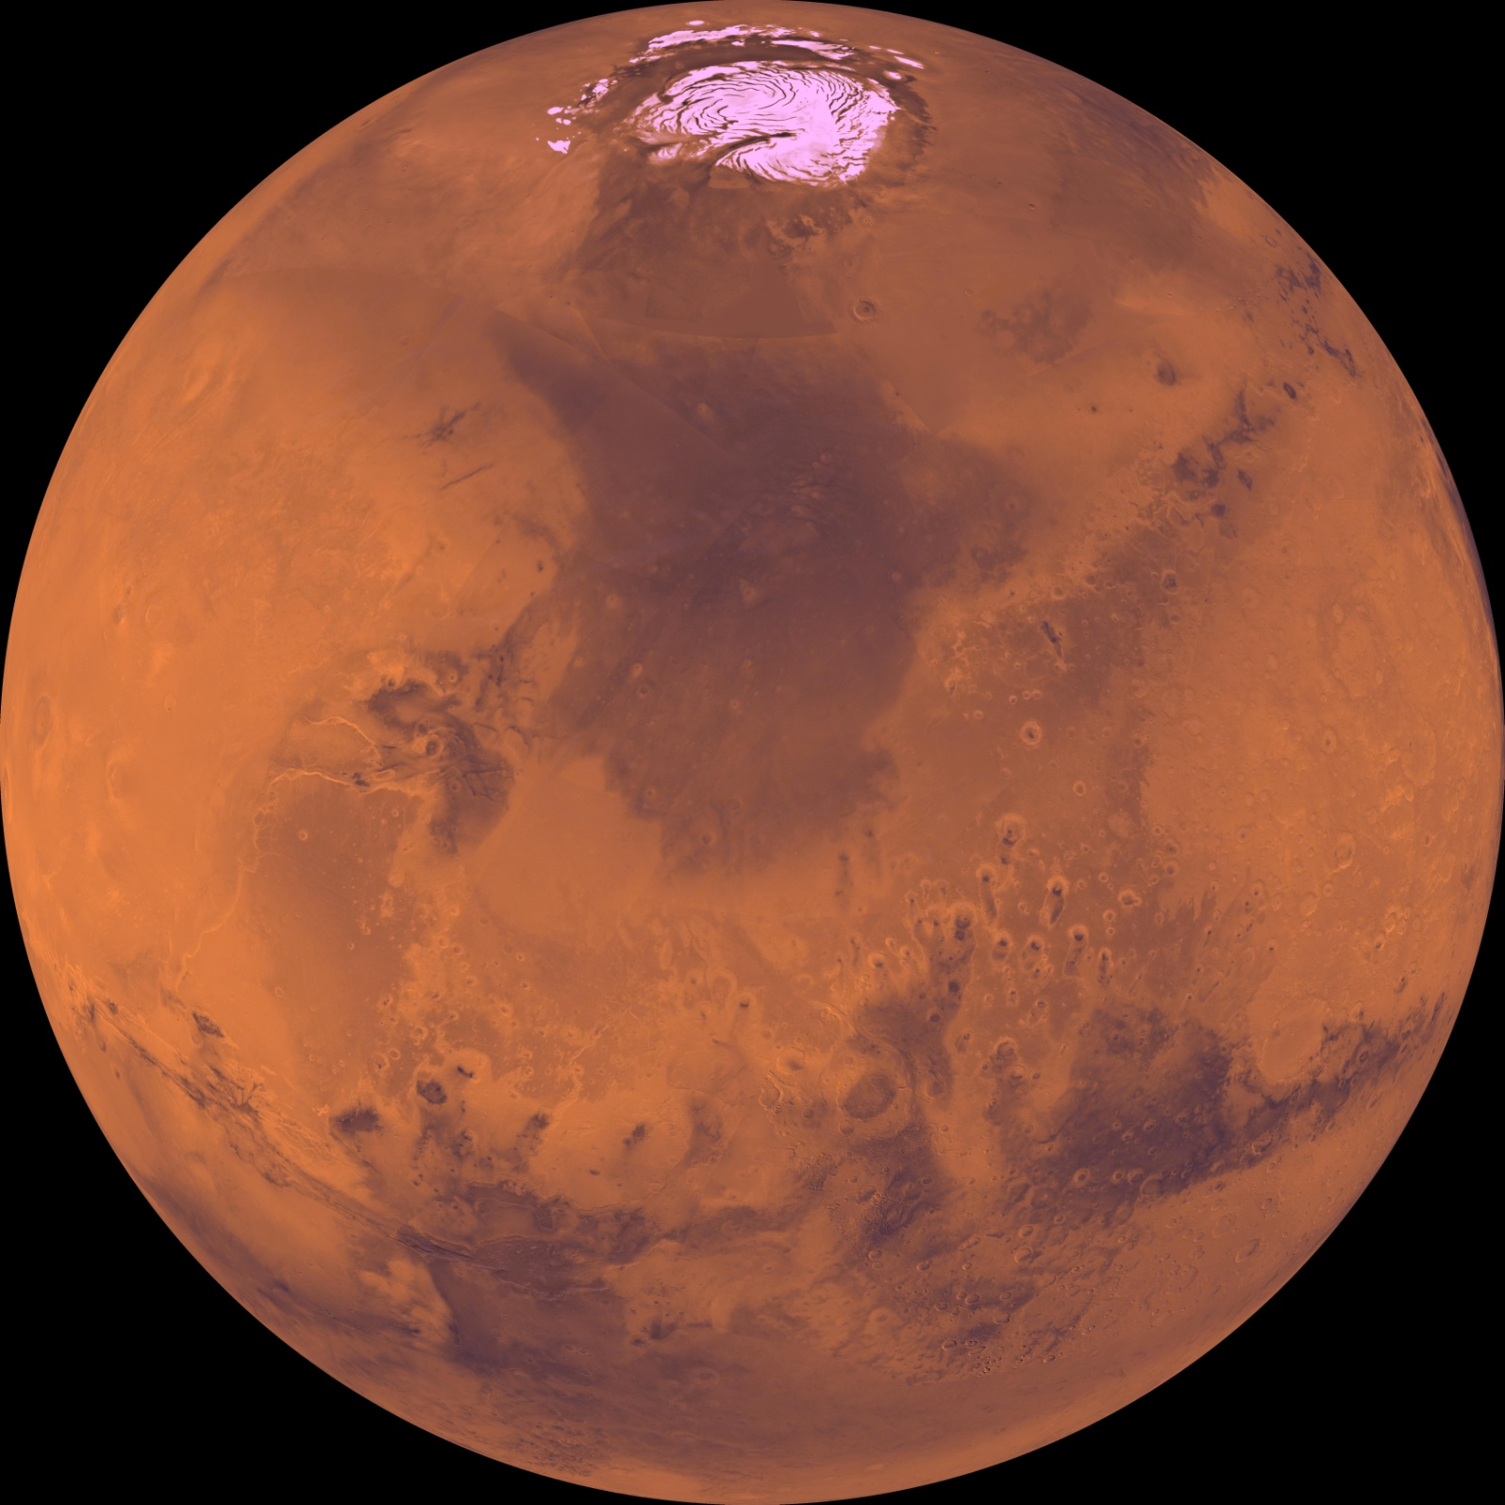

Slide 31
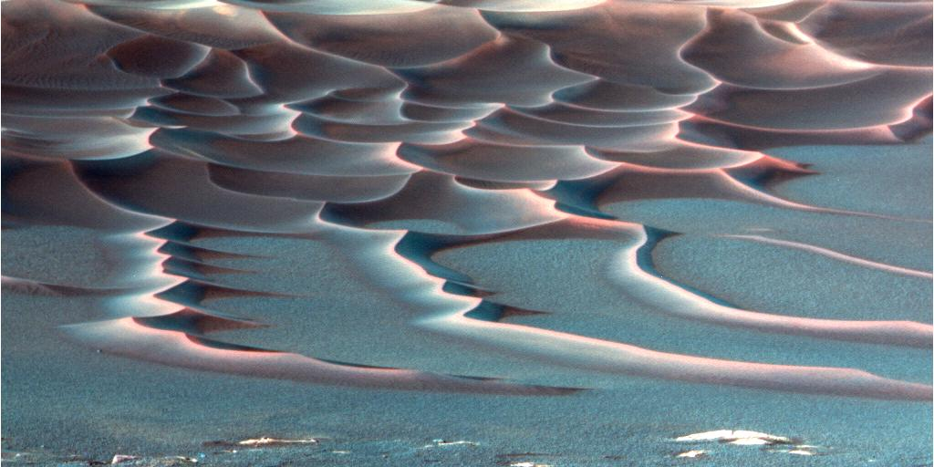

Slide 33
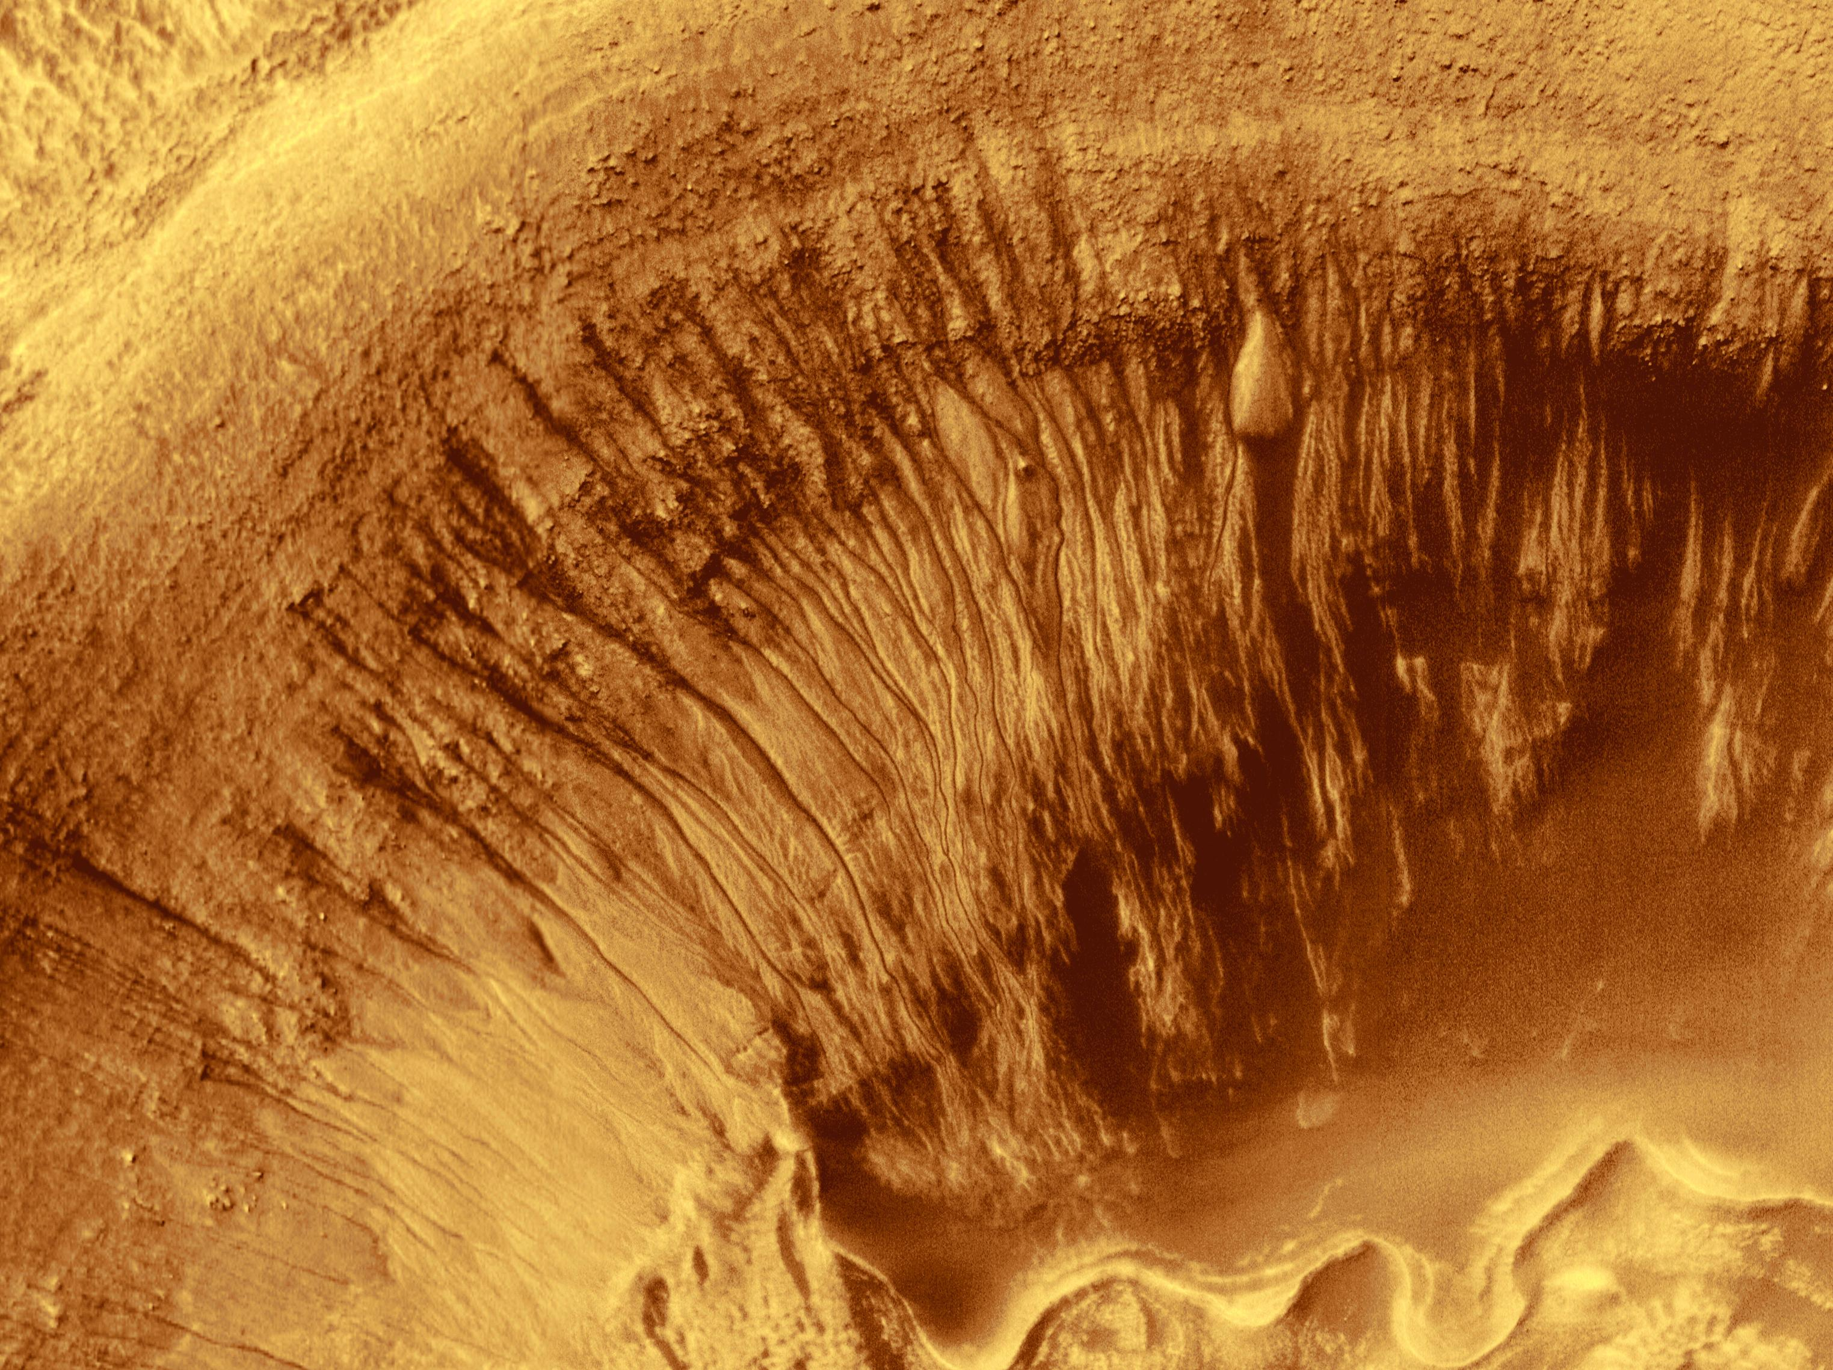

Slide 34
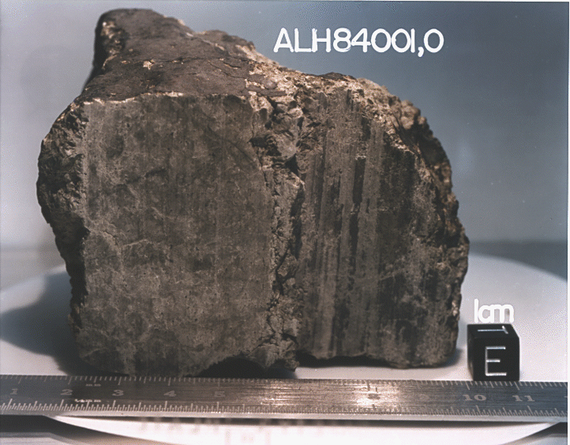
Life on Mars?
Martian meteorite?
Mars gets hit by asteroid, rocks escape, eventually hit Earth
Find in Antarctica (rock on snow!)
MAYBE fossil bacteria: but ambiguous

Slide 35
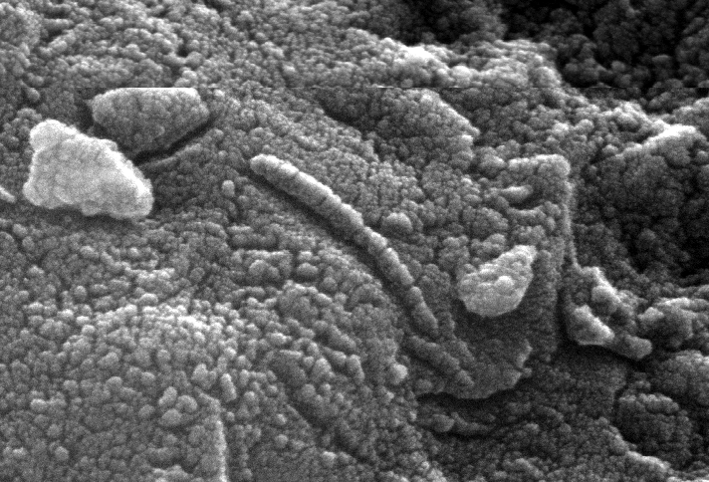
Life on Mars?
Martian meteorite?
Mars gets hit by asteroid, rocks escape, eventually hit Earth
Find in Antarctica (rock on snow!)
MAYBE fossil bacteria: but ambiguous

Slide 37
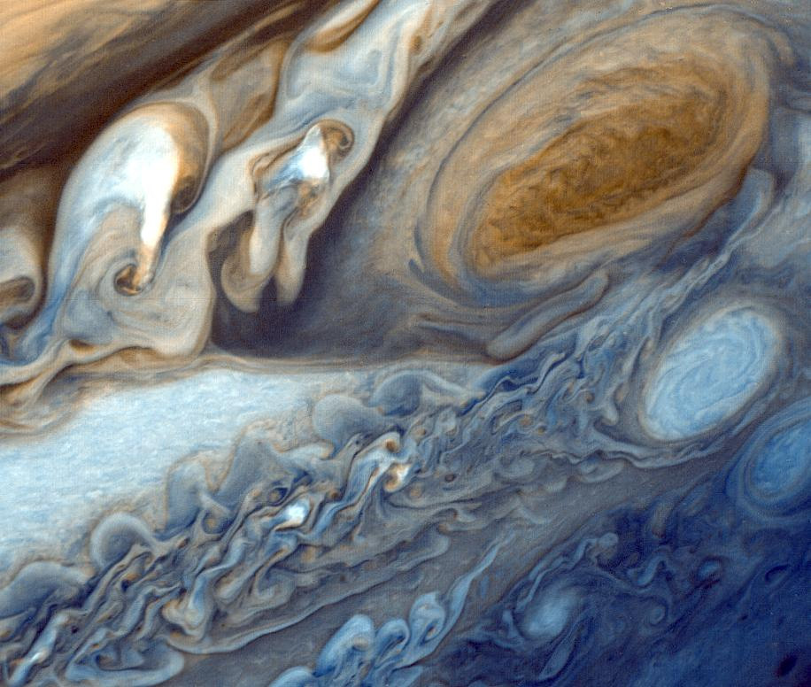

Slide 38
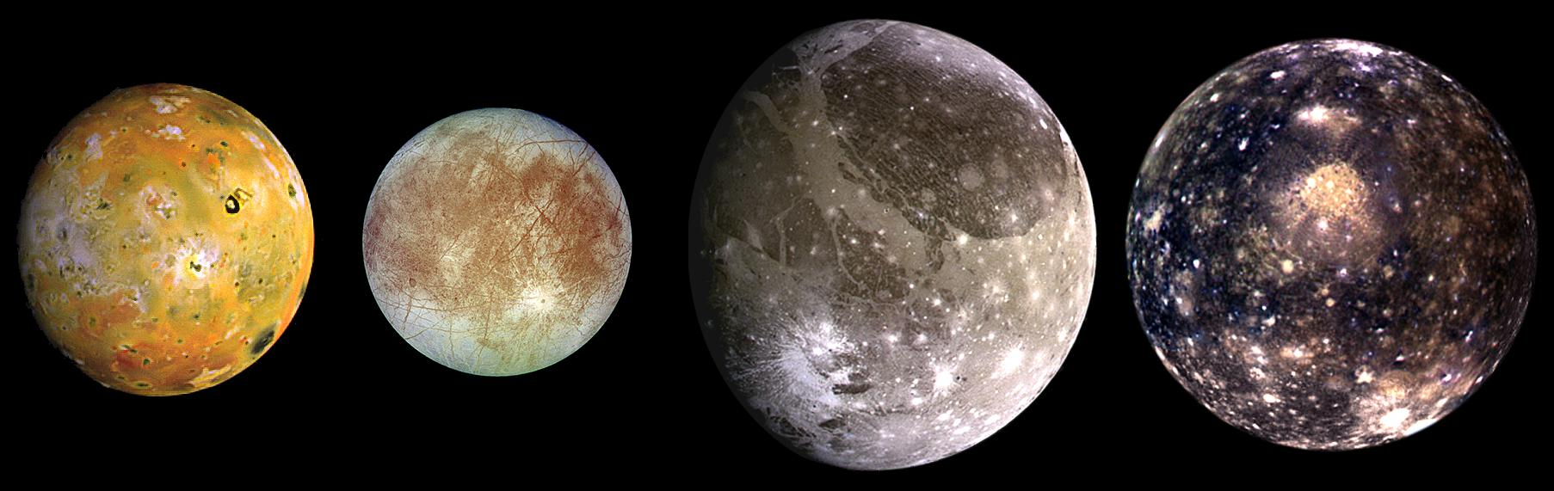

Slide 40
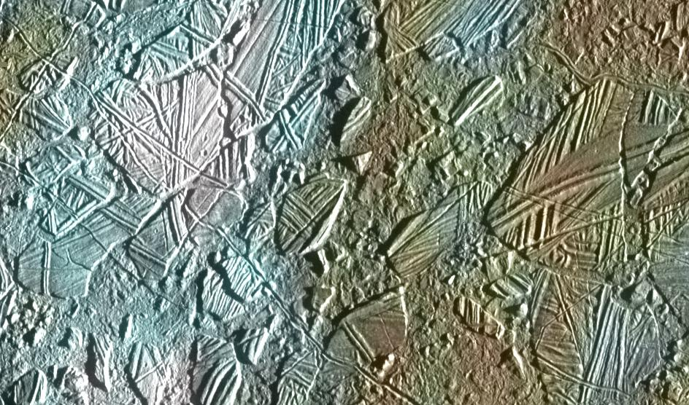

Slide 41
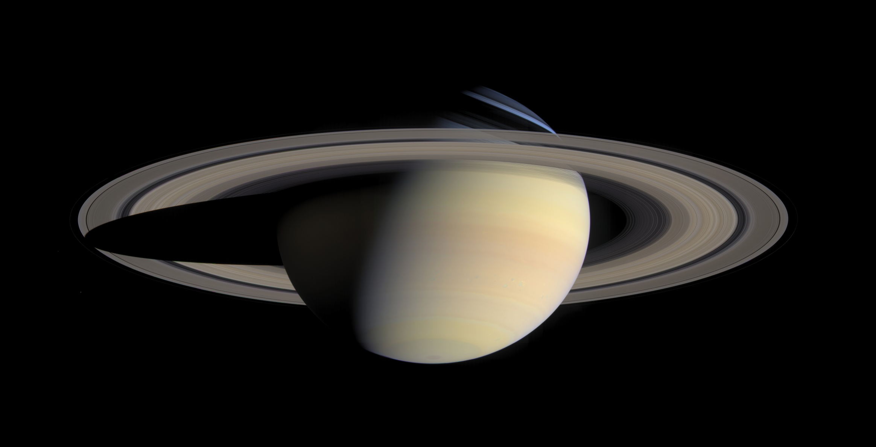

Slide 42
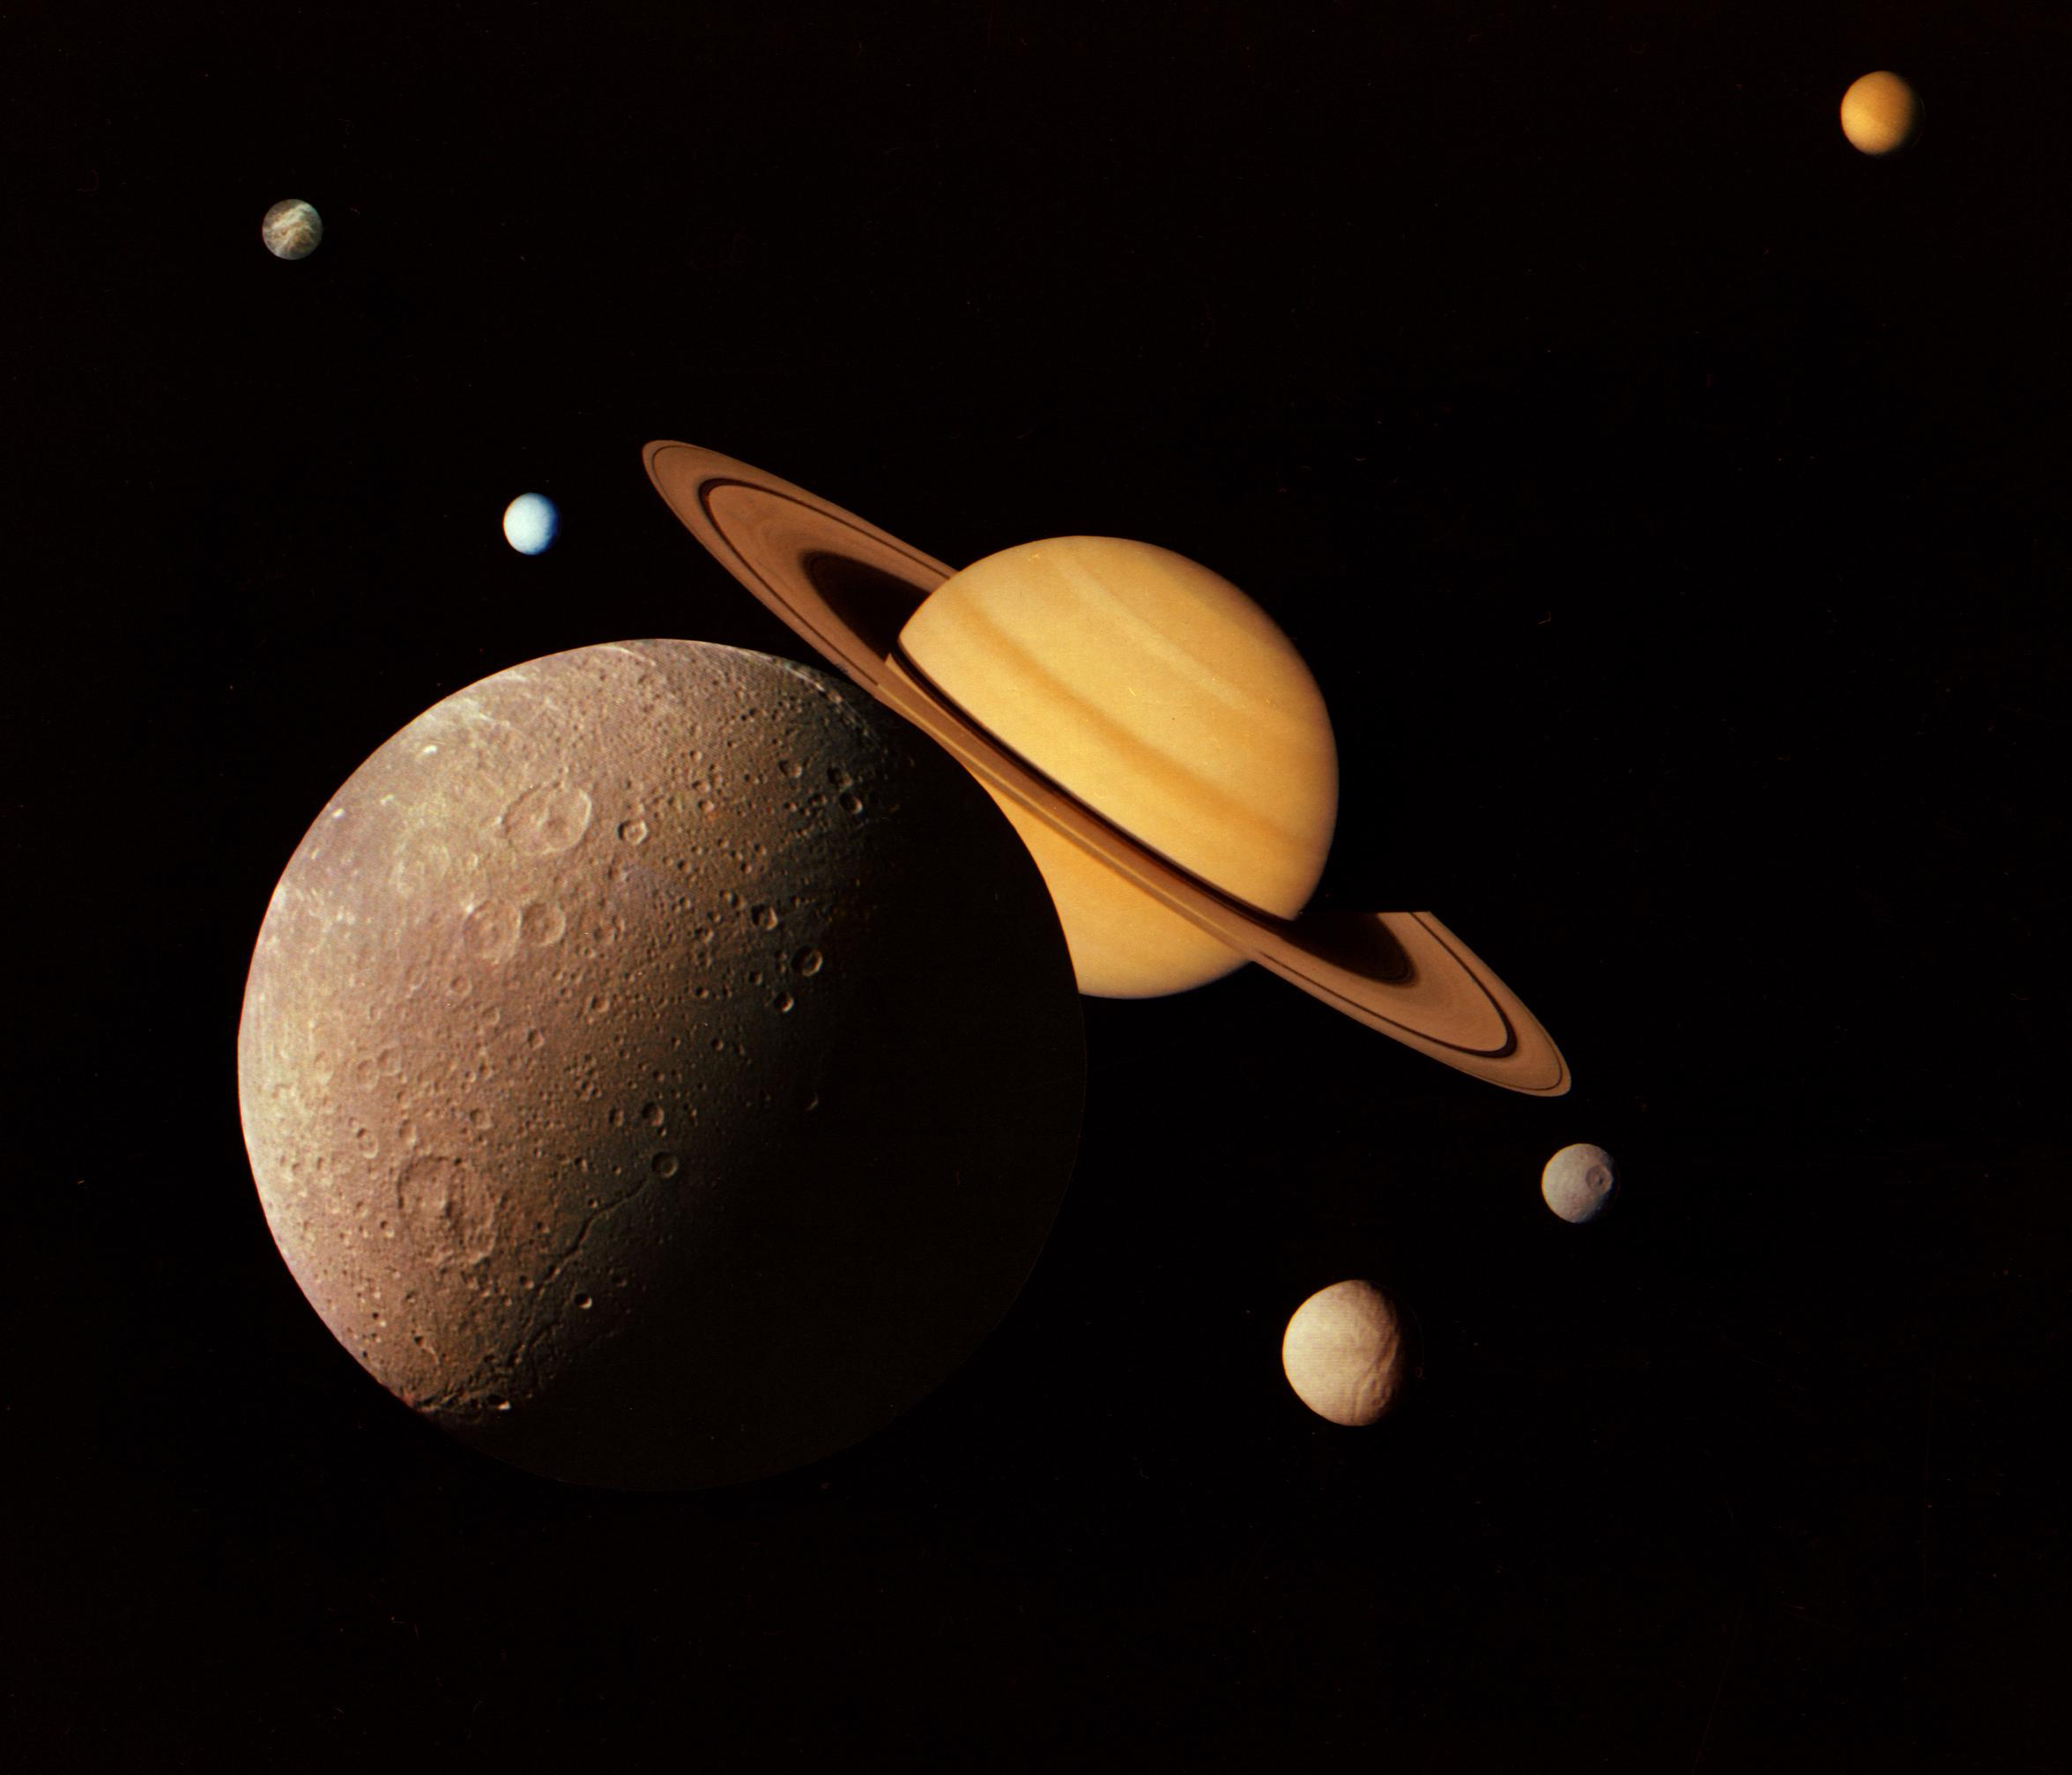

Slide 43
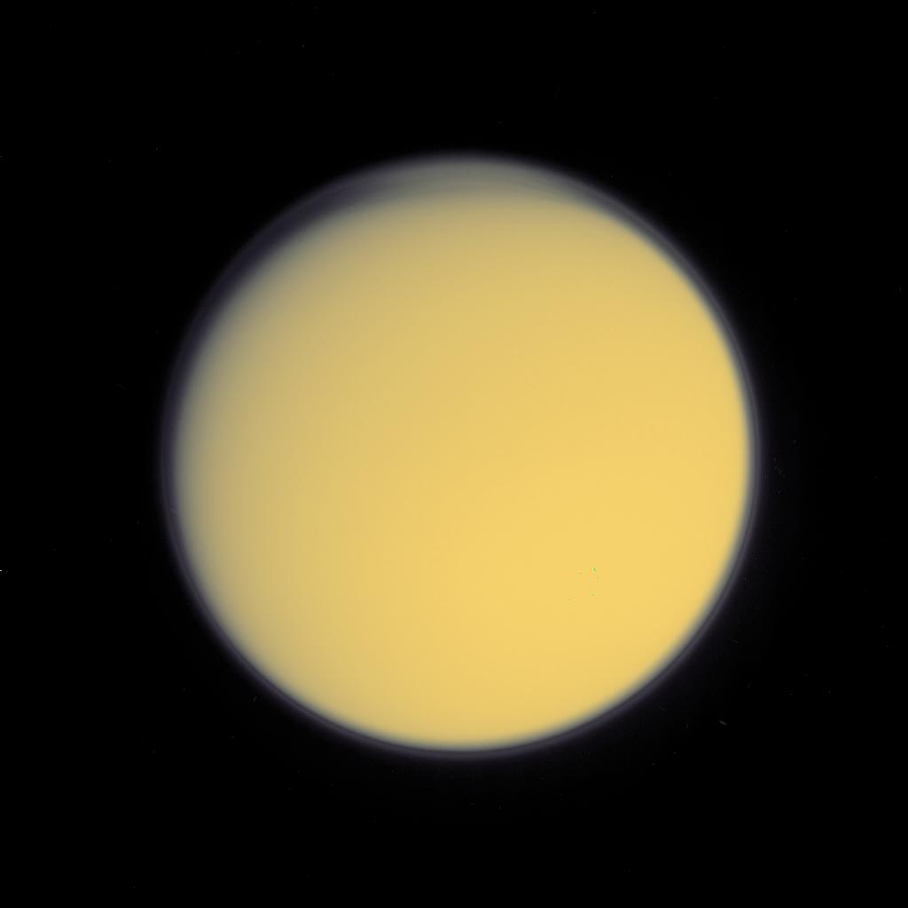

Slide 44
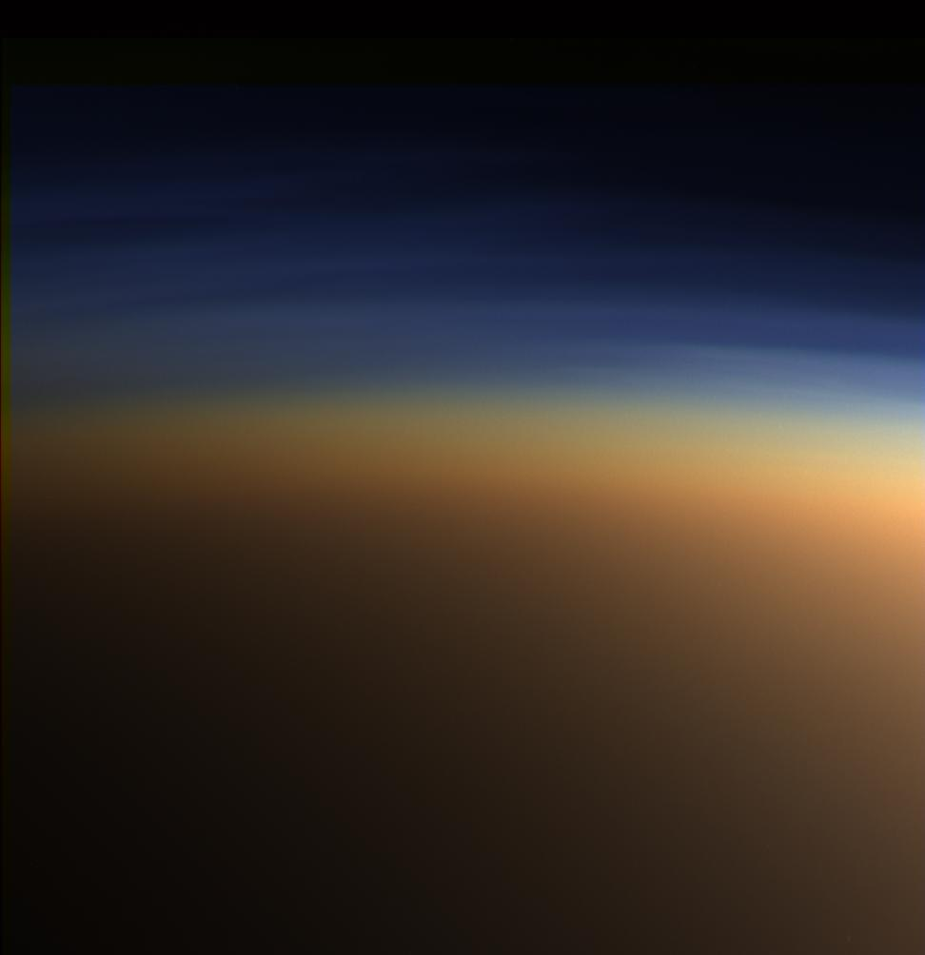

Slide 45
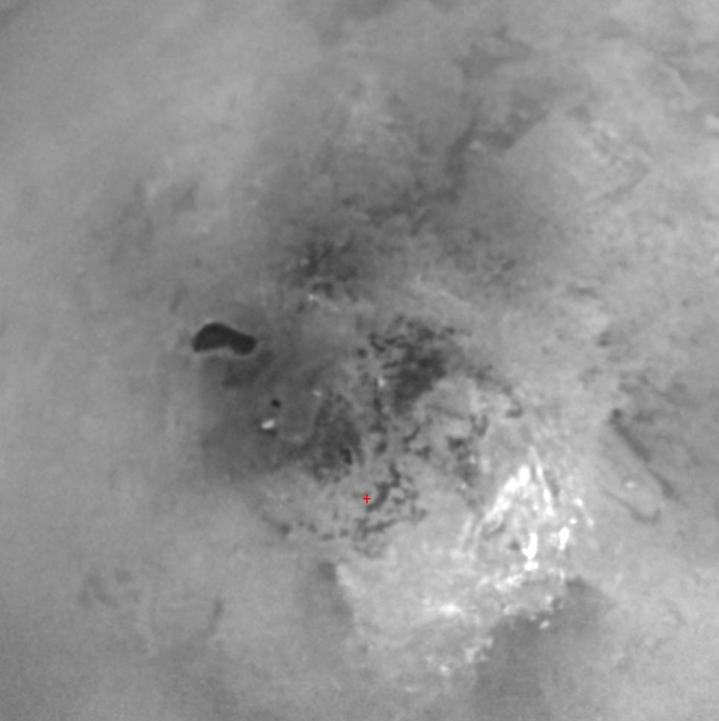

Slide 48
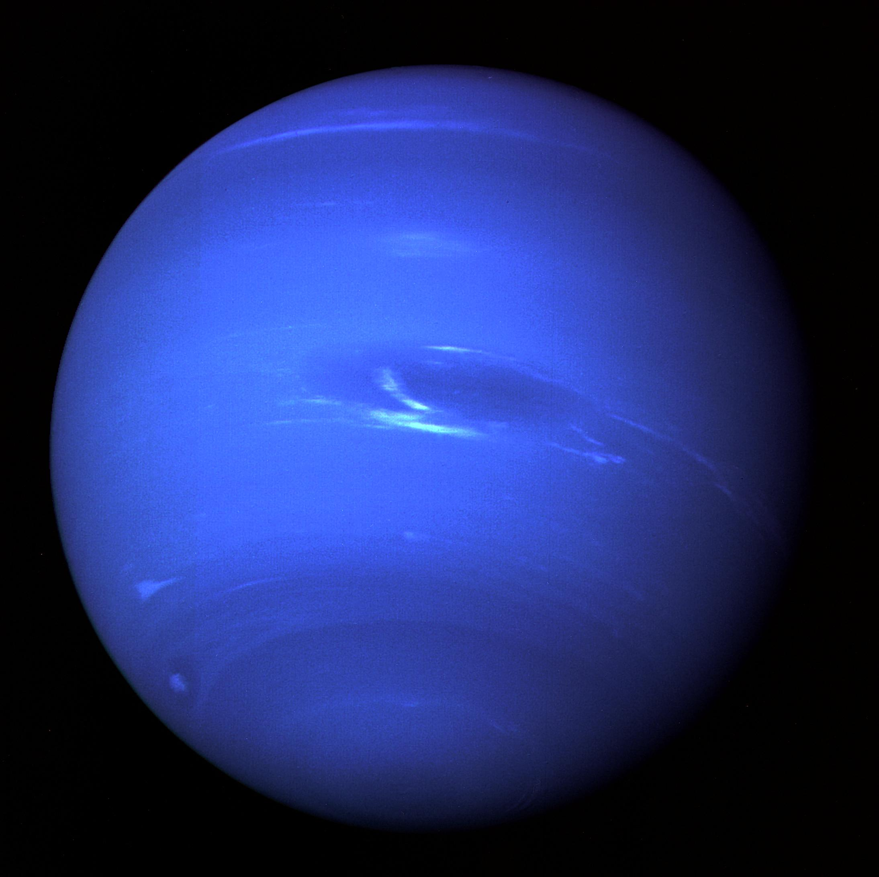

Slide 49
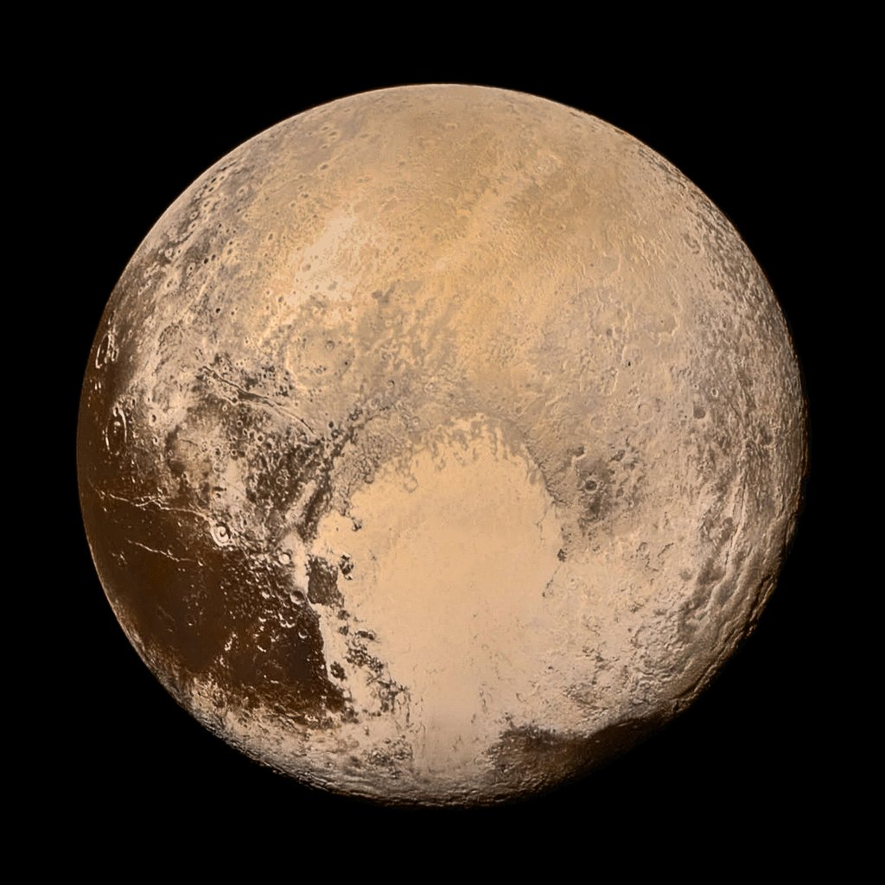

Slide 50
Drake equation
# of civilizations in our galaxy =
number of stars x
fraction of stars with planets x
number of Earth-like planets per star x
fraction on which life arises x
fraction that develop intelligent life x
fraction that develop civilization

Slide 51
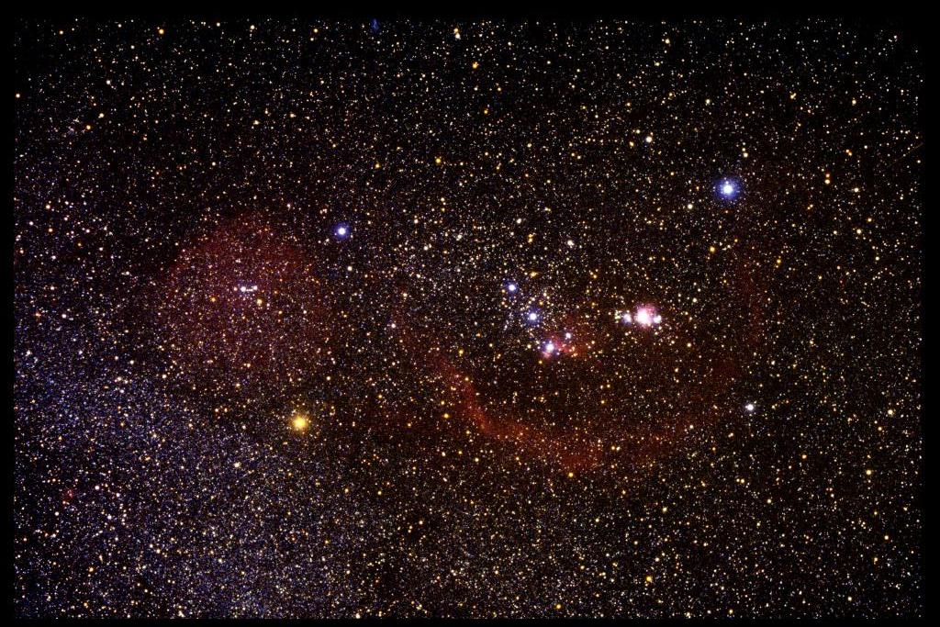

Slide 53
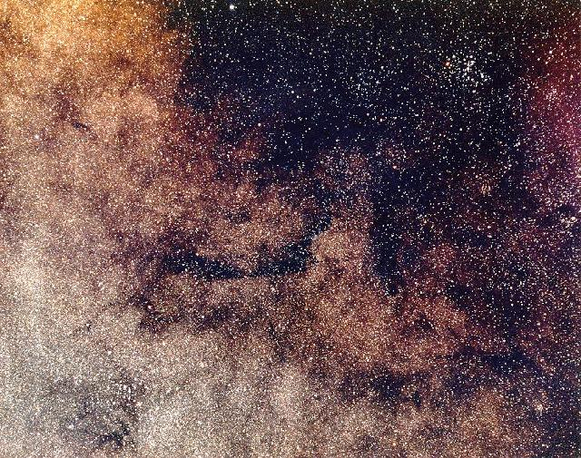

Slide 54
sharper view from telescopes in space

Slide 55
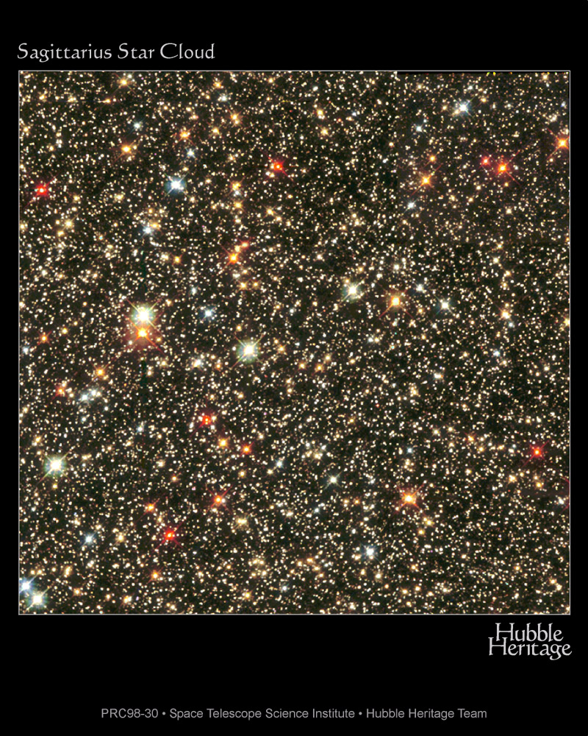

Slide 56
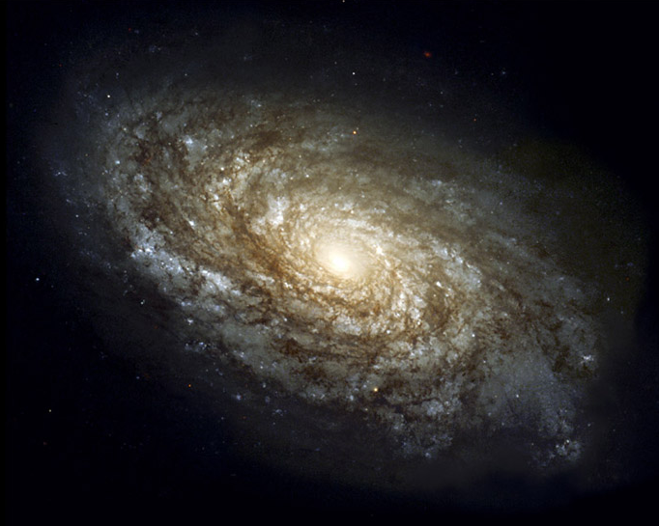
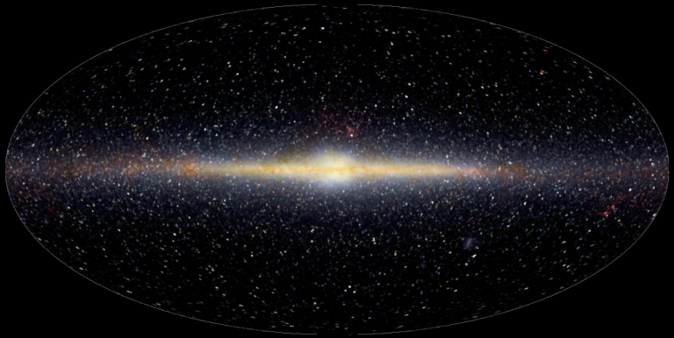
100,000 light years, 100,000 million stars
Sun

Slide 57
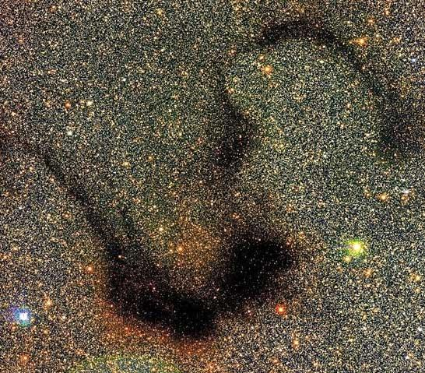

Slide 58
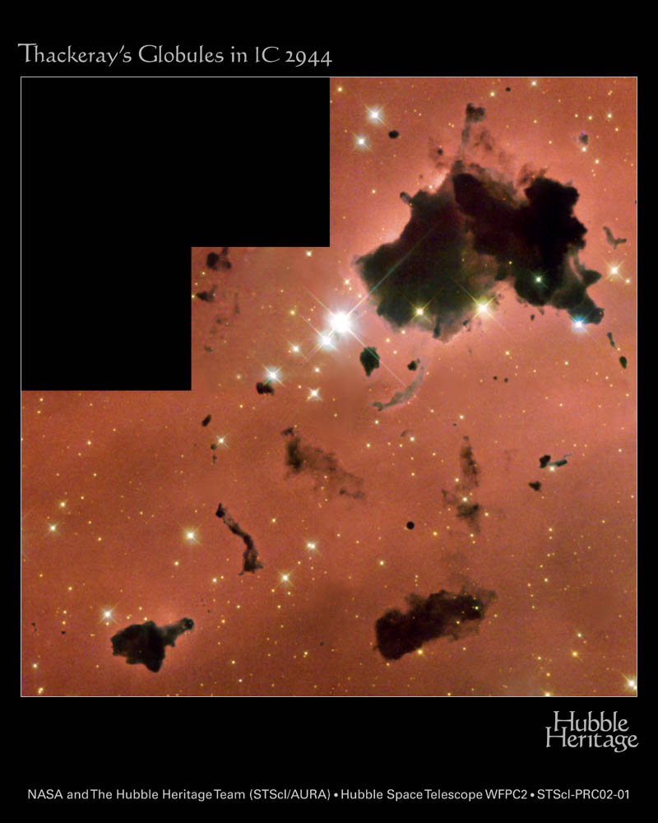

Slide 59
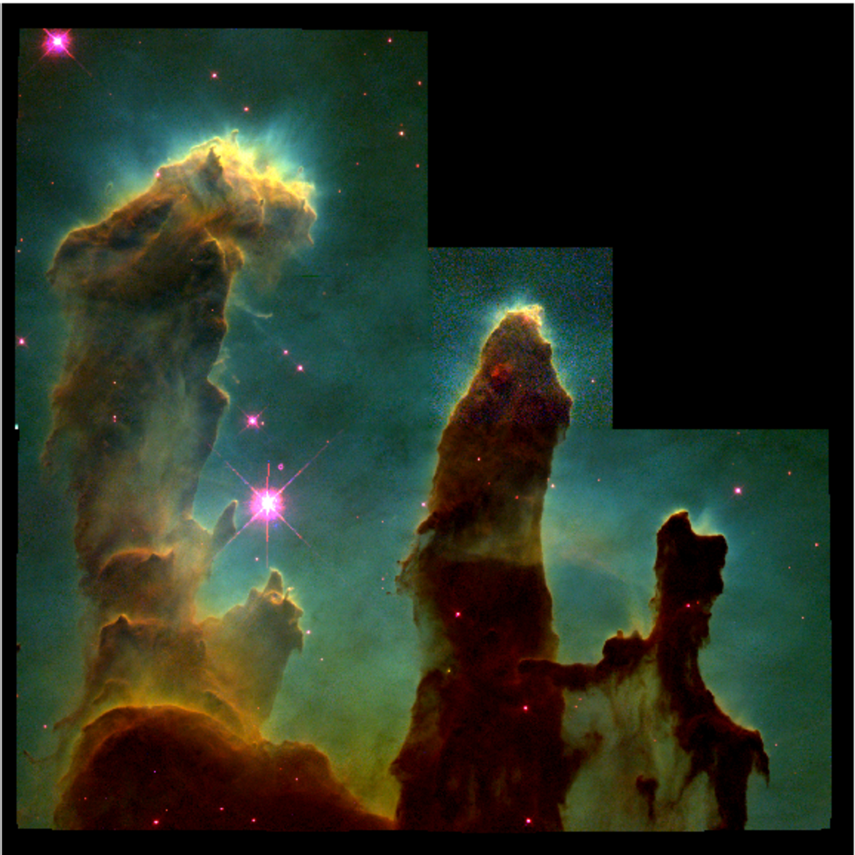

Slide 60
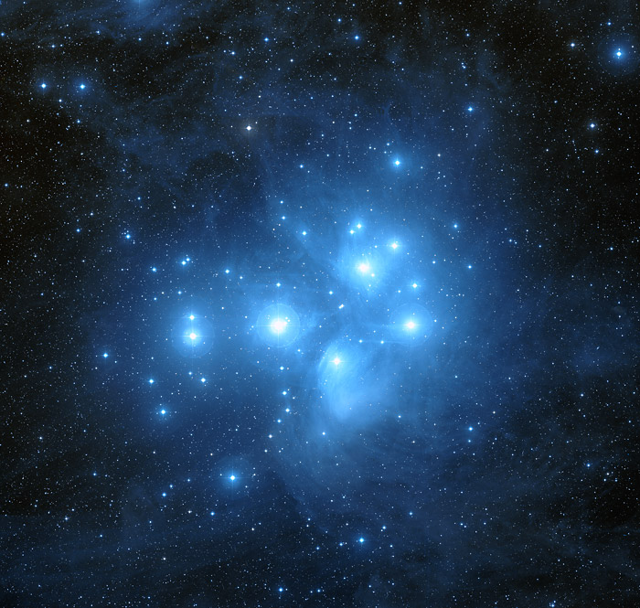

Slide 61
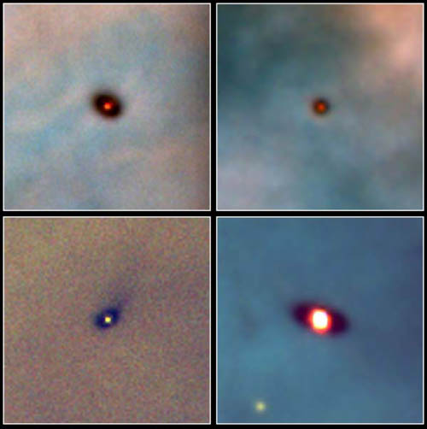

Slide 62
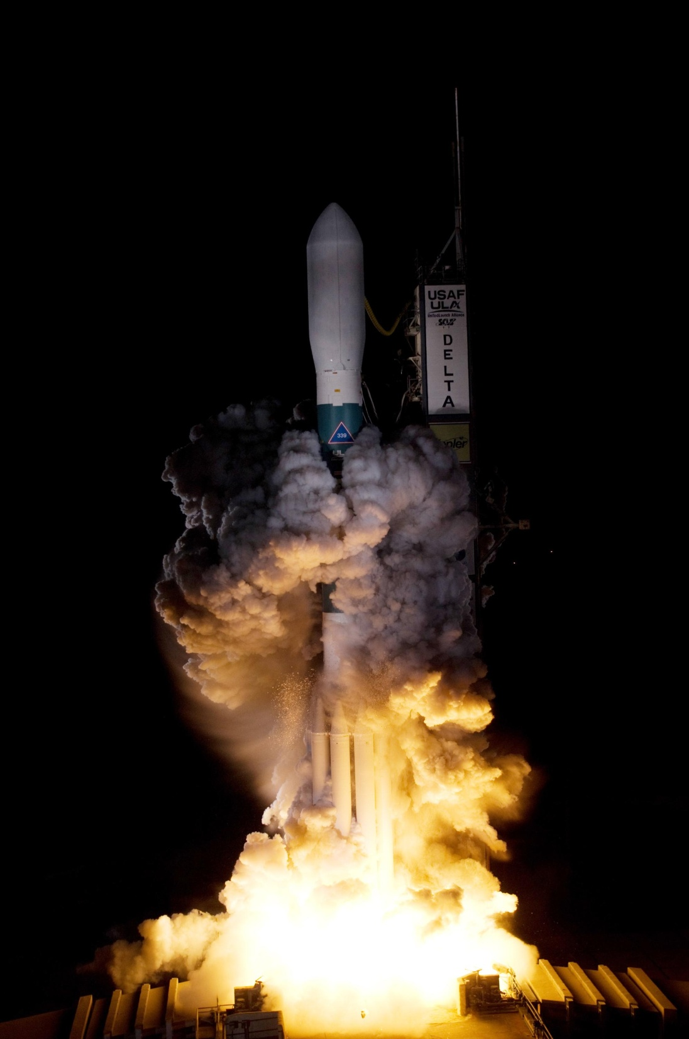
NASA Kepler mission to detect Earth sized planets March 7 2009

Slide 64
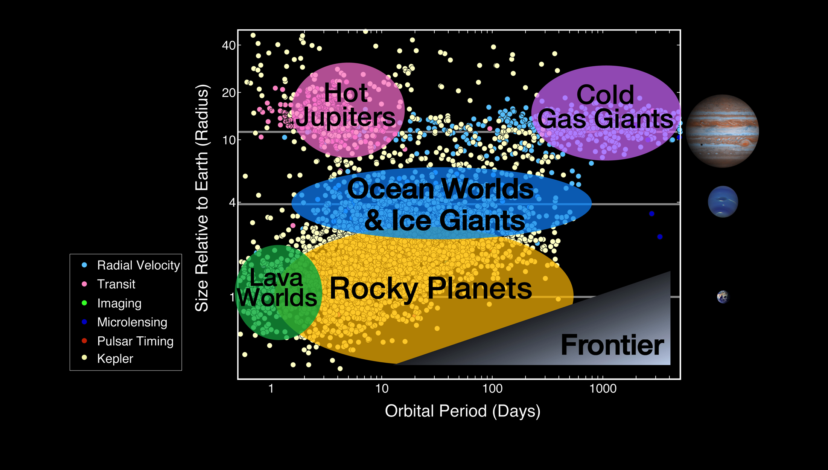
Lots (2000++) of extrasolar planets!

Slide 65
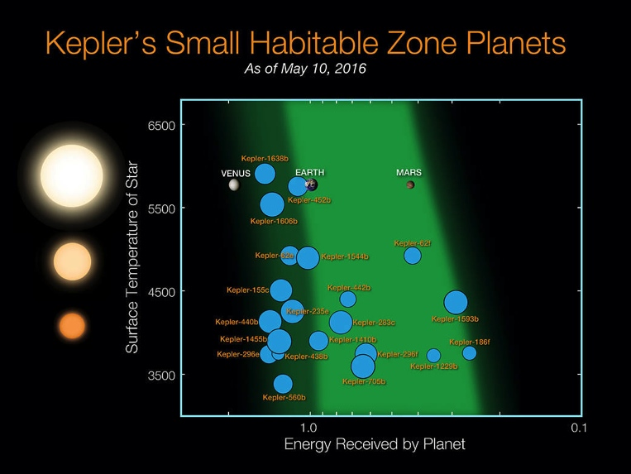

Slide 66
Drake equation
# of civilizations in our galaxy =
number of stars x
fraction of stars with planets x
number of Earth-like planets per star x
fraction on which life arises x
fraction that develop intelligent life x
fraction that develop civilization

Slide 67
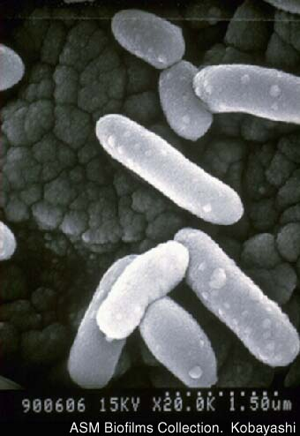

Slide 68
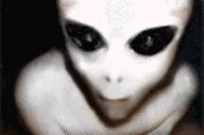

Slide 69
Your turn !!
Everyone think of a question you’d like to ask
Planets and life
Beginning and end of the Universe
Science and faith
Women in science
how to get my job (WORK!! And keep on working)

