Slide 1
Order and Chaos
Prof Chris Done
Department of Physics

Slide 2
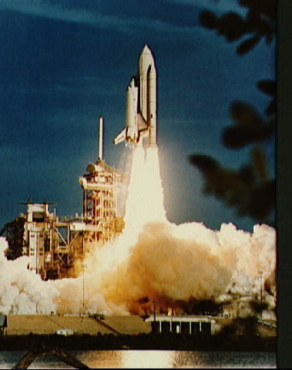
A real (rocket!) scientist
BSc Astronomy Astrophysics and Theoretical physics (St Andrews)
PhD Astrophysics Cambridge
Observe the universe (black holes) using instruments in space
NASA, ESA, JAXA..

Slide 3
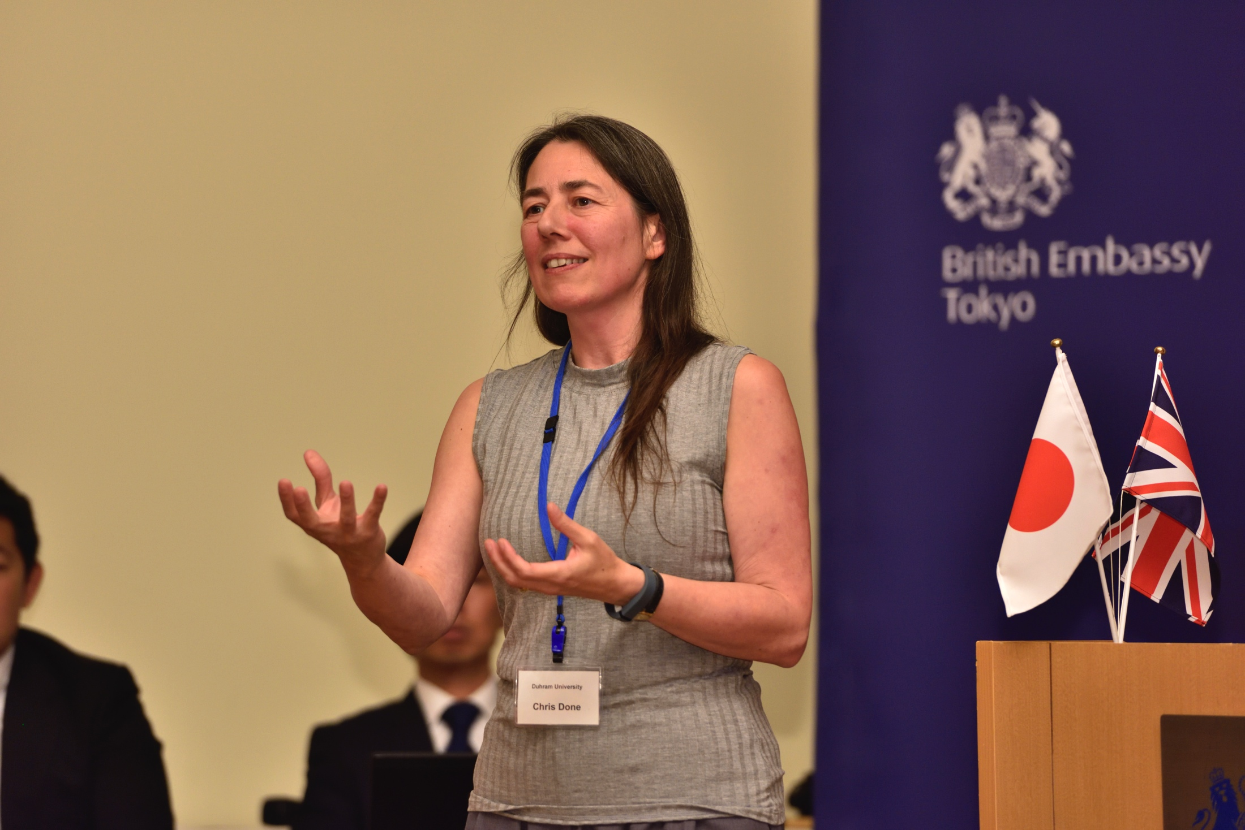
A real (rocket!) scientist
BSc Astronomy Astrophysics and Theoretical physics (St Andrews)
PhD Astrophysics Cambridge
NASA
Leicester , Durham, Tokyo

Slide 4
Asking questions in science

Slide 5
A real Christian: alpha course - place to ask questions about faith

Slide 6
Religion and science:
Conflict (chaos)
or
Concord (order)?
or does this oversimplify the range of options?

Slide 7
What is ‘religion’
Conflict between ‘science and religion’ usually refers to an assumed conflict between science and belief in God
For the purposes of this talk, ‘religion’ will refer to monotheistic religions like Islam, Judaism, and Christianity – especially these three as they share a lot of the same background ‘beginning’ narratives – but much of this is applicable to other faith traditions as well (Hindu,Buddist…)

Slide 8
Inevitable Conflict?
.
“There is a fundamental difference between religion, which is based on authority, [and] science, which is based on observation and reason. Science will win because it works.” – Stephen Hawking
“Religion is based on dogma and belief, whereas science is based on doubt and questioning.” – Jerry Coyne
How do we know truth: Epistemology
Scientism – science is the only way to know truth

Slide 9
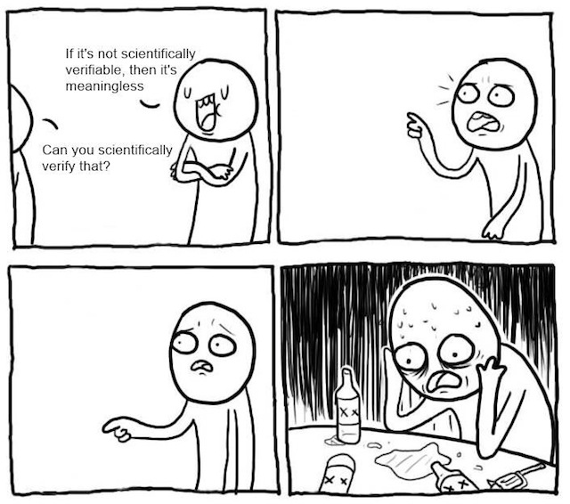

Slide 10
Inevitable Conflict?
.
Scientism – Science is the only way to know truth – this statement cannot be tested through science.
Its self refuting so its false.
Science is the only reliable way to know truth ?
Do you know that truth reliably?
Fundamentalist religion – faith is the only way to know truth…

Slide 11
What is truth?
There is a unique objective reality – assumption!
Questions of existence ARE NOT relative.
This chair EITHER exists…

Slide 12
What is truth?
There is a unique objective reality – assumption!
Questions of existence ARE NOT relative.
This chair EITHER exists…
…or does not!

Slide 13
What is truth?
There is a unique objective reality – assumption!
Questions of existence ARE NOT relative.
This chair EITHER exists…
…or does not!
There either is a God (theism) or there isn’t (atheism). These CANNOT both be true.
NOT ‘God is true for you but not for me’

Slide 14
What is truth?
Questions of interpretation ARE relative
Why is the kettle boiling?
Electricity, heats the water until it undergoes phase transition to steam
I want a cup of tea
These are BOTH true, different perspectives on the same reality. Tell us very different things.

Slide 15
Book of Gods word and works
Nature (works)
Bible (words)
interpreted by
Science
How
Why (natural)
Theology
Why
For whom
Answers questions

Slide 16
Book of Gods word and works
Nature (works)
Bible (words)
interpreted by
Science
How
Why (natural)
Theology
Why
For whom
Answers questions

Slide 17
Book of Gods word and works
Nature (works)
Bible (words)
interpreted by
Science
How
Why (natural)
Theology
Why
For whom
Answers questions

Slide 18
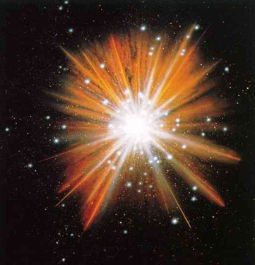
The beginning (Universe)
according to
science

Slide 19
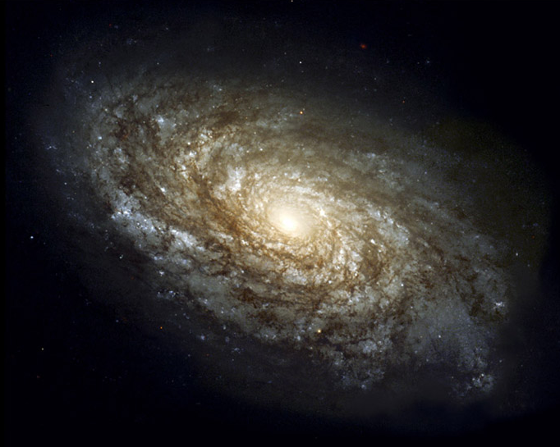
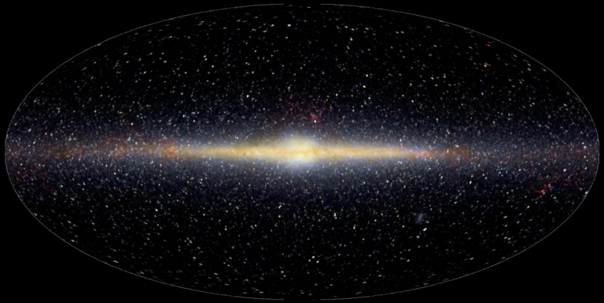
100,000 light years, 100,000 million stars
Sun

Slide 20
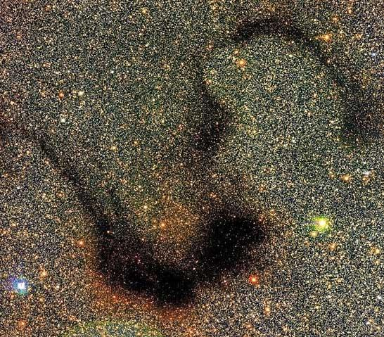
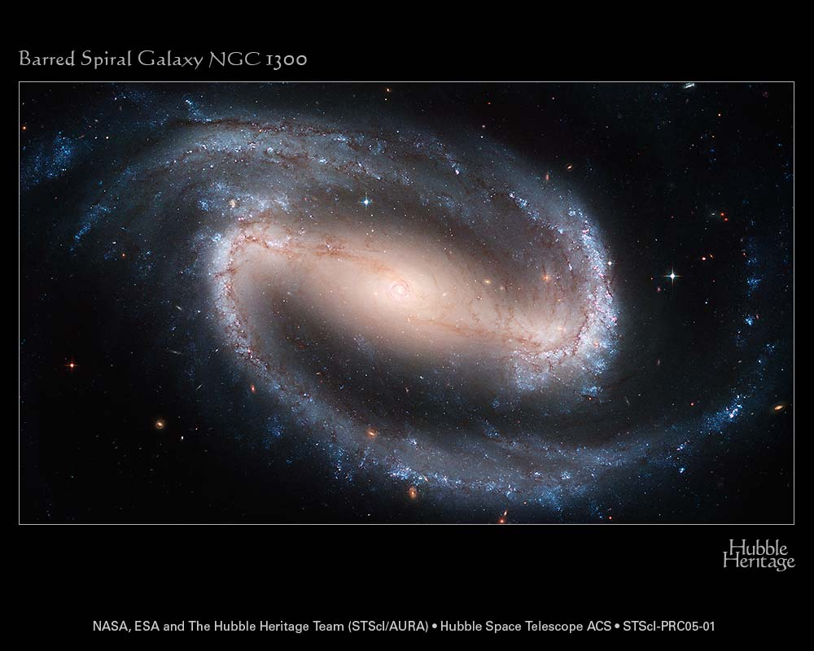

Slide 21
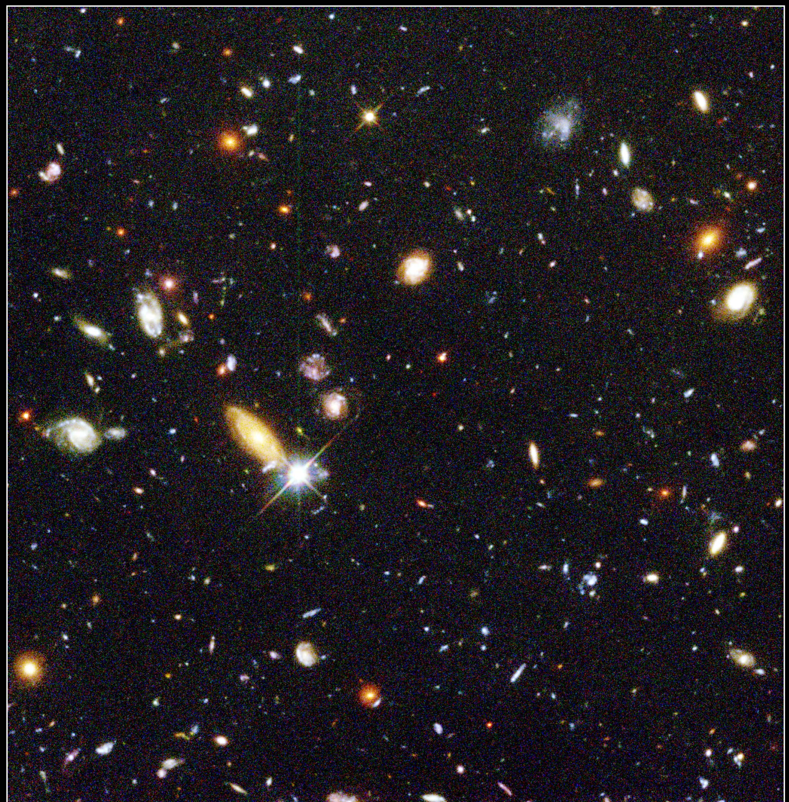

Slide 22
An expanding Universe
Can’t be static, unchanging, eternal universe if gravity!
Galaxies have gravity so attract each other
So should be all moving towards each other
But actually they are overwhelmingly moving away!

Slide 23
An expanding Universe
Can’t be static, unchanging, eternal universe if gravity!
Galaxies have gravity so attract each other
So should be all moving towards each other
But actually they are overwhelmingly moving away!

Slide 24
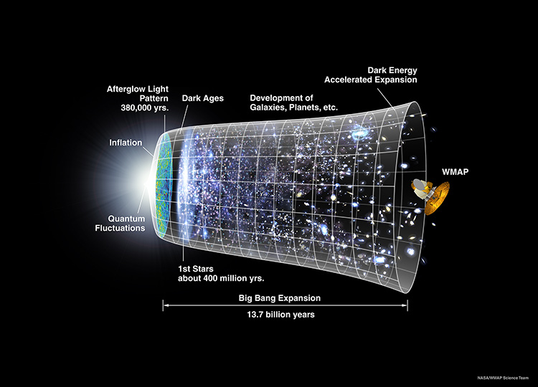
Physical universe
Galaxies closer in past
Very dense, hot, smooth early universe
Very different from what we see now vast voids, cold, clumpy

Slide 25
Physical universe
Galaxies closer in past
Very dense, hot, smooth early universe
Very different from what we see now vast voids, cold, clumpy

Slide 26
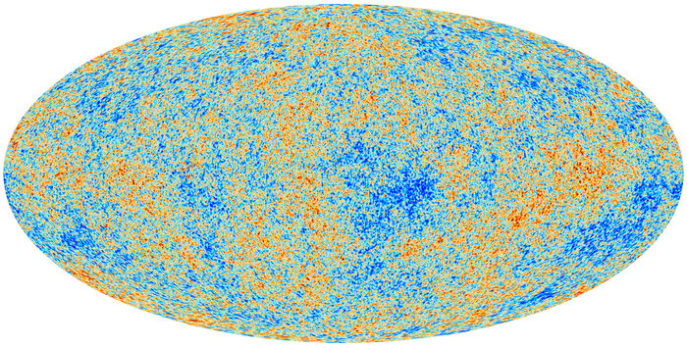
Cosmic microwave background

Slide 28
Physical universe
Eternity of future expansion
Accelerating!

Slide 29
Eternity of future time
Sun will run out of fuel in 5 billion years
Expand and destroy the Earth
Develop space drives, move to another planet
But that sun will also run out of fuel…
Galaxies making more stars, but their gas and dust is also running out.
All stars die, even black holes eventually evaporate. No energy so no life possible.
Our genes are not immortal.

Slide 30
The beginning according to Christianity/Judaism
In the beginning, God created the heavens and the earth. Now the earth was formless and empty, darkness was over the surface of the deep (chaos), and the Spirit of God was hovering over the waters. And God said “let there be light” and there was light … (ordering and filling)

Slide 31
The beginning according to Christianity/Judaism
Refrain – morning, evening the first day
As a teenager I thought that this meant a 24 hour day!!
Bishop Usher (and others, including Bede) used geneologies in Genesis and elsewhere in the Bible to date creation to ~4000 BC ie 6000 years ago

Slide 32
Me as a teenager! Scientist=atheist?
Scientific answers beginning of universe and life clearly different to 4000BC!
Evolution happened (4Byr) hence no God
The Big Bang happened (13.7Bys) hence no God

Slide 33
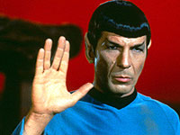
Untrue ?
The main reason I wasn’t a Christian
I thought it was simply not true.

Slide 34
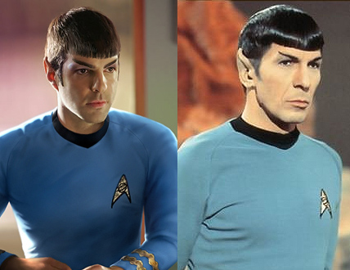
Untrue ?
The main reason I wasn’t a Christian
I thought it was simply not true.

Slide 35
What is the bible?
One book (collection) to speak to all people & times
Poetry, allegory, history, eyewitness accounts
All ages
Children/adults/seniors
All centuries
different technologies
All nationalities/cultures
All IQs

Slide 36
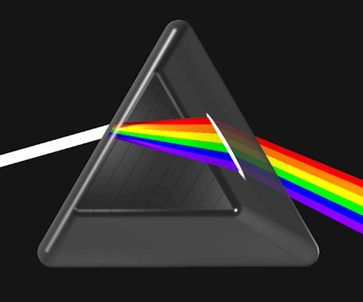
Bible has to address all these and more so it uses lots of different ways….
Poetry
Allegory
History
Eyewitness
GOD

Slide 37
But how to know?
Bible contains poetry, allegory, wisdom ‘how to live’ and ‘who to live for’ as well as history and eyewitness accounts
How to know whats meant to be taken literally and what is a poetic description?
We have to THINK ABOUT IT!! Do some work! Scholarship through the ages and modern day!

Slide 38
So what kind of book is Genesis?
Augustine ~400AD Great teacher in the early church “On the literal interpretation of Genesis”
What kind of days these were is extremely difficult or perhaps impossible for us to conceive…In matters that are so obscure and far beyond our vision …we should not rush in headlong and so firmly take our stand on one side that if further progress in the search for truth justly undermines this position we too fall with it

Slide 39
Science answers not in conflict with biblical account if Genesis is not a science textbook
Evolution happened (4Byr)
The Big Bang happened (13.7Byr)
Doesn’t tell us whether or not the Bible is ‘true’

Slide 40
Concord - Science revealing God?
What (if anything!) does science reveal about the existence and nature of any God
Any God who could create the entire universe (space, time, matter, energy) is FAR beyond us
Creator is different to their creation – so God is outside space, time, matter, energy…

Slide 41
Inevitable Conflict?
.
Naturalism – ‘Nature is all that exists’
What experiment can I perform to demonstrate that there are no non-natural entities?
Science tools study the natural world – not very useful at studying non-natural entities

Slide 42
Inevitable Conflict?
.
“Any account of nature should pass the tests of scientific evidence… any new discoveries will but enlarge our knowledge of the natural."— Humanist Manifesto II
“One of the greatest gifts science has brought to the world is continuing elimination of the supernatural.” - James Watson, Nobel laureate for DNA

Slide 43
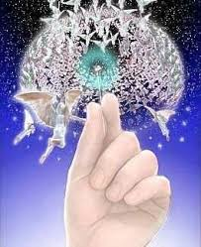
Inevitable Conflict?
.
How many angles can dance on the head of a pin?
Get a microscope and look….?
presupposes that they are in time and space and made of/can affect matter and energy

Slide 44
Inevitable Conflict?
.
Methodological naturalism (I can’t use God or a miracle as an answer to a scientific question) does not imply metaphysical naturalism (that such things cannot exist)

Slide 45
If science can’t tell us, how can we know what God is like ?
God can!
Needs God to reveal himself to us
All faiths have at their core the idea of a revelation of God – prophets, teachers..
Christianity is unique is saying God himself came to us in Jesus – a human who shared our humanity but whose essential identity was God.
Jesus shows us what God is like ‘if you have seen me you have seen God’ John 14:9

Slide 46
How I became a Christian
Friend of mine invited me to her church – I expected ritual formality, but saw something very different. Made me ask some questions….
…They asked questions back! ‘Who do you think Jesus was?’

Slide 47
Jesus – a good teacher?
Taught – love your neighbour as yourself, love your enemy, forgive those who wrong you
Lived – reached out to outcasts of society: tax collectors, prostitutes, lepers
But let people worship him as God!!
Mad (he thought he was God, but he wasn’t!)
Bad (he knew he wasn’t God, but let people worship him anyway!!)
God (he knew he was God, so worship is the right response!)

Slide 48
Evidence for Jesus as God ?
The stories in the bible about Jesus originated from his followers (disciples - eyewitnesses)
They said that his life was more about his death than his teaching! God so loved the world that he gave his only Son….
…. And that he then was raised to life by God, and they met with him!!
Clearly this was testable 2000 years ago. But how can we assess this claim now? Evidence?

Slide 49
Things to explain
Physical: The body was not in the tomb. The Romans who killed him would have produced it at the first sign of rumour that Jesus had risen from death!
Psychological: The disciples transformation from running away to fearlessly telling everyone that Jesus is alive (physical evidence – church, roman history…)
Lets look at the possibilities like a scientist!

Slide 50
Evidence for Jesus being alive
Observation
Explanation?
Consequence
Body
Not In
Tomb
Disciples stole it
They would know that Jesus was really dead
Not very likely - people might die for what they truly believe in, but not generally for something they knew to be a lie

Slide 51
Evidence for Jesus being alive
Observation
Explanation?
Consequence
Body
Not In
Tomb
Someone else stole it
Why do the disciples say he’s alive??

Slide 52
Evidence for Jesus being alive
Observation
Explanation?
Consequence
Someone else stole it
AND
The disciples have a mass hallucination and imagine they see Jesus alive
Two very unusual and unconnected things have to happen.
Body
Not In
Tomb

Slide 53
Evidence for Jesus being alive
Observation
Explanation?
Consequence
Jesus is raised to life
Disciples convinced that Jesus is God, lord of life and death.
So they are fearless, and tell everyone!
Body
Not In
Tomb
In science the most likely solution is the one which best explains multiple observations

Slide 54
How I became a Christian
Evidence – not proof!
Science is about evidence not proof
Very little in science is derived from axioms (formal logic). Even Maths !
Eg General Relativity (I do black holes)
Curvature = Gravity – Einstein’s equations are the simplest way to write this mathematically but the idea is creative

Slide 55
How I became a Christian
Evidence – not proof!
Science is about evidence not proof
Very little in science is derived from axioms (formal logic). Even Maths !
Eg General Relativity (I do black holes)
Curvature = Gravity – Einstein’s equations are the simplest way to write this mathematically but the idea is creative

Slide 57
Conclusions
Ask questions !!
Of the world around us (science)
Of our faith (religion)
Weigh answers and evidence
Meaning & Purpose
I believe that if there is a God, our choices, our destiny, matters on a much larger canvas than this physical Universe, however infinite it may be in either time or space

