Slide 1
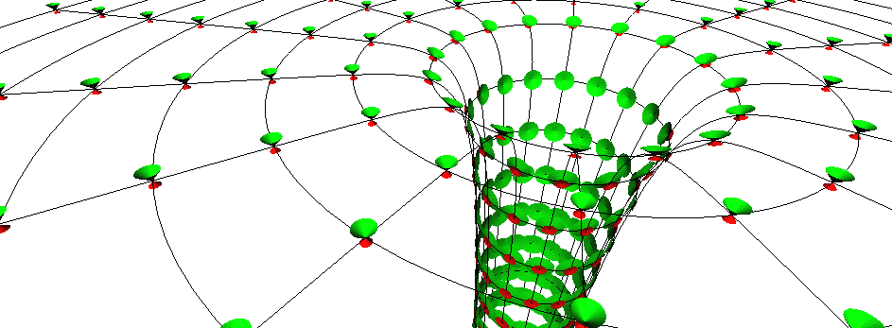
Black holes in Einstein General Relativity
Prof Chris Done, University of Durham

Slide 2
Lecture 1
General relativity
Black holes and neutron stars binaries
Accretion flows in strong gravity (and no B field) – discs and other spectral states

Slide 3
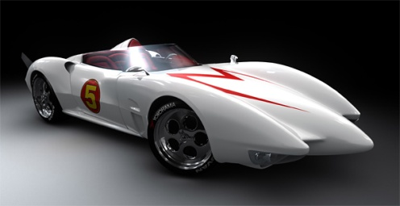
Einstein’s gravity: Special relativity
Travelling at fixed speed c through spacetime….
Generally all through time
If put some of the motion through space then takes longer to move through time (time dilation)
speed = distance/time so length contraction

Slide 4
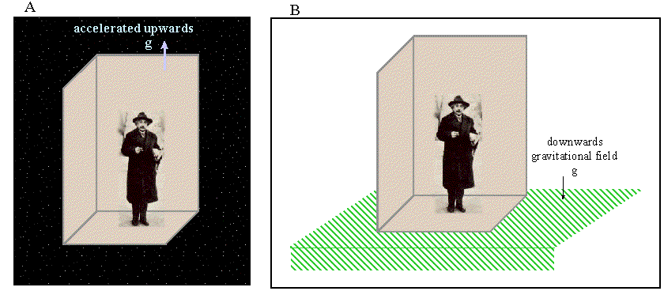
Einstein’s gravity: general relativity
SR doesn’t do acceleration, gravity makes acceleration
Is there a difference? Look the same, behave the same…
Maybe they ARE the same - ‘happiest thought’
Principle of equivalence: acceleration=gravity

Slide 5
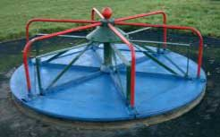
Acceleration: Special relativity
Circular motion easiest to think about
Measure roundabout circumference (cL) and radius (rL) by crawling around with ruler of length L
Get ratio c/r=2π
Now rotate ….

Slide 6
Acceleration: special relativity
Length contracts along direction of motion so need more ruler lengths to go round c’ > c!! But radius unaffected as its not in direction of motion
Ratio c’/r > 2π
Can’t happen!! …in flat space

Slide 7
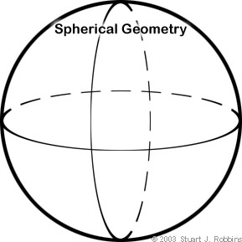
Positive curvature
E.g. surface of a sphere.
Equator =2πr
Diameter 2r= πr
c’/r =4 < 2π
Wrong way!! We want something >2π

Slide 8
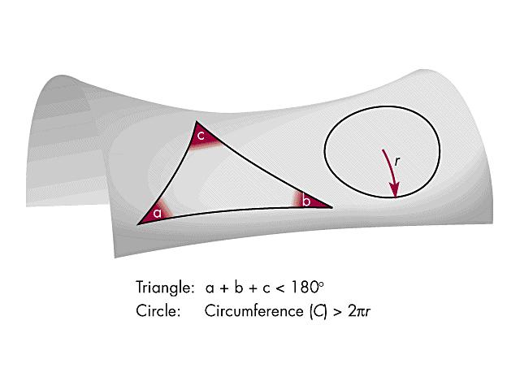
Curved spaces
Negative curvature
Space curves torwards in one direction and away in the other - c’/r >2π

Slide 9
Acceleration = Curvature (SR)
Gravity = Acceleration (EP)
hence
Gravity = Curvature

Slide 10
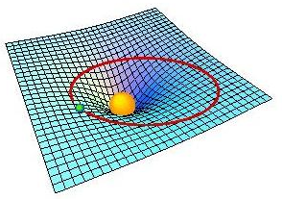
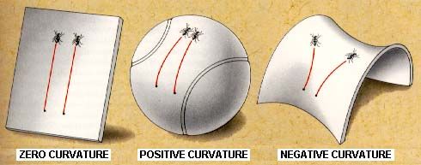
Gravity: warped spacetime
Gravity IS curvature
Natural paths (no forces acting ie inertial frames) are ‘straight lines’ on curved space - geodesics

Slide 11
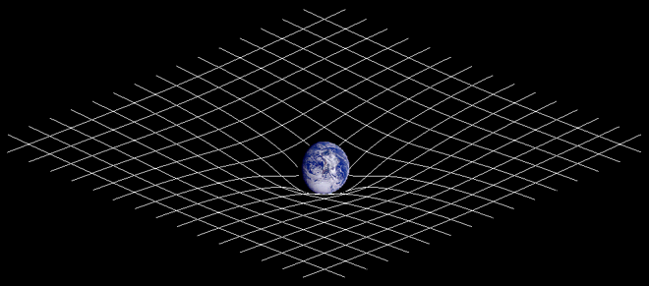
Gravity: Einstein
NOT action at a distance force (Newtonian)
Space(time) warped by mass(energy)
http://en.wikipedia.org/wiki/General_relativity

Slide 12
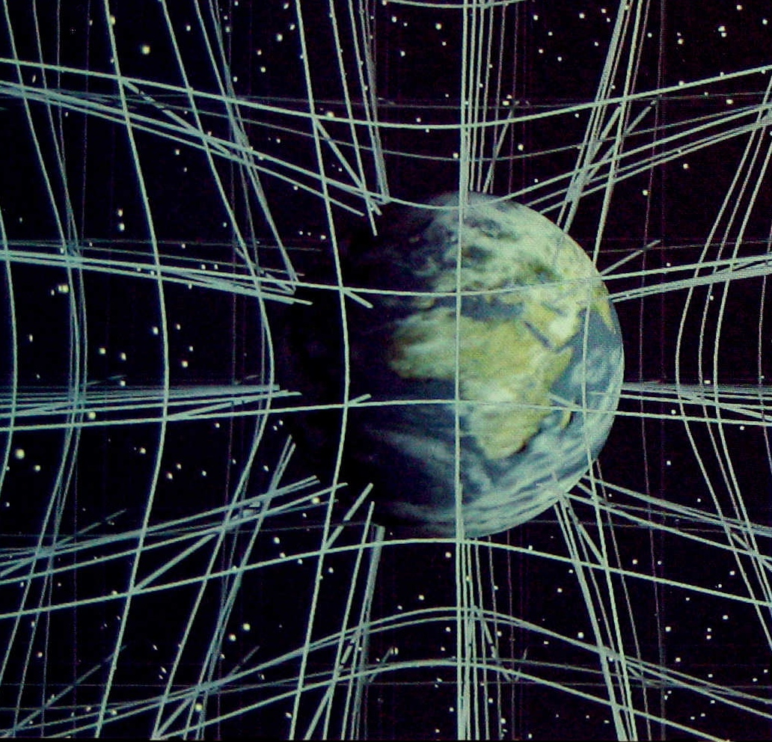
Gravity: Einstein
Should think of it in 3D but difficult to draw!
Christopher Vitale of Networkologies and the Pratt Institute.

Slide 13
Toolkit for GR
How to describe curvature ?
How does mass(energy) curve space(time) ?

Slide 14
Toolkit for GR
How to describe curvature ?
How does mass(energy) curve space(time) ?
How to describe these ‘straight line’ natural paths?
True position
Apparent position

Slide 15
Toolkit for GR
How to describe curvature ?
How does mass(energy) curve space(time) ?
How to describe these ‘straight line’ natural paths?
Tensors
True position
Apparent position

Slide 16
Curved spacetime: general relativity
ds²=(1-2GM/c²r) c²dt² - (1-2GM/c²r)⁻¹ dr² - r²dθ² - r²sin²dφ²
Schwarszchild metric – R_{s}=2GM/c² get stationary paths with ds²=(1-2GM/c²r) c²dt² <0 so don’t exist!
EVENT HORIZON

Slide 17
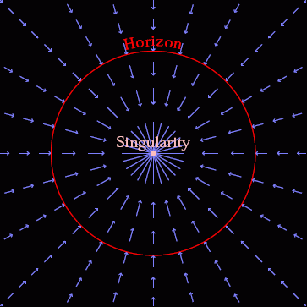
Gravity: warped spacetime
Spacetime itself in falling in at the speed of light
Nothing travels faster than light so everything swept down below event horizon
© Andrew Hamilton

Slide 18
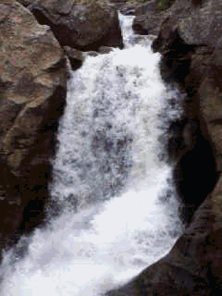
Gravity: warped spacetime
Spacetime itself in falling in at the speed of light

Slide 19
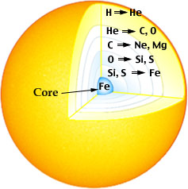
Black hole recipe:
But get less and less energy!
Iron is crossover between fusion and fission! No more energy!
Iron core builds up as iron ‘ash’ sinks down from layers above. pulled in by gravity but no other energy!

Slide 20
Black hole recipe:
Fe core pulled in by gravity. How far can material be compressed?
Electron degeneracy pressure – wave-particle duality in quantum mechanics. Smaller box, smaller wavelength, higher energy, faster!
Can’t go faster than c!

Slide 21
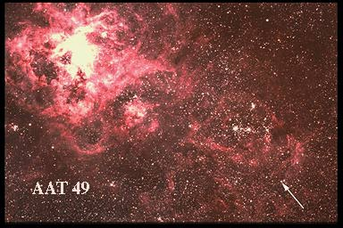
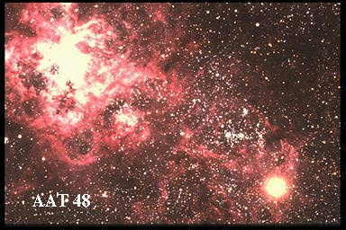
End of life of massive stars
Hit this when Fe core is 1.4x mass of Sun
e⁻ + p⁺ > n + ν_{e}
Neutrons have higher mass, shorter wavelength so fit in MUCH smaller box! Floor drops away.
Implosion, followed by dramatic supernovae explosion!

Slide 22
The core!
But core being hit by infalling layers from above
Neutrons get squashed into smaller and smaller box, going faster and faster
Hit c at 1.4-3x mass of sun (depends on rotation rate)
no known state of matter can hold up complete collapse
Event horizon only factor of 3 smaller than a neutron star

Slide 23
Observing black holes?
How to test this ?
The thing about a black hole, its main distinguishing feature is its black! And the thing about space, your basic space colour is its black! So how are you supposed to see them ? Red Dwarf

Slide 24
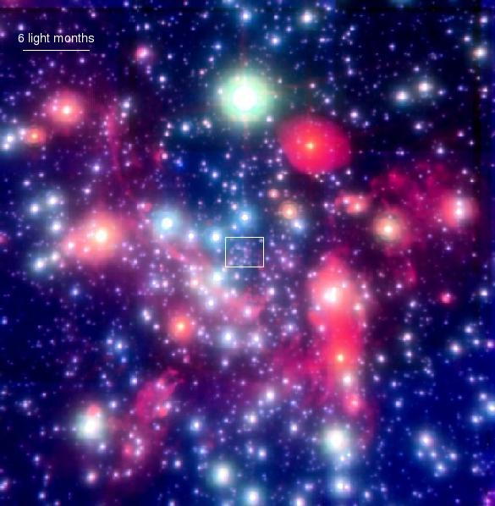
By gravity – all they possess!
Gravitational effect on nearby stars
Stars in GC get to within a lightday, but this is 2000x event horizon. Not probing the REALLY curved BH spacetime.
Hard to detect

Slide 25
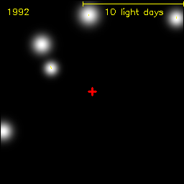
By gravity – all they possess!
Gravitational effect on nearby stars
Stars in GC get to within a lightday, but this is 2000x event horizon. Not probing the REALLY curved BH spacetime.
Hard to detect

Slide 26
Observing black holes?
How to test this ?
The thing about a black hole, its main distinguishing feature is its black! And the thing about space, your basic space colour is its black! So how are you supposed to see them ? Red Dwarf

Slide 27
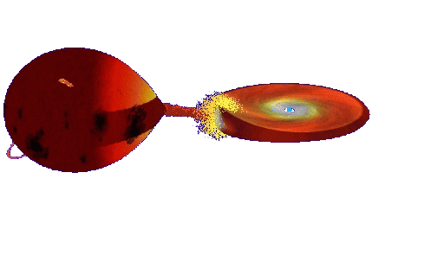
Accretion
Continuous ring of gas – friction dissipates energy
Makes material hot
BRIGHT accretion discs glowing X-ray hot
© Andrew Beardmore

Slide 28
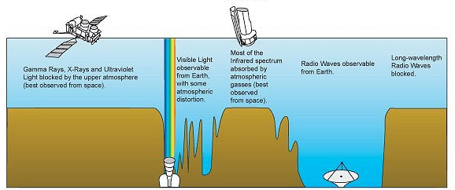
X-rays blocked by atmosphere
NASA image
X-rays
Visible
Radio
Wavelength

Slide 29
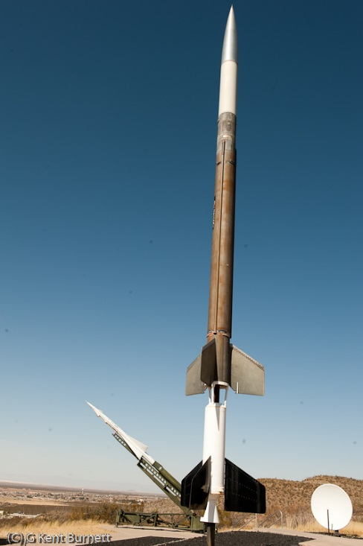
Rocket Science!
Nobel Prize to Giaconni in 2002 for discovery of cosmic X-ray sources in the 1960s
Black holes position highlighted by the high energy X-ray radiation released by material falling towards the event horizon
NASA image

Slide 30
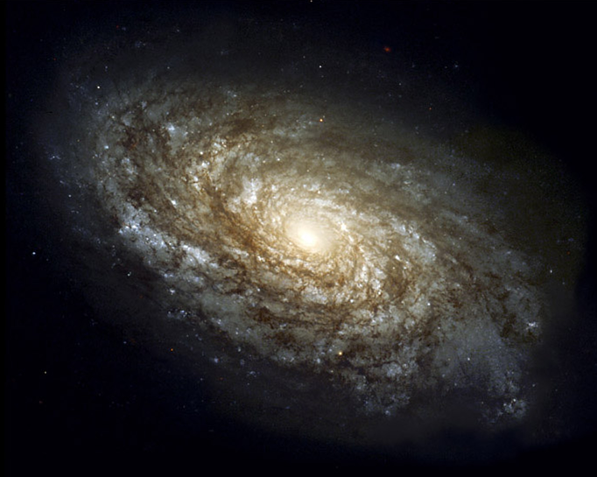
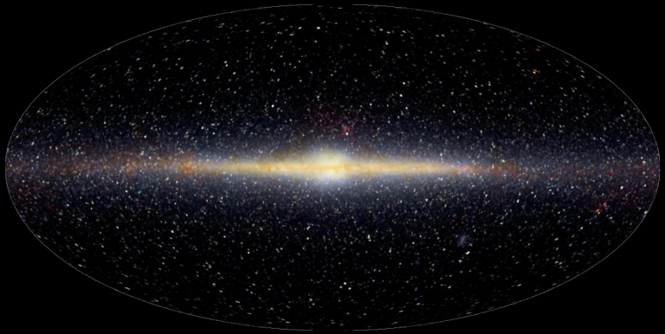
100,000 light years, 100,000 million stars
Sun

Slide 31
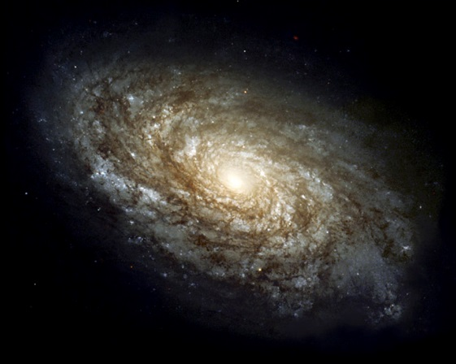
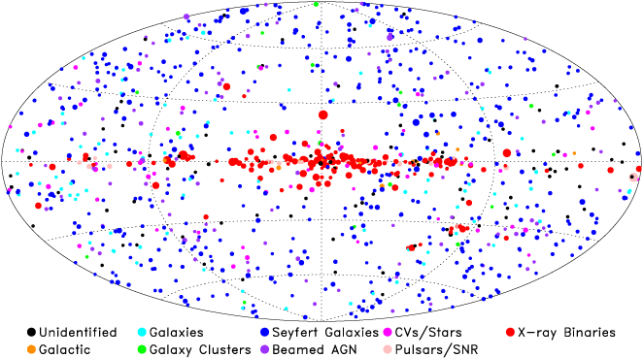
Supermassive BH
Million-Billion x Sun
Stellar mass BH
10x Sun
NASA image

Slide 32
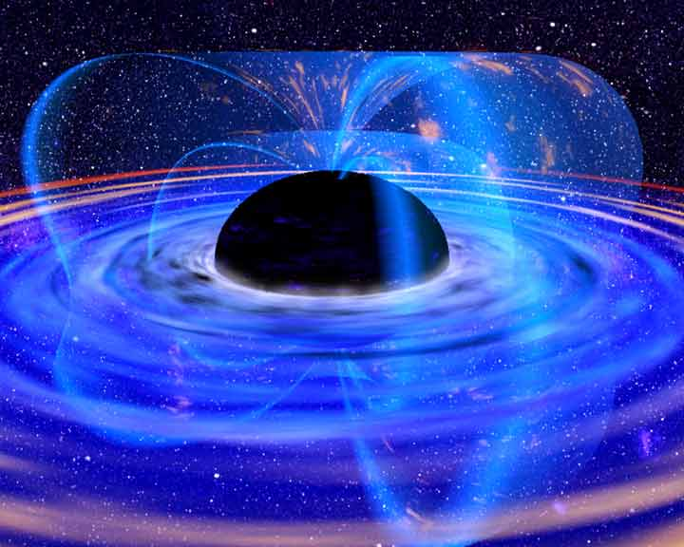
Accretion
Accreting BH: huge X-ray luminosity close to event horizon R_{s}
Emission from region of strong spacetime curvature
Observational constraints on strong gravity if we can understand accretion!

Slide 33
Accretion
Accreting BH: huge X-ray luminosity close to event horizon R_{s}
Emission from region of strong spacetime curvature
Observational constraints on strong gravity if we can understand accretion!
Neutron star size ~ Risco so accretion flow sees same gravity - then hits surface - test of event horizon (if no B field)

Slide 34
Spectra
Plot νf(ν) as this peaks at energy where power output of source peaks.
N(E)=AE ^{−Γ}
F(E)=EN(E)= AE^{−Γ+1}=AE^{-α}
α=Γ−1
Log Εf(Ε)
Soft spectrum
Most power at low E
α>1 Γ>2
Log Ε
dL= F(E) dE = EF(E) dE/E = EF(E) dlog E

Slide 35
Spectra
Plot νf(ν) as this peaks at energy where power output of source peaks.
N(E)=AE ^{−Γ}
F(E)=EN(E)= AE^{−Γ+1}=AE^{-α}
α=Γ−1
Log Εf(Ε)
hard spectrum
Most power at high E
α<1 Γ<2
Log Ε
dL= F(E) dE = EF(E) dE/E = EF(E) dlog E

Slide 36
Spectra
Plot νf(ν) as this peaks at energy where power output of source peaks.
N(E)=AE ^{−Γ}
F(E)=EN(E)= AE^{−Γ+1}=AE^{-α}
α=Γ−1
Log Εf(Ε)
flat spectrum
Equal power per decade
α=1 Γ=2
Log Ε
dL= F(E) dE = EF(E) dE/E = EF(E) dlog E

Slide 37
Accretion
Continuous ring of gas – friction dissipates energy
Makes material hot
BRIGHT accretion discs glowing X-ray hot
© Andrew Beardmore

Slide 38
Orbits in Newtonian gravity
Gravity attractive – wants to be closer in.
but if closer then rotate faster due to angular momentum conservation
Bigger outward centrifugal force!
Stable orbits everywhere
Energy
Angular momentum, barrier ∝1/r²
r
Newtonian gravity ∝ -1/r

Slide 39
Orbits in Newtonian gravity
Gravity attractive – wants to be closer in.
but if closer then rotate faster due to angular momentum conservation
Bigger outward centrifugal force!
Stable orbits always possible - potential minimum
Energy
Angular momentum, barrier ∝1/r²
r
Newtonian gravity ∝ -1/r

Slide 40
Orbits in Einstein’sgravity
Extra term, adds to gravity at small radii
Energy
Angular momentum, barrier ∝1/r²
r
Newtonian gravity ∝ -1/r
Einstein ∝ -1/r³

Slide 41
Orbits in Einstein’sgravity
Extra term, adds to gravity at small radii
But still got possibility of stable orbits….
Energy
Angular momentum, barrier ∝1/r²
r
Newtonian gravity ∝ -1/r
Einstein ∝ -1/r³

Slide 42
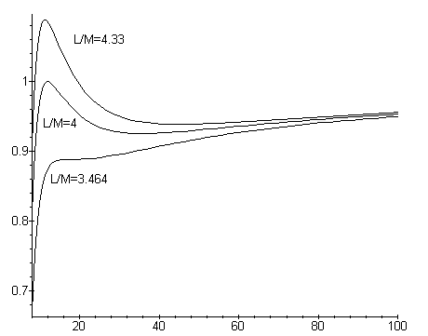
Orbits in general relativity
But not when too close
When within a factor ~3 of the event horizon then no more stable orbits
Last stable circular orbit – sets the inner edge of the disc!

Slide 43
Orbits in general relativity
But not when too close
When within a factor ~3 of the event horizon then no more stable orbits
Last stable circular orbit – sets the inner edge of the disc!

Slide 44
Orbits in general relativity
But not when too close
When within a factor ~3 of the event horizon then no more stable orbits
Last stable circular orbit – sets the inner edge of the disc!
6Rg - Orbital velocity only ~0.3c !! Light orbits 3Rg, horizon 2Rg

Slide 45
Spectra of accretion flow: disc
Differential Keplerian rotation
Viscosity B: gravity → heat
Thermal emission: L = AσT⁴
Temperature increases inwards until minimum radius R_{lso}(a*) For a*=0 and L~L_{Edd} T_{max} is
1 keV (10⁷ K) for 10 M
10 eV (10⁵ K) for 10⁸ M
Log ν f(ν)
Log ν
Notes:
Accretion discs are the most well known form of the accretion flow. Inner radii rotate faster so there is viscous friction (a magnetic dynamo) which converts gravitational energy to heat. If this thermalises then at large radii there is not much gravitational energy and a lot of area, so producing low temperature, while at small radii there is lots of energy and not much area, so high temperature. There is a minimum radius – the last stable orbit which is a GR prediction – so there is a maximum temperature. At LEdd this is of order 1keV, or 10 million degrees for GBH, or 10eV, a hundred thousand degrees for a supermassive BH.

Slide 46
Spectra of accretion flow: disc
Differential Keplerian rotation
Viscosity B: gravity → heat
Thermal emission: L = AσT⁴
Temperature increases inwards until minimum radius R_{lso}(a*) For a*=0 and L~L_{Edd} T_{max} is
1 keV (10⁷ K) for 10 M
10 eV (10⁵ K) for 10⁸ M
Log ν f(ν)
Log ν
Notes:
Accretion discs are the most well known form of the accretion flow. Inner radii rotate faster so there is viscous friction (a magnetic dynamo) which converts gravitational energy to heat. If this thermalises then at large radii there is not much gravitational energy and a lot of area, so producing low temperature, while at small radii there is lots of energy and not much area, so high temperature. There is a minimum radius – the last stable orbit which is a GR prediction – so there is a maximum temperature. At LEdd this is of order 1keV, or 10 million degrees for GBH, or 10eV, a hundred thousand degrees for a supermassive BH.

Slide 47
Spectra of accretion flow: disc
Differential Keplerian rotation
Viscosity B: gravity → heat
Thermal emission: L = AσT⁴
Temperature increases inwards until minimum radius R_{lso}(a*) For a*=0 and L~L_{Edd} T_{max} is
1 keV (10⁷ K) for 10 M
10 eV (10⁵ K) for 10⁸ M
Log ν f(ν)
Log ν
Notes:
Accretion discs are the most well known form of the accretion flow. Inner radii rotate faster so there is viscous friction (a magnetic dynamo) which converts gravitational energy to heat. If this thermalises then at large radii there is not much gravitational energy and a lot of area, so producing low temperature, while at small radii there is lots of energy and not much area, so high temperature. There is a minimum radius – the last stable orbit which is a GR prediction – so there is a maximum temperature. At LEdd this is of order 1keV, or 10 million degrees for GBH, or 10eV, a hundred thousand degrees for a supermassive BH.

Slide 48
Spectra of accretion flow: disc
Differential Keplerian rotation
Viscosity B: gravity → heat
Thermal emission: L = AσT⁴
Temperature increases inwards until minimum radius R_{lso}(a*) For a*=0 and L~L_{Edd} T_{max} is
1 keV (10⁷ K) for 10 M
10 eV (10⁵ K) for 10⁸ M
Maximum spin T_{max} is 3x higher at same total luminosity
Log ν f(ν)
Log ν
Notes:
Accretion discs are the most well known form of the accretion flow. Inner radii rotate faster so there is viscous friction (a magnetic dynamo) which converts gravitational energy to heat. If this thermalises then at large radii there is not much gravitational energy and a lot of area, so producing low temperature, while at small radii there is lots of energy and not much area, so high temperature. There is a minimum radius – the last stable orbit which is a GR prediction – so there is a maximum temperature. At LEdd this is of order 1keV, or 10 million degrees for GBH, or 10eV, a hundred thousand degrees for a supermassive BH.

Slide 49
Spectra of accretion flow: disc
Differential Keplerian rotation
Viscosity B: gravity → heat
Thermal emission: L = AσT⁴
Temperature increases inwards until minimum radius R_{lso}(a*) For a*=0 and L~L_{Edd} T_{max} is
1 keV (10⁷ K) for 10 M
10 eV (10⁵ K) for 10⁸ M
Maximum spin T_{max} is 3x higher at same total luminosity
Log ν f(ν)
Log ν
Notes:
Accretion discs are the most well known form of the accretion flow. Inner radii rotate faster so there is viscous friction (a magnetic dynamo) which converts gravitational energy to heat. If this thermalises then at large radii there is not much gravitational energy and a lot of area, so producing low temperature, while at small radii there is lots of energy and not much area, so high temperature. There is a minimum radius – the last stable orbit which is a GR prediction – so there is a maximum temperature. At LEdd this is of order 1keV, or 10 million degrees for GBH, or 10eV, a hundred thousand degrees for a supermassive BH.

Slide 50
Observed disc spectra in BHB!!
Fit disc models to get maximum temperature and flux in the disc
L=2πD² F /cos i = A T⁴
A=2πr_{in}² R_{g}² (R_{g}=GM/c²)
Get one measure of inner radius IF we know the system parameters!
GX-339-4
Kolehmainen et al 2010

Slide 51
BHB – Quasars for the impatient
BRIGHT! Huge amounts of data, long term variability (days –years) in mass accretion rate (due to H ionisation instability in disc)
Observational template of accretion flow as a function of L/L_{Edd} onto ~10 M BH (6-14 M)
2 years
DGK07

Slide 52
BHB – Quasars for the impatient
Observational template of accretion flow as a function of L/L_{Edd} onto ~10 M BH (very homogeneous!)
2 years
DGK07

Slide 53
Variability of disc:long timescale
L/L_{Edd} ∝AT⁴_{max} (Ebisawa et al 1993; Kubota et al 1999; 2001)
Constant size scale – last stable orbit!! BH spin

Slide 54
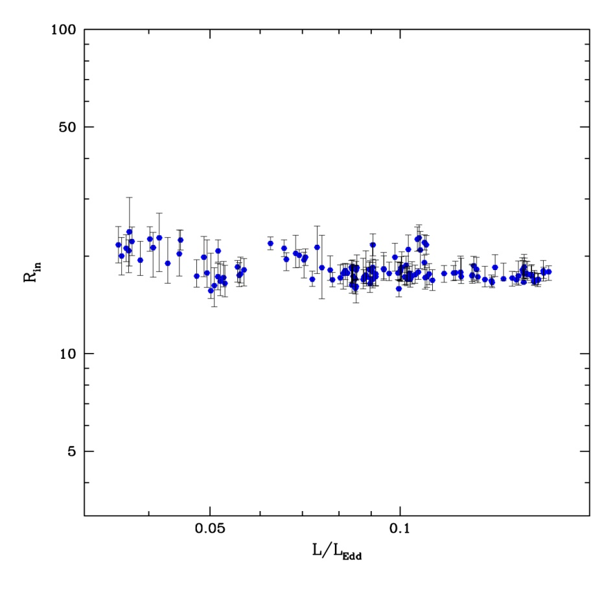
Disc spectra: last stable orbit
L/L_{Edd} ∝T⁴_{max} (Ebisawa et al 1993; Kubota et al 1999; 2001)
Constant size scale – last stable orbit!!
Proportionality constant gives a measure R_{lso} i.e. spin as L=σ R² T⁴
Not quite as simple as this
Proper relativistic emissivity (Novikov-Thorne)
corrections for spectrum not being blackbody (fcol)
Corrections for relativistic propagation effects
Gierlinski & Done 2003

Slide 55
Observed disc spectra
a=0-0.7
a=0-0.8
a<0.7
a~0.65
a<0.9
Davis, Done & Blaes 2006, Shaffee et al 2006, Kohlemainen & Done 2009, Kubota et al 2009

Slide 56
Eddington limit
Ionised H gas falling in
Generates flux of radiation outwards F=L/4πr²
Pressure=F/c=Force/area
Outwards radiation interacts with electrons! Cross-section area σ
Outwards force is F=Lσ/4cπr²
Inwards force is gravity.
Balance at Eddington limit
L_{Edd}σ/4cπr² = GM/r²
L_{Edd}= 4cπGM/σ = 1.3x10³⁸ M ergs/s

Slide 57
Conclusions
Einstein GR – predicts black hole event horizon and last stable orbit which depends on spin
Can only see the effect of these if have material close to black hole. ie accretion. Classic solution of the accretion flow equations is cool, geometrically thin, optically thick disc (Shakura & Sunyaev 1973)
At high mass accretion rates, spectra seen from BHB look like a simple disc and varies on long timescales like a simple disc WITH FIXED inner edge. Consistent with last stable orbit! Moderate spin
…..to be continued….

