Slide 1
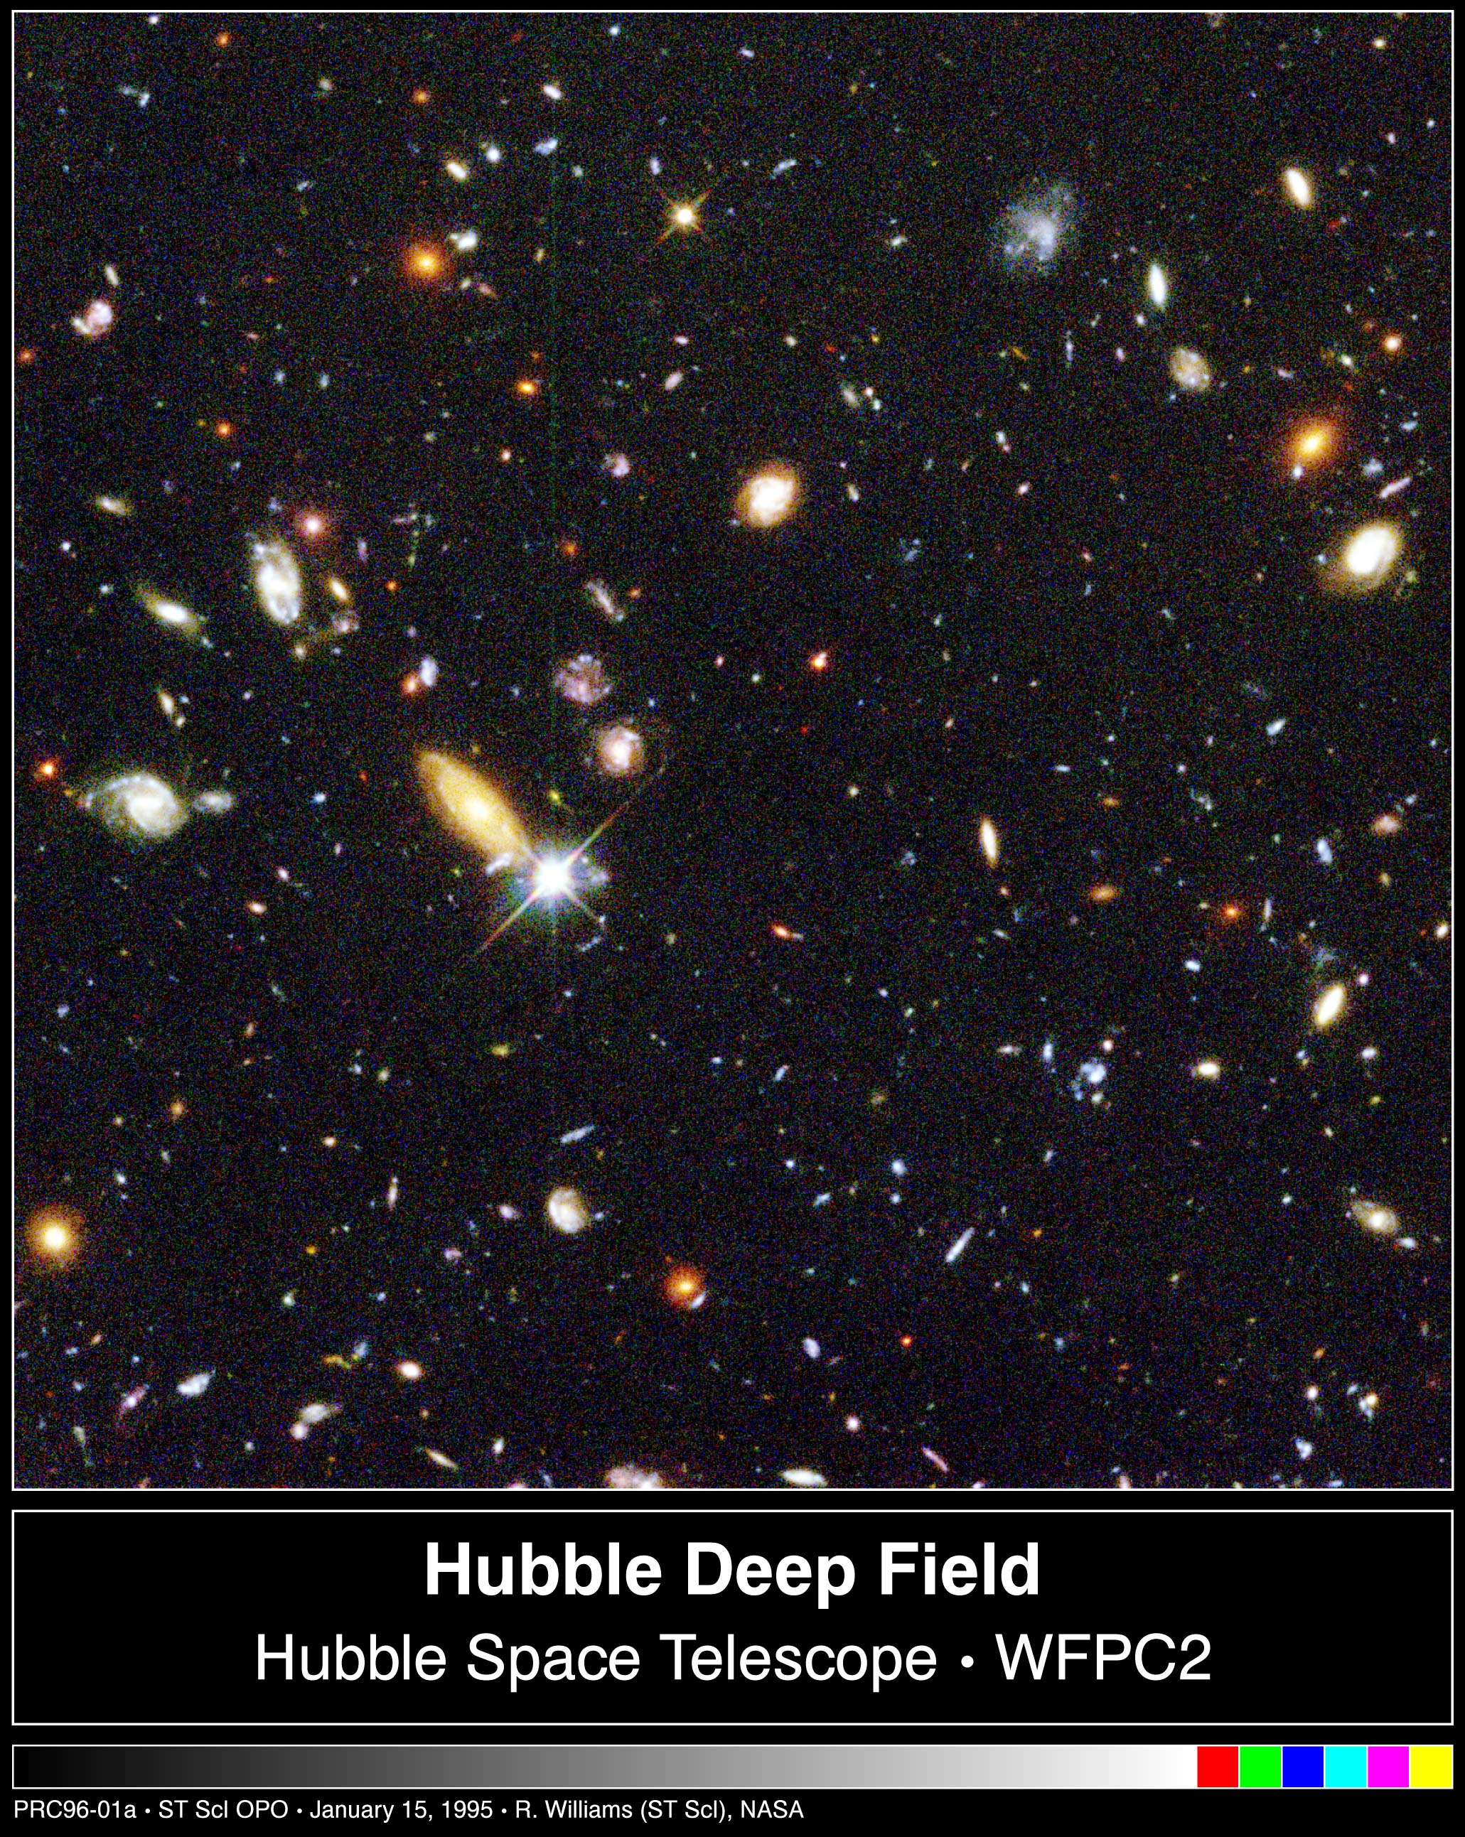
Physics and purpose?
Prof Chris Done, University of Durham

Slide 2
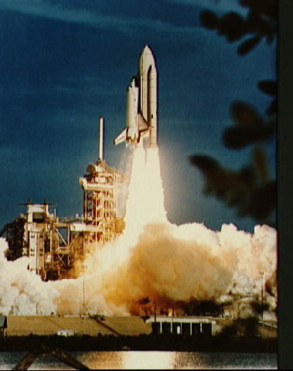
A real (rocket!) scientist
BSc Astronomy Astrophysics and Theoretical physics (St Andrews)
PhD Astrophysics Cambridge
NASA/JAXA/ESA
Leicester, Durham
L1 special relativity+ quantum mechanics

Slide 3
Significance: physical universe?
Earth is just one of planets around the Sun
Sun is just one of 100 million stars in our Galaxy, many of which have planets – life?
Our Galaxy is one of 100 million galaxies in the observable universe but maybe infinite
Our Universe may be one of multiple universes…..
If the physical universe(s) is all there is, then our lives are very small and insignificant

Slide 4
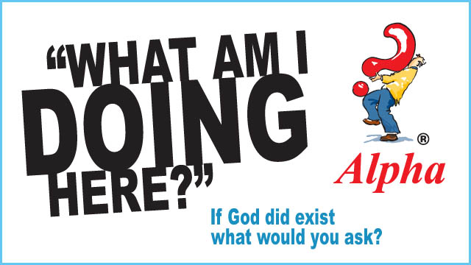
A real Christian – run alpha

Slide 5
Significance: Christianity
For God so loved the world that he sent his one and only Son, that whoever believes in him shall not perish but have eternal life. John 3:16
Our lives have eternal significance. The eternal, all powerful God who made the entire universe(s) was willing to lay down that power and be born as one of us and die for us, so we could know him.

Slide 6
I was not always a Christian
Me at 11!
I wanted to be a scientist, I thought scientists had to be atheists (!!)
Religion was a psychological defense to avoid reality of death

Slide 7
Why I wanted to be a scientist!
Star Trek!
Every week a new adventure, discovery, generally solved by the half Vulcan Science Officer, Mr Spock…

Slide 8
Untrue ?
The main reason I wasn’t a Christian
I thought it was simply not true.

Slide 9
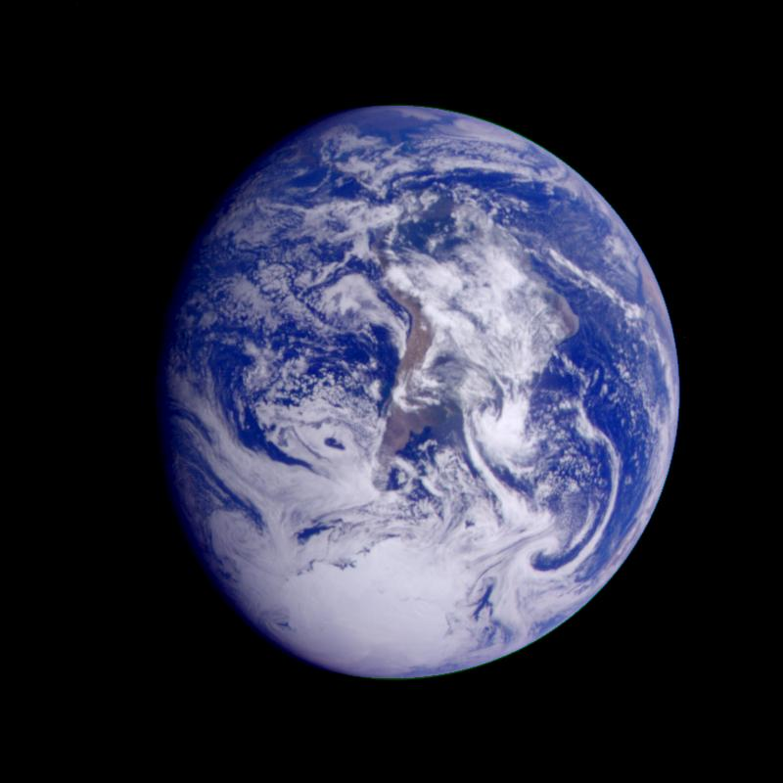
On it everyone you love, everyone you know, everyone you ever heard of, every human being who ever was, lived out their lives.
Carl Sagan

Slide 10
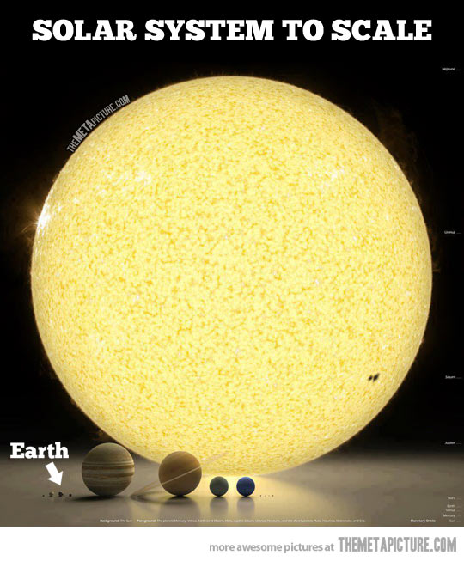

Slide 12
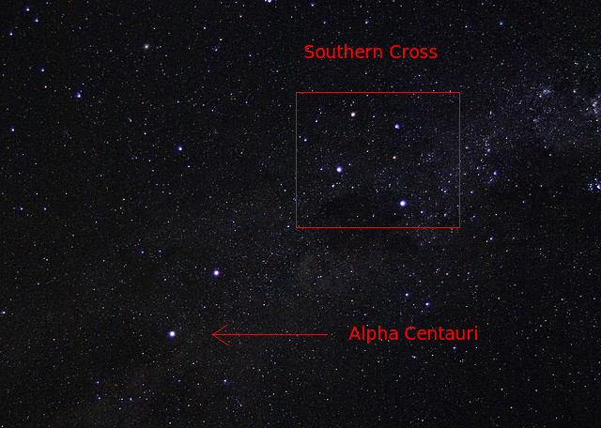
Nearest star;
4+ years

Slide 13
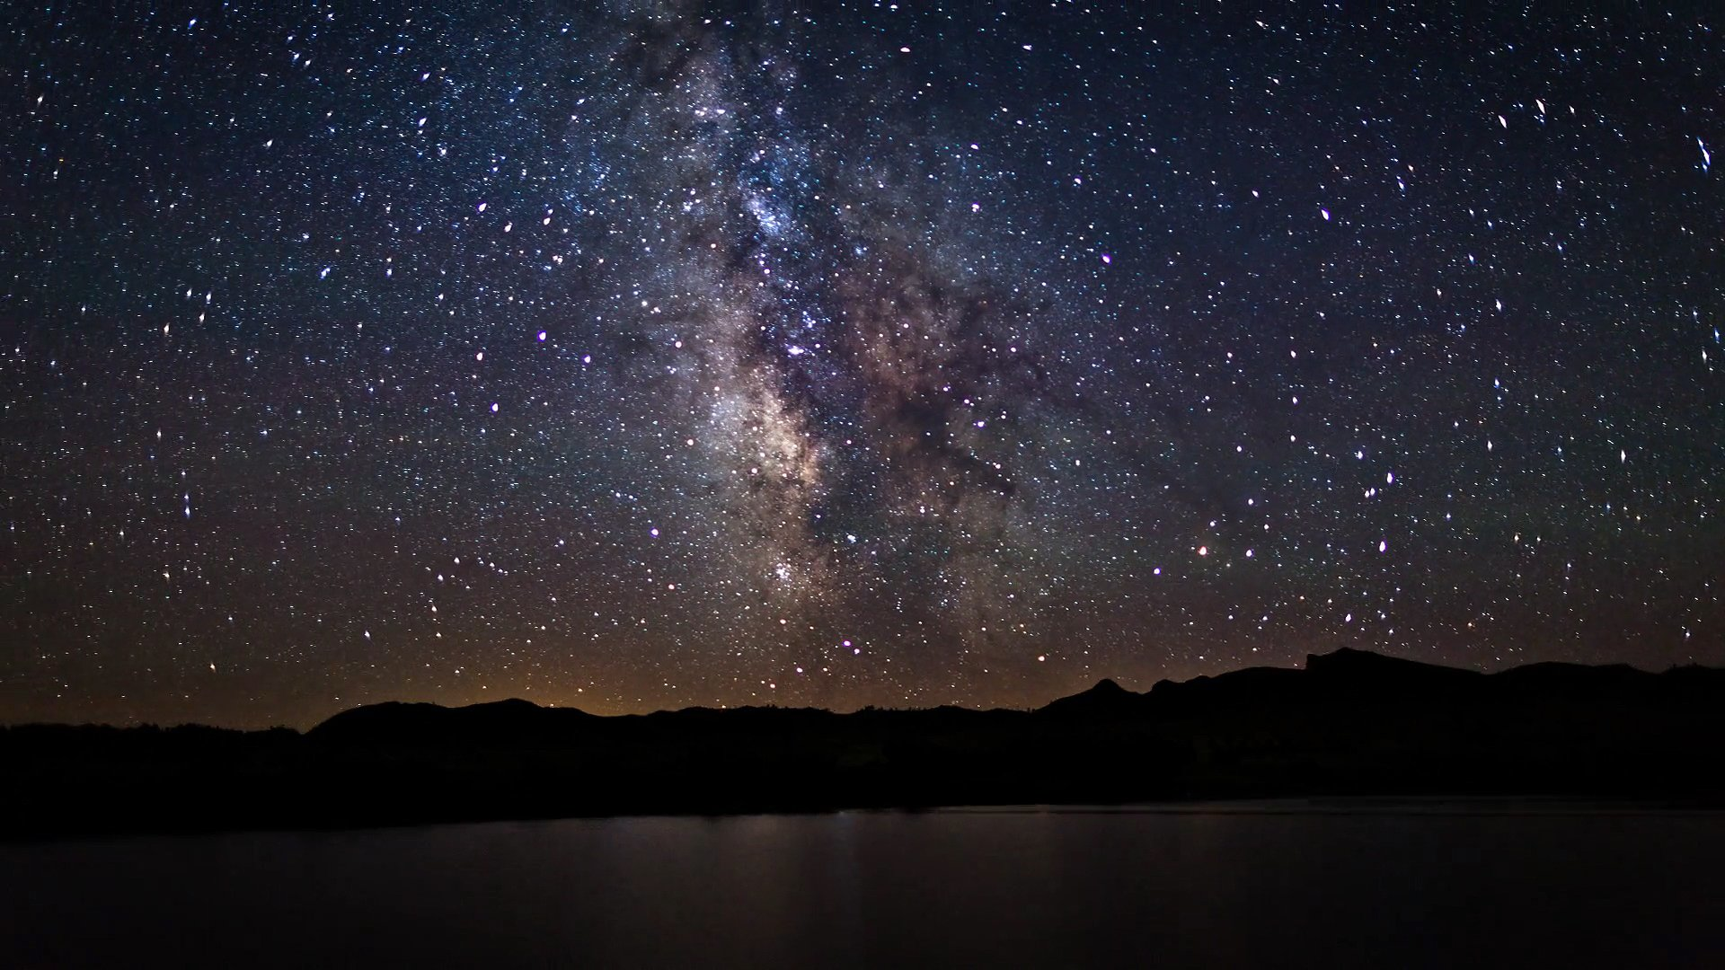

Slide 14
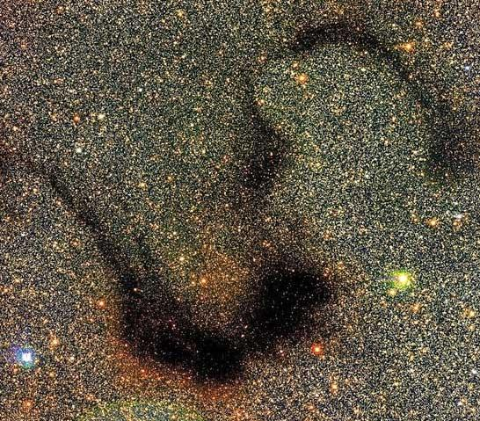

Slide 15
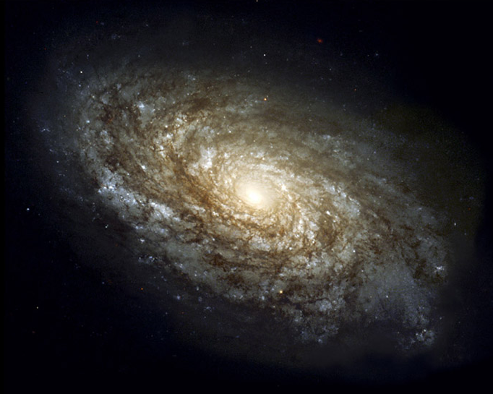
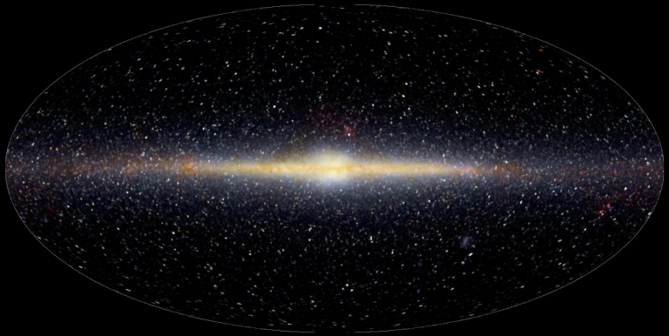
100,000 light years, 100,000 million stars
Sun

Slide 16
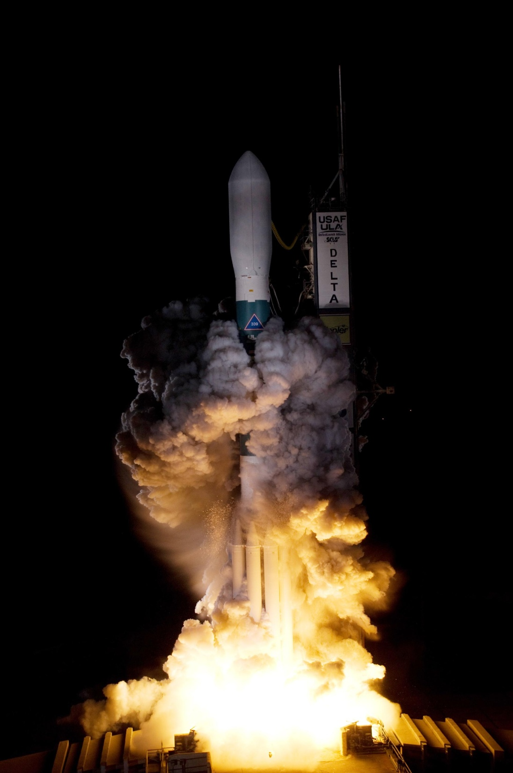
NASA Kepler mission to detect Earth sized planets March 7 2009

Slide 18
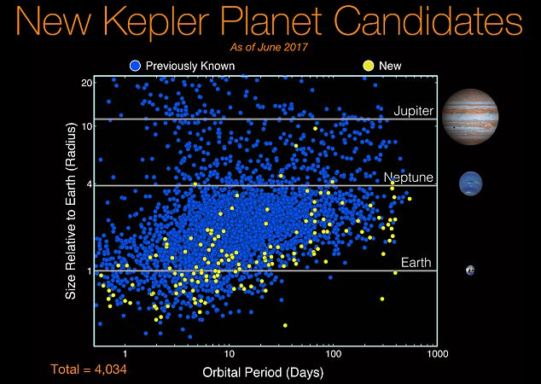

Slide 19
100,000 light years, 100,000 million stars
Sun

Slide 20
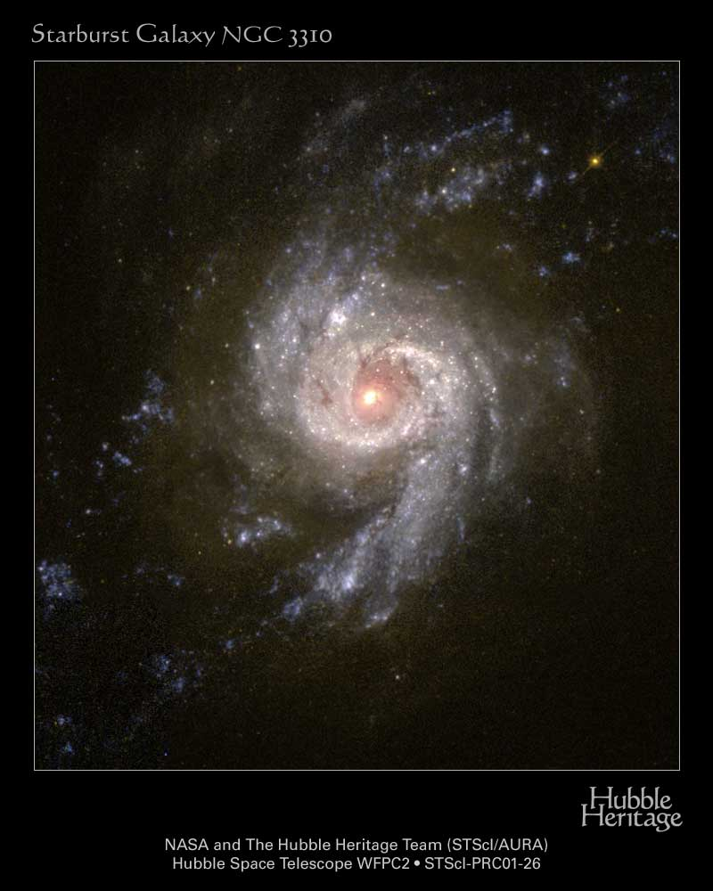
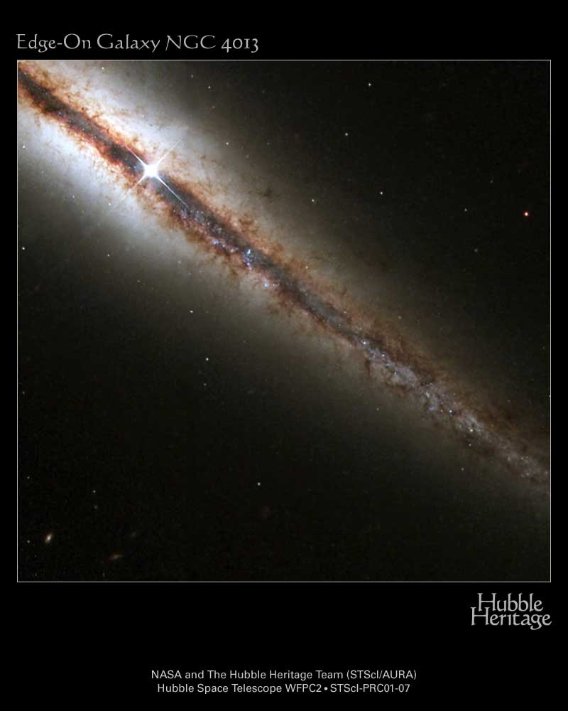

Slide 21
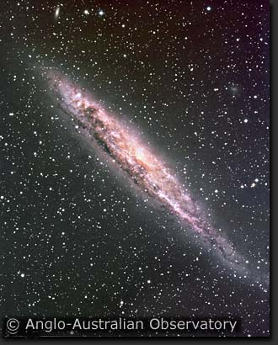

Slide 23
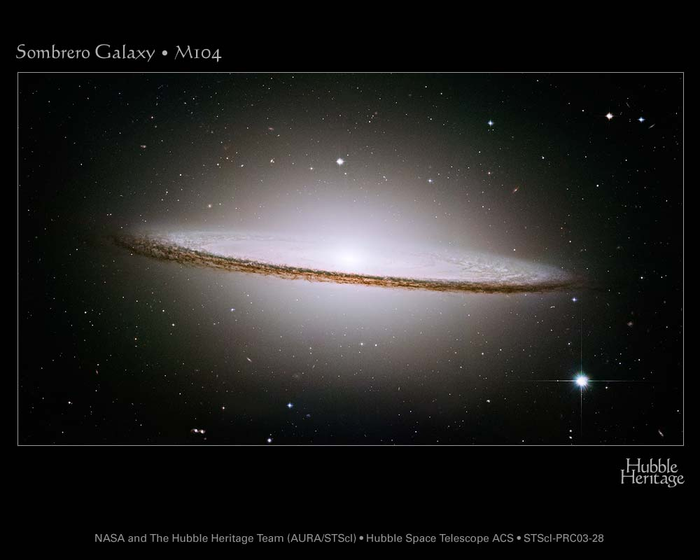

Slide 25
Significance and meaning in a vast universe?
Sun is one of a 100 billion stars in our galaxy, many have planets, maybe some support life
Our galaxy is one of 100 billion galaxies in the observable universe …
From the perspective of the physical universe: We are very small, not at all important

Slide 26
Significance and meaning?
Short term – we all want our lives to have impact - shape communities, build cities, write books, launch satellites….

Slide 27
Significance and meaning?
For people with children, that some part of their genes goes on, experiencing and shaping the far future that we will never see.
But how far can this go? Dawkins ‘the Selfish gene’ – the immortal gene

Slide 28
An expanding Universe
Can’t be static, unchanging, eternal universe if gravity!
Galaxies have gravity so attract each other
So should be all moving towards each other

Slide 29
An expanding Universe
Can’t be static, unchanging, eternal universe if gravity!
Galaxies have gravity so attract each other
So should be all moving towards each other
But actually they are overwhelmingly moving away!
And accelerating, no recollapse!!

Slide 30
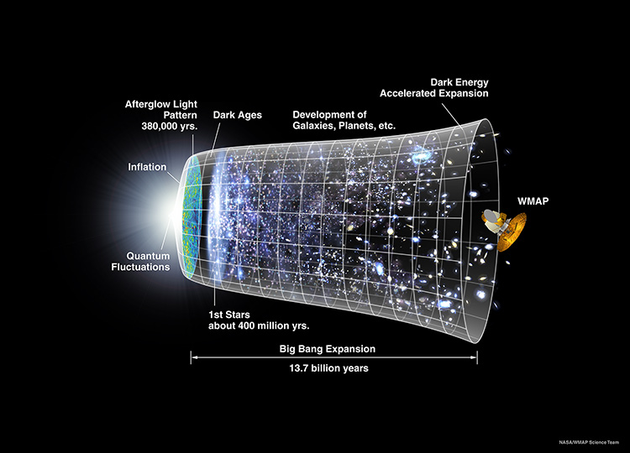
Physical universe
Galaxies closer in past
Very dense, universe in past - hot
Very different from what we see now
Future also very different from now

Slide 31
Eternity of future time
Sun will run out of fuel in 5 billion years
Expand and destroy the Earth
Develop space drives, move to another planet
But that star will also run out of fuel…
Galaxies making more stars, but their gas and dust is running out.
All stars die, even black holes eventually evaporate. No energy so no life possible.
Our genes are not immortal.

Slide 33
Is the physical universe all there is?
Big bang, a moment of creation
‘Why is there something rather than nothing?’
Quantum fluctuations
Fine-tuning of the Universe – ‘its almost as if the Universe knew we were coming’
Multiverse
Complexity of life – design: Paleys watchmaker
Evolution

Slide 34
Can science show us anything about God?
Any God who could create this universe is FAR beyond us
Creator is different to their creation – so God is outside space, time, matter, energy…science tools study space, time, matter, energy…
So science probably won’t help us very much in discovering what God is like!

Slide 35
How can we know what God is like ?
Needs God to reveal himself to us
Jesus shows us what God is like ‘if you have seen me you have seen the Father’ Jn 14:9
All faiths have at their core the idea of a revelation of God – prophets, teachers..
Christianity is unique is saying God himself came to us in Jesus – a human who shared our humanity but whose essential identity was God.

Slide 36
How I became a Christian
Friend invited me (atheist!) to her baptism when I was 17
People worshiping like they meant it….
Who do you think Jesus was?
Good teacher!! Bad answer….

Slide 37
Jesus – just a good teacher?
Taught – love your neighbour as yourself, love your enemy, forgive those who wrong you
Lived – reached out to outcasts of society: tax collectors, prostitutes, lepers
But let people worship him as God!!
Mad (he thought he was God, but he wasn’t!)
Bad (he knew he wasn’t God, but let people worship him anyway!!)
God (he knew he was God, so worship is the right response!)

Slide 38
Evidence for Jesus as God ?
Disciples (eyewitness account) said his life was more about his death than his teaching!
But that he was then raised to life by God, and they met with him!!
Evidence for this:
Psychological: disciples changed from running away in fear to boldly saying Jesus was alive
Physical: The body was gone from the tomb or the Romans would have produced it to stop the rumours that he was alive

Slide 39
Evidence for Jesus being alive
Observation
Explanation?
Consequence
Body
Not In
Tomb
Disciples stole it
They would know that Jesus was really dead
Not very likely - people might die for what they truly believe in, but not generally for something they knew to be a lie

Slide 40
Evidence for Jesus being alive
Observation
Explanation?
Consequence
Body
Not In
Tomb
Someone else stole it
Why do the disciples say he’s alive??

Slide 41
Evidence for Jesus being alive
Observation
Explanation?
Consequence
Someone else stole it
AND
The disciples have a mass hallucination and imagine they see Jesus alive
Two very unusual and unconnected things have to happen.
Body
Not In
Tomb

Slide 42
Evidence for Jesus being alive
Observation
Explanation?
Consequence
Jesus is raised to life
Disciples convinced that Jesus is God, lord of life and death.
So they are fearless, and tell everyone!
Body
Not In
Tomb
The most likely solution? The one which best explains the observations

Slide 43
How I became a Christian
Evidence – not proof!
Science is about evidence not proof
Enough evidence that it is most likely true
I didn’t want Christianity to be true!!

Slide 44
Christianity as a relationship
Not just intellectual assent to set of beliefs
Relationship with God – two way
This surprised me!!
Eg what to do at university – doctor (helps people) or astrophysicist (what I wanted to do)

Slide 45
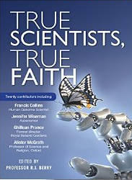
God was right and I did make a good astrophysicist
1st woman full professor of astrophysics in Durham

Slide 46
Conclusions
If the physical universe is all there is then our lives have no significance against an eternity of future time in a universe of darkness.
There is evidence in Jesus that the physical universe is not all there is, that there is a God who loves us and calls us into relationship with him. Our lives, and our choices matter on a much larger canvas than this physical Universe, however infinite it may be in either time or space.

Slide 47
Understanding God through Nature?
I’m also a potter!
What (if anything!) do my pots reveal about me?

Slide 48
Understanding God through science?
Probably they don’t tell you much!
I think we should understand the world by experience and study of science and understand God by relationship with him and study of the bible

Slide 49
Can a scientist believe in miracles?
Yes and No
Yes: God made physical laws, so can break them if he chooses!
Jesus in the bible walks on water, heals the sick, and is raised from the dead!!
Christians all over the world (including me!) will say he is living and active in our lives.

Slide 50
Can a scientist believe in miracles?
No: Not as an answer to a scientific problem!
A science answer relates to the natural world – God is a supernatural being
For example, we don’t yet understand the beginning of life, or the beginning of the Universe, or human consciousness – so we could say ‘it must be God’
But this places God only in the gaps in our knowledge – and as our knowledge grows the gaps shrink. Science seen as a threat to God!!

Slide 51
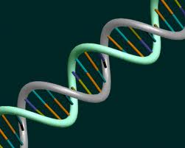
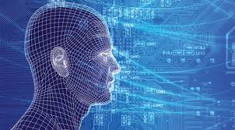
What we understand
What we don’t understand
All current science
Particle physics
(small scales)
Big Bang
(large scales)
Biology/chemistry
G
O
D

Slide 52
What we understand
What we don’t understand
Future
science
Particle physics
(small scales)
Big Bang
(large scales)
Biology/
chemistry
G
O
D

Slide 53
What we understand
What we don’t understand
All current science
Particle physics
(small scales)
Big Bang
(large scales)
Biology/chemistry
G O D
G O D
G O D

Slide 54
What we understand
What we don’t understand
Future
Science
Particle physics
(small scales)
Big Bang
(large scales)
Biology/
chemistry
G O D
G O D
G O D

Slide 55
Science revealing God ?
Big bang, a moment of creation
‘Why is there something rather than nothing?’
Quantum fluctuations
Fine-tuning of the Universe – ‘its almost as if the Universe knew we were coming’
Multiverse
Complexity of life – design: Paleys watchmaker
Evolution

Slide 56
What (if anything!) does science reveal about the existence and nature of the Christian God as revealed in the bible?
Enormous amount of evidence against 7 day literal interpretation of Genesis – but it doesn’t have to be read that way.
How do we interpret the bible ?

Slide 57
Who are you??
Questions different
Perspectives different even if questions are same!
Neither scientist, nor Christian
Scientist, not a Christian
Christian, and scientist
Christian, not a scientist

Slide 58
Bible has to address all these audiences and much more….
One book (collection) to speak to all people & times
Poetry, allegory, history, eyewitness accounts
All ages
Children/adults/seniors
All centuries
different technologies
All nationalities/cultures
All IQs

Slide 59
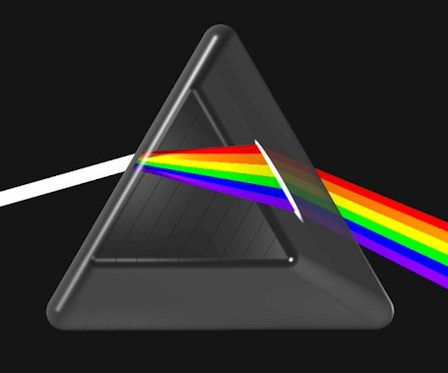
Bible has to address all these and more so it uses lots of different ways….
Poetry
Allegory
History
Eyewitness
GOD

Slide 60
The beginning according to Christianity/Judaism
In the beginning, God created the heavens and the earth….God said let there be
Light
Heaven and earth
Land and sea, with plants on the land
Sun moon and stars
Fish, birds
Animals and mankind

Slide 61
Bible view: Gods Universe
There is something rather than nothing because God spoke it into being
The sun/moon/stars are just part of his creation, not Gods in their own right
Everything is Gods creation and is good, not some cosmic finely balanced dichotomy between good and evil…

Slide 62
Bible view: humans and God
Adam and Eve – God created them ‘from the dust of the earth’ and they lived in a garden
Everything was theirs to eat except the tree of the knowledge of good and evil. God to Adam - Eat that and you will surely die
Serpent to Eve: did God really say that?
Eve to Adam – lets try it… so they did, then they were ashamed and hid from God

Slide 63
Bible view: humans and God
We are meant for relationship with God and with each other
We have real freedom to choose and we can choose the wrong things. This breaks our relationship with God, and with each other.
Biblically, this is why we are broken. And we can’t fix it because we have a problem with God as well as with ourselves

Slide 64
How to draw the line….
I interpret this allegorically – but also real events?
Hunter gatherers – Adam and Eve walked with God in a garden in the cool of the day
Shepherds/pastorial nomads (Abel) then farmers (Cain) 10,000-5000 BC, - curse: work the ground
Farming: larger population, but worse nutrition
Settled communities – possessions, inequality, war (Abel murdered by Cain)
Bible echo of the most dramatic change in human (pre)history, irrevocable shift to farming

Slide 65
Book of Gods word and works
Nature (works)
Bible (words)
interpreted by
Science
How
Why (material)
Theology
Why
For whom
Answers questions

Slide 66
I do not feel obliged to believe that the same God who has endowed us with sense, reason and intellect has intended us to forget their use.
Galileo Galilei

Slide 67
The Universe that we observe has precisely the properties we should expect if there is, at bottom, no design, no purpose, no evil, no good, nothing but pitiless indifference
Richard Dawkins - God`s Utility Function

Slide 68
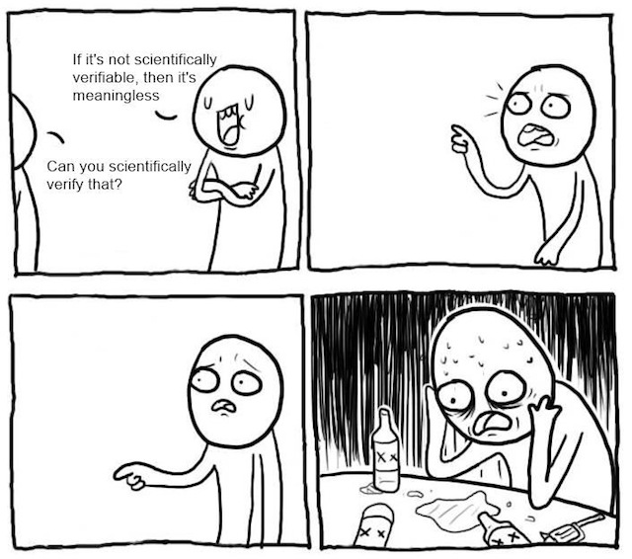

Slide 69
Inevitable Conflict?
.
Scientism – Science is the only way to know truth – this statement cannot be tested through science.
Its self refuting so its false.
Science is the only reliable way to know truth ?
Do you know that truth reliably?
Fundamentalist religion – faith is the only way to know truth…

Slide 70
What is truth?
There is a unique objective reality – assumption!
Questions of existence ARE NOT relative.
This chair EITHER exists…

Slide 71
What is truth?
There is a unique objective reality – assumption!
Questions of existence ARE NOT relative.
This chair EITHER exists…
…or does not!

Slide 72
What is truth?
There is a unique objective reality – assumption!
Questions of existence ARE NOT relative.
This chair EITHER exists…
…or does not!
There either is a God (theism) or there isn’t (atheism). These CANNOT both be true.
NOT ‘God is true for you but not for me’

Slide 73
What is truth?
Questions of interpretation ARE relative
Why is the kettle boiling?
Electricity, heats the water until it undergoes phase transition to steam
I want a cup of tea
These are BOTH true, different perspectives on the same reality. Tell us very different things.

Slide 74
Augustine ~400AD
One of the great teachers in the early church. Wrote a book
“On the literal interpretation of Genesis”
What kind of days these were is extremely difficult or perhaps impossible for us to conceive…
Not all Christians read it as literal 24 hour days even before modern science, so Christians certainly don’t have too now.

Slide 75
If they find a Christian mistaken in a field which they themselves know well and hear him maintaining his foolish opinions about our books, how are they going to believe those books in matters concerning the resurrection of the dead, the hope of eternal life, and the kingdom of heaven, when they think their pages are full of falsehoods on facts which they themselves have learnt from experience and the light of reason?
Augustine: The literal meaning of Genesis

Slide 76
Usually, even a non-Christian knows something about … the motion and orbit of the stars, about the kinds of animals, shrubs etc and this knowledge he holds to as being certain from reason and experience. Now, it is a disgraceful and dangerous thing for an infidel to hear a Christian, presumably giving the meaning of Holy Scripture, talking nonsense on these topics; and we should take all means to prevent such an embarrassing situation….The shame is not so much that an ignorant individual is derided, but that people outside the household of faith think our sacred writers held such opinions, and, to the great loss of those for whose salvation we toil, the writers of our Scripture are criticized and rejected as unlearned men.

