Slide 1
Foundations of Physics 2A
Quantum MECHANICS
Prof Done
Calculate energy levels of H

Slide 2
Books:
Bransden
and Joachain
Syllabus defined
on chapters

Slide 3
Books:
Griffiths
I will use this approach to the material as it’s genius at this level

Slide 4
Lectures: derivations/examples on the board.
You write them down and follow it!
Fairly comprehensive notes on duo after each lecture if there are bits you don’t get (I write fairly fast and not always legibly)

Slide 5
Office hour: Monday 1-2pm
Rarely time at the end of a lecture
Email me if you want to talk about the material but can’t make that slot and we can arrange a time
Chris.done@durham.ac.uk

Slide 6
This lecture:
Review of L1
Schroedingers equation
probability waves

Slide 8
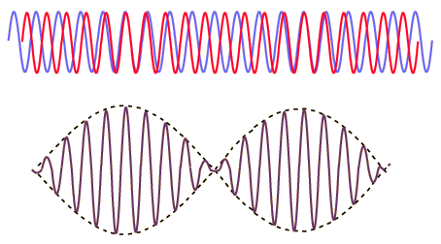

Slide 28
Review of L1
Schroedingers equation
probability waves

