Slide 1
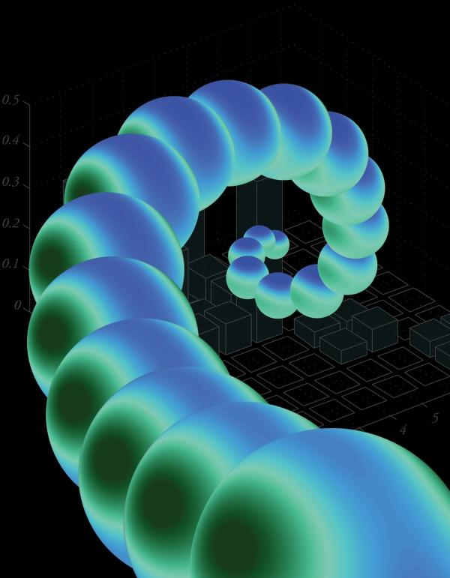
Squeezing light into nanometre cages: putting the nano into photonics
Department of Physics
The 2011 Rochester lecture
Professor Jeremy Baumberg
Director of the NanoPhotonics Centre, University of Cambridge
Wednesday 7th December 2011 at 4.30pm
In the Appleby Lecture theatre (W103)

