Slide 1
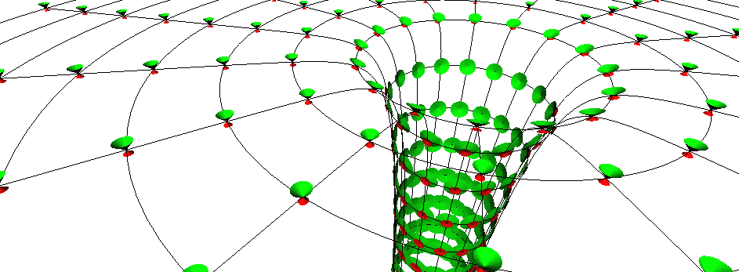
Black holes science fact, fiction or fantasy!
Prof Chris Done, University of Durham

Slide 2
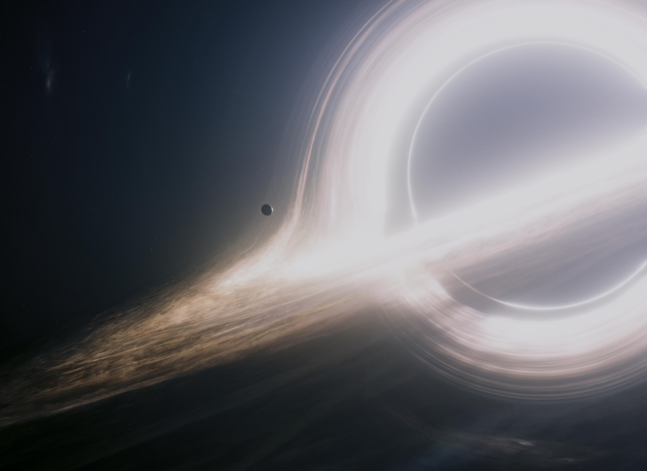
Black holes in
Science fiction
Movies
Interstellar!

Slide 3
What are they?
How could they form?
How can we know they exist
Can we use them for
time travel
space travel – wormholes
alternate universes

Slide 4
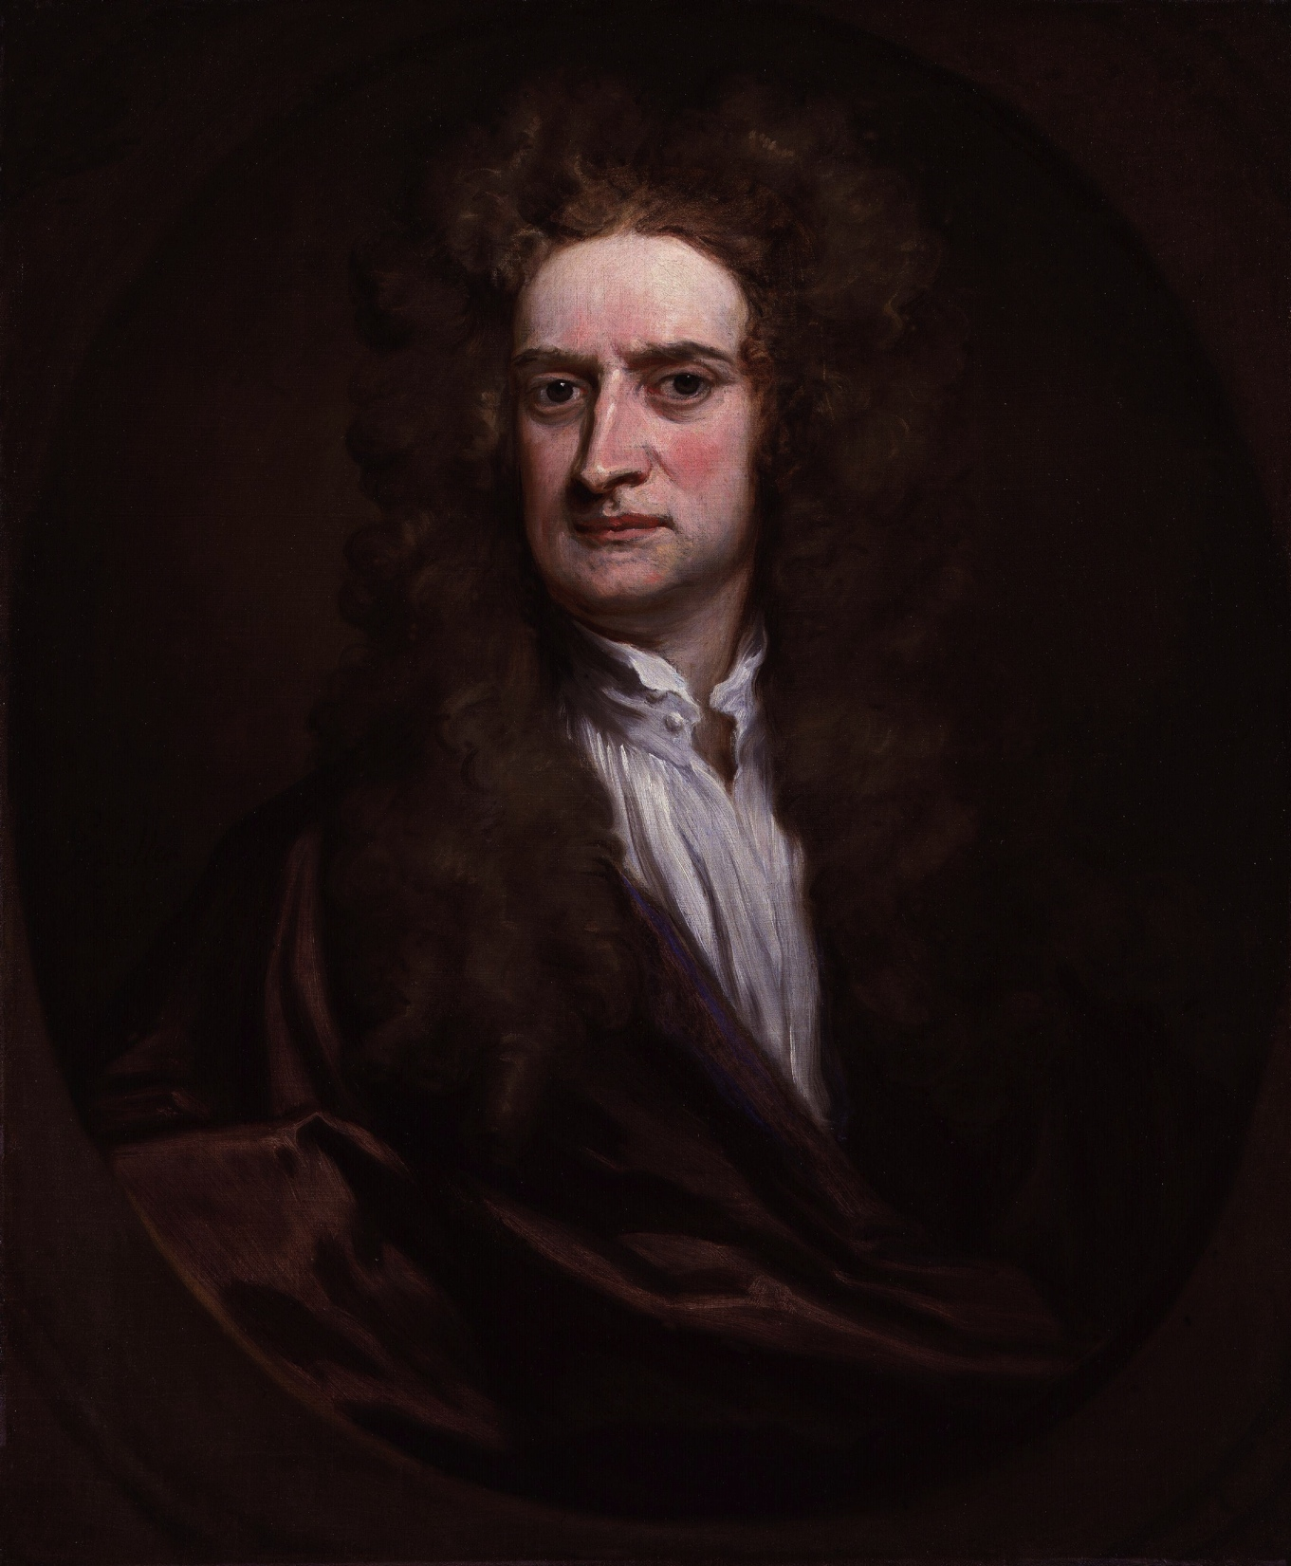
Gravity: Newton
Amazing synthesis of two very separate things
Apple falling from tree
Moon orbiting Earth
What is gravity?
http://en.wikipedia.org/wiki/Isaac_Newton

Slide 5
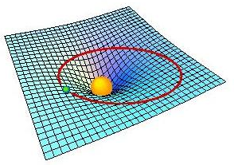
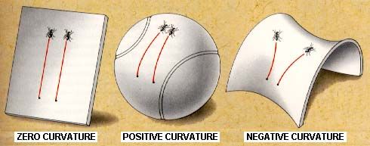
Gravity: warped spacetime
Straight paths on curved space!!
NOT a spooky, action at a distance force (Newtonian)
Space(time) warped by mass(energy)

Slide 6
Gravity: warped spacetime
Matter tells space how to curve, curvature tells matter how to move

Slide 7
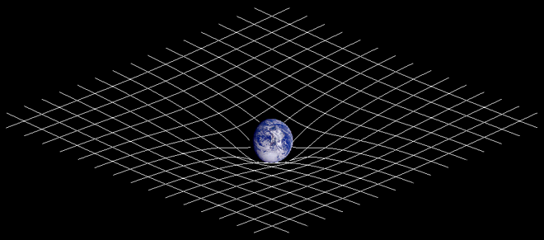
Gravity: Einstein
NOT a spooky, action at a distance force (Newtonian)
Space(time) warped by mass(energy)
http://en.wikipedia.org/wiki/General_relativity

Slide 8
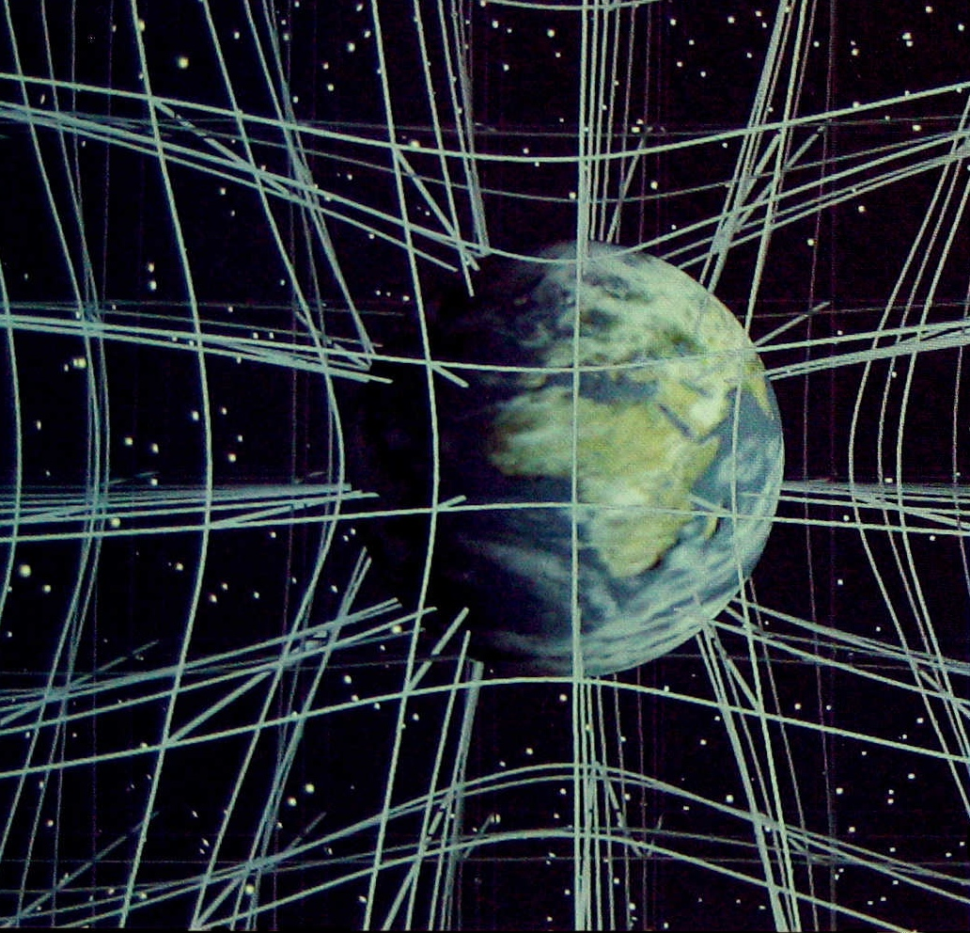
Gravity: Einstein
Should think of it in 3D but difficult to draw!
Christopher Vitale of Networkologies and the Pratt Institute.

Slide 9
Gravity: Einstein
And time is bent as well (slowed down)!
Christopher Vitale of Networkologies and the Pratt Institute.

Slide 10
Gravity: warped spacetime
So light is affected too!
Lightbending – light travels in straight lines over curved surface so path looks curved!
One of first tests of GR …
True position
Apparent position

Slide 11
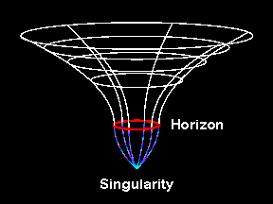
Gravity: warped spacetime
More gravity, more mass in same space or same mass, smaller size
Black hole – escape velocity is faster than light so can’t get out!
Black holes don’t suck inexorably! Unlike bad SF movies…

Slide 12
Gravity: warped spacetime
More gravity, more mass in same space or same mass, smaller size
Black hole – escape velocity is faster than light so can’t get out!
Black holes don’t suck inexorably! Unlike bad SF movies…

Slide 13
Gravity: warped spacetime
More gravity, more mass in same space or same mass, smaller size
Black hole – escape velocity is faster than light so can’t get out!
Black holes don’t suck inexorably! Unlike bad SF movies…

Slide 14
Gravity: warped spacetime
More gravity, more mass in same space or same mass, smaller size
Black hole – escape velocity is faster than light so can’t get out!
Black holes don’t suck inexorably! Unlike bad SF movies…
© Andrew Hamilton

Slide 15
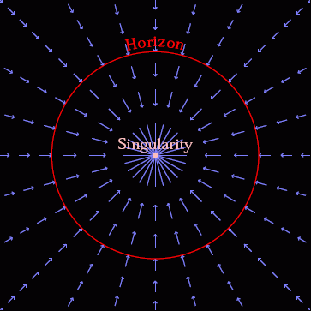
Gravity: warped spacetime
Spacetime itself in falling in at the speed of light
Nothing travels faster than light so everything swept down below event horizon
© Andrew Hamilton

Slide 16
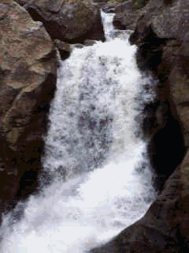
Gravity: warped spacetime
Spacetime itself in falling in at the speed of light

Slide 17
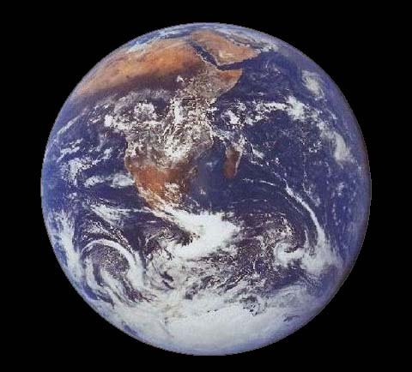
Gravity: warped spacetime
Utterly extreme. Need mass of earth squashed down to 1cm! Or mass of sun squashed into size of London.
Impossible!!!!!!!!?
How to get such extreme compression?
NASA image

Slide 18
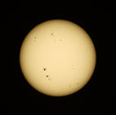
Black hole recipe: I
Take 1 massive star (at least 10 bigger than Sun)
Stars fuse 4H to He
Lose mass, gain energy via Einstein’s E=mc²
Hydrogen bomb! in its stable life – outward pressure of hot gas (fusion) balanced by inward pull of gravity.

Slide 19
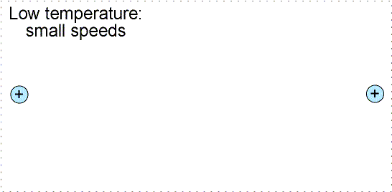
Electrostatic repulsion

Slide 21
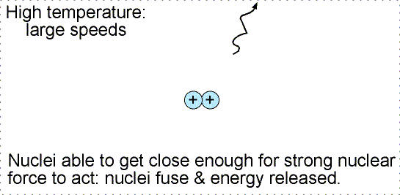
But now got 2 protons both with +ve charge
Strong repulsion between them as well as the strong nuclear force binding them together

Slide 22
One of them decays into a positron
(+ve electron = anti-electron = antimatter!) and a neutrino.
Leaves neutron next to proton bound together by strong nuclear force. Isotope of Hydrogen called Deuterium

Slide 24
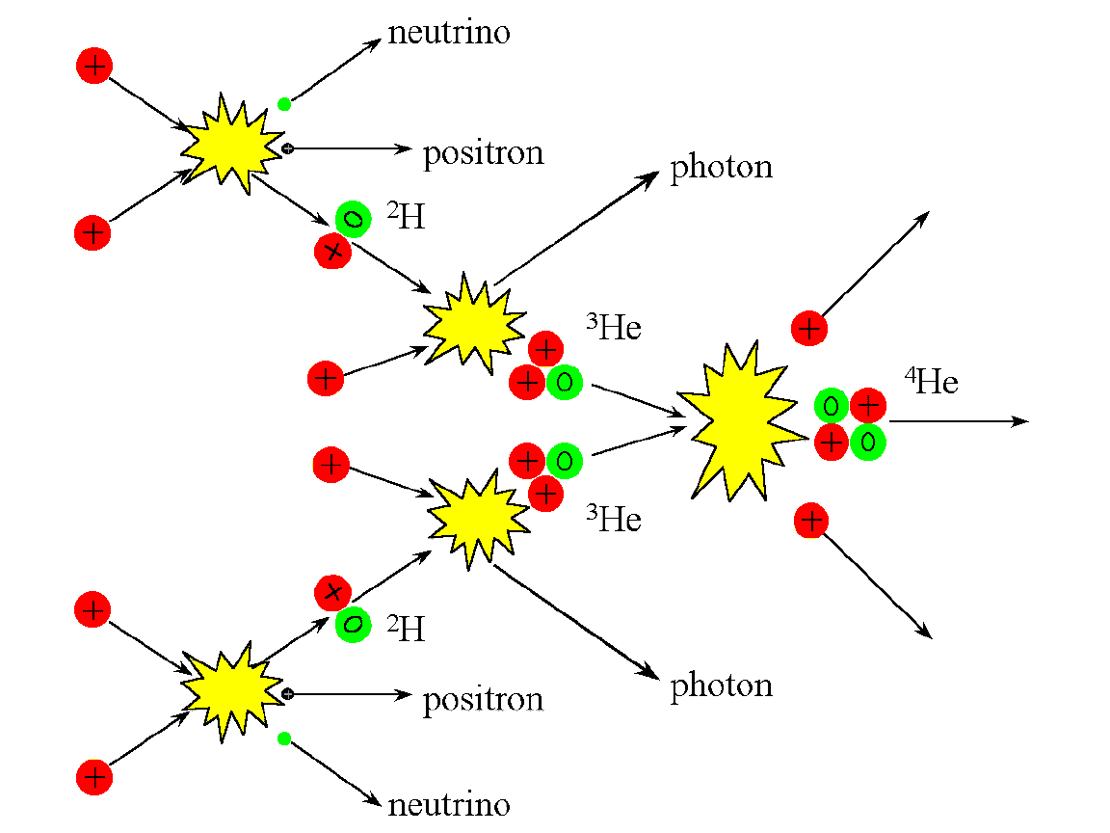

Slide 25
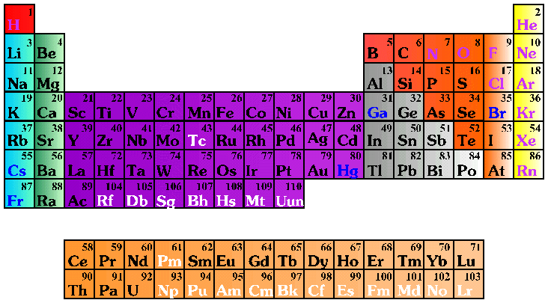
Chemistry!

Slide 26
Black hole recipe: I
Cook until H all gone.

Slide 27
Chemistry!
He core pulled in by gravity, temperature increases. If high enough fuse 3He to C
C core pulled in by gravity temperature increases. If high enough fuse C+He to O
O core pulled…….

Slide 28
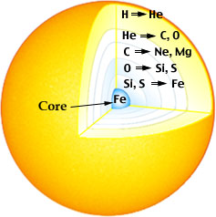
Black hole recipe: II
Run out of H but gravity never runs out – contracts core so higher temperatures
then fuse higher atomic number elements…
Builds up all the chemical elements of the periodic table!

Slide 29
Black hole recipe: II
But get less and less energy!
Iron is crossover between fusion and fission! No more energy!
Iron core builds up as iron ‘ash’ sinks down from layers above. pulled in by gravity but no other energy!

Slide 30
Black hole recipe: III
Fe core pulled in by gravity. How far can material be compressed?
Electron degeneracy pressure – wave-particle duality in quantum mechanics. Smaller box, smaller wavelength, higher energy, faster!
Can’t go faster than c!

Slide 31
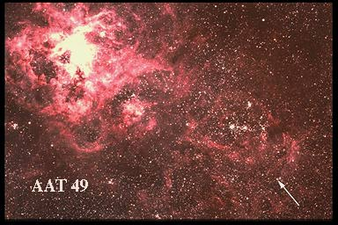
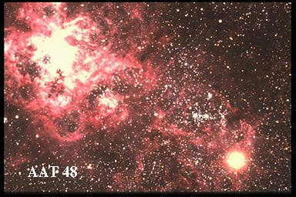
Black hole recipe: IV
Hit this when Fe core is 1.4x mass of Sun
e⁻ + p⁺ > n + ν
Neutrons have higher mass, shorter wavelength so fit in MUCH smaller box! Floor drops away.
Dramatic supernovae explosion!
Neutron star core left held up by degenerate neutrons.
mass of sun, size of London.

Slide 32
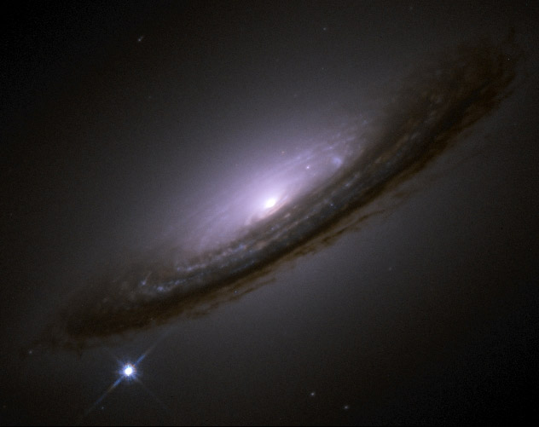
Supernovae
Supernovae - massive star core collapse
Single exploding star can outshine an entire galaxy!
NASA image

Slide 33
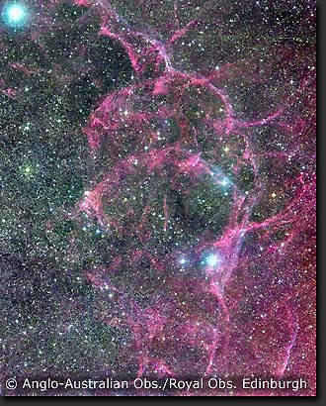
A digression…..
Outer layers blasted across interstellar space
Contains all heavy elements needed for life (C, N, O, Fe etc)
Where slams into molecular gas then triggers next generation of stars/planets(/life?)

Slide 34
Black hole recipe: V
But core being hit by infalling layers from above
Neutrons get squashed into smaller and smaller box, going faster and faster
Hit c at 1.4-3x mass of sun (depends on rotation rate)
no known state of matter can hold up complete collapse
Event horizon only factor of 3 smaller than a neutron star

Slide 35
Observing black holes?
How to test this ?
The thing about a black hole, its main distinguishing feature is its black! And the thing about space, your basic space colour is its black! So how are you supposed to see them ? Red Dwarf

Slide 36
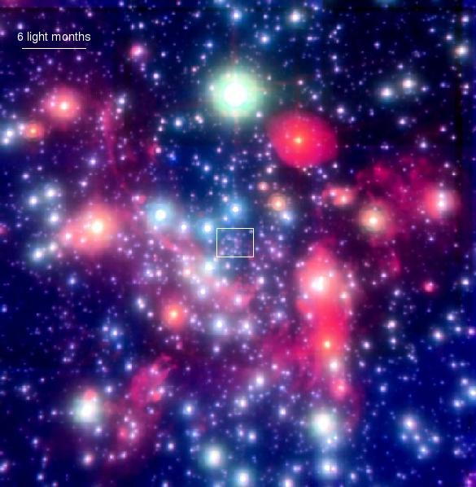
By gravity – all they possess!
Gravitational effect on nearby stars
Stars in GC get to within a lightday, but this is 2000x event horizon. Not probing the REALLY curved BH spacetime.
Hard to detect

Slide 37
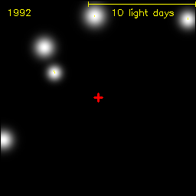
By gravity – all they possess!
Gravitational effect on nearby stars
Stars in GC get to within a lightday, but this is 2000x event horizon. Not probing the REALLY curved BH spacetime.
Hard to detect

Slide 38
Observing black holes?
How to test this ?
The thing about a black hole, its main distinguishing feature is its black! And the thing about space, your basic space colour is its black! So how are you supposed to see them ? Red Dwarf

Slide 39
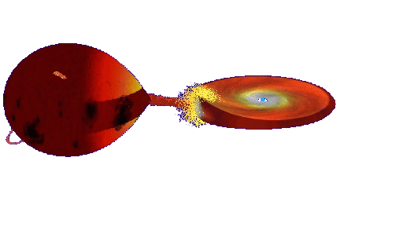
Accretion
Continuous ring of gas – friction dissipates energy
Makes material hot
BRIGHT accretion discs glowing X-ray hot
© Andrew Beardmore

Slide 40
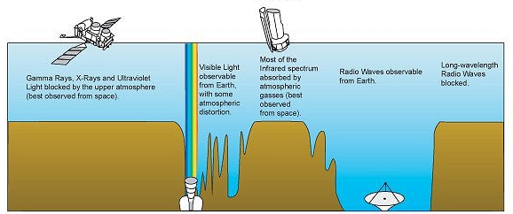
X-rays blocked by atmosphere
NASA image
X-rays
Visible
Radio
Wavelength

Slide 41
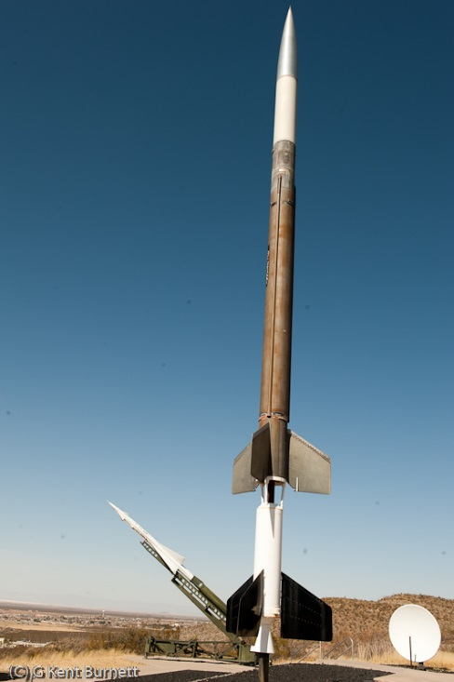
Rocket Science!
Nobel Prize to Giaconni in 2002 for discovery of cosmic X-ray sources in the 1960s
Black holes position highlighted by the high energy X-ray radiation released by material falling towards the event horizon
NASA image

Slide 42
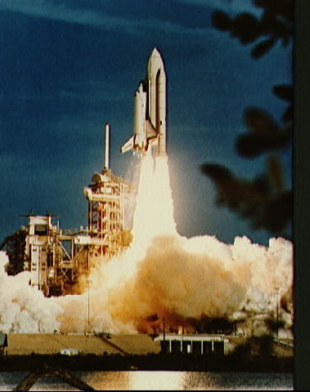
Rocket Science!
X-ray astronomy transforms black holes from theoretical speculation to observable objects
Observe black holes and get to do rocket science!!
Suzaku (2005)

Slide 43
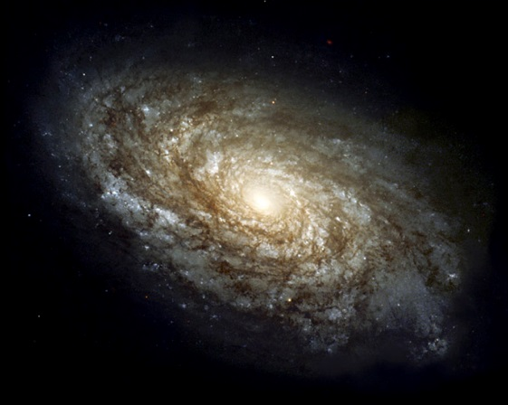
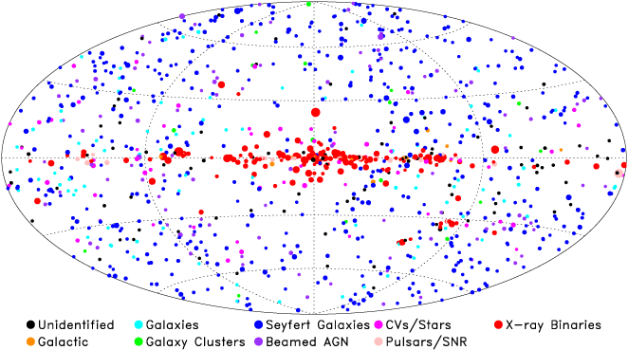
Supermassive BH
Million-Billion x Sun
Stellar mass BH
10x Sun
NASA image

Slide 44
Gravitational waves!

Slide 45
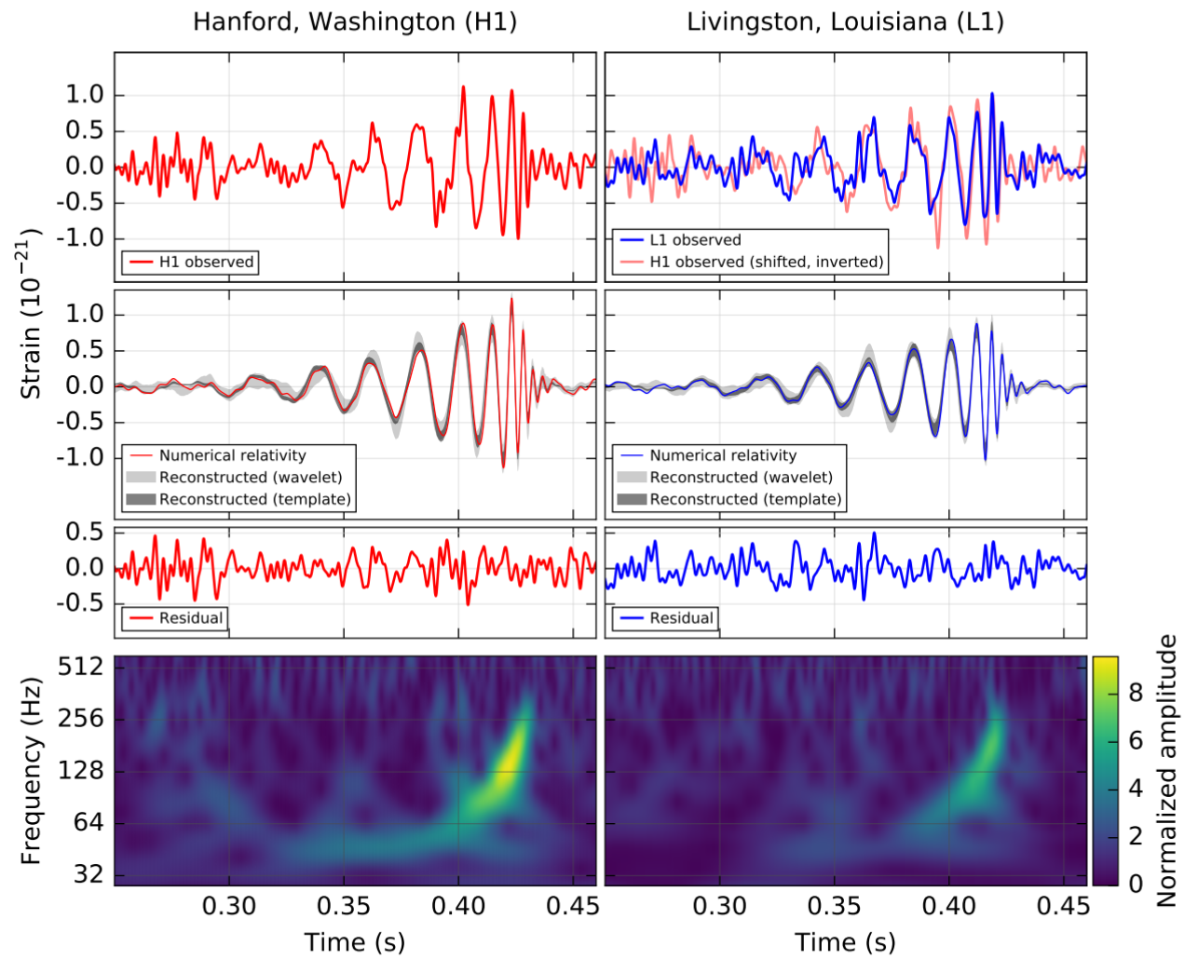

Slide 46
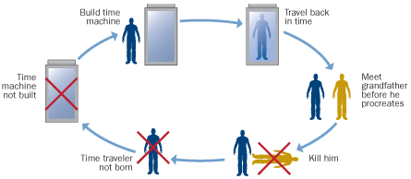
So can we use them for time travel??
YES to the future
NO(?) to the past which is good as Grandfather paradox!

Slide 47
Back to the Future!!

Slide 48
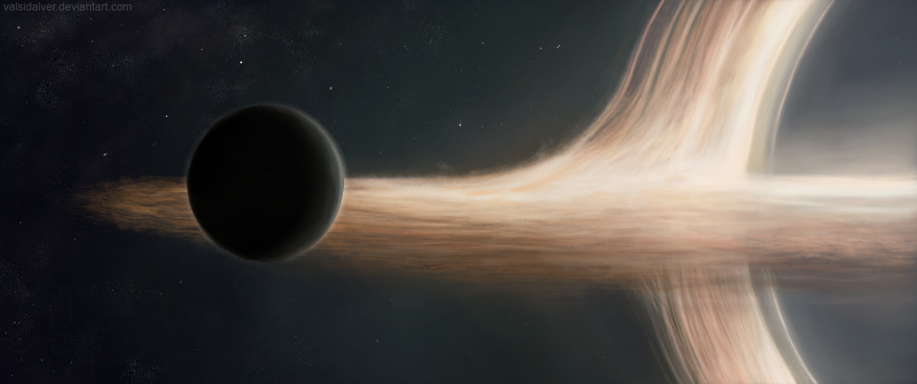
Interstellar – planet so close to black hole that time is slowed down!
YES - to the future!

Slide 49
Needs Gargantua - or ripped apart
Tidal forces are the difference in gravity = curvature between your head and feet.
Scale of curved space relative to scale of us

Slide 50
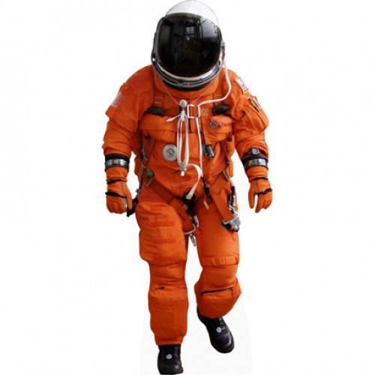
Tidal forces are the difference in gravity = curvature between your head and feet.
Scale of curved space relative to scale of us

Slide 51
Needs Gargantua - or ripped apart

Slide 52
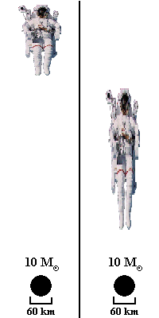
Needs Gargantua! Tidal forces are the difference in gravity = curvature between your head and feet.
Scale of curved space relative to scale of us

Slide 53
Tidal forces are the difference in gravity = curvature between your head and feet.
Scale of curved space relative to scale of us

Slide 55
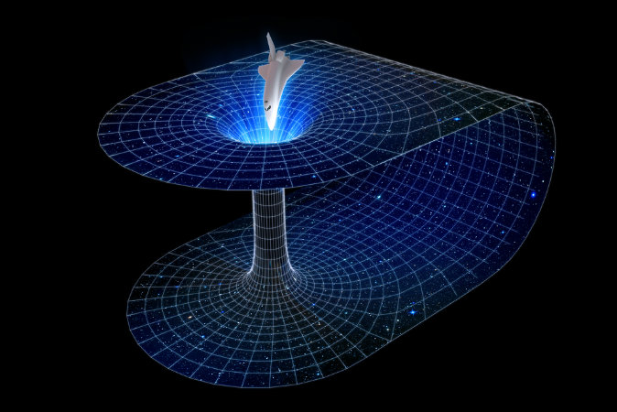
Wormholes:short cut through space
Need to do this WITHOUT black holes (or you end up at the bottom of a black hole!!

Slide 56
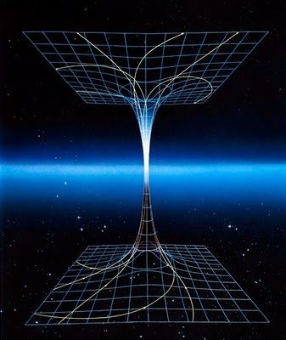
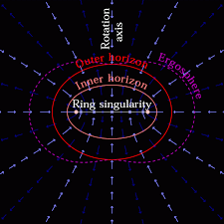
Wormholes: to another universe!!
Rotating black holes….

Slide 57
Conclusions
Einstein GR, strong gravity, event horizon
We see such objects !! They exist!
So we could do time travel to the far future
But probably not to the past…
Nor use them as wormholes….
But they make excellent SciFy plots!

Slide 59
Gravitational waves!

Slide 61
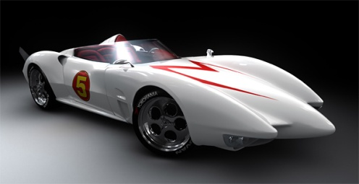
Einstein’s gravity: Special relativity
Travelling at fixed speed c through spacetime….
Generally all through time
If put some of the motion through space then takes longer to move through time (time dilation)!!
speed = distance/time so length contraction along motion

Slide 62
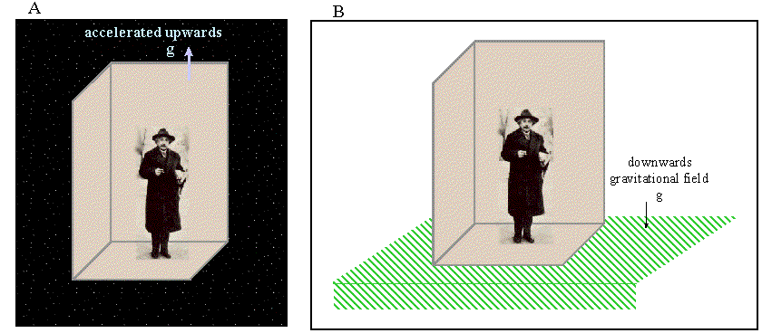
Einstein’s gravity: general relativity
SR doesn’t do acceleration, gravity makes acceleration
Is there a difference? Look the same, behave the same…
Maybe they ARE the same - ‘happiest thought’
Principle of equivalence: acceleration=gravity

Slide 63
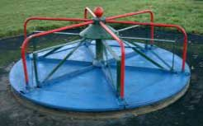
Acceleration: Special relativity
Circular motion easiest to think about
Measure roundabout circumference C and diameter D by crawling around with ruler
Get ratio C/D=π
Now rotate ….

Slide 64
Acceleration: special relativity
Length contracts along direction of motion so need more ruler lengths to go round C’ > C!! But diameter is not affected as its not in direction of motion
Ratio C/D > π
Can’t happen!! …in flat space

