Slide 1
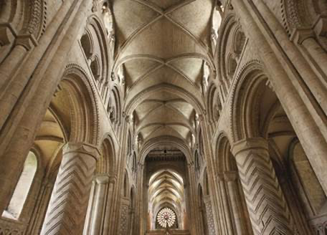
What is the church?
Not a building
(even if beautiful)

Slide 2
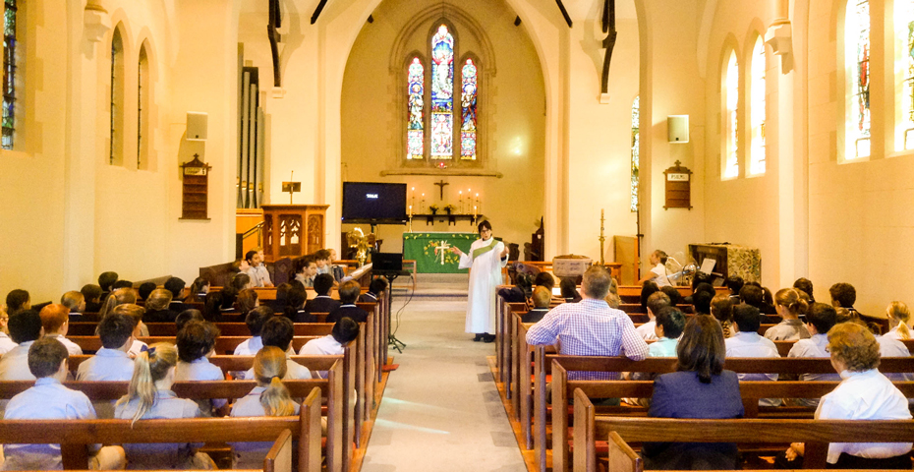
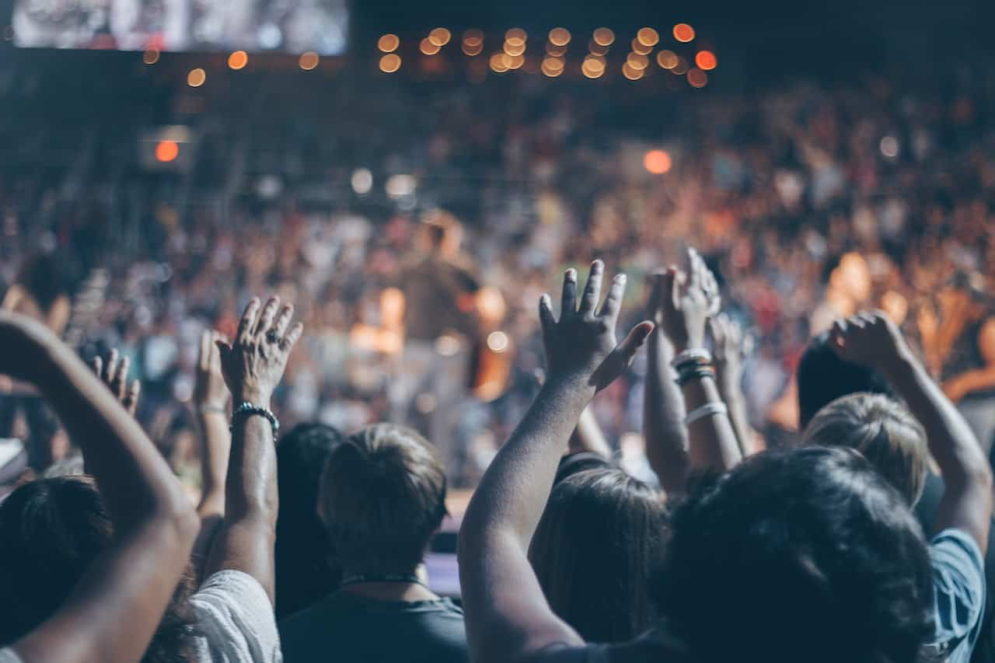
What is the church?
Not just 1-2 hours on a Sunday whether its like either of these photos!
(though its part of it)

Slide 3
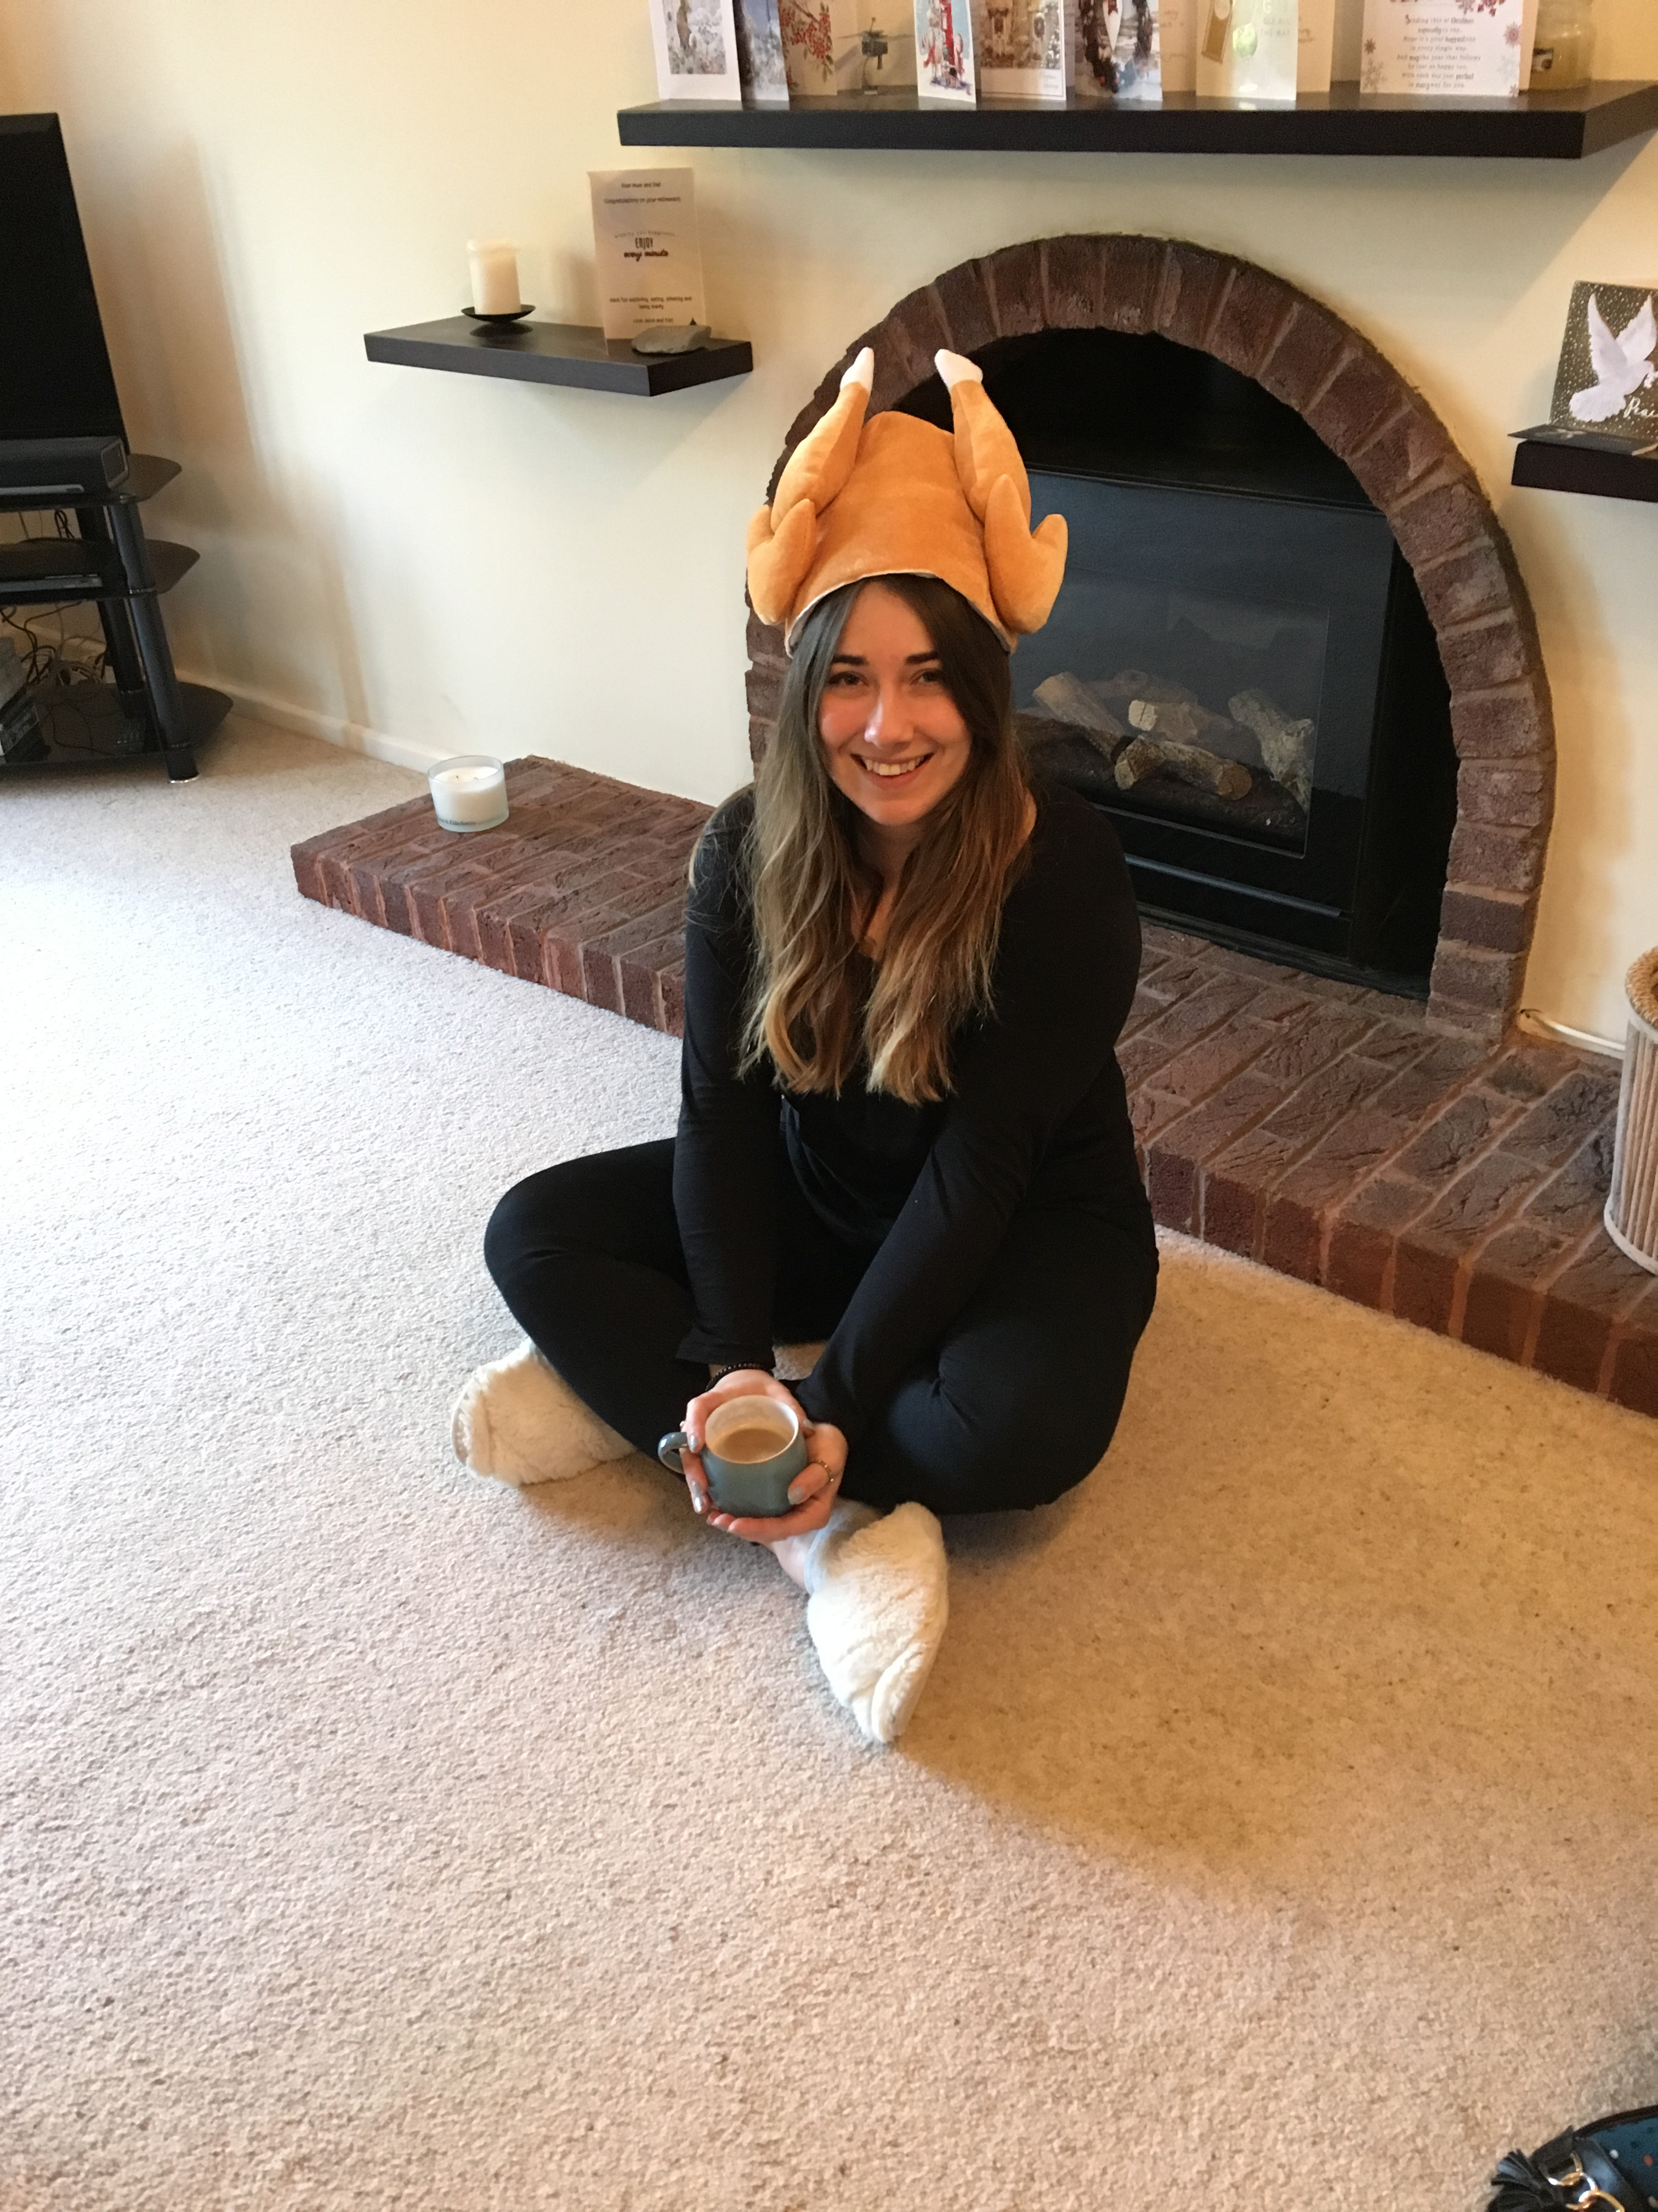
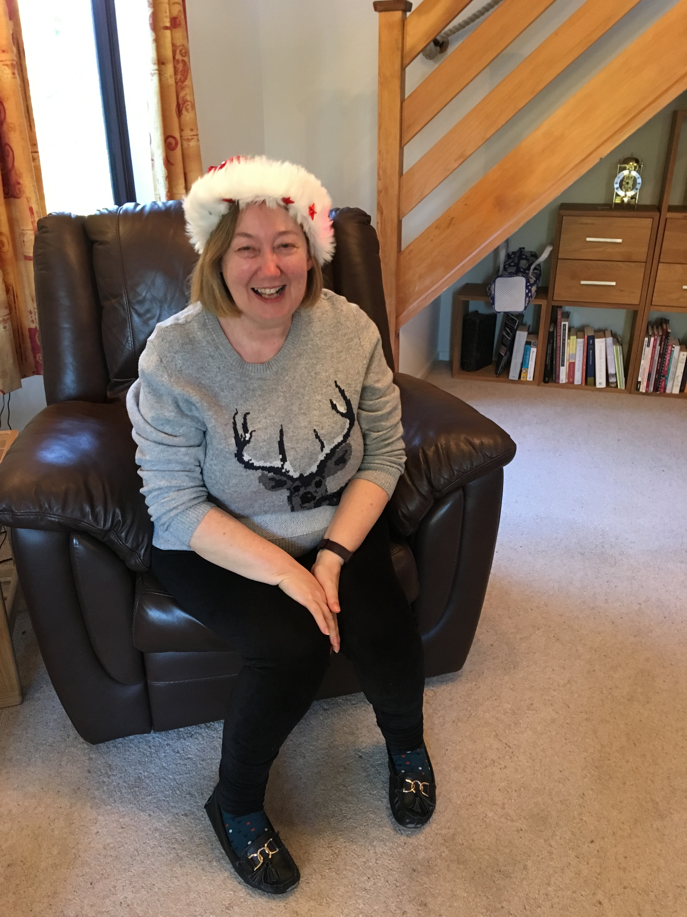
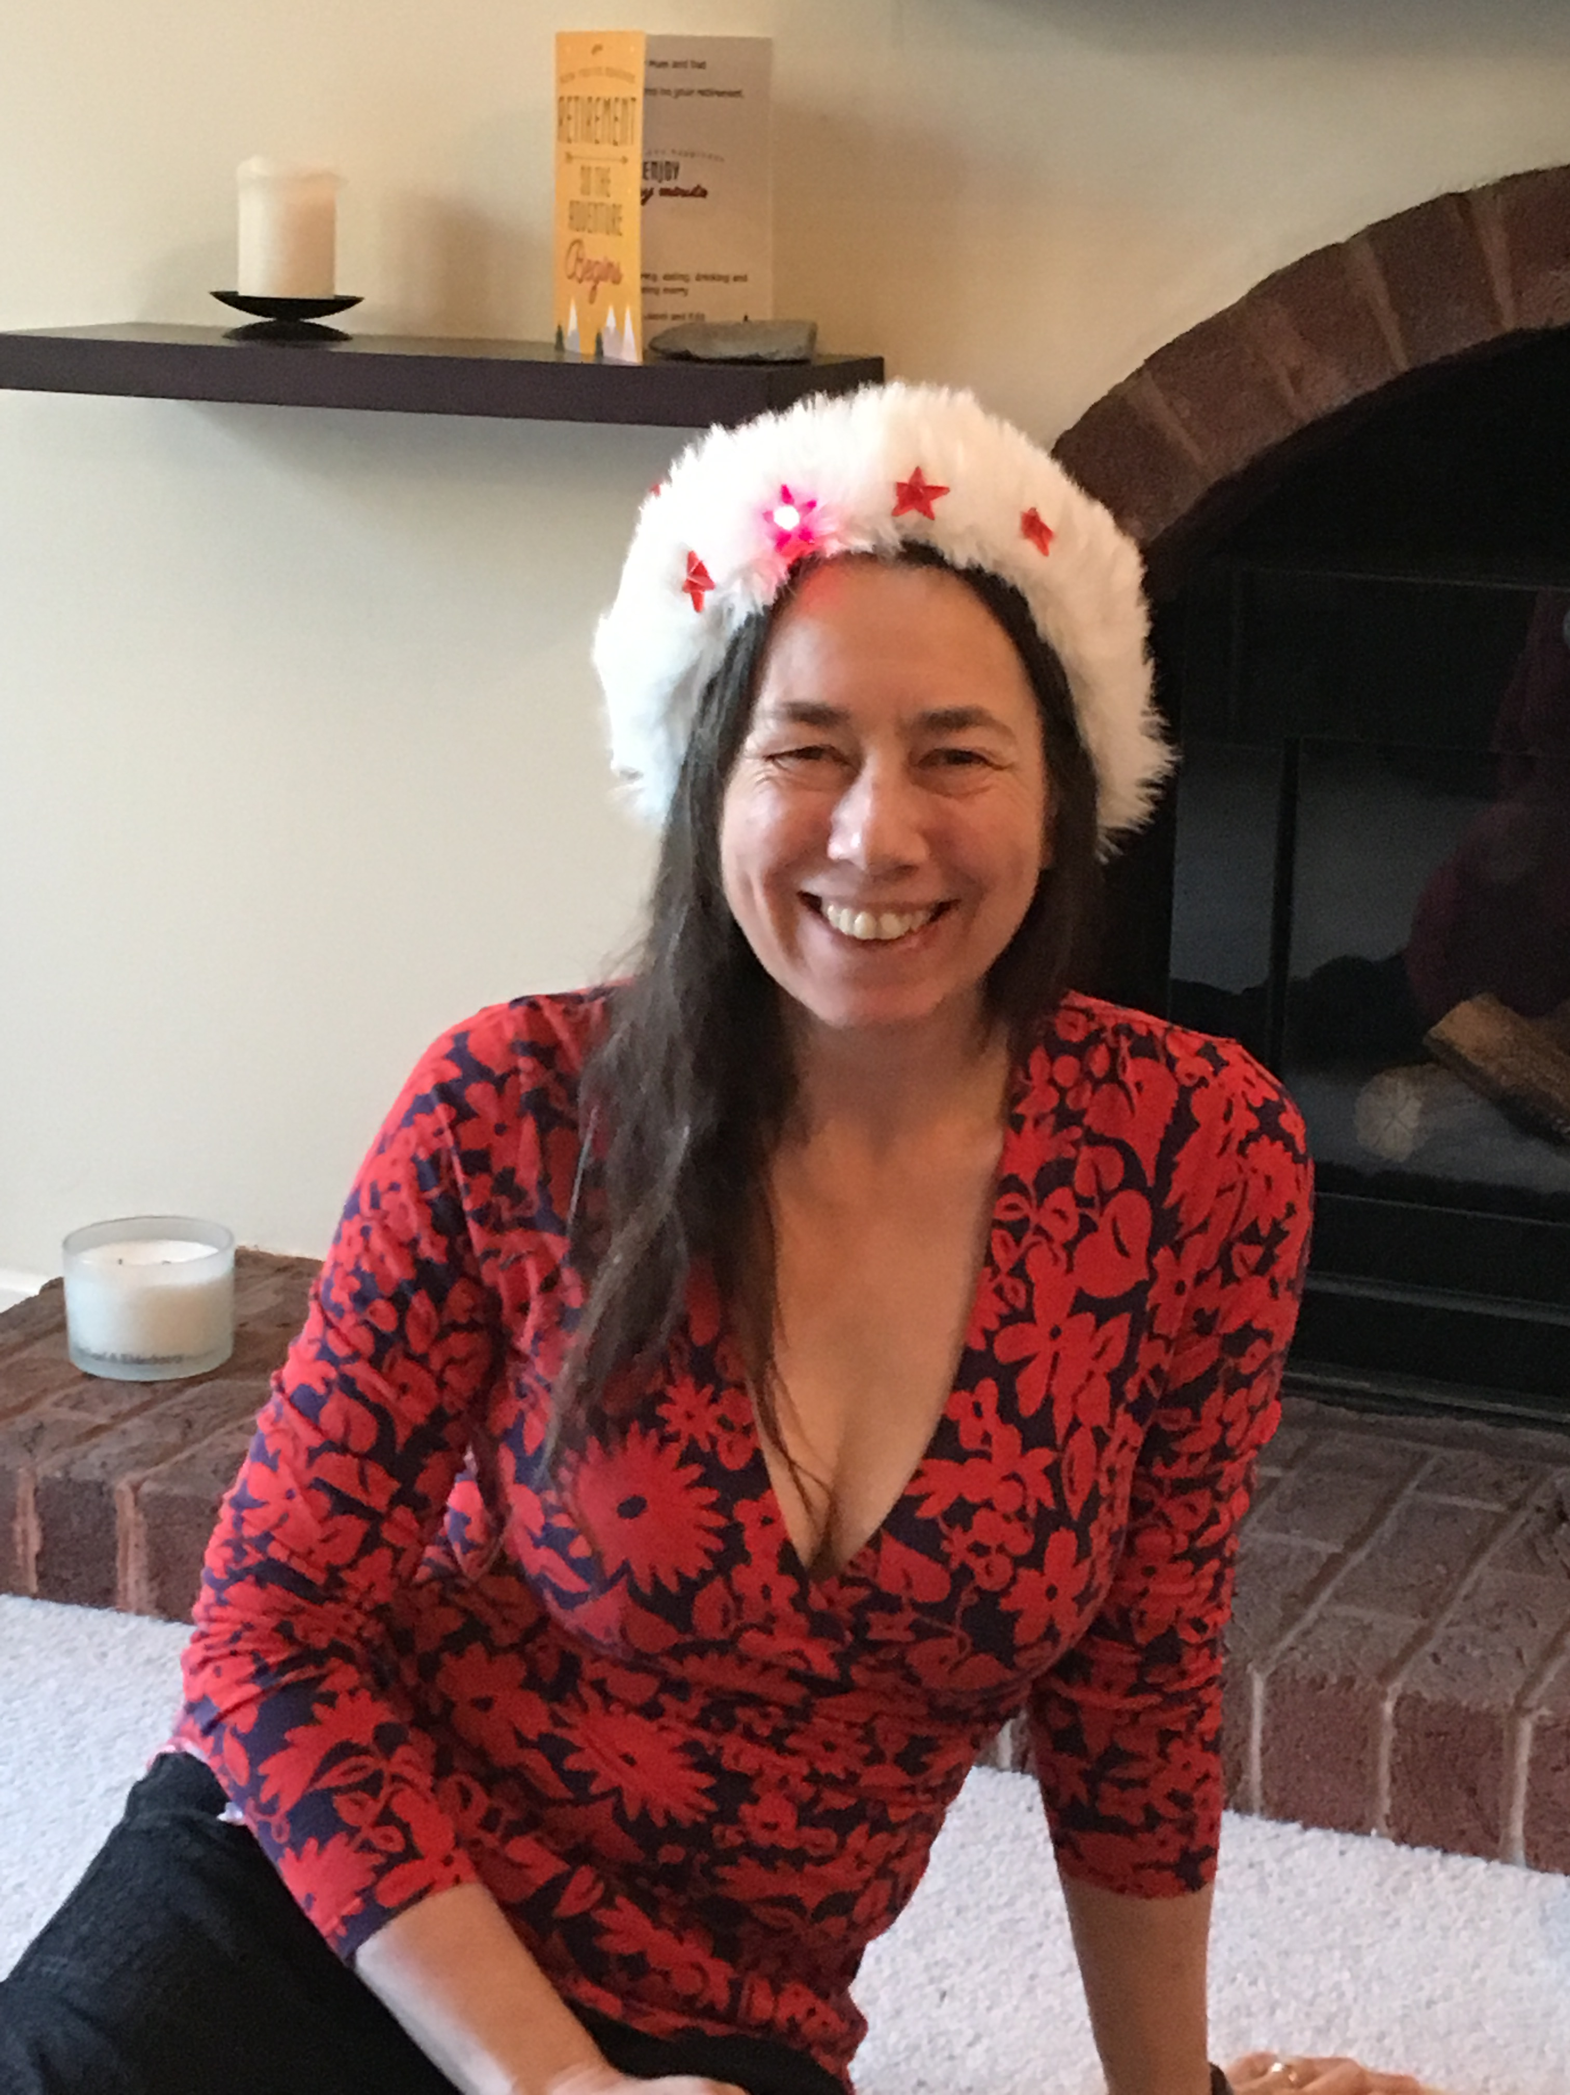
Family! children of God, Jesus is our brother
The thing that unites us is MUCH bigger than our differences…

Slide 4
Family – children of God, jesus is our brother
The thing that unites us is MUCH bigger than our differences
Brexit/remain, vax/anti, Rich/poor, monarchist/not, black/white, gender/sexuality, science/faith
My life got easier when I stopped looking for people like me!
Social media amplifies voices we like to hear/agree with.
we like to think that all right thinking people think the same way as us on controversial issues. They don’t and we don’t!

Slide 5
How do we build family with differences…
With difficulty!!! But we do it in our families and its just the same
It takes time and effort – especially after covid
Practice hospitality, don’t give up the habit of meeting together…
Covid was very isolating and we kind of got used to it!
We need to get back into the habit (need to change!)

Slide 6
Small groups!
Get to know each other as individuals - All sorts of people/life stages.
grieve with each other, celebrate with each other
Share our experience of god, working in our lives
Worship together, pray together,
prophesy over each other, practice using spiritual gifts
Support each other in reaching out, reach out together

Slide 7
Small groups!
Get to know each other as individuals - All sorts of people/life stages.
grieve with each other, celebrate with each other
Share our experience of god, working in our lives
Worship together, pray together,
prophesy over each other, practice using spiritual gifts
Support each other in reaching out, reach out together

Slide 8
Small groups!
Traditionally they meet on an evening
I’ve got kids, I work shifts, I travel a lot, I can’t travel …
Think of what could work for you – sat morning/day group?
If it doesn’t exist, come and talk to alan.
We can help connect people to set it up together!

Slide 9
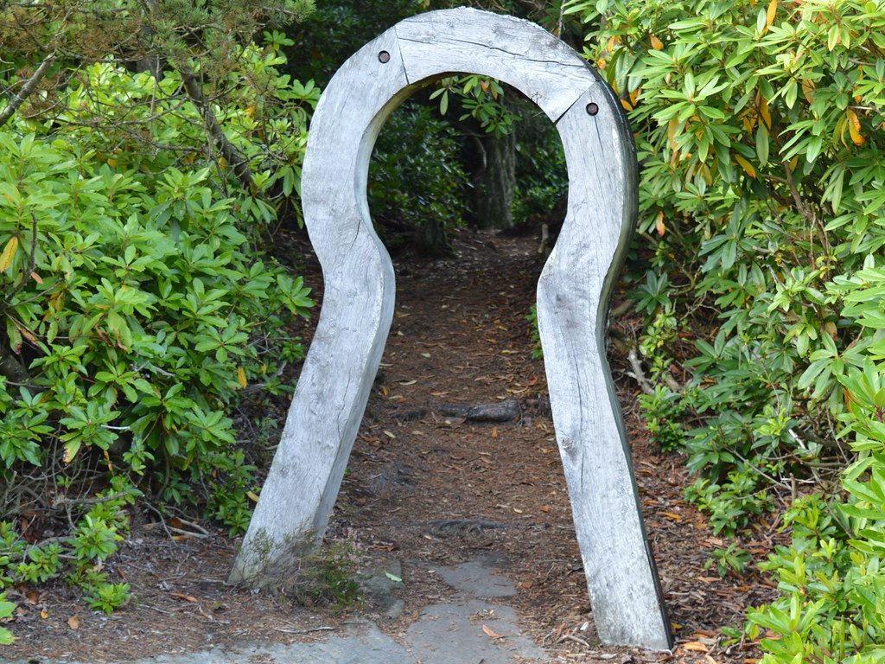
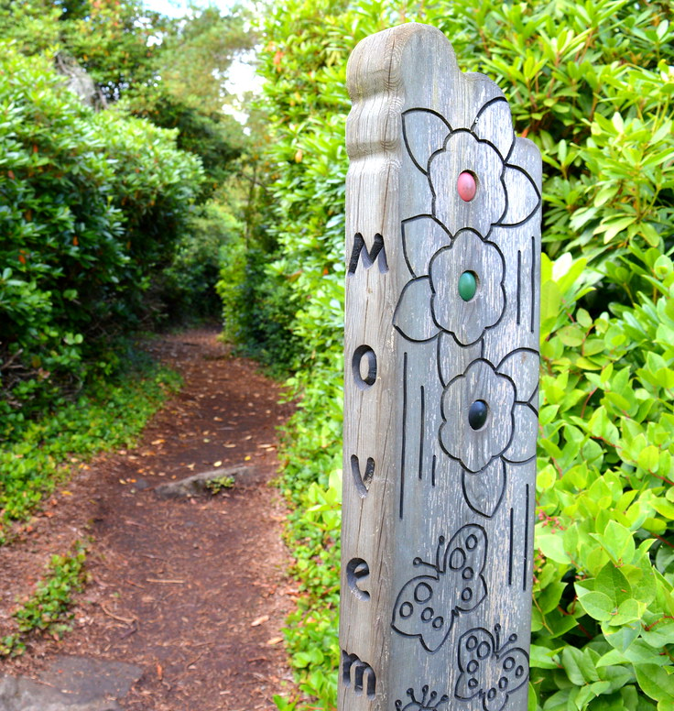
Cragside labyrinth - amazing(groan)

Slide 10
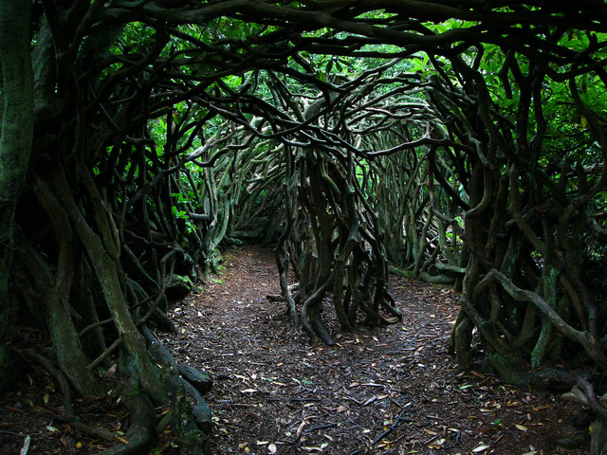
Cragside labyrinth… dark and scary if you are lost (aged 6….)

Slide 11
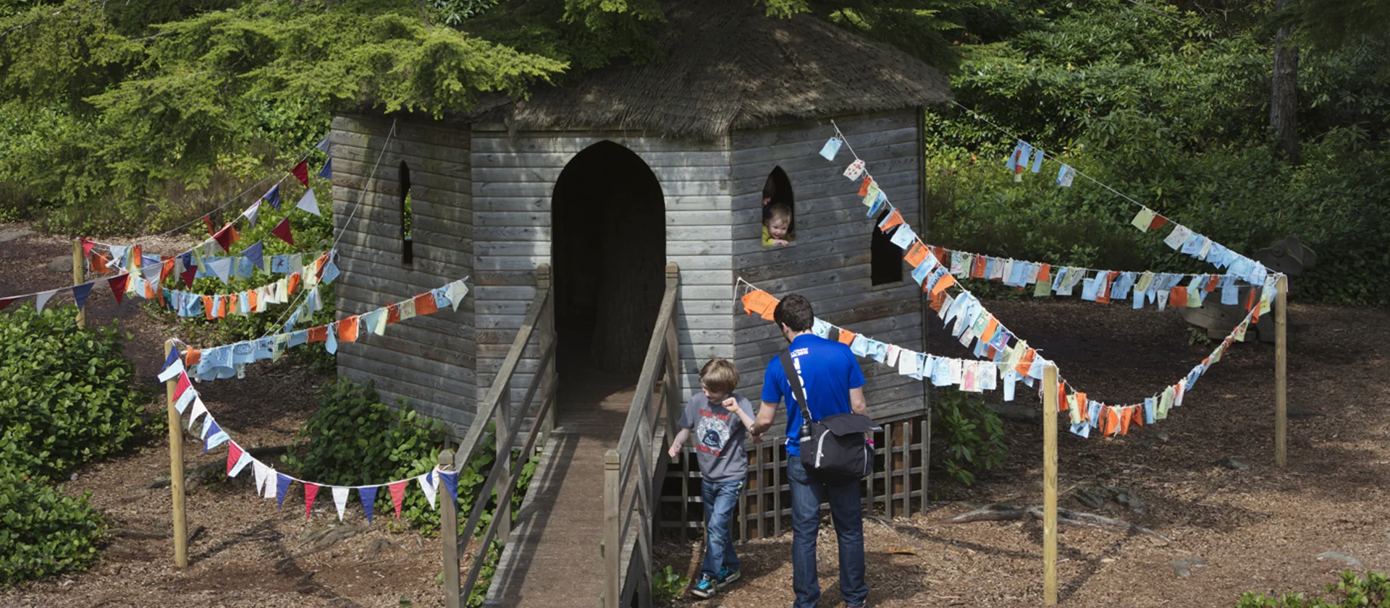
Cragside labyrinth .. Centre (treehouse)

Slide 12
Following people who seem to know where they are heading and what they are doing….
Don’t just find company in the maze of life to make you feel safe, come into the centre, come and meet your family, and be family

Slide 13
Following people who seem to know where they are heading and what they are doing….
Don’t just find company in the maze of life to make you feel safe, come into the centre, come and meet your family, and be family
And if all this is news to you, that you can have a family
Come and meet jesus, the one who makes all this possible
And then come and meet your family

