Slide 1
The Clipped Power Spectrum
Fergus Simpson
University of Edinburgh
FS, James, Heavens, Heymans (2011 PRL)
FS, Heavens, Heymans (arXiv:1306.6349)

Slide 2
Outline
Introduction to Clipping
Part I: The Clipped Bispectrum
Part II: The Clipped Power Spectrum

Slide 3
Outline
Introduction to Clipping
Part I: The Clipped Bispectrum
Part II: The Clipped Power Spectrum

Slide 4
Ripples
(easy)
Waves
(hard)

Slide 5
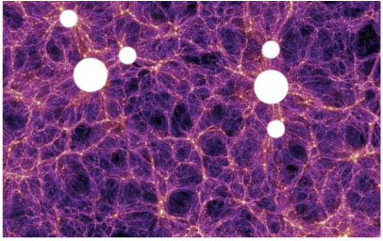
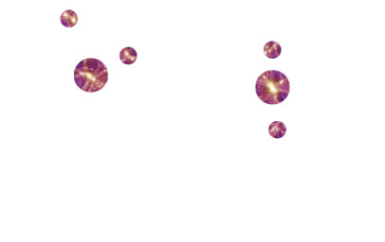
Accuracy of Perturbation Theory
Not only time dependence…
…but also spatial dependence:

Slide 6
Local Density Transformations
Reduce nonlinear contributions by suppressing high density regions
Neyrinck et al (2009)

Slide 7
Clipping
Typically only 1% of the field is subject to clipping

Slide 8
Outline
Introduction to Clipping
Part I: The Clipped Bispectrum
Part II: The Clipped Power Spectrum

Slide 9
The Bispectrum

Slide 10
The Clipped Bispectrum

Slide 11
The Clipped Bispectrum

Slide 12
The Clipped Bispectrum
FS, James, Heavens, Heymans PRL (2011)

Slide 13
Part I Summary
>10⁴ times more triangles available after clipping
Enables precise determination of galaxy bias
BUT
Why does it work to such high k?
What about P(k)?

Slide 14
Outline
Introduction to Clipping
Part I: The Clipped Bispectrum
Part II: The Clipped Power Spectrum

Slide 15
The Power Spectrum

Slide 16
The Clipped Power Spectrum

Slide 17
The Clipped Power Spectrum

Slide 18
Clipped Perturbation Theory
Reduce contributions from by suppressing regions with large

Slide 19
Clipping Part II: The Power Spectrum
Exact solution for a Gaussian Random Field δ_{G}:
Exact solution for δ² :

Slide 20
The Clipped Power Spectrum

Slide 21
The Clipped Power Spectrum

Slide 22
The Clipped Galaxy Power Spectrum

Slide 23
Parameter Constraints
FS, Heavens, Heymans arXiv:1306.6349

Slide 24
Part II: Summary
Clipped power spectrum is analytically tractable
Higher order PT terms are suppressed
Nonlinear galaxy bias terms are suppressed
Well approximated by
Applying δ_{max} allows k_{max} to be increased
~300 times more Fourier modes available
BUT what happens in redshift space?

