Slide 1
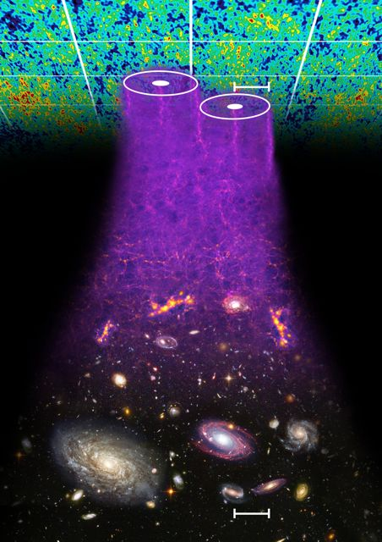
Cosmological Particle Physics
Tamara Davis
University of Queensland
With Signe Riemer-Sørensen,
David Parkinson, Chris Blake,
and the WiggleZ team

Slide 2
Overview
Measuring neutrinos with large scale structure
The WiggleZ dark energy survey
WiggleZ power spectrum
Modeling non-linearities
Neutrino mass constraints
Number of relativistic species
Also BOSS results

Slide 3
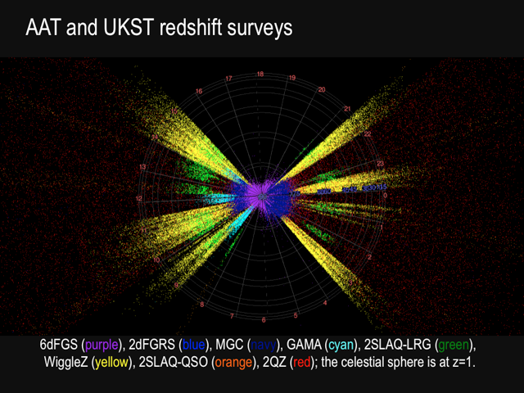
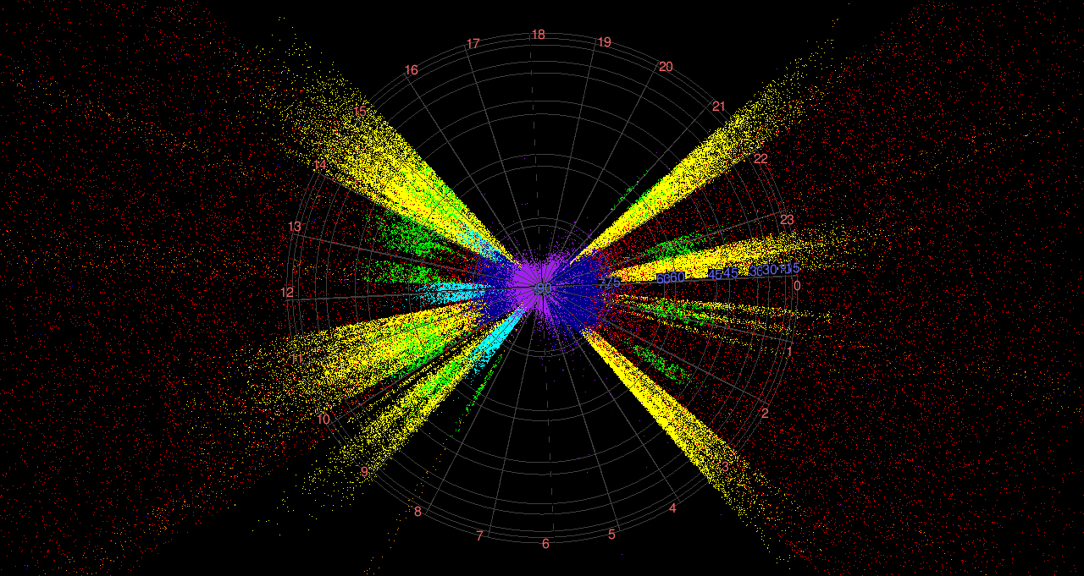

WiggleZ survey fields
(and other Aussie surveys)
7 equatorial fields, each 100-200 deg²
>9° on side, ~3 x BAO scale at z > 0.5
Physical size ~ 1300 x 500 x 500 Mpc/h

Slide 4
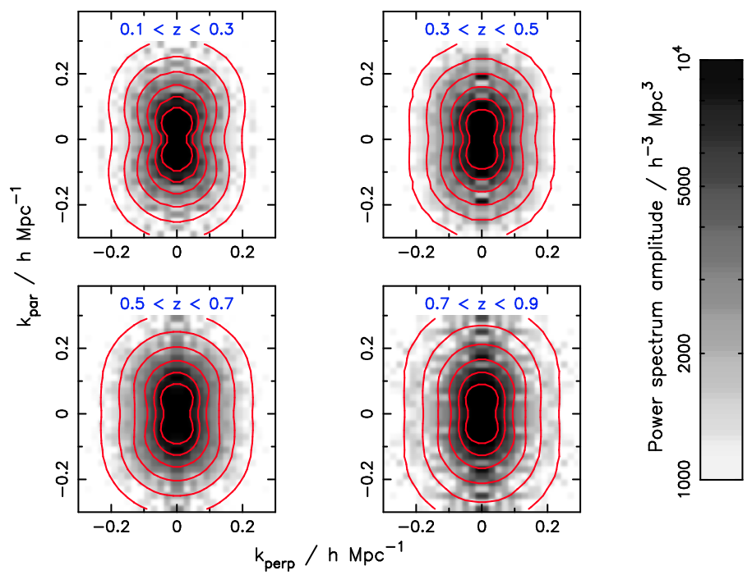
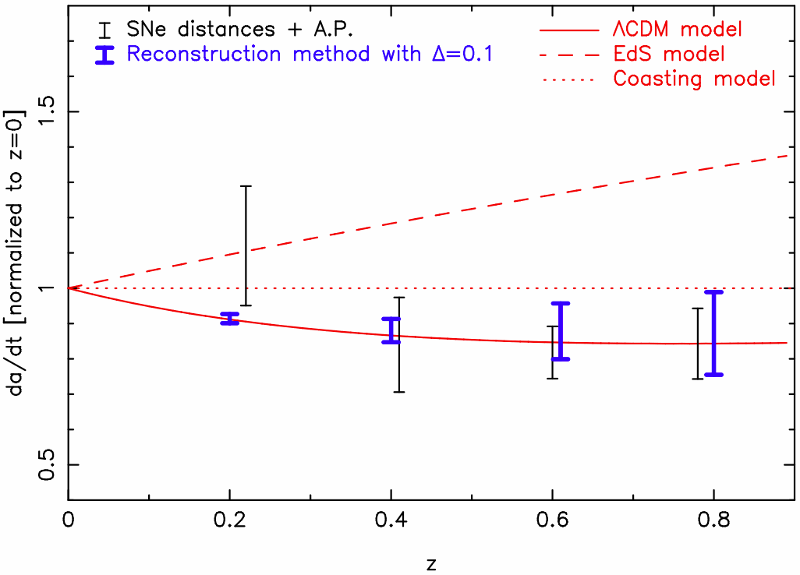
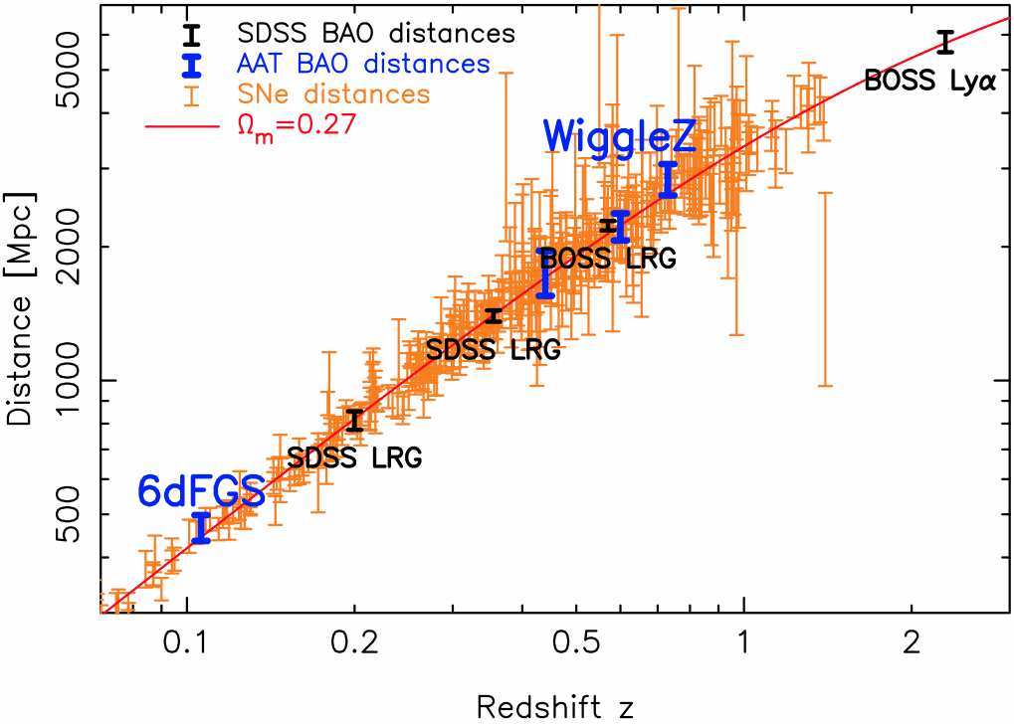
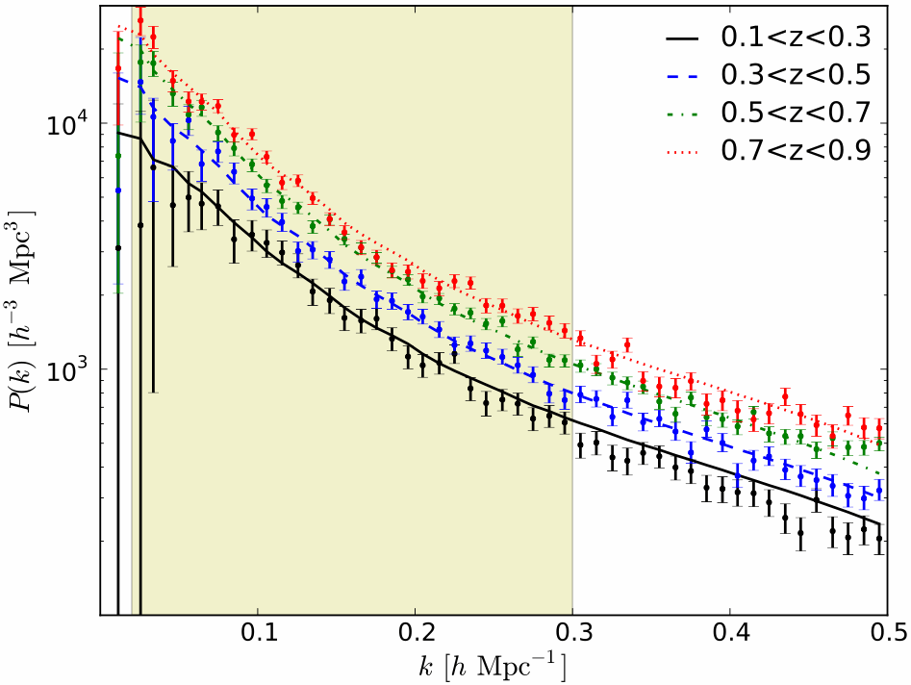
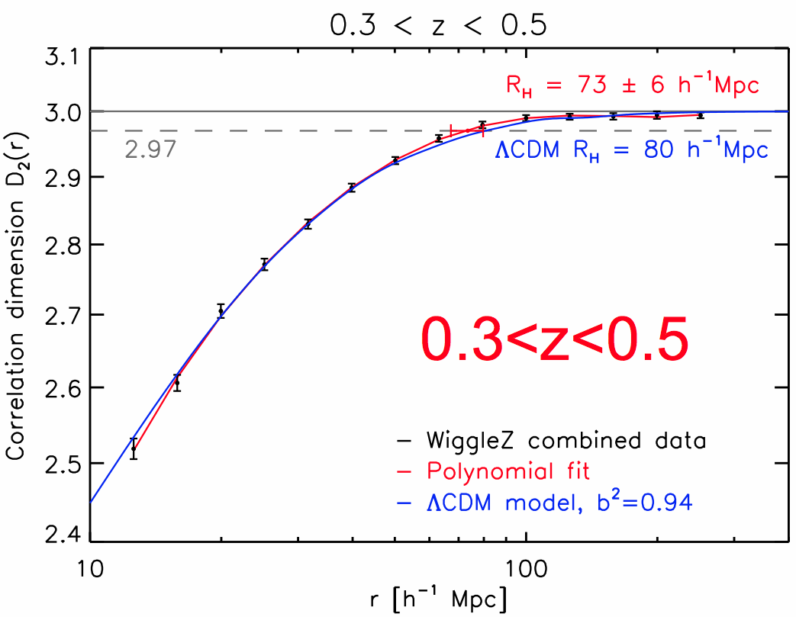
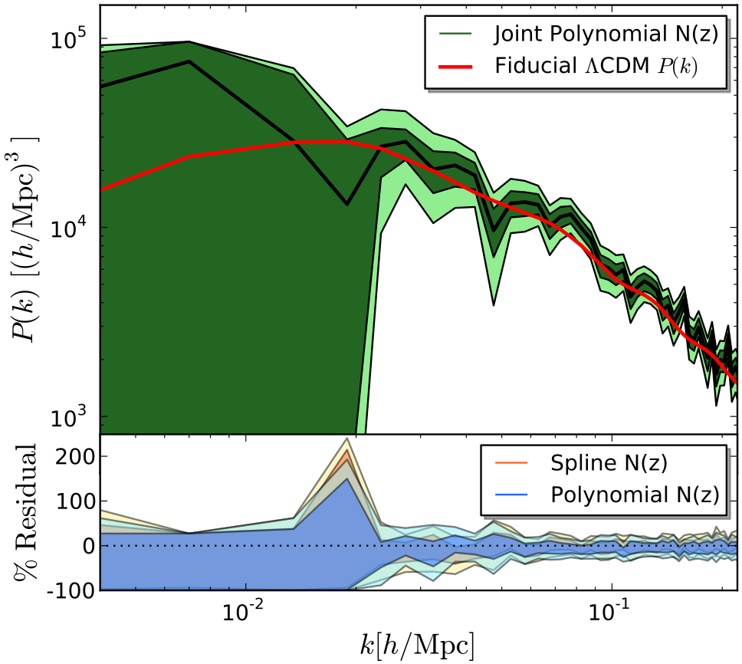
WiggleZ results
Baryon Acoustic Osc.
Growth
AP: H(z)
Blake+
1105.2862
1108.2635
Blake+
1108.2637
1204.3674
Blake+ 1104.2948
Contreras+ 1302.5178
P(k), CosmoMC, data
Homogeneity
Turnover
Parkinson+
1210.2130
Scrimgeour+
1205.6812
Poole+ 1211.5605

Slide 5
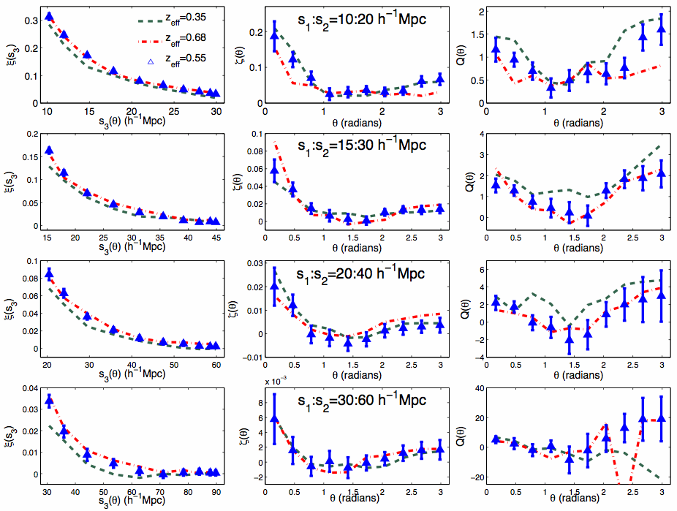
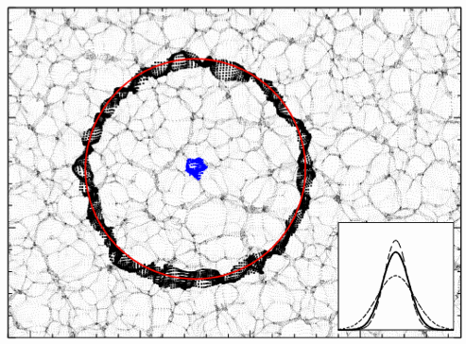
Baryon Acoustic Osc.
Growth
AP: H(z)
Blake (Thurs 9.30)
Beutler(Thurs 10.00)
P(k), CosmoMC, data
Homogeneity
Turnover
Scrimgeour (Poster)
Bispect, 3pt, topology
Reconstruction
2D BAO
Marin (Thurs 15.15)
Kazin(Thurs 10.20)
Marin+ 1303.6644

Slide 6
Neutrino mass and N_{eff}
Riemer-Sørensen, Blake, Parkinson, Davis, et al. 2012 (1112.4940)
Riemer-Sørensen, Parkinson, Davis, Blake 2013 (1210.2131)
Riemer-Sørensen, Parkinson, Davis 2013a,b (1301.7102, 1306.4153)

Slide 7
Upper-limit on neutrino mass
Riemer-Sørensen, Parkinson, Davis 1306.4153
Planck+BAO
Σm_{ν} < 0.247 eV
Planck+BAO+WiggleZ
Σm_{ν} < 0.15 eV
= 40% improvement on Planck+BAO alone
Riemer-Sørensen, Parkinson, Davis 2013
Flat ΛCDM
Allowed range for the sum of neutrino masses is now:
0.05 eV < Σm_{ν} < 0.15 eV
(lab oscillation expts) (cosmology, 95% confidence)

Slide 8
How to constrain neutrino mass
WiggleZ range
Non-linearities
important
Heavy neutrinos =
strong suppression over
short range
Light neutrinos =
weak suppression over
long range
Ω_{ν}
Changes balance of radiation to dust
  changes expansion rate vs time
  changes horizon size at matter radiation equality

Slide 9
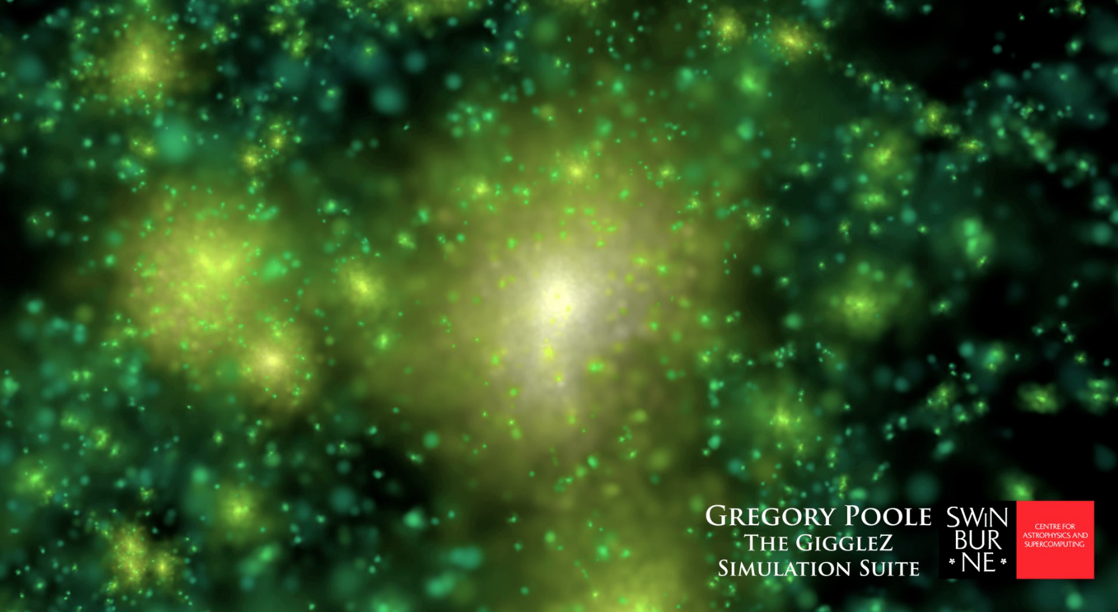
Modeling
Use sims to make non-linear corrections

Slide 10
Details: Which tracers? Different bias.
WiggleZ has some advantages:
High redshift
Less biased than Luminous Red Galaxies (LRGs)
However, harder
to simulate
Non-linearities less severe for WiggleZ
WiggleZ galaxies at z = 0.2
Massive highly biased galaxies at z = 0.2
WiggleZ galaxies at z = 0.6

Slide 11
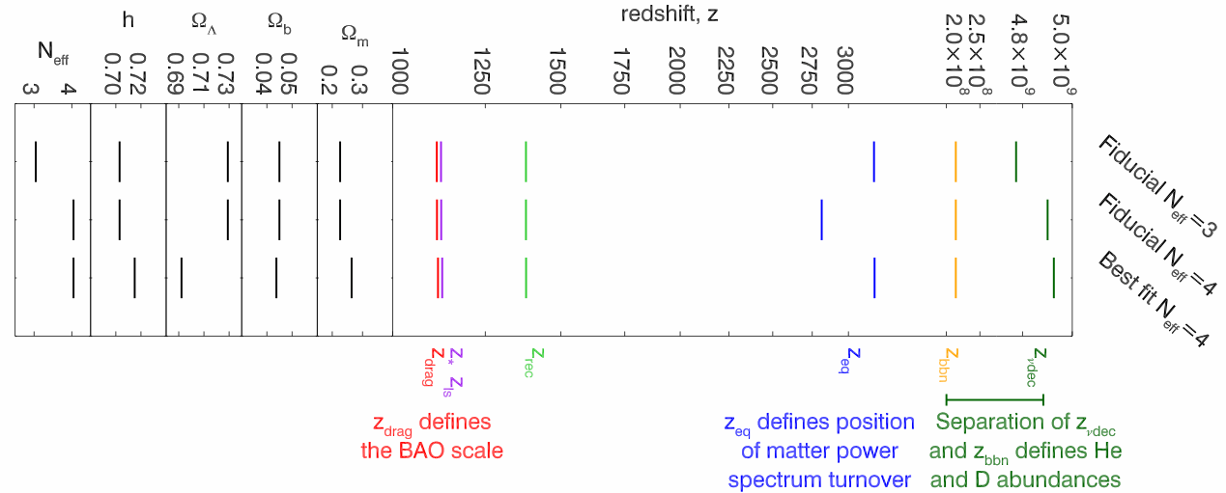
Neutrino effects – N_{eff}
Riemer-Sørensen et al. 1301.7102

Slide 12
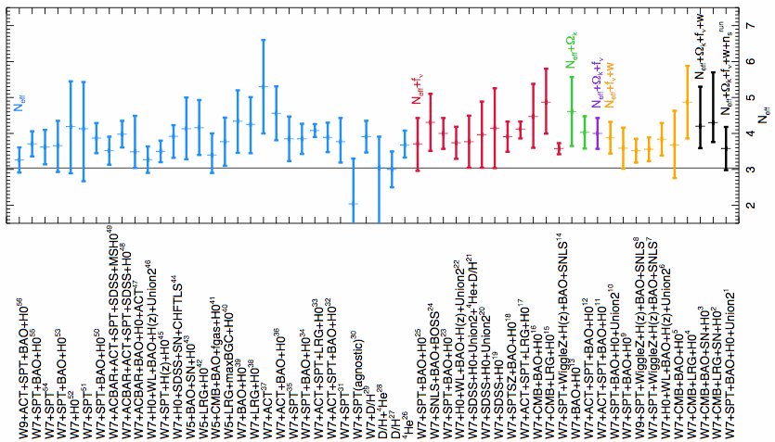
Existing measurements
Total Mass: (e.g.)
SDSS (Reid+ 10) Σm_{υ} < 0.62eV
Photo (Thomas+ 10,
dePutter+ 12) Σm_{υ} < 0.28eV
Ly-α (Seljak+ 06) Σm_{υ} < 0.17eV
1301.7102
Number of relativistic species:
N_{eff} = 4
N_{eff} = 3
+BAO
Planck+WL+highL

Slide 13
The WiggleZ measurement
WiggleZ power spec. (bars)
Best fit ΛCDM models for
k_{max}=0.2 hMpc⁻¹ (red solid)
k_{max}=0.3 hMpc⁻¹ (blue solid)
Linear CLASS models for the same parameters (dotted).
(We actually fit
4 z-bins, 7 regions,
simultaneously, so
28 power spectra.)
1306.4153

Slide 14
Details: How far to trust P(k)
Contours for Planck+WiggleZ as a function of k_{max}. Notice the agreement with Planck.
Only k_{max}=0.3 hMpc⁻¹ deviates.
We choose k_{max}=0.2h Mpc⁻¹ for the analysis.
Riemer-Sørensen et al. 1306.4153
1306.4153

Slide 15
Details: Wider parameter space
+WiggleZ P(k)
Planck
+WiggleZ P(k)
+ Other BAO
+Other BAO
excluded by particle physics.
+HST
Riemer-Sørensen et al. 1306.4153
Σm_{ν} < 0.15eV (95% CL) for BAO+Planck+WiggleZ

Slide 16
Strongest upper-limit on neutrino mass
Riemer-Sørensen et al. 1306.4153
Planck+BAO
Σm_{ν} < 0.247 eV
Planck+BAO+WiggleZ
Σm_{ν} < 0.15 eV
= 40% improvement on Planck+BAO alone
Riemer-Sørensen, Parkinson, Davis 2013
Allowed range for the sum of neutrino masses is now:
0.05 eV < Σm_{ν} < 0.15 eV
(lab oscillation expts) (cosmology, 95% confidence)

Slide 17
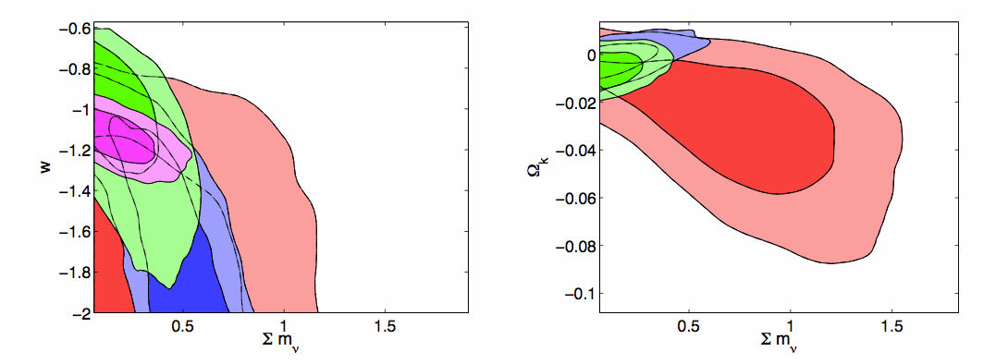
New BOSS paper!
Planck
+BOSS BAO
+BOSS P(k)
+SNe Ia
Giusarma, de Putter, Ho, Mena 2013
Planck+BAO+BOSS
Σm_{ν} < 0.39 eV (ΛCDM) **NOT FLAT**
Σm_{ν} < 0.48 eV (wCDM)

Slide 18
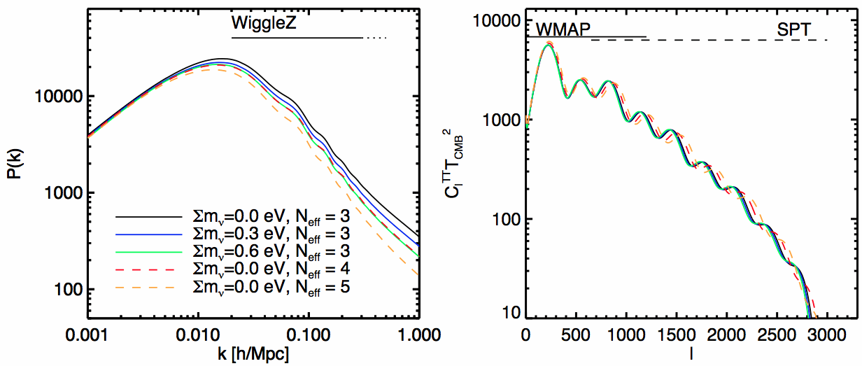
Neutrino mass + number of species (N_{eff})
(95% limits)
Planck+WP+highL : N_{eff} = 3.29 + 0.67 - 0.64 and Σm_{ν} < 0.60 eV
Planck+WP+highL+BAO : N_{eff} = 3.32 + 0.54 - 0.52 and Σm_{ν} < 0.28 eV
Planck+++WiggleZ : N_{eff} = 3.72 ± 0.36 ± 0.71 and Σm_{ν} < 0.27 eV
Planck+++WiggleZ+BAO : N_{eff} = 3.90 ± 0.34 ± 0.69 and Σm_{ν} < 0.24 eV
Notes:
Doing so,
we find Neff=3.72 ± 0.36, and a weaker upper limit
of 􏰀mν< 0.27eV for Planck+WiggleZ. For the most
stringent combination of Planck+WiggleZ+BAO we get
Neff =3.9 ± 0.34 and 􏰀 mν < 0.24 eV. Although the
Planck results alone gave no strong support for extra
species, they still sat at N =3.36+0.68 for Planck alone5
eff −0.64 or Neff =3.52+0.48 when combined with BAO and H0 , ap-
−0.45 proximately 1σ above the standard Neff= 3.046. Com-
bining with large scale structure measurements, as we have done here, now prefers extra species at approxi- mately the 2σ level (Neff =3.72 ± 0.36), and with HST that goes up to 3σ (Neff =3.94 ± 0.28). We note that with extra neutrino species allowed, the tension between Planck+HST is somewhat alleviated [as also noted by 1], and that remains true after WiggleZ data is added, but the tension still remains and the resulting neutrino mass constraint may be artificially enhanced. As mentioned in [24] the preference for high Neff might simply originate in lack of understanding of late time physics.

Slide 19
Existing measurements
Number of relativistic species:
N_{eff} = 4
N_{eff} = 3
+BAO
+WiggleZ
+WiggleZ+BAO
Planck+WL+highL
Riemer-Sørensen et al. 1301.7102

Slide 20
Summary
Riemer-Sørensen, Blake, Parkinson, Davis, et al. 2012 (1112.4940)
Riemer-Sørensen, Parkinson, Davis, Blake 2013 (1210.2131)
Riemer-Sørensen, Parkinson, Davis 2013a,b (1301.7102, 1306.4153)
Large scale structure can put limits on neutrino mass, & number of relativistic species.
Those upper limits are getting close to the lower limits from particle physics experiments.
Better modelling of non-linear structure formation is needed before we can be confident of the result, & before we can use more of the data.
Notes:
Chris Lidman, Brian Boyle, Warrick Couch
don't blink, as big as my..., resistance is futile, unplanned discharge, leprosy, spandex

