Slide 1

Measurement of the electron’s electric dipole moment
Mike Tarbutt
Centre for Cold Matter, Imperial College London.
Ripples in the Cosmos, Durham, 22nd July 2013

Slide 2
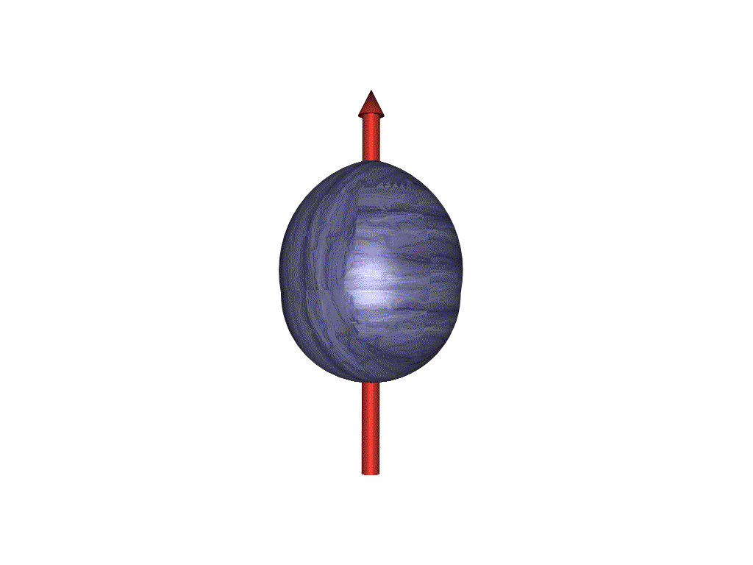
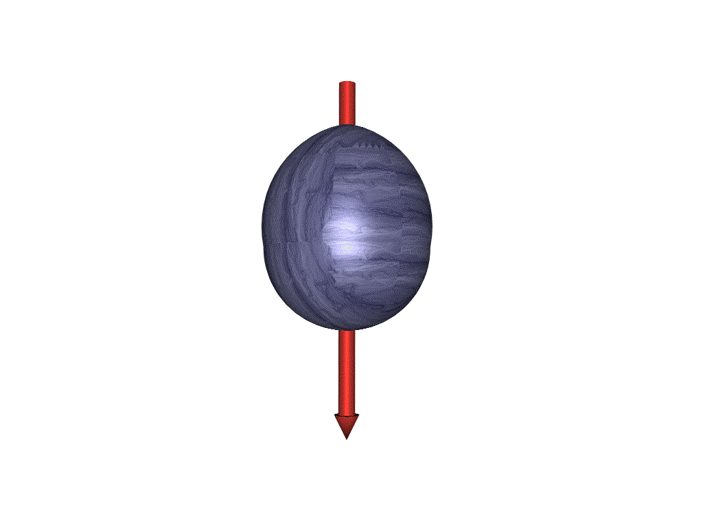
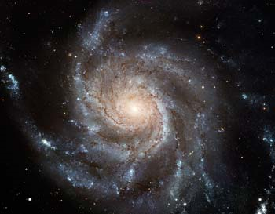
The electron’s electric dipole moment (EDM, d_{e})
-
T
10⁻²²
-
Spin
Spin
+
+
10⁻²⁴
MSSM
Edm
Edm
10⁻²⁶
Multi Higgs
Left -Right
Other SUSY
Either d_{e} = 0, or T
10⁻²⁸
Predicted values for the electron edm d_{e} (e.cm)
10⁻³⁰
T
implies
CP
10⁻³²
10⁻³⁴
10⁻³⁶
Standard Model
Insufficient CP

Slide 3
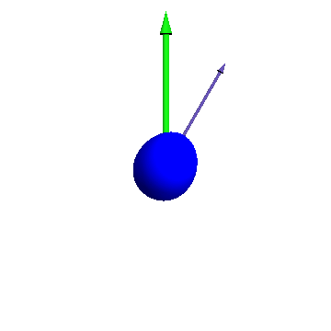
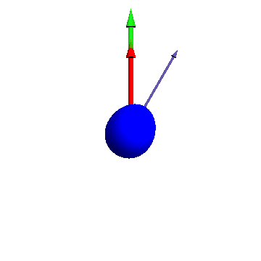
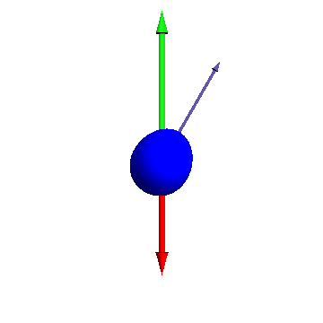
Measuring the EDM – spin precession
B
& E
E
Particle precessing in a magnetic field
Particle precessing in parallel magnetic and electric fields
Particle precessing in anti-parallel magnetic and electric fields
Measure change in precession rate when electric field direction is reversed
We use the valence electron in the YbF molecule

Slide 4
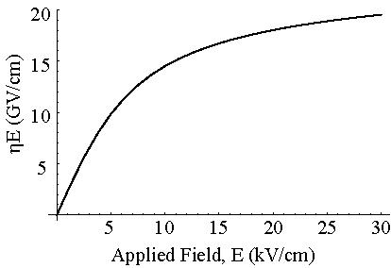
We use a beam of YbF molecules
Interaction energy = - d_{e} .E_{eff}
E_{eff} = F P
Polarization factor
Structure dependent, ~ 10 (Z/80)³ GV/cm
Effective field, E_{eff} (GV/cm)

Slide 5
Simplified measurement scheme
Pulsed YbF molecular beam
1st rf pulse
E
hf = 2μB
± 2 d_{e} E_{eff}
B
±
2nd rf pulse
analyze spin direction

Slide 6
Result (2011)
6194 measurements of the EDM, each derived from 4096 beam pulses
Each measurement takes 6 minutes
d_{e} = (-2.4 ± 5.7_{stat} ± 1.5_{syst}) × 10⁻²⁸ e.cm
| d_{e} | < 10.5 × 10⁻²⁸ e.cm (90% confidence level)
Nature 473, 493 (2011)

Slide 7

Implications
Excluded region
10⁻²²
selectron
γ
10⁻²⁴
MSSM
e
e
10⁻²⁶
gaugino
Multi Higgs
Left -Right
Other
SUSY
10⁻²⁸
Predicted values for the electron edm d_{e} (e.cm)
10⁻³⁰
Mass of new particle
CP-violating phase
10⁻³²
10⁻³⁴
For M_{s}= 200 GeV and θ_{CP} ≈1
10⁻³⁶
=> d_{e} ≈ 10⁻²⁴ e.cm
Standard Model
M_{s} > 4 TeV ?
θ_{CP} < 10⁻³ ?

Slide 8
Some other electron EDM experiments
With molecules:
ThO at Harvard \ Yale - new result anticipated with very high sensitivity
WC at Michigan – in development
With ions:
HfF⁺ at JILA – trapped ion with rotating E & B fields, very long coherence times, being developed
With atoms:
Trapped ultracold Cs at Penn State and U. Texas, being developed
Trapped ultracold Fr at Tohoku / Osaka, being developed
With solids:
Gadolinium Garnets at LANL and Amherst – lots of electrons, but difficult to control systematic effects

Slide 9
Particle EDMs - historic and present limits
d(μ)  2×10⁻¹⁹
neutron:
10⁻²⁰
electron:
σ [d] (e.cm)
10⁻²²
d(p)  6×10⁻²³
10⁻²⁴
d(n)  3×10⁻²⁶
10⁻²⁶
d(e)  1×10⁻²⁷
10⁻²⁸
1960
1970
1980
1990
2000
2010
2020
2030
Year

Slide 10
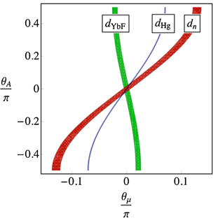
CMSSM constraints from EDM measurements
tan β = 3, M_{SUSY}=500GeV
M. Le Dall and A. Ritz, Hyperfine Interactions 214, 87 (2013)

Slide 11
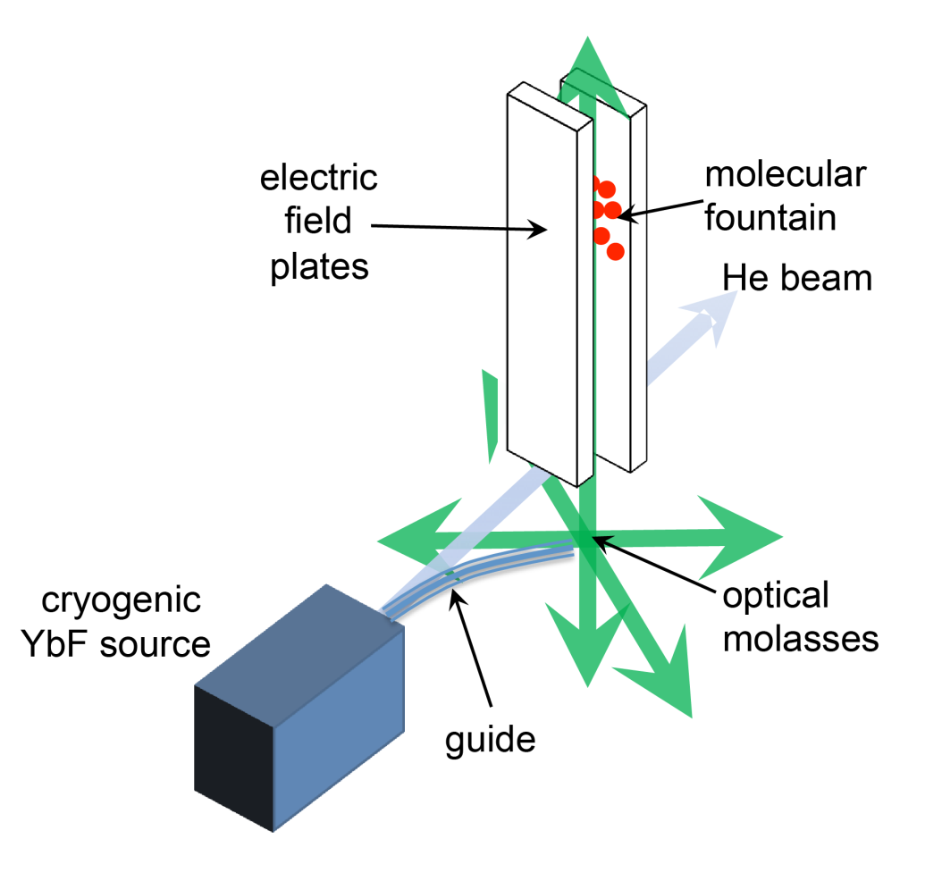
Future experiments with YbF molecules
Upgrades to existing experiment – x10 improvement (in progress)
Molecular fountain of ultracold YbF molecules (under development)
x1000 improvement

Slide 12

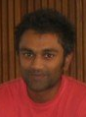

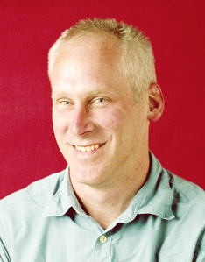

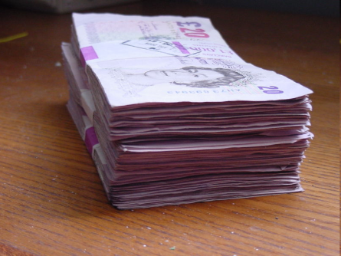


Thanks...
Dhiren Kara
Jack Devlin
Joe Smallman
Jony Hudson
Ben Sauer
Ed Hinds

Slide 13
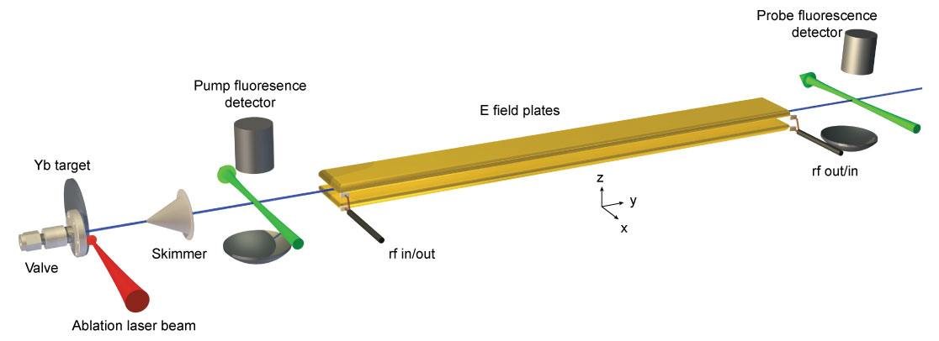
The YbF EDM experiment – schematic
J. J. Hudson, D. M. Kara, I. J. Smallman, B. E. Sauer, M. R. Tarbutt & E. A. Hinds, Nature 473, 493 (2011)

Slide 14
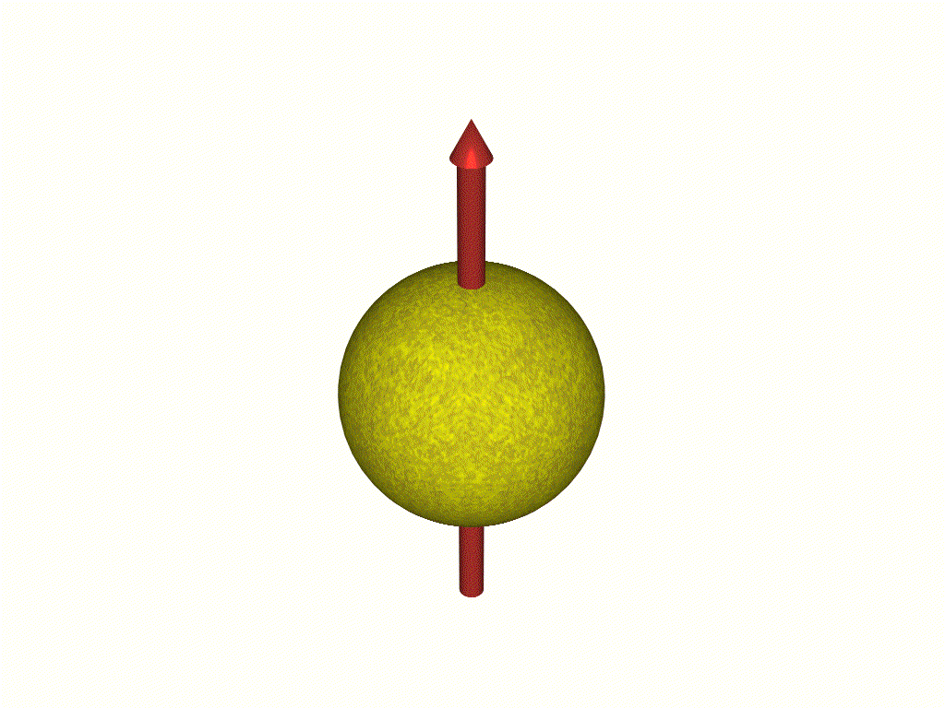
Using atoms & molecules to measure d_{e}
For a free electron in an applied field E, expect an interaction energy -d_{e}.E
N.B. Analogous to interaction of magnetic dipole moment with a magnetic field, -μ . B
E
Interaction energy = - d_{e} .E_{eff}
E_{eff} = F P
Polarization factor
Structure dependent, ~ 10 (Z/80)³ GV/cm
Electric
Field
Atom / Molecule
For more details, see E. A. Hinds, Physica Scripta T70, 34 (1997)

Slide 15
Ground state YbF
E
d_{e} E_{eff}
M_{F}
-1
0
+1
F = 1
-d_{e} E_{eff}
X ²Σ⁺ (ν = 0, N = 0)
170 MHz
F = 0
Electric
Field
We measure the splitting 2d_{e}E_{eff} between the M_{F} = +1 and M_{F} = -1 levels

Slide 16
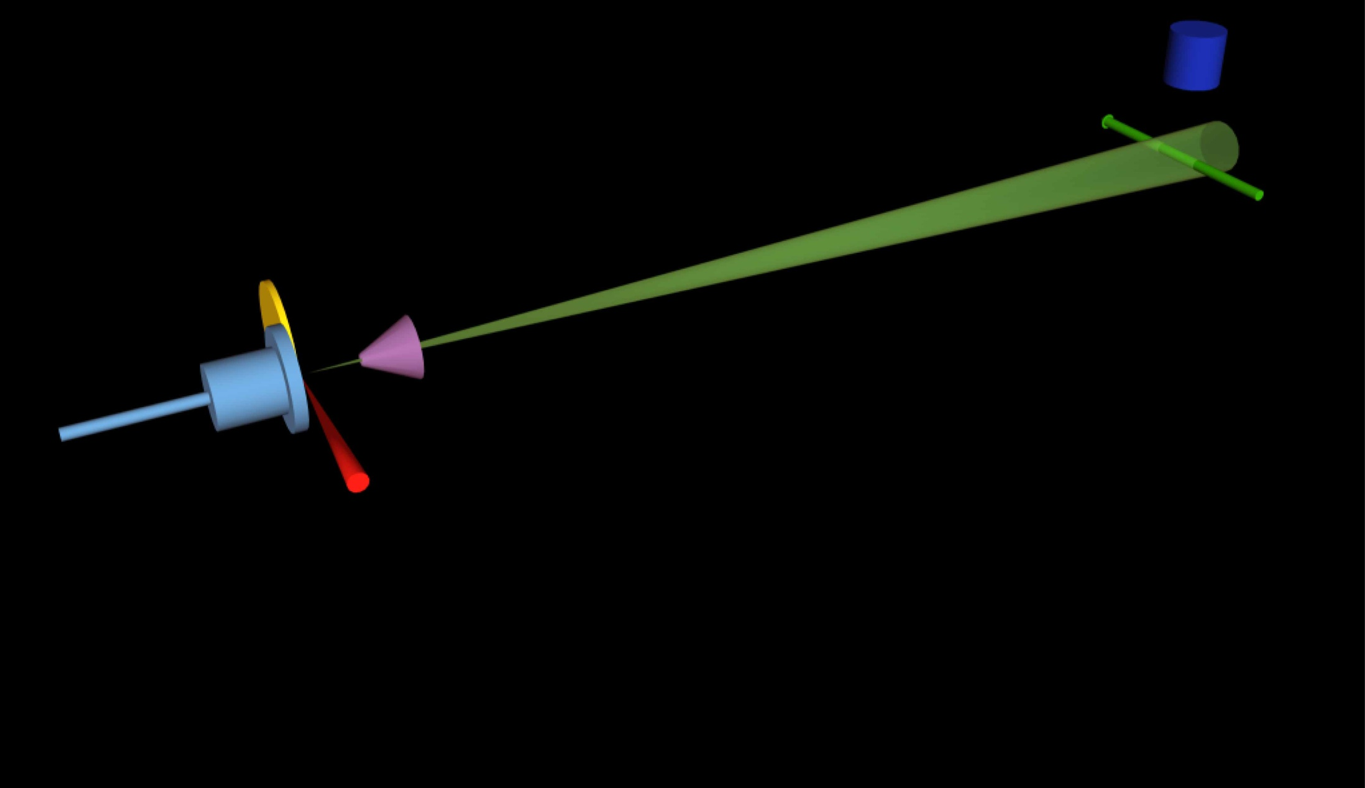
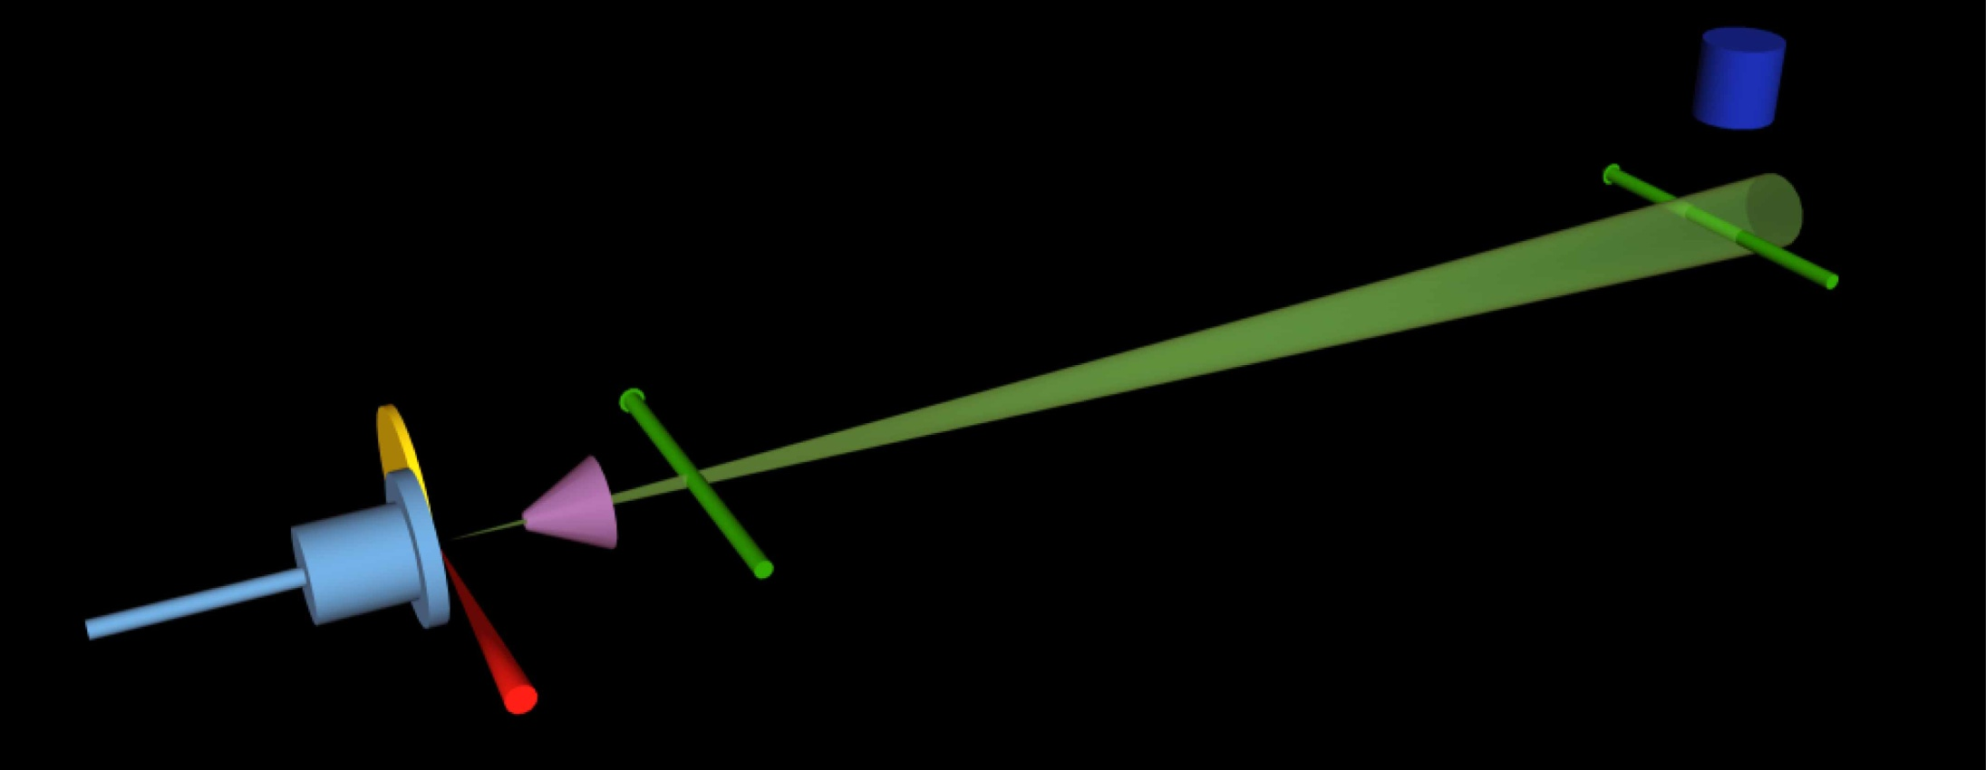
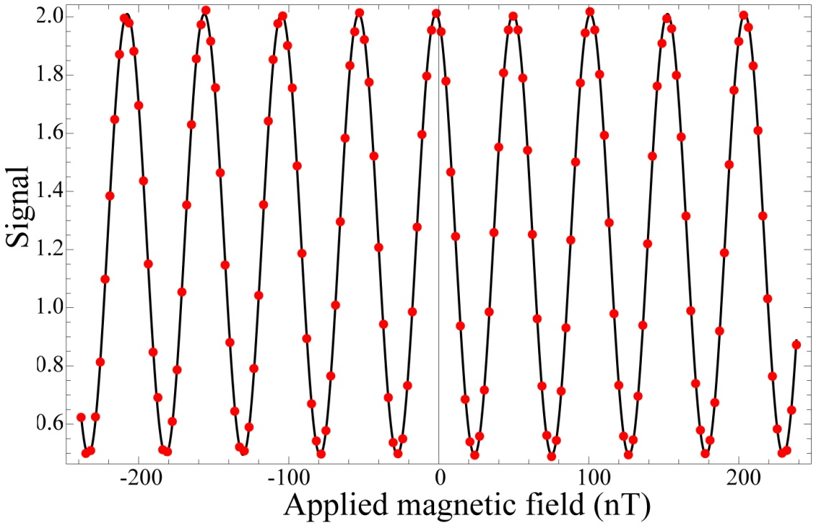
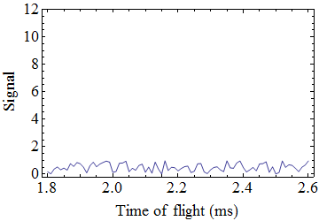
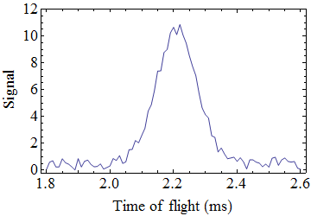
Measurement scheme – a spin interferometer
PMT
3K beam
Pulsed YbF
beam
Probe
A-X Q(0) F=0
Pump
A-X Q(0) F=1
F=1
F=0

Slide 17
Measuring the edm with the interferometer
Signal α cos² [φ/2] = cos² [(μ_{B} B – d_{e} E_{eff} ) T / ћ]
Counts
B
E
E

Slide 18
Modulate everything
±E
±B
±ΔB
±rf1f
spin
interferometer
±rf2f
±rf1a
Signal
±rf2a
±rfφ
±laser f
9 switches:
512 possible correlations
The EDM is the signal correlated with the sign of E.B
We study all the other 511 correlations in detail

Slide 19
Correcting a systematic error
F = 1
E
F = 1
E
Stark-shifted hyperfine interval
rf
rf
Stark-shifted hyperfine interval
F = 0
F = 0
rf detuning
Imperfect E-reversal
phase shift: ~100 nrad/Hz
Changes detuning via Stark shift
Phase correlated with E-direction
Correction to EDM: (5.5 ± 1.5) × 10⁻²⁸ e.cm

Slide 20
Systematic uncertainties
Effect | Systematic uncertainty (10⁻²⁸ e.cm)
Electric field asymmetry | 1.1
Electric potential asymmetry | 0.1
Residual RF1 correlation | 1.0
Geometric phase | 0.03
Leakage currents | 0.2
Shield magnetization | 0.25
Motional magnetic field | 0.0005

Slide 21
How to do better
The statistical uncertainty scales as:
Electric field
Total number of participating molecules
Coherence time

Slide 22
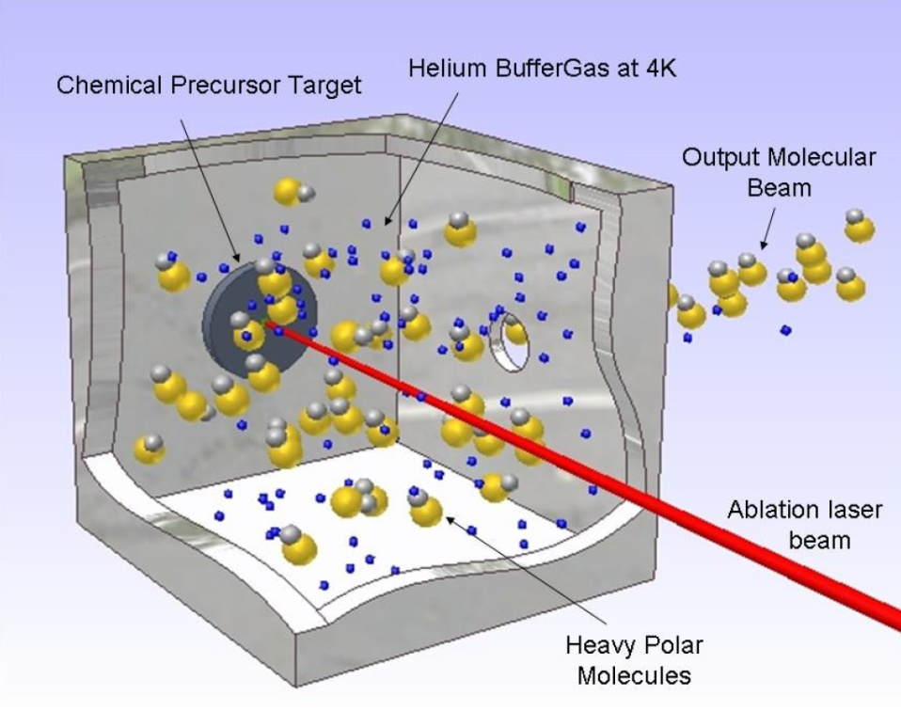
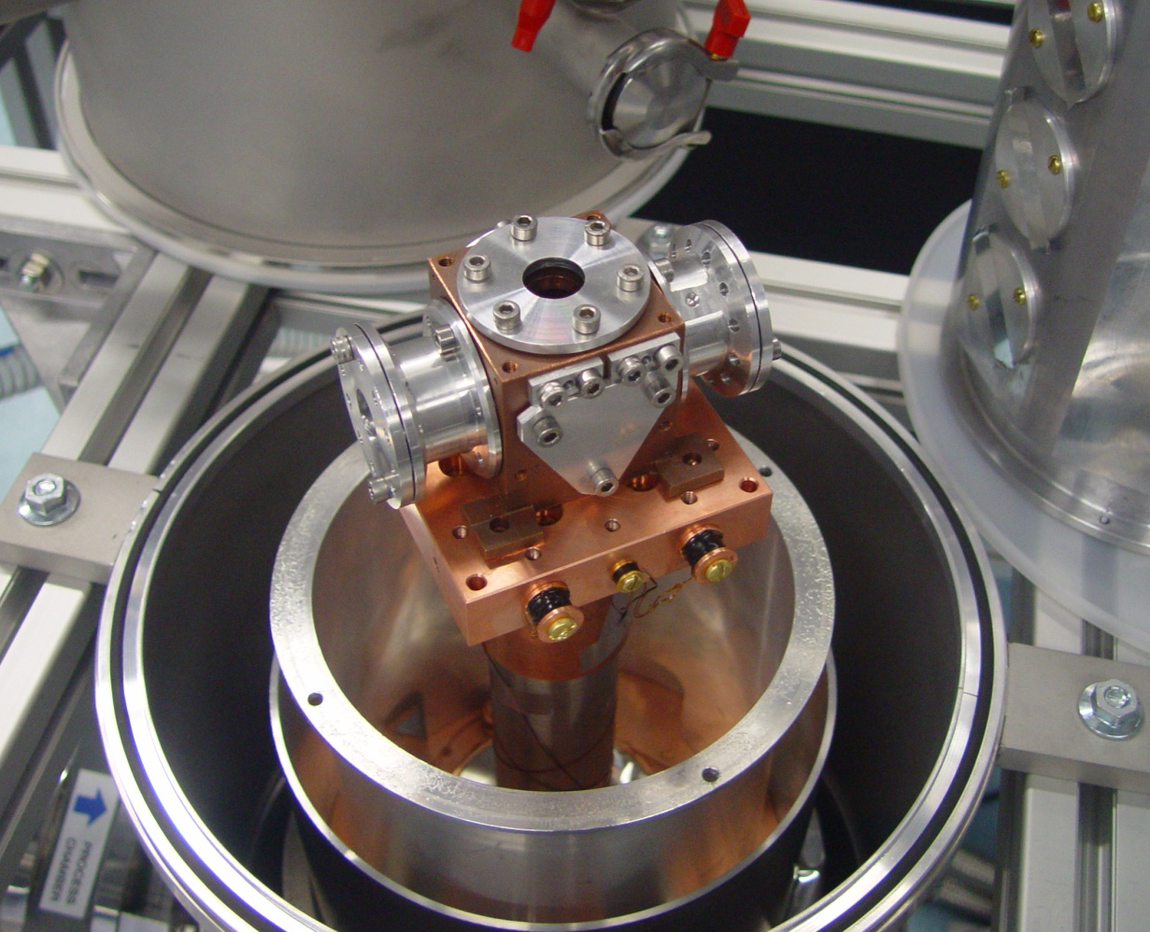
Cryogenic source of YbF
Produce YbF molecules by ablation of Yb/AlF₃ target into a cold helium buffer gas
Helium is pumped away using charcoal cryo-sorbs
Produces intense, cold, slow-moving beams

Slide 23
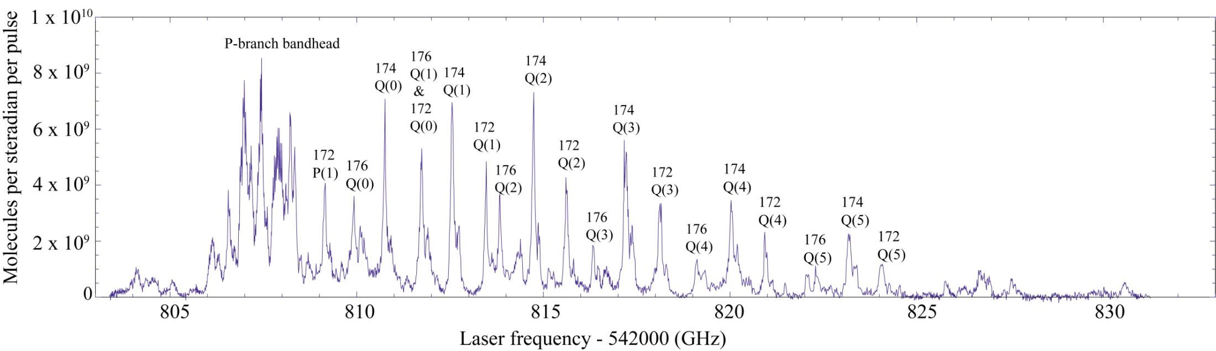
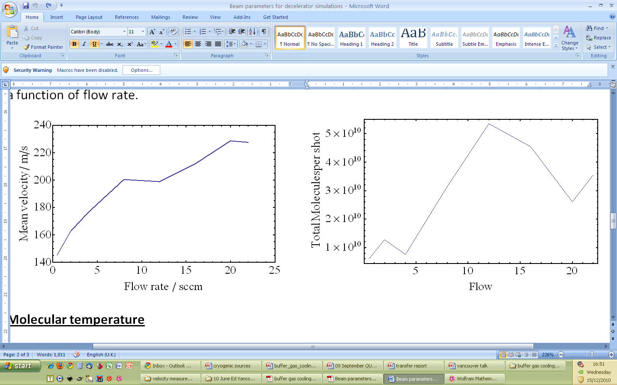
Cold, slow beam of YbF molecules
Rotational temperature: 4 ± 1 K
Translational temperature: 4 ± 1 K
Speed vs helium flow
Flux vs helium flow
Molecules / steradian / pulse
Flow rate / sccm

Slide 24
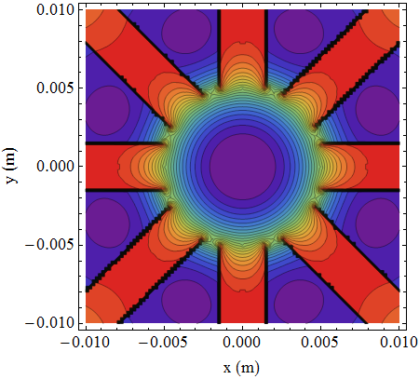

Magnetic guide
Permanent magnets in octupole geometry, depth of 0.6 T
Separates YbF molecules from helium beam
Guides 6.5% of the distribution exiting the source

Slide 25
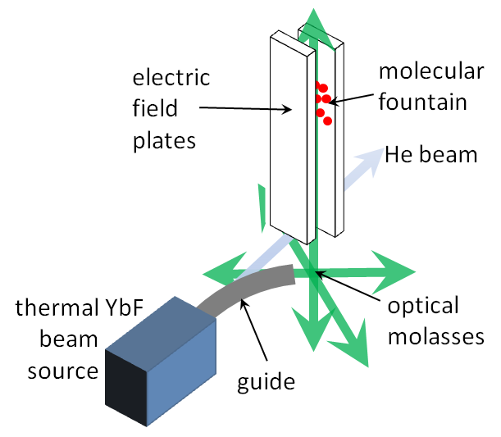
Laser cooling
v’= 0
A²Π_{½}
0.3%
6.9%
92.8%
584 nm
568 nm
X²Σ⁺(N=1)
552 nm
v’’=2
v’’=1
v’’= 0
Laser
Laser
Excited state
Laser cooling is the key step!!
Spontaneous emission
Absorption
Ground state

Slide 26
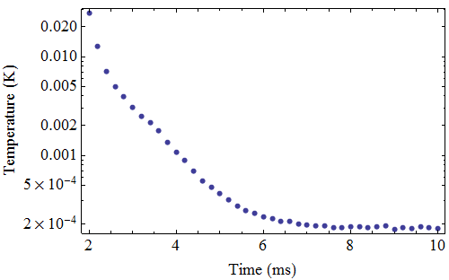
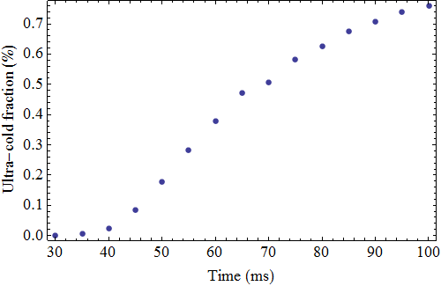
Simulations for YbF in an optical molasses
6 beams each containing 12
frequencies from 3 separate lasers
– 750 mW total

Slide 27
Sensitivity of an EDM fountain experiment
Quantity | Value | How determined?
Molecules in cell | 10¹³ | Measured by us
Extraction efficiency | 0.5 % | Measured by Doyle group
Fraction in relevant rotational state | 24 % | Boltzmann distribution
Fraction accepted by guide | 6.5 % | Magnetic guide simulation
Fraction cooled in molasses | 0.76 % | Molasses simulation
Rotational state transfer efficiency | 100 % | Pi-pulse
Fraction though fountain | 7.5 % | Free-expansion at 185μK
Detection efficiency | 100 % | Fluorescence on closed transition
Coherence time | 0.25 s | By design
Repetition rate | 2 Hz | By design
EDM sensitivity in 8 hours | 6 x 10⁻³¹ e.cm | Statistical sensitivity

