Slide 1
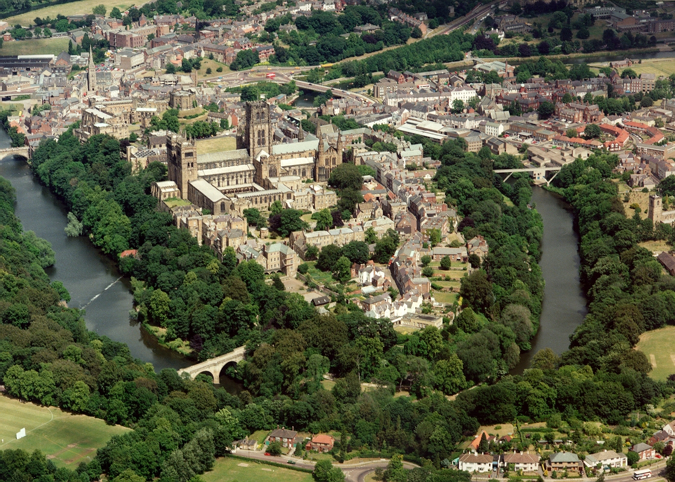
The City of Durham
Notes:
The next slide shows an aerial view of Durham city. Archaeological evidence suggests a history of settlement at Durham since roughly 2000 BC. The magnificent Durham Cathedral is a World Heritage Site with the nearby Durham Castle, which is also one of Durham University’s Colleges. At its feet, Durham City sparkles with cafés, galleries, wonderful hotels and one-off shops. Nearby there are the vast moors and valleys of Teesdale and Weardale, majestic castles, living museums, bustling market towns and villages, all offering authentic experiences and hospitality that are unique to County Durham. Durham has welcomed International Students for many years and you will be sure of a warm and friendly reception when you arrive in the city.

Slide 2
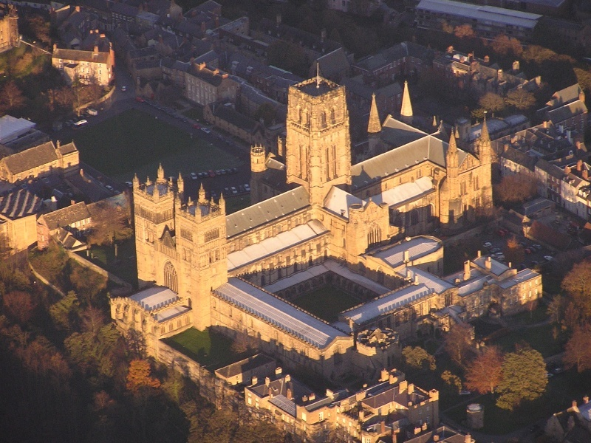
Durham is a UNESCO World Heritage site,
in common with….

Slide 3
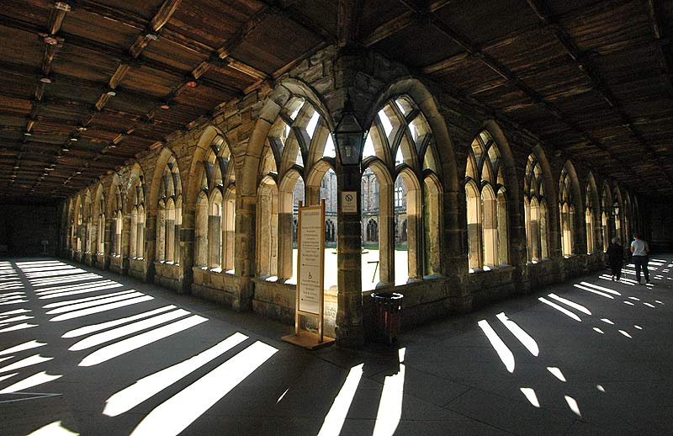

Slide 5
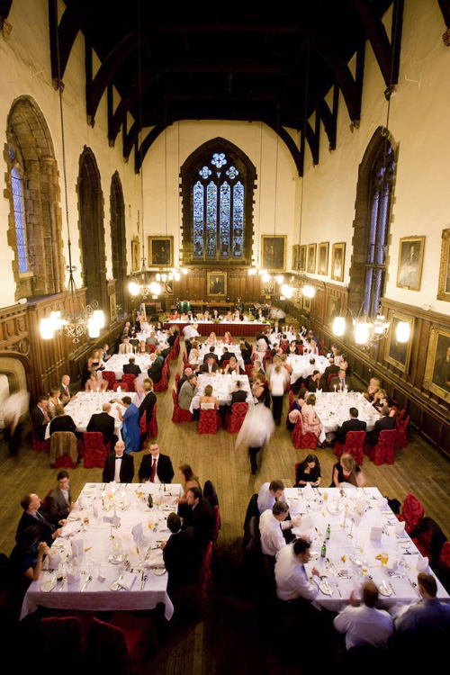
Durham Castle = University College

Slide 6
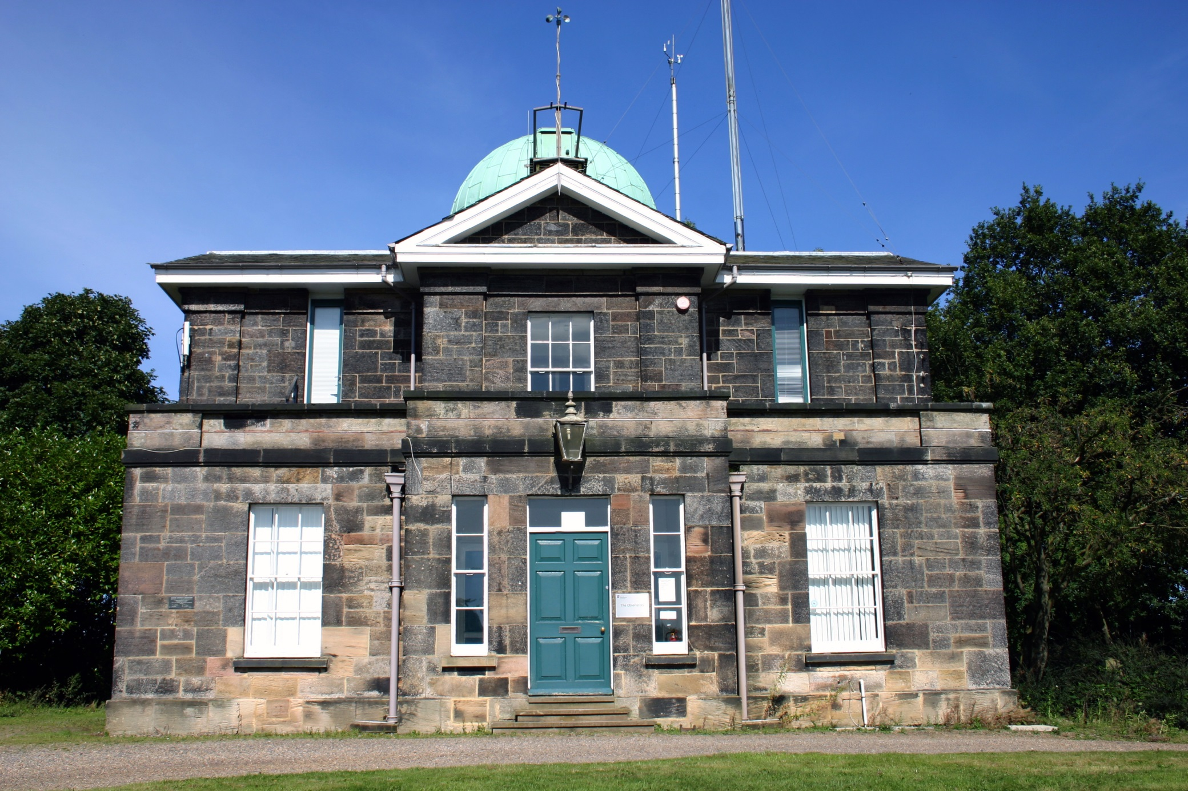
Astronomy in Durham Old and New…

