Slide 1
Sept/25 Elba – didn’t make notes but slot was 40 mins
Jan/26 Hull -- exactly 29 minutes – very good but maybe spoke too fast!
Potsdam/Steinmetz/26 – managed in 20mins; really good

Slide 2
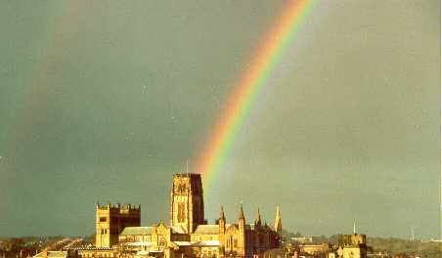

Will ΛCDM live to fight another day?
Carlos S. Frenk
Institute for Computational Cosmology, Durham

Slide 3
The ΛCDM model of cosmogony
Cosmological constant
Cold dark matter
Proposed in 1980s, it is an ab initio, fully specified model of cosmic evolution and the formation of cosmic structure
Has strong predictive power and can, in principle, be ruled out
Has made a number of predictions that were subsequently tested empirically (e.g. CMB, LSS, galaxy formation)
Three Nobel Prizes in Physics since 2006

Slide 4
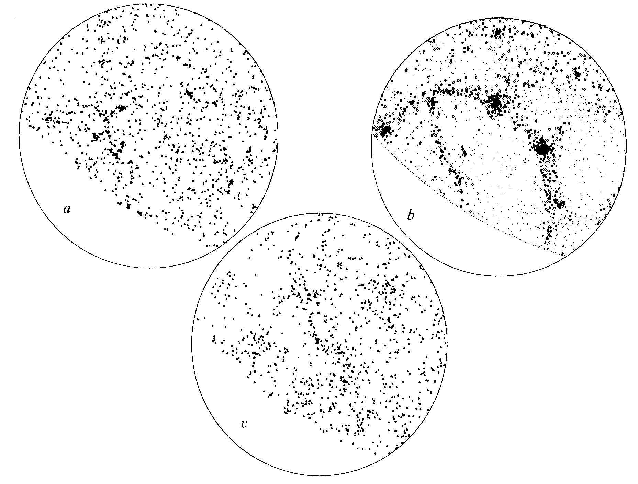
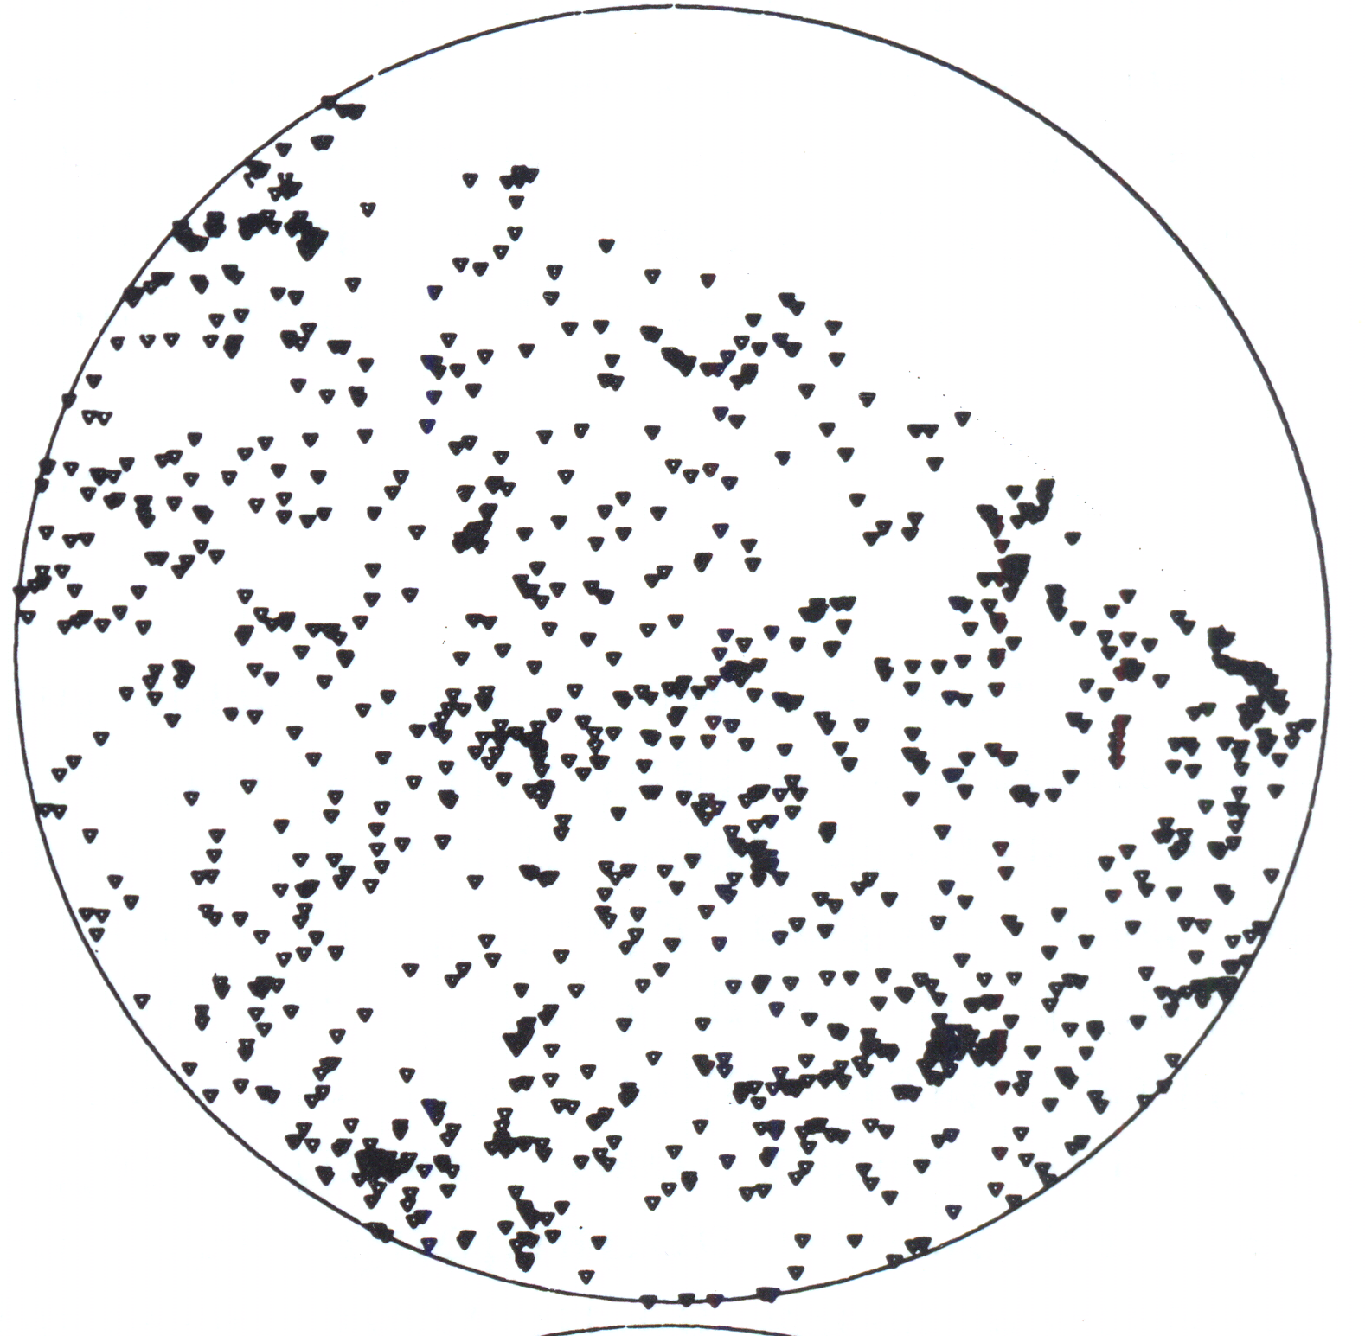
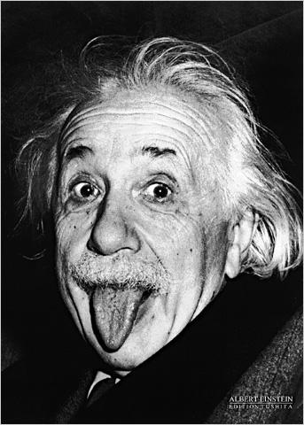
Non-baryonic dark matter cosmologies
ΛCDM gave the best match to the data
ΛCDM Ω=0.2
was inconceivable in 1985
CDM Ω=1
HDM Ω=1
CfA redshift survey
Davis, Efstathiou, Frenk & White‘85
Davis, Efstathiou, Frenk & White ‘85

Slide 5
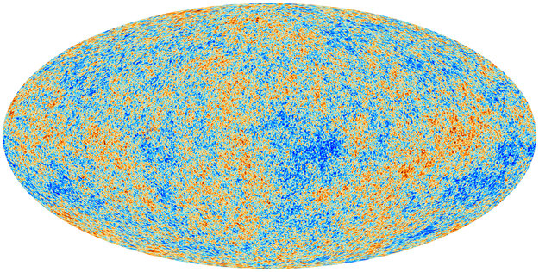
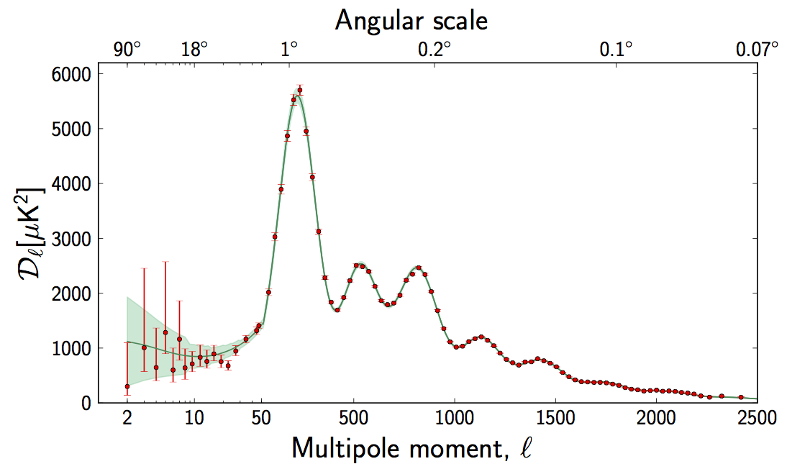
Planck: CMB temperature anisotropies
Fluctuation amplitude
The data confirm the theoretical predictions
ΛCDM
Planck coll. 2015
Peebles ‘82; Bond & Efstathiou‘84

Slide 6
Tests of ΛCDM
CDM: small scales
Λ: large scales
The first galaxies
DESI survey
JWST
GALFORM
COLIBRE

Slide 7
Planck: CMB temperature anisotropies
Fluctuation amplitude
The data confirm the theoretical predictions
ΛCDM
Accuracy ~ a few percent
Planck coll. 2015
Peebles ‘82; Bond & Efstathiou‘84

Slide 8

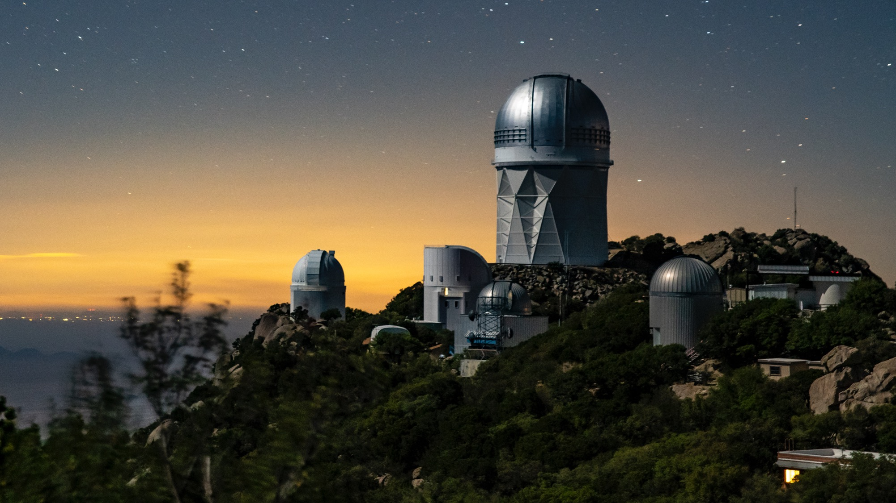









Tests of ΛCDM a subpercent accuracy?
72 participating institutions across the world

Slide 10
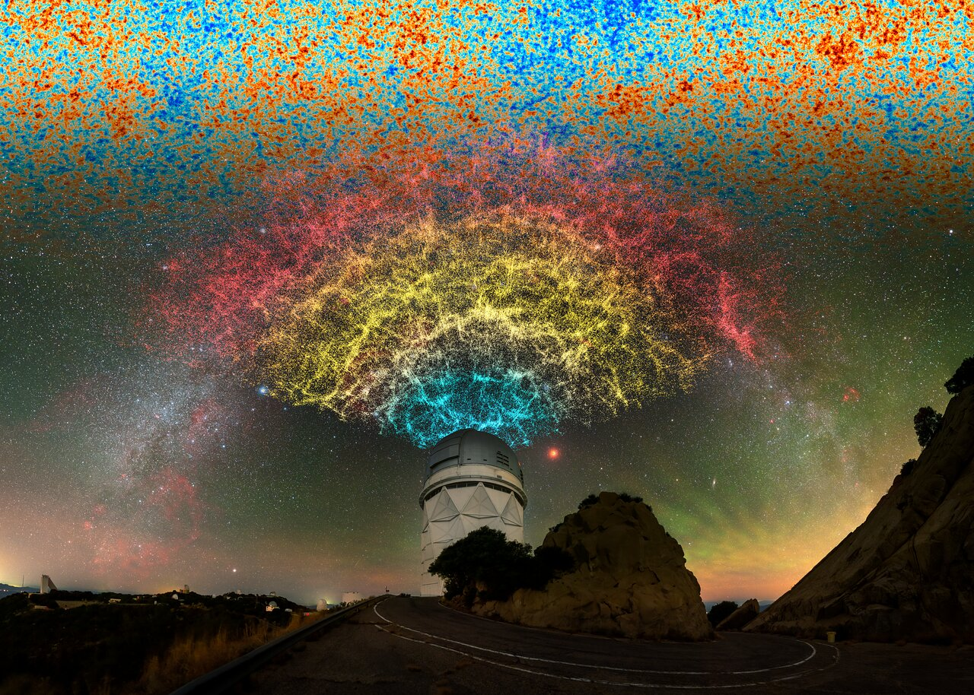
Tests based on baryon acoustic oscillations

Slide 11
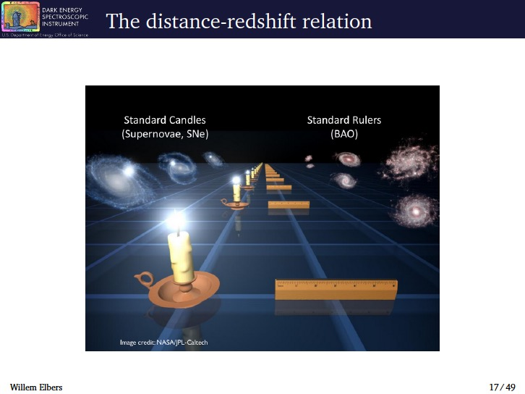
Planck: CMB temperature anisotropies
Fluctuation amplitude
ΛCDM
Baryon acoustic oscillations (BAO) coherent oscillations of γ-baryon fluid
Baryon acoustic oscillations (BAO) should be reflected in gal distribution
standard ruler
Frozen in a recombination
→ Baryons → halos → galaxies
Planck coll. 2015

Slide 12
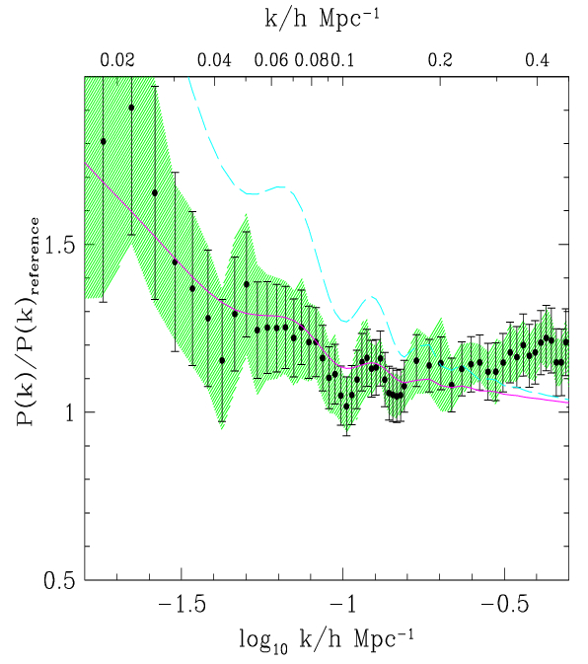
Baryon acoustic oscillations in 2dFGRS
P(k) / P_{ref}(Ω_{baryon}=0)
221,000 redshifts
ΛCDM model
Baryon oscillations conclusively detected in 2dFGRS!!!
Millennium sim
ΛCDM convolved with window
Cole, Percival, Peacock, Baugh, Frenk + 2dFGRS ‘05

Slide 13
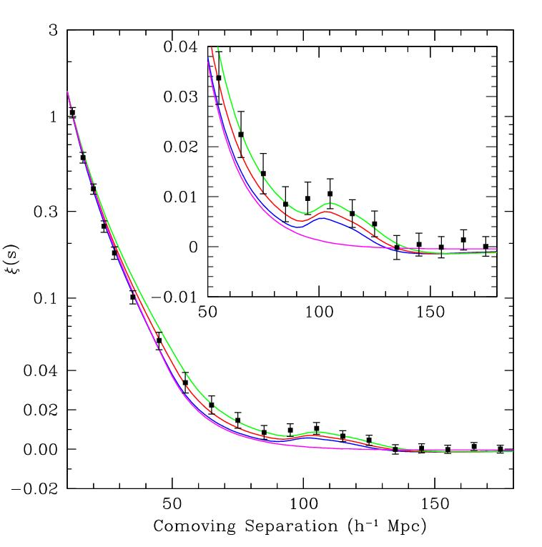

Baryon acoustic oscillations in SDSS
47,000 SDSS LRGs
0.72 cubic Gpc
Constraint on spherically averaged BAO scale
Constrain distance parameter:
Angular
diameter
distance
Eisenstein et al ‘05
Hubble
parameter

Slide 14
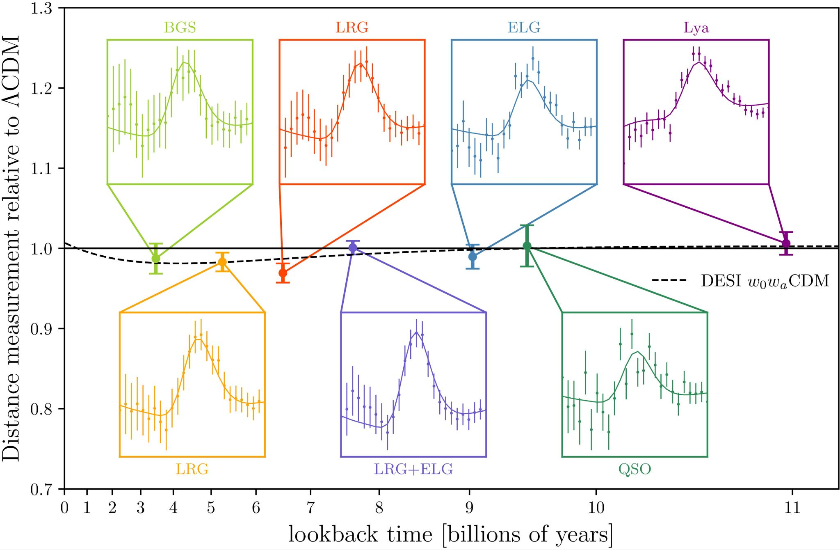

DESI BAO measurements
Can measure expansion history of universe

Slide 15
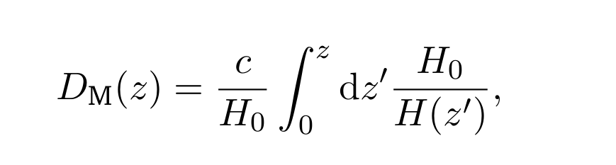
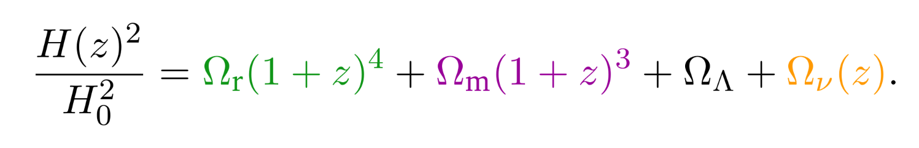
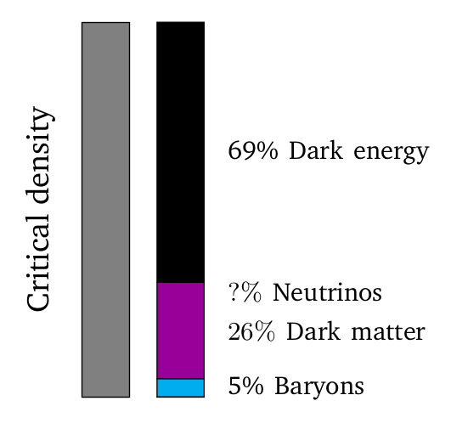
The distance-redshift relation
The distance-redshift relation depends on the energy density of various matter components, including massive neutrinos:
Radiation Matter Dark energy Neutrinos

Slide 16
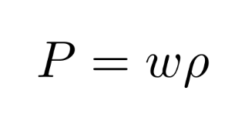
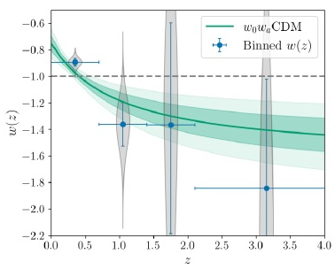
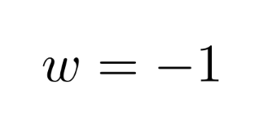

DESI BAO and dark energy
Dark energy has a negative pressure:
Binned reconstruction of ω (z)
Simplest case:
(Λ)
Λ
Introduce a time-varying equation of state:

Slide 17
DESI BAO and dark energy
Dark energy has a negative pressure:
Simplest case:
(Λ)
Introduce a time-varying equation of state:

Slide 18
DESI BAO and dark energy
Dark energy has a negative pressure:
Simplest case:
(Λ)
Introducing a time-varying equation of state:
—
3.2σ
3.4σ
3.2σ
—
—
DESI collaboration: Adame+ ‘24
Hoyt+ ‘26

Slide 19
Tests of ΛCDM
CDM: small scales
Λ: large scales
The first galaxies
DESI survey
JWST
GALFORM
COLIBRE

Slide 20
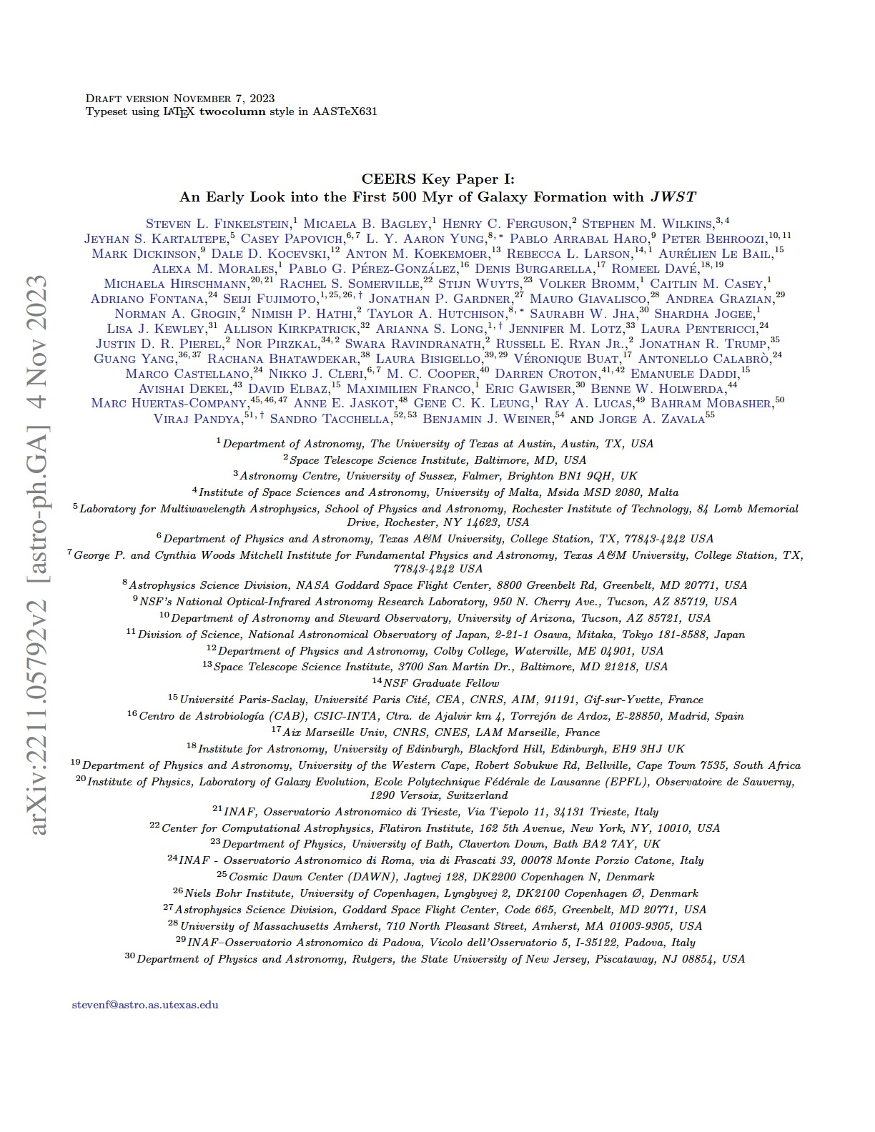
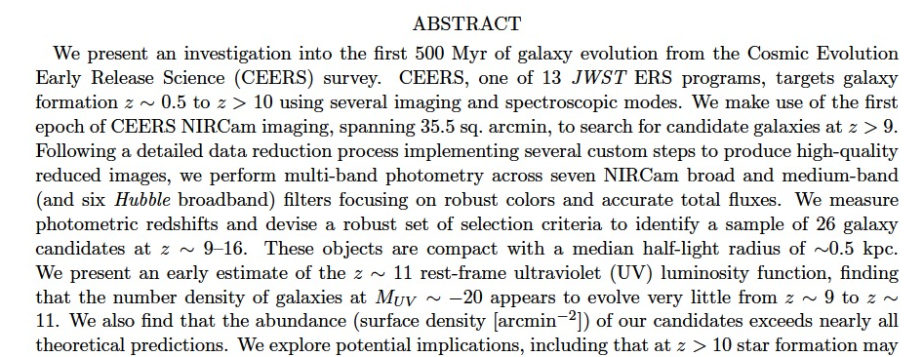
JWST galaxies at z= 8 -15

Slide 21
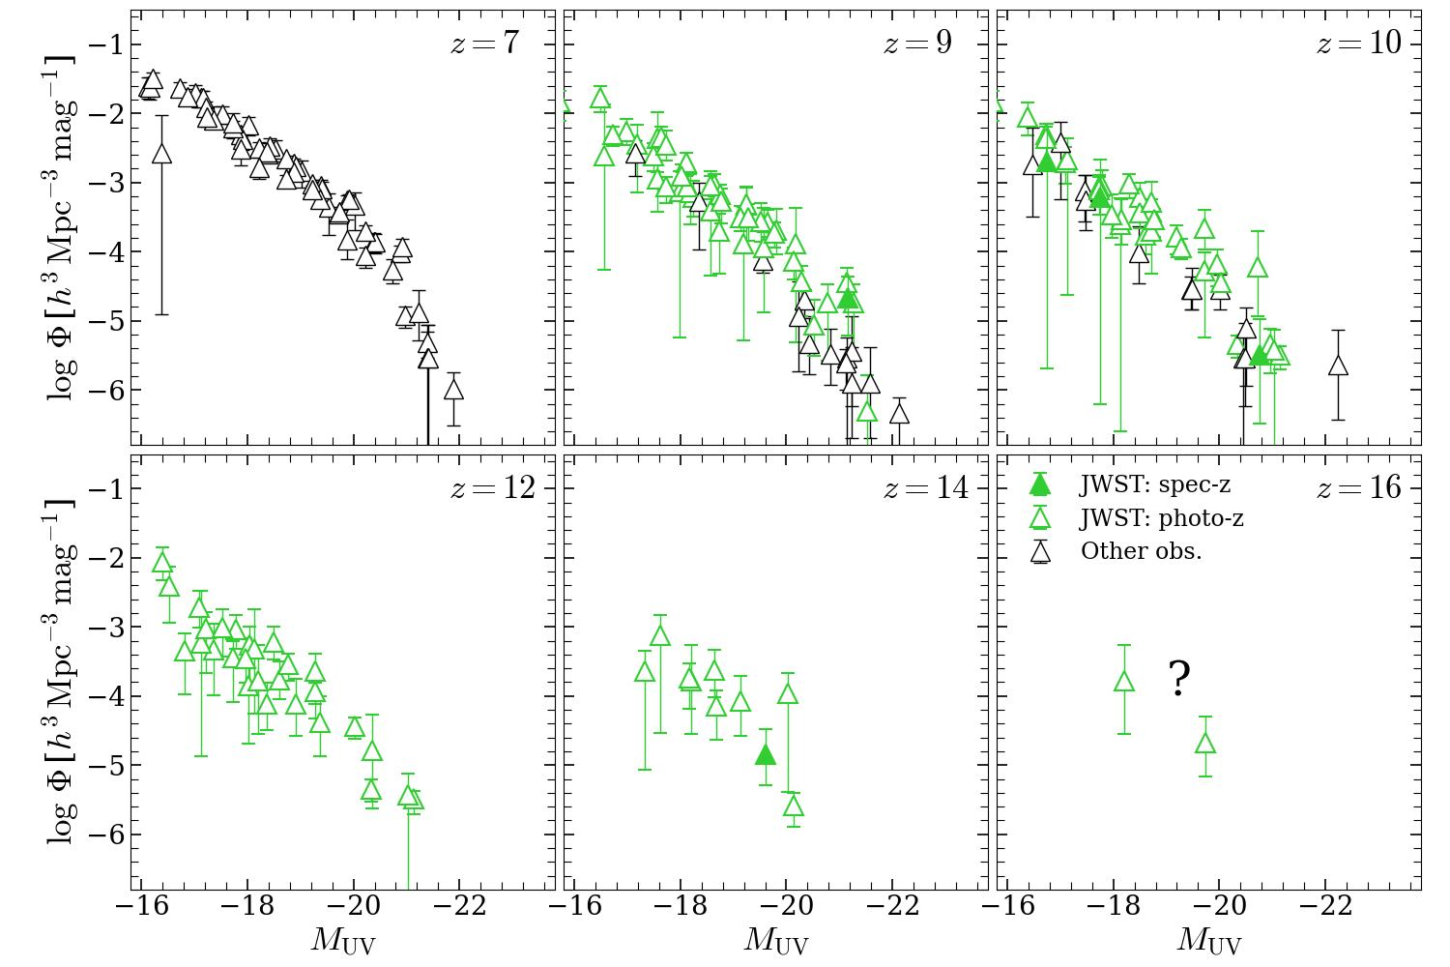
JWST galaxies at z=7-16

Slide 22
JWST galaxies at z= 8 -16

Slide 23
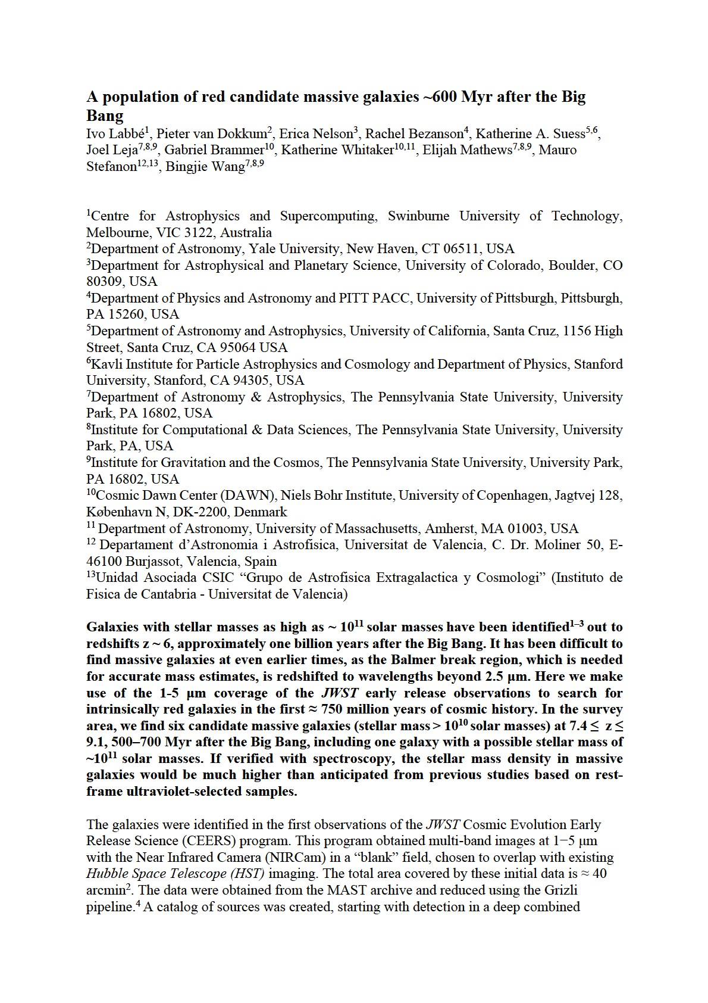
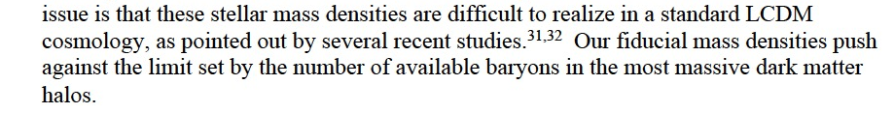
JWST galaxies at z= 8 -16

Slide 24
JWST galaxies at z= 8 -16
Were there any predictions for the high-z UVLFs pre-JWST launch?
→ Ask ChatGPT!

Slide 25
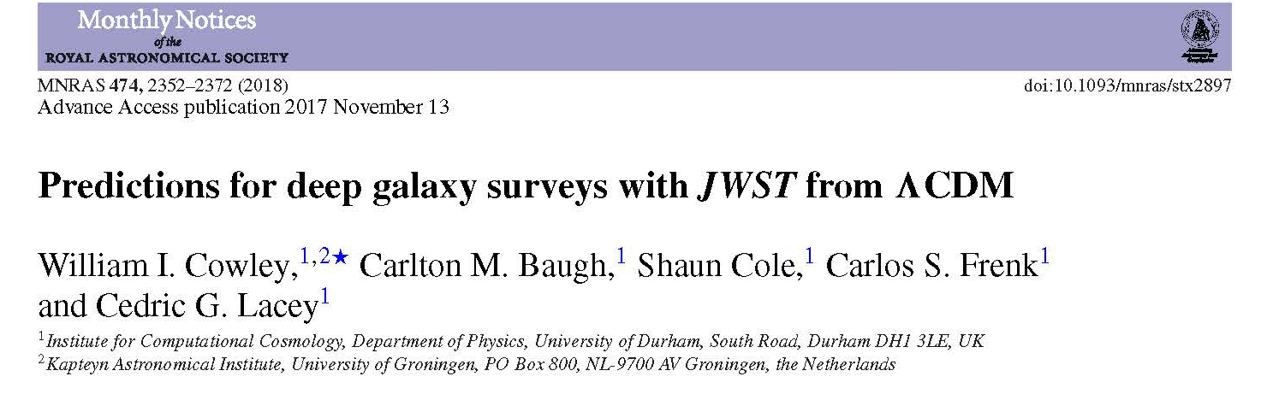
JWST galaxies at z=15
Pre-JWST-launch predictions from GALFORM
2018
GALFORM applied to Milennium XXL N-body simulation
→ Has enough resolution and volume!

Slide 26
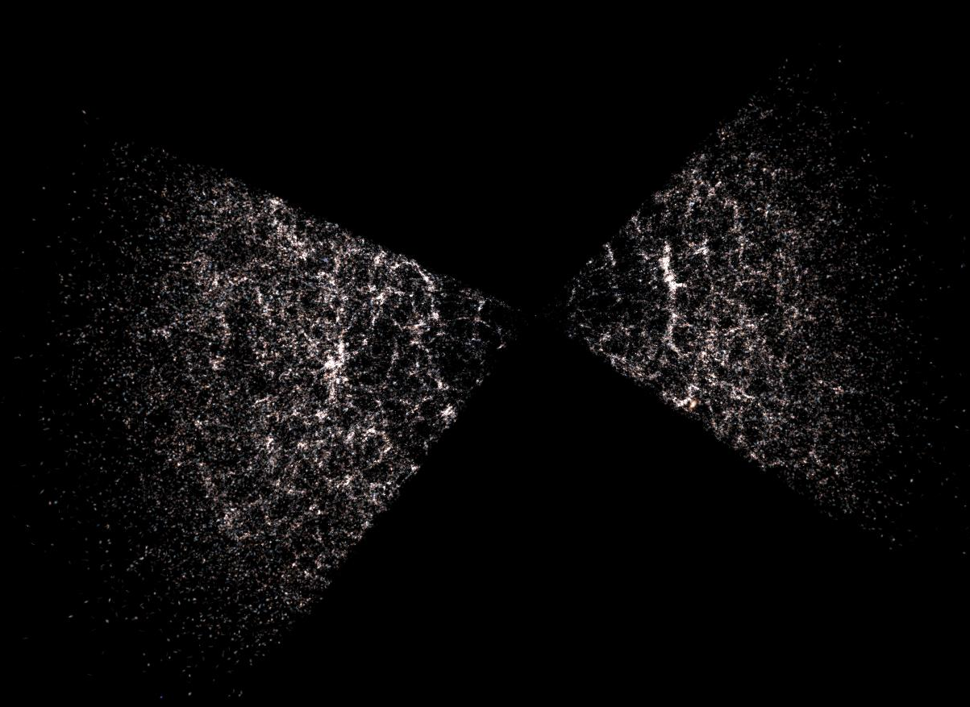
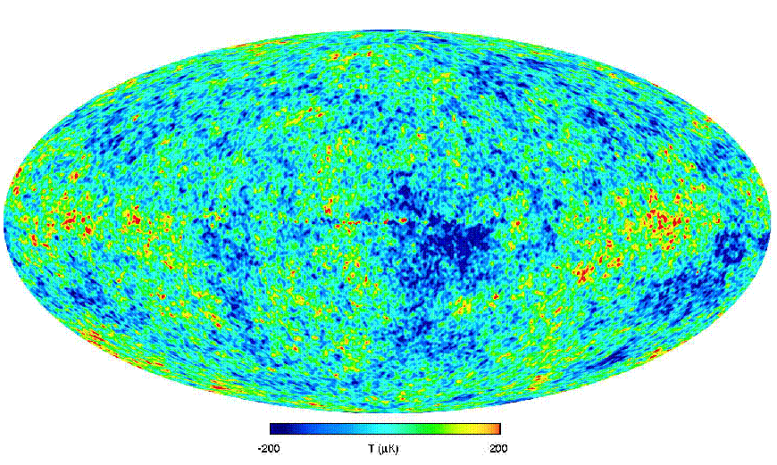
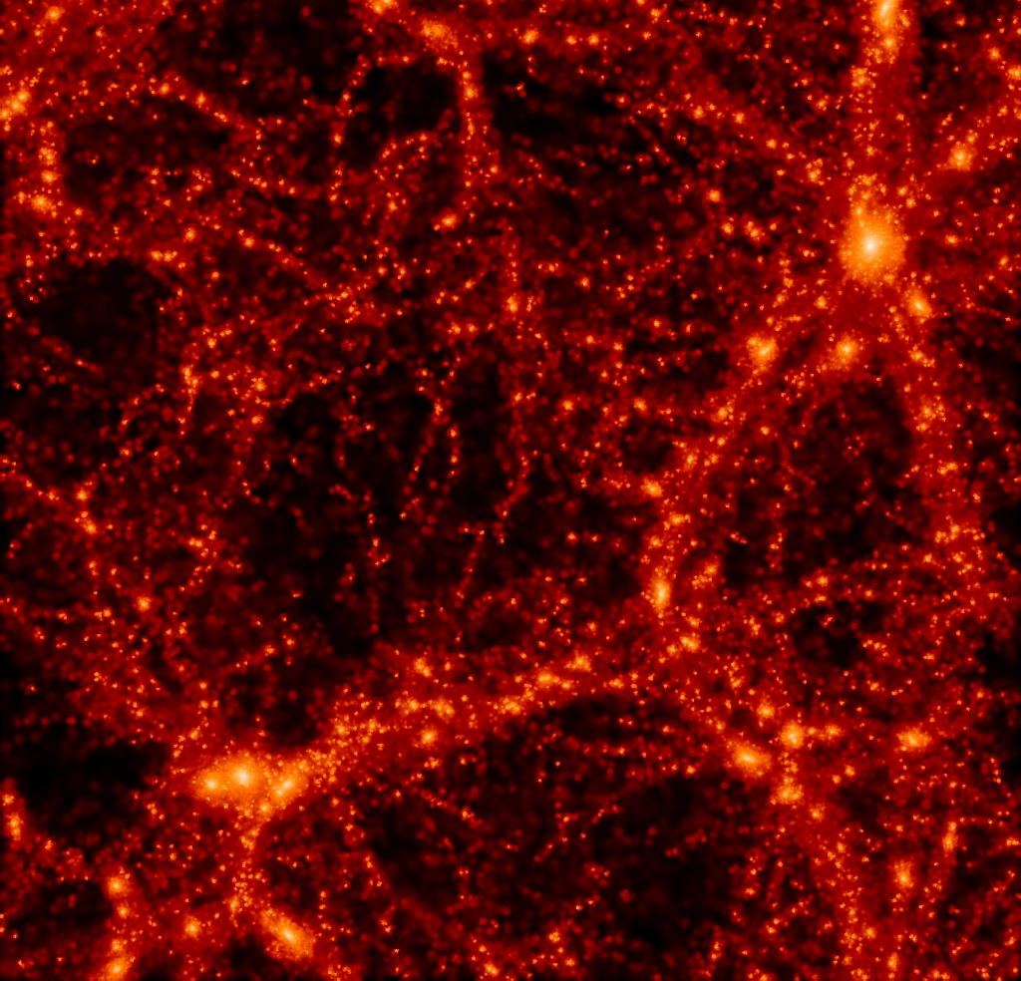
Cosmological model
(Ω_{m}, Ω_{Λ}, h); dark matter
z=0
z=1000
Primordial fluctuations
δρ/ρ(M, t)
Dark matter halos
(N-body simulations)
Well understood
Gas processes
(cooling, star formation, feedback)

Slide 27
Cosmological model
(Ω_{m}, Ω_{Λ}, h); dark matter
z=0
z=1000
Primordial fluctuations
δρ/ρ(M, t)
Dark matter halos
(N-body simulations)
Well understood
Gas processes
(cooling, star formation, feedback)
Semi-analytics
Hydro simulations
Formation and evolution of galaxies

Slide 28
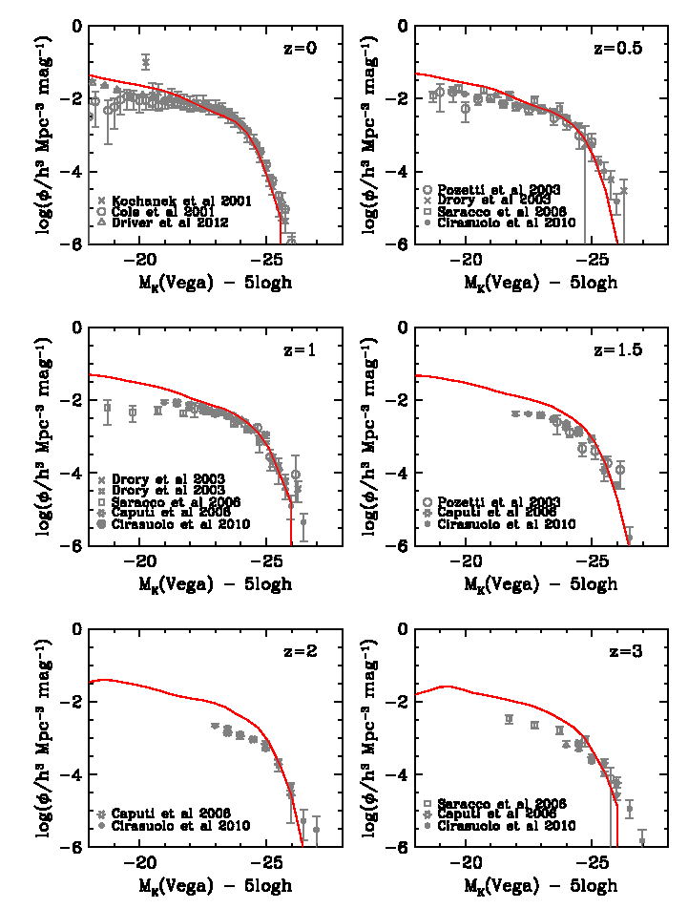
Evolution of the luminosity fn.
GALFORM
GALFORM gives excellent match to the evolution of the K-band galaxy luminosity function to z=3
This is a genuine prediction!
Lacey, Baugh, Frenk et al. ‘16

Slide 29
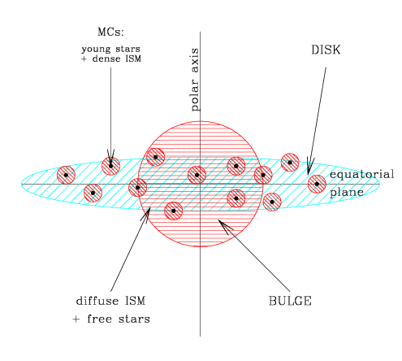
Dust emission and absorption
Absorption and emission by dust
Dust in diffuse medium and molecular clouds
Phys. dust grain model +PAHs
Radiative transfer of starlight through clumpy dust medium
Heating of dust grains → dust temp. distribution
Grains with distri. of size/T → IR/submm emission
Granato, Lacey, Silva, Baugh, Bressan, Cole & Frenk ‘00

Slide 30
A big failure in GALFORM

Slide 31
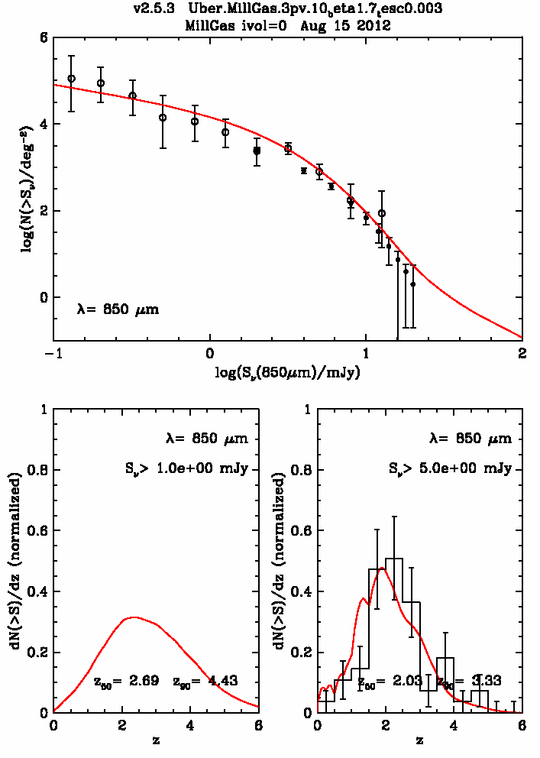
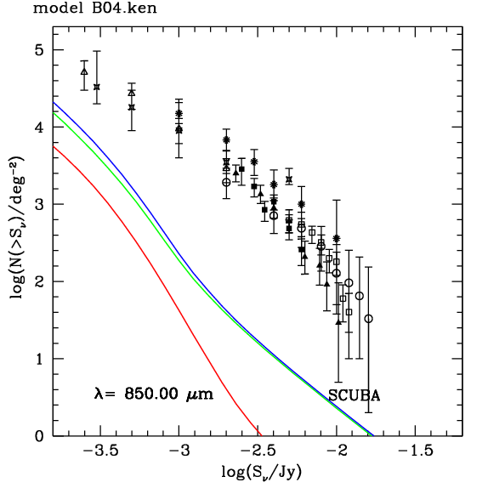
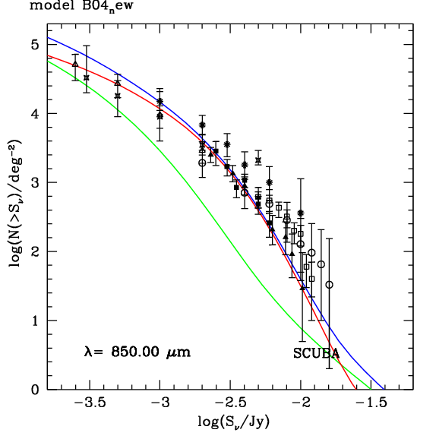
Sub-mm galaxies
Top-heavy IMF in starbursts
Normal IMF
Top-heavy IMF in starbursts
total
Cole et al ‘00
Baugh et al ‘05
Top heavy IMF in bursts
Top heavy IMF in bursts
total
bursts
Top heavy IMF in bursts
bursts
quiescent
quiescent
Lacey et al ‘12
N(z) → Galform prediction
Sub-mm counts too low by factor ~30 for normal IMF

Slide 32
JWST galaxies at z=7-16
Two crucial components of GALFORM
A top-heavy IMF in starbursts (only)
A detailed dust obscuration model

Slide 33
JWST galaxies at z=7-16

Slide 34
JWST galaxies at z=15
Pre-JWST-launch predictions from GALFORM
2018
GALFORM applied to Milennium XXL N-body simulation
→ Has enough resolution and volume!

Slide 35
JWST galaxies at z=7-16

Slide 36
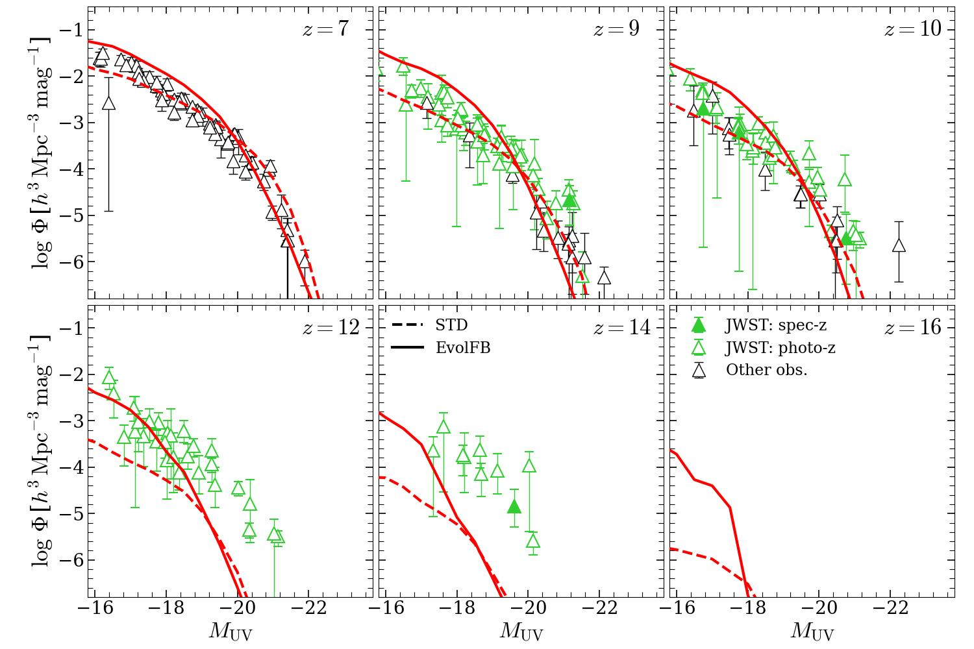
JWST galaxies at z=7-16
Key – top heavy IMF in bursts
Theoretical predictions precede data (Cowley + ‘18)
372 M yrs
300 M yrs
Shengdong Lu, CSF, Bose, Lacey, Cole,Baugh , Helly ‘25

Slide 37
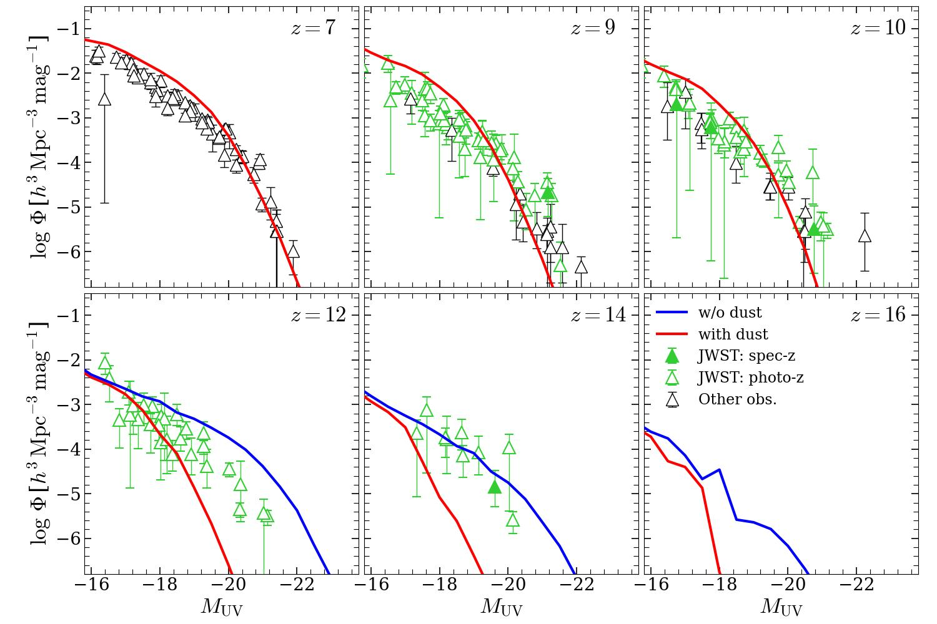
JWST galaxies at z=7-16
Key – top heavy IMF in bursts
Theoretical predictions precede data (Cowley + ‘18)
372 M yrs
300 M yrs
No dust
Shengdong Lu, CSF, Bose, Lacey, Cole,Baugh , Helly ‘25

Slide 38
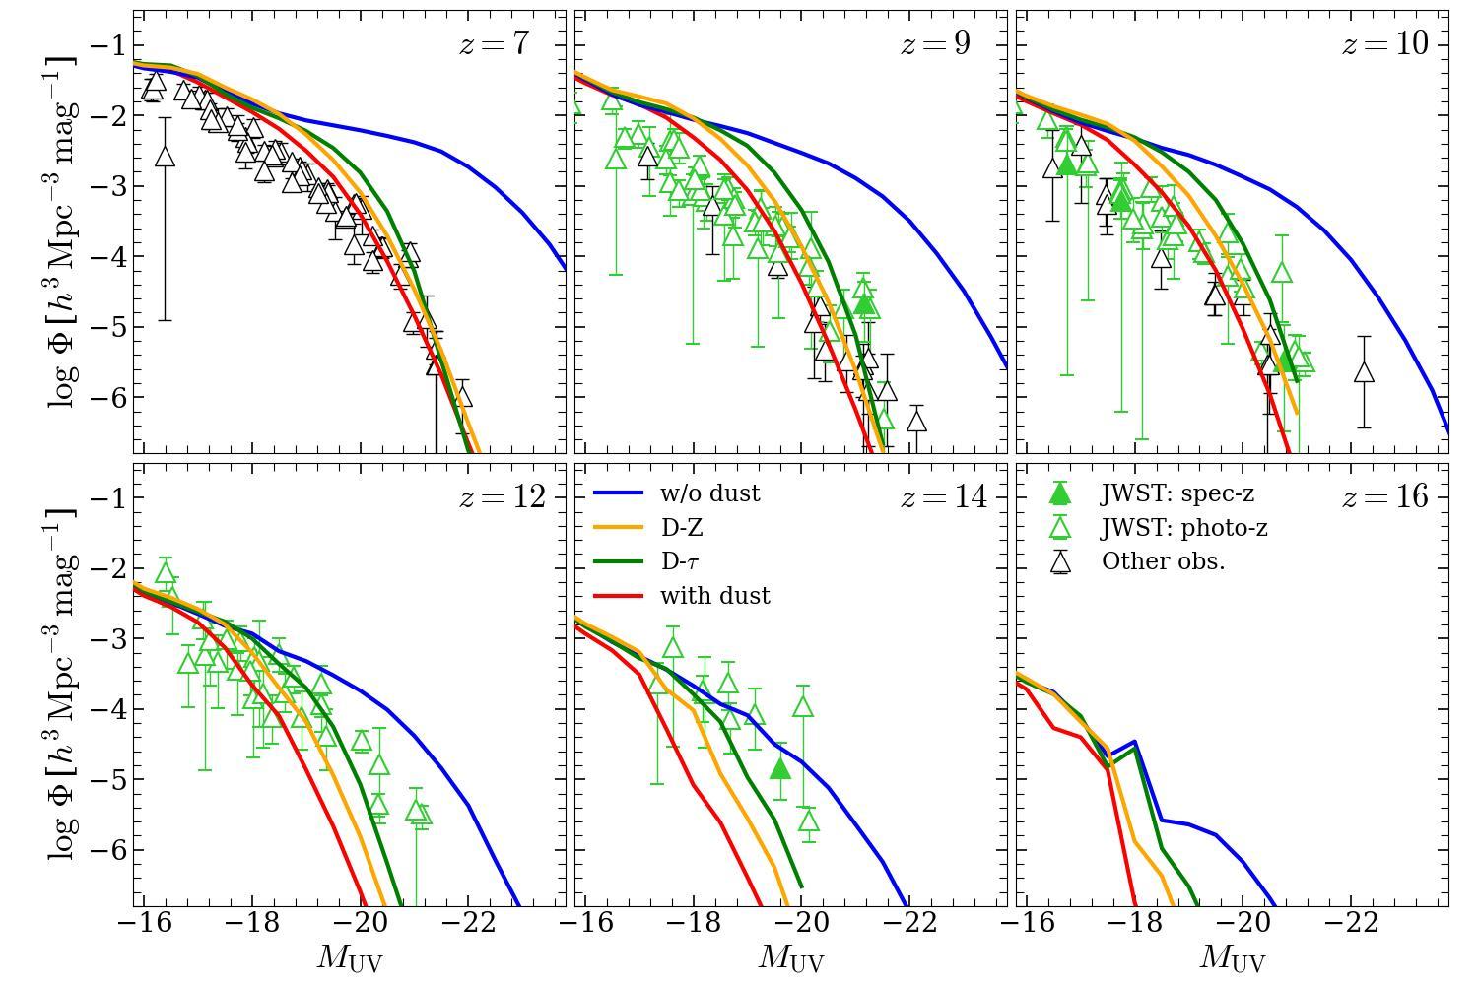
JWST galaxies at z=7-16
Key – top heavy IMF in bursts
Theoretical predictions precede data (Cowley + ‘18)
372 M yrs
300 M yrs
No dust
Schneider & Maiolino ‘24
Shengdong Lu, CSF, Bose, Lacey, Cole,Baugh , Helly ‘25

Slide 39
JWST galaxies at high z
UV luminosity function of JWST galaxies at z = 7 – 14 → just as predicted in ΛCDM in 2018 (with dust grains forming gradually at z>12)!
Lu, CSF+ ‘24
Key to this success
1. Top-heavy IMF in starbursts
2. Proper modelling of dust

Slide 40
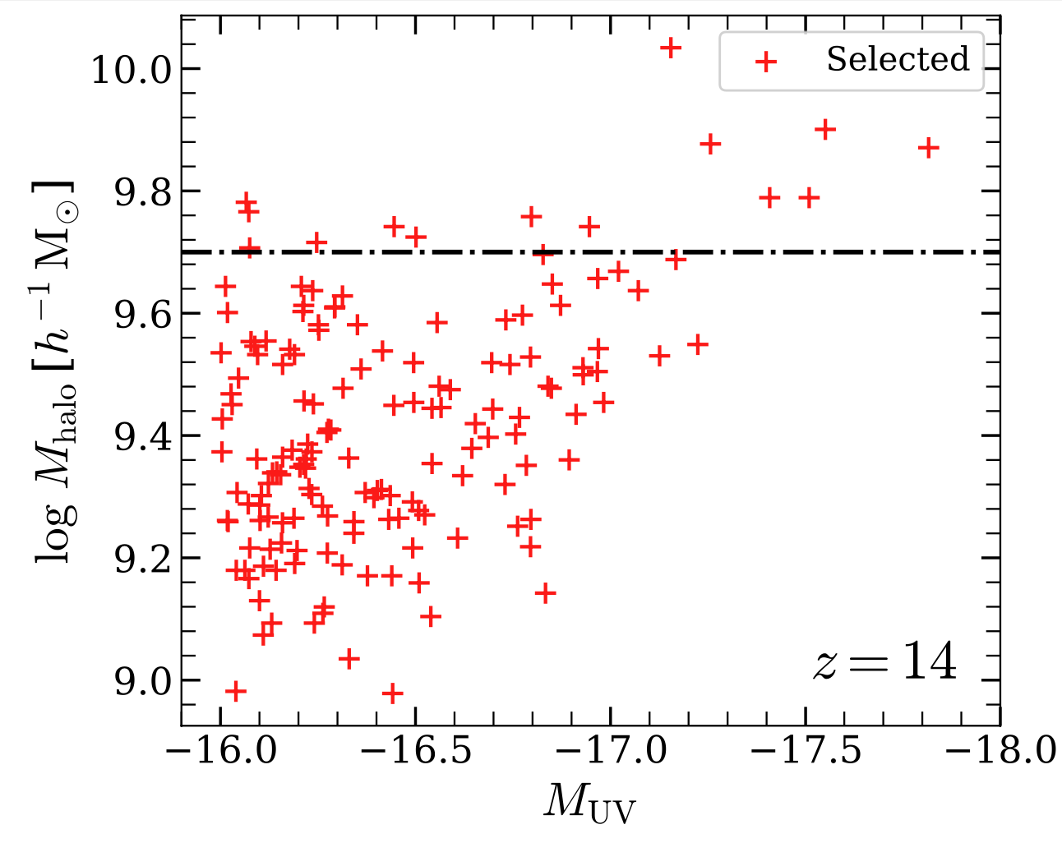
Properties of z=14 galaxies
JWST z=14 galaxies in narrow range of halo mass
100% bright B-L&F ‘22
100% dark B-L&F ‘22
Shengdong Lu, CSF, Bose, Lacey, Cole,Baugh , Helly ‘25

Slide 41
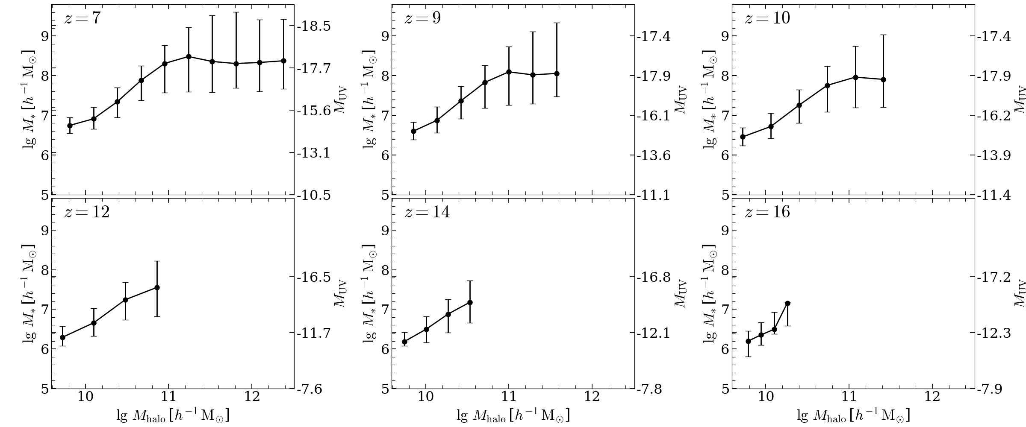
JWST galaxies at z=7-16
Predicted halo-stellar mass relation
Lu, CSF + ‘24
 | z | Stellar mass | Halo mass
 | 12 | 2 x 10⁸ M_{o} (~Sagittarius) | 6 x 10¹⁰ M_{o} (~Sagittarius)
 | 16 | 10⁷ M_{o} | 2 x 10¹⁰ M_{o}
brightest galaxy:
LMC: M* = 3x10⁹M_{0;} M_{halo}= 2x10¹¹M_{o}

Slide 42
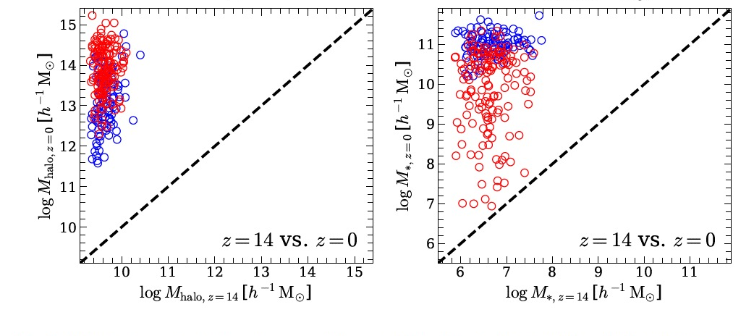
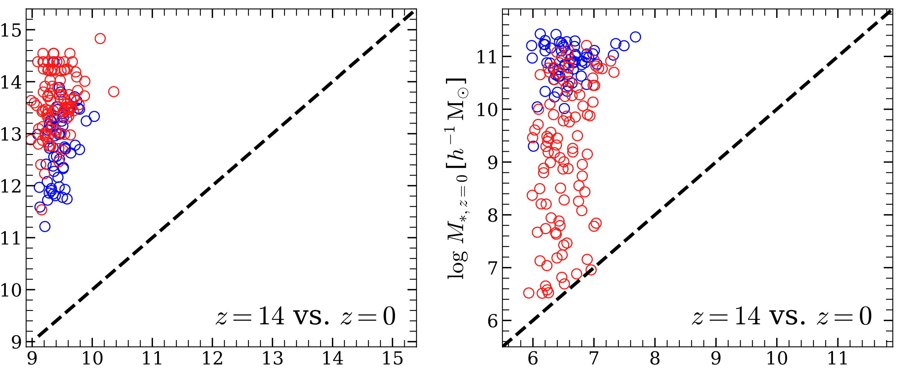
Descendants of z=14 bright gals
z=14 vs z=0
Lu, CSF + ‘24
Halo mass
Stellar mass
satellites
centrals
Centrals
Satellites
Satellites
Centrals
satellites
Log M_{halo} (z=0) [h⁻¹ M_{o}]
centrals
Log M* (z=0) [h⁻¹ M_{o}]
Log M_{halo} (z=14) [h⁻¹ M_{o}]
Log M* (z=14) [h⁻¹ M_{o}]
JWST galaxies: dwarfs at z=14, progenitors of bright centrals today

Slide 43
Cosmological model
(Ω_{m}, Ω_{Λ}, h); dark matter
z=0
z=1000
Primordial fluctuations
δρ/ρ(M, t)
Dark matter halos
(N-body simulations)
Well understood
Gas processes
(cooling, star formation, feedback)
Semi-analytics
Hydro simulations
Formation and evolution of galaxies

Slide 44
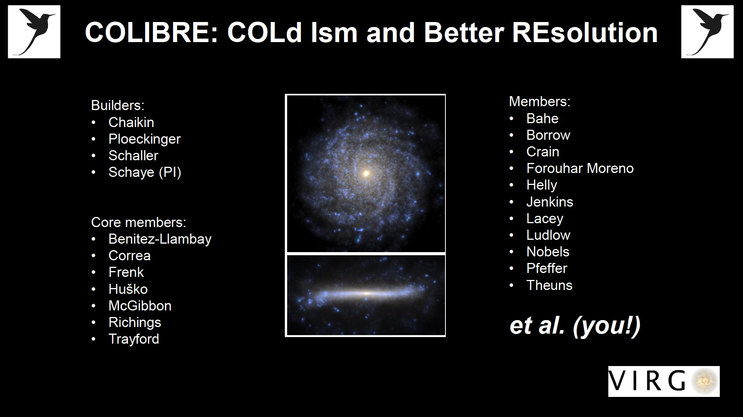
The COLIBRE simulations
A new generation of cosmological simulations of galaxy formation

Slide 45
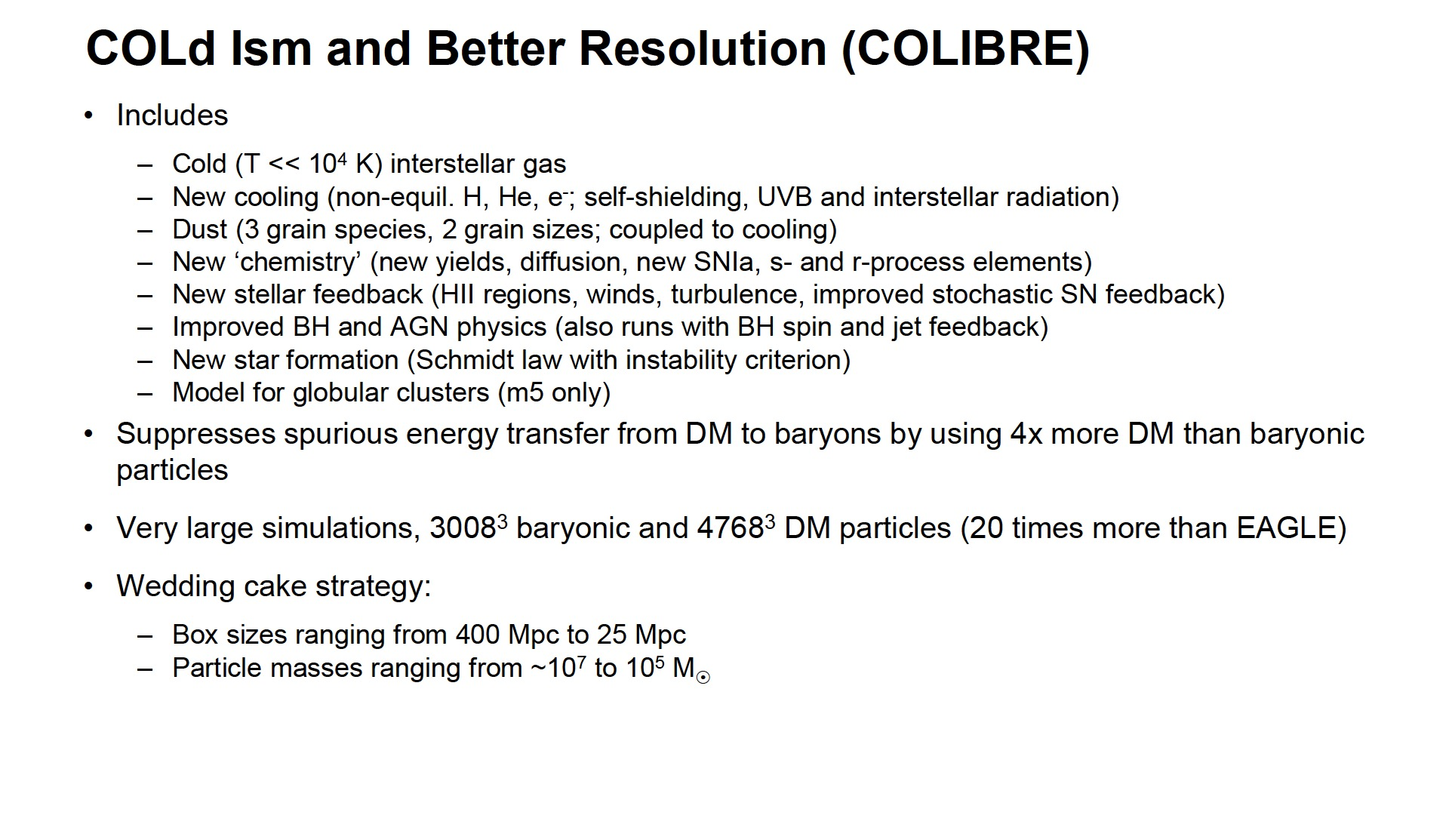
The COLIBRE simulations

Slide 47
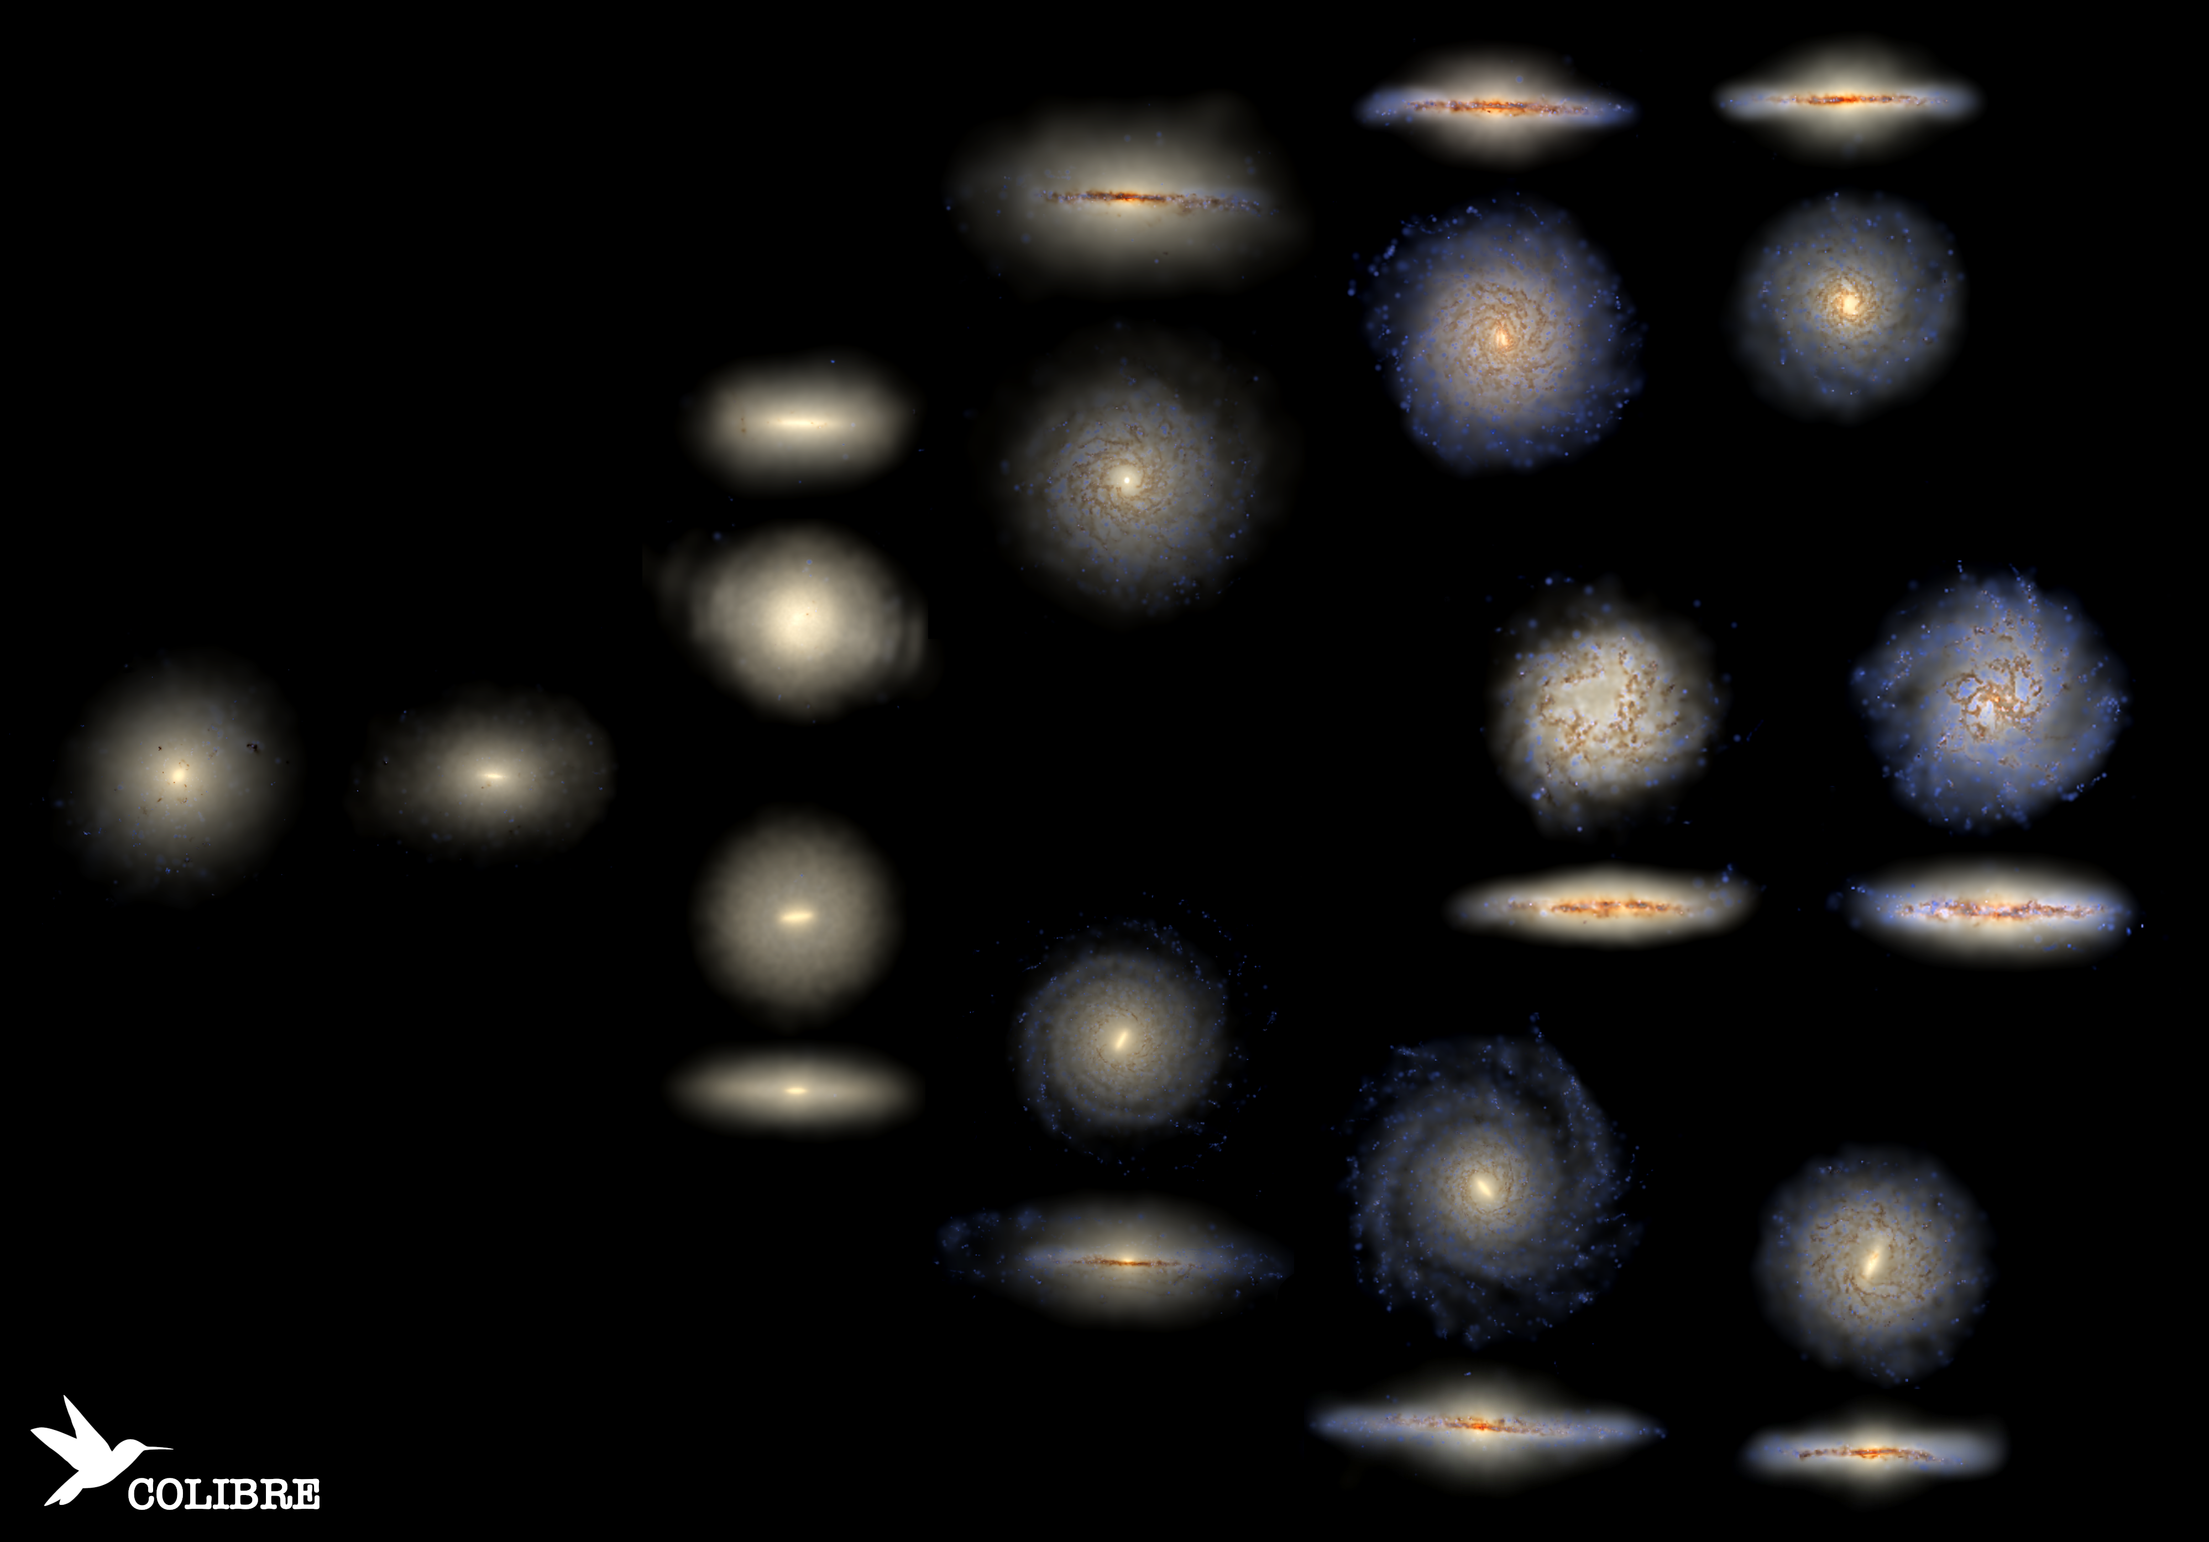

Slide 48
The COLIBRE simulations
→ Calibrate subgrid model parameters by requiring match to z=0 stellar mass function and stellar mass-size relation
→ Luminosities: post-process stellar light with SKIRT to calculate radiative transfer through gas and self-consistent dust
⇒ Galaxy luminosity functions, from UV to sub-mm

Slide 49
Galaxy luminosity functions in COLIBRE
z=0
FUV
NUV
u
Lu, CSF + COLIBRE ‘26
g
r
i
Shengdong Lu, CSF, Lacey, Gebek, Schaye, Cole, Bose + COLIBRE ’26a

Slide 50
Galaxy luminosity functions in COLIBRE
z=0
z
Y
J
Lu, CSF + COLIBRE ‘26
H
K
Shengdong Lu, CSF, Lacey, Gebek, Schaye, Cole, Bose + COLIBRE ’26a

Slide 51
Galaxy luminosity functions in COLIBRE
z=0
Lu, CSF + COLIBRE ‘26
Shengdong Lu, CSF, Lacey, Gebek, Schaye, Cole, Bose + COLIBRE ’26a

Slide 52
Galaxy luminosity functions in COLIBRE
z=0
COLIBRE assumes Chabrier IMF – match to submm LF?
→ IMF does not make any difference at z=0; top-heavy IMF only required at high z
Shengdong Lu, CSF, Lacey, Gebek, Schaye, Cole, Bose + COLIBRE ’26a

Slide 53
The COLIBRE simulations
→ UV luminosity function at high redshift
Colibre assumes a Chabrier initial stellar mass function
Shengdong Lu, CSF, Lacey, Gebek, Schaye, Cole, Bose + COLIBRE ‘26b

Slide 54
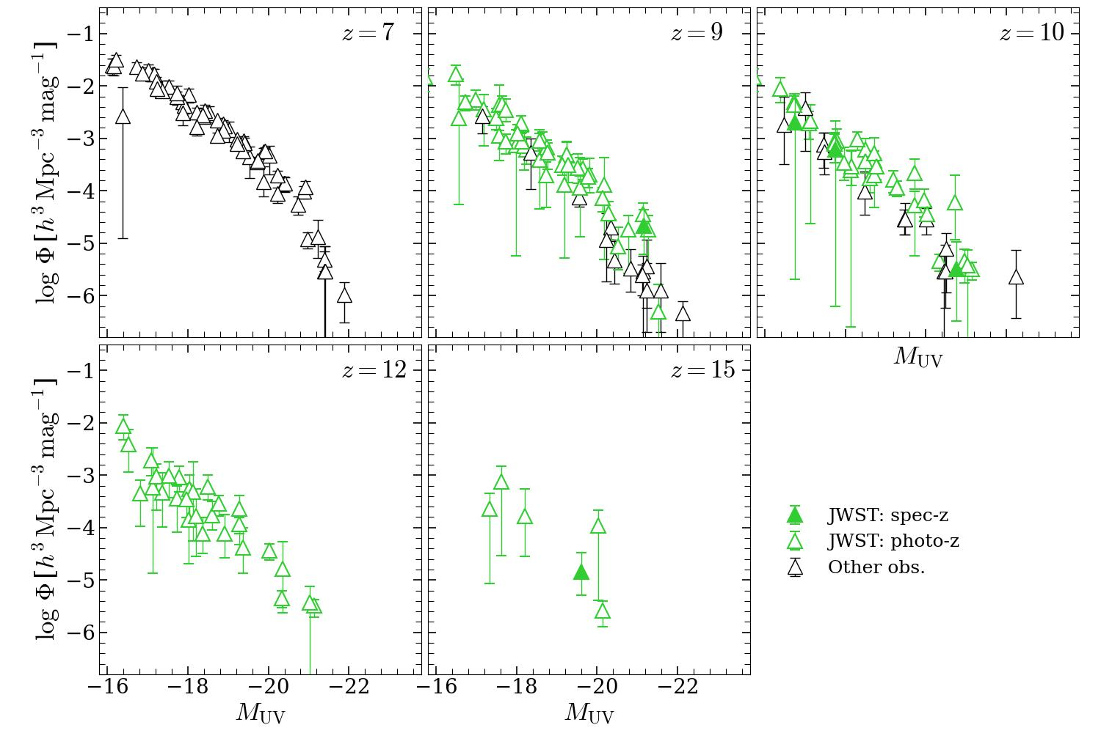
UVLFs in COLIBRE

Slide 55
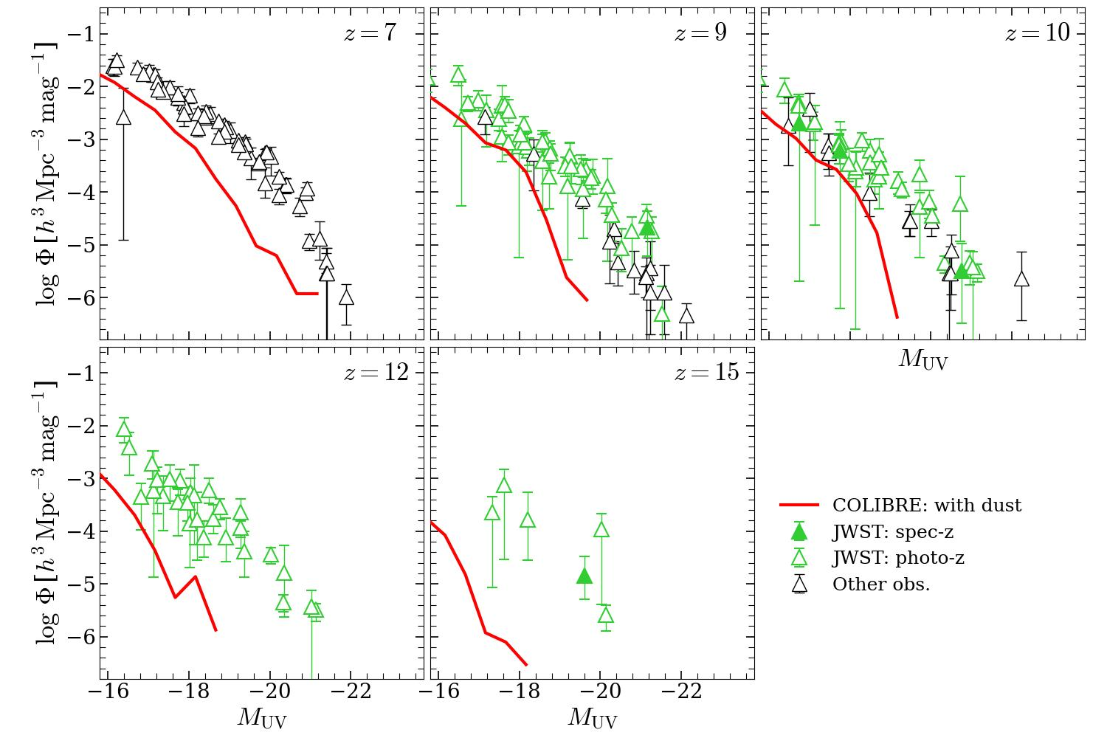
UVLFs in COLIBRE
Lu, CSF +Colibre team
Shengdong Lu, CSF, Lacey, Gebek, Schaye, Cole, Bose + COLIBRE ‘26b

Slide 56
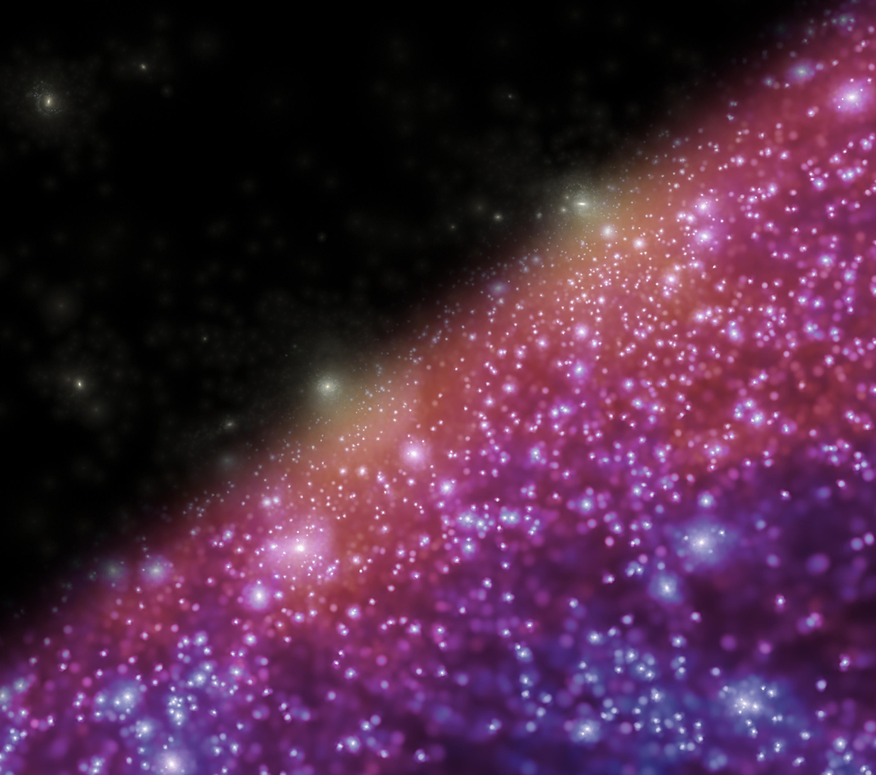
Conclusions
Large scales
● DESI BAO (>1% precision → ΛCDM ruled out at 3.4σ; ◊ evolving DE model (w₀w_{a}CDM) favoured
Small scales
Abundance of JWST galaxies at z<14 → as predicted in CDM
JWST galaxies have low mass: 10⁷ – 10⁸ M_{o}
Descendents of z=14 JWST galaxies in > 5 x 10¹¹ M_{o} halos today

Slide 57
Will ΛCDM live to fight another day?
CDM certainly will
Λ not so sure

