Slide 1
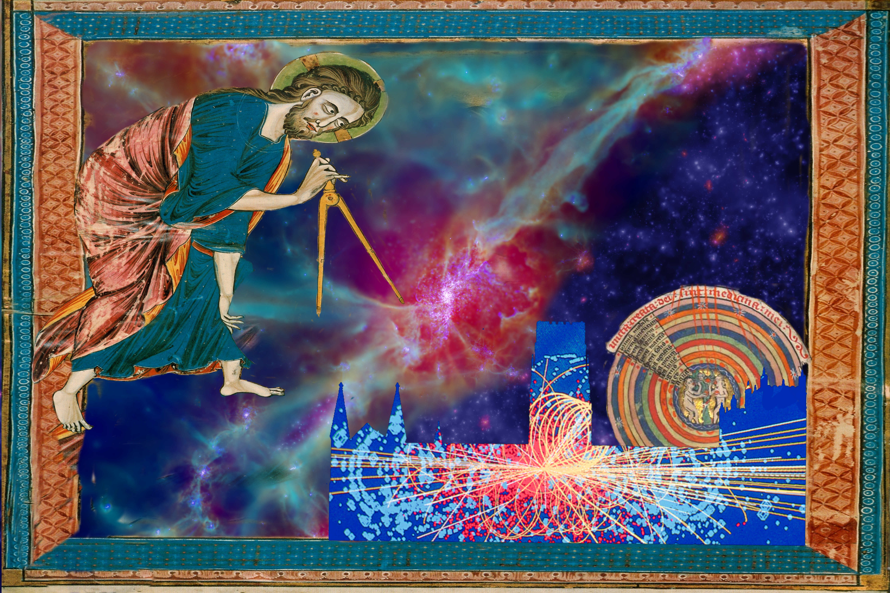

Slide 2
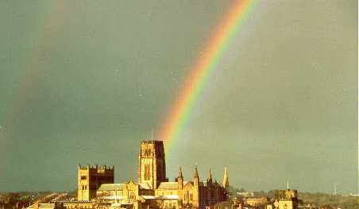


Slide 3
The first light in the Universe
Carlos S. Frenk
Institute for Computational Cosmology, Durham

Slide 4
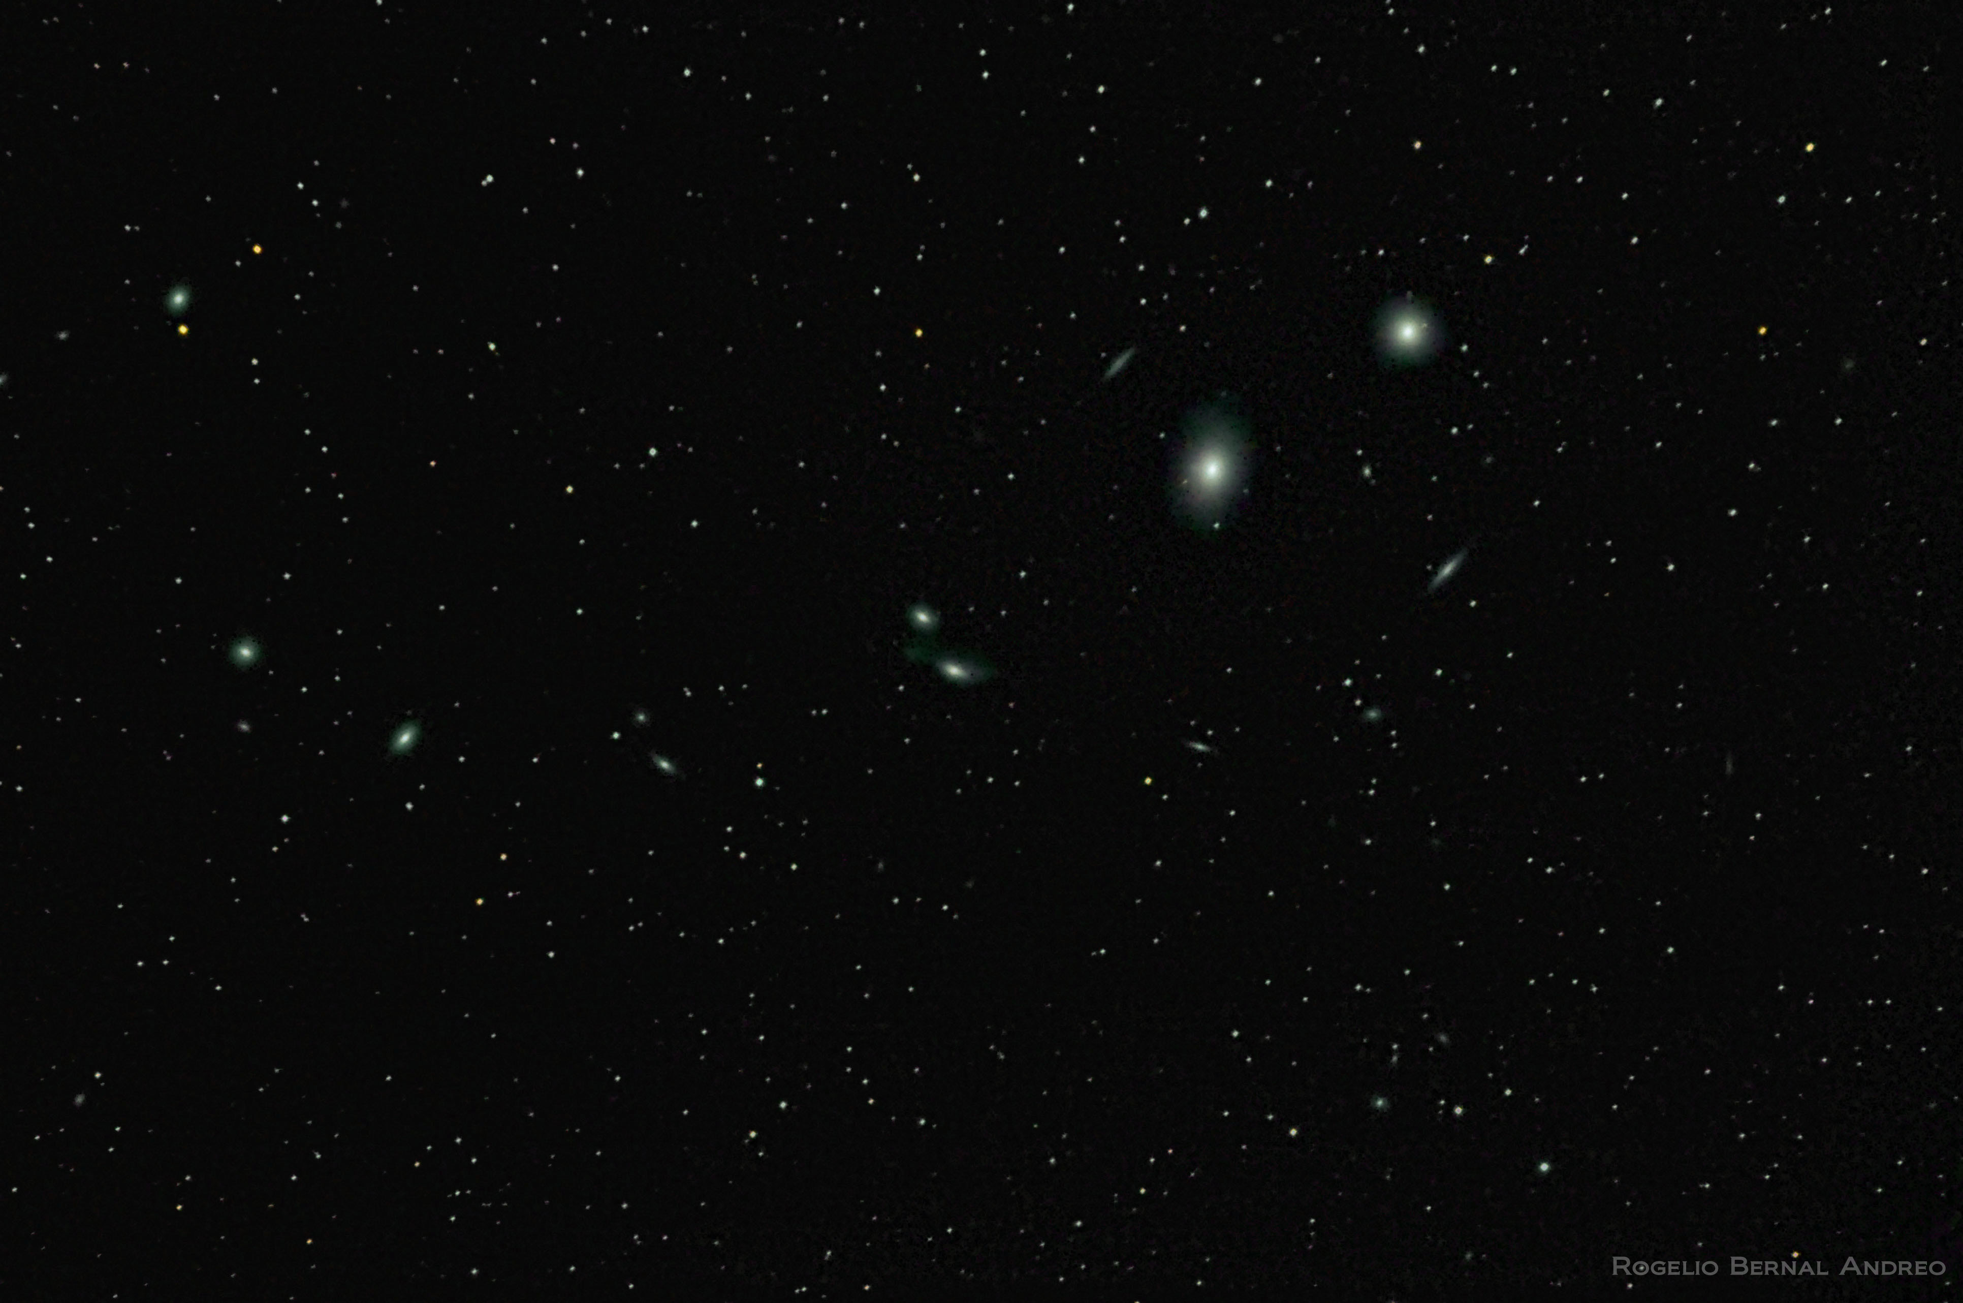

Slide 5
A few basic facts about the cosmos
Most of the Universe is almost empty
Extragalactic space is very dark
Extragalactic space is bathed in the residual heat left over from the Big Bang

Slide 6
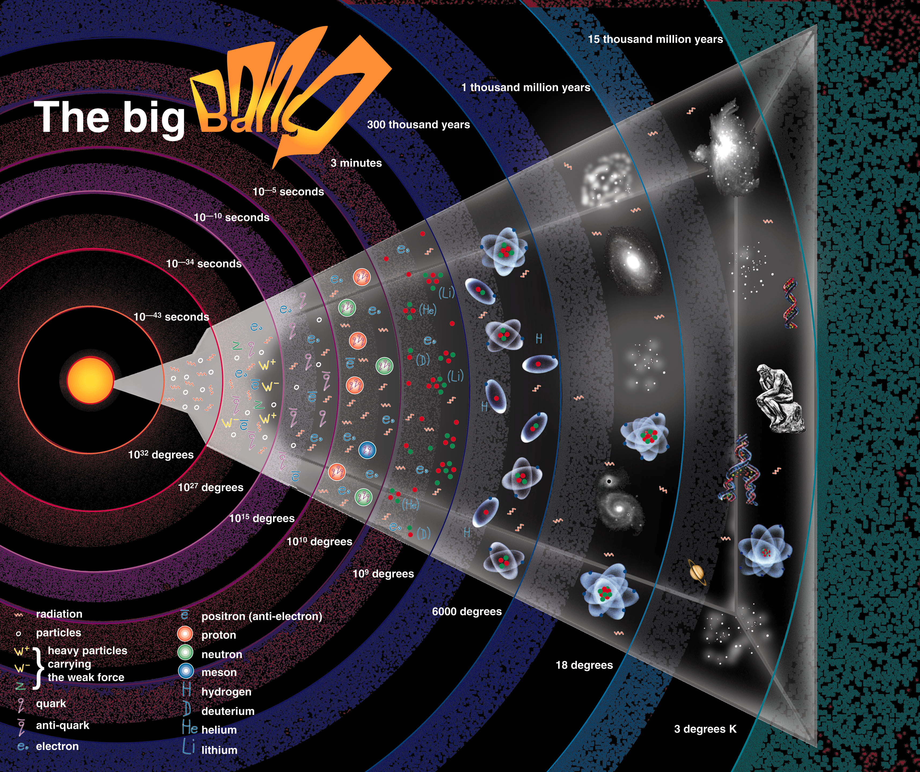

Slide 7
Near the Big Bang the Universe was so dense that all the matter in today’s visible universe would have fitted inside a proton

Slide 8
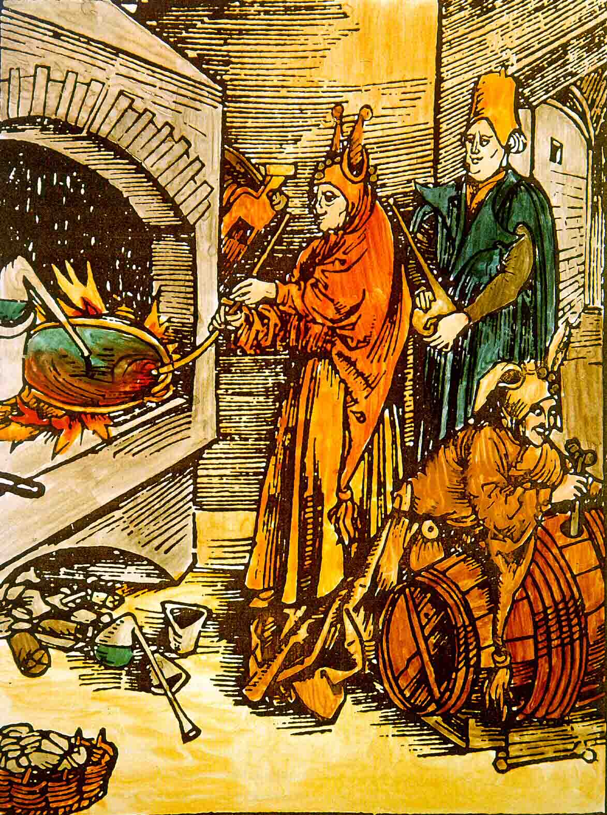
The early universe was very hot

Slide 9
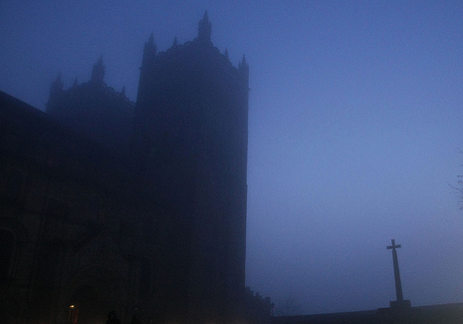
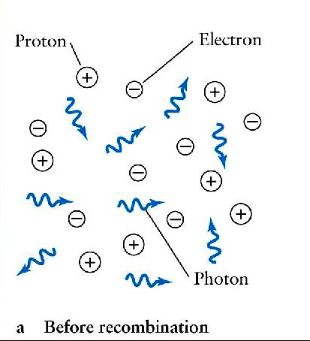
… the early universe was foggy

Slide 10
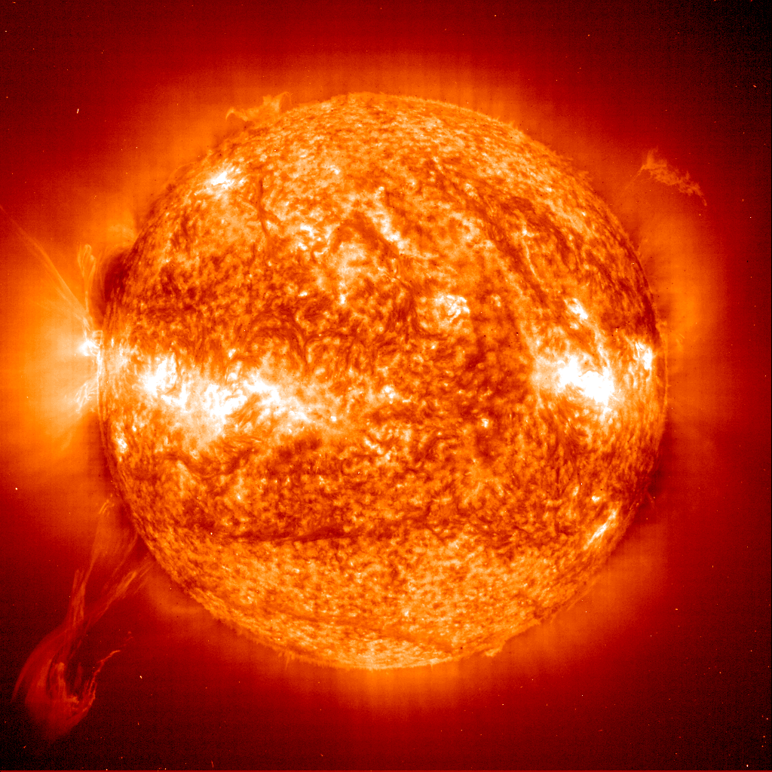
At t=380,000 yrs, first H atoms form & fog of the Big Bang lifts
Radiation from the early universe escapes

Slide 11
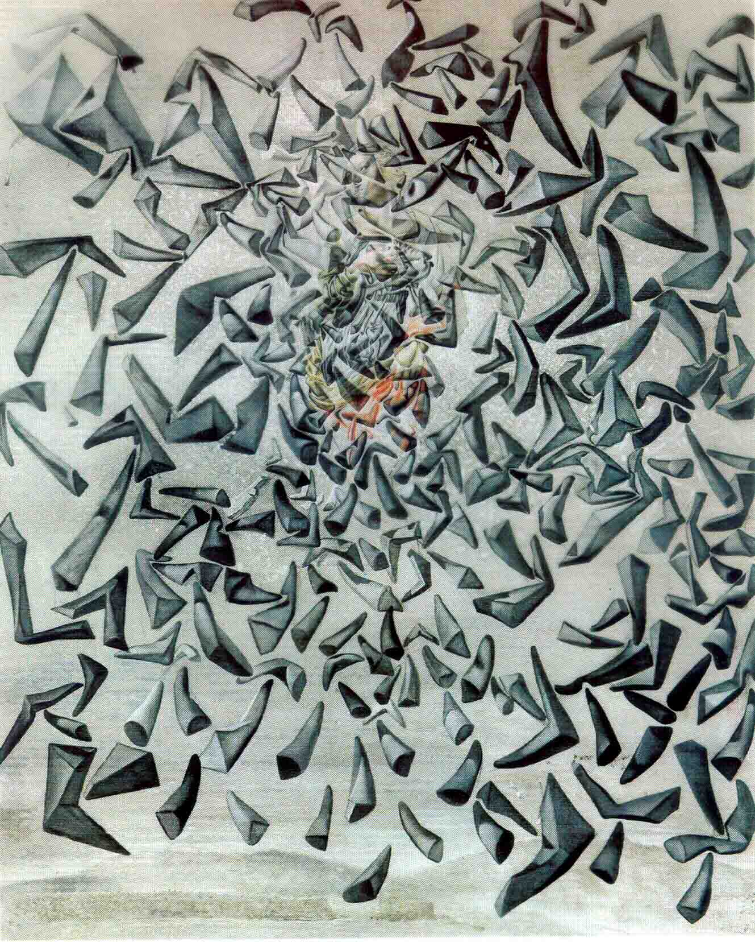
The echo of the Big Bang
As the Universe expanded the radiation began to cool
This radiation has been propagating ever since and today it is so cold that it is in the form of microwaves

Slide 12
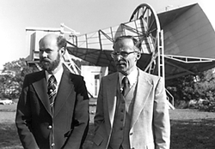
The echo of the Big Bang
In 1964, Arno Penzias & Bob Wilson were carrying out experiments using a microwave antenna for satellite communications.
As they pointed the antenna towards the sky, their receiver registered a faint ‘hiss’ coming from all directions that would not go away.
A stunning triumph for the Big Bang theory!

Slide 13
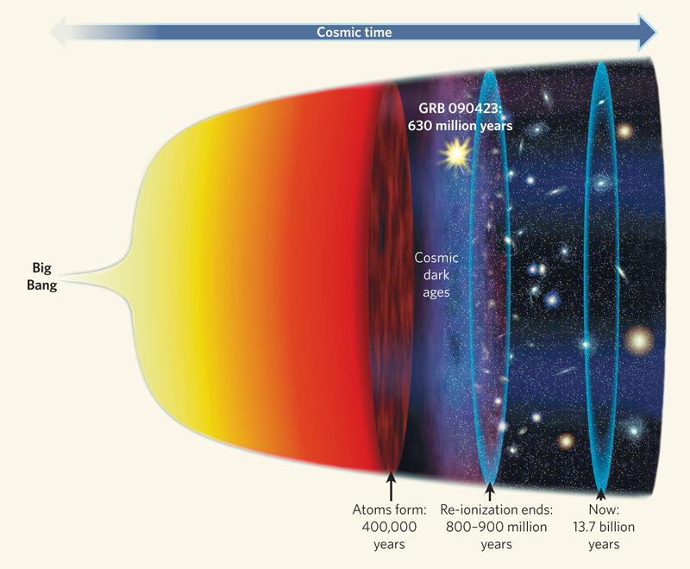
After the initial burst of light from the fireball, the Universe entered a dark age

Slide 14
The dark ages ended when the first suns began to shine

Slide 15
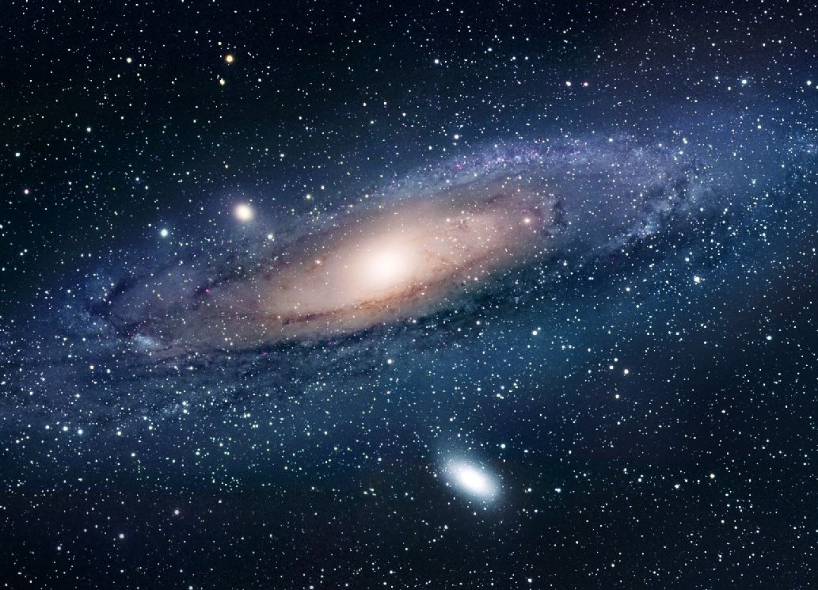
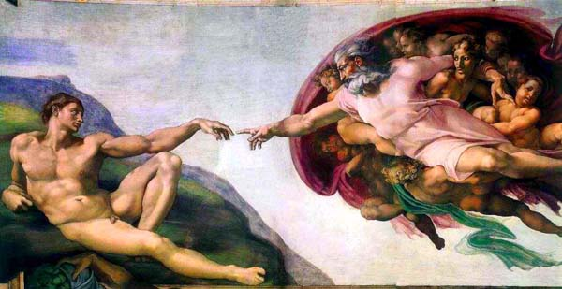
Where do the stars and galaxies come from?

Slide 16
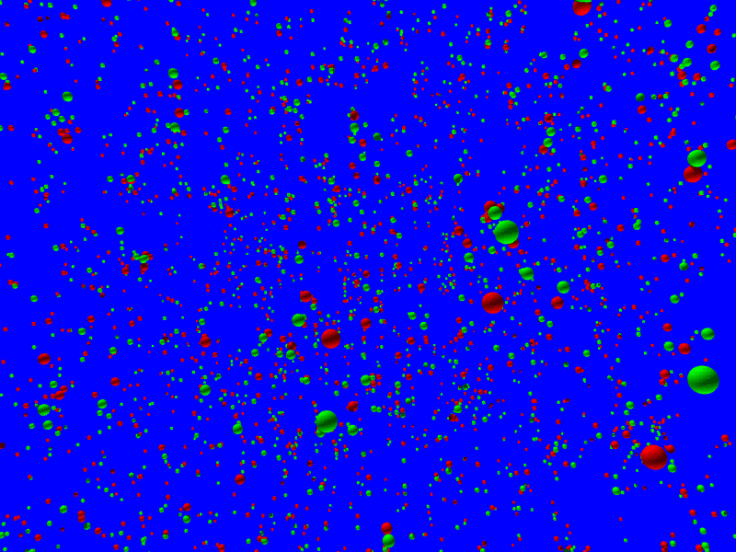

Slide 17
Cosmic inflation → initial conditions

Slide 18
The cosmic microwave background is emitted
Cosmic inflation → initial conditions

Slide 19
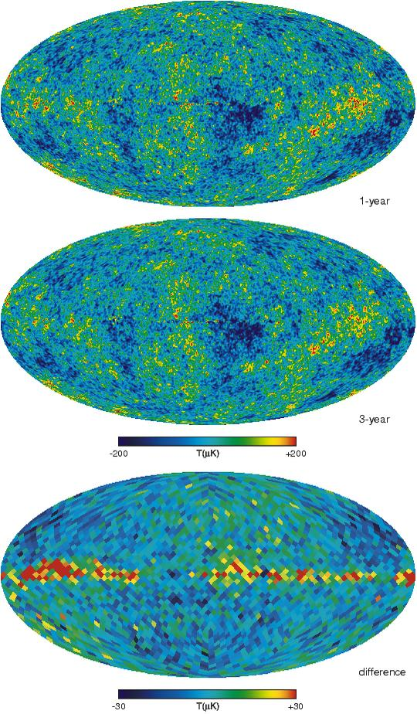
The temperature of this radiation should show small irregularities
Cosmic inflation → initial conditions

Slide 20
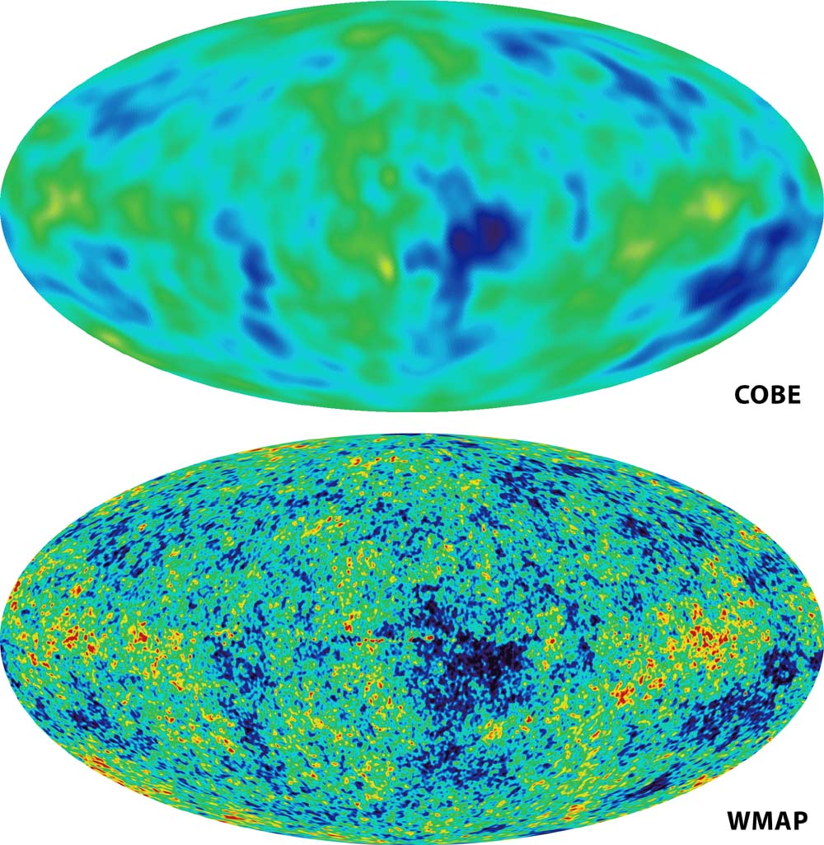
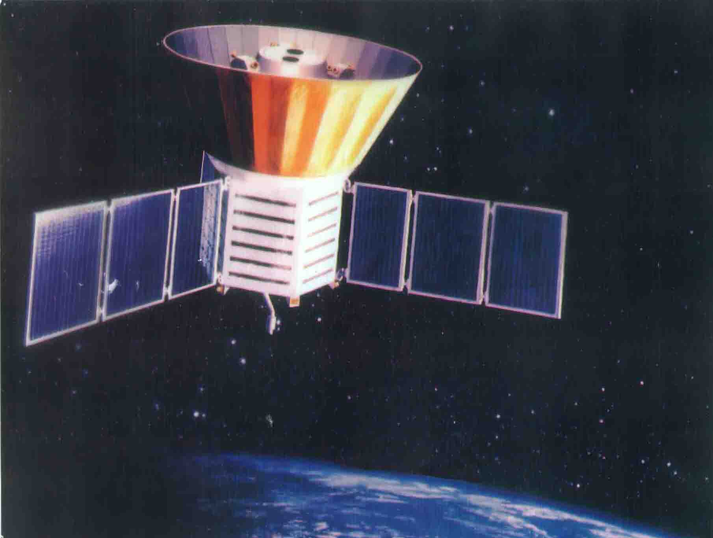
The CMB
1992
The cosmic microwave background radiation (CMB) provides a window to the universe at t~3x10⁵ yrs
In 1992 COBE discovered temperature fluctuations (ΔT/T~10⁻⁵) consistent with inflation predictions

Slide 21
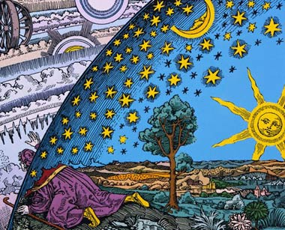
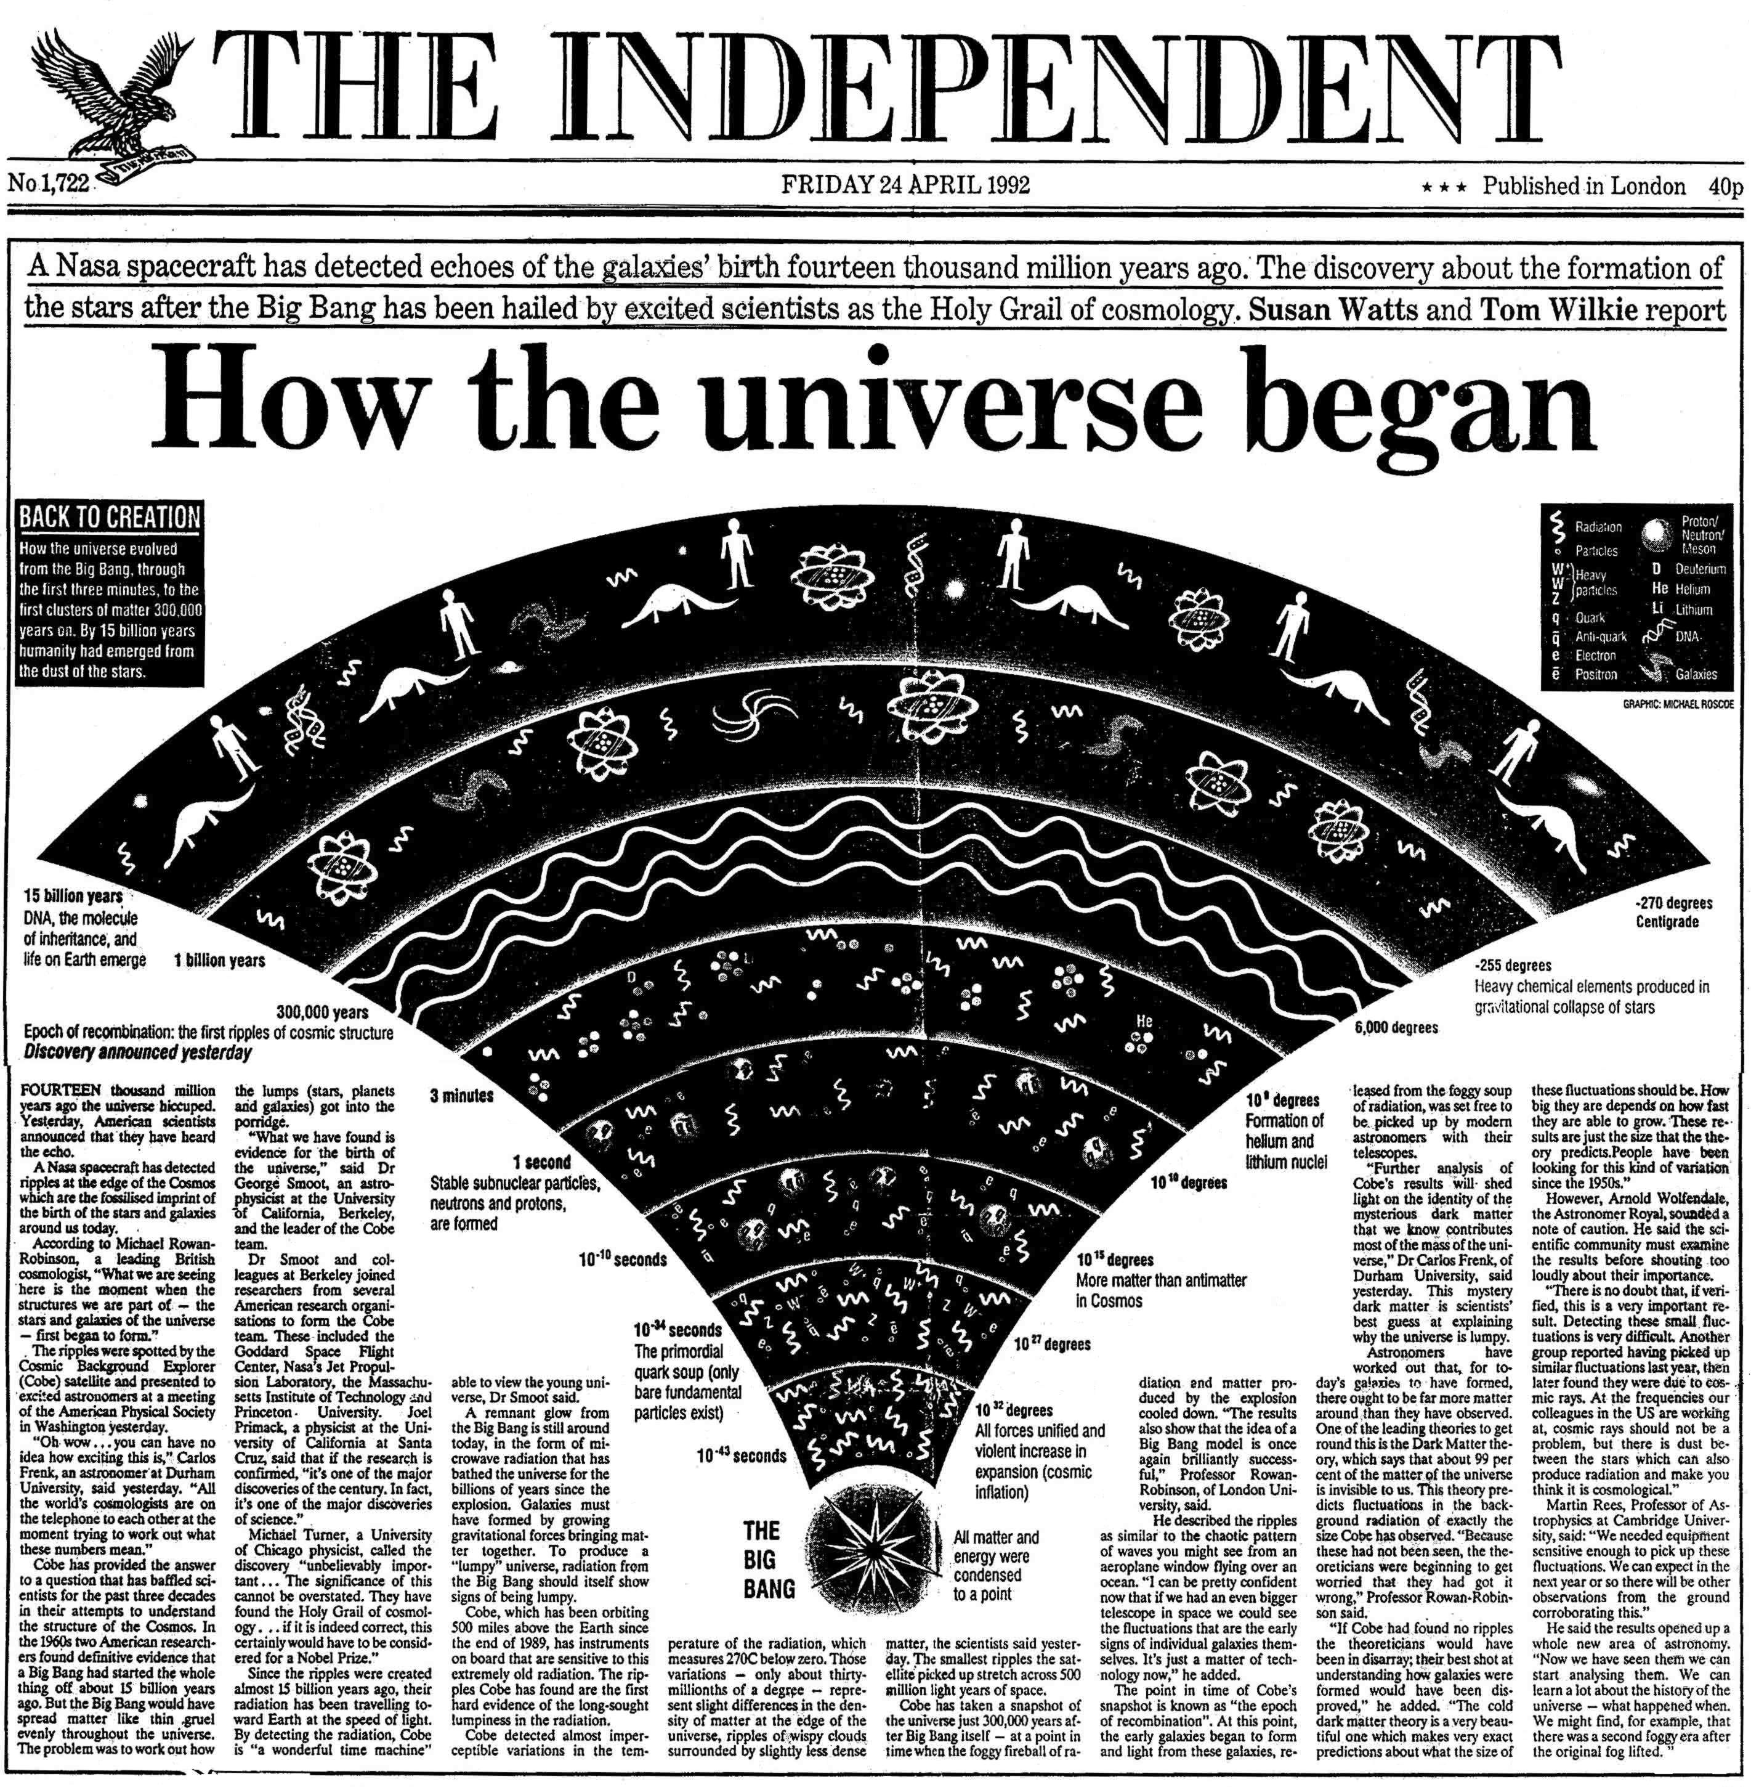
Flammarion 1888: tete des etoiles

Slide 22
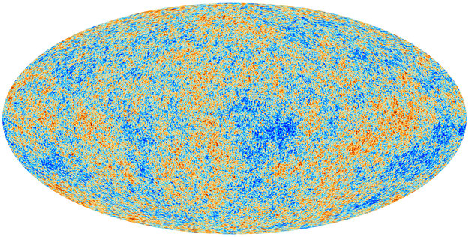
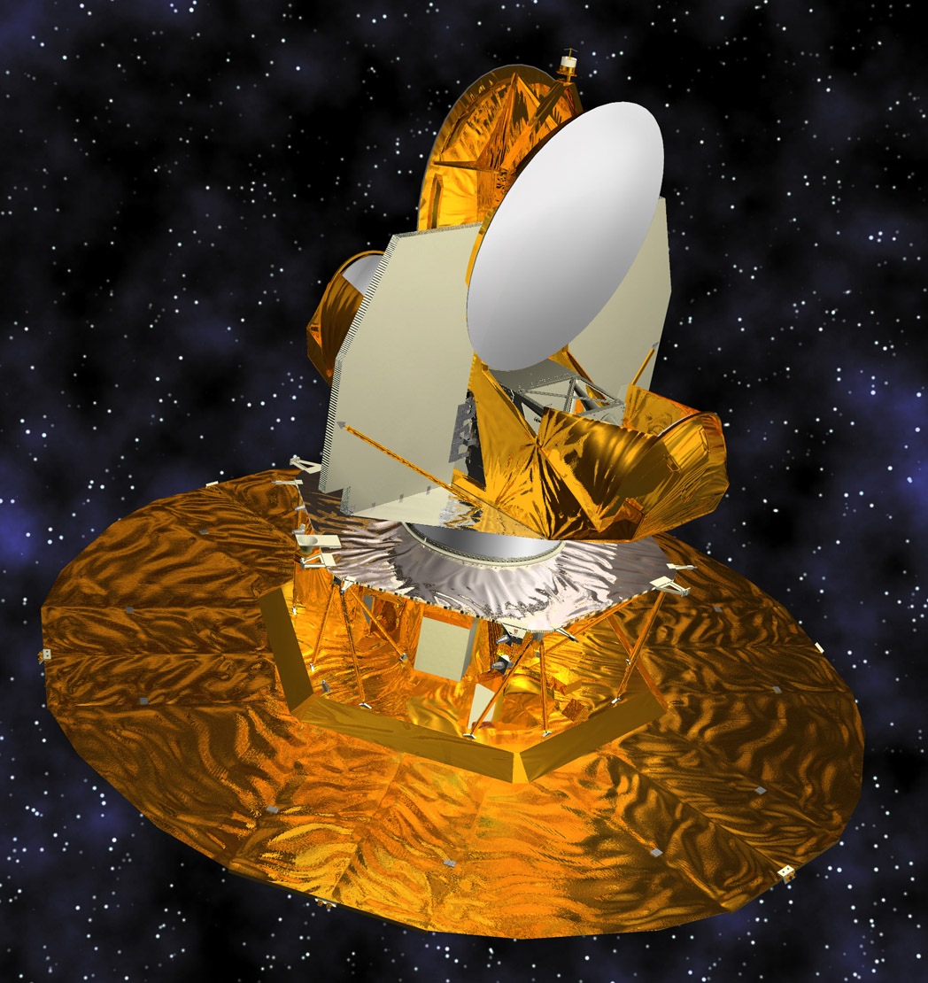
The CMB
1992
2012
Planck

Slide 23
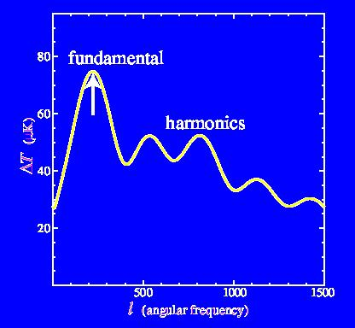
The temperature of this radiation should show small irregularities
Cosmic inflation → initial conditions

Slide 24
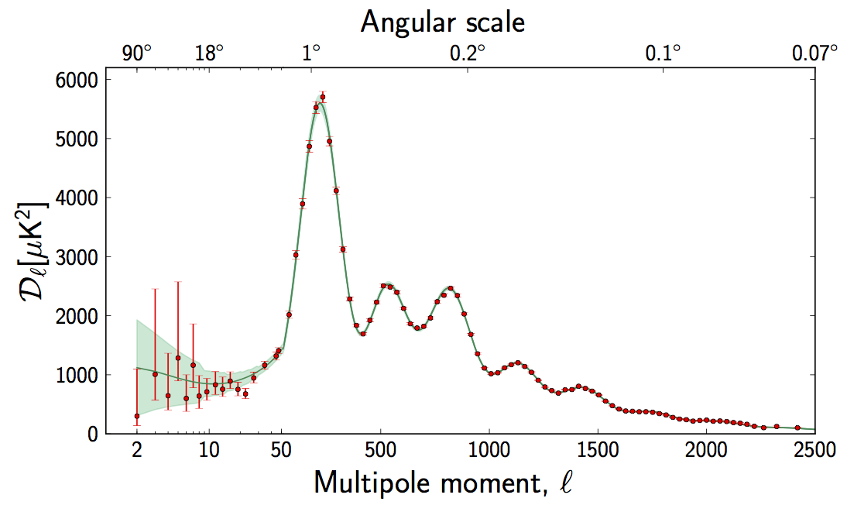
Planck: CMB temperature anisotropies
Fluctuation amplitude
The data confirm the theoretical predictions
Planck coll. 2015

Slide 25
The quantum fluctuations from inflation reflected in the temperature of the microwave background →
Initial conditions for the formation of galaxies

Slide 26
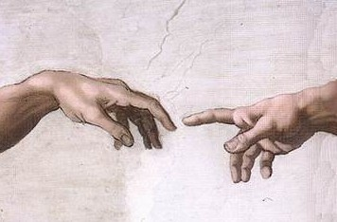
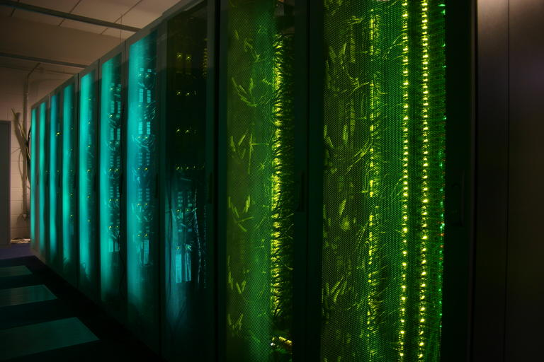
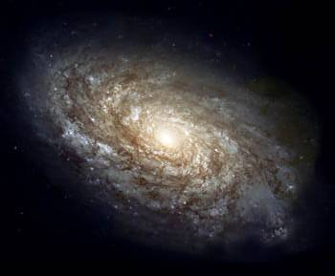
Where do galaxies come from?
Initial conditions
?

Slide 27
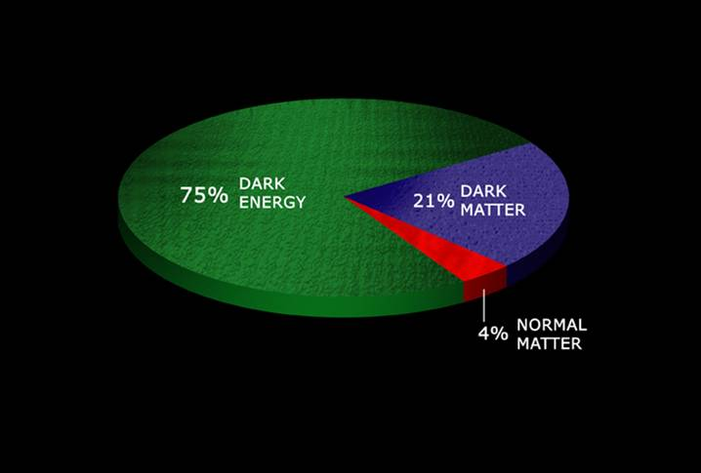
The content of our universe
An elementary particle created soon after the Big Bang (cold dark matter)
70%
25%
5 %
Dark matter ≡ matter that does not emit light at any wavelength

Slide 28
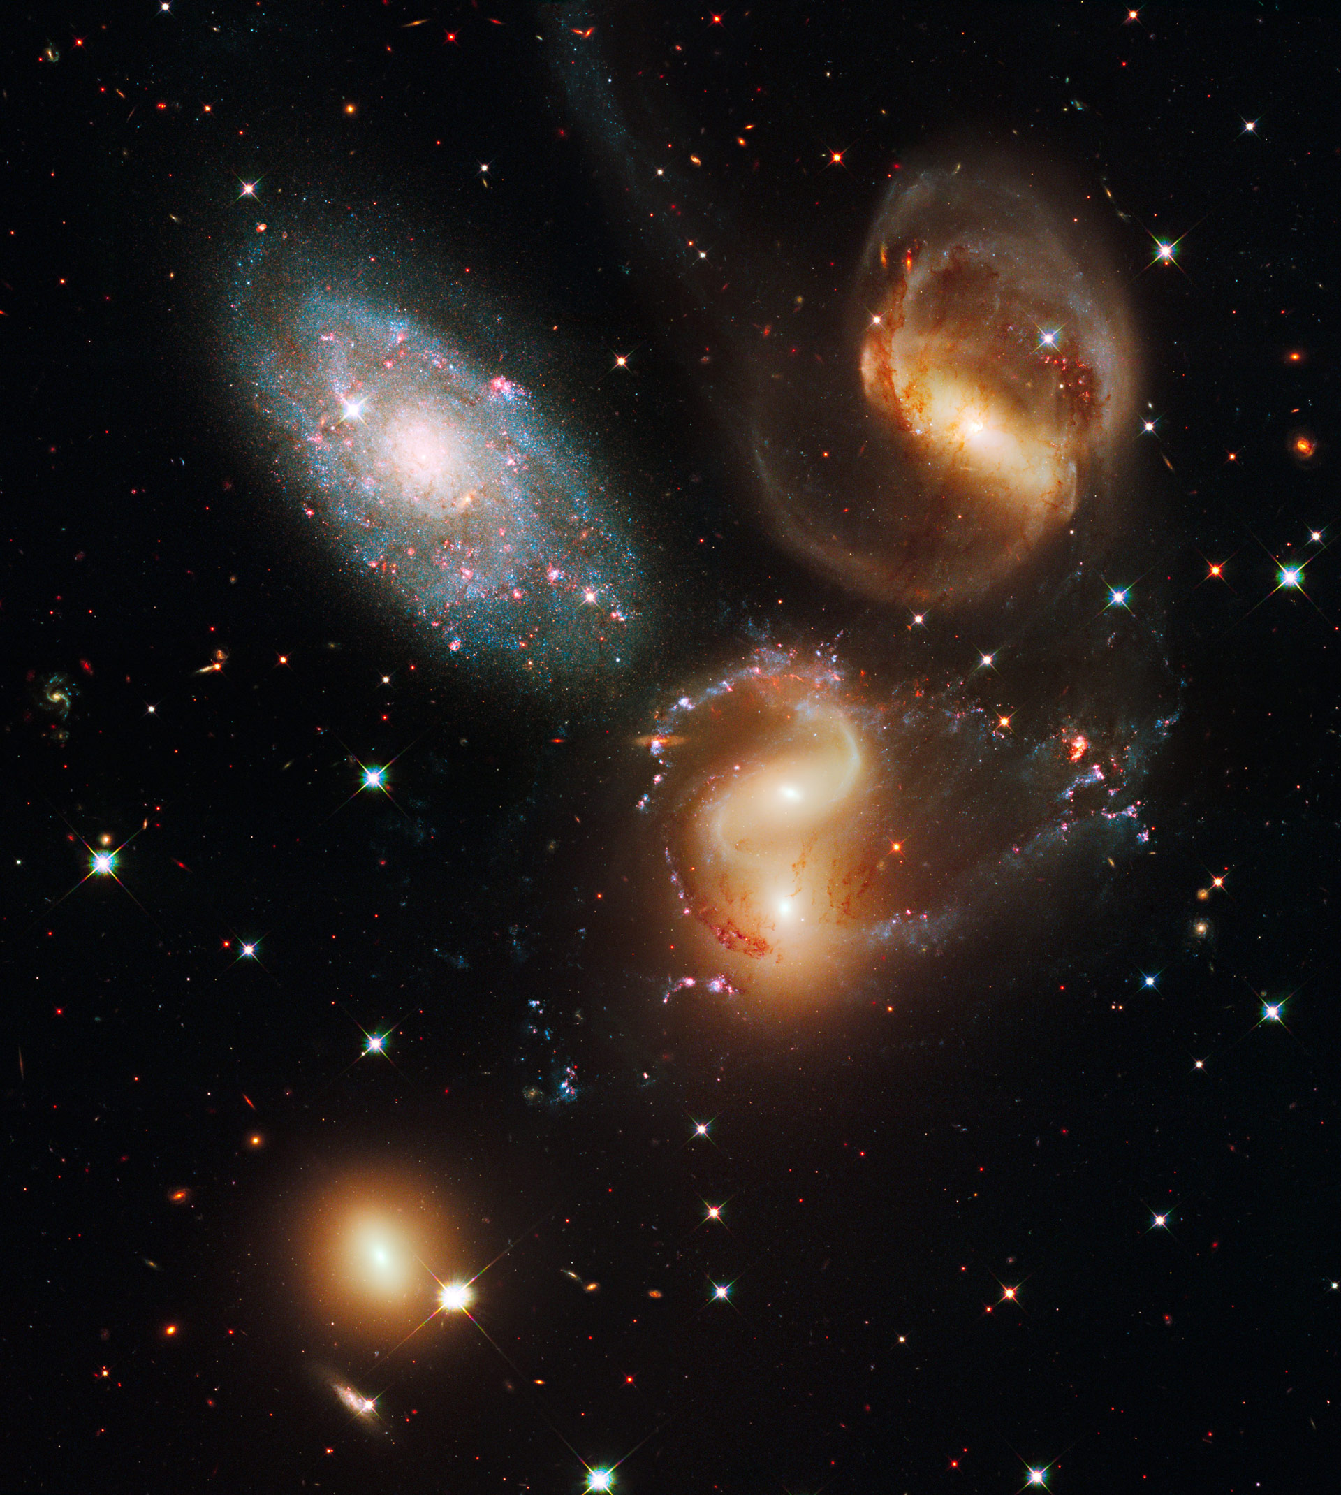
How to make a virtual universe
Initial conditions + assumption about content of Universe
Equations of physics: General Relativity Mechanics Hydrodynamics
Atomic physics, etc

Slide 29
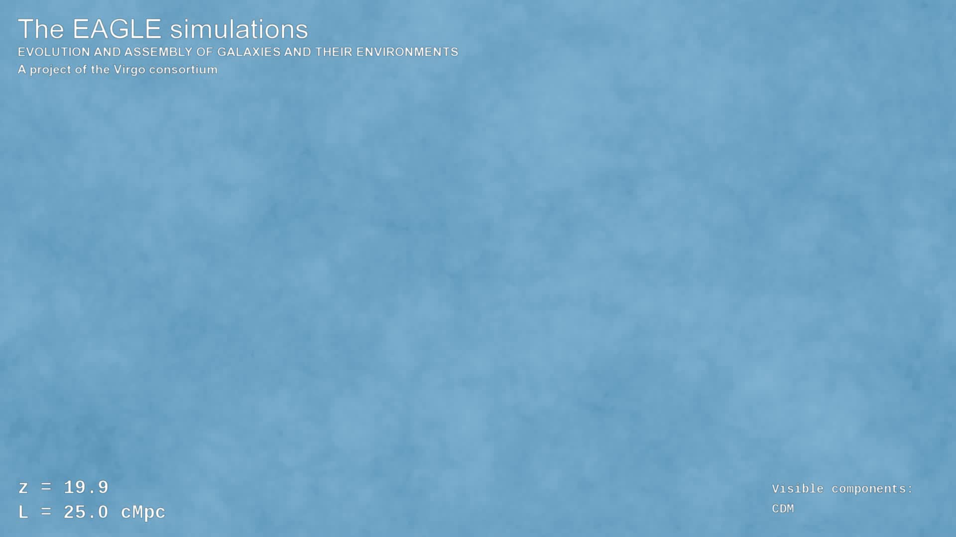

Slide 30
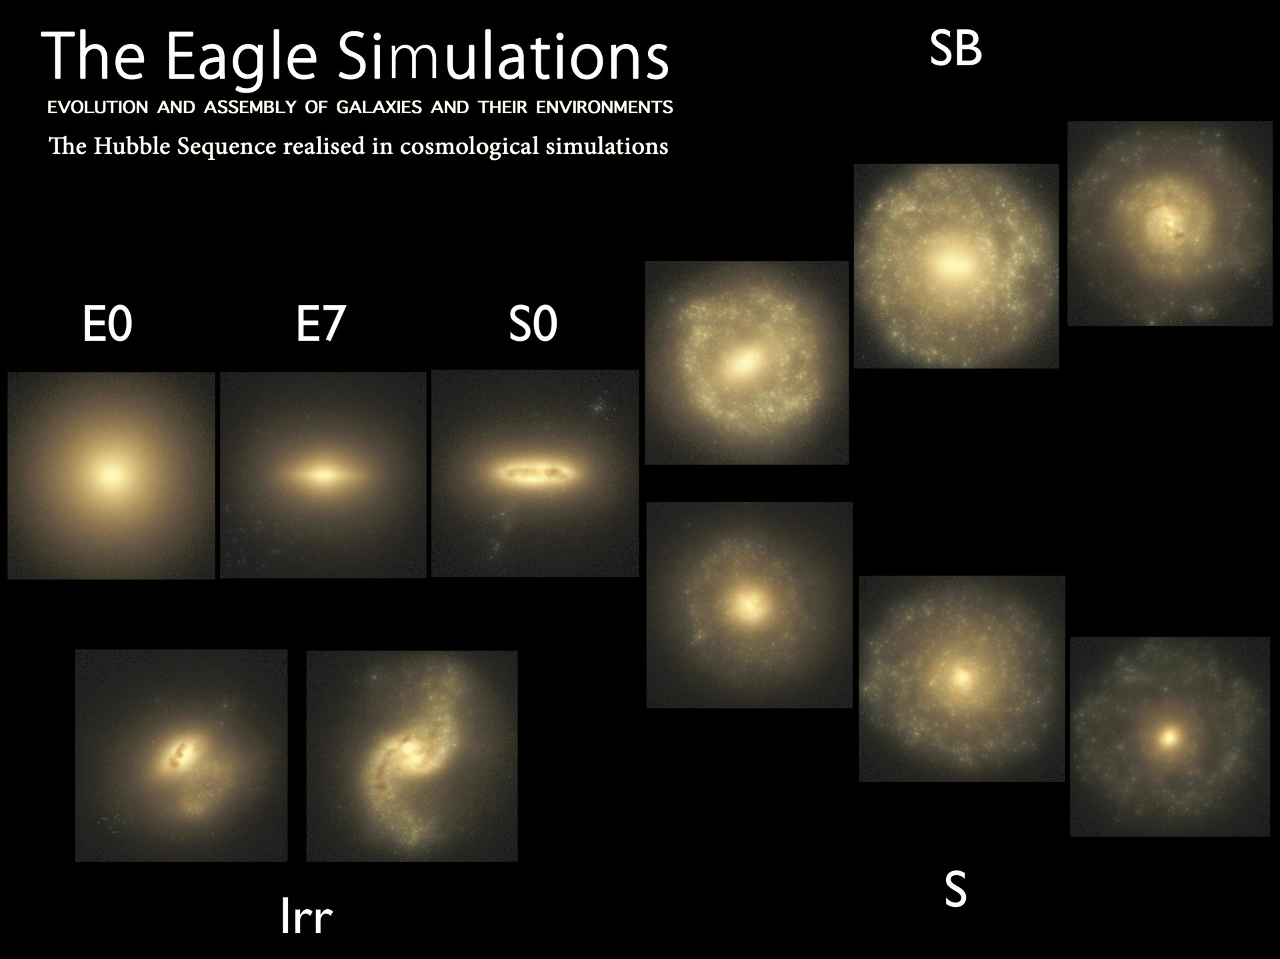
Trayford et al ‘15

Slide 31
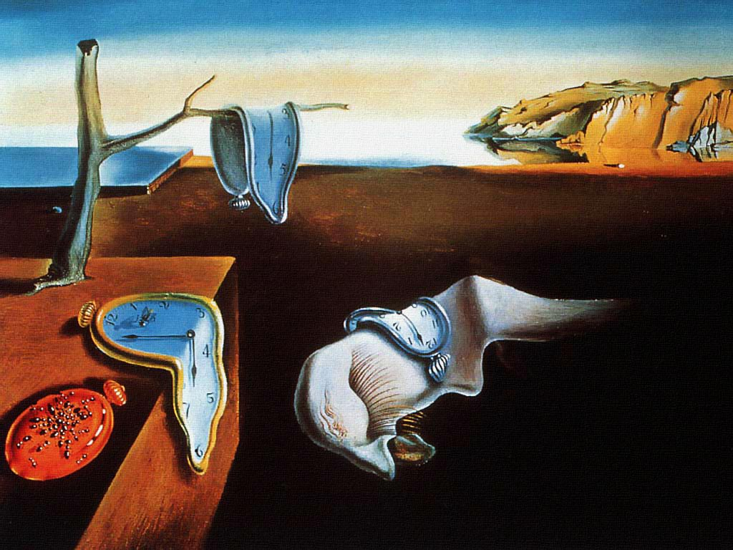
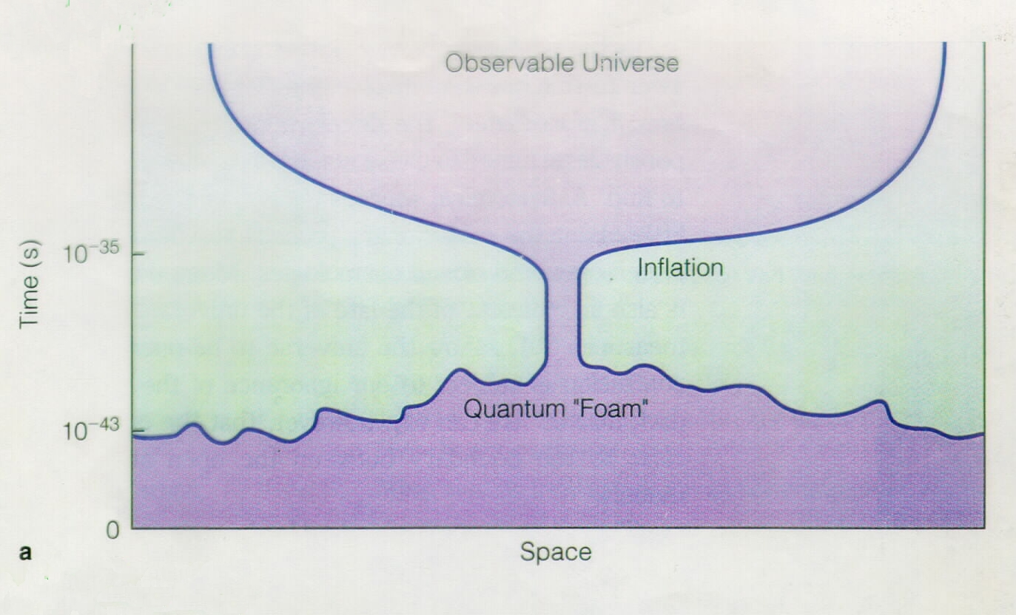
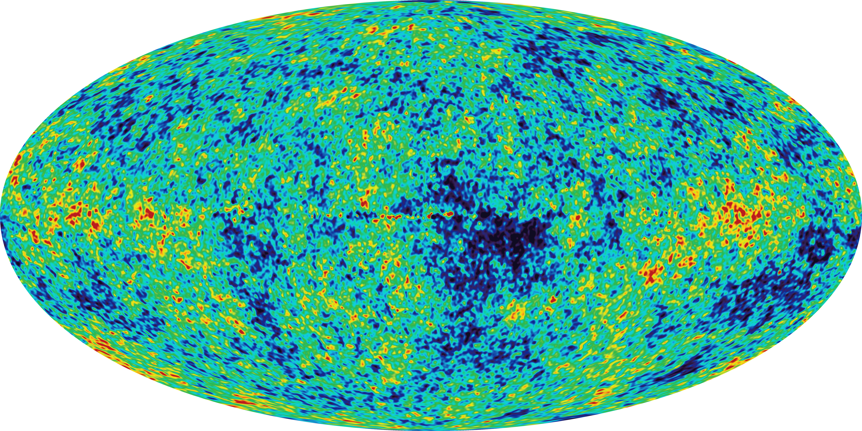
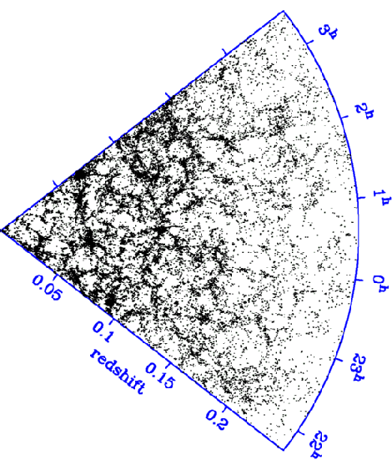
The origin of cosmic structure
Inflation (t~10⁻³⁵ s)
Small (quantum) ripples
CMB (t~3x10⁵ yrs)
Galaxies (t~13x10⁹yrs)
Cold dark matter
Ripples seen as hot & cold spots in cosmic radiation
Galaxies form
Recent measurements of CMB temperature fluctuations and of the galaxy distribution confirm this paradigm.

Slide 32
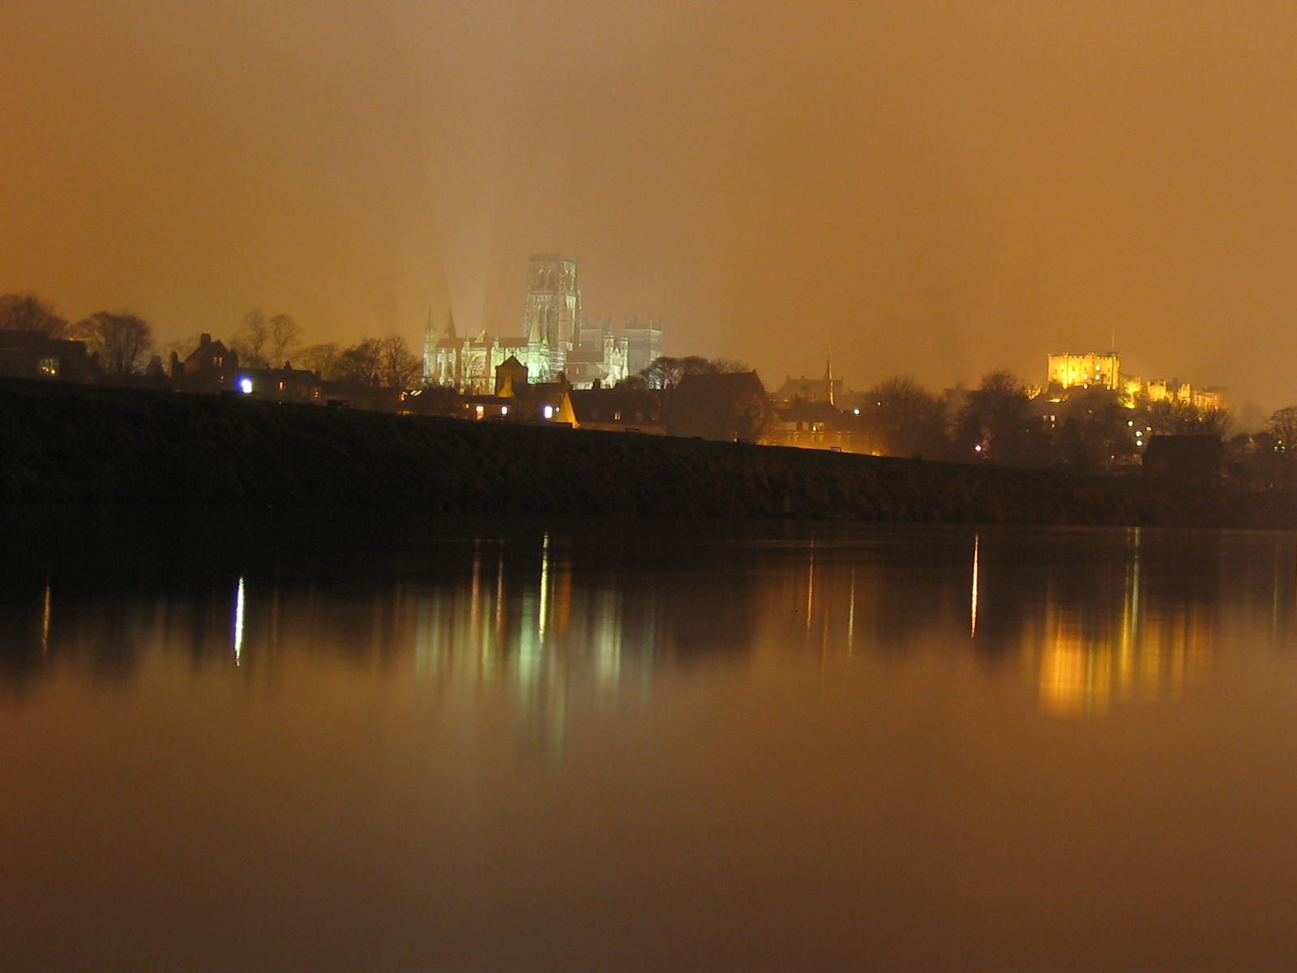
The golden era of cosmology

