Slide 1
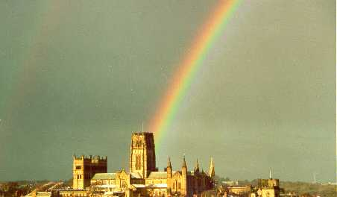

Dark matter
Carlos S. Frenk
Institute for Computational Cosmology, Durham

Slide 2
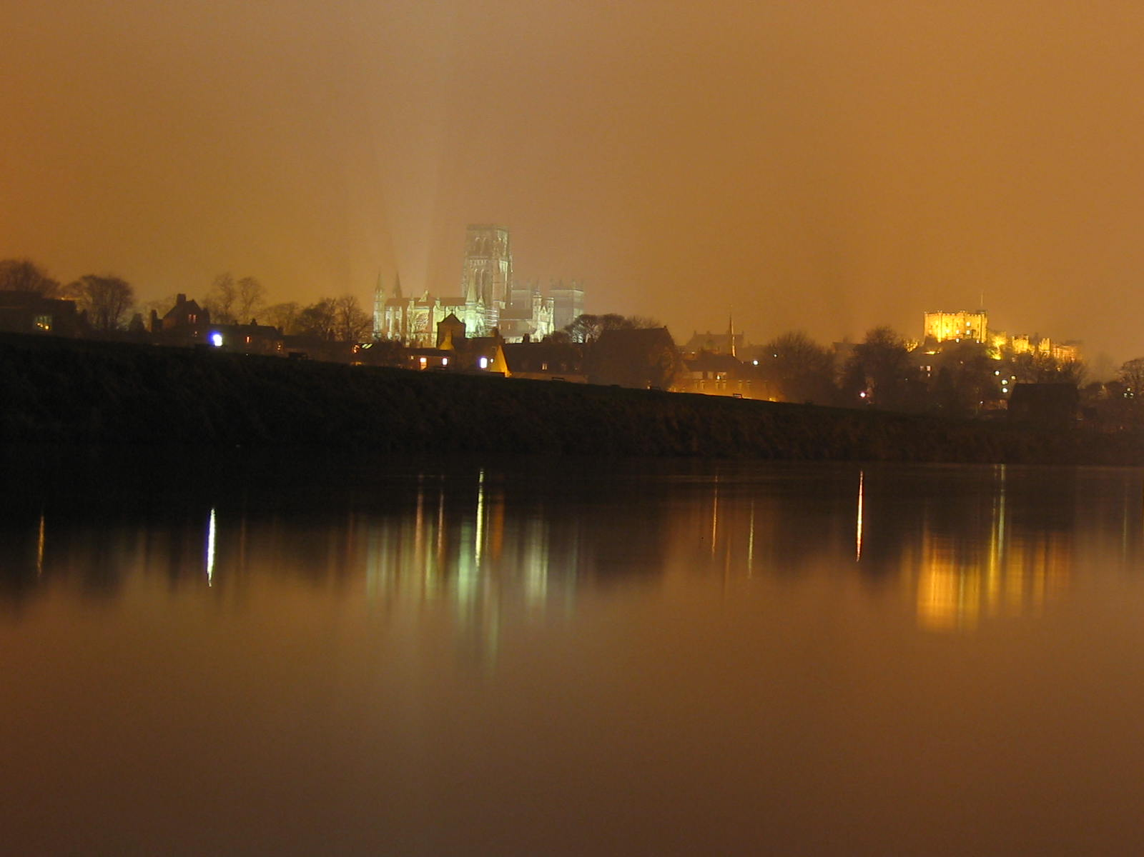
The identity of the dark matter is one of the great mysteries of modern science

Slide 3
The content of the Universe

Slide 4
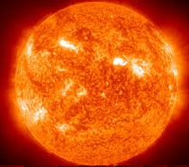
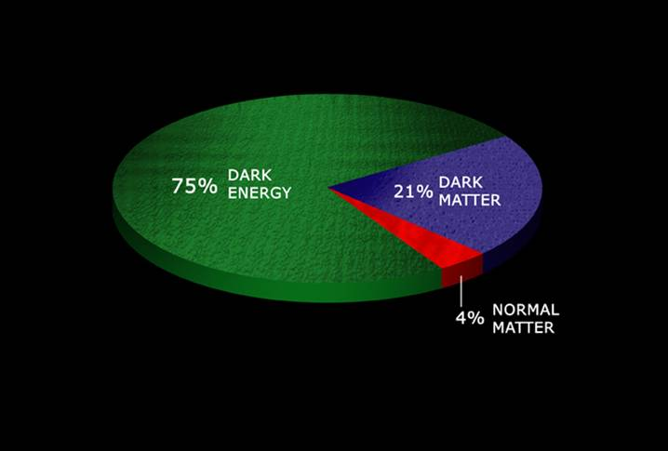
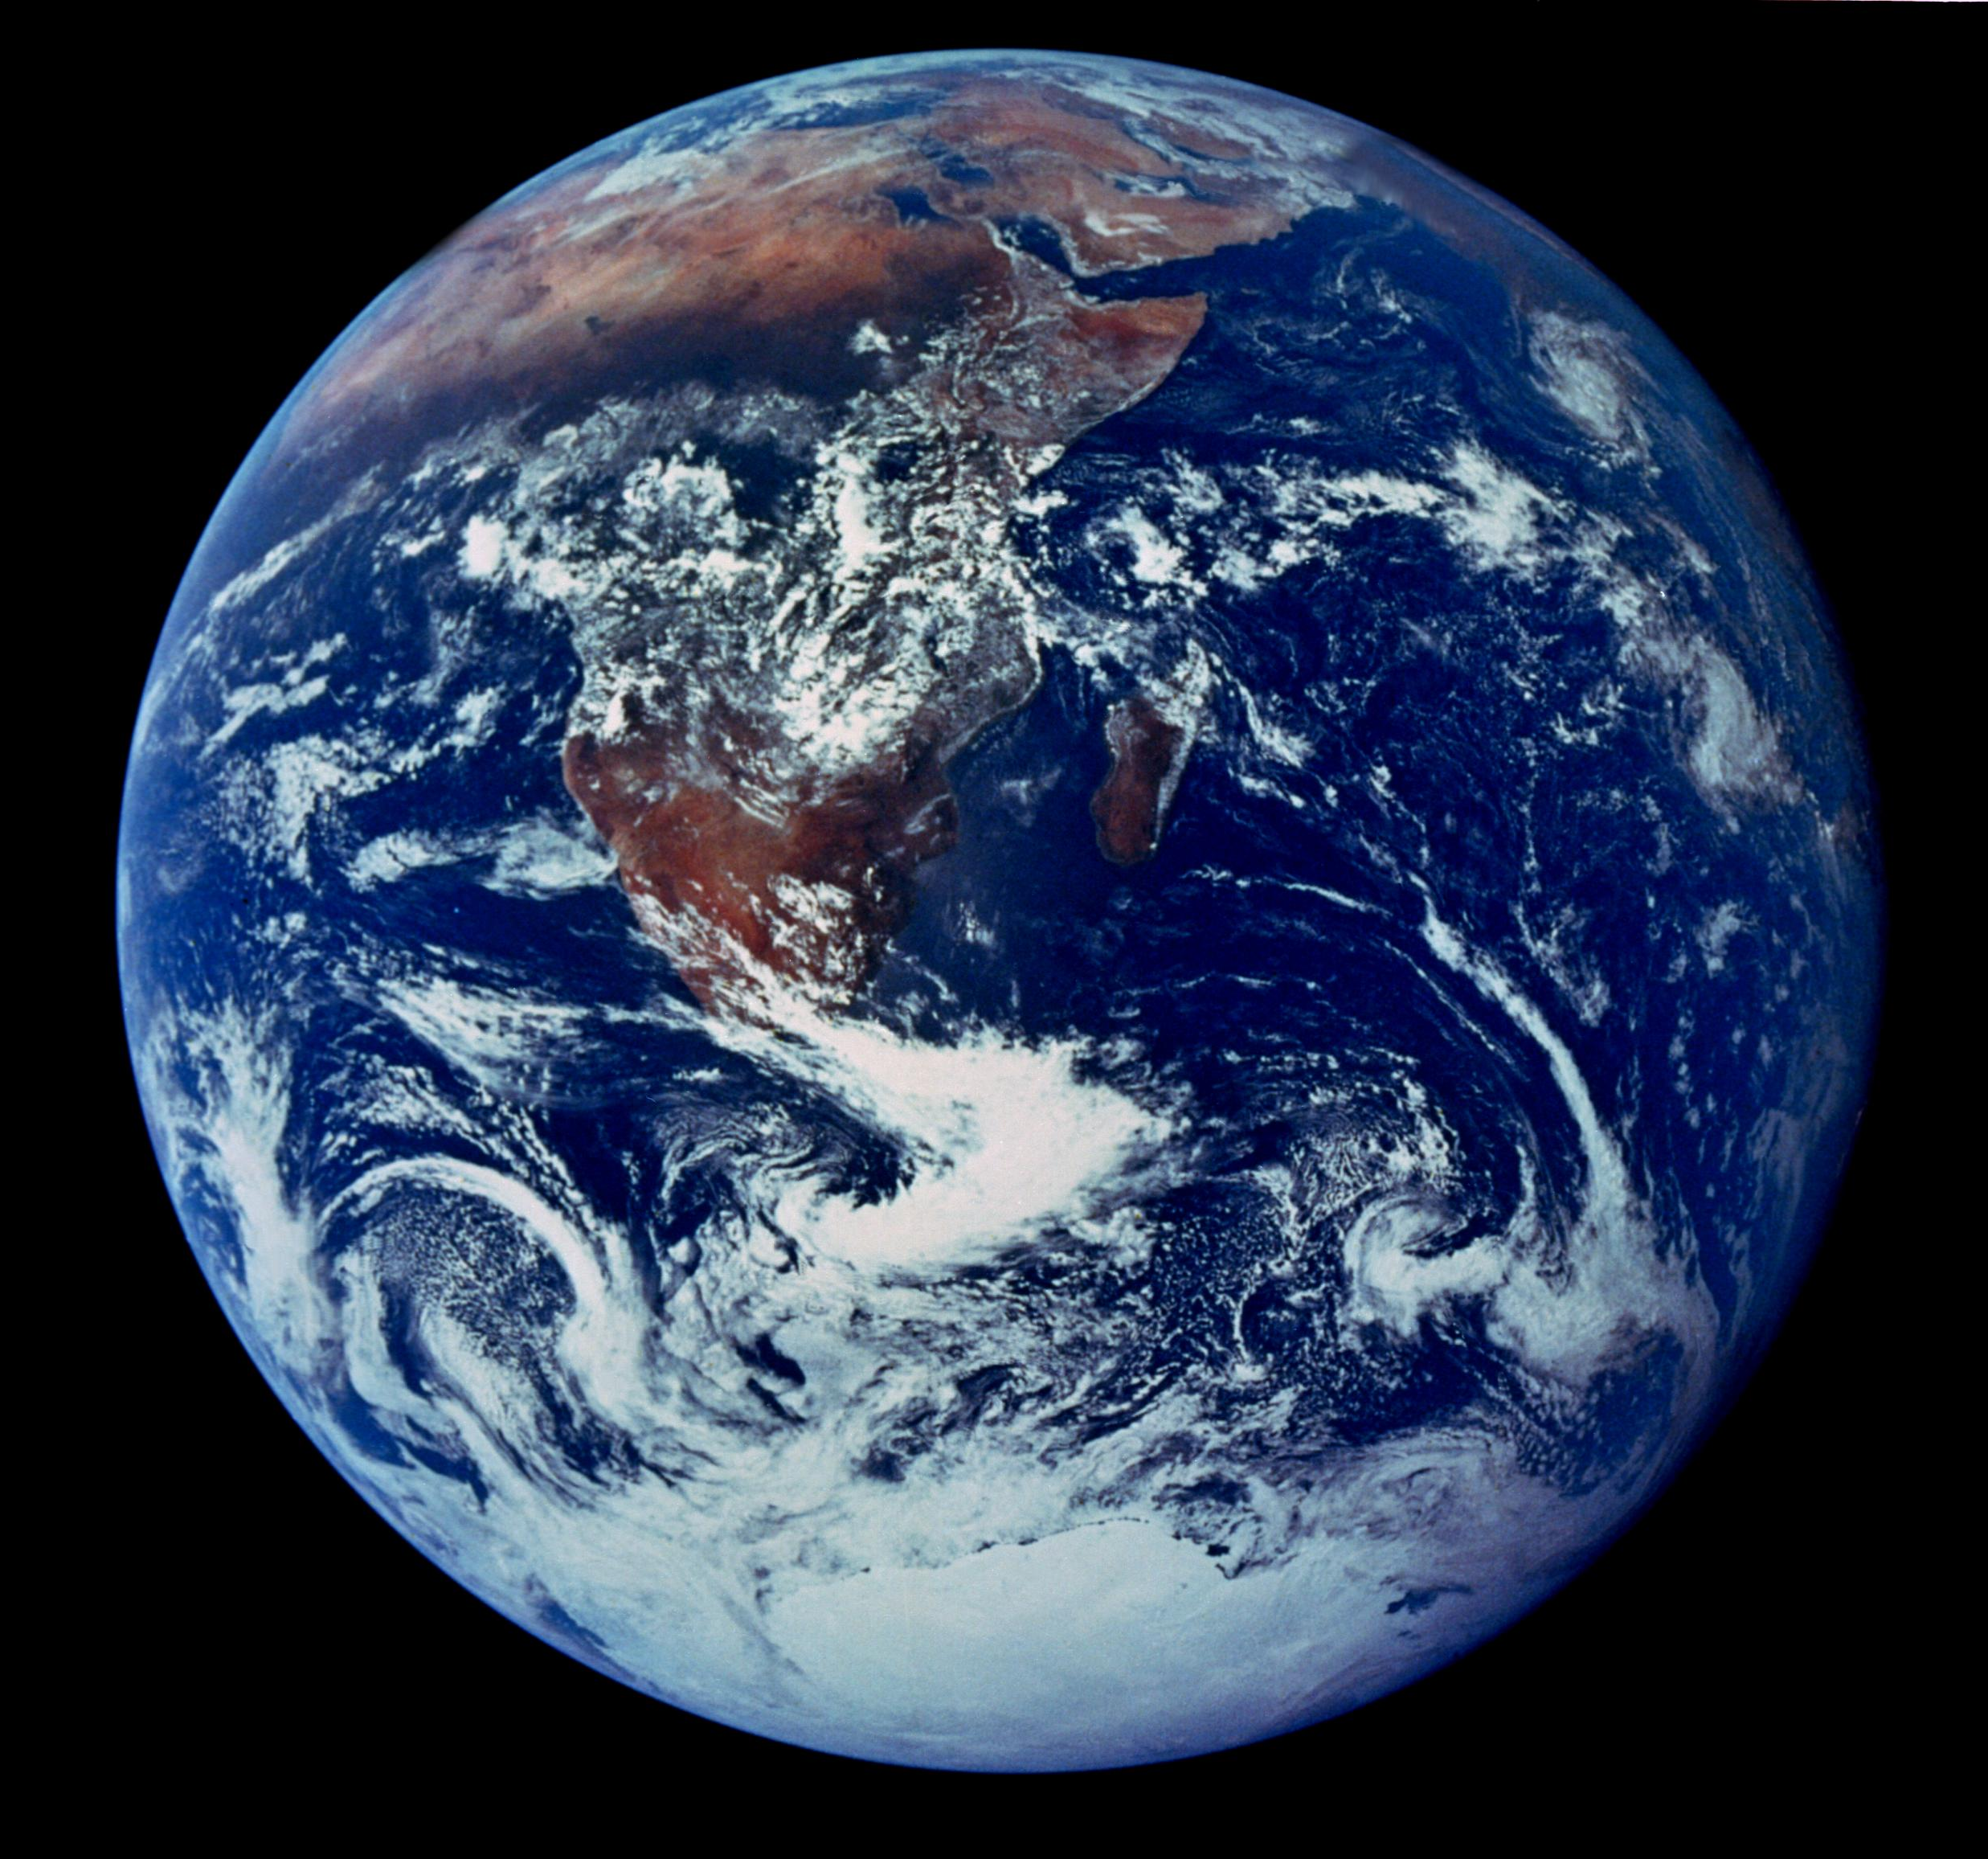
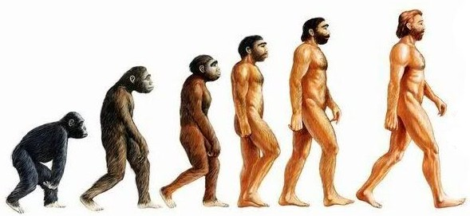
The content of our universe
5 %
Normal matter ≡ matter made of ordinary atoms

Slide 5
The content of our universe
25%
5 %
Dark matter ≡ matter that does not emit light at any wavelength

Slide 6

The content of our universe
70%
25%
5 %
Dark energy ≡ mysterious form of energy which opposes gravity

Slide 7
What is the cosmic dark energy?
A form of energy that produces a repulsive force, causing the universal expansion to accelerate
It is likely to be energy associated with empty space – the vacuum

Slide 8
The content of our universe
70%
25%
5 %
Dark matter ≡ matter that does not emit light at any wavelength

Slide 9
We can’t see the dark matter
How do we know it exists?

Slide 10
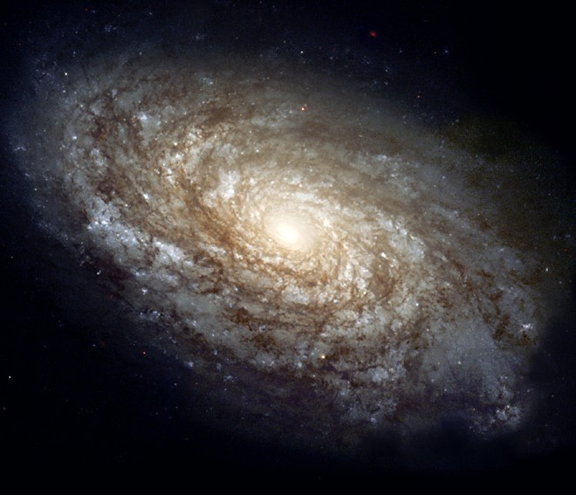
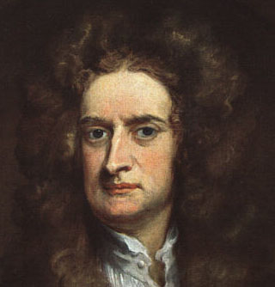
Stars rotate too fast to be held in place by gravity of visible mass

Slide 11
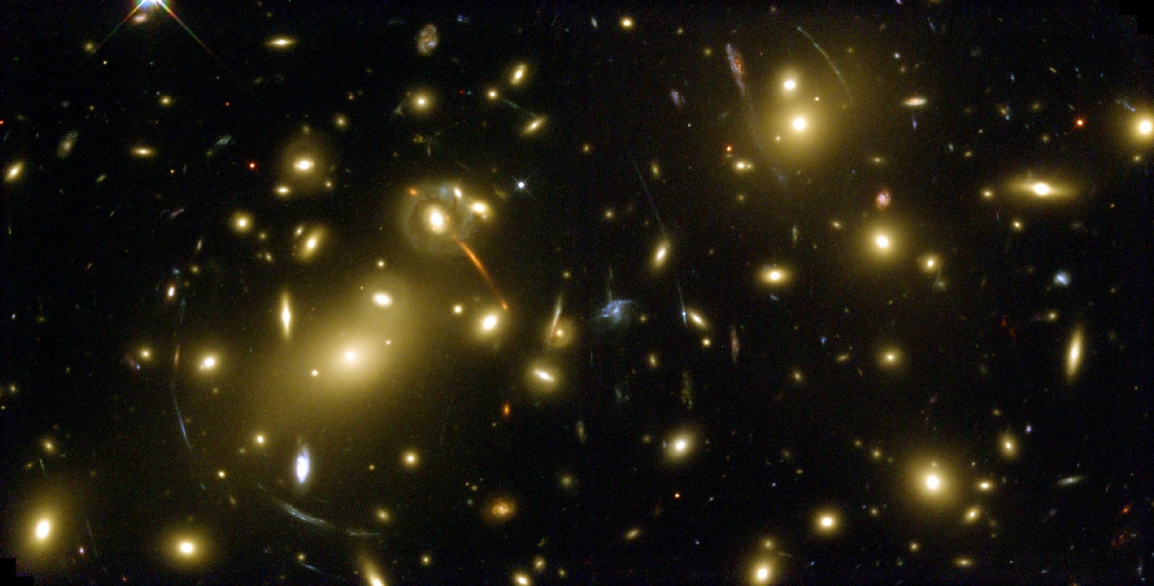
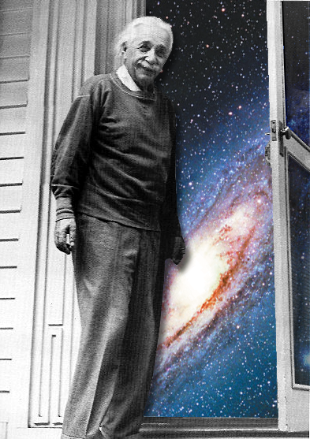
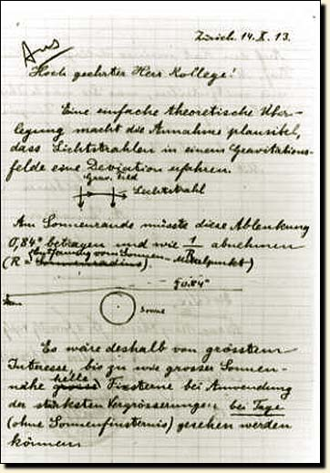
Gravitational lensing: mapping the dark matter
Light from distant galaxies is deflected by dark matter in cluster, distorting the galaxies’ images into arcs

Slide 12
Gravitational lensing: mapping the dark matter
Light from distant galaxies is deflected by dark matter in cluster, distorting the galaxies’ images into arcs

Slide 13
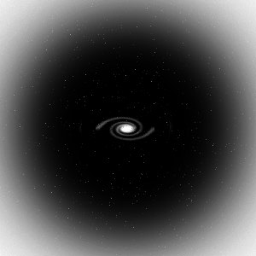
Clumps of dark matter: dark halos
→ dark matter keeps galaxy in place

Slide 14
We know dark matter exists because:
The rotation velocity of stars in galaxies
The distortion of galaxy images behind clusters

Slide 15
What is the dark matter?

Slide 16
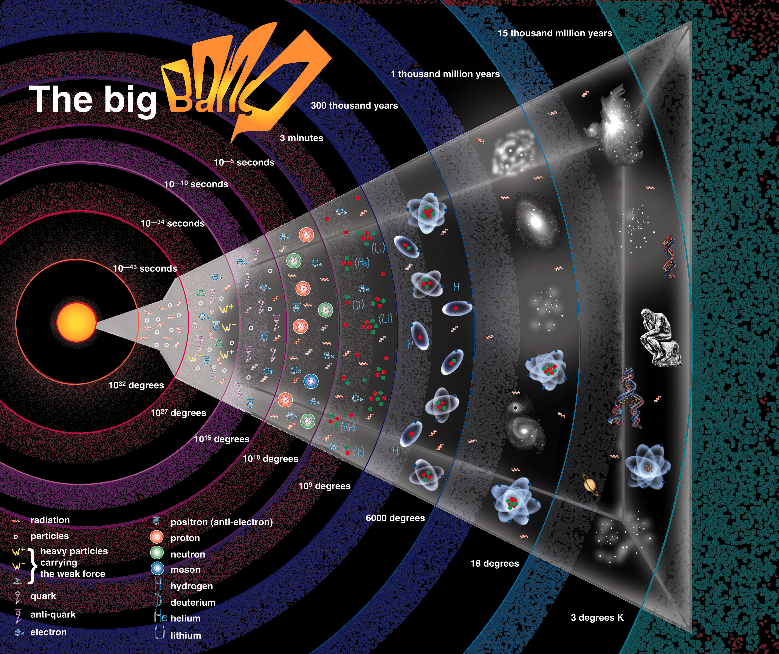
Dark matter
?
Cold dark matter

Slide 17
The content of our universe
why is DM so important?
25%
5 %
Dark matter ≡ matter that does not emit light at any wavelength

Slide 18
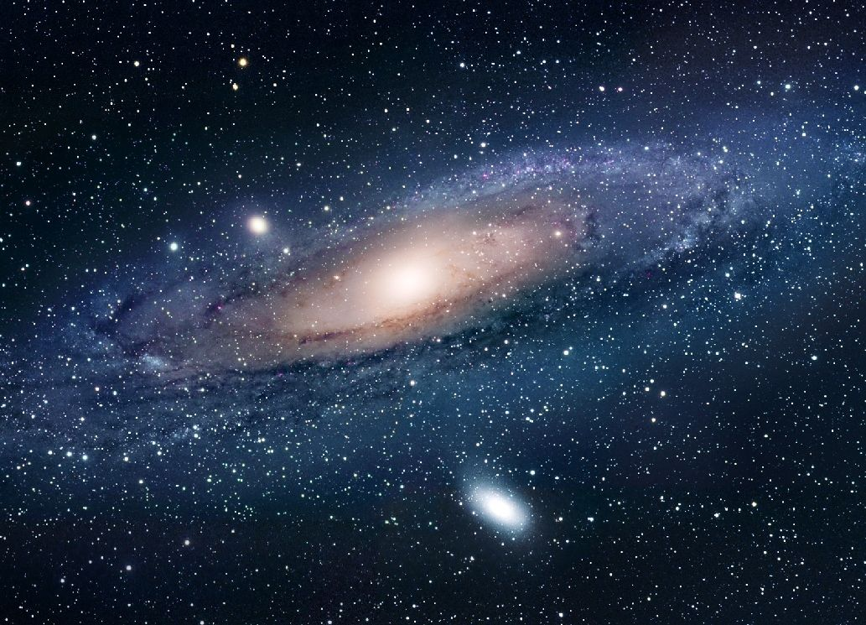
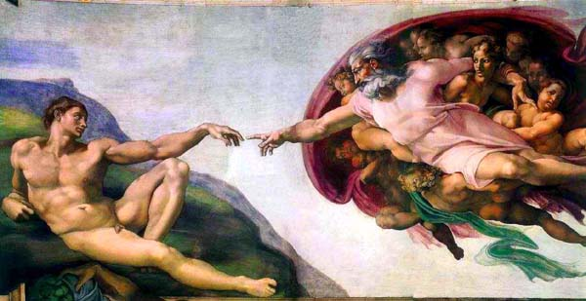
The gravity of the dark matter drives formation of cosmic structure
Where do the galaxies come from?

Slide 19
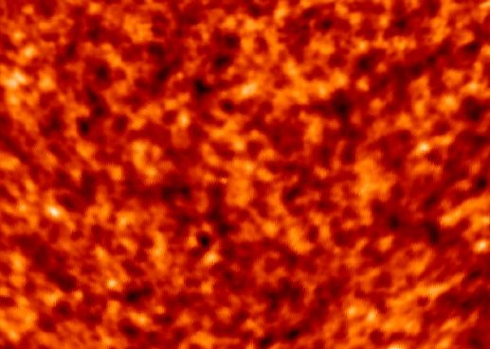
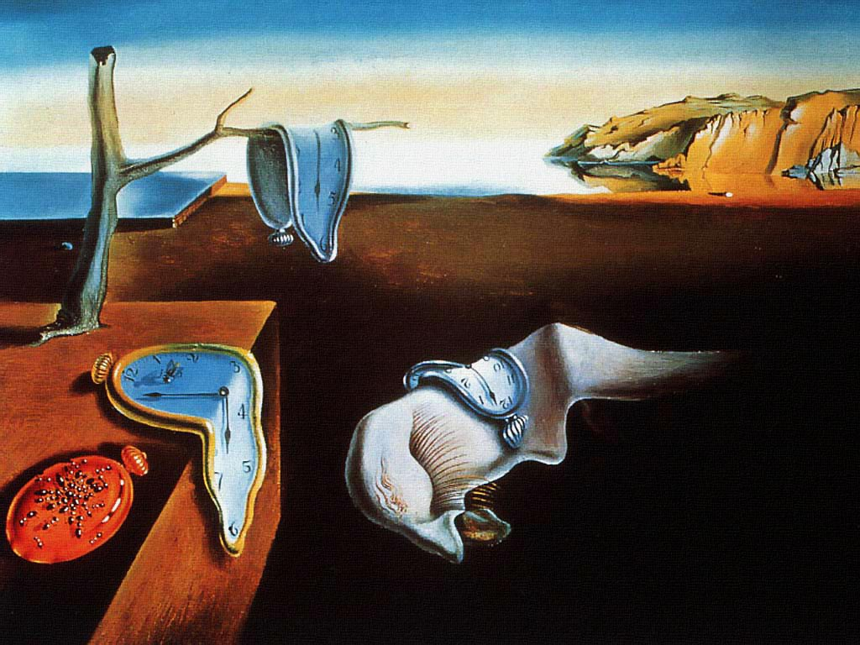
The origin of galaxies
t=10⁻³⁵ sec
Early universe was seeded by tiny mass irregularities produced by quantum processes (quantum fluctuations of the vacuum)
t=13.8 billion yrs

Slide 20
The tiny quantum irregularities were hugely amplified by the gravity of the dark matter

Slide 21
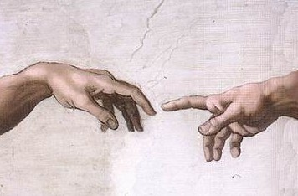
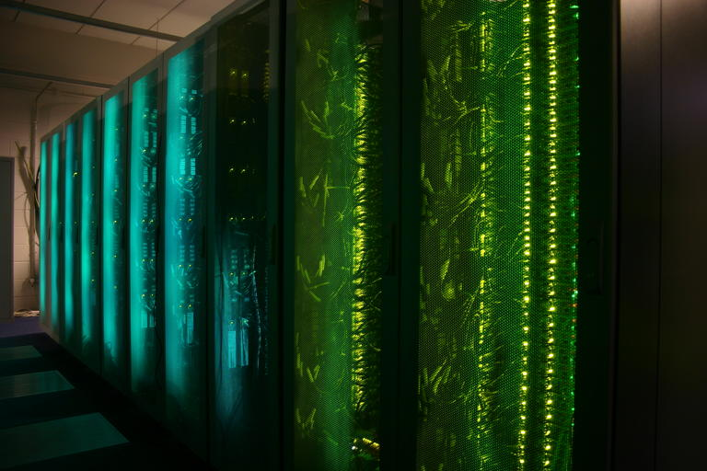
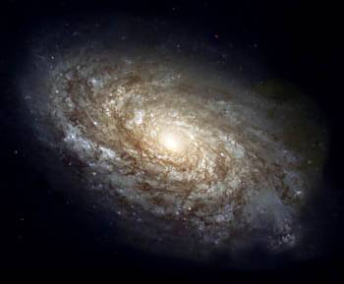
Where do galaxies come from?
Initial conditions
?

Slide 22
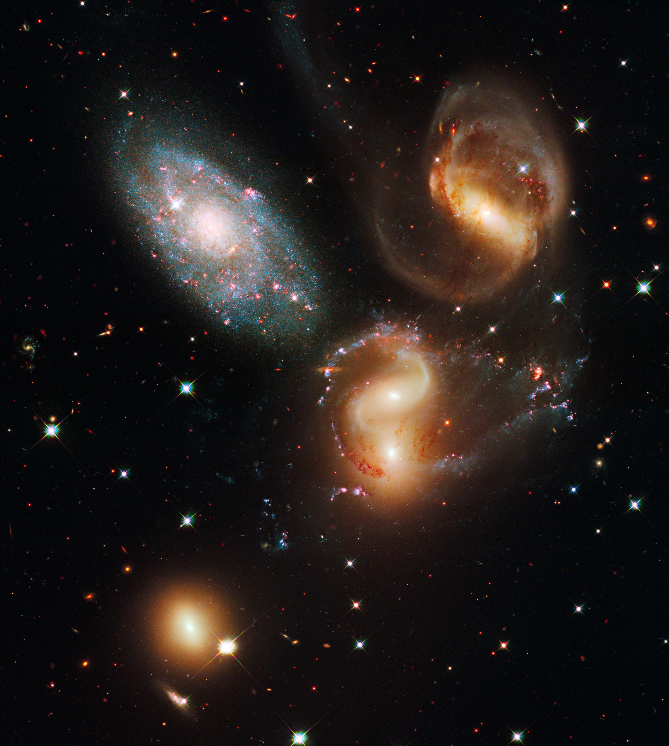
How to make a virtual universe
Initial conditions + assumption about content of Universe
Equations of physics: General Relativity Mechanics Hydrodynamics
Atomic physics, etc

Slide 23
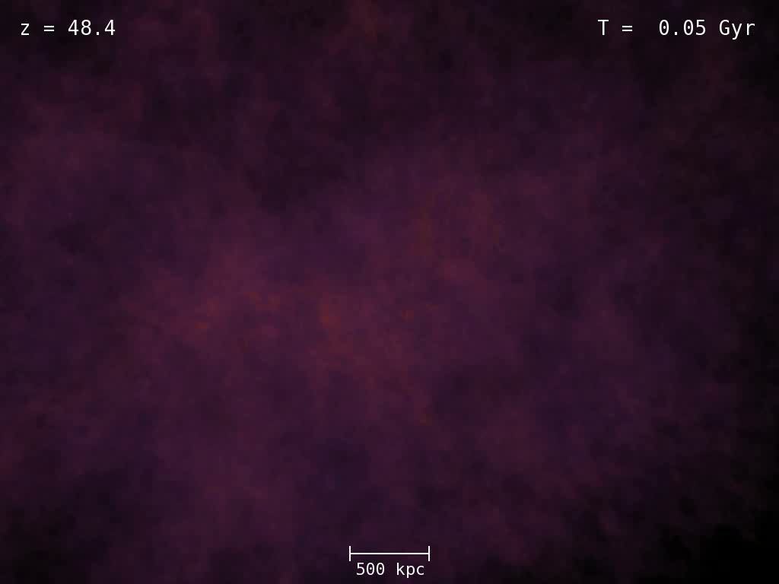

Slide 24
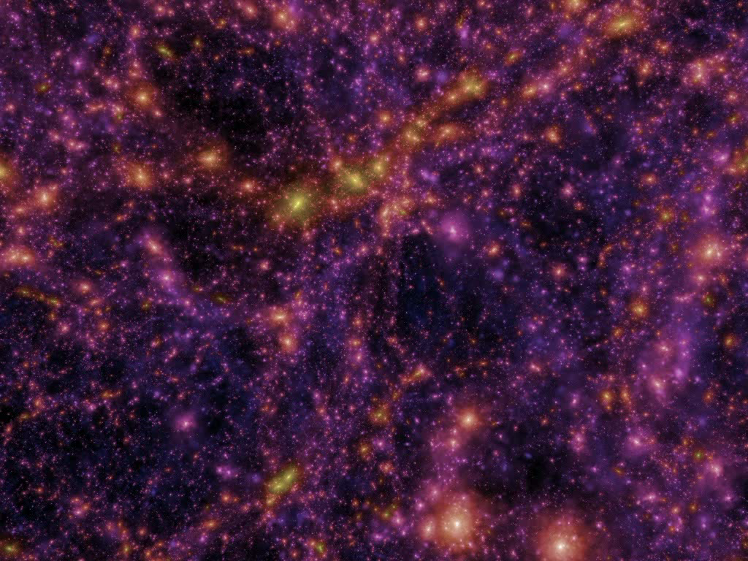

Slide 25
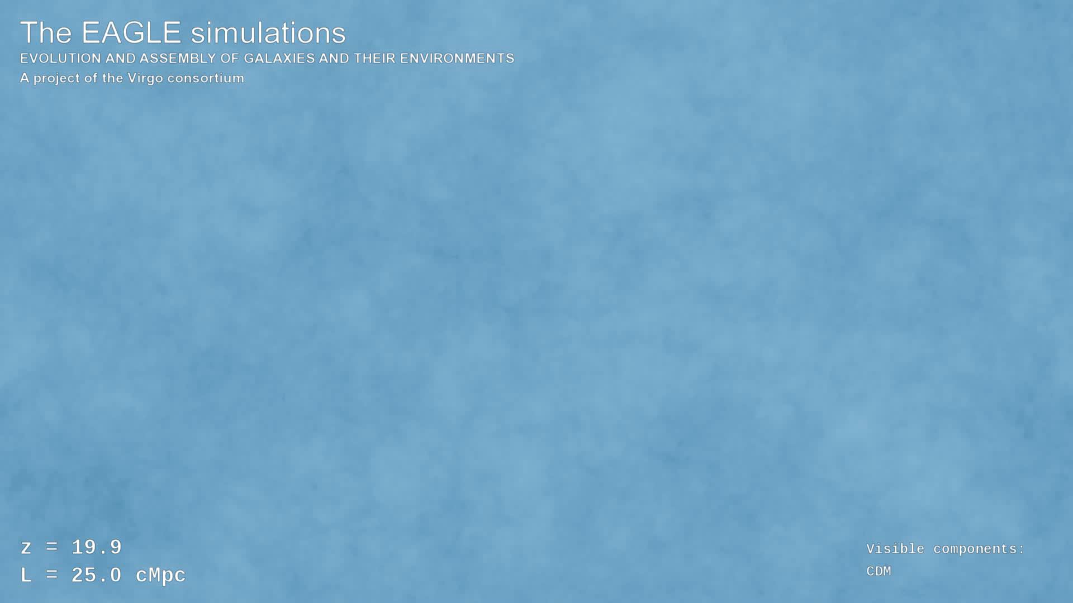

Slide 26
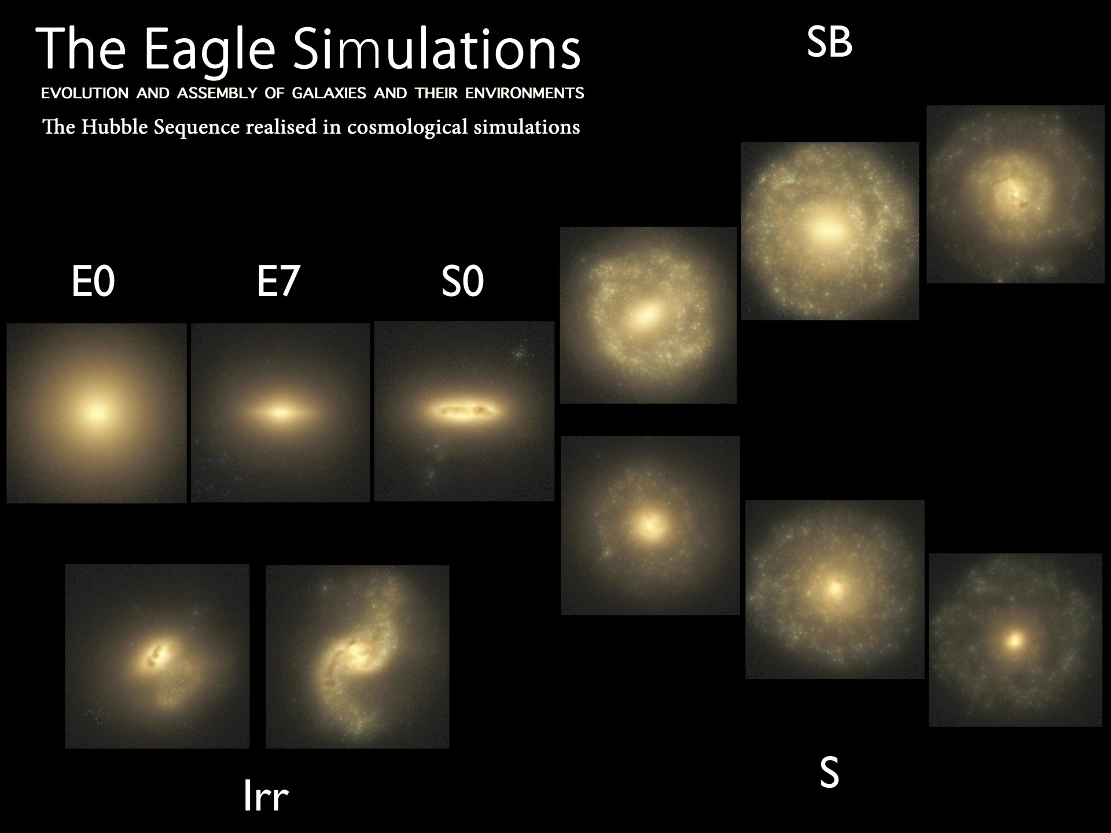
Trayford et al ‘15

Slide 27
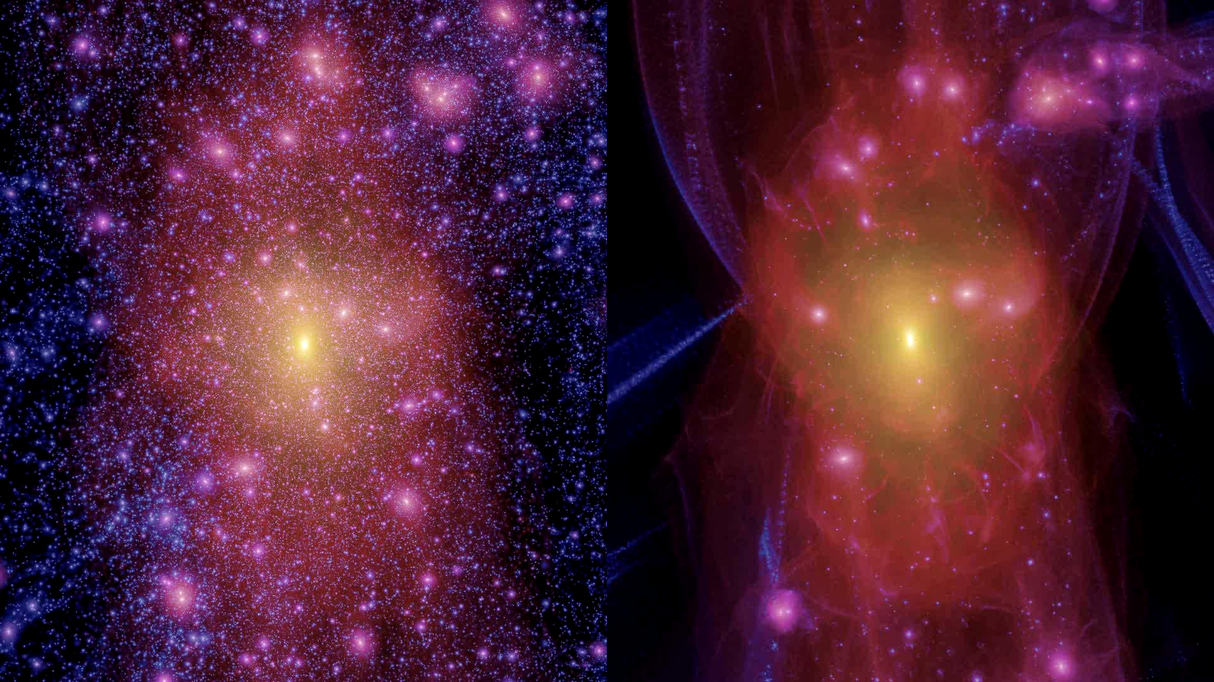
cold dark matter
warm dark matter
Lovell, Eke, Frenk, Gao, Jenkins, Wang, White, Theuns, Boyarski & Ruchayskiy ‘12

Slide 28






What is the dark matter?
Key assumption: the dark matter is an elementary particle formed in the early universe, different from particles in ordinary atoms

Slide 29



What is the dark matter?

Slide 30
The search for dark matter
Experimental physics

Slide 31

The search for dark matter

Slide 32

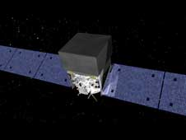
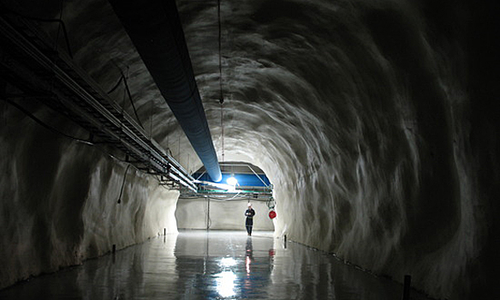
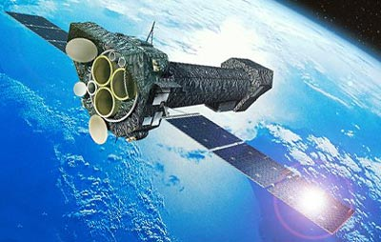
Cold dark matter ?
Theory predicts: dark matter is an elementary particle
Fermi (cold DM)
LHC – will it make it?
69 countries
~20 countries
Direct detection
~15 countries
XMM (warm DM)

Slide 33
The identity of the dark matter is one of the great mysteries of modern science
… and the answer may be just round the corner

