Slide 1
Public Engagement Committee
Council Update, May 2019
Professor Carlos Frenk,
Chair of Public Engagement Committee

Slide 2
Royal Society Strategic Plan 2017-2022
Three main strategic aims:
Promoting excellence in science
Supporting international collaboration
Demonstrating the importance of science to everyone

Slide 3
Public Engagement Committee
Oversee implementation of strategic aim 3:
➔ Demonstrating the importance of science to everyone
Definition of public engagement: ‘One of the Royal Society’s strategic priorities is to demonstrate the importance of science to everyone. Our wish is to engage with all to make scientific knowledge and the scientific approach part of the fabric of society. This includes listening to the views of the public, involving the public in our work and inspiring the public to explore new discoveries, the rich history of science and the scientists that shape our world.’

Slide 4
Public Engagement Committee
Oversee implementation of strategic aim 3:
➔ Demonstrating the importance of science to everyone
Why?

Slide 5
Public Engagement Committee
Royal Society Bodmer 1985 report on Public Understanding of Science
2. WHY IT MATTERS
2.1. Would the world be a better, or even a different, place if the public understood more of the scope and the limitations, the findings and the methods of science? A basic thesis of this report is that better public understanding of science can be a major element in promoting national prosperity, in raising the quality of public and private decision-making and in enriching the life of the individual. These are nationally important long-term aims and require sustained commitment if they are to be realized. Improving the public understanding of science is an investment in the future, not a luxury to be indulged in if and when resources allow.

Slide 6
Public Engagement Committee
Oversee implementation of strategic aim 3:
➔ Demonstrating the importance of science to everyone
Why?
Pragmatic: modern life relies on scientific advances and innovation
Self-preservation: humanity faces unprecedented challenges whose solution will rely on science and engineering
Ethical: science is mostly supported by the tax-payer
Philosophical: access to knowledge is a key part of a democratic society

Slide 7
Public engagement strategic aims
To be a leader and innovator in supporting public engagement with science
Proactively inform, involve and listen to the public on emerging trends in science and technology
Inspire and enthuse all sectors of society about science, encouraging participation and aspiration
Public Engagement should become an indispensable and valued element of the research lifecycle

Slide 8
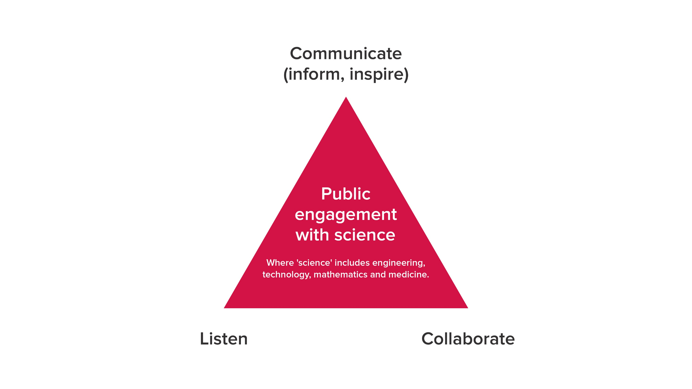
Public engagement triangle

Slide 9
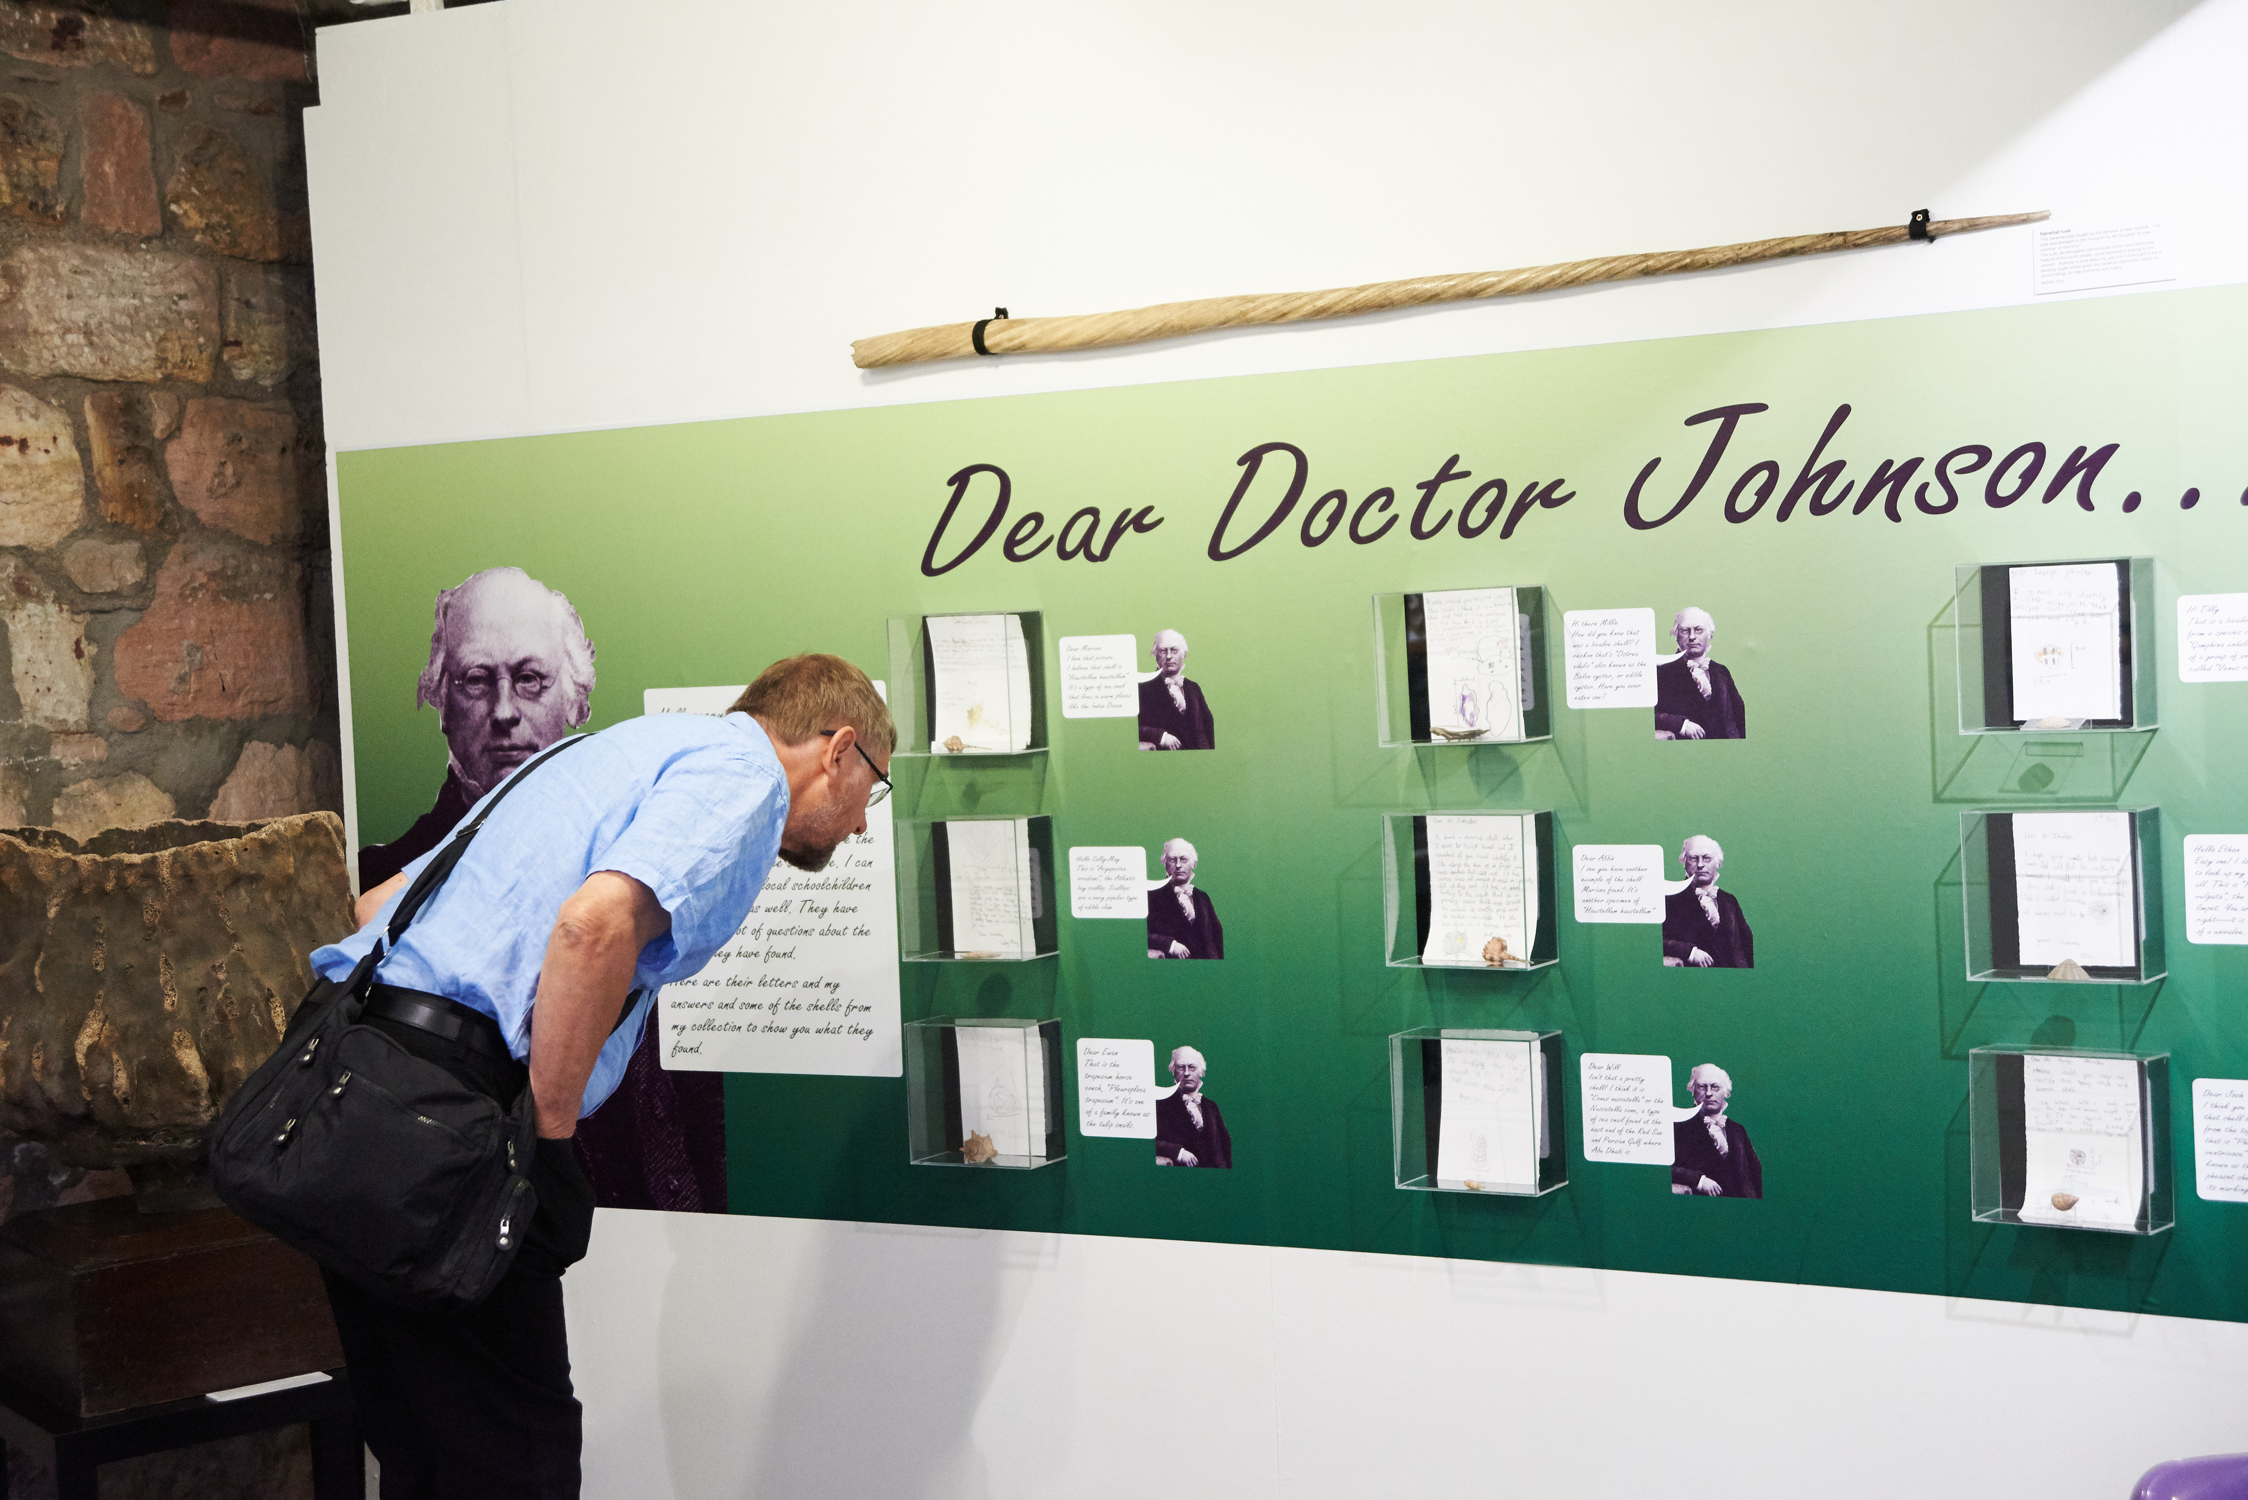
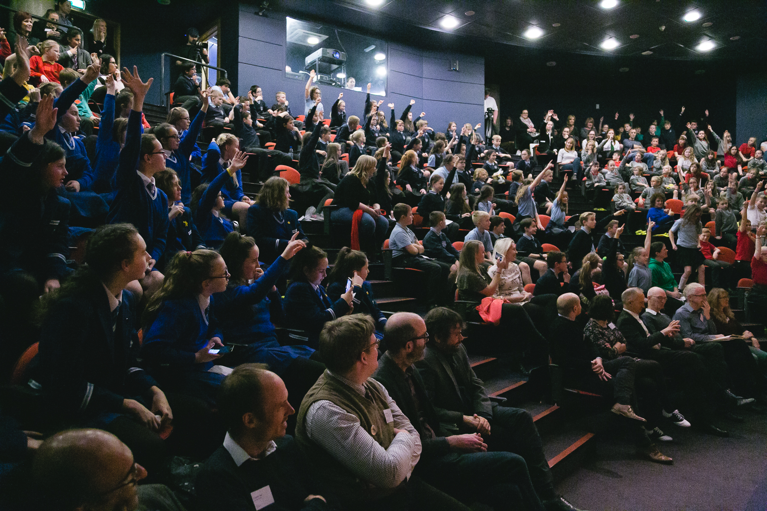
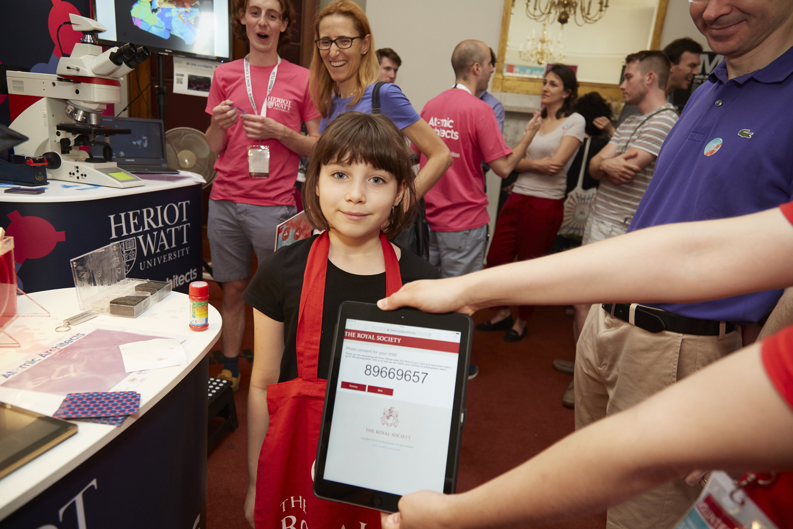
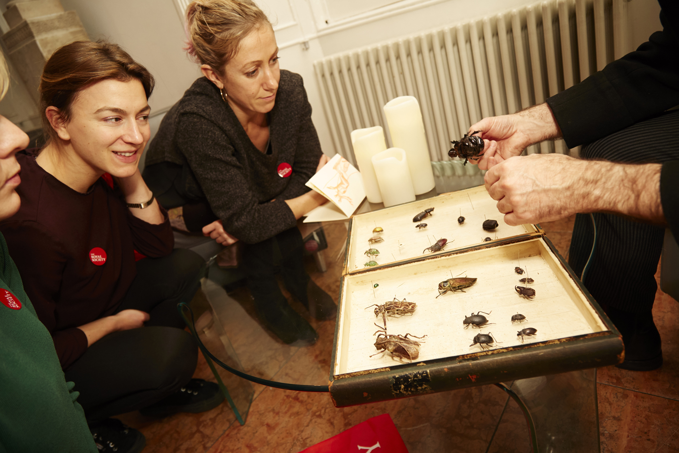
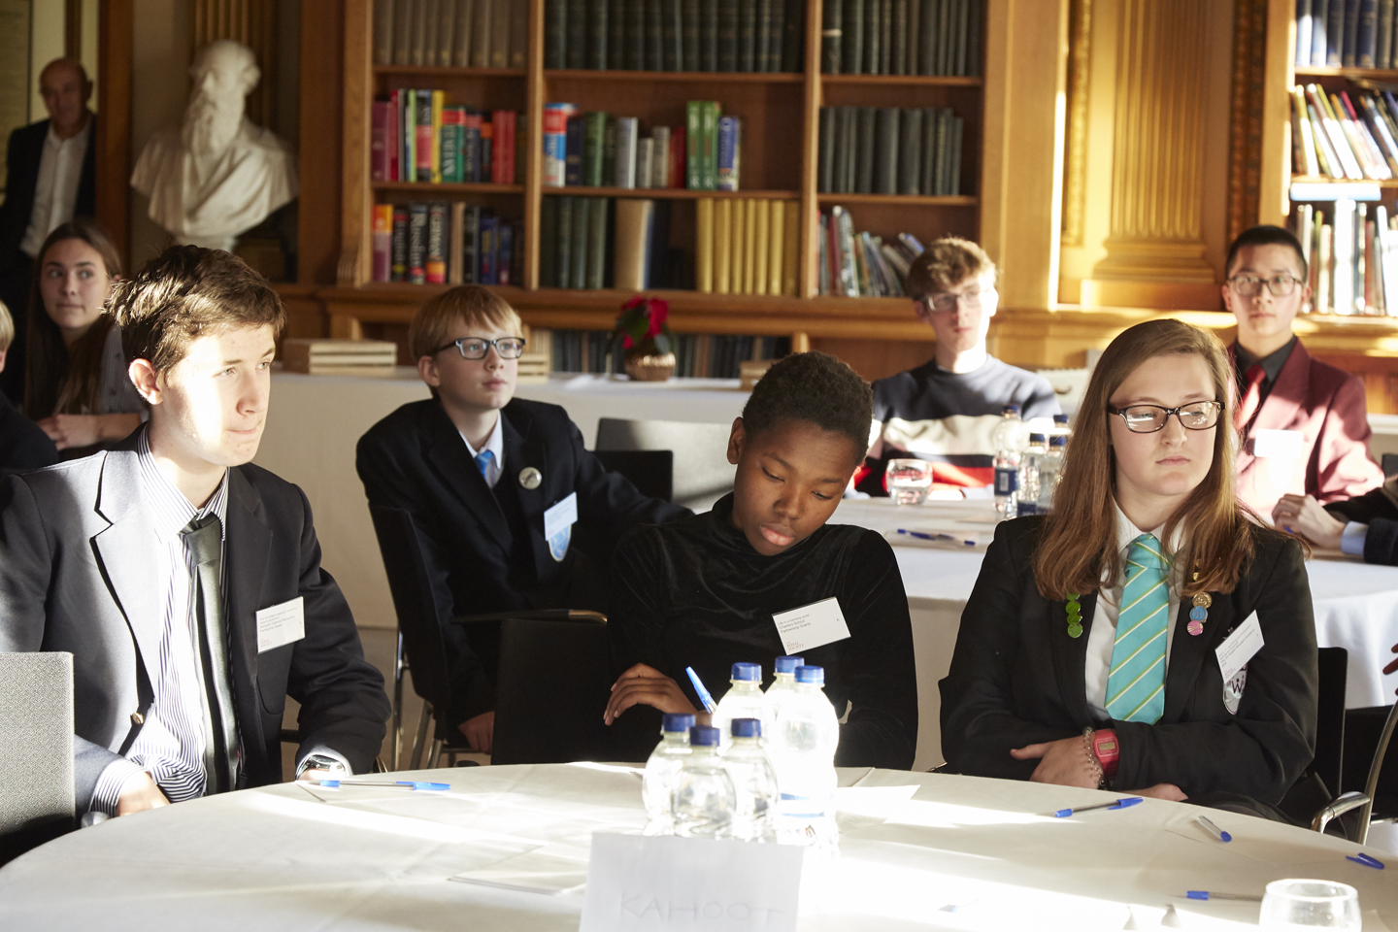
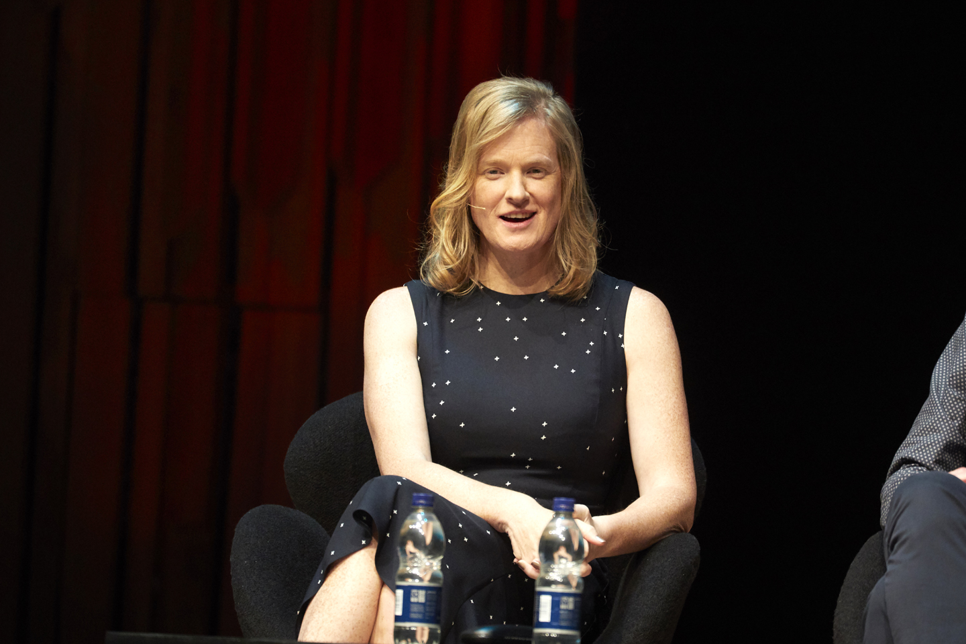
Who are our audiences?
Notes:
Public - interest in science and engage with the Society
- interest in science but do not engage with the Society
- culturally active but don’t necessarily engage
- the curious
Professional – Fellows, Scientists, Universities, Industry, Government, Education, Partners in science communication

Slide 10
Discussion questions to which we will come back t at the end
1
How can we engage the Fellowship more in our public engagement work?
2
What else would you like us to focus on in the digital programme?
3
How else would you like to see schools involved in the Society’s work?

