Slide 1
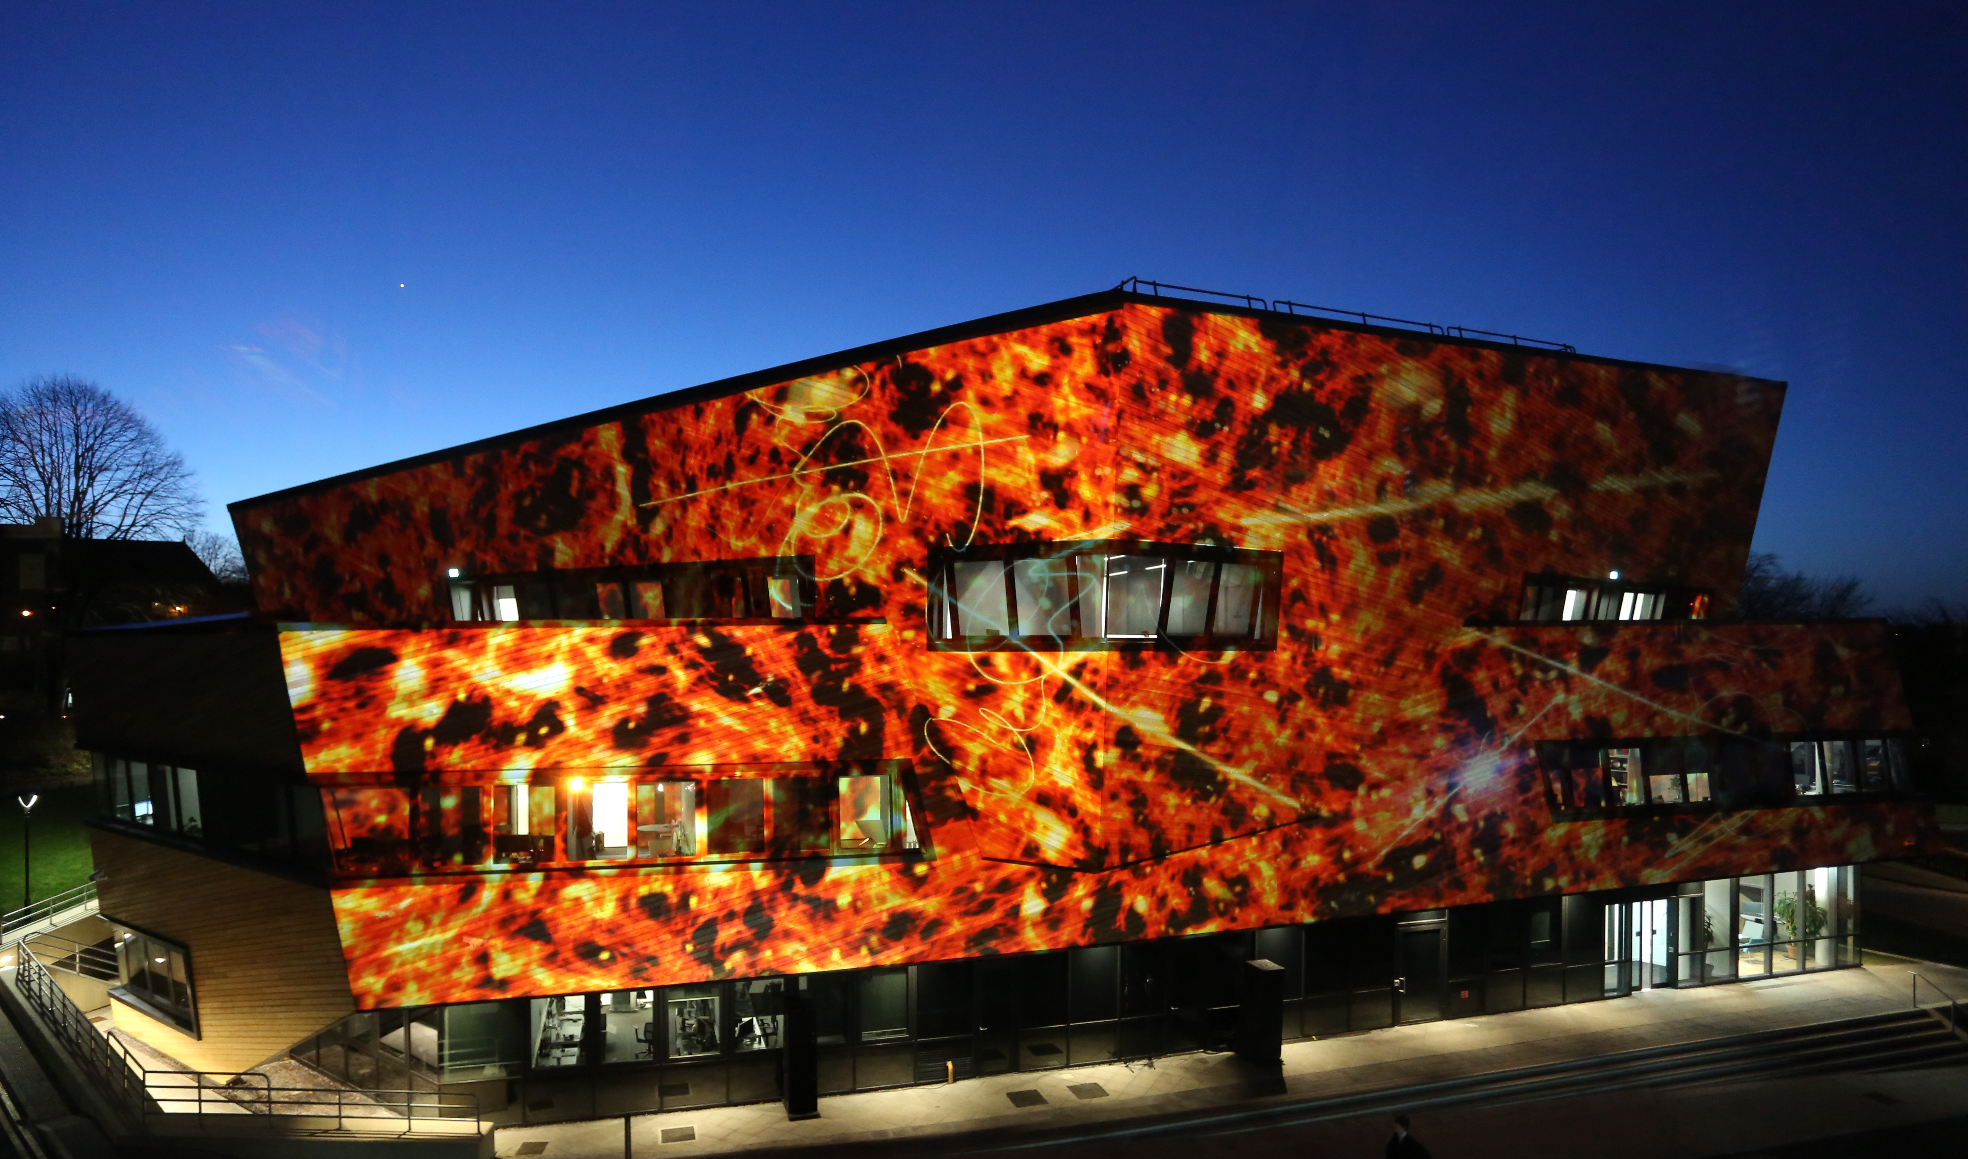
Dwarfs: the giants of cosmology
The Ogden Centre at Durham

Slide 2
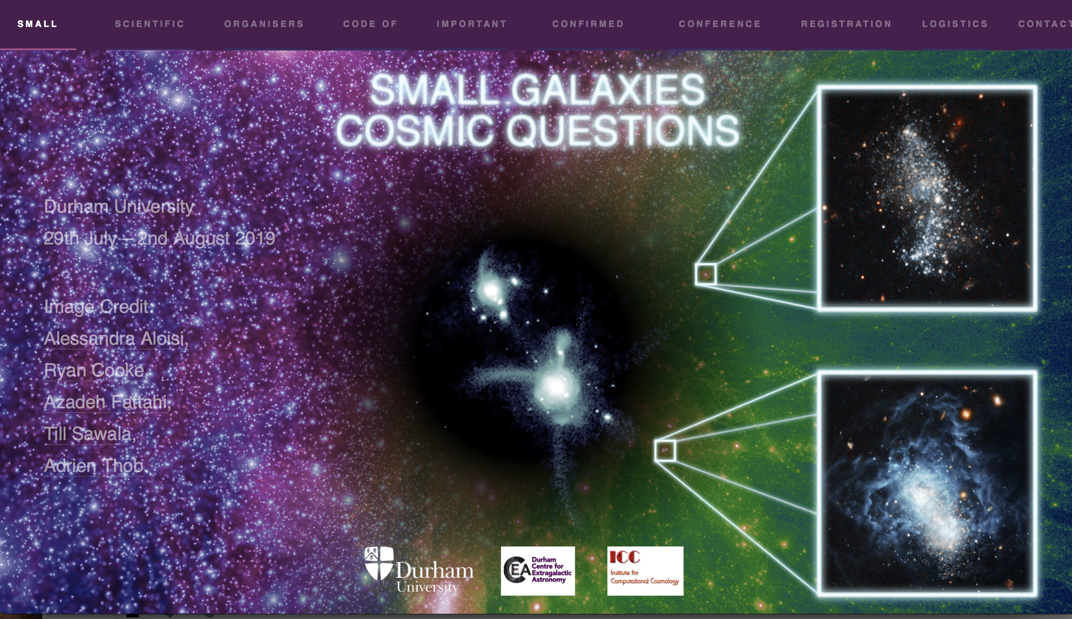
Dwarfs: the giants of cosmology
Conference key questions
The Ogden Centre at Durham
Is ΛCDM correct? What can dwarf galaxies tell us about the identity of dark matter?
Can we identify signatures of reionization in the dwarf population? What role did dwarfs play in reionization?
What do the star formation histories and chemical properties of dwarfs tell us about galaxy formation?
How will the next generation of surveys and simulations answer the above questions?

Slide 3
Dwarfs: the giants of cosmology
Conference key questions
The Ogden Centre at Durham
Is ΛCDM correct? What can dwarf galaxies tell us about the identity of dark matter?
Can we identify signatures of reionization in the dwarf population? What role did dwarfs play in reionization?
What do the star formation histories and chemical properties of dwarfs tell us about galaxy formation?
How will the next generation of surveys and simulations answer the above questions?

Slide 4
Is ΛCDM incorrect?
The four “problems” of CDM
The “missing satellites” problem
The “too-big-to-fail” problem
The “plane of satellites” problem
The “core-cusp” problem
Solved before they became a “problem” for CDM

Slide 5
Formation of CDM halos
Frenk et al 1985

Slide 6
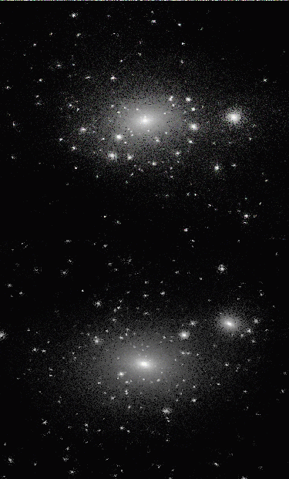
Moore et al ‘99
See also Klypin et al ’99

Slide 7
Moore et al ‘99
Bullock, Kravtsov, Weinberg ‘00
Include simple model of reionization

Slide 8
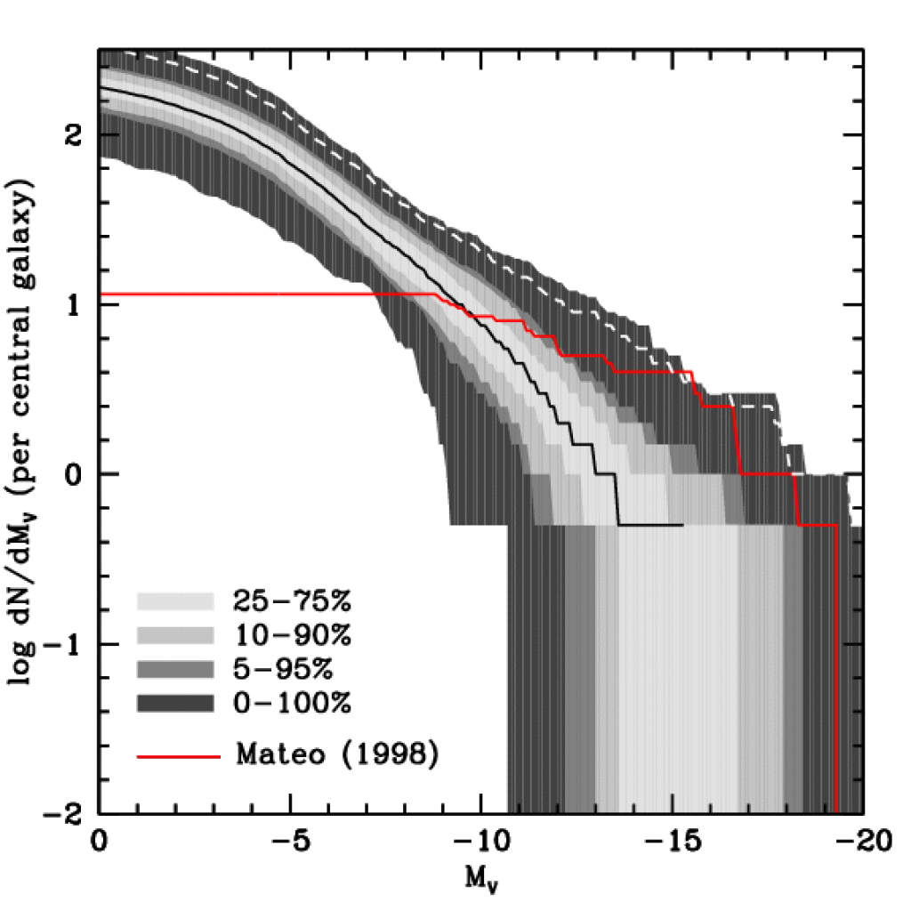
Luminosity Function of Local Group Satellites
Include effects of reionization and SN feedback
dark halos (const M/L)
Median model → correct abund. of sats brighter than M_{V}=-9 and V_{cir} > 12 km/s
Model predicts many, as yet undiscovered, faint satellites
LG data
LMC/SMC should be rare (~10% of cases)
Benson, Frenk, Lacey, Baugh & Cole ’02
(see also Kauffman+ ’93, Bullock+ ’00, Somerville ‘02)

Slide 9
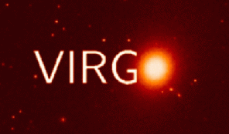
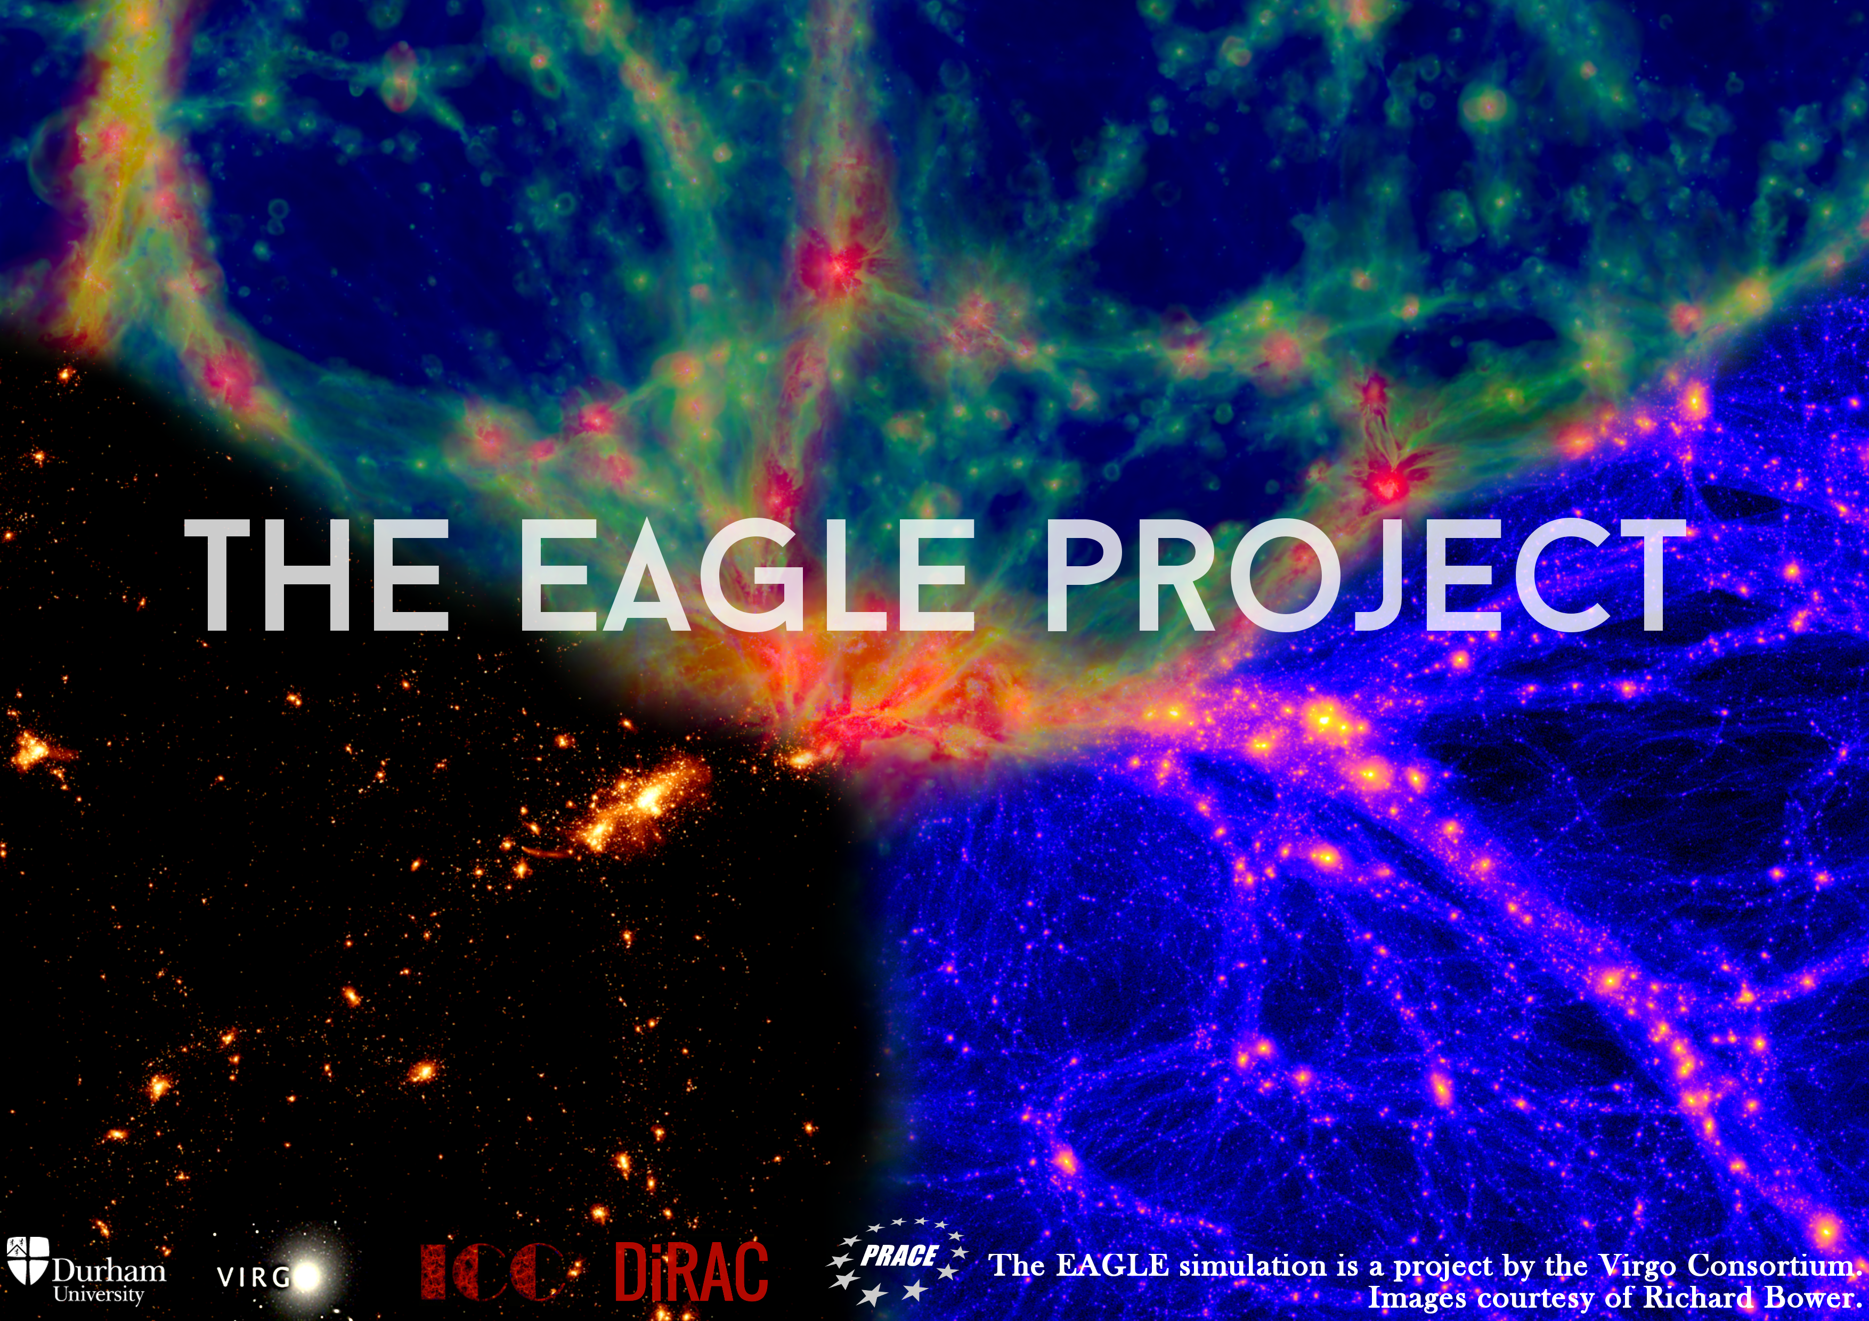
icc.dur.ac.uk/Eagle
“Evolution and assembly of galaxies and their environment”
Virgo Consortium
Durham: Richard Bower, Michelle Furlong, Carlos Frenk, Matthieu Schaller, James Trayford, Yelti Rosas-Guevara, Tom Theuns, Yan Qu, John Helly, Adrian Jenkins.
Leiden: Rob Crain, Joop Schaye.
Other: Claudio Dalla Vecchia, Ian McCarthy, Craig Booth…

Slide 10
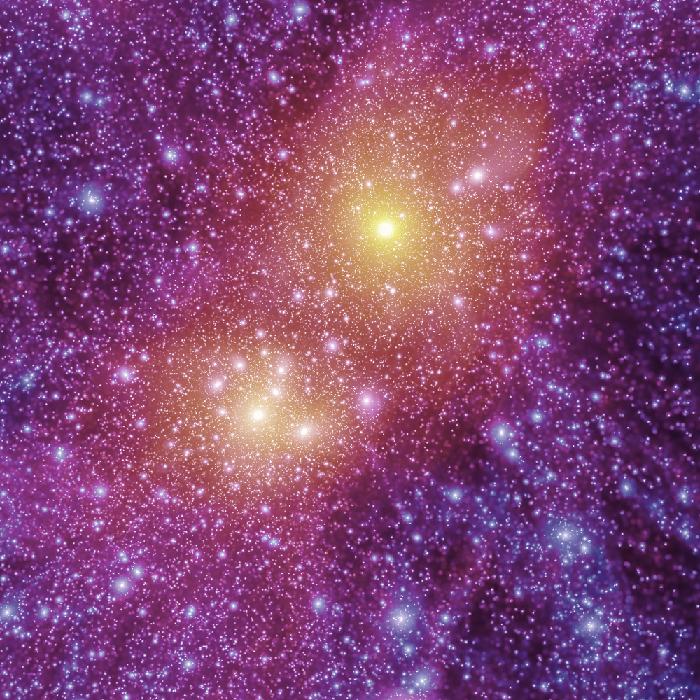
Dark matter
APOSTLE EAGLE full hydro simulations
Local Group
CDM
Sawala, CSF et al ‘16

Slide 11
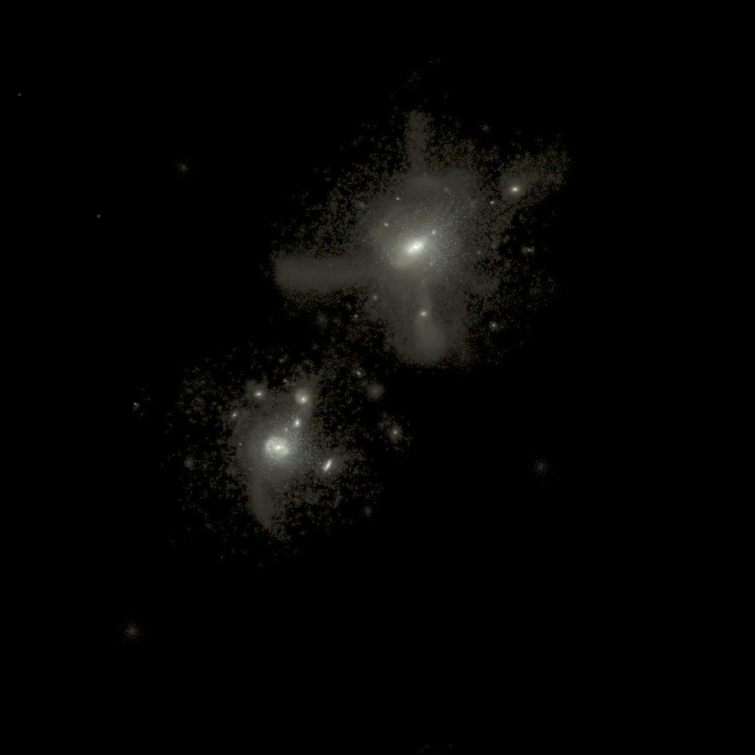
Stars
APOSTLE EAGLE full hydro simulations
Local Group
Stars
Far fewer satellite galaxies than CDM halos
Sawala, CSF et al ‘16

Slide 12
EAGLE Local Group simulation
M31
Milky Way
Local volume
Observed
Observed
Dark halos
Dark halos
Dark halos
Observed
Sawala, CSF et al ‘16

Slide 13
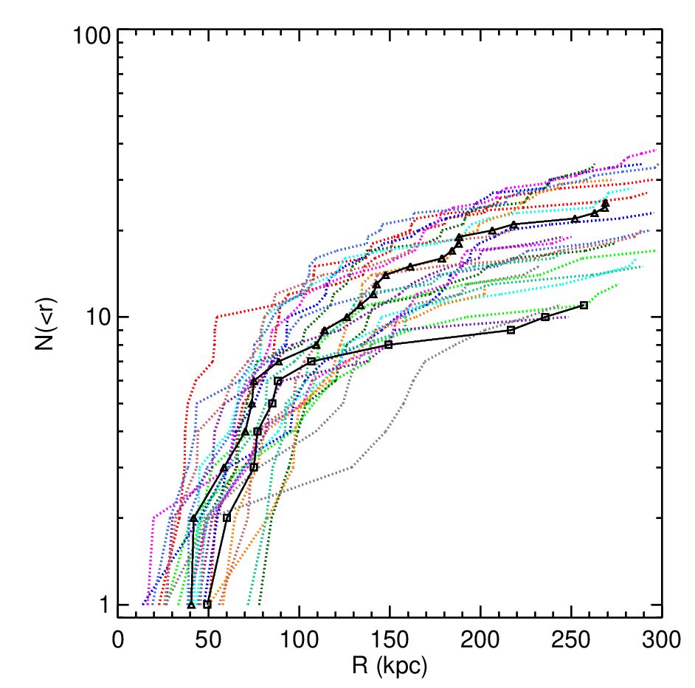
EAGLE Local Group simulation
… and the radial distribution
24 ”Milky Way” galaxies in Apostle
The radial distribution of the bright (M>10⁵M_{o}) is a ~10% outlier
(see A. Wetzler’s talk)
M31
MW
Lovell et al ’17, Fattahi et al ‘19

Slide 14
Luminosity Function of Local Group Satellites
Include effects of reionization and SN feedback
dark halos (const M/L)
Median model → correct abund. of sats brighter than M_{V}=-9 and V_{cir} > 12 km/s
How do we test this?
Model predicts many, as yet undiscovered, faint satellites
LG data
LMC/SMC should be rare (~10% of cases)
Benson, Frenk, Lacey, Baugh & Cole ’02
(see also Kauffman+ ’93, Bullock+ ’00, Somerville ‘02)

Slide 15
§
Luminosity Function of Local Group Satellites
Include effects of reionization and SN feedback
dark halos (const M/L)
Median model → correct abund. of sats brighter than M_{V}=-9 and V_{cir} > 12 km/s
Model predicts many, as yet undiscovered, faint satellites
LG data
LMC/SMC should be rare (~10% of cases)
Benson, Frenk, Lacey, Baugh & Cole ’02
(see also Kauffman+ ’93, Bullock+ ’00, Somerville ‘02)

Slide 16
Luminosity Function of Local Group Satellites
Include effects of reionization and SN feedback
Koposov et al 08
(SDSS)
★
★
Median model → correct abund. of sats brighter than M_{V}=-9 and V_{cir} > 12 km/s
★
★
★
Model predicts many, as yet undiscovered, faint satellites
LG data
LMC/SMC should be rare (~10% of cases)
Benson, Frenk, Lacey, Baugh & Cole ’02
(see also Kauffman+ ’93, Bullock+ ’00, Somerville ‘02)

Slide 17
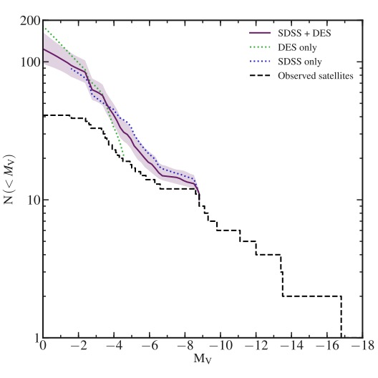
The MW satellite luminosity function
Cumulative satellite lum. fn.
Total No in MW (M_{V} =0; r<300 kpc)
About 55 satellites known in the MW so far from partial surveys (e.g. SDSS, Pan-STARRS, DES)
Can infer total population from survey selection function, assuming a radial distribution (from simulations)
(Newton+18, Koposov+08, Tollerud+08, Hargis+14)
Newton, Cautun, CSF+ ‘18

Slide 18
The MW satellite luminosity function
10² M_{o}
10⁵ M_{o}
In the highest-resolution hydro galaxy simulations (Auriga, Apostle, Fire), the star particle mass is ~10⁴ M_{o}
Total No in MW (M_{V} =0; r<300 kpc)
Cumulative satellite lum. fn.
Can’t study ultra-faint satellites with current hydro simulations
Newton, Cautun, CSF+ ‘18
But we can use semi-analytic modelling (GALFORM)

Slide 19
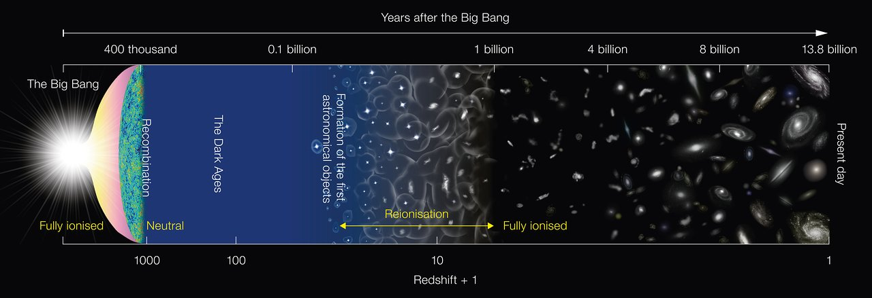
The two phases of galaxy formation
Phase II
Failed dwarfs
Phase I
Phase I: Galaxies begin to form during the “dark ages”
First stars reionize H and heat it up to 10⁴K → prevents gas from cooling in halos of “T_{vir}” < 10⁴K − galaxy formation is interrupted
Phase II: Halos with “T_{vir}” > 10⁴K form → galaxy formation resumes

Slide 20
The satellite luminosity function
Two populations of sats formed: (i) before and (ii) after reionization
Pre-existing GALFORM model
(ii) Formed after z_{reion}
(i) Formed before z_{reion}
Bose, Deason, CSF ‘18

Slide 21
The MW satellite luminosity function
10² M_{o}
10⁵ M_{o}
In the highest-resolution hydro galaxy simulations (Auriga, Apostle, Fire), the star particle mass is ~10⁴ M_{o}
Total No in MW (M_{V} =0; r<300 kpc)
Cumulative satellite lum. fn.
Can’t study ultra-faint satellites with current hydro simulations
Newton, Cautun, CSF+ ‘18
But we can use semi-analytic modelling (GALFORM)

Slide 22
The MW/M31 sat. luminosity function
Differential satellite luminosity function
MW satellites (Newton+ ’18) plus M_{V}<-8 M31 satellites (Mcconnachie ’12)
Bose, Deason, CSF ‘18

Slide 23
Theory vs data: test of CDM prediction
(ii) Formed after z_{reion}
(i) Formed before z_{reion}
Bose, Deason, CSF ‘18

Slide 24
When galaxy formation is taken into account
→
CDM predicts the observed abundance of satellites
→
There is no such thing as the “satellite problem” in CDM!

Slide 25
The “small-scale crisis” of CDM
The four “problems” of CDM
The “missing satellites” problem
The “too-big-to-fail” problem
The “plane of satellites” problem
The “core-cusp” problem

Slide 26
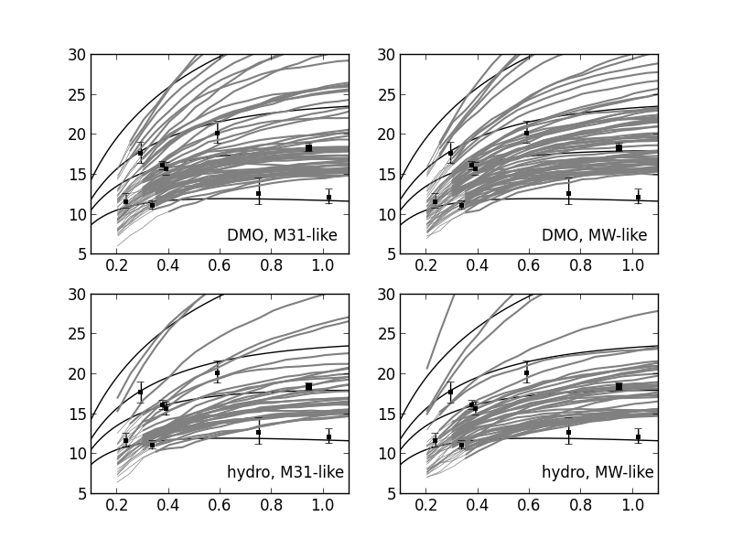
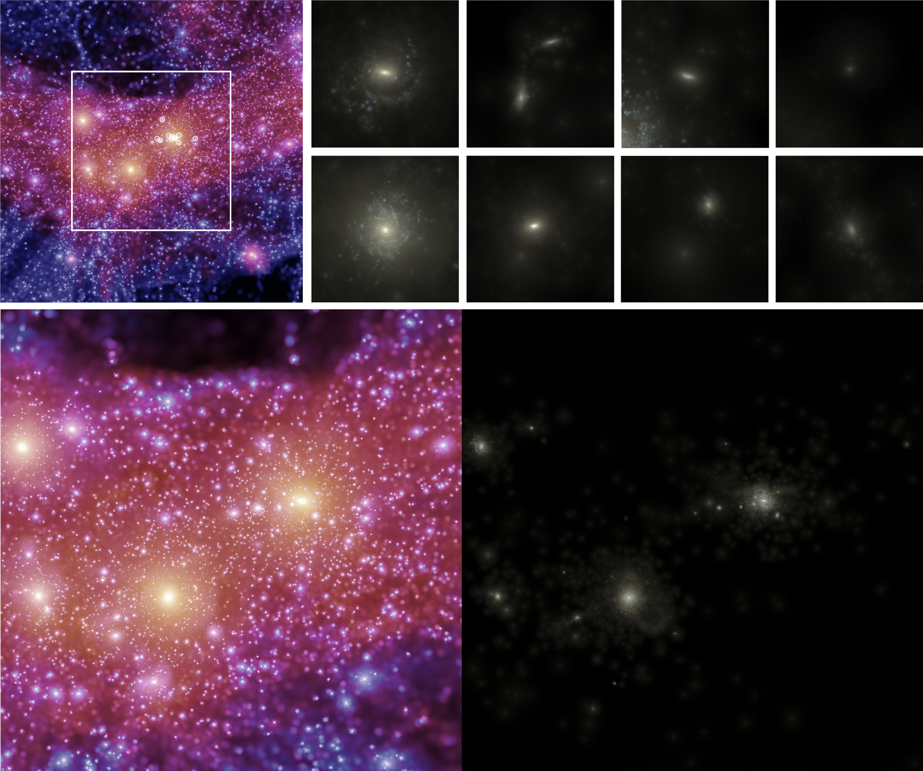
Rotation curves of dark matter subhalos
Boylan-Kolchin et al. ‘11
DM-only simulation
V_{c} (km/s)
r (kpc)
r (kpc)
9 dwarf satellites of Milky Way: mass within half-light radius
(excluding LMC, SMC, Sag)

Slide 27
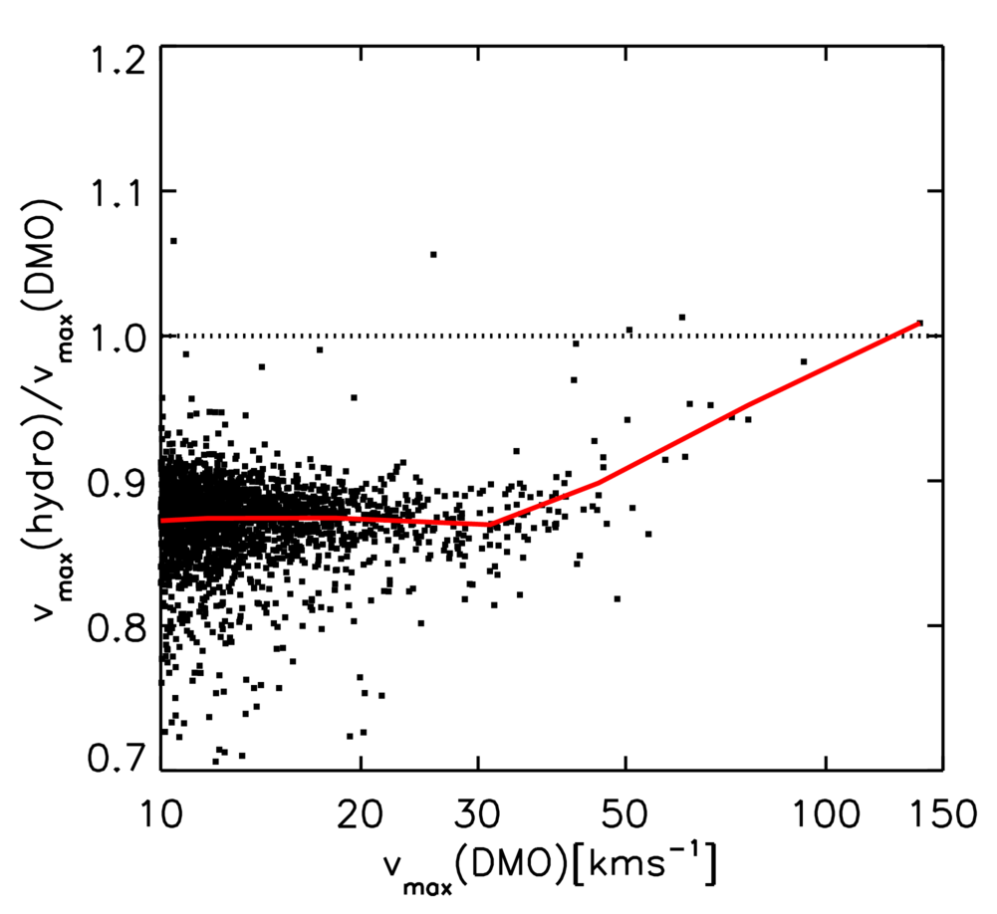
To-big-to-fail in CDM: baryon effects
V _{max} = max V_{c}
CDM
Reduction in V_{max} due to SN feedback:
→ Lowers halo mass & thus halo growth rate
Sawala, CSF et al. ‘13, ‘14

Slide 28
Too-big-to-fail: the baryon bailout
DM-only simulation
V_{c} (km/s)
r (kpc)
r (kpc)
Gas simulation
V_{c} (km/s)
r (kpc)
r (kpc)
Number of subhalos of given Vmax is greatly reduced in gas simulations
Sawala, CSF et al. ‘14

Slide 29
The “small-scale crisis” of CDM
The four “problems” of CDM
The “missing satellites” problem
The “too-big-to-fail” problem
The “plane of satellites” problem
The “core-cusp” problem

Slide 30
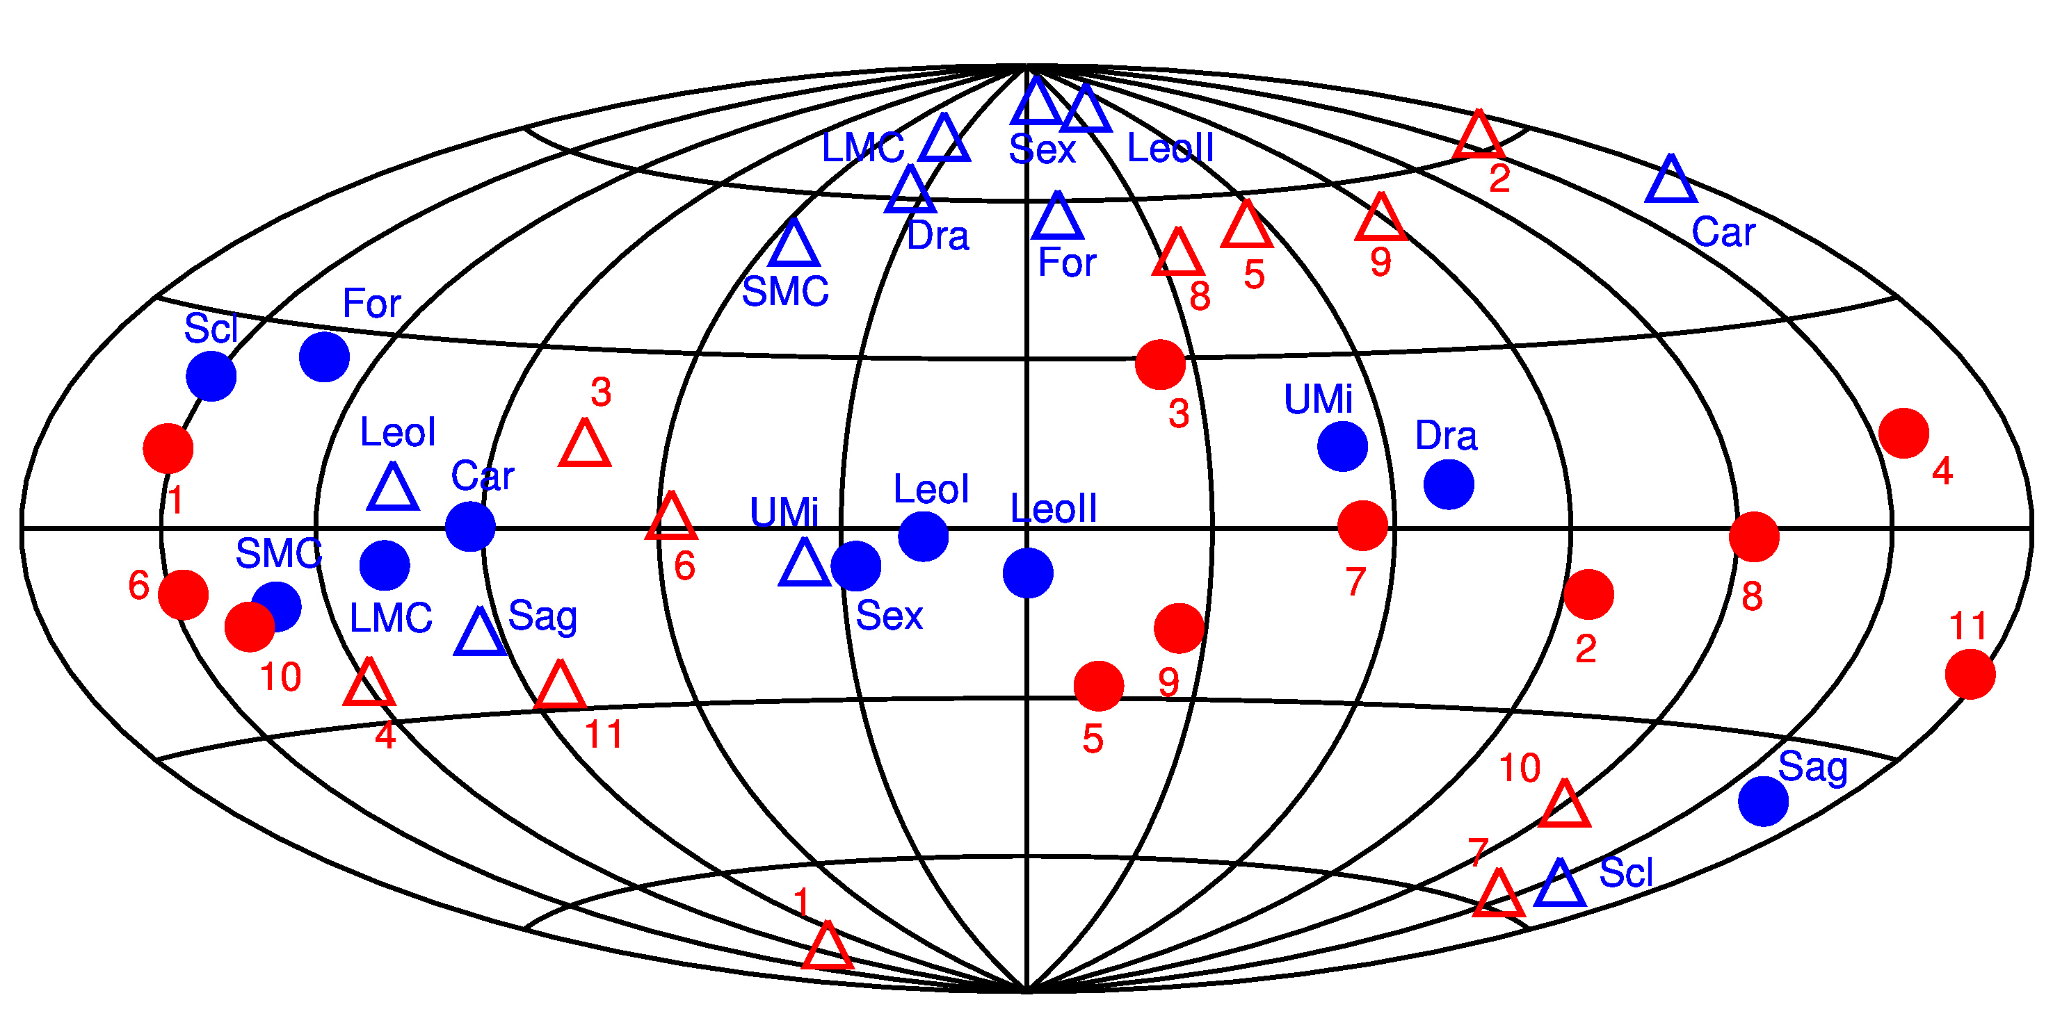
The “satellite disk” problem
Direction of ang. mom.
Direction of ang. mom
MW satellites
LG simulations
Lynden-Bell ‘76

Slide 31
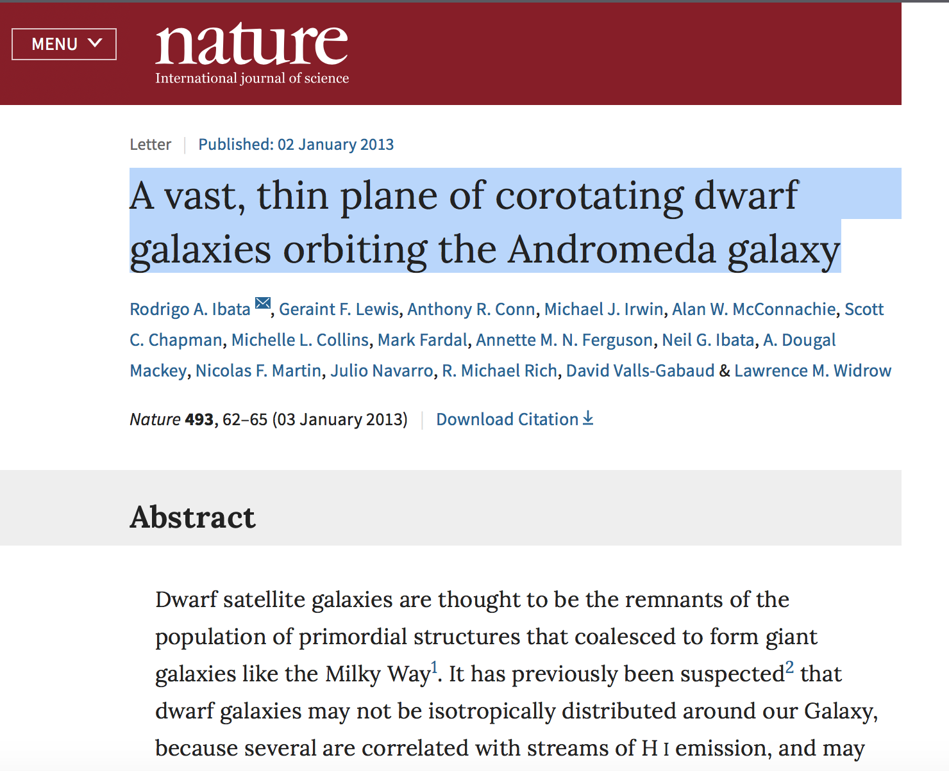
A satellite plane in Andromeda
(From Millennium simulation) “0.04% of host galaxies display satellite alignments that are at least as extreme as the observations, when we consider their extent, thickness and number of members rotating in the same sense.
Ibata et al ‘14

Slide 32
The significance of Ibata’s plane
Including “trials factor”
Significance of Ibata’s plane is reduced by x100 when trials factor is included
8.8% of halos in ΛCDM simulation have even more prominent disks than Ibata’s
Frequence of rare planes in CDM
In random distribution, 1 in 30,000 chance of finding a plane of 15 sats (out of 27) as thin found by Ibata et al., with at least 13 having same sense of rotation
Cautun, CSF, et al ‘15

Slide 33
The “small-scale crisis” of CDM
The four “problems” of CDM
The “missing satellites” problem
The “too-big-to-fail” problem
The “plane of satellites” problem
The “core-cusp” problem

Slide 34
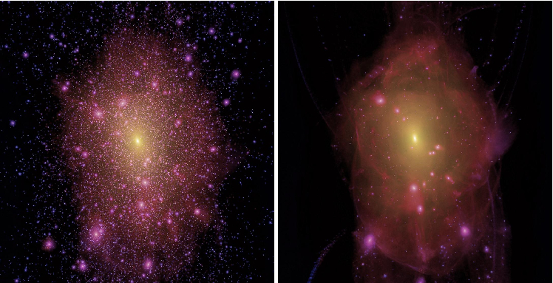
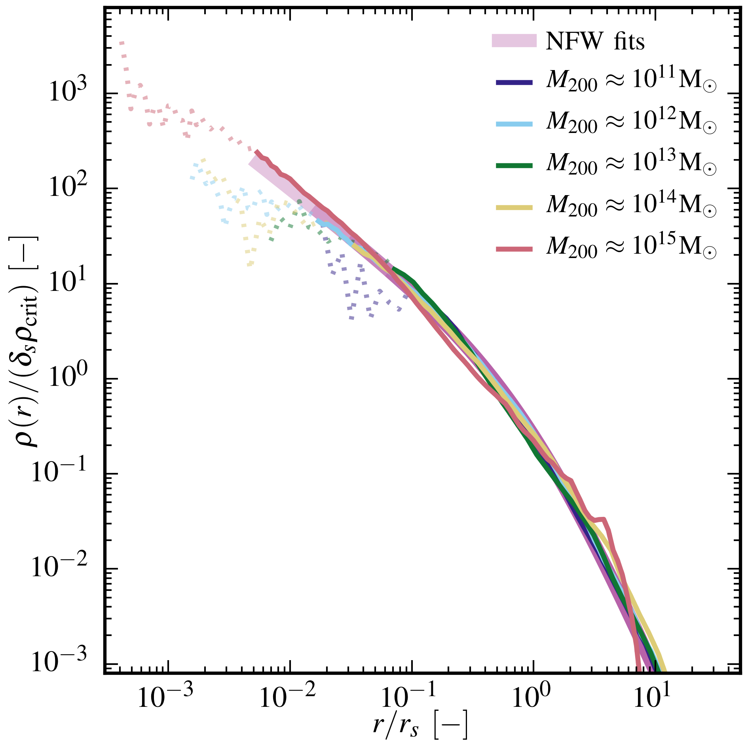
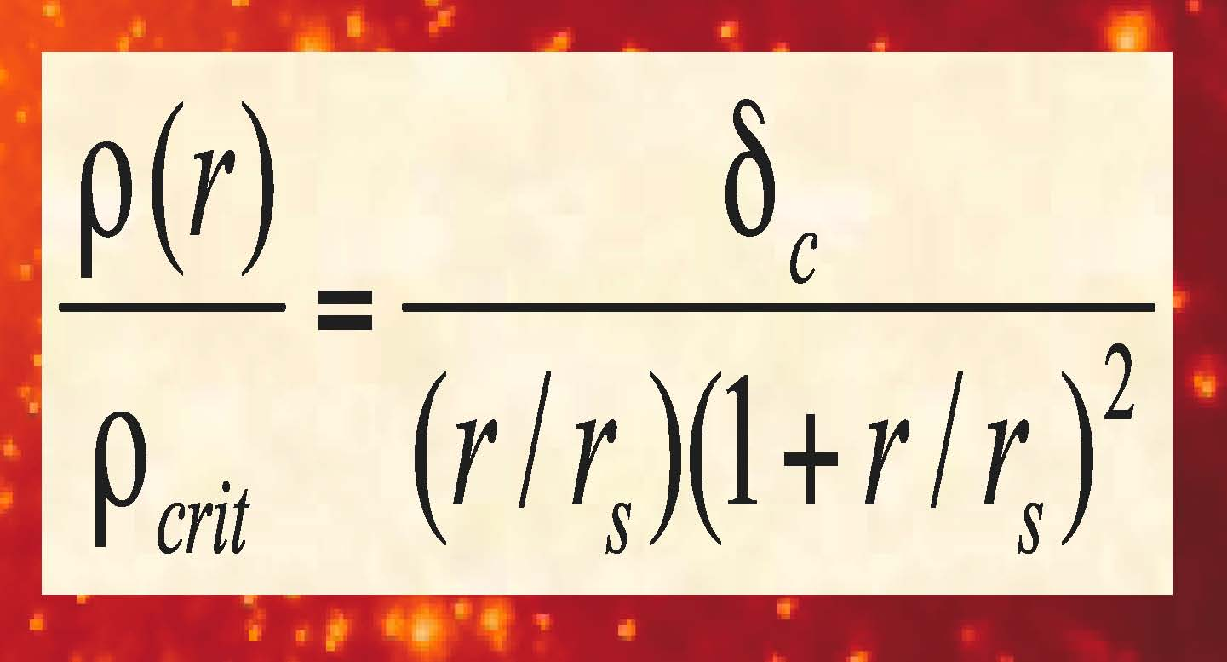
The Density Profile of Cold Dark Matter Halos
Shape of halo profiles ~independent of halo mass & cosmological parameters
Density profiles are “cuspy” - no `core’ near the centre
Fitted by simple formula:
(Navarro, Frenk & White ’97)
Galaxy clusters
Dwarf galaxies
More massive halos and halos that form earlier have
higher densities (bigger δ)
Log radius (kpc)

Slide 35
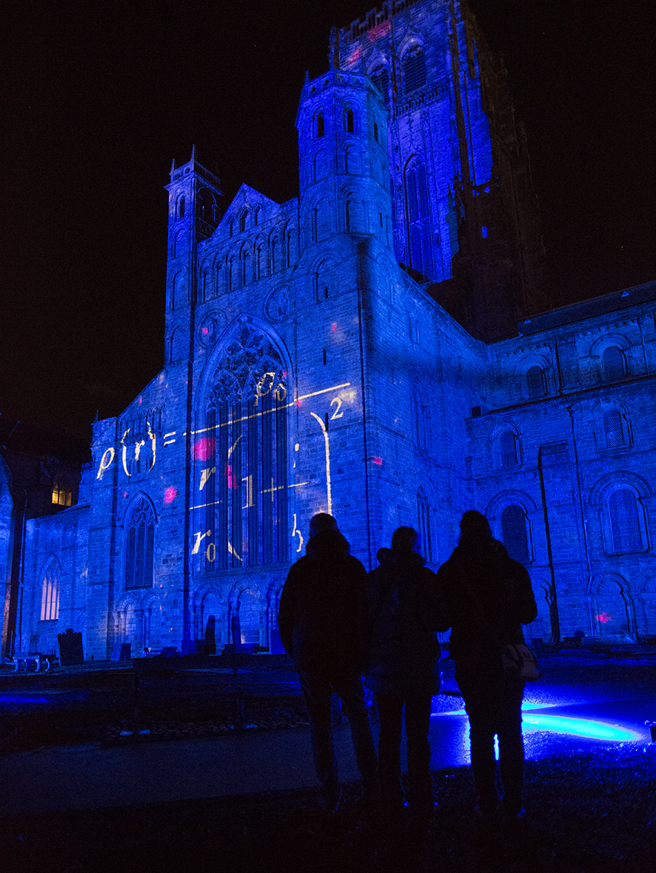

Slide 36
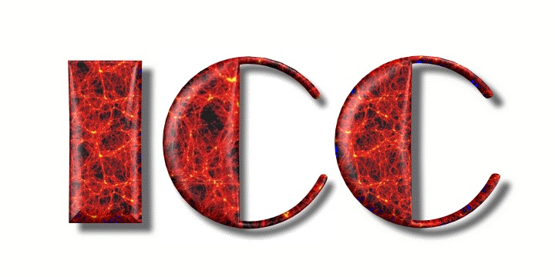

Cores or cusps?
Myth 1: dwarf galaxies have cores
Myth 2: all hydro simulations makes cores in dwarfs
Cores
Cusps

Slide 37
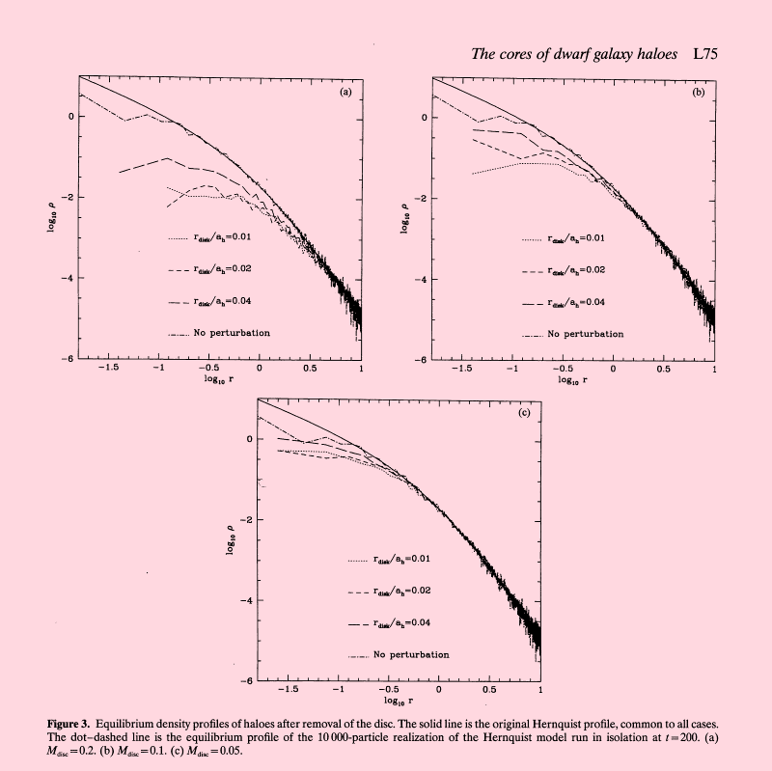
The physics of core formation
Cusps → cores
Perturb central halo region by growing a galaxy adiabatically and removing it suddenly (Navarro, Eke & Frenk ‘96)
Navarro, Eke & Frenk (1996)
Cores may also form by repeated fluctuations in central potential (e.g. by SN explosions) (Read & Gilmore ’05; Pontzen & Governato ’12,’14; Bullock & Boylan-Kolchin ’17)

Slide 38
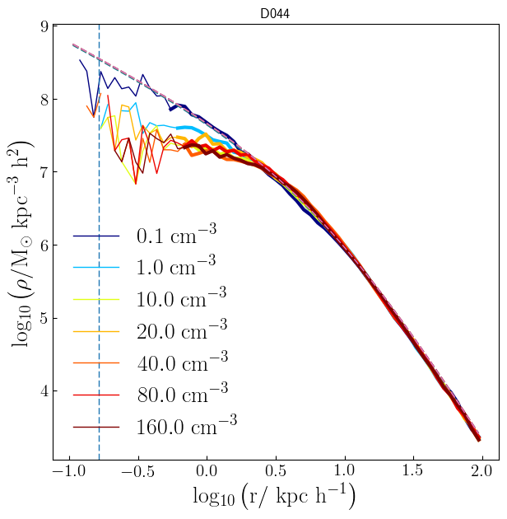
Cores or cusps in simulations?
Low threshold (e.g. EAGLE)
High threshold
Benitez-Llambay, CSF et al ‘17

Slide 39
The “small-scale crisis” of CDM
The four “problems” of CDM
The “missing satellites” problem
The “too-big-to-fail” problem
The “plane of satellites” problem
The “core-cusp” problem
1, 2, 4 → problems only if you ignore galaxy formation!

Slide 40

How to rule out CDM

Slide 41
Can we distinguish CDM/WDM?
cold dark matter
warm dark matter
Rather than counting faint galaxies,
count the number of dark halos (”failed dwarfs”)

Slide 42
Can we distinguish CDM/WDM?
cold dark matter
warm dark matter
Three ways to count dark halos
ReLHICS (Benitez-Llambay)
Gaps in streams (Erkal)
Gravitational lensing (Nirenberg)

Slide 43
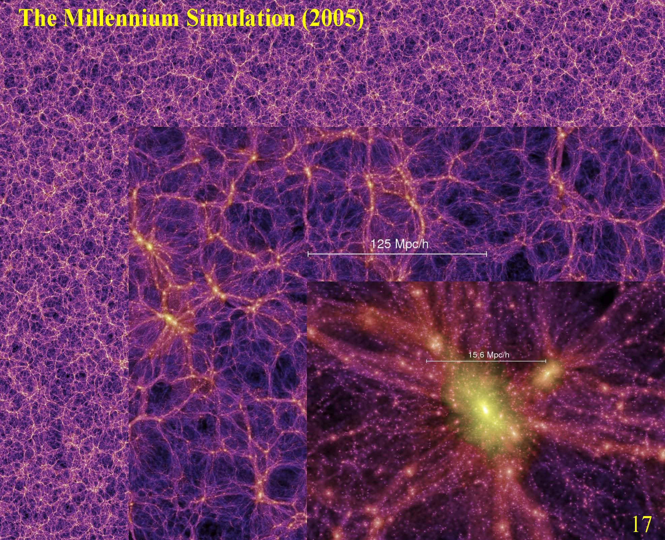
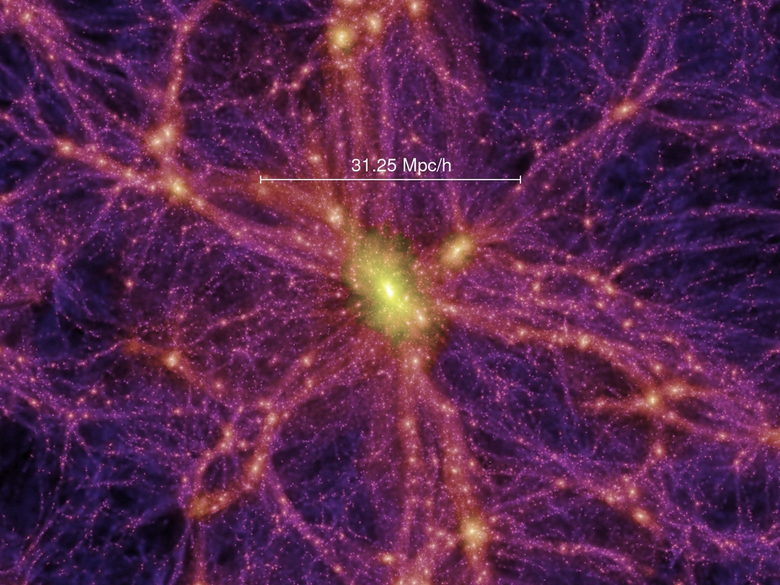
The Millennium/Aquarius/Phoenix simulation series
0.5 Mpc/h
Springel et al ‘05, ’08, Gao et al ‘11

Slide 44
The subhalo mass function
CDM
WDM
m_{ν} = 7 keV, L₆ = 10
“coldest” 7keV sterile ν
(m_{thermal}= 3.3 keV)
CDM
WDM
m_{c}
3 x fewer WDM subhalos at 3x10⁹ M_{o}
10 x fewer at 10⁸ M_{o}
Bose, CSF et al ‘16

Slide 45
Can we distinguish CDM/WDM?
cold dark matter
warm dark matter
Dark halos can be detected through gravitational lensing

Slide 46
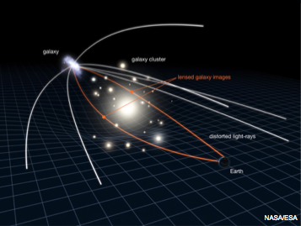
Gravitational lensing: Einstein rings
When the source and the lens are well aligned → strong arc or an Einstein ring

Slide 47
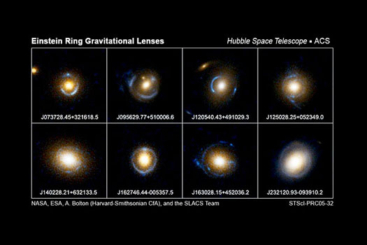
SLAC sample of strong lenses

Slide 48
Gravitational lensing: Einstein rings
Additional lensing by line-of-sight halos perturb image
When the source and the lens are well aligned → strong arc or an Einstein ring

Slide 49
Gravitational lensing: Einstein rings
Halos projected onto an Einstein ring distort the image
m_{sub} = 2.8 x 10¹⁰ M_{o}
Vegetti et al ‘10

Slide 50
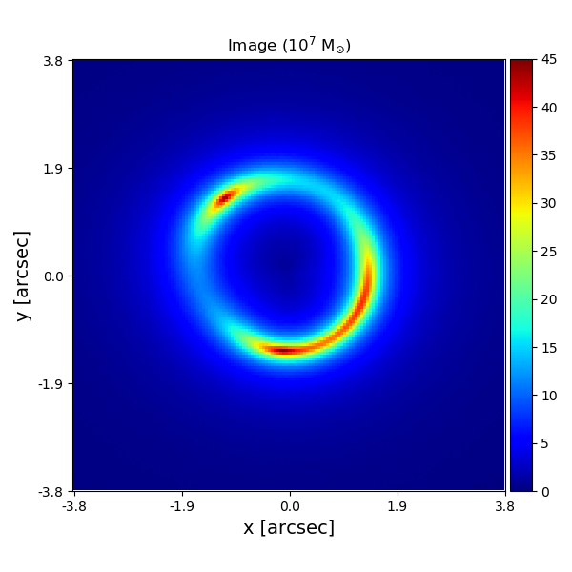
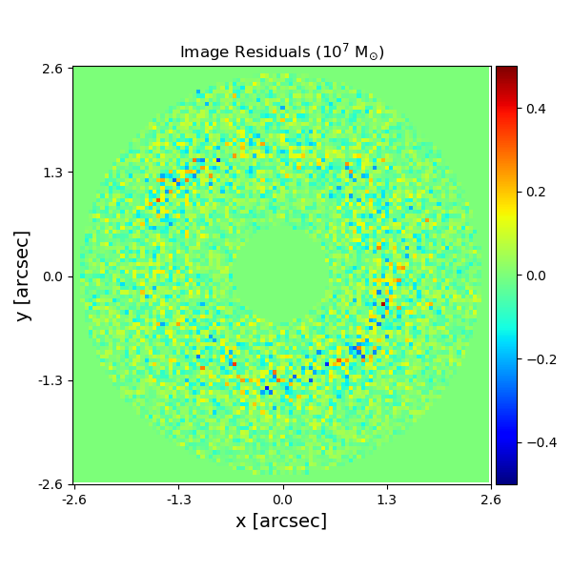
Gravitational lensing: Einstein rings
HST “data”: z_{source}=1; z_{lens}=0.2
10⁷ M_{o} halo – NOT so easy to spot
Image
Residuals
He, Li, CSF et al ‘19

Slide 51
Detecting substructures with strong lensing
Can detect subhalos as small as 10⁷ – 10⁸ M_{o}
If WDM is right, should find NO 10⁷ M_{o} halos
If CDM is right, should find MANY 10⁷ M_{o} halos
He, Li, CSF et al ‘19

Slide 52
Detecting substructures with strong lensing
Detection limit = 10⁷ h⁻¹M_{o} is achievable with current data and techniques
~100 Einstein ring systems with detection limit of 10⁷ h⁻¹M_{o} is enough to either rule out a 7 keV sterile ν or CDM itseilf
Li, CSF et al ‘16

Slide 53
Conclusions
Is ΛCDM correct? What can dwarf galaxies tell us about the identity of dark matter?
No evidence that ΛCDM is incorrect; dwarfs rule out part of WDM parameter space
Can we identify signatures of reionization in the dwarf population? What role did dwarfs play in reionization?
The ultra-faints (M* < 10⁵M_{o}) made most of their stars z>z_{reion}
How will the next generation of surveys and simulations answer the above questions?
Distortions of strong gravitational lenses offer a clean test of CDM vs WDM and can potentially rule out CDM

Slide 54
Conclusions
Is ΛCDM correct? What can dwarf galaxies tell us about the identity of dark matter?
No evidence that ΛCDM is incorrect; dwarfs rule out part of WDM parameter space
Can we identify signatures of reionization in the dwarf population? What role did dwarfs play in reionization?
The ultra-faints (M* < 10⁵M_{o}) made most of their stars z>z_{reion}
How will the next generation of surveys and simulations answer the above questions?
Distortions of strong gravitational lenses offer a clean test of CDM vs WDM and can potentially rule out CDM

