Slide 1
Aquarius movie to z=1.7 takes 90s; Eagle movie takes 90s also; CDM/WDM movie: 30s
Stockholm/Aug/23: started from Portsm/Donosia; about 30 mins. V good; explain better VVV technique, biases in VVV
Vienna Aug/22: forgot to make notes!
Milano Jun/22: pilfered this and added Willem’s n background slides
Chicago May/22: 65 mins. V good but over time. Need to work on summary slides
Indiana Mar/22: 65 mins. Pretty good but over time. Need to work on summary slides
Madrid Nov/20: 60 mins. Added cosmic contents for general audience; took out Ale’s gal form; felt too rushed towards the end, but pretty good.
Mexico Oct/20: 58 mins. V. good
Hamburg Sep/20: 55 mins. V. good
Durham Jul/19: 23 mins. Pretty much new talk. Good but spoiled by “sloppy” comment
Buenos Aires Juj/19: 32 mins. Good but a bit ott and Julio contradicted me on diversity
Holland Jun/19: vvg ~55 min (w. anectdotes). Someone said best talk ever heard.

Slide 2
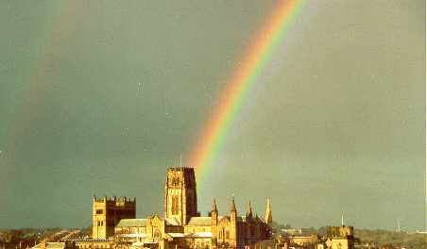
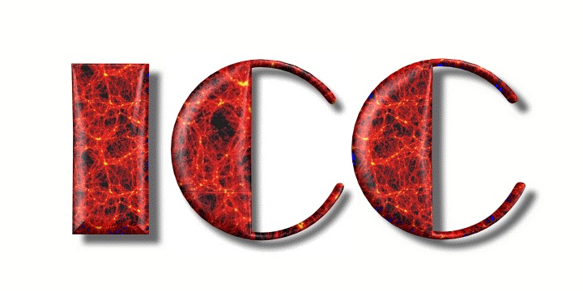
A definitive test of the cold dark matter hypothesis
Carlos S. Frenk
Institute for Computational Cosmology, Durham

Slide 3
Non-baryonic dark matter candidates
From the early 1980s:
Type example mass
hot | neutrino | few tens of eV
warm | sterile ν | keV-MeV
cold | axion neutralino | 10⁻⁵eV - 100 GeV

Slide 4
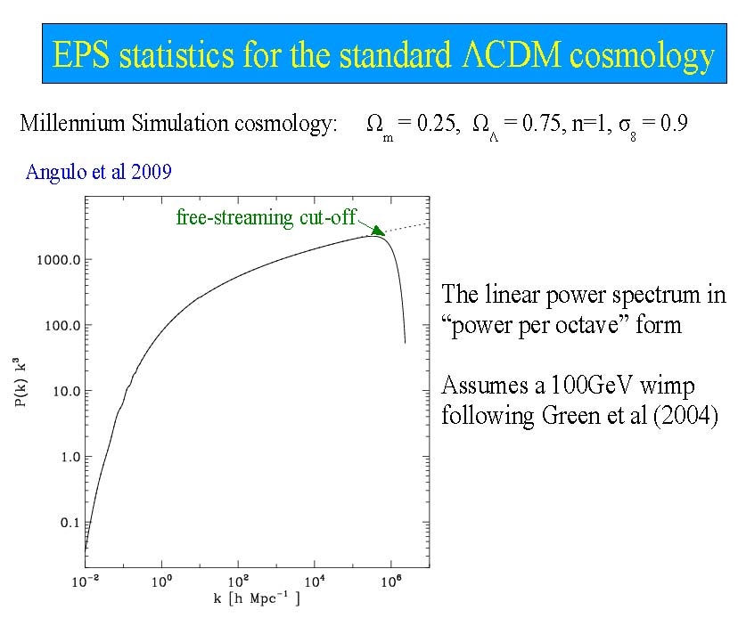
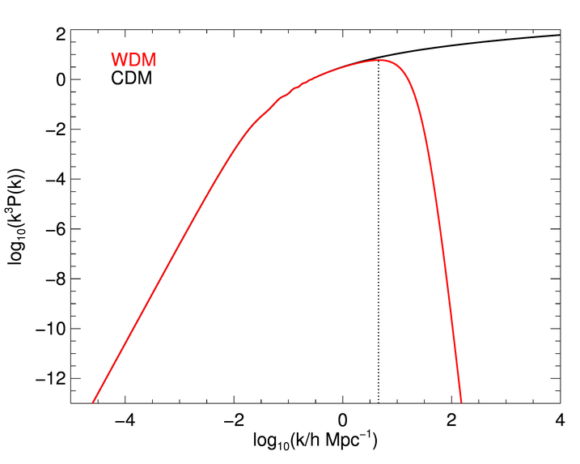
The dark matter power spectrum
Free-streaming cutoff
The linear power spectrum (“power per octave” )
k³ P(k)
HDM
Earth mass
cold
dwarf gals
Fluctuation amplitude
warm
Log k³P(k)
galaxy clusters
Free streaming →
λ_{cut} α m_{x}⁻¹
for a thermal relic
n≈1
hot
These possibilites can be tested with astrophysics
Log k [h Mpc⁻¹]
small scales
Large scales

Slide 5
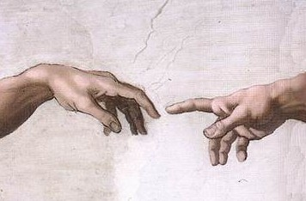
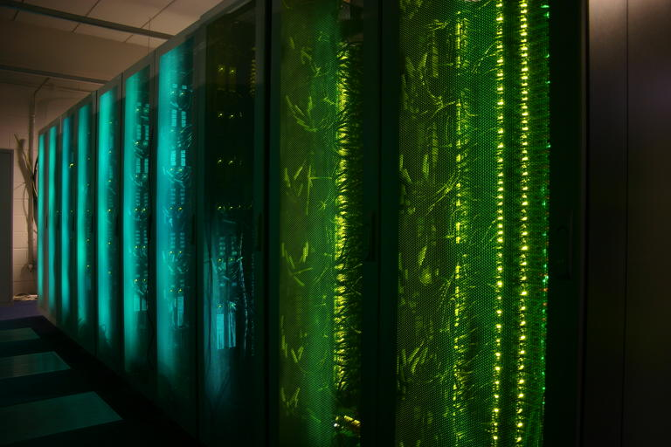
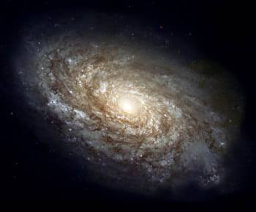
Non-linear evolution
The linear power spectrum
cold
HDM
Log k³P(k)
warm
hot
Log k [h Mpc⁻¹]

Slide 6
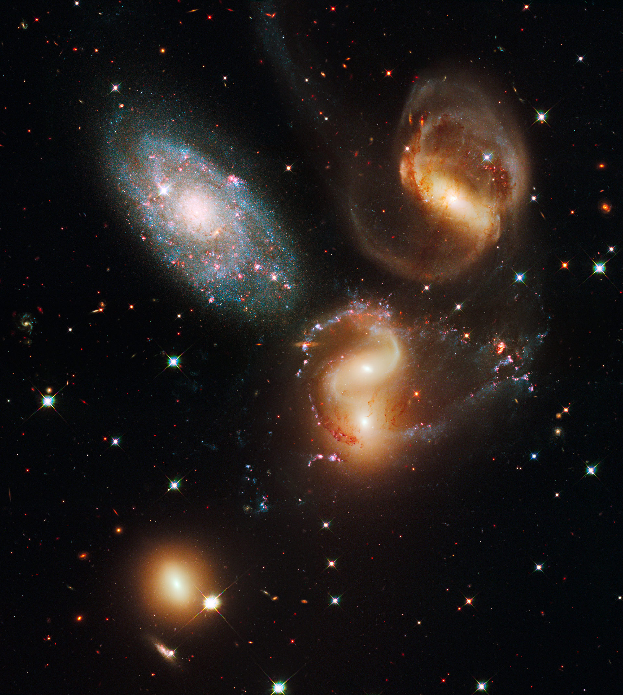
Non-linear evolution: simulations
Assumption about content of Universe → Initial conditions
Relevant equations: Collisionless Boltzmann; Poisson; Friedmann eqns; Radiative hydrodynamics
Subgrid astrophysics
How to make a virtual universe

Slide 7

Hot dark matter
m_{ν} = 30 ev → Ω_{m} = 1
1981

Slide 8
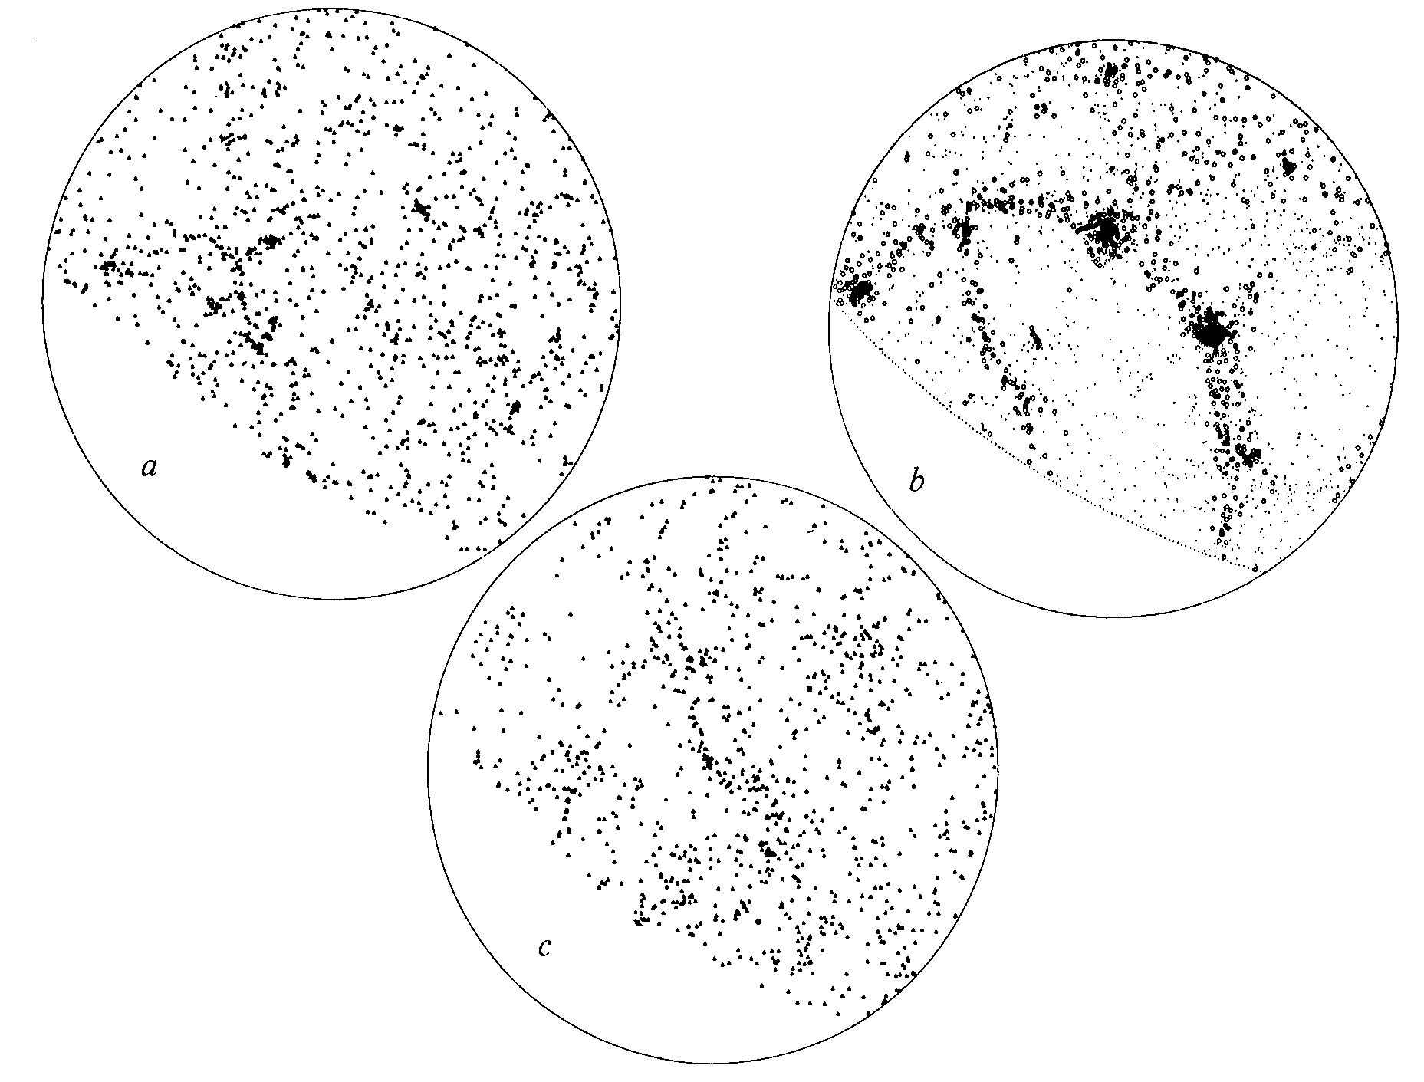
Non-baryonic dark matter cosmologies
ΛCDM Ω=0.2
Neutrinos Ω=1
HDM Ω=1
CfA redshift survey
Davis, Efstathiou, Frenk & White ‘85
Frenk, White & Davis ‘83
Davis, Efstathiou, Frenk & White ‘85

Slide 9
Non-baryonic dark matter cosmologies
Neutrino DM → wrong clustering
ΛCDM Ω=0.2
Neutrinos cannot make appreciable contribution to Ω → m_{ν}<< 30 ev
Neutrinos Ω=1
HDM Ω=1
CfA redshift survey
Frenk, White & Davis ‘83
Davis, Efstathiou, Frenk & White ‘85

Slide 10
Non-baryonic dark matter cosmologies
Neutrino DM → wrong clustering
ΛCDM Ω=0.2
Neutrinos cannot make appreciable contribution to Ω → m_{ν}<< 30 ev
Neutrinos Ω=1
Early CDM N-body simulations gave promising results
HDM Ω=1
CfA redshift survey
Davis, Efstathiou, Frenk & White‘85
Frenk, White & Davis ‘83
Davis, Efstathiou, Frenk & White ‘85
In CDM structure forms hierarchically

Slide 11
The properties of the dark matter distribution on all scales in CDM is a solved problem

Slide 12
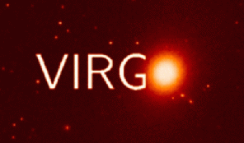
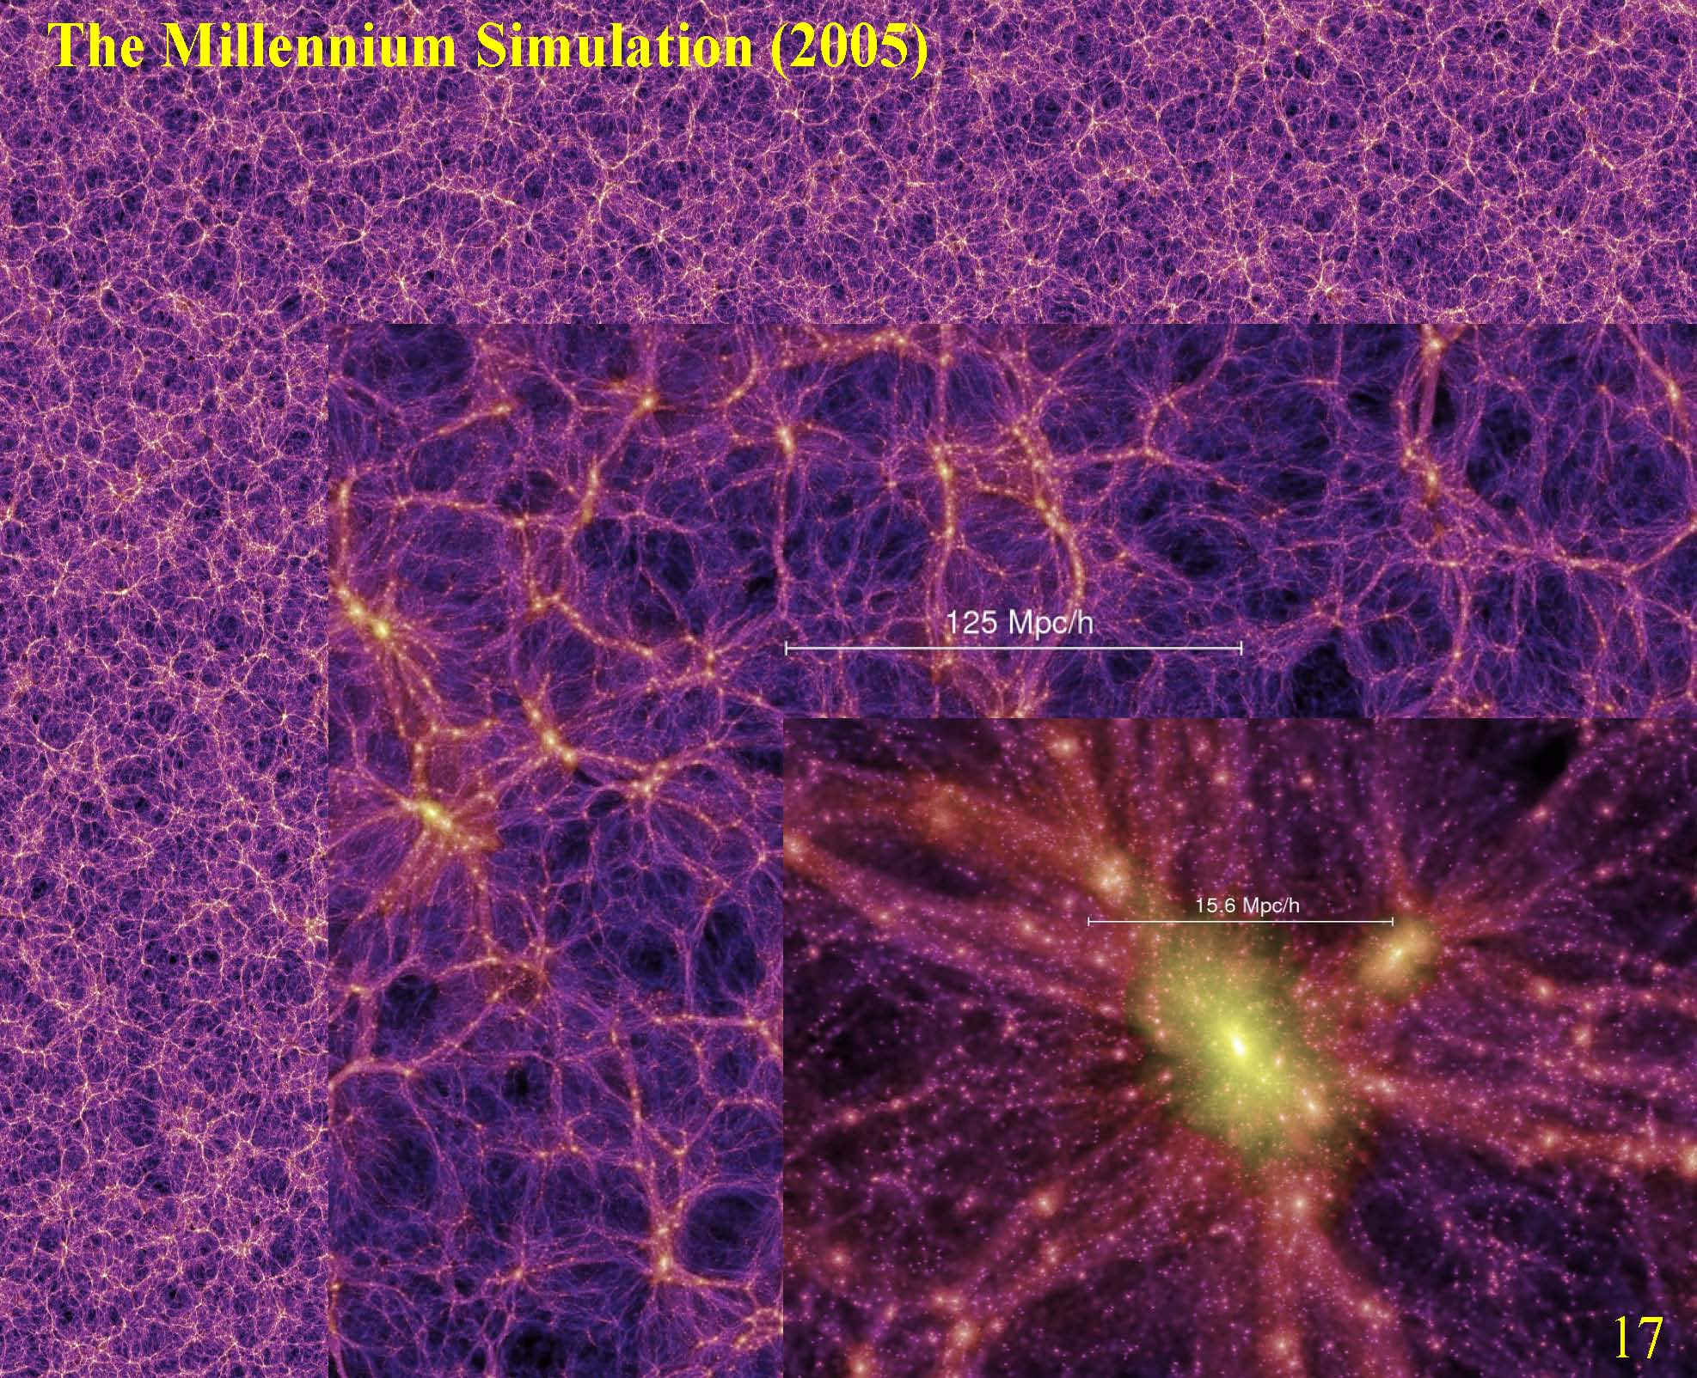
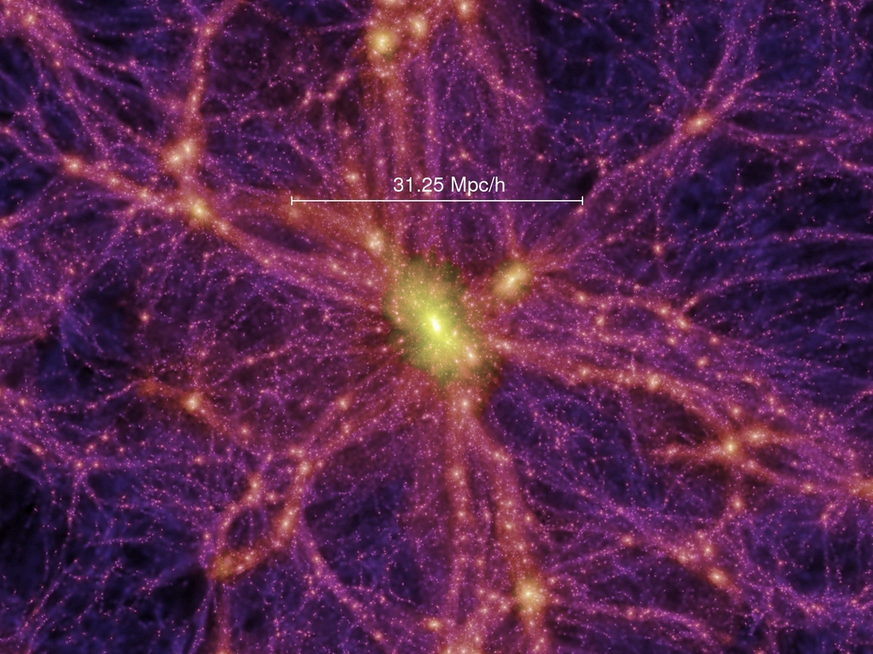
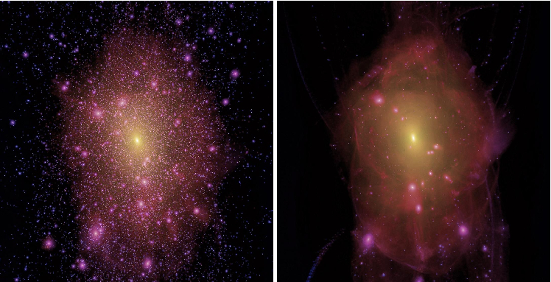
The Millennium/Aquarius/Phoenix simulation series
The properties of the dark matter distribution on all scales in CDM is a solved problem
0.5 Mpc/h
Springel et al ‘05, ’08, Gao et al ‘11

Slide 13
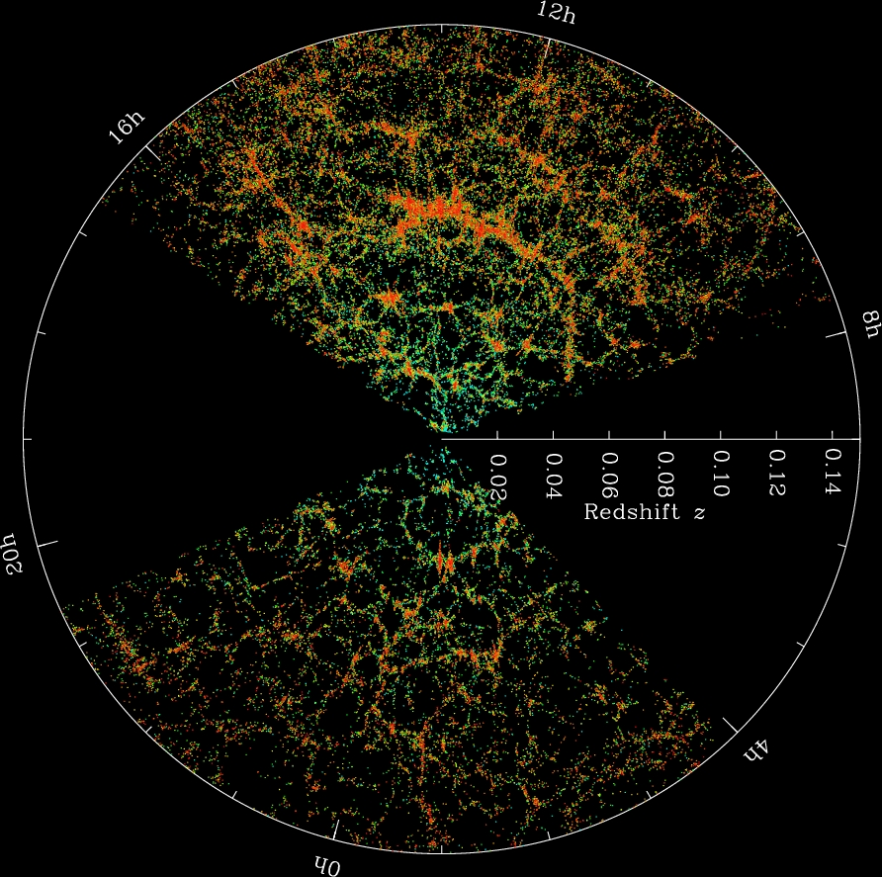
The Millennium/Aquarius/Phoenix simulation series
0.5 Mpc/h
Springel et al ‘05, ’08, Gao et al ‘11

Slide 14
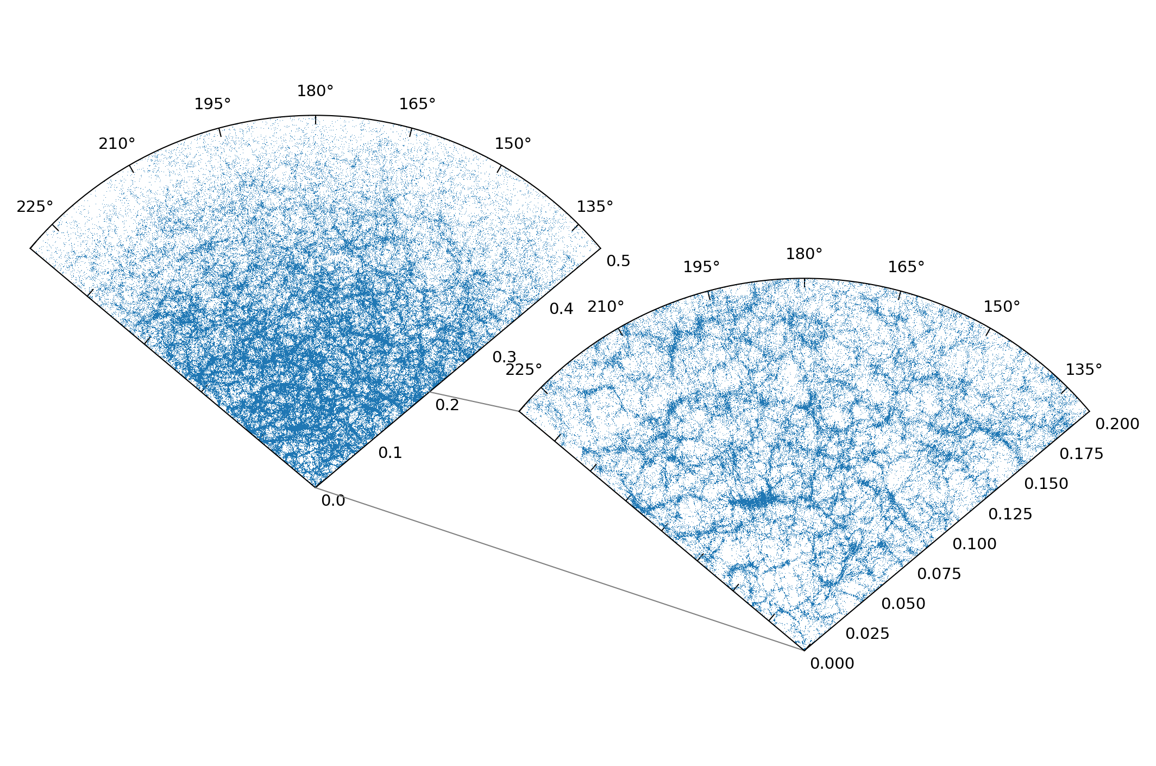
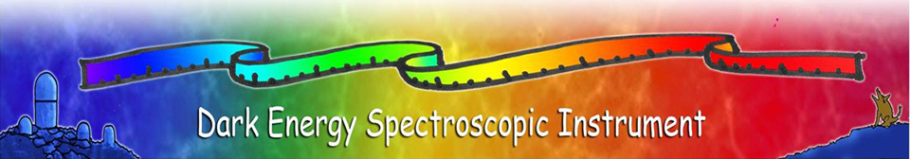
2020s
Galaxy distribution encodes info about dark matter and dark energy
5 billion yrs
DESI already has > 10 million spectra
0.5
z
1% accuracy!!!
Lookback time
0.2
Image: Eleanor Dawning (Durham undergrad)

Slide 15
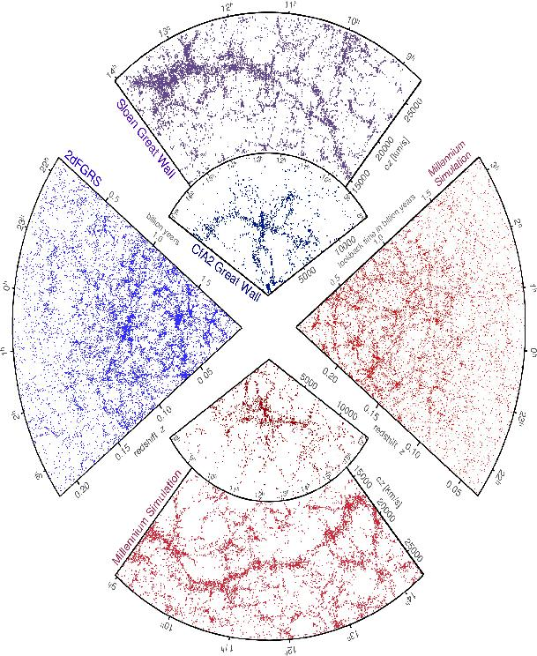
real
SDSS
CfA
2dFGRS
simulated
Springel, Frenk & White Nature, April ‘06

Slide 16
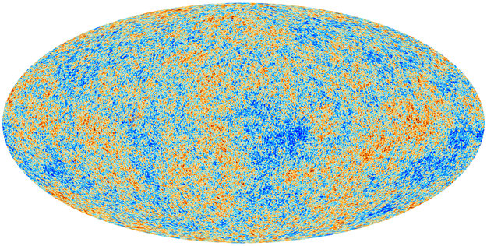
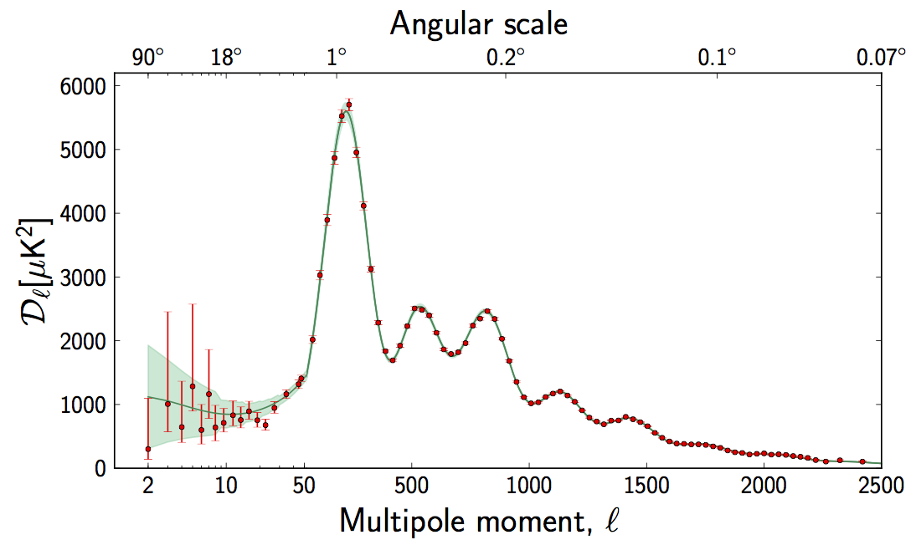
Planck: CMB temperature anisotropies
Fluctuation amplitude
The data confirm the theoretical predictions from the 1980s
ΛCDM
Planck coll. 2015

Slide 17
The ΛCDM model of cosmogony
Proposed in 1980s;
now empirically supported by:
CMB temperature anisotropies
z=1000
Galaxy clustering
z=0
Fluctuation amplitude
real
Planck coll. 2015
simulated
Springel, Frenk & White 2006

Slide 18
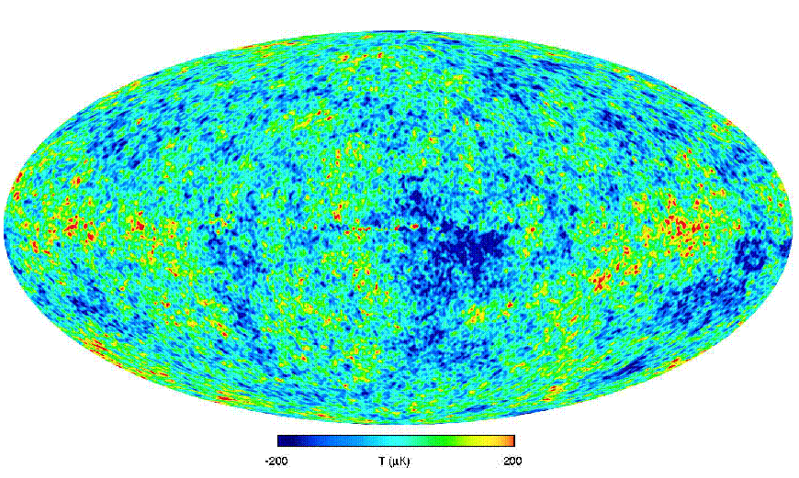
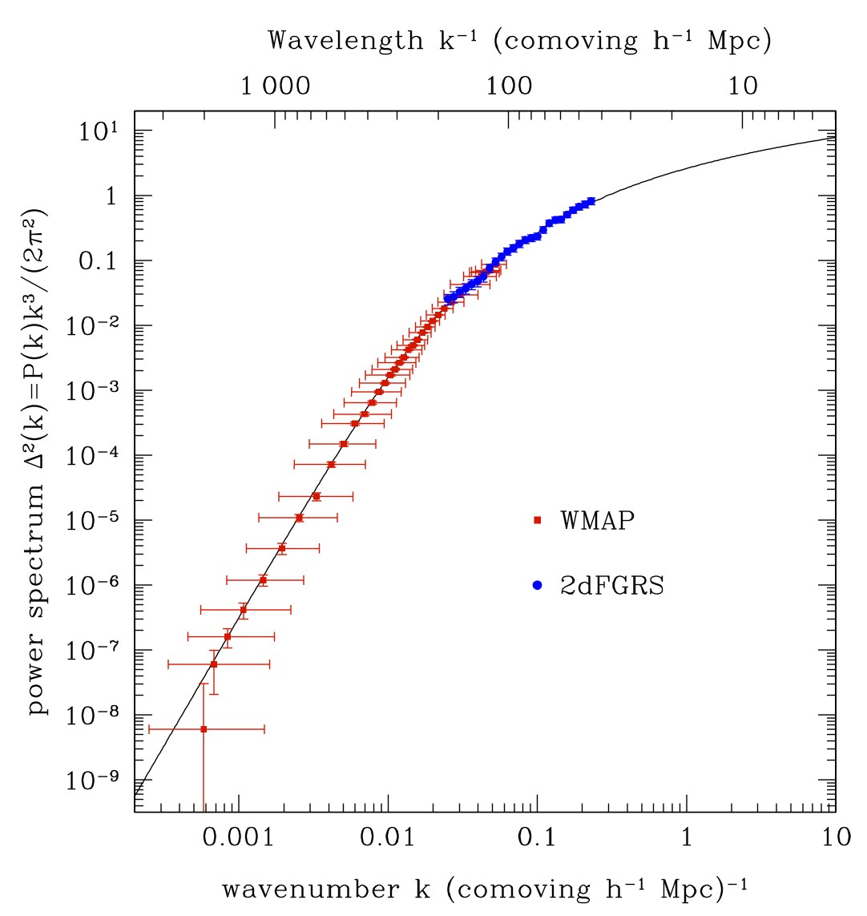
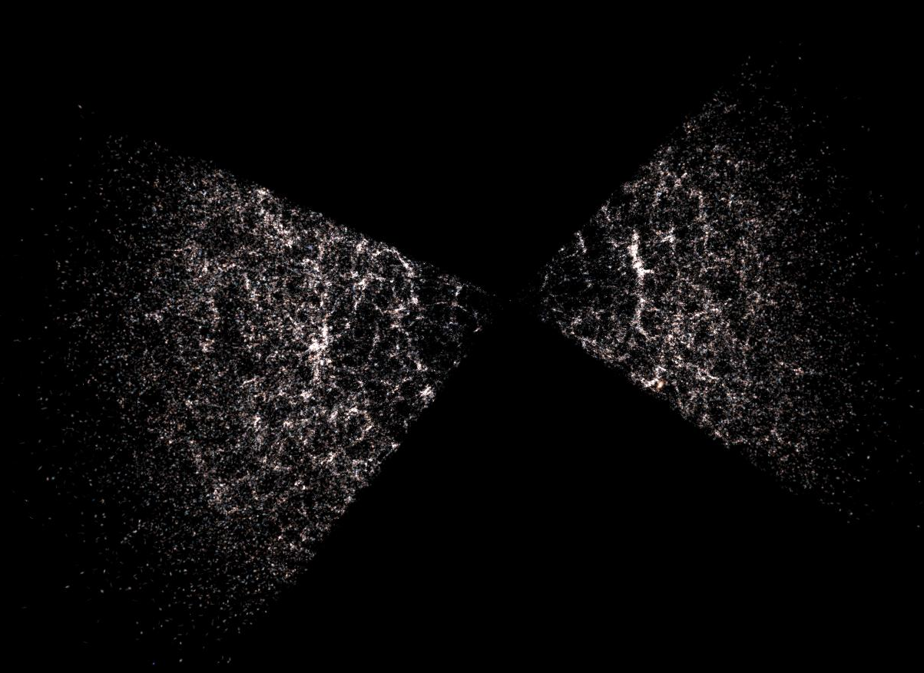
The cosmic power spectrum: from the CMB to the 2dFGRS
1000
10
z~1000
Log k³P(k)
wavelength k⁻¹ (comoving h⁻¹ Mpc)
z=0
Gal clustering (2dFGRS)
z~0
CMB (WMAP)
ΛCDM
Power spectrum P(k) (h⁻¹ Mpc)³
?
?
⇒ ΛCDM provides an excellent description of mass power spectrum from 10-1000 Mpc
Sanchez et al 06
wavenumber k (comoving h⁻¹ Mpc)⁻¹

Slide 19
The cosmic power spectrum: from the CMB to the 2dFGRS
1000
10
Log k³P(k)
wavelength k⁻¹ (comoving h⁻¹ Mpc)
Free streaming →
λ_{cut} α m_{x}⁻¹ for thermal relic
m_{CDM} ~ 100GeV susy; M_{cut} ~ 10⁻⁶ M_{o}
m_{WDM} ~ few keV sterile ν; M_{cut}~10⁹ M_{o}
z=0
Dwarf galaxies
Gal clustering (2dFGRS)
~ 5×10⁹ M_{o}
CMB (WMAP)
sterile ν
ΛCDM
warm DM
Power spectrum P(k) (h⁻¹ Mpc)³
wavenumber k (comoving h⁻¹ Mpc)⁻¹

Slide 20
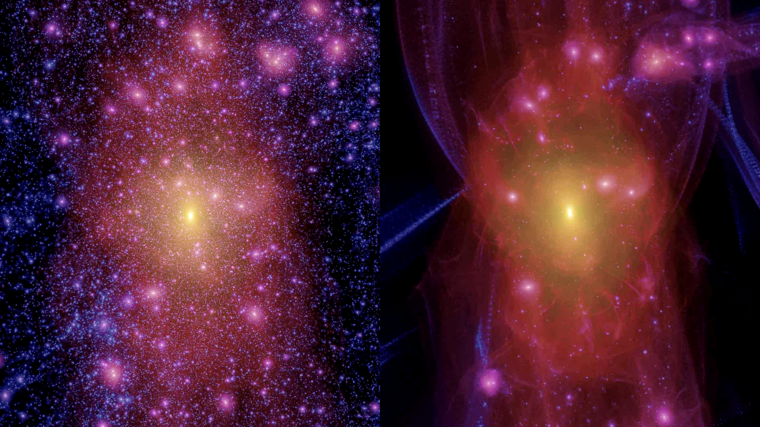
cold dark matter
warm dark matter
Lovell, Eke, Frenk, Gao, Jenkins, Wang, White, Theuns, Boyarski & Ruchayskiy ‘12

Slide 21
8 mins

Slide 22
The Millennium/Aquarius/Phoenix simulation series
The properties of the dark matter distribution on all scales in CDM is a solved problem
We now know:
halo mass function down to the cutoff mas
the internal structure of halos of all masses
the spatial distribution of halos & diffuse DM
0.5 Mpc/h
Springel et al ‘05, ’08, Gao et al ‘11

Slide 23
The cold dark matter power spectrum
k³ P(k)
z~1000
The linear power spectrum (“power per octave”)
Assumes a 100GeV wimp Green et al ‘04
Earth mass
Fluctuation amplitude
Large scales
Log k
Small scales

Slide 24
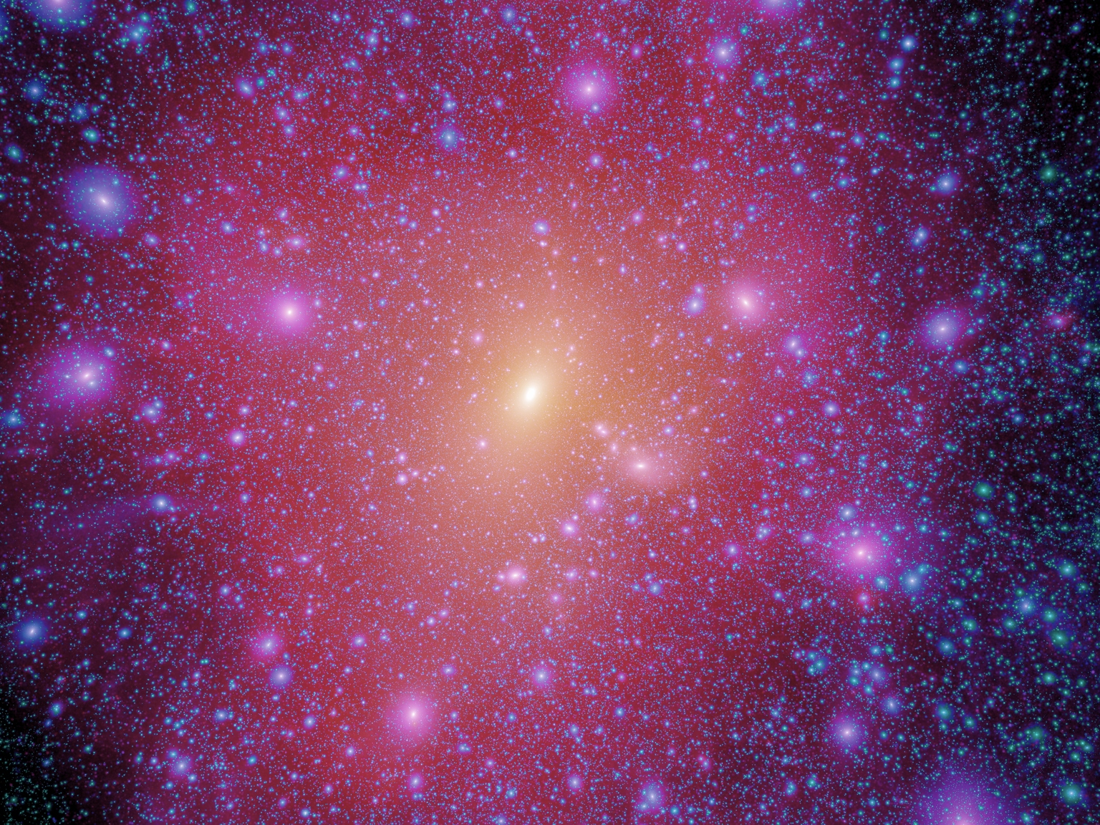
The cold dark matter linear power spectrum
The linear power spectrum (“power per octave” )
Assumes a 100GeV wimp Green et al ‘04
k³ P(k)
z~1000
λ_{cut} α m_{x}⁻¹
10⁻⁶ M_{o} for 100 GeV wimp
Galaxies
Fluctuation amplitude
Clusters
Aquarius resolution 10³ M_{o}
n=1
CMB
Large scales
k [h Mpc⁻¹]
Small scales

Slide 25
The Millennium/Aquarius/Phoenix simulation series
To resolve Earth-mass halos in a cosmological simulation would require 10²⁷ particles → impossible
0.5 Mpc/h
Springel et al ‘05, ’08, Gao et al ‘11

Slide 26
Wang, Bose, Frenk, Gao, Jenkins, Springel & White 2020
M_{char} =10¹⁴ M⊙
Nature

Slide 27
M_{char} =10¹² M⊙

Slide 28
M_{char} =10⁹ M⊙

Slide 29
M_{char} =10⁶ M⊙

Slide 30
M_{char} =10³ M⊙

Slide 31
M_{char} =10 M⊙

Slide 32
M_{char} =10⁻¹ M⊙

Slide 33
M_{char} =10⁻⁴ M⊙

Slide 34
M_{char} =10⁻⁶ M⊙

Slide 35
Mass function of CDM halos over 25 orders of magnitude in mass
The most fundamental prediction of CDM
Wang, Bose, CSF, Gao, Jenkins, Springel, White ‘20

Slide 36
cold dark matter
warm dark matter
Lovell, Eke, Frenk, Gao, Jenkins, Wang, White, Theuns, Boyarski & Ruchayskiy ‘12

Slide 37
Mass function of CDM halos over 25 orders of magnitude in mass
CDM
m_{ν} = 7 keV, L₆ = 10
“coldest” 7keV sterile ν
(m_{thermal}= 3.3 keV)
WDM
Wang, Bose, CSF, Gao, Jenkins, Springel, White ‘20
/ M_{o}

Slide 38
The structure of dark matter halos of all masses

Slide 39
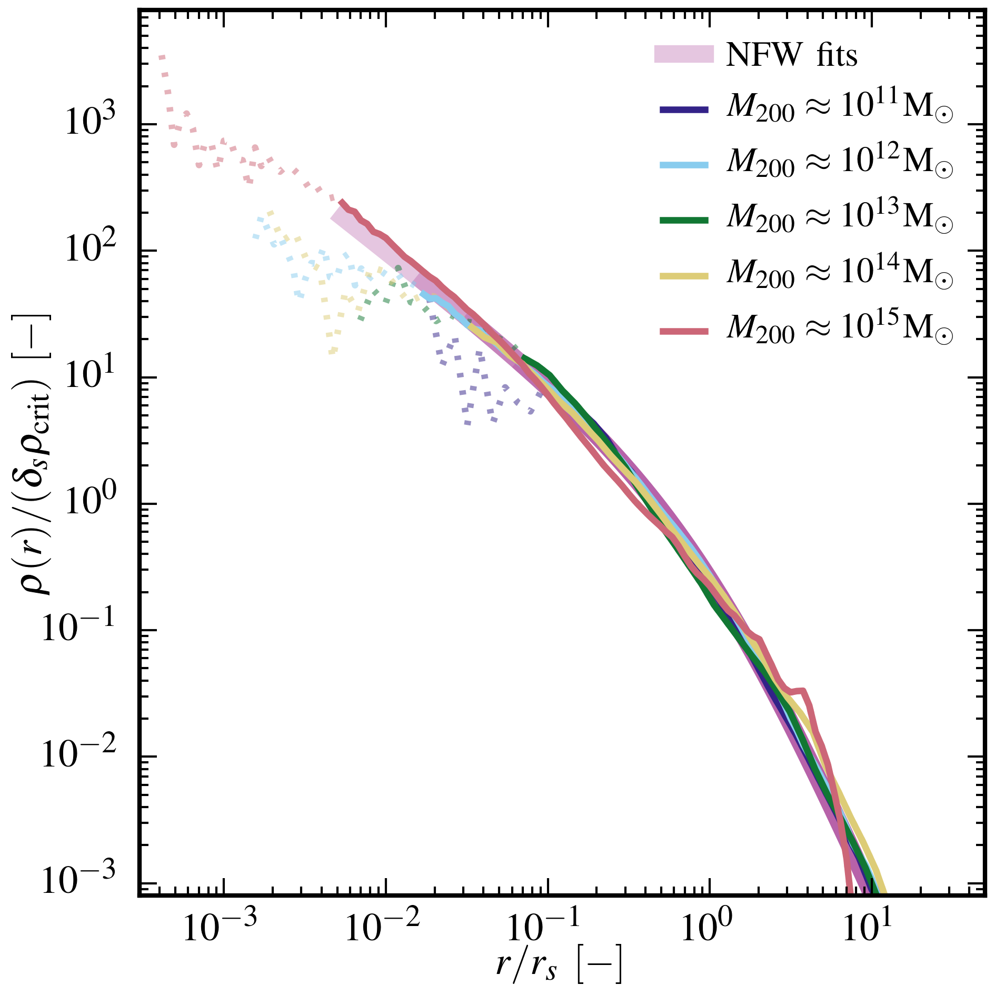
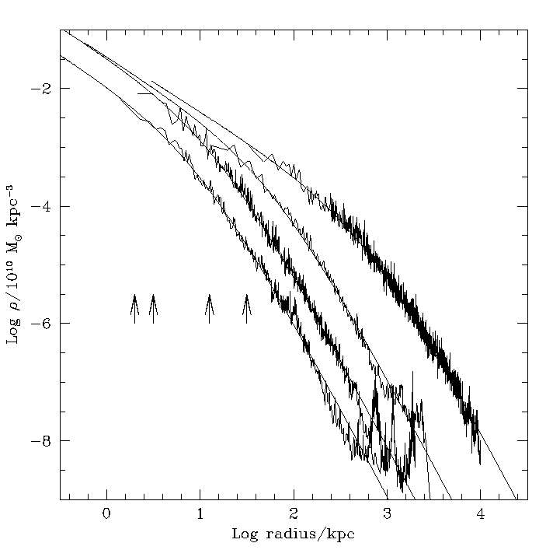
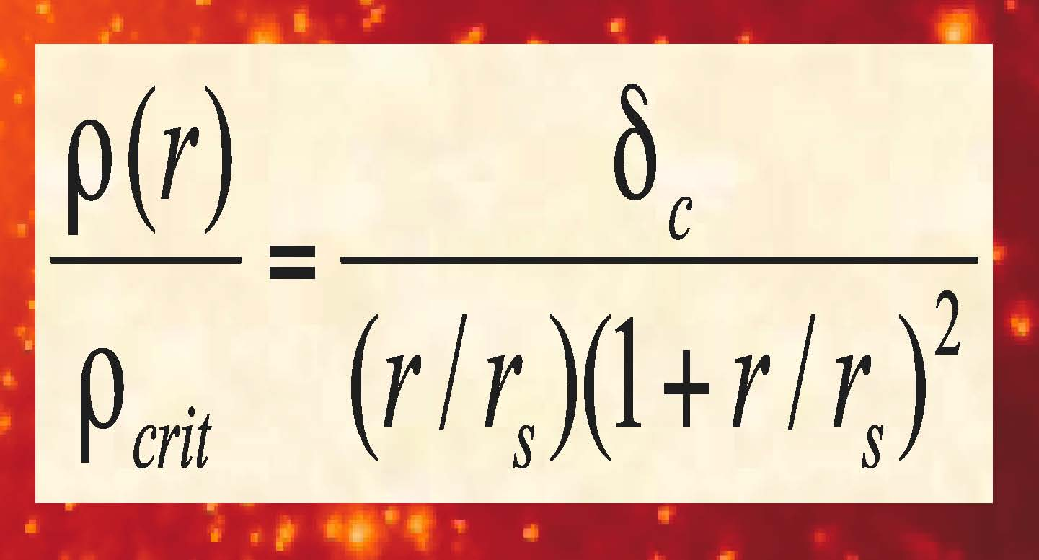
The Density Profile of Cold Dark Matter Halos
Shape of halo profiles ~independent of halo mass & cosmological parameters
Density profiles are “cuspy” - no `core’ near the centre
Fitted by simple formula:
(Navarro, Frenk & White ’97)
Galaxy clusters
Dwarf galaxies
Log density (10¹⁰ M_{o} kpc³)
More massive halos and halos that form earlier have
higher densities (bigger δ)
Log radius (kpc)

Slide 40
Universal halo density profiles
Log r² δ
ρ – ρ_{NFW}/ρ
The “Einasto” formula
Fits mean profiles even better
ρ – ρ_{Ε}/ρ
Log r² δ
Gao, N, F, W + 2008
Log r/r_{vir}
Log r/r_{vir}

Slide 41
Density profile shapes
Slope of density profile
Over 20 orders of magnitude in halo mass and 4 orders of magnitude in density, the mean density profiles of halos are fit by NFW to within 20% and by Einasto (α =0.16) to within 7%
Wang, Bose, CSF + ‘20

Slide 42
Concentration-mass relation
Concentrations at small mass are lower than all previous extrapolations by up to factors of tens.
A turndown at 10³ Earth masses is due to the free-streaming limit.
The scatter depends only weakly on halo mass
C _{Einasto}
Previous resolution
Wang, Bose, CSF + ‘20

Slide 43
14 mins

Slide 44
A digression: the cosmic neutrino background
Neutrinos are the only non-baryonic form of dark matter known!
The make on a small contribution, ~ 1%, to the dark matter
Cosmic neutrinos were produced a few seconds after the Big Bang and produce a cosmic background today
May be detected by Ptolomy experiment

Slide 45
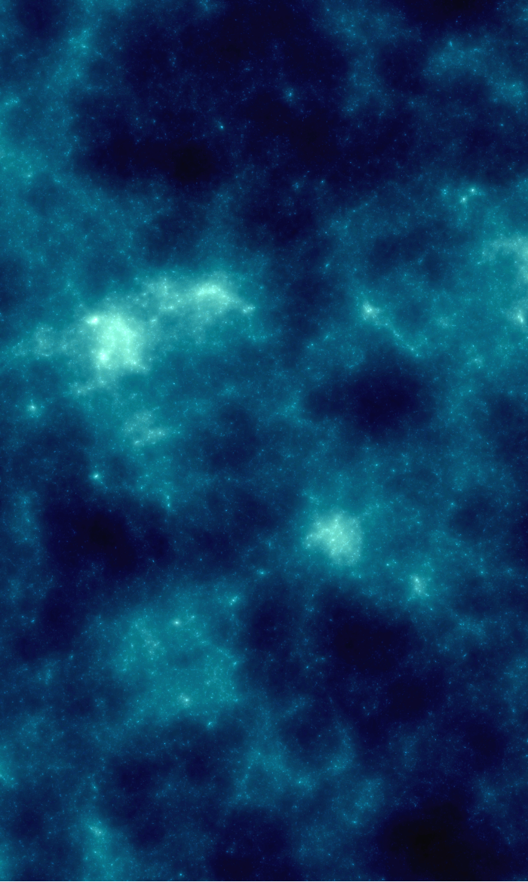
The cosmic neutrino background
Willem Elbers
Elbers, CSF, Jenkins, Li, Pascoli, Lavaux, Jasche, Springel ‘23

Slide 46
Constrained realization simulations
Simulations from CDM initial conditions, with phases adjusted to reproduce the local observed galaxy clustering
Constrained by 2MASS++ survey
Sawala, CSF+ 2022; MaAlpine, Sawala, CSF+ 2022

Slide 47
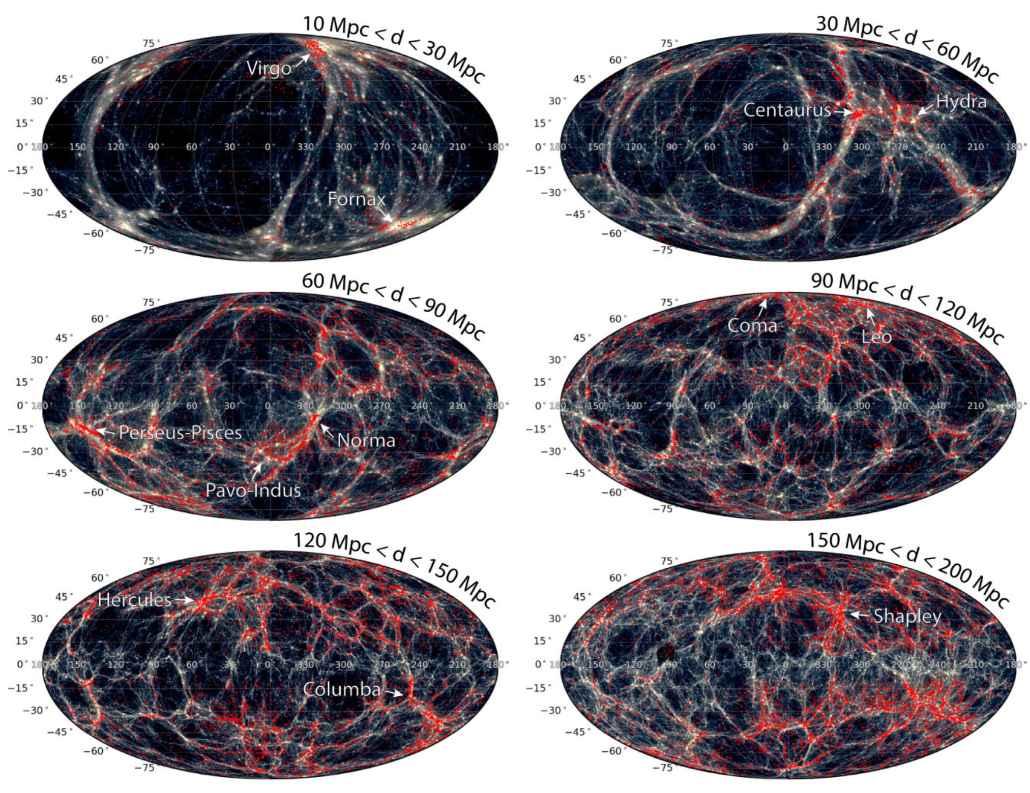
Constrained simulations
SIBELIUS DARK
Grey: dark matter in SIBELIUS DARK
Red: galaxies in 2M++ survey, used for reconstruction
Mcalpine, Sawala , CSF+ ‘22

Slide 48
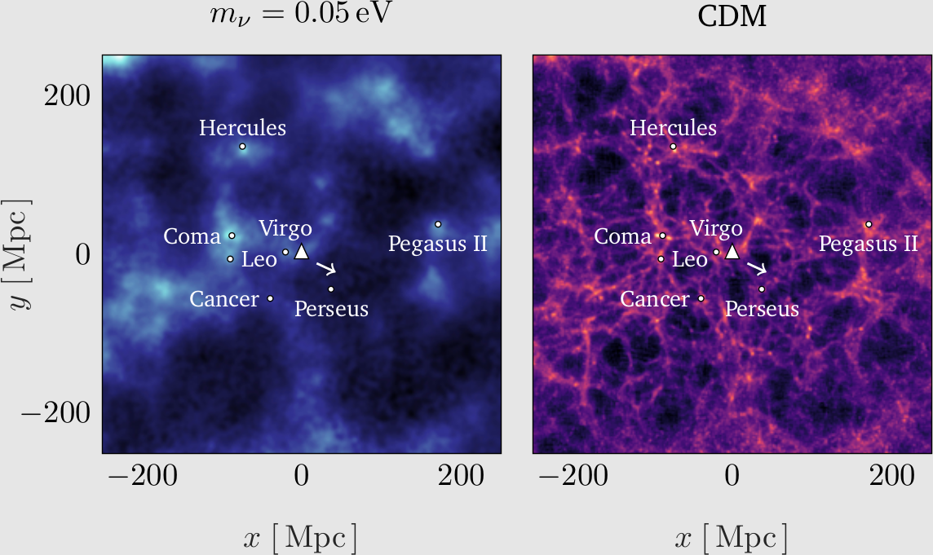
Constrained simulations with νs
The position of the Milky Way is indicated by a white triangle
and the dipole direction by an arrow
Elbers, CSF+ ‘23

Slide 49
Local CDM distribution in z-space
Elbers, CSF+ ‘23

Slide 50
Local ν distribution in z-space
Elbers, CSF+ ‘23

Slide 51
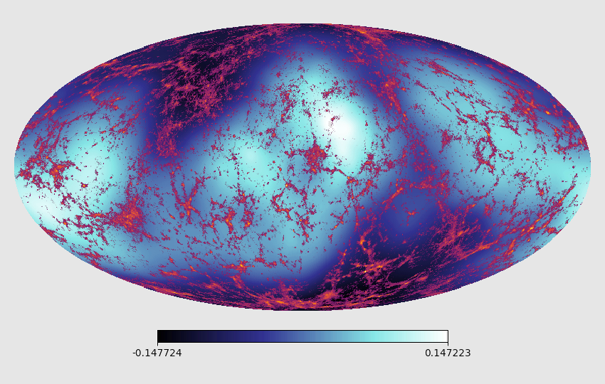
Angular anisotropies
Local neutrino density perturbations without dipole:
Elbers, CSF+ ‘23

Slide 52
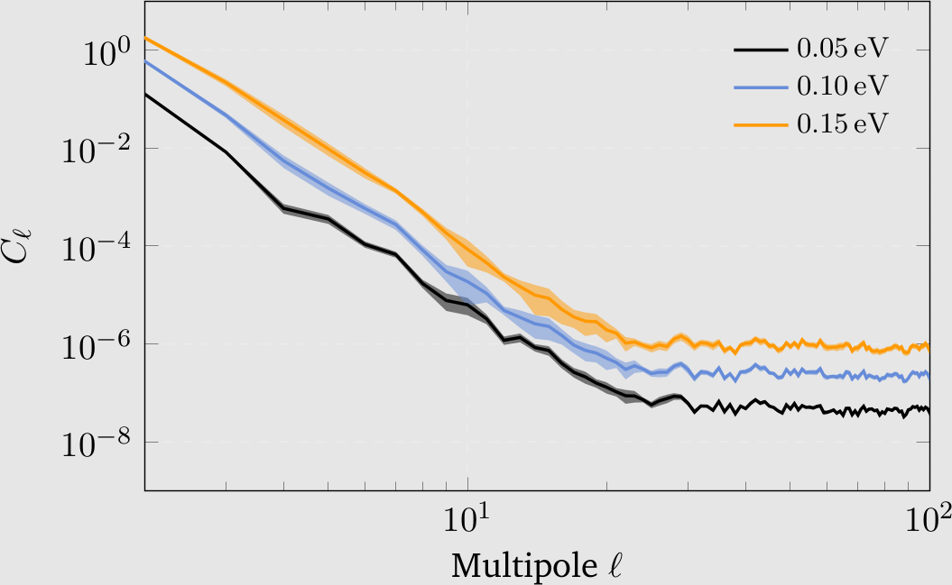
Angular power spectrum of ν perturbations
Elbers, CSF+ ‘23

Slide 53
17 minutes

Slide 54
A conclusive test of CDM

Slide 55
Mass function of CDM halos over 25 orders of magnitude in mass
Wang, Bose, CSF, Gao, Jenkins, Springel, White, Nature ‘20
The VVV project
CDM
The most fundamental prediction of CDM

Slide 56
CDM
Most subhalos never make a galaxy!

Slide 57
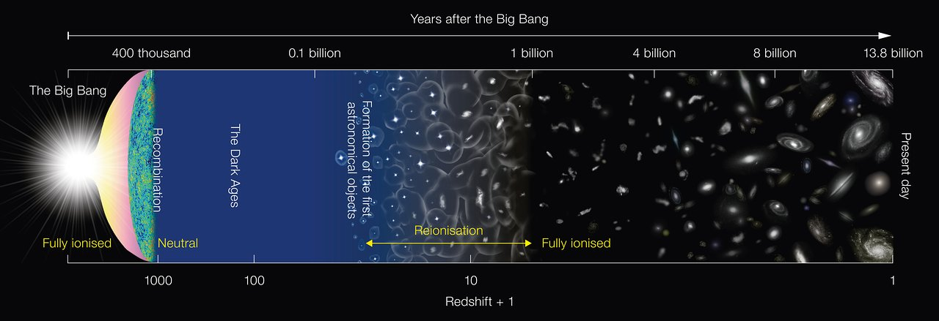
The two phases of galaxy formation
Phase II
Phase I
Phase I: H gas is neutral → can only cool in halos m>m_{thr,1}
First stars reionize H and heat it up to 10⁴K
Phase II: H Gas is ionized (“T_{vir}” > 10⁴)
→ can only cool in halos m>m_{thr,2}

Slide 58
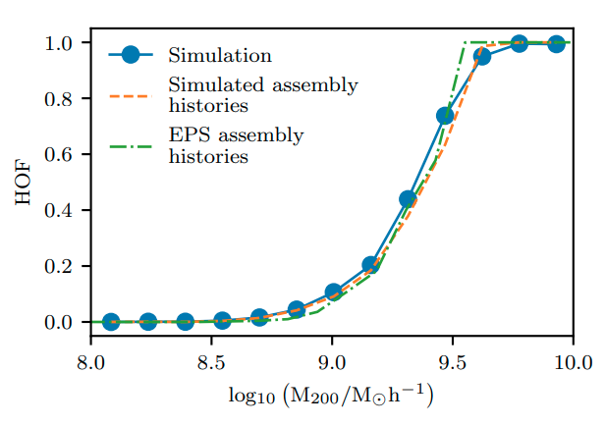
A galaxy formation primer
Halo Occupation Fraction (HOF): fraction of halos of a given mass today that host a galaxy
M<3x10⁸M_{o} → dark
fraction of halos that host a galaxy
M>3x10⁹M_{o} → visible
Benitez-Llambay & CSF ‘20

Slide 59
Mass function of CDM halos over 25 orders of magnitude in mass
visible
Wang, Bose, CSF, Gao, Jenkins, Springel, White - Nature 2020

Slide 60
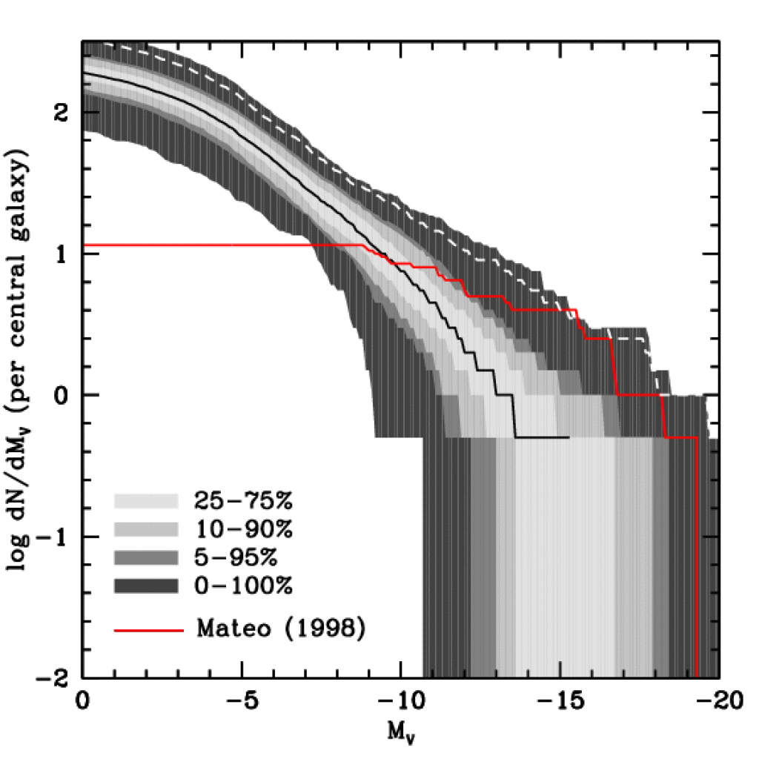
Luminosity Function of Local Group Satellites
Semi-analytic model of galaxy formation iqncluding effects of reionization and SN feedback
Koposov et al 08
(SDSS)
★
★
★
★
Median model → correct abundance of sats brighter than M_{V}=-9 (V_{cir} > 12 km/s)
★
Model predicts many, as yet undiscovered, faint satellites
LG data
Benson, Frenk, Lacey, Baugh & Cole ’02
(see also Kauffman+ ’93, Bullock+ ’00, Somerville ‘02)

Slide 61
CDM
Most subhalos never make a galaxy!
→
CDM predicts the observed abundance of satellites
→
There is no such thing as a “missing satellite problem” in CDM!

Slide 62
20 minutes

Slide 63
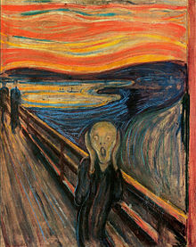
How can we test CDM?

Slide 64
… and distinguish CDM/WDM?

Slide 65
… and distinguish CDM/WDM?
cold dark matter
warm dark matter
Rather than counting faint galaxies,
count the number of starless dark halos

Slide 66
Can we count dark haloes?
cold dark matter
warm dark matter
→ Gravitational lensing

Slide 67
Mass function of CDM halos over 25 orders of magnitude in mass
lensing
m_{ν} = 7 keV, L₆ = 10
“coldest” 7keV sterile ν
(m_{thermal}= 3.3 keV)
visible
WDM
Wang et al ‘20
/ M_{o}

Slide 68
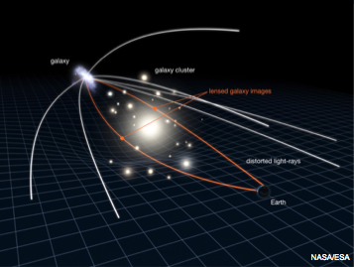
Gravitational lensing: Einstein rings
When the source and the lens are well aligned → strong arc or an Einstein ring

Slide 69
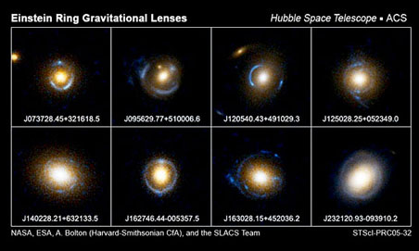
SLAC sample of strong lenses

Slide 70
Gravitational lensing: Einstein rings
Additional lensing by line-of-sight halos perturb image
When the source and the lens are well aligned → strong arc or an Einstein ring

Slide 71
Gravitational lensing: Einstein rings
Halos projected onto an Einstein ring distort the image
m_{sub} = 2.8 x 10¹⁰ M_{o}
Vegetti et al ‘10

Slide 72
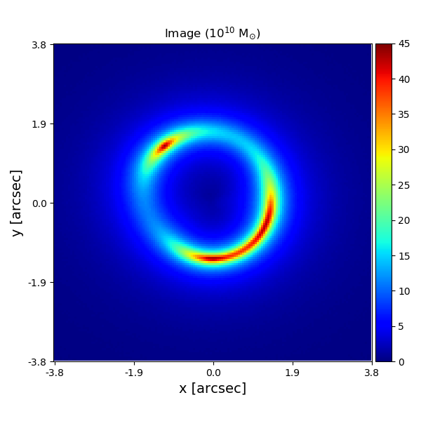
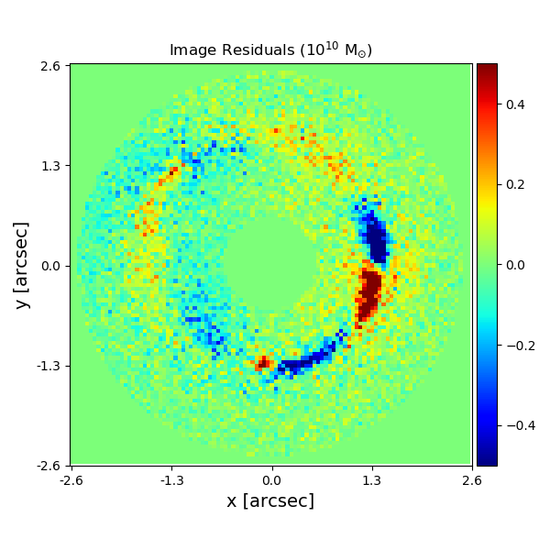
Gravitational lensing: Einstein rings
HST “data”: z_{source}=1; z_{lens}=0.2
10¹⁰M_{o} halo – easy to spot
Image
Residuals
He, Li, CSF et al ‘19

Slide 73
Gravitational lensing: substructures
Searched for substructure in 55 lenses with good HST imaging
→ 2 detections:
SLACS0946+1006 → Log M_{sub} = 11.59 ^{+0.18 – 0.34}
BELLS1226+5457 → Log M_{sub} = 11.80 ^{+0.16 −0.30}
Nightingale + ‘22

Slide 74
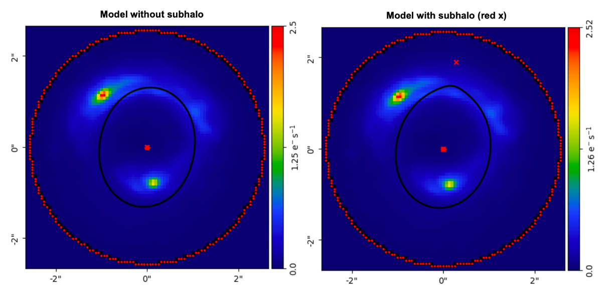
Gravitational lensing: substructures
JWST
And another one in JWST data:
→ Log M_{sub} = 11.59 ^{+0.18 – 0.34}
Lange, Nightingale, CSF+ ‘23

Slide 75

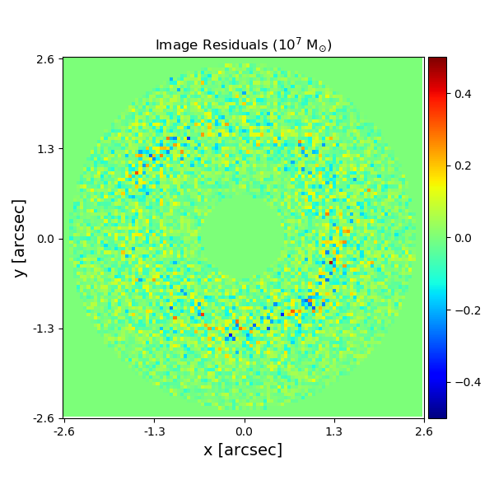
Strong lensing: detecting small halos
HST “data”: z_{source}=1; z_{lens}=0.2
10⁷ M_{o} halo – NOT so easy to spot
Image
Residuals (image – smooth model)
He, Li, CSF et al ‘19

Slide 76
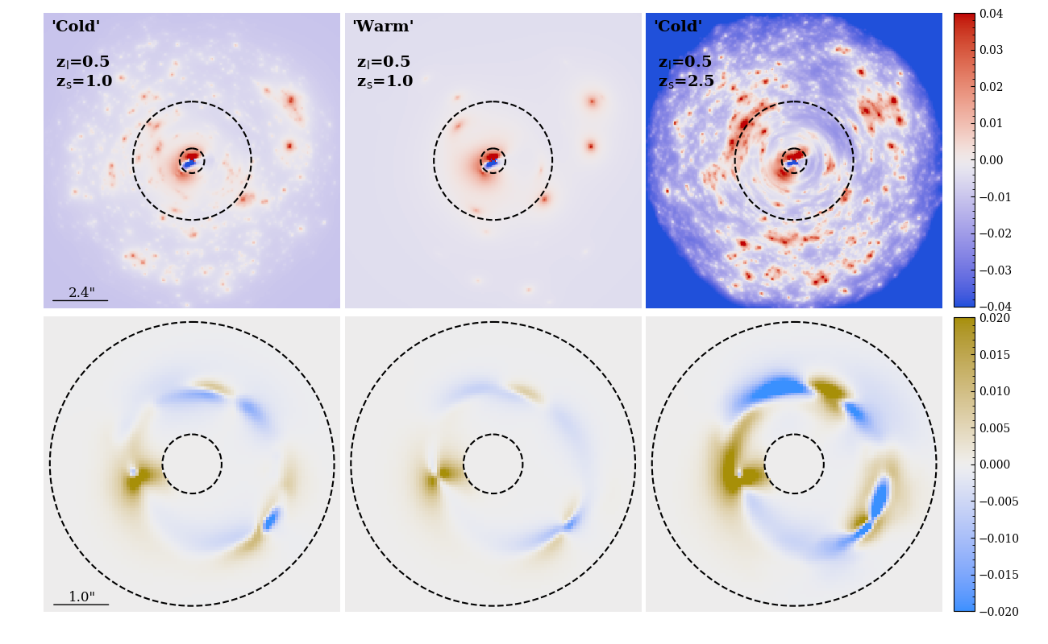
Strong lensing: detecting small halos
CDM
WDM
CDM
Convergence map
Residuals from smooth model
He et al. ‘20

Slide 77
Detecting halos w. strong lensing
Can detect halos as small as 10⁷ M_{o}
If WDM is right, should find NO 10⁸ M_{o} halos
If CDM is right, should find MANY 10⁸ M_{o} halos
He, Li, CSF et al ‘19

Slide 78
23 minutes

Slide 79
Mass function of CDM halos over 25 orders of magnitude in mass
annihilation radiation
lensing
visible
Wang, Bose, CSF, Gao, Jenkins, Springel, White - Nature 2020

Slide 80
Indirect CDM detection through annihilation radiation
Supersymmetric particles are Majorana particles → annihilate into Standard Model particles (including γ-rays)
Intensity of annihilation radiation at x is:
halo density at x (astrophysics)
cross-section (particle physics)
→ relic abundance in simple SUSY models
⇒ Theoretical expectation requires knowing ρ(x)
⇒ Accurate high resolution N-body simulations of halo formation from CDM initial conditions

Slide 81
Density profile shapes
Slope of density profile
Over 20 orders of magnitude in halo mass and 4 orders of magnitude in density, the mean density profiles of halos are fit by NFW to within 20% and by Einasto (α =0.16) to within 7%
Earth-mass halo
Wang, Bose, CSF + ‘20

Slide 82
Earth-mass halo
Delos & White ‘23

Slide 83
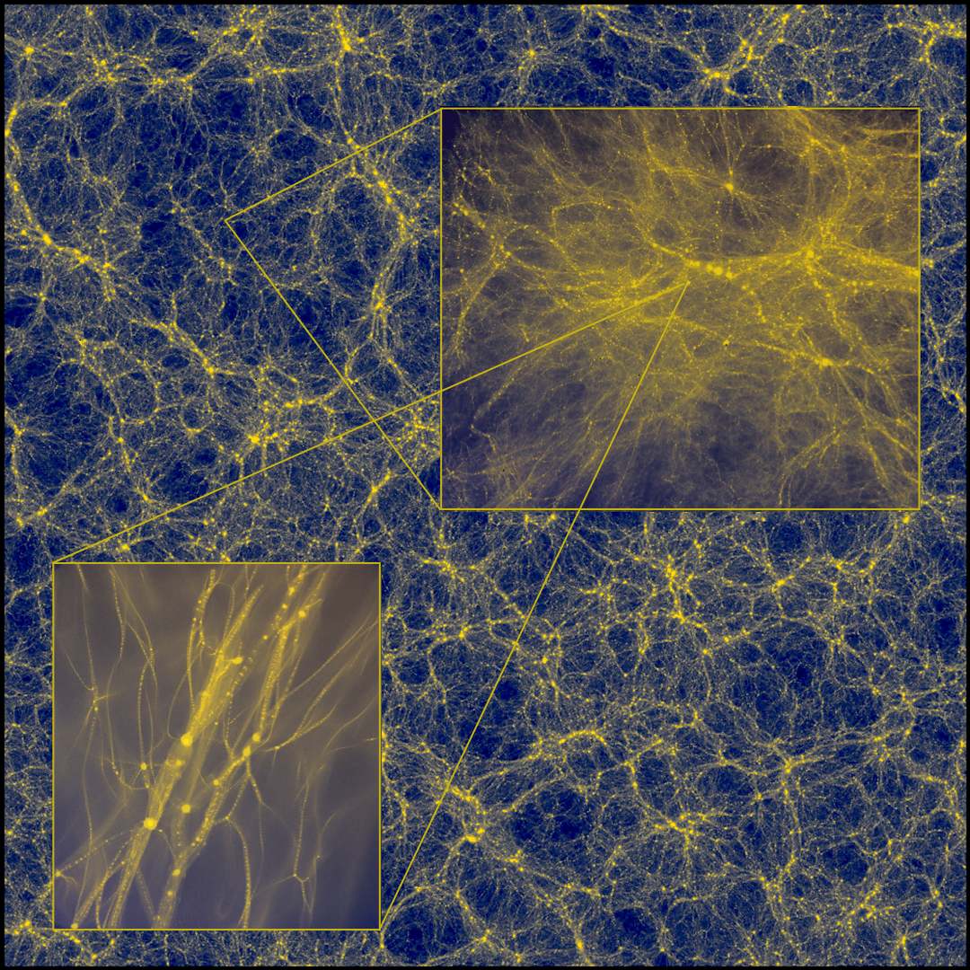
Prompt cusps
Delos & White ‘22
For standard WIMPs, they make up ~1% of all the dark matter
In MW, disrupted by tides & stellar encounters within ~20 Kpc
Dominate DM annihilation signal from outer halo of MW and all extragalactic objects, leading to L ∝ ρ_{DM}, not ∝ ρ²_{DM}

Slide 85
The Galactic Centre excess
Cusp emission dominates at >20⁰ from centre
Surface brightness from MW halo comparable to that from halos of external galaxies
Prompt cusps dominate the 1 – 10 Gev background
Delos & White ‘23
Only just consistent with γ-ray background

Slide 86
Conclusions
The properties CDM (no baryons) on all scales - solved problem
The abundance & structure of CDM halos (down to Earth’s mass) and of WDM (no halos of mass <10⁸ M_{o}) is now known
CDM (and WDM) halos of all masses have NFW density profiles (except in very inner parts for halos near the cutoff)
There is NO “small-scale” crisis in CDM
Local large-scale structure is reflected in the cosmic neutrino background. MW dipole & angular PS depend in the ν mass
Distortions of strong gravitational lenses offer a clean test of CDM vs WDM → and can potentially rule out CDM!
Prompt cusps of Earth mass dominate the annihilation radiation from outer halo of MW and extragalactic objects

